Slide 2
Planning your Big Data Architecture on Azure
BRK2576
Brian Mitchell
Business Program Manager, Data Insights

Slide 3
A long time ago in a paradigm far,
far away…
We weren’t so specialized

Slide 4
MCDBA 2000 Requirements
SQL Server Administration exam.
SQL Server Design exam.
Microsoft Windows 2000 Server or Windows Server 2003 exam.
One elective exam - usually involving .NET or network infrastructure.

Slide 5
Azure Certifications
70-532 Developing Microsoft Azure Solutions
70-533 Implementing Microsoft Azure Infrastructure Solutions
Coming Soon
70-534 Architecting Microsoft Azure Solutions

Slide 6
With paradigm shifts
Every team needs a leader
Who can bridge the old and the new

Slide 7

Traditional Batch BI
DW
OLAP
ETL
Bulk-load
Transactional Data
OLAP Processing
Reporting

Slide 8
Problems with scaling this model
Throwing hardware at it
Scaling out with multiple ETL Servers
Tricks with processing on one SSAS while serving queries with another
SANS, SANS, SANs
Limit what goes into DB and Cube
DR and HA

Slide 9


SSIS
SQL DB
SSAS
SSRS
Migrate
ETL
Database
OLAP
Reporting

Slide 10

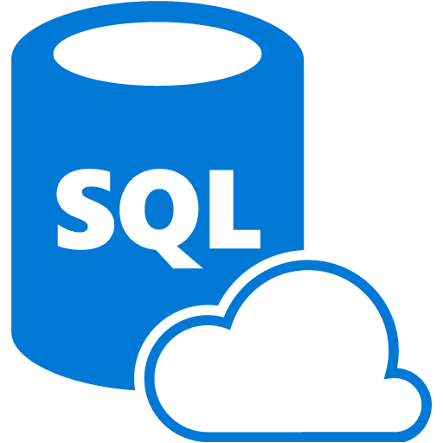
Data Ingest
Data Storage
Data Processing
Presentation
Acquire Raw Materials
Store Materials
Transform raw materials into “finished goods”
Deliver
Azure DB

Slide 11


HDInisght
Azure ML
Power BI
Azure Data Factory
Migrate
ETL
Database
OLAP
Reporting

Slide 12

Commonalities of Architectures
Batch
Data Ingestion
Data Storage
Data Processing
Presentation

Slide 13
Streaming
Commonalities of Architectures
Data Ingestion
Data Processing
Data Storage
Presentation

Slide 14
Real Time Streaming Analytics

Slide 15
Common Scenarios
Finance
Telco
Retail
Manufacturing
Transportation
Web
Sources
Sentiment
Clickstream
Machine
Sensors
Server Logs
Geo-location
Prevent
Securities Fraud
Compliance Violations
Security Breach
Network Outage
Security Breach
Network Outage
Machine Failures
Driver & Fleet Issues
App Failures
Operational Issues
Optimize
Order Routing
Pricing
Bandwidth Allocation
Customer Service
Offers
Pricing
Supply Chain
Routes
Pricing
Site Content

Slide 16



Streaming
Continuous Standing Query
Real-time continuous result set
Streaming event data
(Clicks, sensor reading, etc)
Application
Data repository
Events discarded
Events archived
Static Reference Data

Slide 17






Presentation
Excel
/
Power BI
Custom Applications
Power Query
Consumption
(
)
Data Storage
SQL Database
Blob Storage
(
attached to HDInsight
)
Real
-
Time
Stream Analytics
HDInsight Storm
Machine Learning
Analytics
Data
-
Event Hubs
Blob Storage
Integration
Data Sources
Operational Data
Devices
Applications
Sensors
3
rd
Party Data
Stores
(
Website etc
.)
Streams

Slide 18
Data Sources

Slide 19
Data Sources
Any
Preferably born in the cloud
Data born at partners
IOT
Real-Time Analytics at Scale for Internet of Things
http://channel9.msdn.com/Events/Ignite/2015/BRK3555

Slide 20
Data Integration

Slide 21
Presentation
Excel
/
Power BI
Custom Applications
Power Query
Consumption
(
)
Data Storage
SQL Database
Blob Storage
(
attached to HDInsight
)
Real
-
Time
Stream Analytics
HDInsight Storm
Machine Learning
Analytics
Data
-
Event Hubs
Blob Storage
Integration
Data Sources
Operational Data
Devices
Applications
Sensors
3
rd
Party Data
Stores
(
Website etc
.)
Streams

Slide 22
Event Hubs for Big Data Ingestion
Storage & Analytics
Custom Code & 3rd Party Services
Event Hub
Web/Mobile User Interfaces
- Hyper Scale -
- Fully Managed -
- Interoperable -
- Secure -
- Cost Effective -
Integration Services
Event Sources
Cloud Services

Slide 23
Event Hubs
Cloud-scale telemetry ingestion from websites, apps, and devices
Log millions of events per second in near real time
Connect devices with flexible authorization and throttling
Time-based event buffering
Managed service with elastic scale
Broad platform reach with native client libraries
Pluggable adapters for other cloud services

Slide 24
Real Time Analytics

Slide 25



Introducing Azure Stream Analytics
Fully managed
real-time analytics
Mission critical reliability and scale
Enables rapid development

Slide 26
Real-time analytics
Real-time Analytics
Intake millions of events per second (up to 1 GB/s)
Low processing latency, auto adaptive (sub-second to seconds)
Correlate between different streams, or with reference data
Find patterns or lack of patterns in data in real-time
Fully Managed Cloud Service
No hardware acquisition and maintenance
No platform/infrastructure deployment and maintenance
Easily expand your business globally leveraging Azure regions
Fully managed
real-time analytics

Slide 27
Mission critical
Mission Critical Reliability
Guaranteed event delivery
Guaranteed business continuity: Automatic and fast recovery
Effective Audits
  Privacy and security properties of solutions are evident
  Azure integration for monitoring and ops alerting
Easy To Scale
  Scale from small to large on demand
Mission critical reliability and scale

Slide 28
Rapid development
Rapid Development with SQL like language
High-level: focus on stream analytics solution
Concise: less code to maintain
Fast test: Rapid development and debugging
First-class support for event streams and reference data
Built in temporal semantics
  Built-in temporal windowing and joining
  Simple policy configuration to manage out-of-order events
  and late arrivals
Enables rapid development

Slide 29
SAQL – Language & Library
DML
SELECT
FROM
WHERE
GROUP BY
HAVING
CASE WHEN THEN ELSE
INNER/LEFT OUTER JOIN
UNION
CROSS/OUTER APPLY
CAST
INTO
ORDER BY ASC, DSC
Date and Time Functions
DateName
DatePart
Day
Month
Year
DateTimeFromParts
DateDiff
DateAdd
Aggregate Functions
Sum
Count
Avg
Min
Max
StDev
StDevP
Var
VarP
Temporal Functions
Lag, IsFirst
CollectTop
String Functions
Len
Concat
CharIndex
Substring
PatIndex
Scaling Extensions
WITH
PARTITION BY
OVER
Windowing Extensions
TumblingWindow
HoppingWindow
SlidingWindow

Slide 30
Learn more about Azure Stream Analytics
Gaining Real-Time IoT Insights using Azure Stream Analytics, AzureML and PowerBI
http://channel9.msdn.com/events/Build/2015/2-708

Slide 31
Presentation
Excel
/
Power BI
Custom Applications
Power Query
Consumption
(
)
Data Storage
SQL Database
Blob Storage
(
attached to HDInsight
)
Real
-
Time
Stream Analytics
HDInsight Storm
Machine Learning
Analytics
Data
-
Event Hubs
Blob Storage
Integration
Data Sources
Operational Data
Devices
Applications
Sensors
3
rd
Party Data
Stores
(
Website etc
.)
Streams

Slide 32
What is HDInsight Storm?
HDInsight Storm is a flavor of Apache Storm, a distributed, fault-tolerant, open source computation system that allows you to process data in real-time.
HDInsight Storm is offered as a managed cluster integrated into the Azure environment, where it may be used as part of a larger Azure solution
Provides guaranteed processing of data/ Fault Tolerance
Programming Language agnostic: Apache Thrift
Highly Scalable

Slide 33
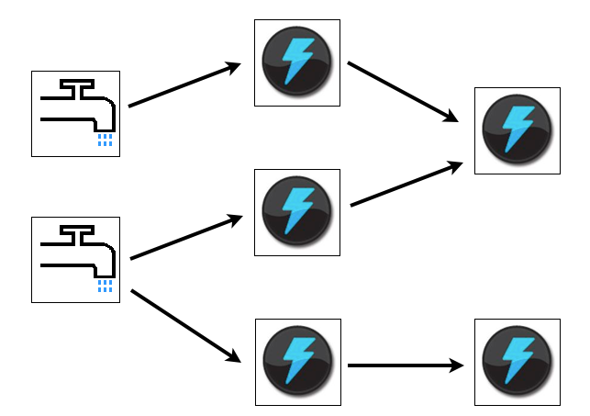
HDInsight Storm Components
A Storm cluster is superficially similar to a Hadoop cluster. The major components that a storm developer will be interacting with are…
Nimbus/ Supervisor nodes
Topology: Spouts/Bolts
Trident Topology

Slide 34
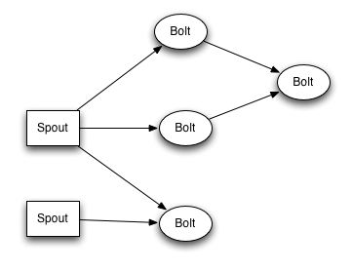
Storm Components
Topology
  Defines a graph of computation that processes streams of data. Unlike MapReduce jobs, topologies run until you stop them.
Spout
  Consumes data from a data source and emits one or more streams.
Bolt
  Consumes streams, performs processing, and may emit streams for further processing.
  Responsible for writing data to external storage, HDInsight HBase, a blob, or other data store

Slide 35
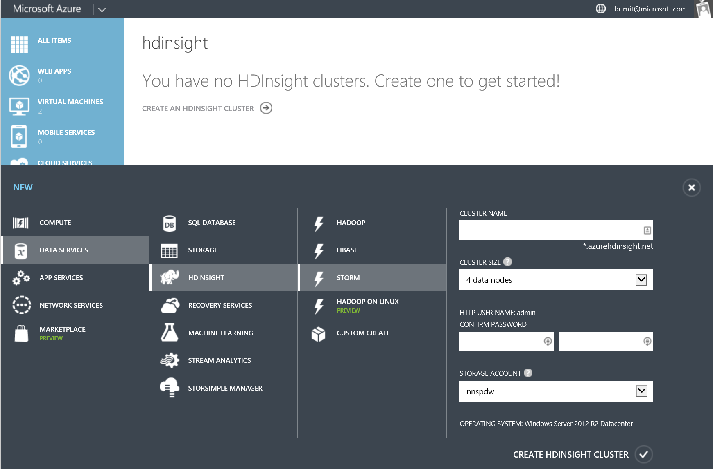
HDInsight Storm

Slide 36
Decision Points
 | StreamInsight | Azure Stream Analytics | Storm
Multi-Tenant | No | Yes | No
Deployment Model | On-Premise or Azure IaaS | Azure PaaS | Azure PaaS
Extensibility | Medium | Low | High
Deployment Complexity | Medium | Low | High
Cost | Medium | Low | High
Open Source Support | No | No | Yes
Programmability | .NET / LINQ | SQL | SCP.NET, Java, Python

Slide 37
Data Storage

Slide 38
Data Storage
Blob Storage
Table Storage
Azure SQL Database
Azure SQL Data Warehouse
Hadoop IaaS
Azure Data Lake

Slide 39


Introducing Azure Data Lake
A hyper scale repository for big data analytic workloads
Built
for Hadoop
Hyper Scale, Massive throughput
Enterprise
Ready

Slide 40





Hadoop Distributed File System (HDFS) For The Cloud
Built from the ground-up as native HDFS
Integrated w/ HDInsight, Hortonworks, Cloudera
Accessible to all HDFS compliant projects
(Spark, Storm, Flume, Sqoop, Kafka, R, etc.)
HDInsight
LOB applications
Devices
Social
Relational
Video
Web
Sensors
Clickstream
Built using open standards
Microsoft Azure Data Lake

Slide 41









Integrated with Azure Stack
ML
Data
Factory
Event
Hubs
HDInsight
Stream Analytics
DocumentDB
Single location for all data running analytics in Azure
Both VMs and managed service can access data
Azure Data Lake
Integrated Solution

Slide 42
Presentation

Slide 43
Presentation
Power BI
Datazen
Excel / PowerPivot
Other

Slide 44
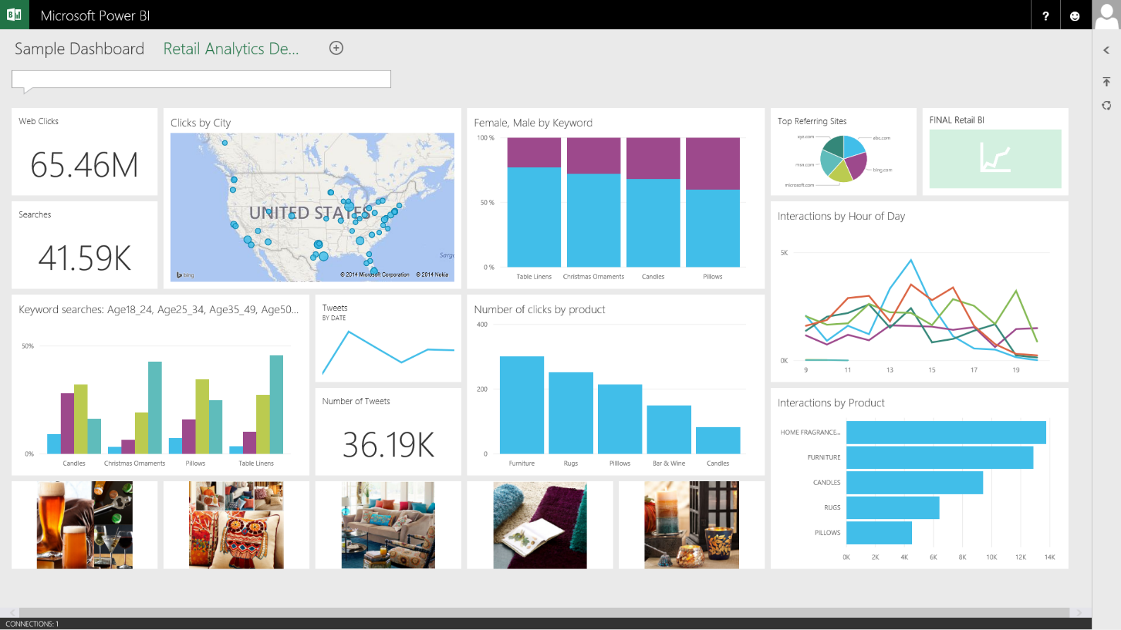
See all your data in a single pane of glass
Live dashboards and interactive reports
Dashboards
Monitor live dashboards
for the data that matters most
Ask questions of your data
through natural language query
Drill through to underlying reports to explore and discover new insight
Pin new visualizations and KPIs
to monitor performance

Slide 45
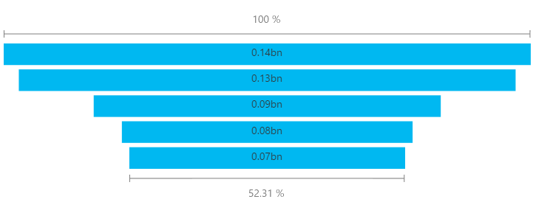
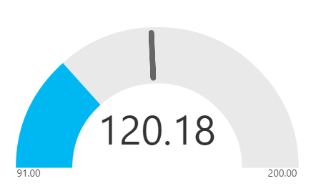
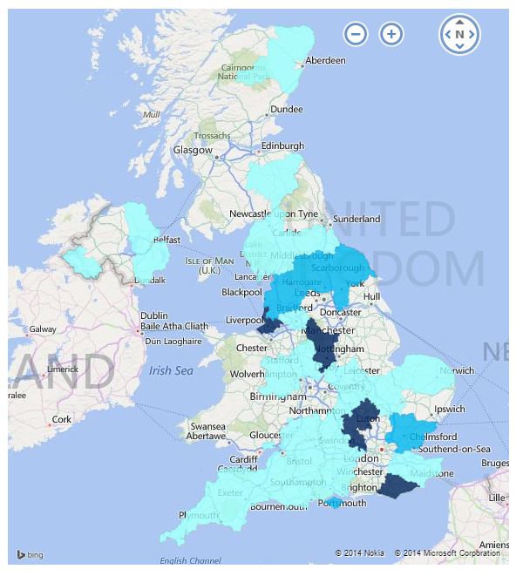
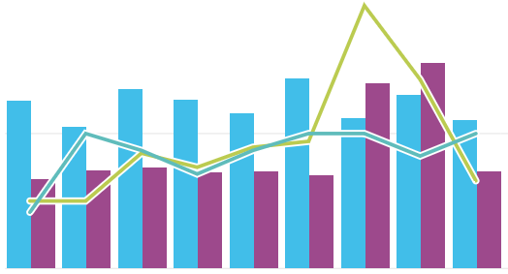
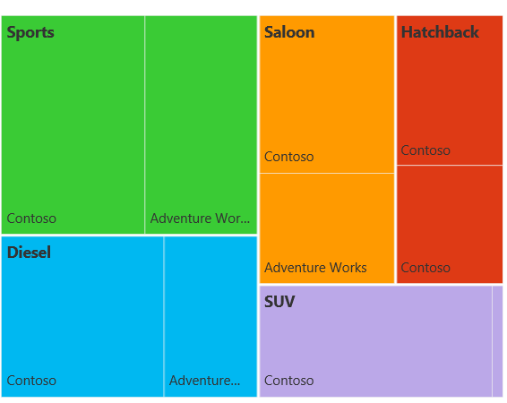
Visualize your data in new ways
New Power BI Visualizations
Funnel
Gauge
Fill Map
Combo Chart
Tree Map

Slide 46
Streaming
Commonalities of Architectures
Data Ingestion
Data Processing
Data Storage
Presentation

Slide 47
Batch Analytics

Slide 48
Analysis output for input processing
Analysis output for storage
Data Sources
Data Ingestion
Data Storage
Data Processing
Presentation
Relational dataset querying and reporting

Slide 49
Demand Product Names?
Analysis output for input processing
Analysis output for storage
SQL Server
Azure Data Factory
Blob Storage
Hadoop
Power BI
Relational dataset querying and reporting

Slide 50
Azure Data Factory

Slide 51
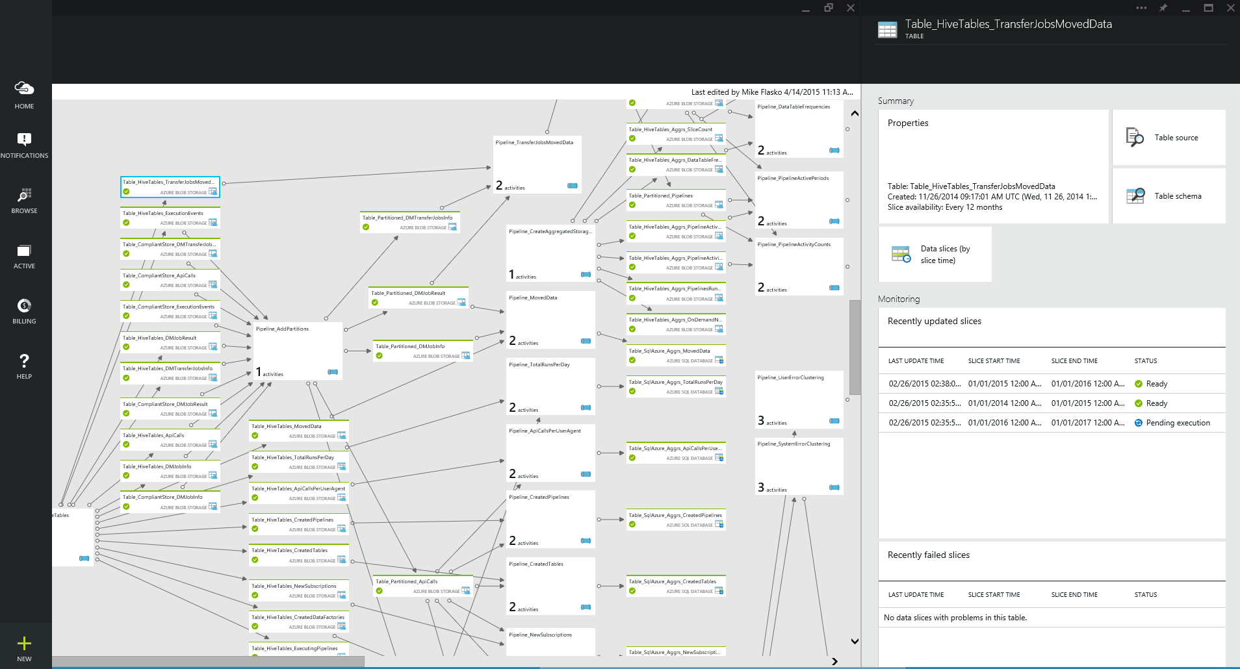
Azure Data Factory
A managed cloud service for building & operating data pipelines (aka. data flows)
Orchestrate, monitor & schedule
  compose data processing, storage & movement services (on premises & cloud)
Automatic infrastructure mgmt
  combine pipeline intent w/ resource allocation & mgmt
  data movement as a service (global footprint & on premises)
Single pane of glass
  one place to manage your network
  of data flows

Slide 52




Azure Data Factory Concepts
Data Set
(Collection of files, DB table, etc)
Activity: a processing step
(Hadoop job, custom code, ML model, etc)
Pipeline: a sequence of
activities (logical group)
…
Data Sources
Ingest
Transform & Analyze
Publish
Call Log Files
Call Log Files
Transform, Combine, etc
Analyze
Move
Visualize
Customer Table
Customer Table
On Premises
Data Mart
Customer Call Details
Customers Likely to Churn
Customer Churn Table
Azure DB
Azure Blob Storage

Slide 53
Building Data Analytics Pipelines Using Azure Data Factory, HDInsight, Azure ML and More
Mike Flasko
https://channel9.msdn.com/Events/Build/2015/2-690

Slide 54
Processing

Slide 55
Choices
Hadoop
Azure SQL Data Warehouse
Azure SQL Database
Worker Roles
Other

Slide 56





Azure as cloud platform of choice
HDInsight
Windows
Linux

Slide 57
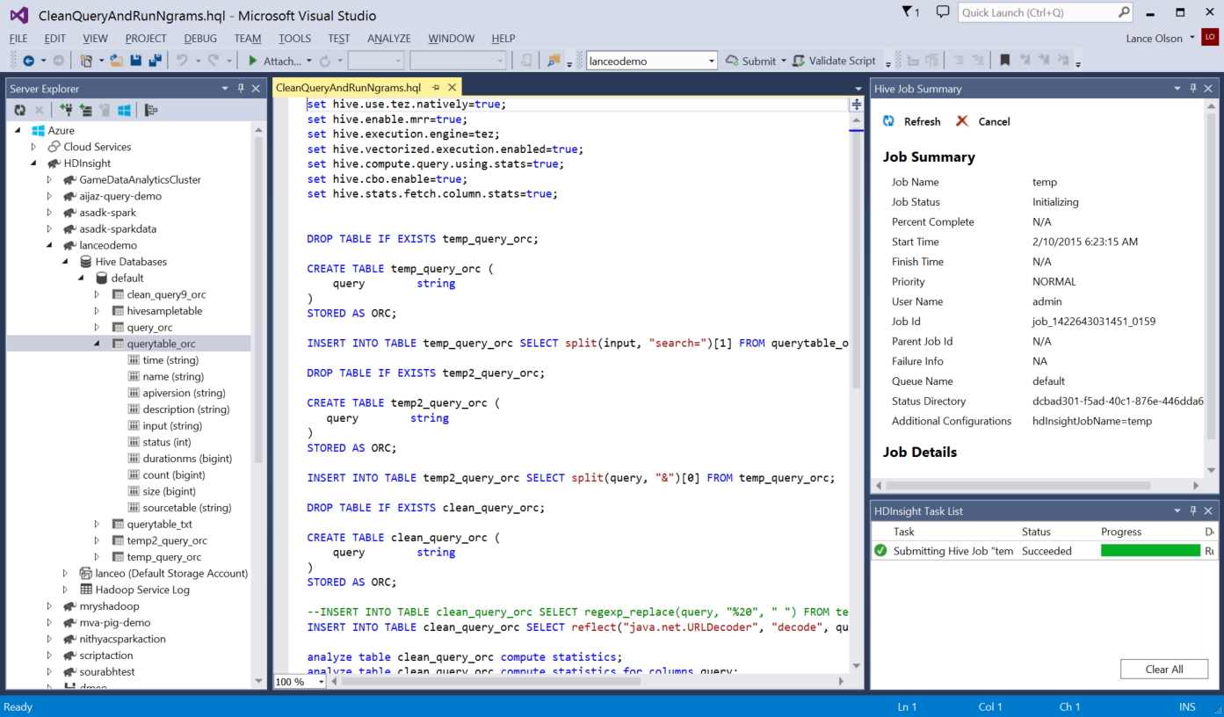
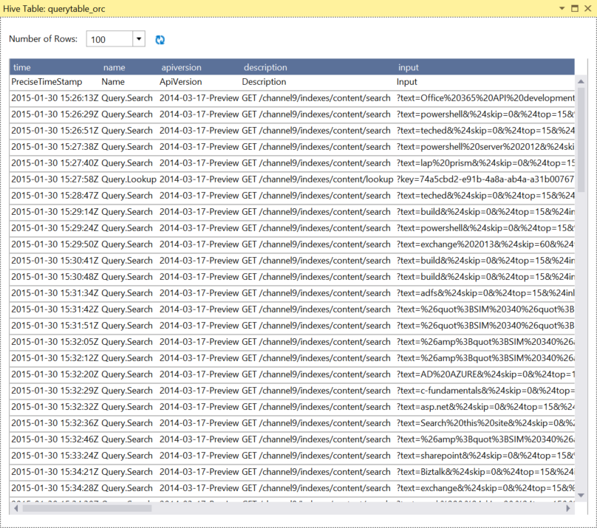
Microsoft Makes Hadoop Easier
Deep Visual Studio Integration
  Debug Hive jobs through Yarn logs or troubleshoot Storm topologies
  Visualize Hadoop clusters, tables, and storage
  Submit Hive queries, Storm topologies (C# or Java spouts/bolts)
  IntelliSense for authoring Hive jobs and Storm business logic

Slide 58
Learn more about Hadoop
Harnessing the Power of Hadoop: Cloud Scale with Microsoft Azure HDInsight
http://channel9.msdn.com/events/Ignite/2015/BRK2557

Slide 59
Demand Product Names?
Analysis output for input processing
Analysis output for storage
SQL Server
Azure Data Factory
Blob Storage
Hadoop
Azure SQL DB
Power BI
Relational dataset querying and reporting

Slide 60
Get your hands dirty
Big Data in Action: Web Log Processing with Microsoft Azure HDInsight
Hands on lab

Slide 61
Machine Learning

Slide 62
Machine Learning & Prescriptive Analytics
Mahout on Hadoop
  Distributed computing
  Comes default within HDI 3.1
  Need to write custom Java code
  Pay for the HDI cluster uptime
  No limit on how much data/# of files it can ingest
  Open-source Community
AzureML
  Each Module runs on a A8 Azure VM
  Drag-n-drop Data Science
  Pay per hour for prediction and Experiment
  Faster to glass
  More analytics/faster model building
  Share ML Workspace with others
  Accepts CSV, TSV and AARF formats.
  AzureML Apps– Project Sage

Slide 63
Real World Architectures

Slide 64
Online Retailer
  Customer Insight Service: Identify a user, his background and his behavior based on their IP Address and a unique Identifier called as Fingerprint. Based on this, personalize the user’s experience and show content (recommendations, coupons) that would help them convert (Browse -> Buy).
    Technologies: PaaS Worker Roles, Event Hubs, Redis Cache, HBase, HDInsight, AzureML
  Capture: A near-real time JavaScript technology, wherein all events on the website can be captured, along with business-defined events, thus helping identify browse patterns to then feed all the information into a Predictive Analysis model.
    Technologies: Javascript, Event Hubs, MongoDB, Stream Analytics, HDInsight, AzureML
  Product Recommendations: Ability to add product recommendations to a page on the website based on a user’s behavior + a product’s features. The goal being upsell, cross-sell and increased RPV %.
    Technologies: AzureML (Project Sage and FBT), HDInsight, Redis Cache, Azure Websites, SQL Azure.
  Coupon Service: Ability to show coupons to certain customers the website to help them convert.
  Personalized Marketing Campaigns: Run campaigns such as ‘Abandoned Cart Emails’, ‘User Inactivity Emails’ & ‘Discount coupon on purchase of a System’, etc.

Slide 65
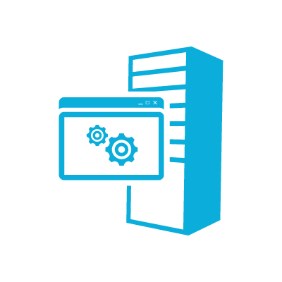

Online Retailer
Data Set
(Collection of files, DB table, etc)
Activity: a processing step
(Hadoop job, custom code, ML model, etc)
Pipeline: a sequence of
activities (logical group)
…
Data Sources
Ingest
Transform & Analyze
Publish
Omniture
Log Files
Transform, Combine, etc
Event Hub
Email Customer
Analyze
Web
Train
Capture
Product Catalog
Product Catalog
Targeted email
On Premises
Data Mart
Data Mart
NRT
Azure DB
Azure Blob Storage

Slide 66

Government Agency
Data Set
(Collection of files, DB table, etc)
Activity: a processing step
(Hadoop job, custom code, ML model, etc)
Pipeline: a sequence of
activities (logical group)
…
Data Sources
Ingest
Transform & Analyze
Publish
XML Files
XML Files
Parse XML
Sqoop
Move
Visualize
Yearly HDI output
Relational Staging Tables for DW
Relational DW’s
Azure DB
2014.txt
2015.txt
Azure Blob Storage
Etc…

Slide 67


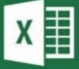


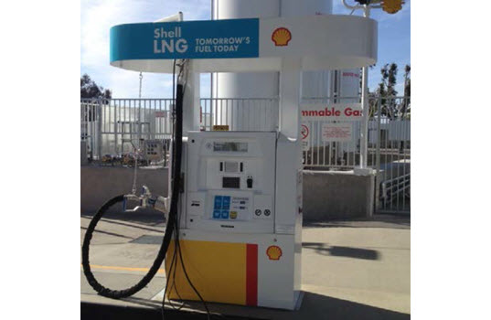

Rockwell Automation is partnered with one of the six oil and gas super majors to build unmanned internet-connected gas dispensers. Each dispenser emits real-time management metrics allowing them to detect anomalies and predict when proactive maintenance needs to occur.
Azure HDInsight
Data
Factory
Power BI for O365
Mobile Device
Hive, Pig,
Real-time notification
Mobile Notification Hub
Azure Blobs
Azure SQL DB
Store sensor data every 5 minutes
    Temperature, pressure, vibration, etc.
    Tens of thousands of data points / second

Slide 68

Neudesic partnered with one of the nation's largest utility companies that recently deployed Smart Utility Meters for power customers, nearly a million meters sending usage data every 15 minutes.
The result: an Azure hybrid big data processing solution that enabled the customer to perform gap analytics: a process for identifying gaps that exist in the power usage readings, over 7x faster than their previous solution! Billions of Smart Meter reads get processed to identify the nature and duration of the gaps to mitigate revenue losses.

Slide 69
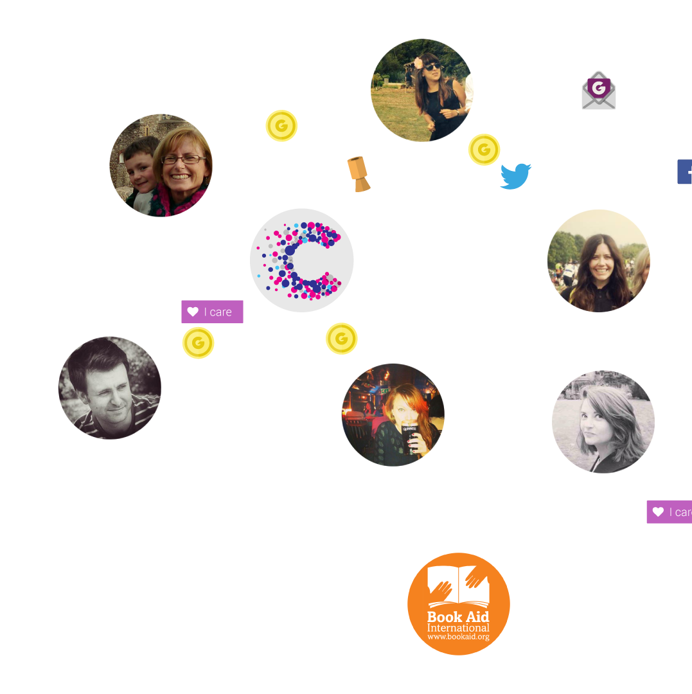





JustGiving wanted to harness the power of their data by using network science to map people’s connections and relationships so that they could connect people with the causes they care about. Based on 15
years of data, the JustGiving GiveGraph is the world’s
largest ecosystem of giving
behavior. It contains more
than 81 million person nodes, thousands of causes and 285 million connections and is the engine that drives JustGiving’s social platform, enabling levels of personalization and engagement that a traditional infrastructure would be unable to deliver.
Give
Graph
Activity
Feeds
Agent
Azure HDInsight
SQL Server
On-premises
Azure Blobs
Real-time Event
Service Bus
Azure Tables
Azure Cache
Website +
Event store
Serves results
Web API

Slide 70
Streaming
Commonalities of Architectures
Data Ingestion
Data Processing
Data Storage
Presentation

Slide 71
Lambda Architecture for Big Data
Real Time
Data Processing
Historical
Data Ingestion
Presentation
Data Storage

Slide 72


Call To Action

Slide 73
HDInsight – Call to Action
Key Sessions at Ignite
  BRK3555-Real-Time Analytics at Scale for Internet of Things
  BRK2550-Big Data for the SQL Ninja
  BRK2576-Planning your Big Data Architecture on Azure
  BRK3556-Optimizing Hadoop using Microsoft Azure HDInsight
  BRK3559-Build Hybrid Big Data Pipelines with Azure Data Factory and Azure HDInsight
Sign Up for HDInsight Free Trial
  http://azure.com/hdinsight
  Sign up for Azure Data Lake Preview
  http://azure.com/datalake

Slide 74

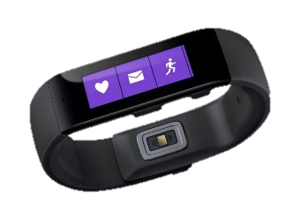


Ignite Azure Challenge Sweepstakes
Attend Azure sessions and activities, track your progress online, win raffle tickets for great prizes!
Aka.ms/MyAzureChallenge
Enter this session code online: BRK2576
NO PURCHASE NECESSARY. Open only to event attendees. Winners must be present to win. Game ends May 9th, 2015. For Official Rules, see The Cloud and Enterprise Lounge or myignite.com/challenge

Slide 75


Please evaluate this session
Your feedback is important to us!
Visit Myignite at http://myignite.microsoft.com
or download and use the Ignite Mobile App
with the QR code above.

