Slide 2
Enterprise-Grade Access Control for Azure
BRK2707
Dushyant Gill
Product Manager, Azure Active Directory
http://www.dushyantgill.com/blog/contact

Slide 3


IAAS/PAAS adoption in Organizations
partner@yahoo.com
Managed Identity
Owner = ellen@outlook.com
prospectivecustomer@live.com
Active Directory
Owner = aaron@hotmail.com
ellen@company.com
Owner = xyz@gmail.com
aaron@company.com
Owner = xyz@yahoo.com

Slide 4
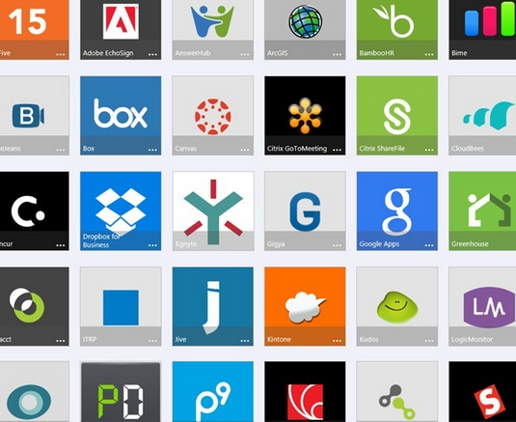
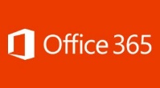

Access to Azure & rest of the cloud
Powered by Azure AD
2500+ Pre-Integrated SAAS Apps
Managed Identity
Users & Groups
Microsoft Online Services
Roles and Role Assignments
Sync
Azure Active Directory
Owner = ellen@outlookcompany.com
Active Directory
ellen@company.com
joe@partner.com
aaron@company.com
prospectivecustomer@live.com
Owner = aaron@hotmailcompany.com
Microsoft Azure IAAS/PAAS
Roles-Based Access Control
Self-Service Groups Management
B2B Access Management
Conditional Access (MFA, Device Health, Network)
Attribute Based Access Control
Managed Access to Daemon Services
Secure Sharing with Consumer Accounts
Self-Service Password Management
Company In-House Developed Cloud Apps

Slide 5
Demo
Azure RBAC in Action
New member joins the team, and automatically gets appropriate access to Azure.

Slide 6
RBAC in Azure
20 Built-In Roles
  Owner, Contributor, Reader and
  Resource type-specific admin roles: VM Contributor, VNet Contributor, SQL DB Contributor …
  Custom roles coming soon
Fine-Grained Control
  Grant access to AD groups, users, and services
  Manage access at granular scopes (resource groups, subscriptions, and individual resources)
  Delegate specific access management
Simple Access Management Experience
  Manage access using portal, command-line, and REST APIs
  Analyze access settings and keep track of changes
  Co-existence with classic service admin, and co-admin model

Slide 7
Access Inheritance and Resource Hierarchy
Access Inheritance
R
RG
R
R
S
RG
R
RG
R
Role Assignment
Role = ‘Owner’
Subject = AAD User
Scope = Resource
Role Assignment
Role = ‘Reader’
Subject = AAD Group
Scope = Subscription
R
Role Assignment
Role = ‘Contributor’
Subject = AAD User
Scope = Resource Group

Slide 8
Demo
Analyze Access Policy
Access change history. Who has access to my subscriptions? What access does a user have on my subscriptions?
http://www.dushyantgill.com/blog/2015/02/08/keep-a-tab-on-access-settings-of-your-azure-subscriptions/

Slide 9
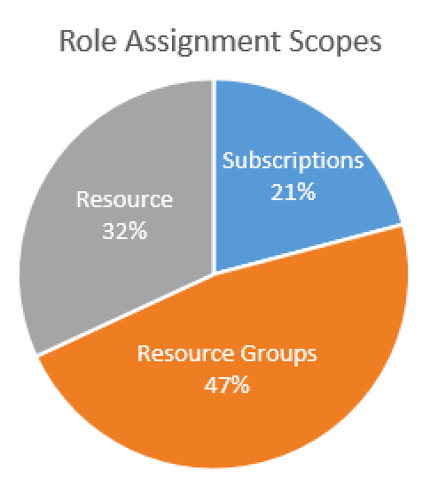
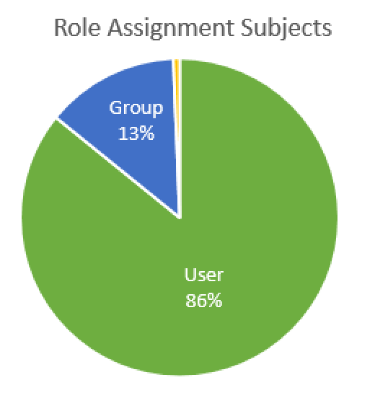
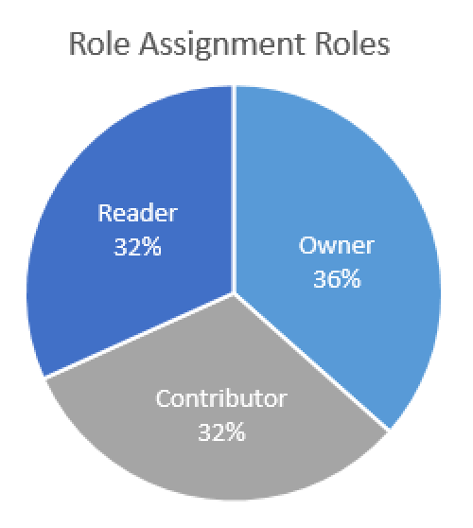
Azure RBAC Usage

Slide 10
Key Learnings from Enterprise Customers
Organizational Accounts not LiveIds
  Use organizational accounts to sign-up and manage Azure. Connect your Azure AD with on-prem AD.
  Resource Groups not Subscriptions
  Use resource groups to segregate workloads with different access needs. Avoid granting access to individual resources unless necessary.
  Manage Access using Groups
  Assign access to AD groups, manage membership of groups for on-going access management.
  Enable Multi-Factor Auth
  Use Azure AD conditional access policies to enable MFA for Azure management.
  Least Privilege
  Pick the right role for the job. Contributor not Owner. Model on-premises roles using resource-type specific Azure roles.
  Keep a tab on Access Changes
  Monitor changes to access settings. Regularly dump and review entire access policy.

Slide 11
Actual Enterprise Implementation
On-Premises
Azure
Active Directory
Users, Groups and Password Sync
Azure
Active Directory
Subscription per Sector
..
Owners of Subscriptions
Sector 1
Sector 2
IT Director’ Office
Region NA
Region SA
..
VNet Contributors of “standard” VNet RGs
Network Admins
“Standard” VNet per Division
in separate resource group
Division Mktg
Division Sales
Billing
Tracked per Division
..
Virtual Machine Contributors of Project RGs and “standard” VNet RGs
Tags
Region, Division, Project
Infrastructure Admins and Support
Resource Group per Project
Project 1
Subnet
On “standard” Vnet assigned to each Project
Project 2
Appropriate Role on Project RGs
..
Project Team Roles
Express Route(s)

Slide 12
Coming Soon
Azure RBAC Custom Roles
Model specific access needs using Azure RBAC custom roles.

Slide 13
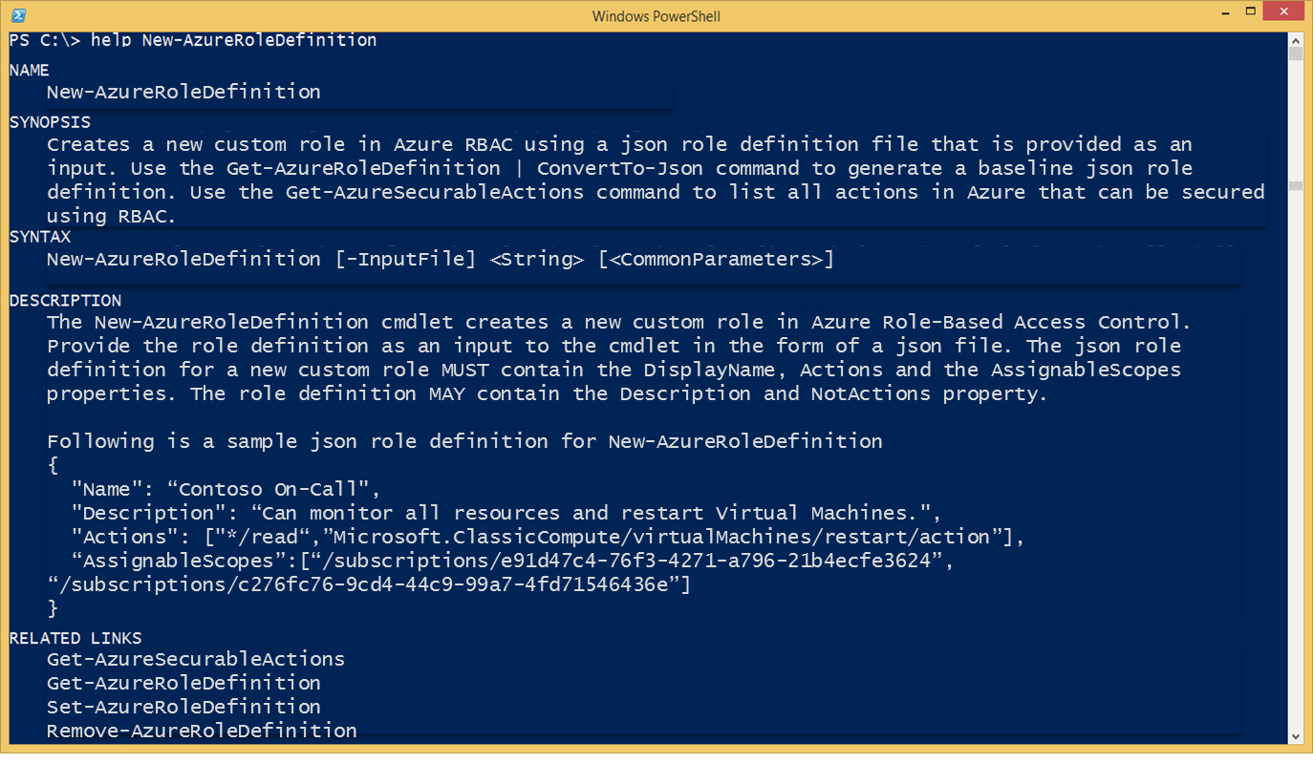
Custom Roles: New-AzureRoleDefinition

Slide 14
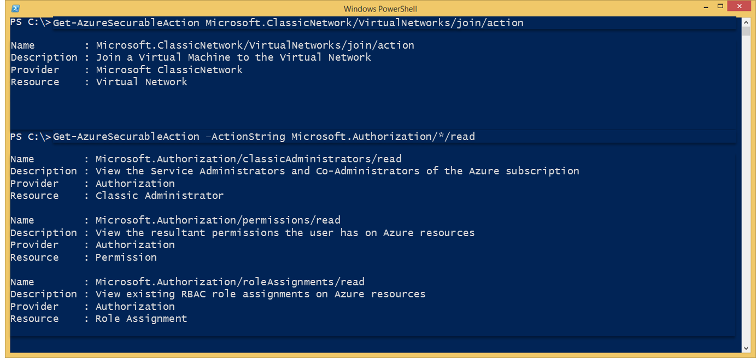
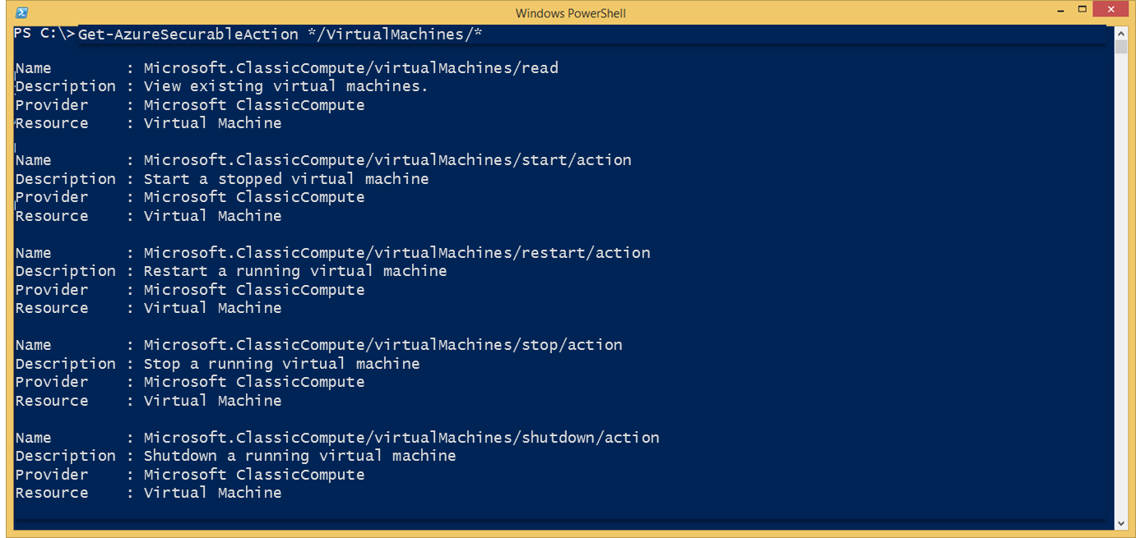
Custom Roles: Get-AzureSecurableActions

Slide 15
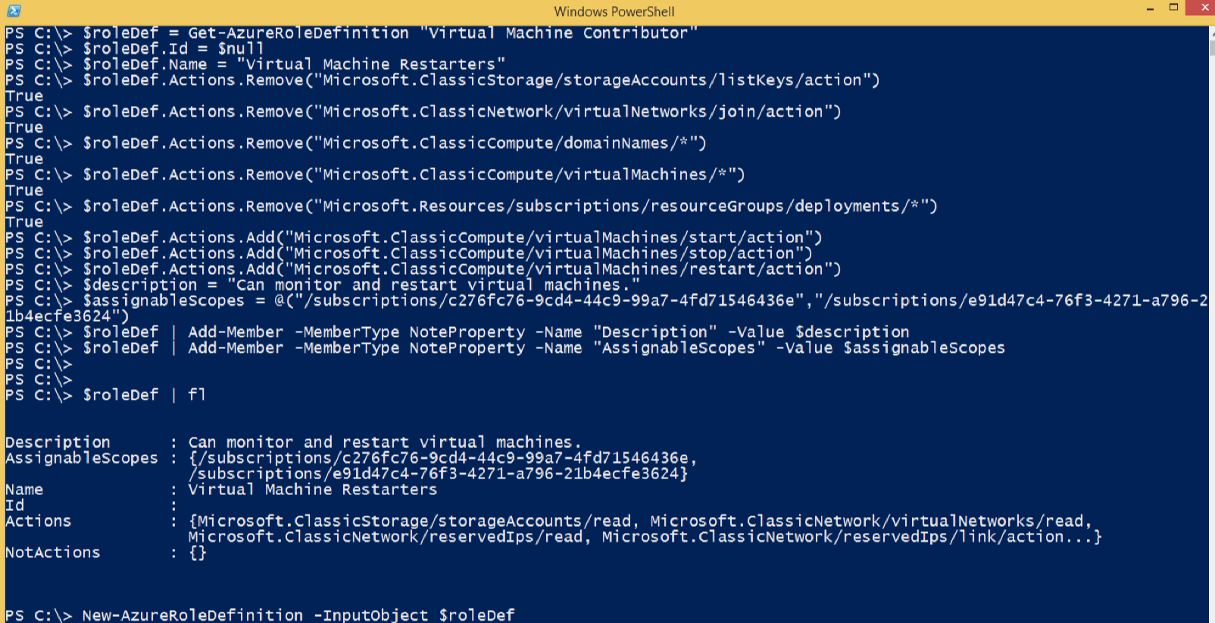
Custom Roles: Create Using Script

Slide 16
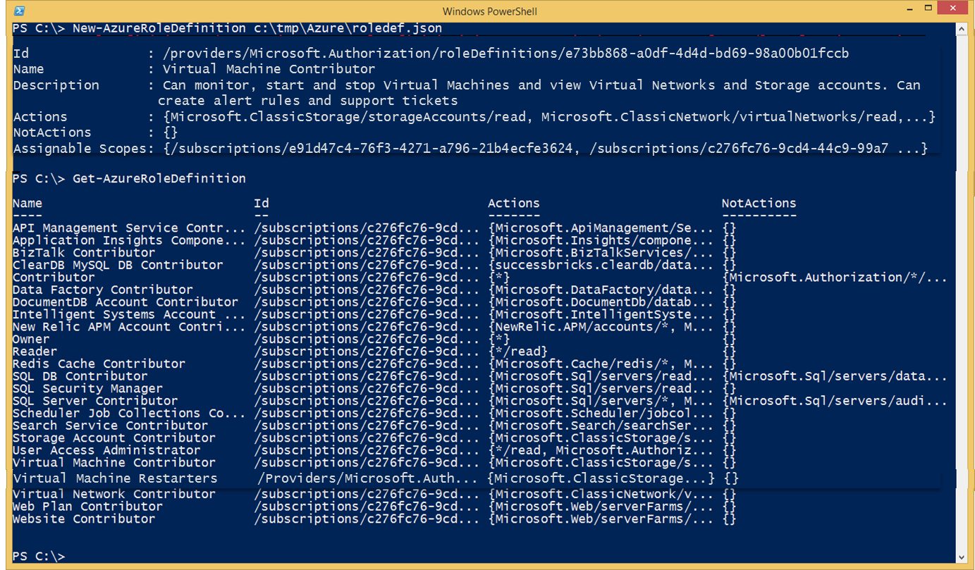
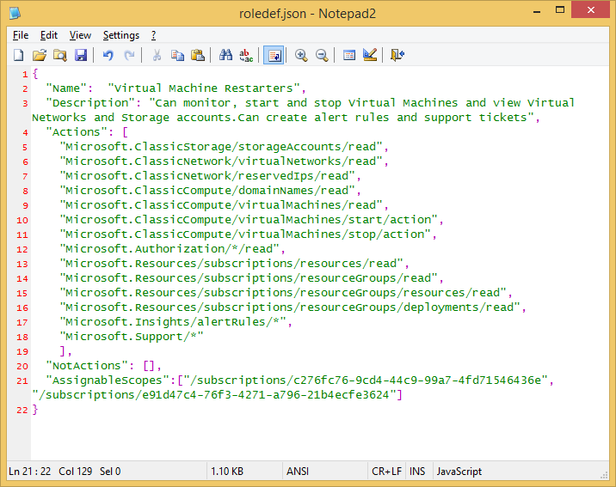
Custom Roles: Create Using Json

Slide 17
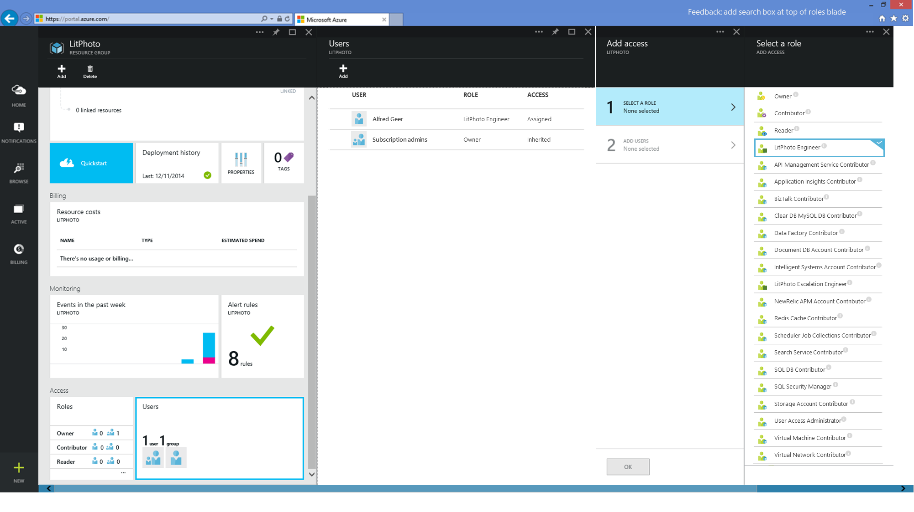

Slide 18
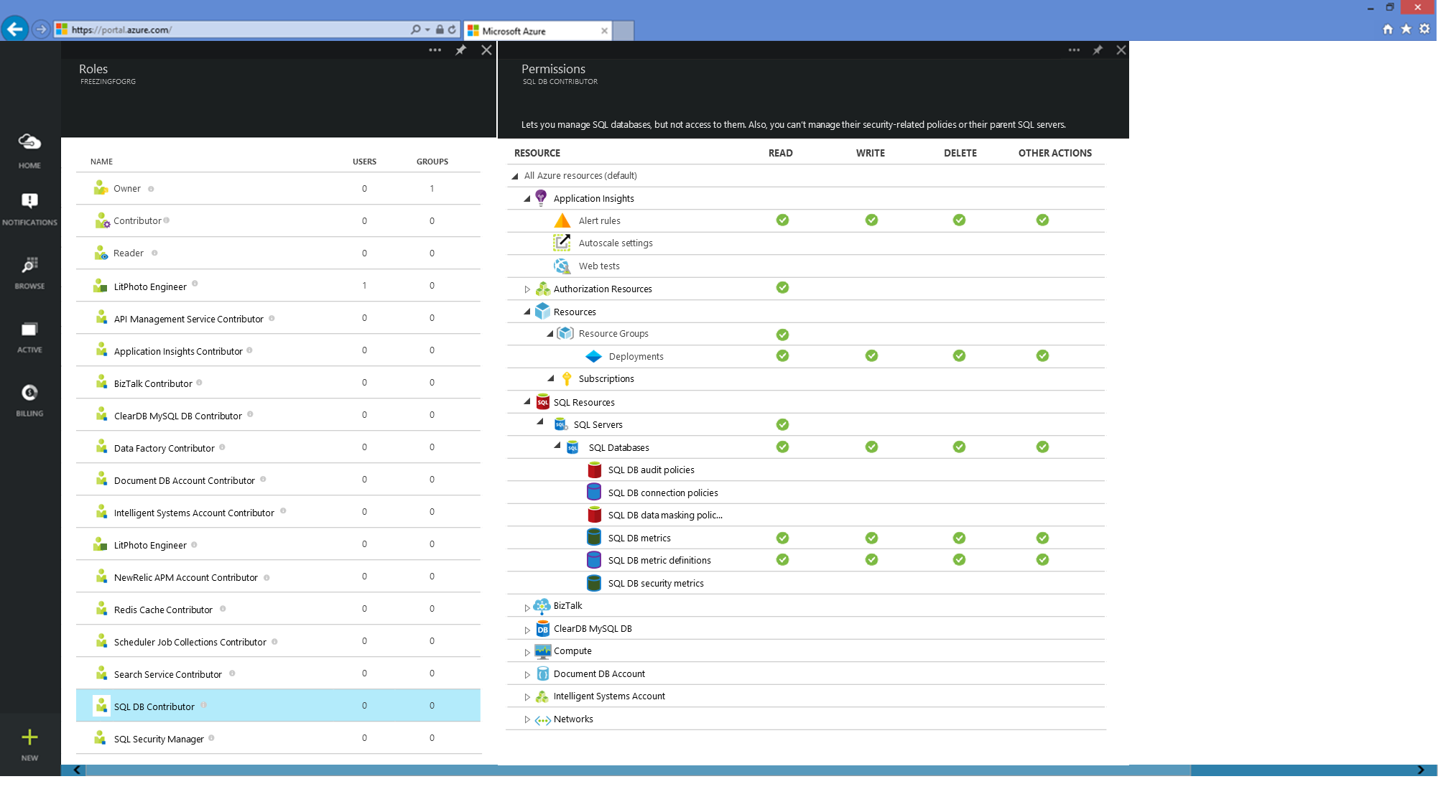

Slide 19
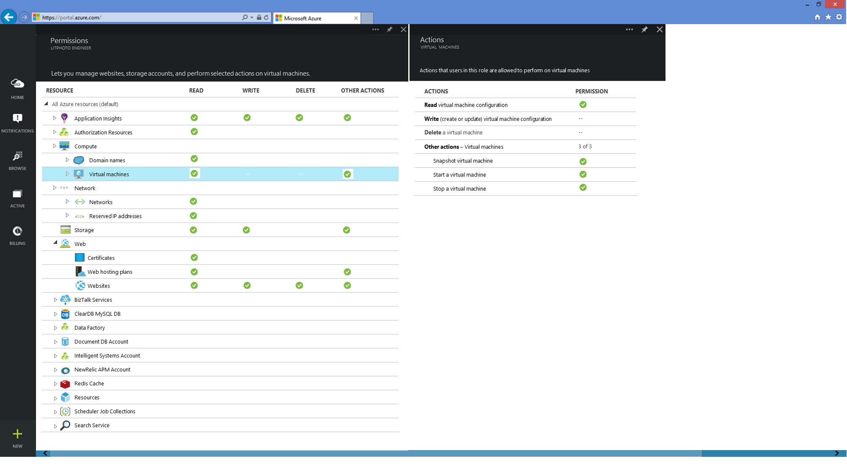

Slide 20
Demo
Conditional Access for Azure Management
Enforce multi-factor auth in Azure Portal and Command-Line from outside company network.

Slide 21
Demo
Bye-bye Azure storage account keys
Extend Azure AD access management to Storage Account Data using Key Vault.
http://www.dushyantgill.com/blog/2015/04/26/say-goodbye-to-key-management-manage-access-to-azure-storage-data-using-azure-ad/

Slide 22

Secure Access to Storage Accounts using Key Vault and Azure AD
1) Authenticate
2) Read Secret
(Storage Account Key)
Azure AD
User/Service
Key Vault
3) Access Storage Account with Key
Write Secret (New Storage Account Key)
Scheduled Job Running in Azure Automation
Storage Account
Storage Account
Regenerate Storage Account Key

Slide 23
Demo
Attribute-Based Access Control for Azure
ABAC for Azure using Azure AD criteria-based groups.
http://www.dushyantgill.com/blog/2015/02/28/attribute-based-access-control-for-azure/

Slide 24
Thank you! Please complete the evaluation.
Reach out to Dushyant at http://www.dushyantgill.com/blog/contact

Slide 25


Please evaluate this session
Your feedback is important to us!
Visit Myignite at http://myignite.microsoft.com
or download and use the Ignite Mobile App
with the QR code above.

