Slide 2
Designing Microsoft Azure Applications to Access Existing Programs and Data on IBM Mainframes
BRK2715
Paul Larsen
Valerie Robb

Slide 3
Enterprise Cloud Solutions
Transform IT value
  Engage customers and empower employees
Azure cloud platform
  Develop applications faster, with more flexibility and at global scale
  Integrate applications with data to unlock insights for your business
App Service
  Seamlessly connect and consume data across anywhere on any device
  Integrate data and messages on existing systems

Slide 4


Azure App Service
Web Apps
Mobile Apps
Web apps
that scale with your business
Build Mobile apps
for any device
Logic Apps
Api Apps
Automate business process across SaaS and on-premises
Easily build and consume APIs in the cloud

Slide 5



API App Connectors for IBM Systems
Microsoft
Connector
for MQ
Microsoft
Connector
for DB2
Microsoft
Connector
for Informix
API app
for connecting applications through Azure App Service
to IBM
WebSphere MQ servers
API app
for connecting applications through Azure App Service
to IBM DB2
databases
API app
for connecting applications through Azure App Service
to IBM Informix
databases

Slide 6





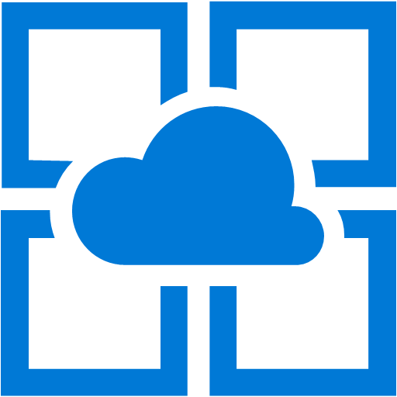
MQ Connector
Azure Datacenter
On-Premises Datacenter
Messages
and
Queues
Microsoft
Connector for MQ
IBM MQ
Protocol and Formats
Microsoft Client
for MQ
TCP/IP
(Hybrid, VPN)
IBM MQ Server
Linux, UNIX,
Windows
IBM z/OS, i5/OS
App Service

Slide 7
MQ Connector
App Service API app
  Connector-specific Web API operations using HTTP GET and POST verbs
    Read single or multiple messages from queue
    Write single or multiple messages to queue
  Swagger documentation
Networking
  Microsoft Client for MQ for connecting to MQ server across a TCP/IP network
  VPN and hybrid connections to on-premises servers
MQ servers
  IBM WebSphere MQ V8

Slide 8
Demo MQ Connector
Valerie Robb

Slide 9

DB2 Connector
Azure Datacenter
On-Premises Datacenter
Tables, Views
Stored Procedure
Catalog, Schema
Connector
for DB2
ADO.NET Provider for DRDA
Standard DRDA Protocol and Formats
DRDA Protocol Client for DB2
TCP/IP
(Hybrid, Relay, VPN)
IBM DB2 Server
Linux, UNIX,
Windows
IBM z/OS, i5/OS
App Service

Slide 10
DB2 Connector
App Service API app
  Connector-specific Web API operations using HTTP GET and POST verbs
  SELECT, INSERT, UPDATE, DELETE, custom SQL statement
  Industry-standard Open Data Protocol (OData) operations
  SELECT, INSERT, UPDATE, DELETE, MERGE
  Compatible with Logic app actions
  Swagger documentation and examples based on configured table list
Networking
  Microsoft Client for DRDA for connecting to DB2 server across a TCP/IP network
  VPN and hybrid connections to on-premises servers
  Azure proxy service with service bus relay to on-premises connector
DB2 servers
  IBM DB2 for z/OS V11 and V10
  DB2 for i V7R2, V7R1 and V6R
  DB2 for LUW V10.5, V10, and V9.7

Slide 11
Demo DB2 Connector
Paul Larsen

Slide 12
Informix Connector
Azure Datacenter
On-Premises Datacenter
Tables, Views
Stored Procedure
Catalog, Schema
Connector
for Informix
ADO.NET Provider for DRDA
Standard DRDA Protocol and Formats
DRDA Protocol Client for Informix
TCP/IP
(Hybrid, Relay, VPN)
IBM Informix Server
App Service
Linux, UNIX, Windows

Slide 13
Informix Connector
App Service API app
  Connector-specific Web API operations using HTTP GET and POST verbs
    SELECT, INSERT, UPDATE, DELETE, custom SQL statement
  Industry-standard Open Data Protocol (OData) operations
    SELECT, INSERT, UPDATE, DELETE, MERGE
  Compatible with Logic app actions
  Swagger documentation and examples based on configured table list
Networking
  Microsoft Client for DRDA for connecting to Informix server across a TCP/IP network
  VPN and hybrid connections to on-premises servers
  Azure proxy service with service bus relay to on-premises connector
Informix servers
  IBM Informix V12.1 and V11.5

Slide 14
Demo Informix Connector
Paul Larsen

Slide 15
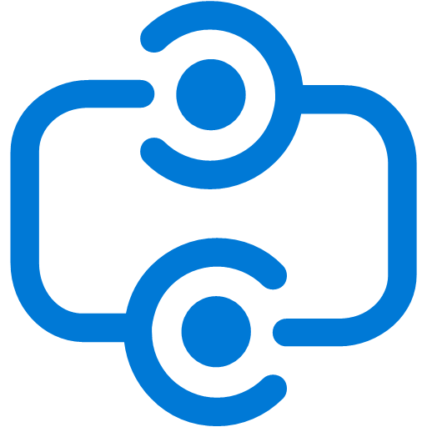
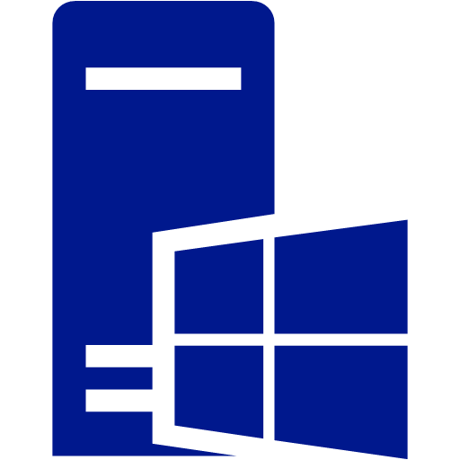




App Service Connectivity to On-Premises
Azure Datacenter
On-Premises Datacenter
Hybrid Connection
Windows
App Service
API App
Service Bus Relay
IIS
API App
Windows
Virtual Network
IBM

Slide 16
Integrate existing IBM Systems
Microsoft
Host
Integration
Server
CICS, IMS
MQ, RACF
DB2, Informix
Host Files
IBM Protocols and Formats
Standard Protocols and Formats
TCP/IP and HRP/IP
Windows Server
IBM z/OS and i5/OS,
AIX, Linux, UNIX, Windows

Slide 17
Microsoft Host Integration Server
Infrastructure
  Network services (connectivity gateway, print and TN services; client device emulation, APIs)
  Security services (enterprise single sign-on)
Data
  BizTalk adapters, OLE DB and ADO.NET providers for DB2 and Informix
Messages and programs
  BizTalk adapters and WCF channel for IBM WebSphere MQ
  BizTalk adapter and Transaction Integrator for CICS, IBM I, and IMS

Slide 18
Roadmap
Azure cloud connectors
  App Service Public Preview
    DB2 Connector
    Informix Connector
    MQ Connector
  Planned (future)
    TI Connector (CICS, IMS, i)
    TI Service (host-initiated)
    DRDA Service (host-initiated)
On-premise servers
  HIS V10 Rapid Deployment TAP
    BizTalk Adapter for Informix
  Planned (future)
    Host Integration Server HIS V10

Slide 19
Related Content
Basics
  BRK3734 – Integration: Extend Mission-Critical to the Cloud
  BRK3715 – Running Enterprise Web and Mobile Apps on Azure App Service
  BRK3719 – Azure API Apps: API back ends for Enterprise Web, Mobile, and Logic Apps
  BRK1450 – Microsoft Azure Logic Apps
Advanced
  BRK2492 – Microsoft Project Siena: Build apps & create new mobile solutions
  PRE03 – Project Siena: Create Custom Mobile Business Apps, No Code Required
  BRK4701 – Azure App Service Logic Apps and BizTalk: Tomorrow’s Integration Starts Today
  BRK4304 – Building a Web of Apps: Launchers, Pickers, App Services, and Much More
  BRK4704 – When Bad Things Happen to Good Apps: Troubleshooting Application on Azure App Service

Slide 20
Discussion

Slide 21


Please evaluate this session
Your feedback is important to us!
Visit Myignite at http://myignite.microsoft.com
or download and use the Ignite Mobile App
with the QR code above.

