Slide 2
Deep Dive into How Microsoft Handles Spam and Advanced Email Threats
BRK3106
Atanu Banerjee, Bulent Egilmez, Ori Kashi

Slide 3
Introduction
Protection built into O365
  Who we are – Information Protection Team
  What we ship – Exchange Online Protection
  What we do – Protect Billions of emails / day
Spam – Constantly evolving
  Comes in a variety of flavors – general spam, promotions, phishing, malware, …
  Heavy financial incentive to continue and expand a multitude of campaign types

Slide 4
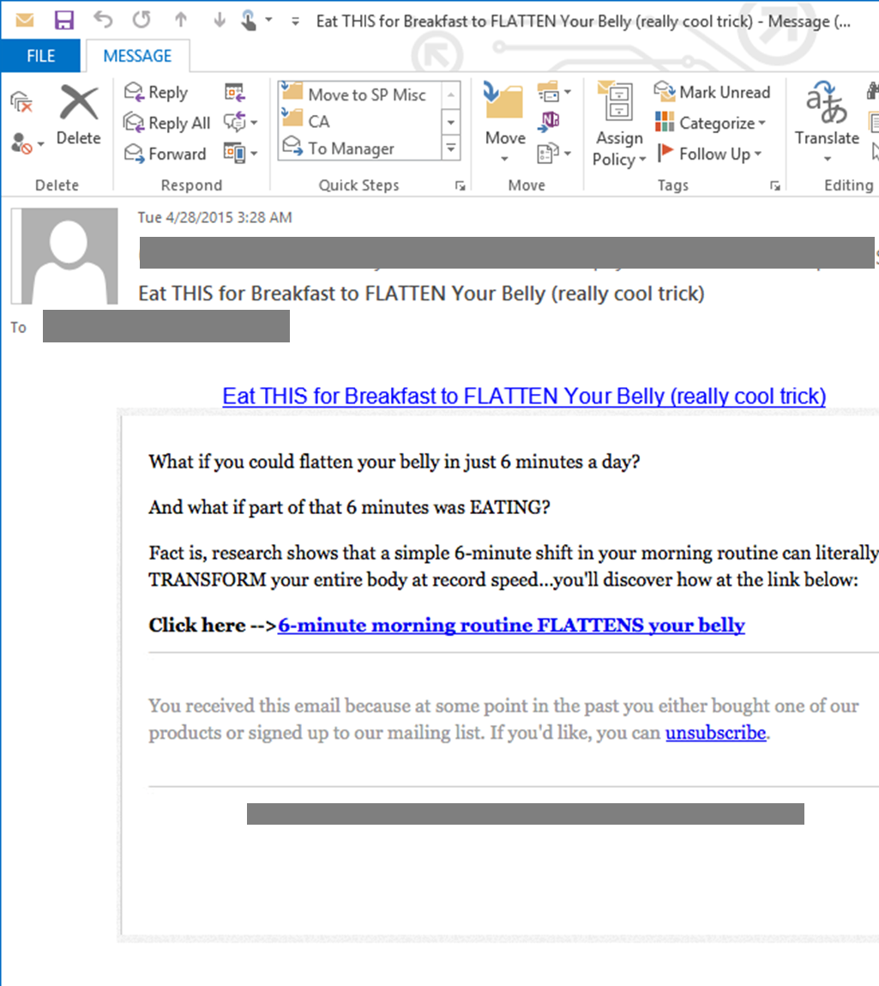
What is Spam?
Malicious or unsolicited mail sent to a mailbox without the option to unsubscribe
Often used as a catch-all of any undesired or questionable mail

Slide 5
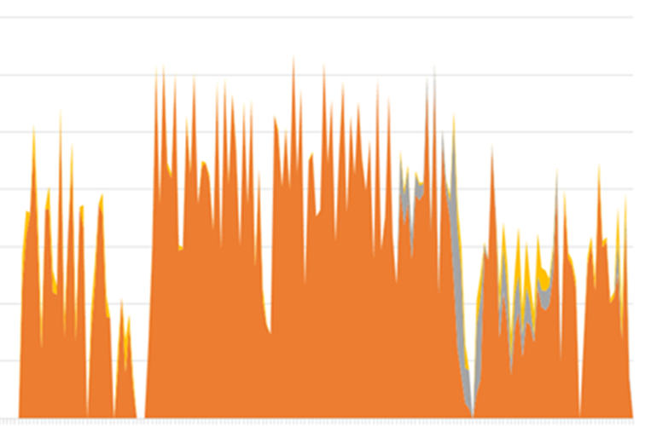
What is Spam?
Malicious or unsolicited mail sent to a mailbox without the option to unsubscribe
Often used as a catch-all of any undesired or questionable mail
Best defense is to disrupt economics of spam
This is what this spam campaign looked like to us
Millions of emails received.
Almost all of them blocked.
Volume
Time
Campaign lasted a few hours

Slide 6
How do we detect Spam?
Sender@ ….
BEFORE
Content Filters

Slide 7

How do we detect Spam?
Sender@Domain
IP
…
BEFORE
Content Filters
TODAY
Content Filters
Connection Filters
Fingerprint Based Filters

Slide 8
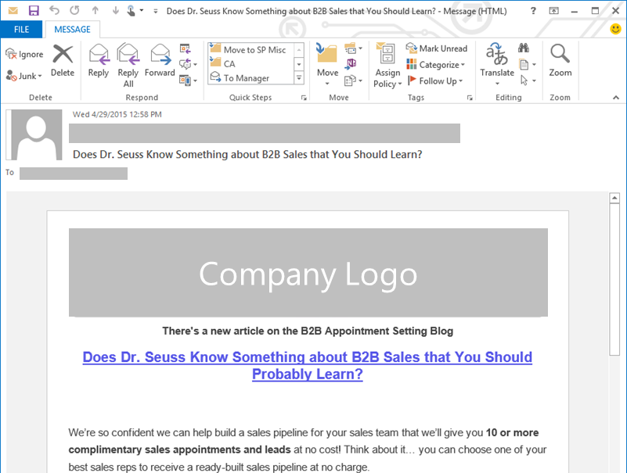
What is Bulk?
An email sent to a large list of recipients for promotional purposes. Typically the Sender has Reputation with us.
Light Gray/Good/ Ham
Recipient intentionally signed up to receive email/ newsletter/ promotions
Always provides the option to unsubscribe
Dark Gray/Bad/ Spam
Recipient didn’t sign up to receive email/newsletter/ promotions
Sometimes provides the option to unsubscribe

Slide 9
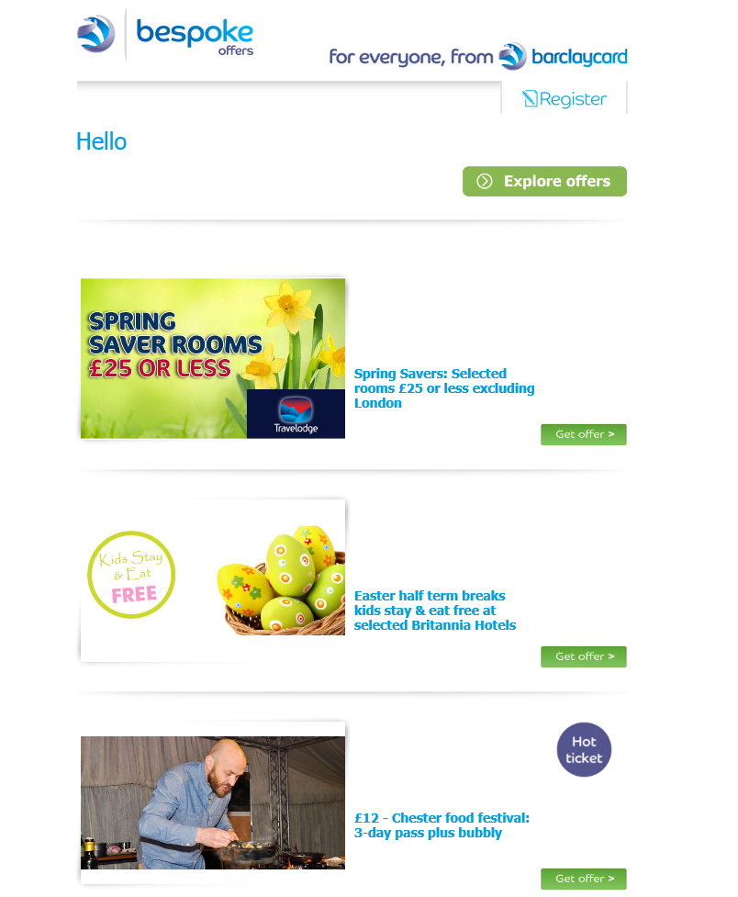
Is Bulk Mail considered Spam or Ham?
Many users don’t want it in their inbox.
Many users want it in their inbox.
We hope you found the information in this email useful. However, if you'd rather not receive future emails of this nature from bespoke offers, it's easy to unsubscribe.

Slide 10
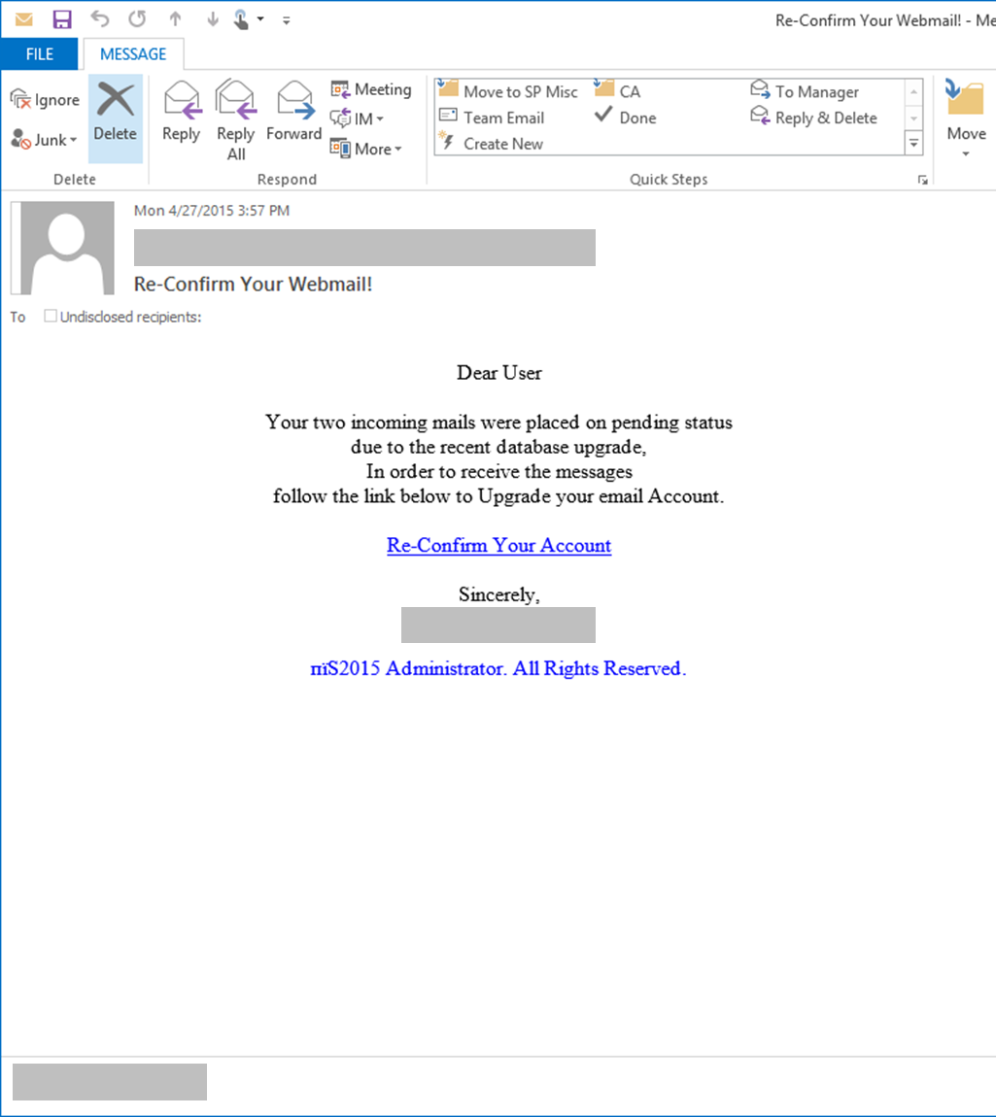
What is Phishing?
A targeted attack on a group of mailboxes with the intention of garnering personal information or credentials
Evolution of Phish
Target: Individual
Motive: Financial
Target: Organization
Motive: Network compromise

Slide 11
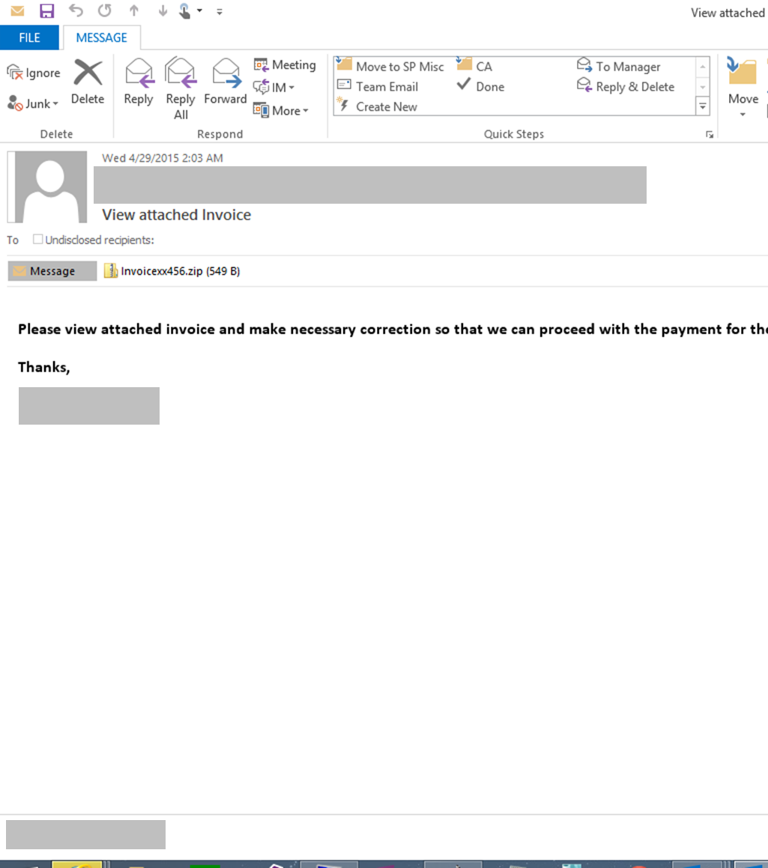
What is Malware?
Malicious code often distributed in email to a recipient
  E.g. Spyware / Keyloggers, RAM scrapers, …
Payload can be delivered via attachment, or URL
Unique requirements for protection

Slide 12
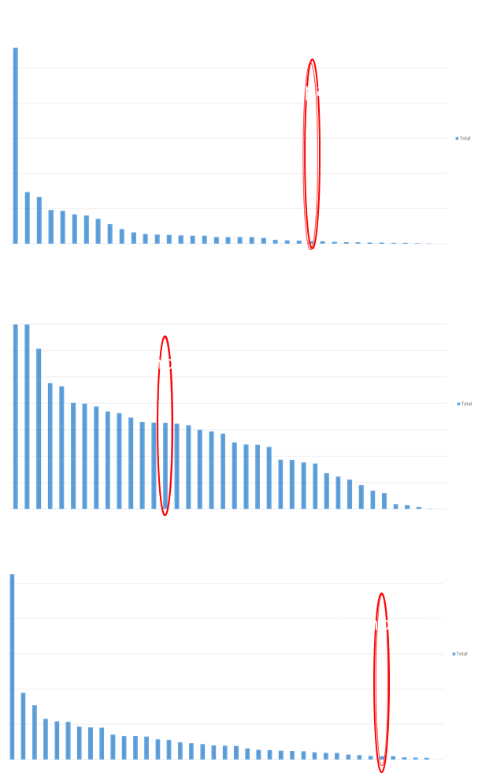
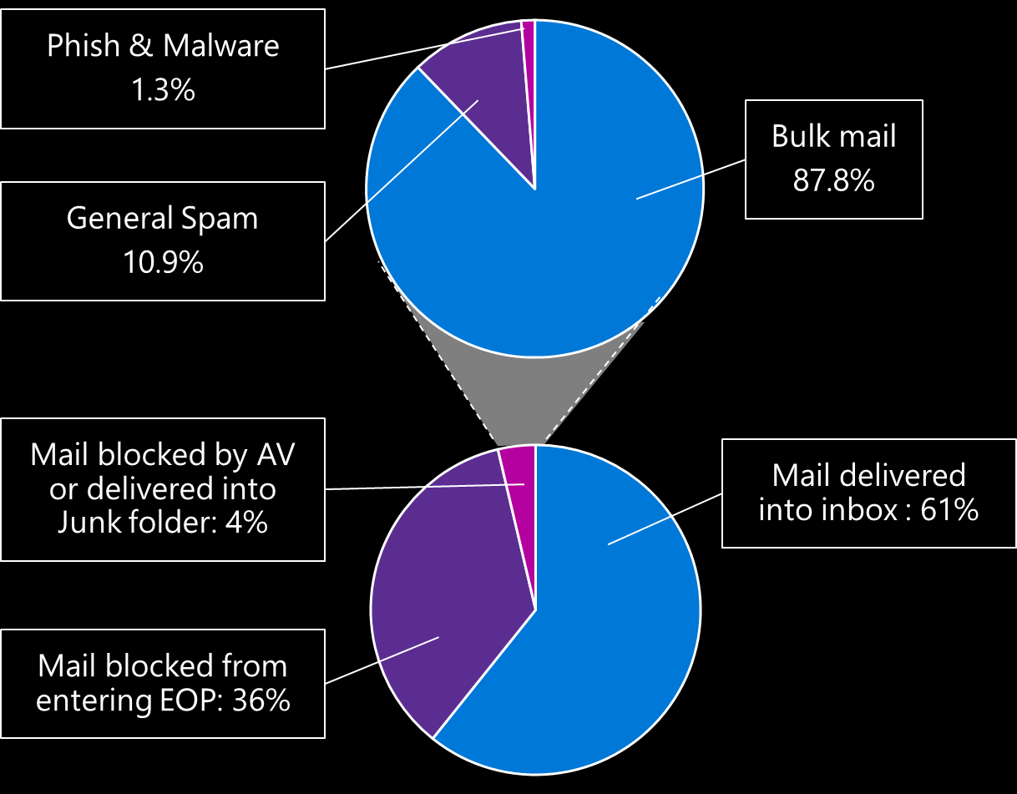
Threat Landscape
Each company has a different threat profile
Bulk mail has largest volumes, but Phish & Malware carry the greatest risk
* Comparing Company X with its peer group (all Enterprise companies)

Slide 13

What makes the threats so dangerous?
Users are often unaware that they are the target of attack
E.g. Malware, Phishing, Trojan Downloaders, …

Slide 14
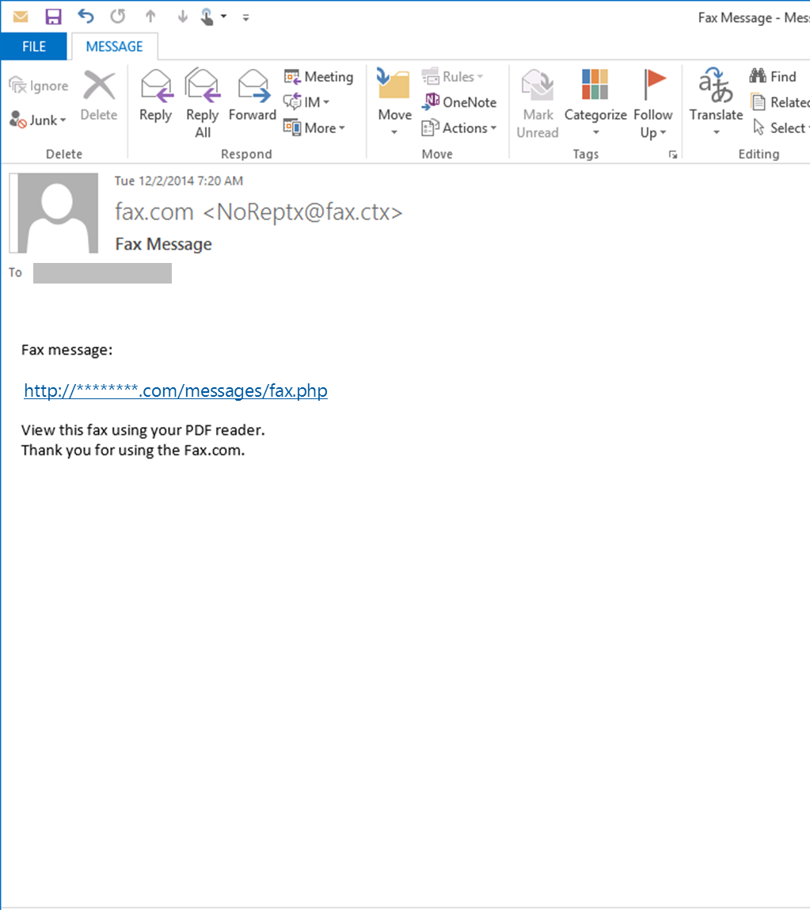
Fax malware campaign
Mails distributed via Botnet
Links to hijacked domains:
http://********.com/messages/fax.php
(Usually unpatched web servers)

Slide 15
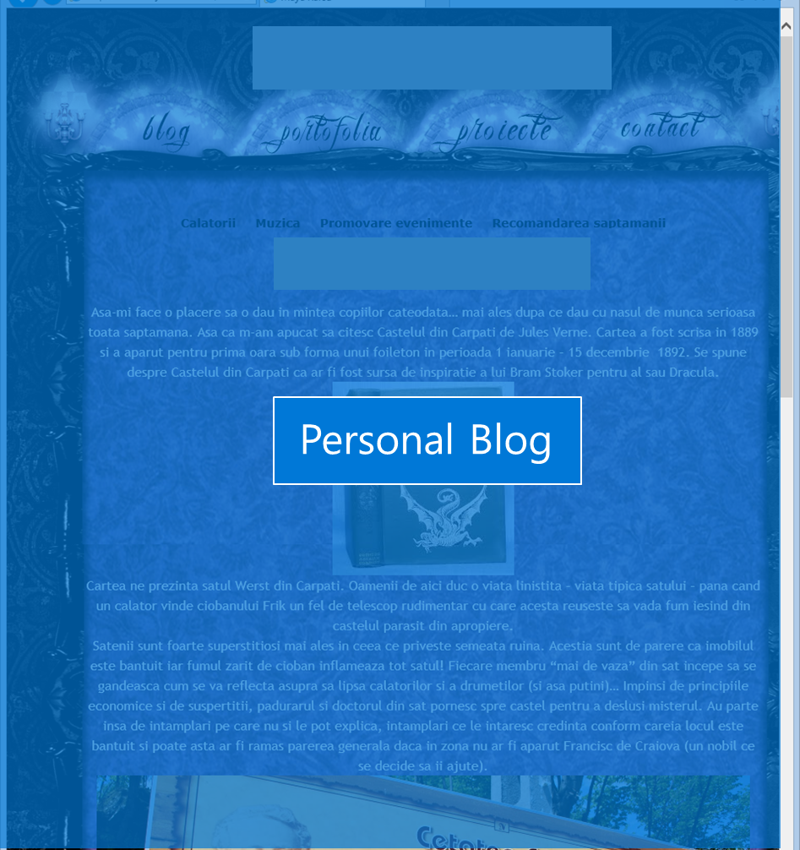
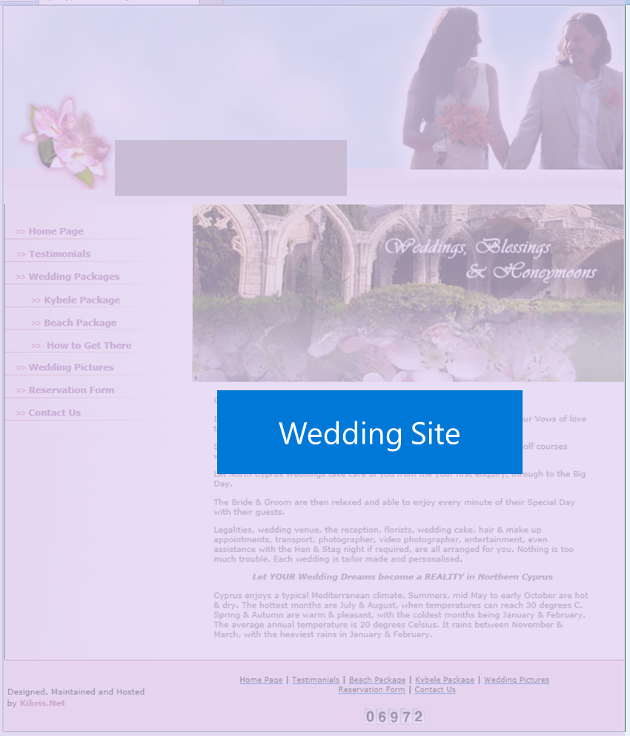
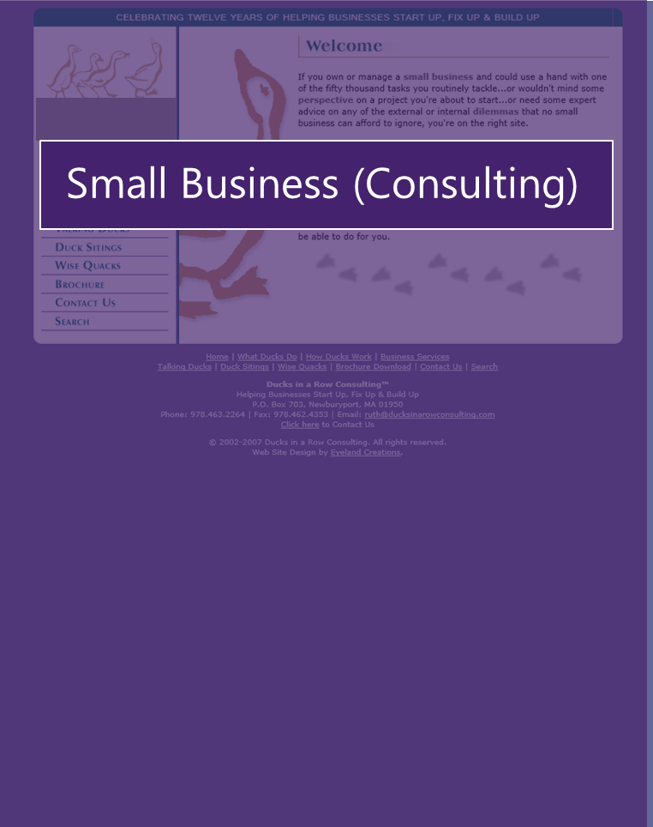
Fax malware campaign
Hijacked domains get listed quickly, and recycled just as quickly.
Obfuscated javascript on the pages of those hijacked domains generates links to true payload.

Slide 16
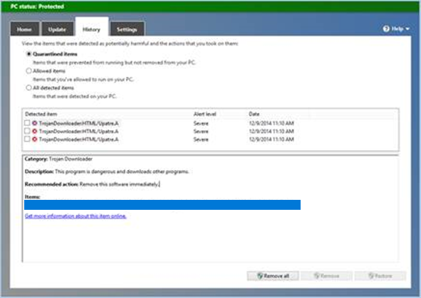
Fax malware campaign
“All your credentials belong to us”
Payload is a Banker Trojan. Malware that is an offshoot of the Zeus Trojan – designed for distribution via spam campaigns.
Malware ‘phones home’ to C&C servers, and installs a keylogger on your PC to intercept traffic to banking websites and steal credentials.
Known malware (e.g. Trojan Downloaders) gets flagged by AV running in EOP (& also Windows)

Slide 17

What makes the threats so dangerous?
Users are often unaware that they are the target of attack
Sometimes the attacks are especially focused on particular individuals
E.g. Malware, Phishing, Trojan Downloaders, …
E.g. Targeted Attacks, Spear Phishing, Whaling …

Slide 18
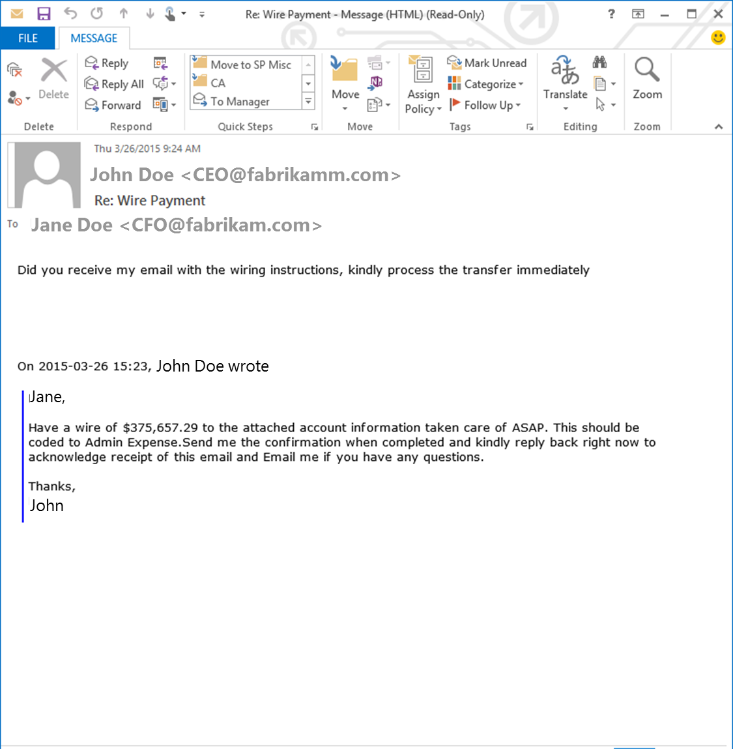
Targeted Attacks
Spear-phishing
  Focused phishing attacks
  Tailored, low volume tactics
  Social Engineering
Whaling
  High value targets

Slide 19

What makes the threats so dangerous?
Users are often unaware that they are the target of attack
Sometimes the attacks are especially focused on particular individuals
Sometimes there is collateral damage outside of our service
E.g. Malware, Phishing, Trojan Downloaders, …
E.g. Targeted Attacks, Spear Phishing, Whaling …
E.g. Backscatter, …

Slide 20
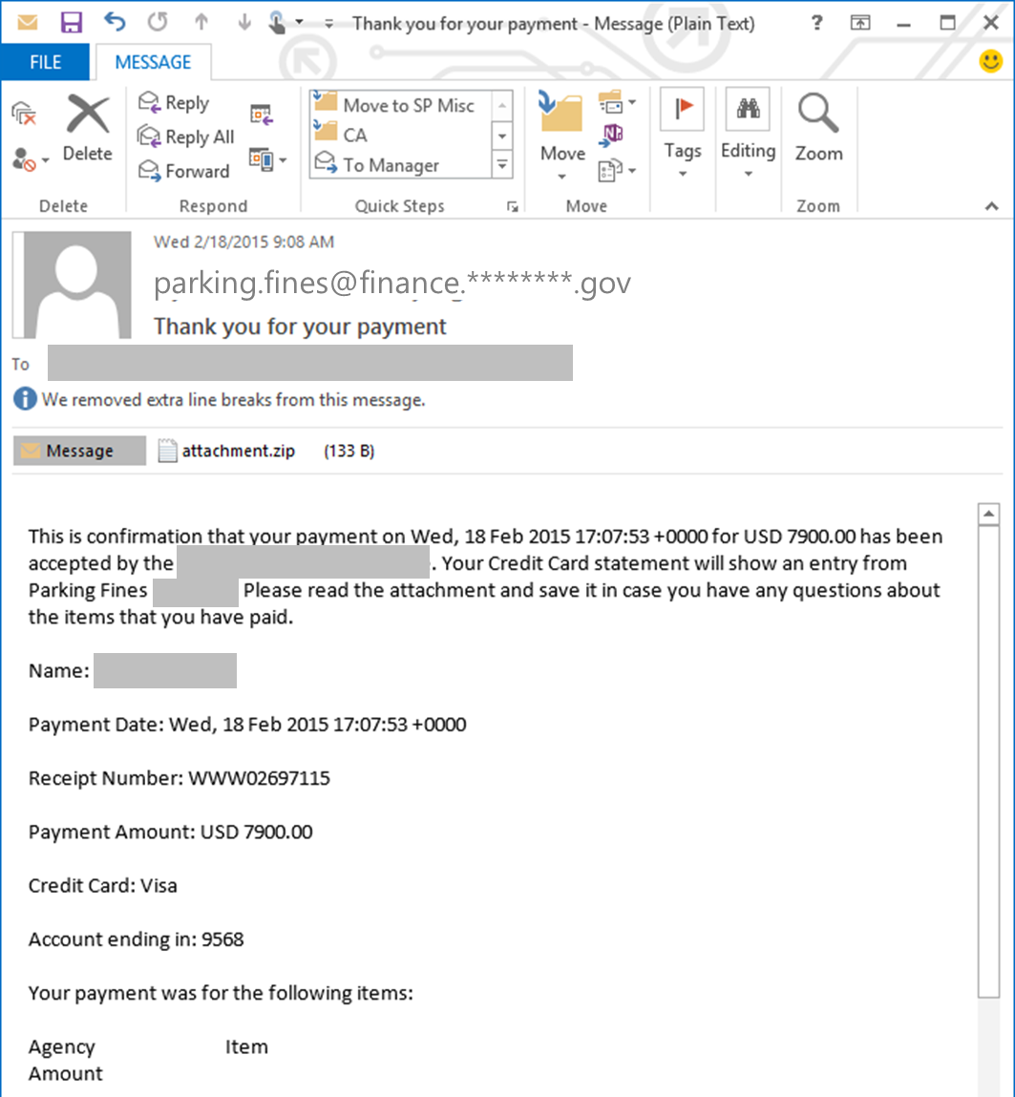
Collateral damage:
Backscatter
Global malware campaign
Spoofing government agency
Some of the mail targeted at email addresses protected by EOP
EOP blocked this campaign

Slide 21
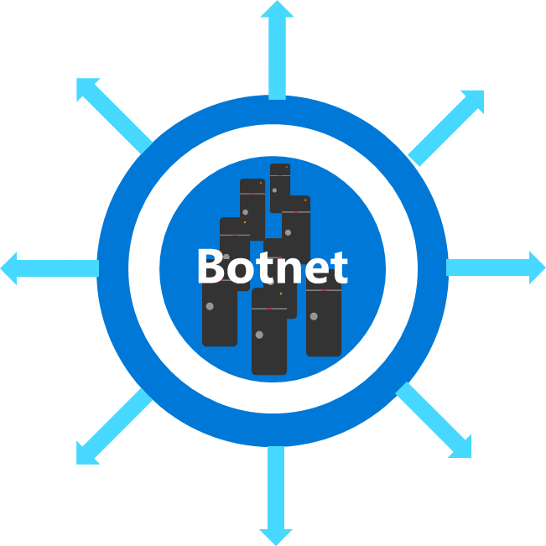
Collateral damage:
Backscatter
********.gov DataCenter
Denial of Service
Millions of NDRs
EOP
Led to DoS of government agency being spoofed
Malware infected mails spoofing ********.gov

Slide 22



Strong Anti-spam filtering - Best of Breed
Automated Protection
New spam and malware filtering engines
Machine Learning algorithms
Analysis and Response Team
Dedicated Analysts who monitor and tune automated systems
0-Day rapid response to emerging threats
3rd Party Threat Intelligence
Integrated threat intelligence from leading reputation and threat intelligence providers

Slide 23
EOP Architecture

Slide 24
Anatomy of a Campaign
Defense in Depth

Slide 25
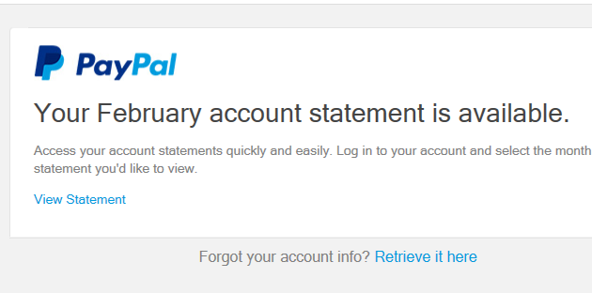
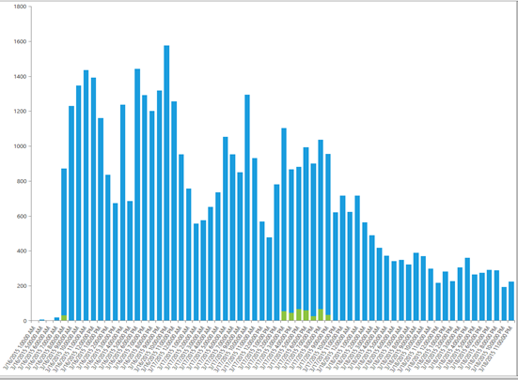
A typical Phishing campaign
Mails look like they come from a well known financial institution.
Common brands phished include:
  Barclays, Commonwealth Bank, ASB Bank, Rabobank, IT Bank, Paypal, National Australia Bank, eBay, Apple
A phishing campaign typically lasts for a few days.

Slide 26
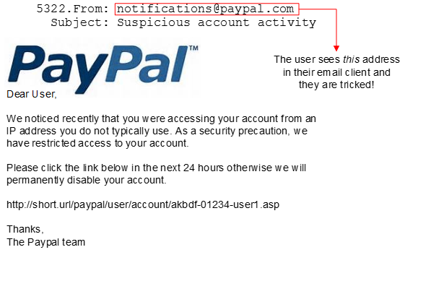
Edge Protection – who is the sender?
Why Spoof?
Impersonating a trusted source to get your financial or business credentials
Tricking you into following a link and thereby infecting your machine with malware

Slide 27
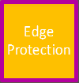
Problem
We cannot trust the Sender to correctly identify themselves
Solution
Multi-layered Edge protection

Slide 28
Inbound Architecture - Mail flow

Slide 29
Problem
We cannot trust the Sender to correctly identify themselves
Solution
Multi-layered Edge protection
The 5321.From address can be spoofed
Authenticated Domain - SPF

Slide 30
How does SPF work?
Sender Policy Framework
Tie the Inbound IP to the sending domain
  Reference - RFC 4408

Slide 31
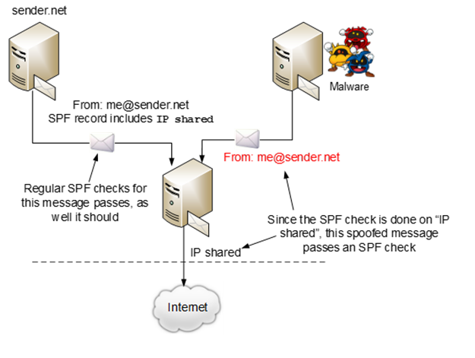
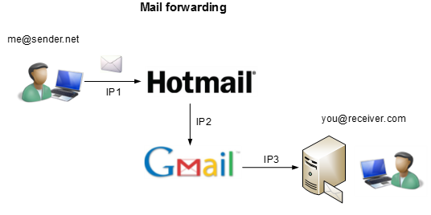
When it is insufficient
Email forwarding breaks SPF check
Weak SPF check on shared IP

Slide 32
Problem
We cannot trust the Sender to correctly identify themselves
Solution
Multi-layered Edge protection
The 5321.From address can be spoofed
Authenticated Domain - SPF
Forwarding email breaks SPF check
Weak SPF check on shared IP
Authenticated digital signature - DKIM

Slide 33
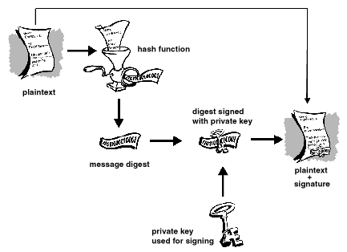
How does DKIM work?
  DKIM – Domain Key Identified Mail
  Email content is encrypted using private key
  The recipient decrypts using public key
  Public key look up based on DNS of signing domain in the DKIM header
  Reference - RFC 6376

Slide 34
Problem
We cannot trust the Sender to correctly identify themselves
Solution
Multi-layered Edge protection
The 5321.From address can be spoofed
Authenticated Domain - SPF
Forwarding email breaks SPF check
Weak SPF check on shared IP
Authenticated digital signature - DKIM
Spammer can authenticate using DKIM
Align 5322.MailFrom with DKIM domain signature - DMARC

Slide 35
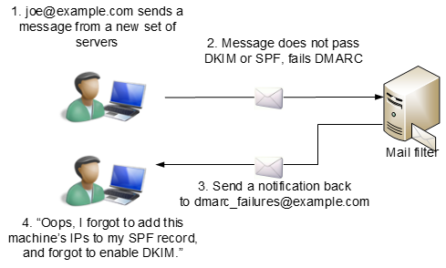
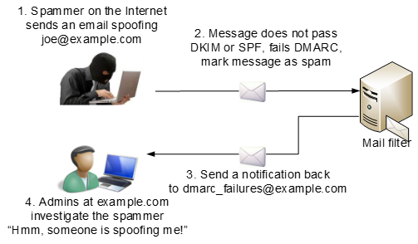
DMARC
Anti-spoofing and anti-phishing technology
  The 5322.From and the domain that is authenticated (using either SPF or DKIM) must be the aligned
  Reporting – Feedback loop
  Reference - Domain-based Message Authentication, Reporting and Compliance (DMARC)

Slide 36
Inbound Architecture - Mail flow

Slide 37
Reputation
What is reputation?
  The importance of reputation in an IPv6 world
Knowing a sender more than a stranger
  How it is monitored today?
  Considerations moving forward
What if your customers/partners get blocked by EOP?
  Delisting
  Reporting junk mail from a sender

Slide 38
IPv4 vs. IPv6
Different scale requires different technology
IPv6 Block list – Low efficiency requiring additional reputation
  Requirements - PTR record & either SPF or DKIM
  Configurable to receive emails from anonymous IPv6 sender

Slide 39
Boomerang - Enhanced Backscatter Protection
What is Backscatter?
Spammers spoofing your email to target any NDRs generated as a secondary attack
Fighting Backscatter with Boomerang
  A cryptographic hash that encodes the original sender into the message – similar to BATV
  Goes beyond BATV to identify conversations

Slide 40
Inbound Architecture - Mail flow

Slide 41
Inbound Architecture - Mail flow

Slide 42
Inbound Architecture - Mail flow

Slide 43
Inbound Architecture - Mail flow

Slide 44
Inbound Architecture - Mail flow

Slide 45
Inbound Architecture - Mail flow

Slide 46
Outbound Protection

Slide 47
Outbound Architecture - Mail flow

Slide 48
Outbound Architecture - Mail flow

Slide 49
Reputation– Part 2
Maintaining a clean reputation
  Service Reputation vs Tenant Reputation
  The danger of reputation compromise
Ensuring we’re active in the reputation community
  How we monitor it today, partnership with major providers
  How we add new relationships
Philosophy
  Proactive vs reactive action with trusted partners

Slide 50
Outbound Architecture - Mail flow

Slide 51
Outbound Architecture - Mail flow

Slide 52
Outbound Architecture - Mail flow

Slide 53
Outbound IP Partitioning
Expanding reputation protection
  Why utilize partitions?
  How this benefits customers
Mail Classification
  Current classifications and how this will evolve
  Good mail (normal)
  NDR
  High Risk (spam)
  Bulk
Service vs Rule Based Routing
  Making the most agile decisions as we increase detection capabilities

Slide 54
Outbound Architecture - Mail flow

Slide 55
Outbound Architecture - Mail flow

Slide 56
Outbound Architecture - Mail flow

Slide 57
Outbound Architecture - Mail flow

Slide 58
Exchange Online Advanced Threat Protection

Slide 59


Evolving threat space
  Short-span attacks
  Serial variant attacks
Short-span attacks can be just minutes to hours
Serial variant attacks generally repeat pattern every few hours
T=0
T=5
T=10
T=15
T=100
Domain classified as malware on URL block lists
First phishing message sent
Attacker can easily change the links in the message after mail is delivered
Phishing message lands in user inbox
User clicks on link in message
Phisher creates malicious domain

Slide 60
Exchange Online advanced threat protection
Protection against unknown malware/virus
Time of click protection
Rich reporting and tracing
Real time protection against Malicious URLs
Growing URL coverage
Built-in URL and message trace
Reports for advanced threats
Behavioral analysis with machine learning
Admin alerts

Slide 61
Service architecture
Sender
Multiple filters + 3 antivirus engines
with Exchange Online protection
Attachment
Supported file type
Clean by AV/AS filters
Not in Reputation list
Detonation chamber
(sandbox)
Executable?
Registry call?
Elevation?
……?
Links
Unsafe
Safe
Recipient
Safe links rewrite

Slide 62
Safe attachments
Protect against zero day exploits in email attachments by blocking messages
Provides admins visibility into compromised users
Leverages sandboxing technology
EOP user
without ATP
IP + envelop filter
Signature-based AV
Blocking known exploits
Antispam filter
EOP user
with ATP

Slide 63
Safe links
Web servers
perform latest URL reputation check
Protect against sites with malicious content,
phishing sites
Provides admins visibility into compromised users
Rewriting the URLs to redirect them through
another server
User clicking URL is taken to EOP web servers for the latest check at the “time of click”
IP + envelop filter
Signature-based AV
Blocking known exploits
Antispam filter
EOP user
without ATP
Rewriting URLs to redirect to a web server
EOP user
with ATP

Slide 64
Demo – Advanced Threat Protection
Bulent Egilmez

Slide 65
O365 Information Protection sessions
SESSION | CODE
Meet Office 365 Compliance Center: Your One Stop Shop for Everything Compliance | BRK2165: 5/5 – 3:15 PM
Extending Microsoft Office 365 Visibility, Security and Compliance: Office 365 Management APIs | BRK2180: 5/6 – 9:00 AM
Evolving Email Protection for Tomorrow's Needs with Exchange Online Protection | BRK2198: 5/6 – 10:45 AM
Your Encryption Controls in Office 365: Across Devices and Platforms | BRK3172: 5/6 – 1:30 PM
End-to-End Data Loss Prevention | BRK3181: 5/6 – 9:00 AM
Device and Data Protection with Mobile Device Management in Office 365 | BRK3113: 5/6 – 3:15 AM
Keeping Your Data in Place with Office 365 Archiving and Retention | BRK2144: 5/6 – 10:45 AM
eDiscovery Redefined: Real Time and In-Place | BRK3121: 5/6 – 5:00 PM
Deep Dive into How Microsoft Handles Spam and Advanced Email Threats | BRK3106: 5/6 – 5:00 PM
Experts Unplugged: Office 365 Security | BRK2193: 5/7 – 3:15 PM
Experts Unplugged: Office 365 Compliance | BRK2145: 5/7 – 5:00 PM
Auditing for Office 365 | BRK3126: 5/8 – 10:45 AM

Slide 66


Please evaluate this session
Your feedback is important to us!
Visit Myignite at http://myignite.microsoft.com
or download and use the Ignite Mobile App
with the QR code above.

