Slide 2
Office 365 Groups Deep-dive
BRK3114
Venkat Ayyadevara
Christophe Fiessinger
Sam Koppes
Microsoft

Slide 3
Agenda
Architecture
Extensibility
Overview
Administration
Summary

Slide 4

Overview
Office 365 Groups

Slide 5

THE WORLD HAS CHANGED

Slide 6

THE RISE OF
DYNAMIC TEAMS
MODERN COLLABORATION
INTELLIGENT FABRIC
PERSONALIZED INSIGHT

Slide 7

Introducing Office 365 Groups
Brings together people, information, and apps across Office 365,
to enable better communication and collaboration.

Slide 8




Groups building blocks
Office 365 Groups
Azure
Active Directory
Outlook
OneDrive
OneNote
Calendar
Skype
Dynamics CRM
Delve
Yammer
…
Apps

Slide 9
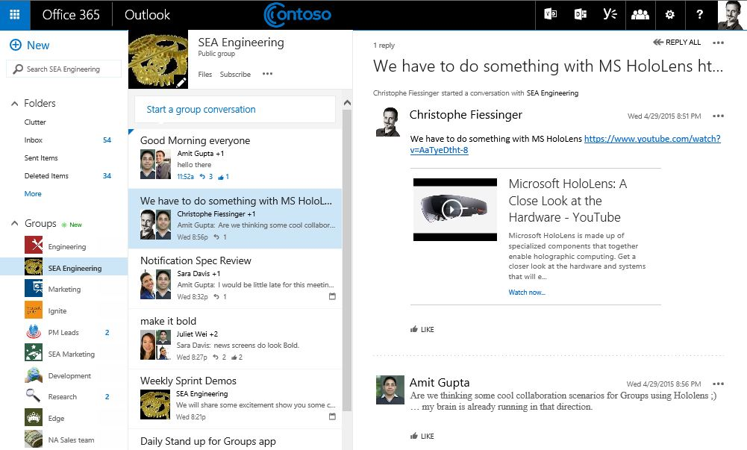
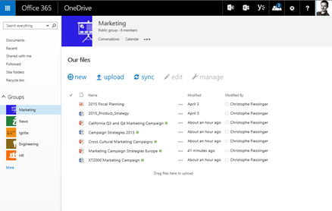
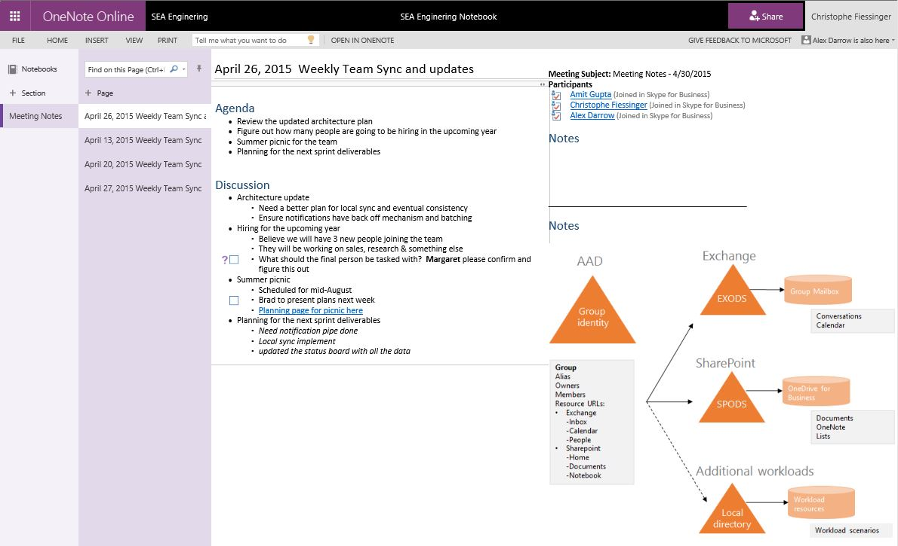
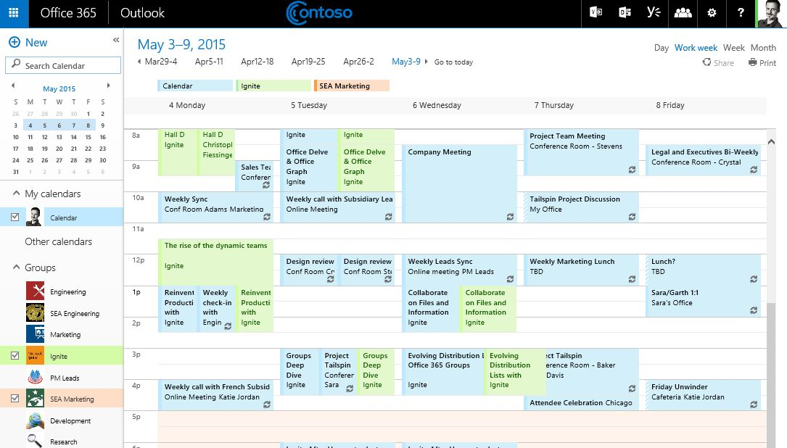
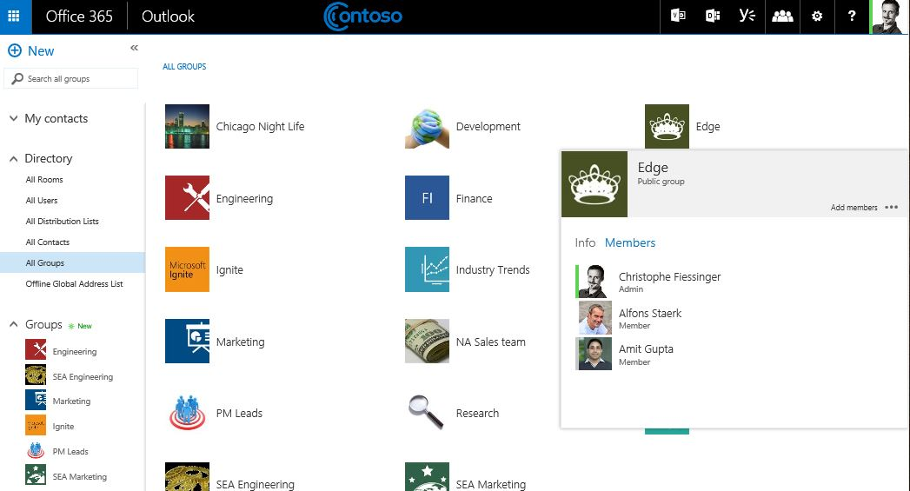
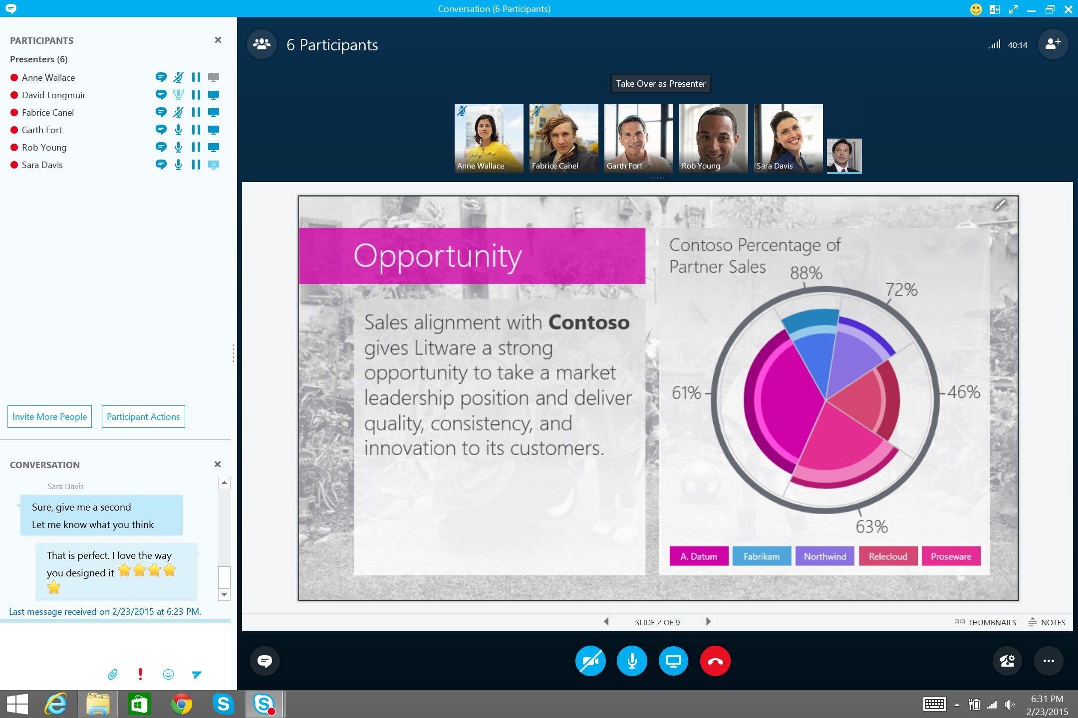
Office 365 Experiences available to all of you!
OUTLOOK CONVERSATIONS
FILES
NOTEBOOK
…
CALENDAR
PEOPLE
SKYPE

Slide 10
Demo
Introducing Office 365 Groups

Slide 11
Architecture
Office 365 Groups

Slide 12
One group system across Office 365
One identity
Azure Active Directory (AAD) is the master
for group identity and membership across Office 365 (Exchange, SharePoint, etc.)
Federated resources
O365 services extend with their data
(e.g., conversations stored in Exchange mailbox & documents stored in OneDrive for a group)
Loose coupling
Services notify each other of changes to
a group (e.g., creation, deletion, updates)
Using sync from AAD to Exchange Online AD and SharePoint Online AD they achieve reliability if they miss notifications
Exchange
Group mailbox
Exchange
Online AD
Conversations
Calendar
AAD
SharePoint
Group
identity
OneDrive
for business
SharePoint
Online AD
Documents
OneNote
Identity
Resource URLs
Owners
Members
Additional workloads
Workload resources
Local
directory
Workload scenarios

Slide 13






Group creation flow
Melissa creates a group in Outlook
MSODS
New group
Azure Active Directory
Exchange Online
SharePoint Online
Create
via AAD Graph
Create
Group
EXO
EXO

Slide 14
Group creation flow
EXO creates a local group
MSODS
New group
Azure Active Directory
Exchange Online
SharePoint Online
Exchange
Online AD
New
group
Create
via AAD Graph
Local
create
Create
Group
EXO
EXO

Slide 15
Group creation flow
EXO notifies SPO, which creates a local group
MSODS
New group
Azure Active Directory
Exchange Online
SharePoint Online
Exchange
Online AD
SharePoint
Online AD
New
group
Create
via AAD Graph
New
group
Local
create
Local
create
Notification
Create
Group
EXO
EXO
SPO

Slide 16
Group management flow
FwdSync broadcasts changes
MSODS
Update group
Azure Active Directory
Exchange Online
SharePoint Online
FwdSync
FwdSync
Exchange
Online AD
SharePoint
Online AD
Update
group
Update Group
via AAD Graph
Update
group
Add
Members
EXO
EXO
SPO

Slide 17


Group mail sync for hybrid tenants
Melissa creates group and invites Dan
AAD
QR1plans@Service.Contoso.com
O365
Service.Contoso.com
GAL
QR1plans
EXO
Melissa@Contoso.com
On-prem
Contoso.com
AD
Local nickname cache
QR1plans@Service.Contoso.com
Welcome
GAL
EX
Dan@Contoso.com

Slide 18

Group mail sync for hybrid tenants
Dan is autosubscribed
‘Agenda’
AAD
QR1plans@Service.Contoso.com
O365
Service.Contoso.com
Post ‘Agenda’
GAL
QR1plans
EXO
Melissa@Contoso.com
On-prem
Contoso.com
AD
Local nickname cache
QR1plans@Service.Contoso.com
‘Agenda’
GAL
EX
Dan@Contoso.com

Slide 19
Group mail sync for hybrid tenants
Dan sends email to the group
‘RE: Agenda’
AAD
QR1plans@Service.Contoso.com
O365
Service.Contoso.com
GAL
QR1plans
EXO
Melissa@Contoso.com
On-prem
Contoso.com
AD
Local nickname cache
QR1plans@Service.Contoso.com
‘RE: Agenda’
GAL
EX
Dan@Contoso.com

Slide 20
Group mail sync for hybrid tenants
AAD connect sync back O365 objects
AAD
QR1plans@Service.Contoso.com
O365
Service.Contoso.com
GAL
QR1plans
EXO
Melissa@Contoso.com
On-prem
Contoso.com
AADConnect
DL object
Target: QR1plans@Service.Contoso.com
AD
GAL
GAL
QR1plans
EX
Dan@Contoso.com

Slide 21
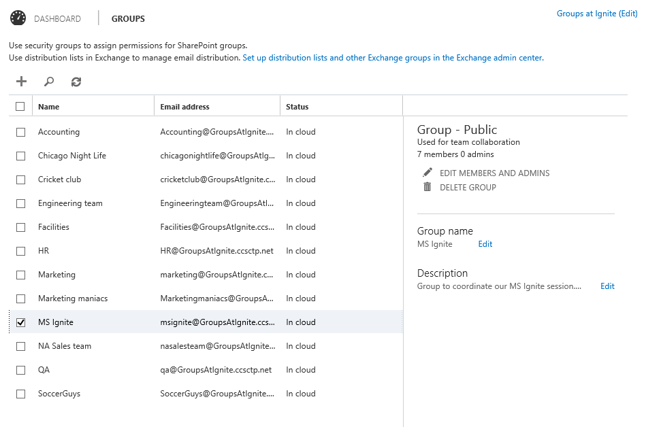
Group management UX
Integrated with in the
O365 Admin Center
  Single-click access from the left nav
Explore the groups in
your tenant
  Easy access to all groups in your tenant
  Browse/search
Manage groups in one place
  Edit group properties in place
  Integrated member/owner management

Slide 22
Demo: Cmdlets
Staying up-to-date with Groups in your tenant
Scripting Group lifecycle

Slide 23
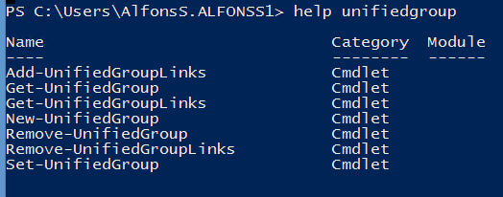

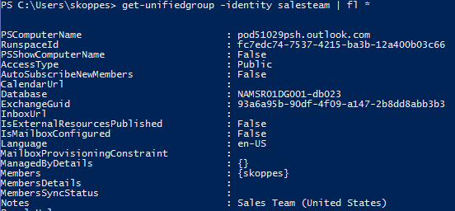

Cmdlets
Full orchestration
  All cmdlets execute against Azure AD as primary
  Synchronous notification/update in Exchange/OneDrive
  Available to tenant admins
*UnifiedGroup
  Create, edit, and delete
  Manage single-value properties available
  on the Group object
*UnifiedGroupLinks
  Manage members, owners, and subscriber list

Slide 24
Demo: Naming Policy
Setting up naming pattern and blocked words
Creating a group, with naming applied
Blocking inappropriate words during create

Slide 25
Demo: Group creation permissions
Specifying a policy restricting groups
Assign the policy to a set of users
Attempt to create a group

Slide 26
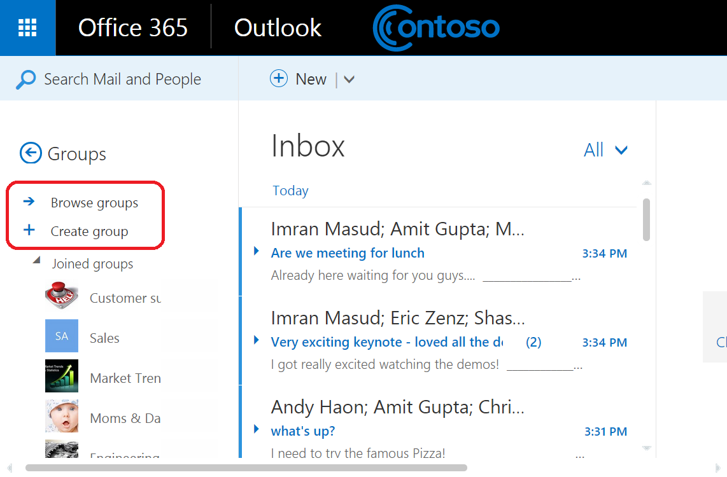
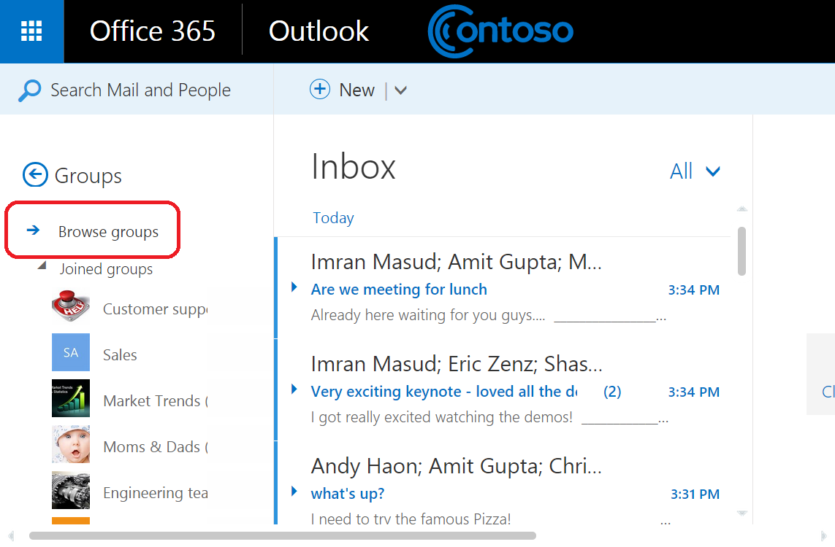

Slide 27
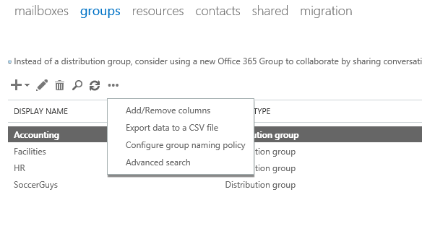
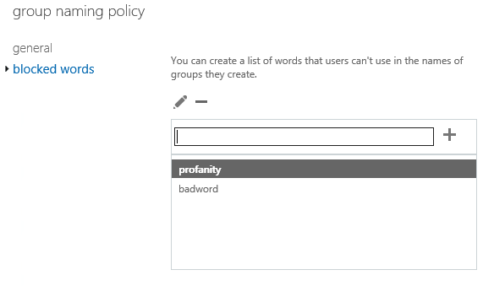
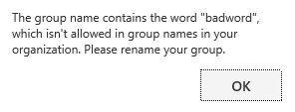
Policy controls
Naming conventions
  Set on display name during create/change
  Blocked word list, pre-/post-fix based on AAD attributes or fixed text
  Same policy for DL and groups
  IT admins can override
Group creation permissions
  Control groups create UI in OWA and OLK for certain or all users through OWA policy
  Does not prevent users from using groups
  IT can still create groups (managed scenarios)

Slide 28
Managing groups
Through admin UI
  O365 admin center (not EAC)
  AAD control panel
Scripted/automated
  CRUD cmdlets:
    *-UnifiedGroup to manage group
    *-UnifiedGroupLinks to manage
    owners, members, subscribers
Policy control
  Naming policy
  Creation restriction

Slide 29
Extensibility
Office 365 Groups

Slide 30
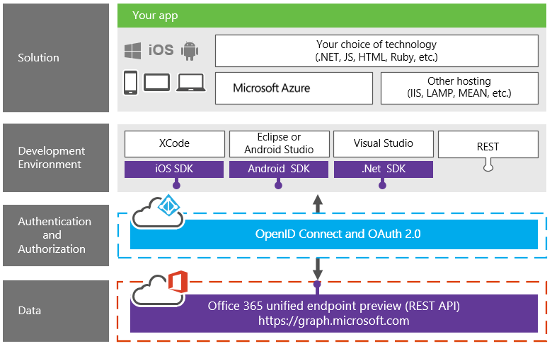
Office 365 platform overview

Slide 31
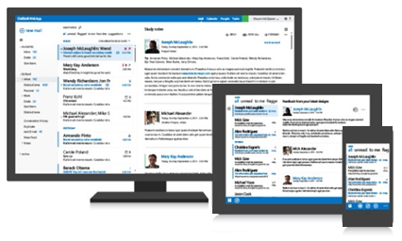
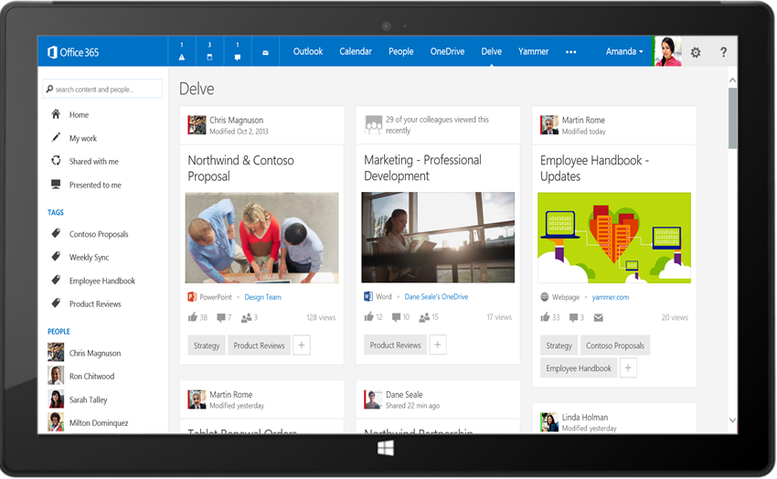
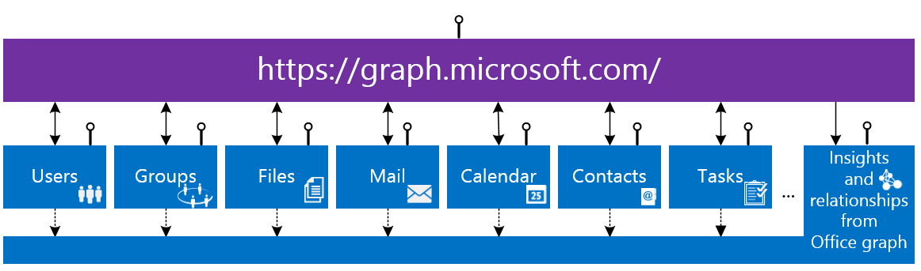
Office 365 unified API (preview)
Your
App
https://graph.microsoft.com/

Slide 32
https://graph.microsoft.com/beta/myorganization/groups?$filter=groupType+eq+'Unified'
MANAGEMENT
/CONVERSATIONS
/EVENTS
/FILES

Slide 33
Building your app
Register app in Azure portal
  Native
  Web app
  Single page app
Configure app permissions
  Groups.Read.All
  Groups.ReadWrite.All
Get token using OAuth2.0 flow
Use OpenID Connect for SSO
Build your code using O365 unified API

Slide 34
Groups management (preview)
Entities, collections, and actions
Samples
  https://graph.microsoft.com/beta/contoso.com/groups/{id}/
  https://graph.microsoft.com/beta/contoso.com/groups/{id}/AddFavorite
ENTITY | COLLECTION | ACTIONS
Group | Groups | CRUD SubscribeByMail, UnsubscribeMyMail, AddFavorite, RemoveFavorite, ResetUnseenCount
User/Me | Users | JoinedGroups
Collection
Action

Slide 35
Groups content: Conversations
Blah
lol
Entities, collections, and actions
Samples
  https://graph.microsoft.com/beta/contoso.com/groups/{id}/conversations
  https://graph.microsoft.com/beta/contoso.com/groups/{id}/threads/{id}/reply
ttyl
ENTITY | COLLECTION | ACTIONS
Conversation | Conversations | Create, read, and delete
Thread | Threads | Reply
Post | Posts | Reply, forward
Attachment | Attachments | CRUD

Slide 36
Groups content: Calendar
Entities, collections, and actions
Samples
  https://graph.microsoft.com/beta/contoso.com/groups/{id}/events
  ../calendarview?startdatetime=2015-04-01 & enddatetime=2015-04-30
ENTITY | COLLECTION | ACTIONS
Calendar |  | Read
Event | Events | CRUD
Calendar view | N/A | Read
Attachment | Attachments | CRUD
Collection
No client-side recurrence expansion required ☺

Slide 37
Groups content: Files
Entities, collections, and actions
Samples
  https://graph.microsoft.com/beta/contoso.com/groups/{id}/files
  https://graph.microsoft.com/beta/contoso.com/groups/{id}/files/{id}/
ENTITY | COLLECTION | ACTIONS
File | Files | CRUD, upload, download
Folder |  | CRUD, enumerate children

Slide 38
Common content queries
SCENARIO | URL
Get top 10 conversations sorted by LastDeliveryTime | /group/{id}/conversations?$top=10&$orderby=LastDeliveryTime
Get the next 10 conversations | /group/{id}/conversations?$top=10&$skip=10
Get selected properties on events starting after a particular Date/Time | /group/{id}/events?$top=10&$select=Subject,Start,End&$filter=Start ge 2014-09-22
Get selected properties on conversation threads | /groups/{id}/conversations/{id}/threads/{id}/posts?$select=body
Get files where the name starts with “c” | /group/{id}/files?$filter=startswith(name,+'c')
Get selected properties on files | /group/{id}/files?$select=dateTimeCreated

Slide 39
Demo: Group APIs
Enumerating groups
Accessing conversations, calendar and files
Subscribing/unsubscribing to a group
Single Page App: https://github.com/mattleib/o365-inbox-spa

Slide 40
Summary
Office 365 Groups

Slide 41
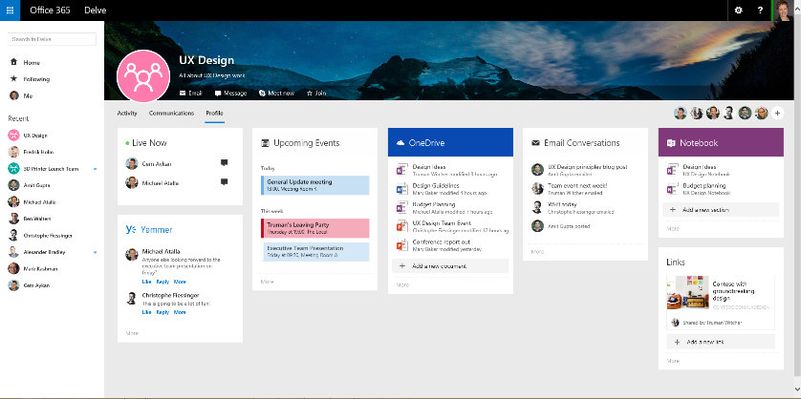
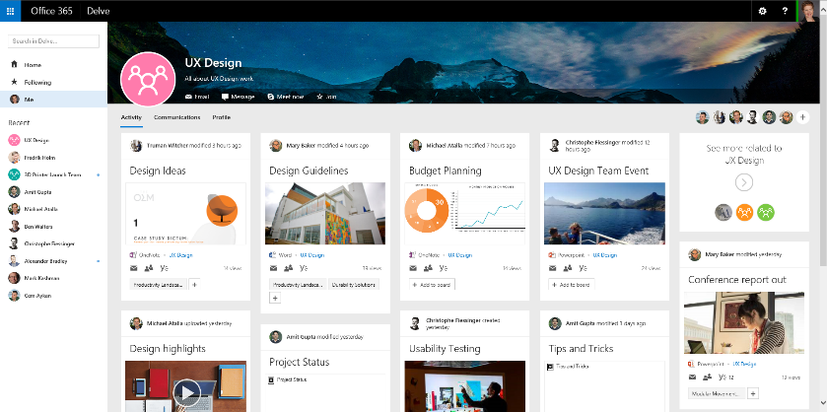
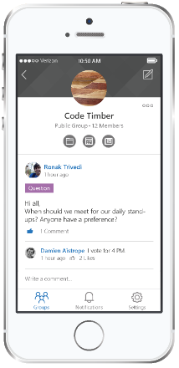
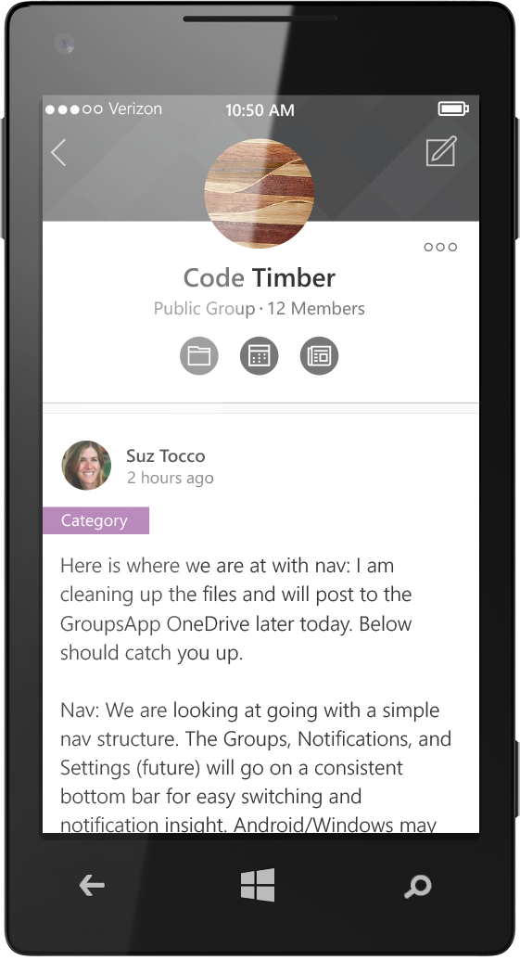
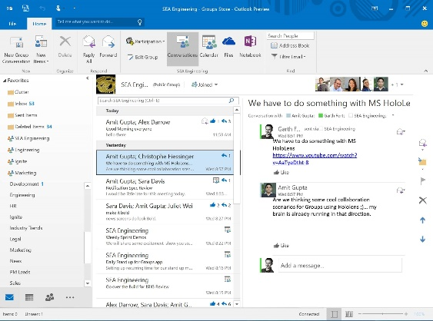
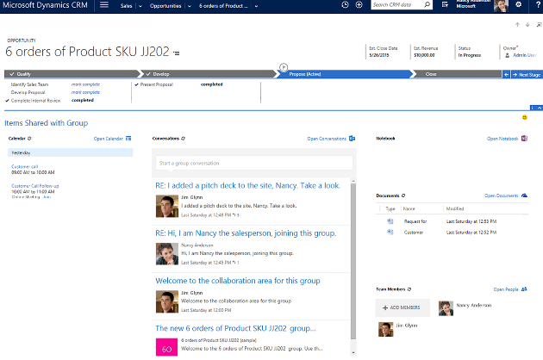
Up next in 2015
  EXPERIENCES
  ADMINISTRATION
  EXTENSIBILITY
Outlook 2016 & mobile app
Office Graph & Delve integration
Skype Meet now
Files & pages
Invite guest users
Dynamics CRM
Extensible to third party apps
eDiscovery & legal hold
Data Loss Prevention
Soft-delete & restore
GAL activity monitoring
Expire inactive groups
Azure Active Directory Connect
Additional AAD improvements
Instant-on provisioning
Notifications
Get/Set Group photo
Full-text search
Batching
Notes

Slide 42
Groups building blocks
Office 365 Groups
Azure
Active Directory
Outlook
OneDrive
OneNote
Calendar
Skype
Dynamics CRM
Delve
Yammer
…
Apps

Slide 43
Office 365 Groups related content and resources
BREAKOUT SESSIONS
Session | Code | Time | Room
The rise of dynamic teams | BRK1106 | Mon May 4, 1:30pm | S104
Identity and Access Management Everywhere | BRK3863 | Mon May 4, 1:30pm | N427
Microsoft Office 365 Groups Overview and Roadmap | BRK2114 | Tue May 5, 9:00am | S103
Office Delve and Office Graph Vision and Roadmap | BRK1105 | Tue May 5, 10:45am | S102
Yammer Roadmap | BRK2103 | Tue May 5, 1:30pm | S501
Microsoft Office 365 Groups Deep Dive | BRK3114 | Tue May 5, 5:00pm | E253
Collaborate on Files and Information within Office 365 Groups | BRK2113 | Wed May 6, 3:15pm | S100
Evolving Distribution Lists with Office 365 Groups | BRK3103 | Wed May 6, 5:00pm | N426
How to Decide When to Use SharePoint and Yammer and Office 365 Groups and Outlook and Skype | BRK2102 | Thu May 7, 1:30pm | S100
KEY RESOURCES
Documentation: http://aka.ms/O365g | Questions: http://aka.ms/O365ng
Roadmap: http://roadmap.office.com | Feedback: http://aka.ms/O365uv | The rise of dynamic teams
Drop by the Exchange and SharePoint booths!

Slide 44
Office 365 Group APIs related content and resources
BREAKOUT SESSIONS
Session | Code | Time | Room
Office Development Matters, and Here's Why... | FND2202 | Mon May 4, 1:30pm | E354B
Building Solutions and Apps That Leverage OneDrive for Business | BRK3122 | Tue May 5, 9:00am | E351
Supercharging Your Custom Solutions with Office 365 Unified API Endpoint | BRK3199 | Tue May 5, 10:45am | N231
Light Up Mobile Apps with the Office 365 APIs | BRK3157 | Tue May5, 5:00pm | N229
Building Solutions with Office Graph | BRK3193 | Tue May 5, 5:00pm | N227
Extending Microsoft Office 365 Visibility, Security and Compliance: Office 365 Management APIs | BRK2180 | Wed May 6, 9:00am | N231
Build an Add-in for Outlook.com, Outlook and Office 365 That Reaches Over 400 Million Users! | BRK3156 | Wed May 6, 1:30pm | N228
Building Tenant-Wide Apps with the New Exchange REST APIs | BRK3145 | Wed May 6, 5:00pm | S106
Overview of Office 365 Development | Lab
KEY RESOURCES
Documentation: Office 365 unified API (PREVIEW)
Additional Resources: http://dev.office.com | http://dev.outlook.com
Questions: Stack Overflow for API questions

Slide 45
Next steps
Sign-up for Office 365
Use Office 365 groups
Give us feedback

Slide 46
Join the conversation!
Share tips and best practices
with other Office 365 experts
http://aka.ms/office365network

Slide 47


Please evaluate this session
Your feedback is important to us!
Visit Myignite at http://myignite.microsoft.com
or download and use the Ignite Mobile App
with the QR code above.

