Slide 2
Ensuring Media Quality in Microsoft Office 365 Skype for Business
BRK3128
Aaron Miller
Senior Program Manager, Skype Enterprise Engineering, Microsoft Corporation
Sasa Juratovic
Senior Program Manager, Skype Enterprise Engineering, Microsoft Corporation

Slide 3
Skype for Business Trivia
Test your Skype for Business knowledge with questions created by MVPs and enjoy the trivia fun tonight with complimentary food & drinks, and the chance to win great prizes!
Tweet a photo from any Skype for Business session using the hashtag #Skype4BTrivia and be entered into a drawing to win a ticket to this invite-only Trivia game for you and a guest. One entry will be randomly selected each day.*
If you don’t score an invite, you can still compete on Twitter with @SkypeBusiness Wednesday at 8:30pm for your chance to win a Surface Pro 3!**
*No purchase necessary. Open only to event attendees. Game ends 5/7/2015. See Skype for Business Facebook for full Official Rules.
**No purchase necessary. Open only to legal residents of any country where Surface Pro 3 is certified for distribution. Game ends 5/7/2015. See Skype for Business Facebook for full Official Rules.
Microsoft Ignite #Skype4BTrivia

Slide 4
Agenda
Why should I care?
Call Quality Methodology
Connecting to Skype for Business Online
Recommended Practices
Tools and resources
Demo
Q & A

Slide 5
Why should I care?

Slide 6

Because if you don’t here is what might happen …
“Good” network conditions
“Bad” network conditions (10% bursty packet loss)
Regular data network requirements != Real-Time Media network requirements

Slide 7
Typical causes for this pain
Latency
  Network latency in a packet-switched network is measured either one-way (the time from the source sending a packet to the destination receiving it), or round-trip delay time (the one-way latency from source to destination plus the one-way latency from the destination back to the source). (Source: http://en.wikipedia.org/wiki/Latency_(engineering)#Packet-switched_networks)
Jitter
  In the context of computer networks, jitter is the variation in latency as measured in the variability over time of the packet latency across a network. (Source: http://en.wikipedia.org/wiki/Jitter)
Packet loss
  Packet loss occurs when one or more packets of data travelling across a computer network fail to reach their destination. (Source: http://en.wikipedia.org/wiki/Packet_loss)
Audio and Video Glitching
  Caused by end user environment – system or devices

Slide 8
Real-Time Media good network characteristics
Consistent flow of data packets
Low latency, jitter and packet loss
  Random loss can be compensated – sequential loss is problematic
  Increase in delay, jitter and/or packet loss can have notable impact on end user experience
Bandwidth requirements
  Audio 50 Kbps to 220 Kbps per stream (incl. IP header and FEC overhead)
  Video 250 Kbps to 4 Mbps per stream (multiple concurrent video streams are possible for multiparty video conferencing)
Latency
  Acceptable round trip latency < 500 msec
  Depends on geography
Jitter
  Acceptable jitter < 30 msec
Packet Loss
  Acceptable packet loss < 10% and not more than 3 consecutive lost packets
UDP vs. TCP
  UDP is preferred for Real-Time Media as TCP recovery (retransmits) is usually too long to be useful

Slide 9
But how is this relevant to Skype for Business Online?
Look at Lync Online Service Description (https://technet.microsoft.com/en-US/library/jj822172.aspx)
  Lync-to-Lync Audio, Video, and Media / Lync Meetings
  Desktop Sharing
  Application Sharing
  Voice
  Video
  Dial-in PSTN Conferencing via Certified Audio Conferencing Provider (ACP)
And more to come (http://blogs.office.com/2015/03/18/skype-for-business-is-here-and-this-is-only-the-beginning/)
  Enterprise voice and audio conferencing in Office 365 (tech preview in the U.S. this summer)
  Enterprise-grade PSTN connectivity (beginning in the U.S. later this year, followed by a global roll out) and Azure ExpressRoute for Office 365
  Modern meetings delivered through a rich portfolio of meetings devices intentionally designed for and integrated with Skype for Business - Skype Room Systems, Polycom RoundTable and Microsoft Surface Hub

Slide 10
Important: Media Quality is part of bigger picture …
Network Readiness
Robust device strategy
Broad communications campaign
Comprehensive user training strategy
Strong Executive sponsorship
Enterprise-wide deployment plan
Dedicated project team, key roles & responsibilities defined
Articulated goals, success metrics & associated timelines
Help Desk
Operations (*)
User Communications
Lync Topology Deployment (*)
Infrastructure Configuration
Devices
User Training
Success Factors
Deployment Preparation

Slide 11
Call Quality Methodology

Slide 12
The Quality Problem
Substantial number of support cases cite call quality issues
Customers struggle to maintain call quality as they scale up
Call Quality Methodology (CQM) was built to provide an insight into this problem
Although CQM has been created with on-premises in mind, approach (but not tools) is applicable to Online

Slide 13
Why is Call Quality hard to achieve?
There is a complex set of dependencies from the endpoint to the access point to the core network to the server
Degradation in any aspect lowers quality for the entire call or conference
Calls are traversing Managed and Unmanaged networks
Call Leg

Slide 14
CQM looks at quality three ways
Servers
Network
Endpoint
Lync servers must be healthy and running without resource constraints
Media stream quality between Lync servers – AV MCU, Mediation, Gateway
Media stream quality between endpoints and endpoints to servers
Endpoint factors including system, device, media transport and media path
Strikethrough is not relevant for you in Online; focus on the rest

Slide 15
Connecting to Skype for Business Online

Slide 16
Connectivity Options - Public
Consumer Level Service
  Home Office
  Public Hotspots
  Coffee Shop Wi-Fi
  Hotel Wi-Fi
  Cellular Hotspots (Mi-Fi)
Business Level Service
  Branch Office(s) with local ISP
  Branch Office(s) with MPLS\WAN back to Central Office(s)
  Central Office(s) with local ISP

Slide 17
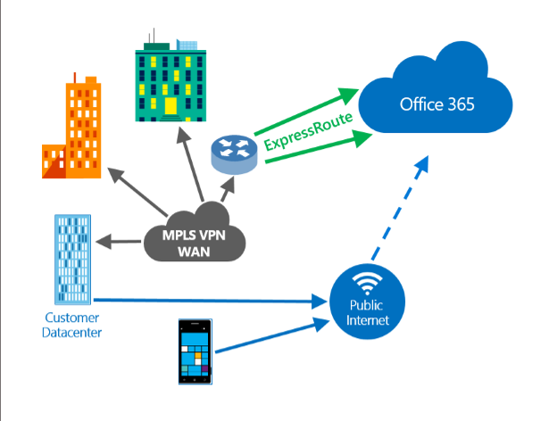
Connectivity Options – Private
Business Level Service
  Branch\Central Office(s) with MPLS\ExpressRoute to Office365
ExpressRoute with Office365
  DSCP packet marking for per-hop queuing & flow control for clients & services
  Version 3.1 of ExpressRoute is Skype for Business ready & honors packet marking on the wire.

Slide 18
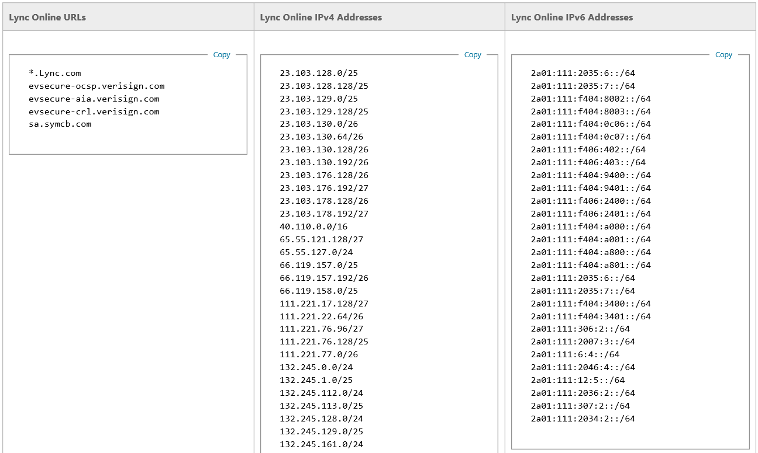
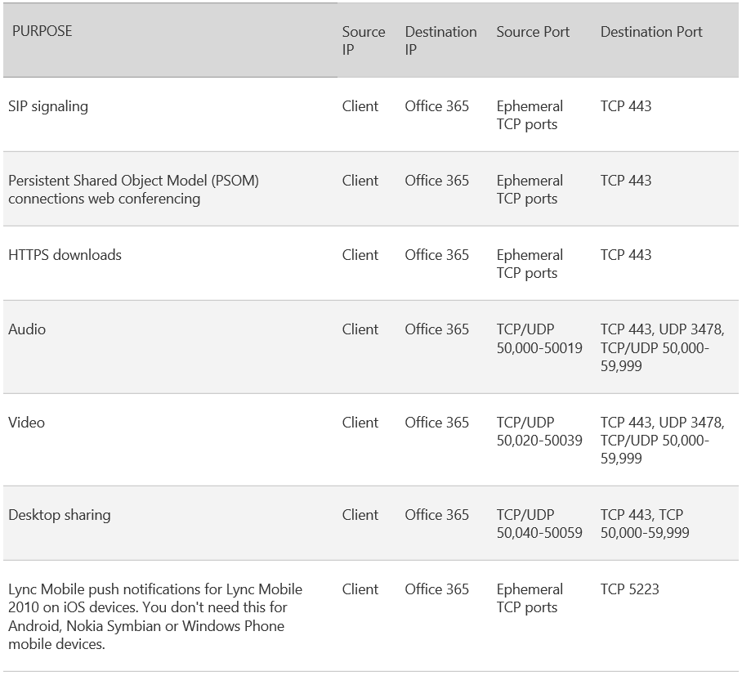
Connectivity Planning
Office 365 URLs and IP address ranges
Set up your network for Lync Online

Slide 19
Connectivity Method
The type of connection for each endpoint makes a difference
 | Wired Internal | Wired External | Wireless Internal | Wireless External | Mobile Broadband (Cellular)
Wired Internal
Wired External
Wireless Internal
Wireless External
Mobile Broadband (Cellular)

Slide 20
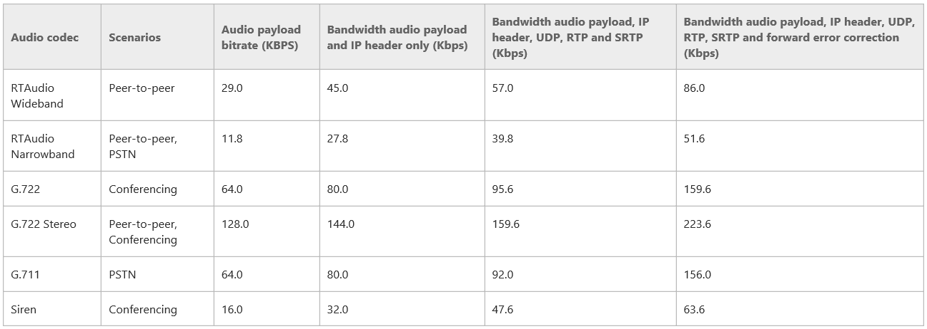
Bandwidth Planning – Voice Rates
https://technet.microsoft.com/en-us/library/jj688118.aspx

Slide 21
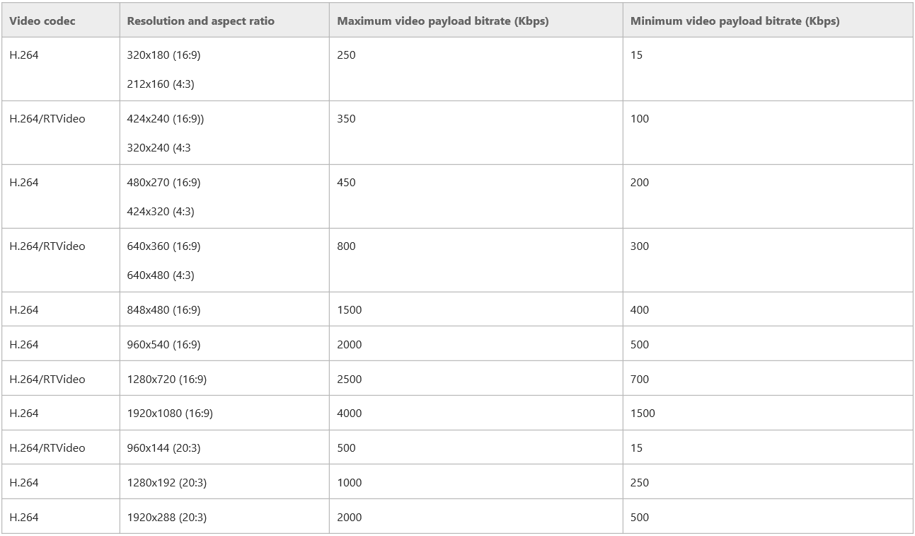
Bandwidth Planning – Video Rates

Slide 22
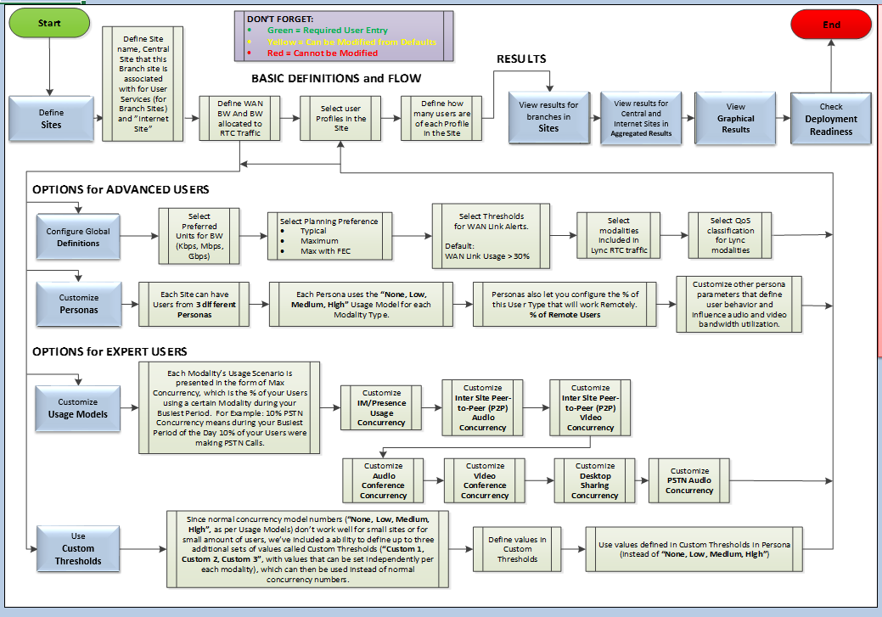
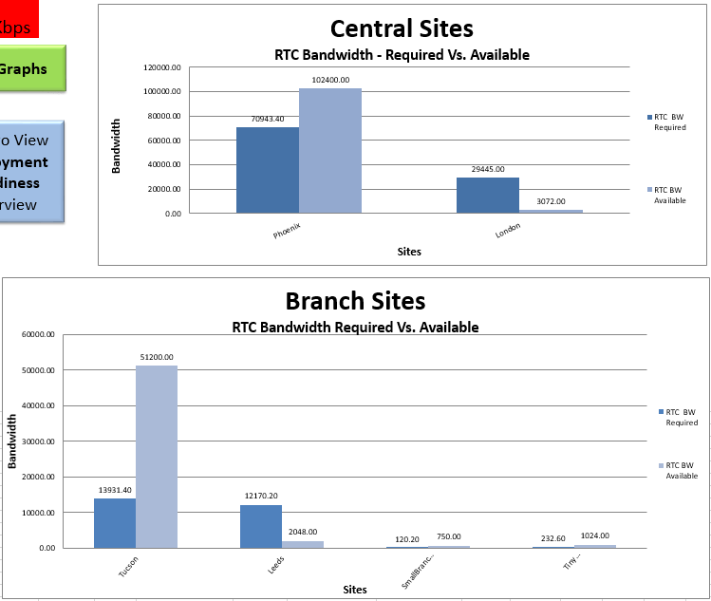
Bandwidth Planning - Calculator Demo
http://www.microsoft.com/en-us/download/details.aspx?id=19011

Slide 23
Network Hurdles
No QoS strategy for critical voice traffic
No tracking of network QoS configuration health and consistency
Network not actively monitored (Total BW, BW available for voice traffic, latency)
Client VPN without split tunnel implemented for Lync traffic
Undocumented networks
  Site Lists and Network Diagrams are reasonable and very helpful

Slide 24
Recommended Practices
… or what should I do to increase probability of successful (voice) deployment in Skype for Business Online?

Slide 25
Network
Perform network assessment
Focus on and optimize real time media traffic for managed networks
Plan for media traffic on your managed networks - https://technet.microsoft.com/en-us/library/jj688118.aspx and http://www.microsoft.com/en-us/download/details.aspx?id=19011
Configure QoS E2E on managed parts of your network
Consider private connectivity to Office 365 (Azure ExpressRoute)
Use enterprise grade wireless infrastructure components. Prefer 5GHz to 2.4GHz
Don’t tunnel real time media through VPN – implement VPN split tunneling
Avoid traffic shapers / WAN optimizers for real time media traffic
Make sure firewalls and proxies are configured per “Office 365 URLs and IP address ranges” guidance (https://technet.microsoft.com/en-us/library/hh373144.aspx)

Slide 26
End user environment
Use enterprise grade devices, especially when on Wi-Fi networks. BYOD could be problematic
Use qualified phones and devices (https://technet.microsoft.com/en-us/office/dn788944)
Don’t run CPU intensive operations while conducting Lync / Skype for Business call on the same machine
Patch machines, use latest known good drivers (NIC, audio capturing/rendering)
When PPT presenting , use PPT sharing instead of App / Desktop Sharing
If audio / video become “choppy”, reduce video window size (or switch video off altogether)
Running on battery could impact call quality; try to be power connected for the duration of the call

Slide 27
End user training
End user training is as important as call quality / reliability
Use the best possible network connectivity (wired preferred over wireless over cellular)
Use fastest and shortest network path possible
  VPN back to corp and then breaking out to Internet from corp is not best route
Starbucks of the world are not best place to conduct your important meetings. Wi-Fi quality and network speed are likely inadequate
Run Lync PreCall Diagnostics Tool before your important call to assess network quality
Consider use of Audio Conferencing Provider (ACP) when on network with questionable quality.
  Be aware of possible of fees or toll charges for this option

Slide 28
Tools and resources

Slide 29
Awareness & Readiness
Skype for Business client awareness and readiness resources (~670MB free download)
  Intro & What’s New Videos
  Announcement Email
  Countdown Email
  Handout\Poster
      Run more effective meetings
  3 Tips and Tricks Emails
      Run more effective meetings
  5 Quick Start Guides
      Audio Setup and Making Calls, Contacts Presence and IM, Meetings, Sharing and Collaboration, Video
  9 How-To Videos
      Better Desktop Sharing, How to use the Contact List, How to Schedule a Skype Meeting and Video in Your Meeting, Impromptu Meeting, Managing Meeting Participants, Office Integration, Recording your Meeting, Tools for Collaboration, Using Presence and Instant Messaging

Slide 30
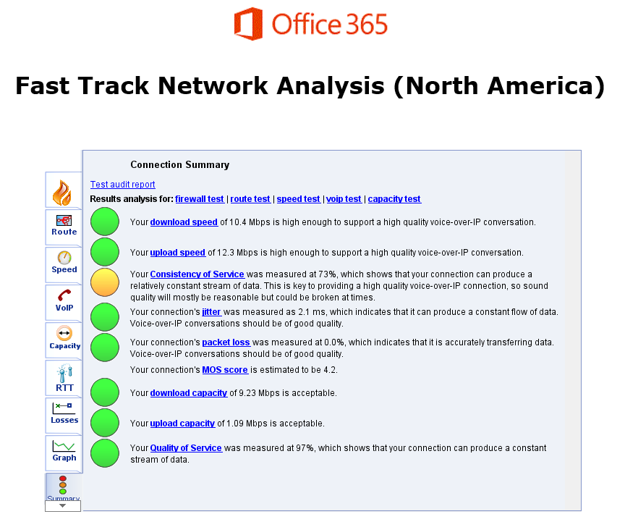
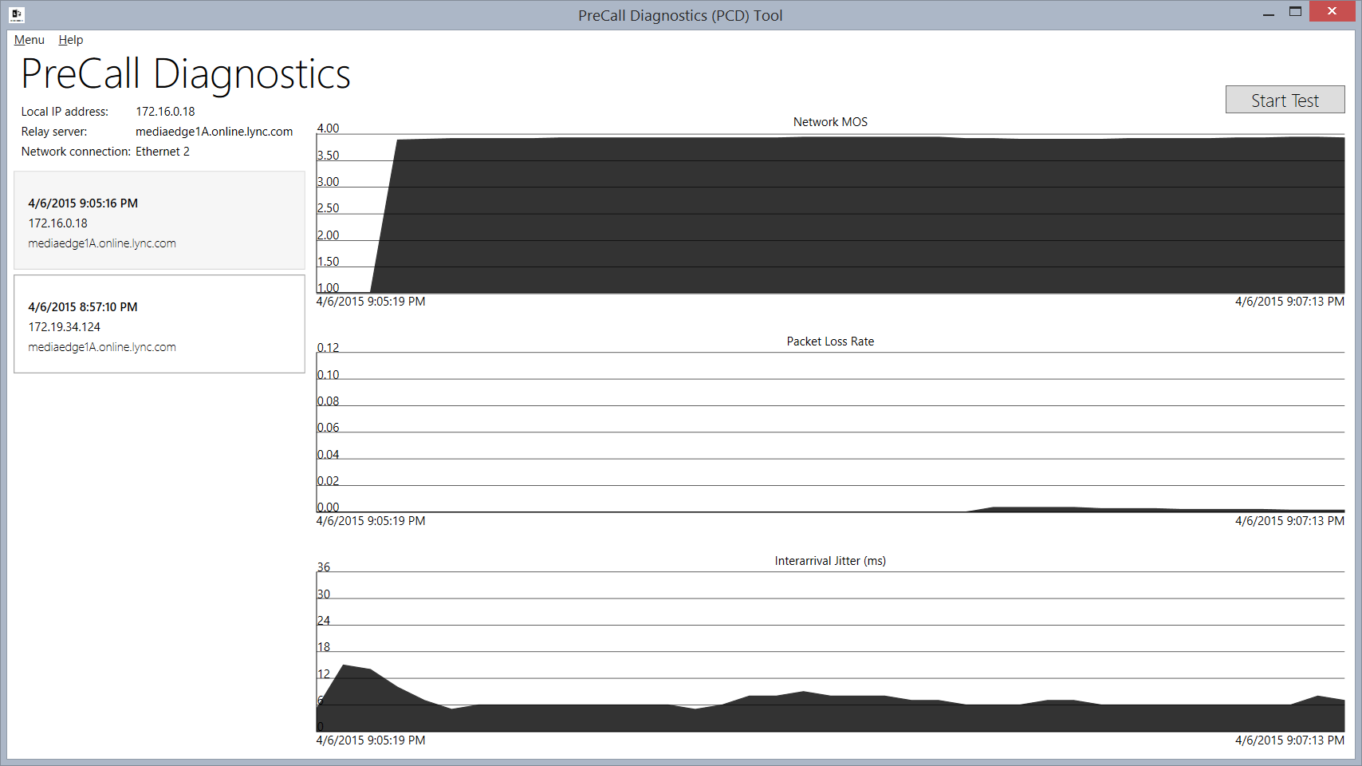
Analyzing Quality – Apps
Fast Track Network Analysis
  Office 365 Network Analysis Tool*
    North America (Virginia, USA):
    http://na1-fasttrack.cloudapp.net/
    EMEA (Amsterdam):
    http://em1-fasttrack.cloudapp.net/
    APAC (Singapore):
    http://ap1-fasttrack.cloudapp.net
  Correlate UDP / TCP test results with modalities
    UDP with Voice\Video over IP
    TCP with Application Sharing
Lync Pre-Call Diagnostics
*Based on the technology found here.

Slide 31
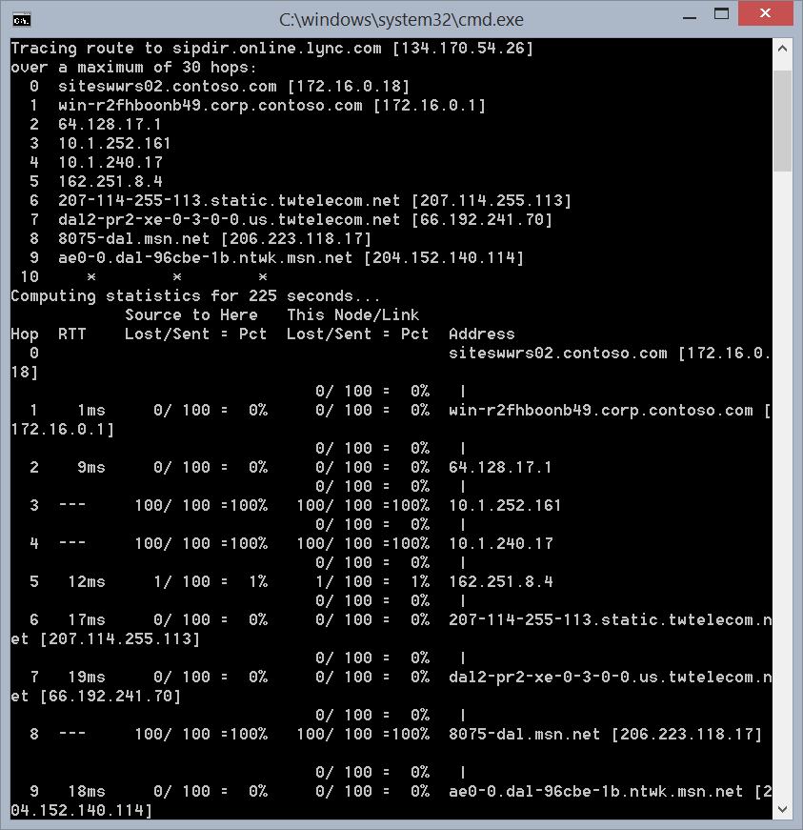
Analyzing Quality – Tools
netmon
(or other similar tools)
  Look for packet loss or failed connections
pathping -4 sipdir.online.lync.com
tracert -4 -d sipdir.online.lync.com

Slide 32
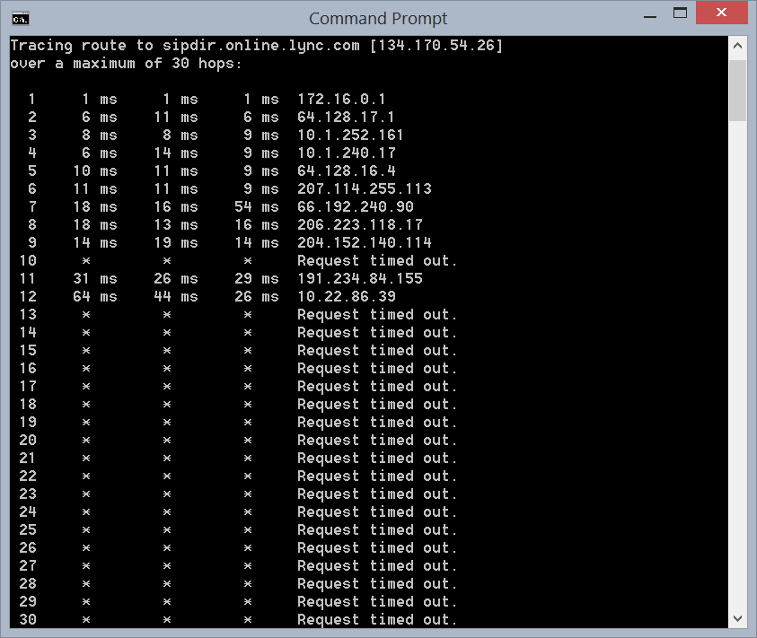
Analyzing Quality – Tools
netmon
(or other similar tools)
  Look for packet loss or failed connections
pathping -4 sipdir.online.lync.com
tracert -4 -d sipdir.online.lync.com

Slide 33
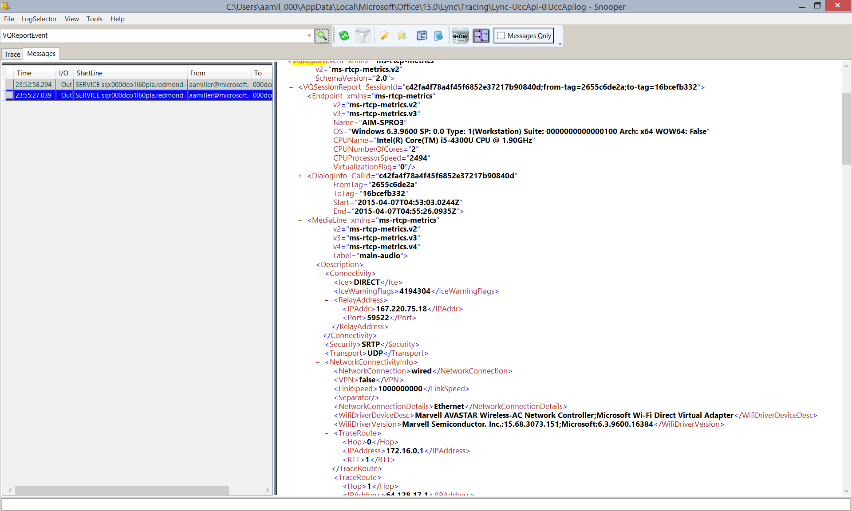
Analyzing Quality – Client Logs
Blog: Troubleshooting Lync Call Quality Locally with Snooper

Slide 34
Fast Track Network Analysis
Demo

Slide 35
Related Sessions
Day | Start | Code | Title | Speakers
Tuesday | 9:00AM | BRK2146 | Getting Started with Skype for Business Online Voice and Audio Conferencing | William Verthein
Tuesday | 10:45AM | BRK2126 | Skype Room Systems: creating better spaces to meet with new devices | Albert Kooiman; Anton Krantz; Dan Stevenson
Tuesday | 1:30PM | BRK3198 | Skype for Business – Doing very large online meetings very easily! | Greg Baribault
Tuesday | 3:15PM | BRK2191 | UC SDN: The Future of Networking | Pascal Menezes & Friends
Tuesday | 3:15PM | BRK3140 | The Voice of Skype for Business: An Overview | Jamie Stark
Wednesday | 10:45AM | BRK4103 | Meetings and Media: The Detailed View | Tommy Clarke
Thursday | 1:30PM | BRK3107 | Wi-Fi and Software Defined Networking with Skype for Business | Craig Hill; Korneel Bullens; Pascal Menezes
Friday | 9:00AM | BRK4108 | Skype for Business: Server Vital Signs | Andrew Sniderman; Brandon Bernier; Jens Trier Rasmussen
Friday | 10:45AM | BRK3174 | Real-Time Call Quality Metrics via Software Defined Networking (SDN) on Skype for Business | Christian Burke; David Tucker; Michael Butler
Friday | 12:30PM | BRK4118 | Skype for Business: Call Quality Management and Operations | Aaron Steele

Slide 36
Q&A

Slide 37


Please evaluate this session
Your feedback is important to us!
Visit Myignite at http://myignite.microsoft.com
or download and use the Ignite Mobile App
with the QR code above.

