Slide 2
Office 365 ProPlus: Updates, Updates, Updates!
BRK3133
Curtis Sawin

Slide 3
What
if…

Slide 4
Agenda
Trust…
…but Verify
Office 365 ProPlus Servicing Overview
Demo: Office updates in action
Managing Office Updates
Coming soon…

Slide 5
Office 365 ProPlus Servicing Overview

Slide 6
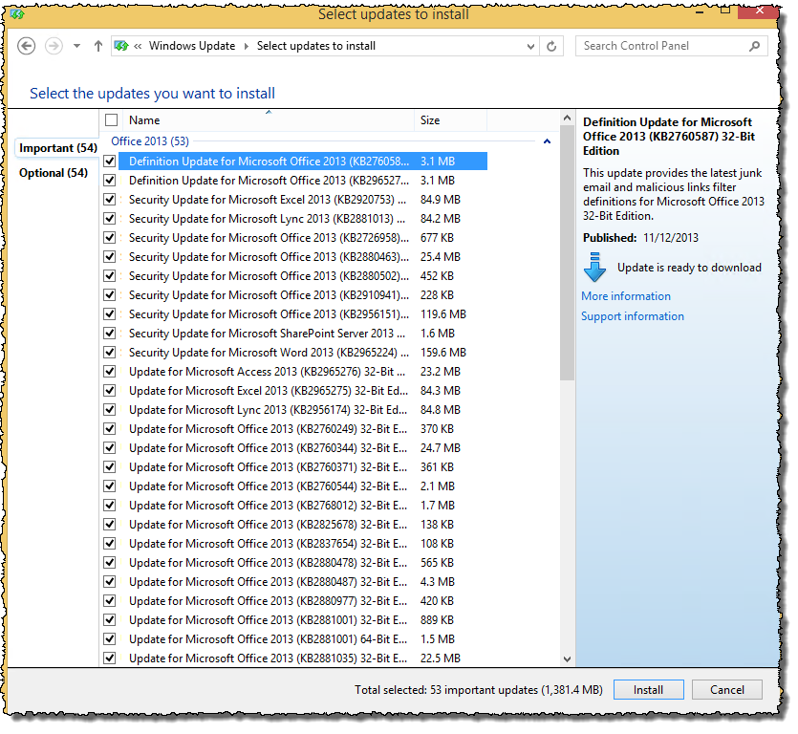
Office 2013 (MSI) Update challenges
No slipstreamed builds
Only Service Packs are slipstreamed
Updates happen serially
MSP + MSP + MSP + MSP…
Significant bandwidth usage
MSPs may contain duplicate content
Ex, all updates since Office 2013 SP1 = 1.4 GB*
*As of April, 2015

Slide 7
Office 365 ProPlus Servicing Overview
Builds, rather than updates
Provided monthly. Contains security, non-security changes. Cumulative…At most one update away from evergreen
Background updating
Deltas are calculated and downloaded in background
Several options to provide IT controls
Take Control of Change
Manage change via small ripples, rather than large, disruptive waves
Consistency enables process automation
Monthly, cumulative builds
Calculated deltas
Flexible options for management, control
Enables agility

Slide 8
Updates and Compatibility
Object Model & API
Virtually static since Office 2010 (http://aka.ms/Kj6vya) Office App Model is future direction... …no planned changes to object model/APIs
Builds supported for 12 months
Consistent with MSI/Service Pack lifecycle policy Enables validation of builds
Telemetry provides objective data
Facilitates a fact-based approach to manage risk
Helps manage change
Extensibility
Lifecycle
Manage risk
Manage change

Slide 9
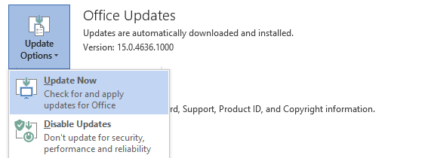
Office Update Triggers
Update Scheduled Task
Runs after user login and @ 3:00 AM (Sun, Tues, Thurs) Can be configured to check CDN or local source Can be disabled
User Initiated
Update Now in the Account section of the Backstage view
Command-line Update
In “%programfiles%\Microsoft Office 15\Client[x86/x64]”
OfficeC2RClient.exe /update user [updatetoversion=“15.0.4711.1004”]

Slide 10
Update Phases
Update Download
Binary Delta compression
Update Apply
Requires applications to be closed
Will apply on reboot
User interaction is possible

Slide 11
Configuring Updates at Install Time Using the Office Deployment Tool
Default configuration – Update check is performed daily using the Microsoft CDN
Use <Update> element to configure updates
Options include: Update location, version, and deadline
<Configuration>
<Add SourcePath="\\server\share" OfficeClientEdition="32">
<Product ID="O365ProPlusRetail">
<Language ID="en-us" />
</Product>
</Add>
<Updates Enabled="TRUE" UpdatePath="\\Server\share\" TargetVersion="15.1.2.3" Deadline=“06/16/2015 18:30"/>
</Configuration>

Slide 12
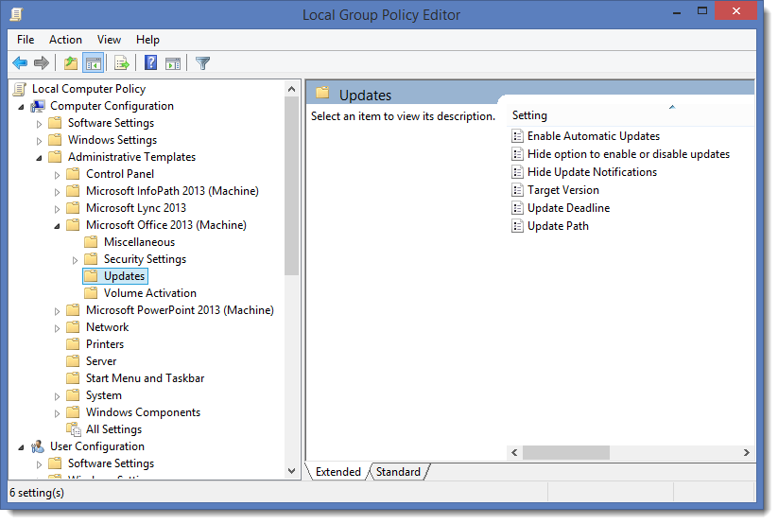
Configuring Updates via Group Policy
Computer Configuration
Administrative Templates
Microsoft Office 2013
Updates
Enable Automatic Updates
Hide option to enable or disable
Update Version
Update Deadline
Update Path
Disable Update notifications

Slide 13
How Automatic Updates Work
Scheduled Task triggered
Most Common Path
New build available?
Ready to apply?
No
No
Do nothing

Slide 14
How Automatic Updates Work
Scheduled Task triggered
Apply Update (Scenario 1 of 3)
New build available?
Ready to apply?
Office processes running?
No
Yes
Yes
No
Download delta
Update Office

Slide 15
How Automatic Updates Work
Scheduled Task triggered
Apply Update (Scenario 2 of 3)
New build available?
Ready to apply?
Office processes running?
3 or 6 days have passed?
No
Yes
Yes
Yes
No
Download delta
Do nothing

Slide 16
How Automatic Updates Work
Scheduled Task triggered
Apply Update (Scenario 3 of 3)
New build available?
Ready to apply?
Office processes running?
3 or 6 days have passed?
No
Yes
Yes
Yes
Prompt user via Toast or Business Bar
Yes
User selects apply?
Download delta
Yes
Select “Close programs?”
Update Office
Yes
Open Office apps

Slide 17
How Automatic Updates Work
Scheduled Task triggered
New build available?
Ready to apply?
Office processes running?
3 or 6 days have passed?
No
Yes
Yes
Yes
Prompt user via Toast or Business Bar
Yes
No
No
No
User selects apply?
Download delta
Do nothing
No
No
Yes
Select “Close programs?”
Update Office
Yes
Open Office apps

Slide 18
Updating Office 365 ProPlus
Curtis Sawin

Slide 19
Managing Office Updates

Slide 20
Update Considerations Where and When
Internal or Cloud source?
Outsource your update infrastructure
Multiple languages can lead to lots of content
Binary delta replication reduces bandwidth needs
Network infrastructure can impact decision
Automatic Updates or controlled updates?
Update management – can it be justified?
Hybrid approaches provide flexibility/control
Group Policy provides granular control Eg, automatically have “some” people get automatic updates

Slide 21
Managing Office Updates Common Questions
“How can I test/approve updates?”
“How can I automate update management?”
“How can I backout, if necessary?”
“How can I determine if it worked?”

Slide 22
Managing Updates A sample plan
Goals
Process is automated
Builds are validated for 2 weeks
Backout is enabled
Opt-out is enabled

Validation Group
+
Production Group
Automation + Time

Slide 23
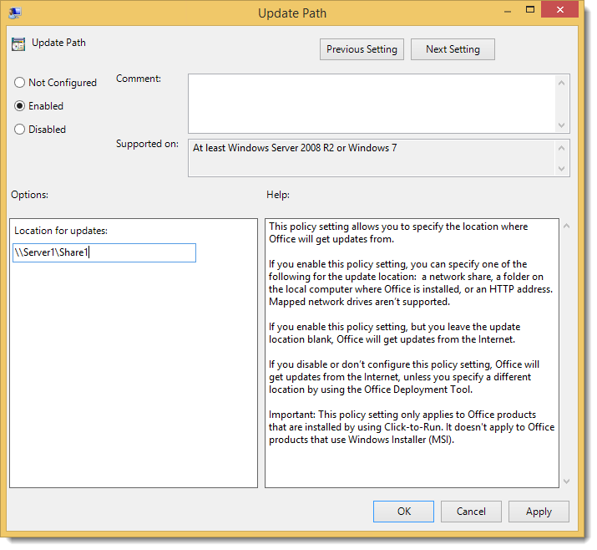
Managing Updates A sample plan
1. Identify “pilot” group/update source
Determine who will validate new builds
Determine internal source(s) to contain Office builds
Use Group Policy & global group filtering to configure update source (eg, “\\server1\Source1”) for testing group
(Optional) Configure to download from cloud

Slide 24
Managing Updates A sample plan
Use Group Policy to configure update source(s) and/or
Define update source at install time using the UpdatePath element
2. Identify production update source

Slide 25
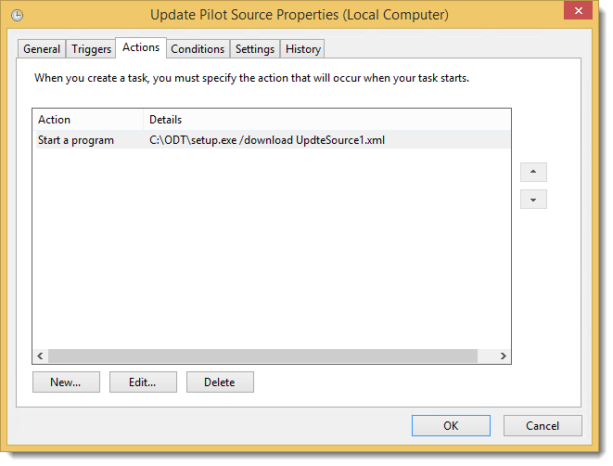
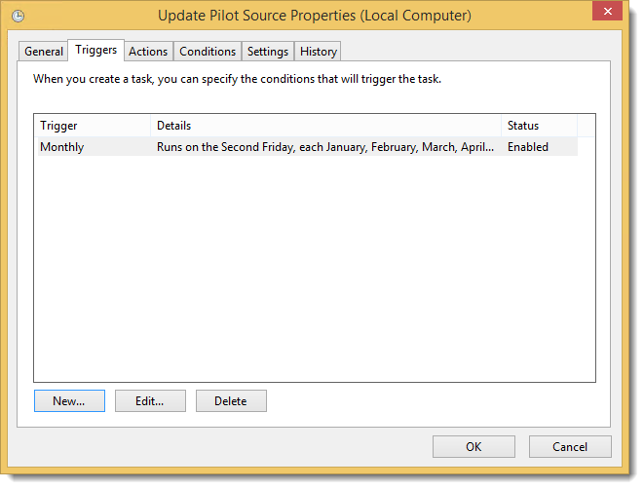
Managing Updates A sample plan
Run “setup.exe /download UpdateSource1.xml”
SourcePath set to Pilot update location
Create a scheduled task to automate download
Run task 2nd Friday of each month
Contents of UpdateSource1.xml:
<Configuration>
<Add SourcePath="\\Server1\Source1" OfficeClientEdition="32">
<Product ID="O365ProPlusRetail">
<Language ID="en-us" />
</Product>
</Add>
</Configuration>
3. Populate pilot update source

Slide 26
Managing Updates A sample plan
Run setup.exe /download UpdateSource2.xml
SourcePath set to Production update location
Create a scheduled task to automate download
Run task 4th Friday of every month
Disable this task to “opt-out” of distributing to production
(Optional) Use software distribution tools to schedule deployment to many locations
4. Populate production update source

Slide 27
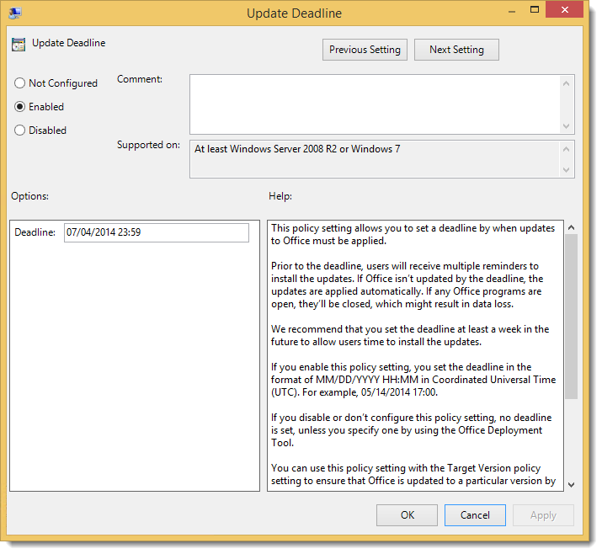
Managing Updates A sample plan
Backout plan - Use OfficeC2RClient.exe (via Software distribution) to downgrade to previous build
Enforcement – Use OfficeC2rClient.exe (via Software distribution) to update to current build
(Optional) Use Update deadline in Group Policy to enforce
Officec2rClient.exe /update user forceappshutdown=True displaylevel=False updatetoversion=15.1.2.3
5. Manage outliers

Slide 28
Coming Soon…

Slide 29
Introducing Office Deferred Updates
Feature updates consolidated and delivered 3 time/year
Preview and validate feature updates up to 4 months prior to delivery
Continuous Security updates delivered monthly

Slide 30
Current Branch Customer experience
Features are released to broad market
Customers are up to date with features as they are released after broad early adopter validation
Opportunity for enterprises to test and validate new features
Security updates and fixes are delivered regularly
CB1
CB2
CB3
CB4
CB5
CB6
CB7
CB8
CB9
CB10
CB11
CB12
jan
feb
mar
apr
may
jun
jul
aug
sep
oct
nov
dec
Time
Dates are for illustration purposes only

Slide 31
Deferred Branch Customer experience
Features are delivered 3 time/year
Security updates and fixes are delivered regularly for up to 4 months
Business customers on auto-update will be moved to a new branch
Business customers can wait to receive feature updates for an additional period of time, testing and validating in their environment before broad deployment
Validation builds are stabilized and available for testing 4 months prior to declaring as deferred branch
CB5
DB3
CB1
DB2
DB1
jan
feb
mar
apr
may
jun
jul
aug
sep
oct
nov
dec
Time
Feature update
Security only update
Extended support
Dates are for illustration purposes only

Slide 32
Additional Sessions
Deploying Office 365 ProPlus Using System Center Configuration Manager
Tuesday, 5/5 – 9:00 AM
Customer Showcase: Deploying Microsoft Office 365 ProPlus
Tuesday, 5/5 – 1:30 PM
Deploying and Updating Office 365 ProPlus using the Office Deployment Tool
Wednesday, 5/6 – 10:45 AM
Office 365 ProPlus and Office 20XX: Mixing it Up!
Thursday, 5/7 – 9:00 AM
Using the Office Telemetry Dashboard to Manage Change
Thursday, 5/7 – 10:45 AM
Office 365 ProPlus: Demystifying Deployments
Thursday, 5/7 – 1:30 PM
Strategies to Make Your Office 365 ProPlus Deployment Project Successful
Friday, 5/8 – 10:45 AM

Slide 33
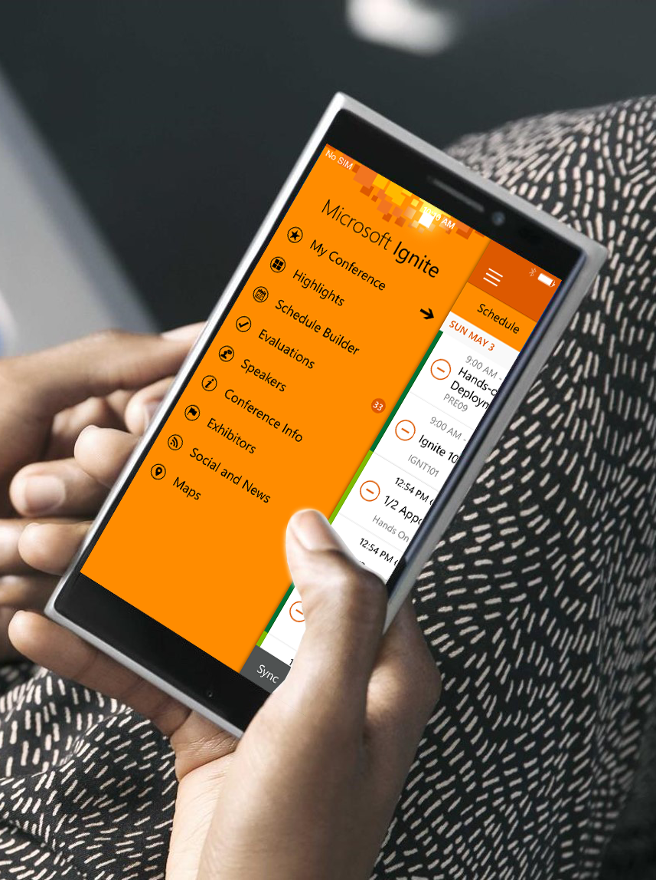
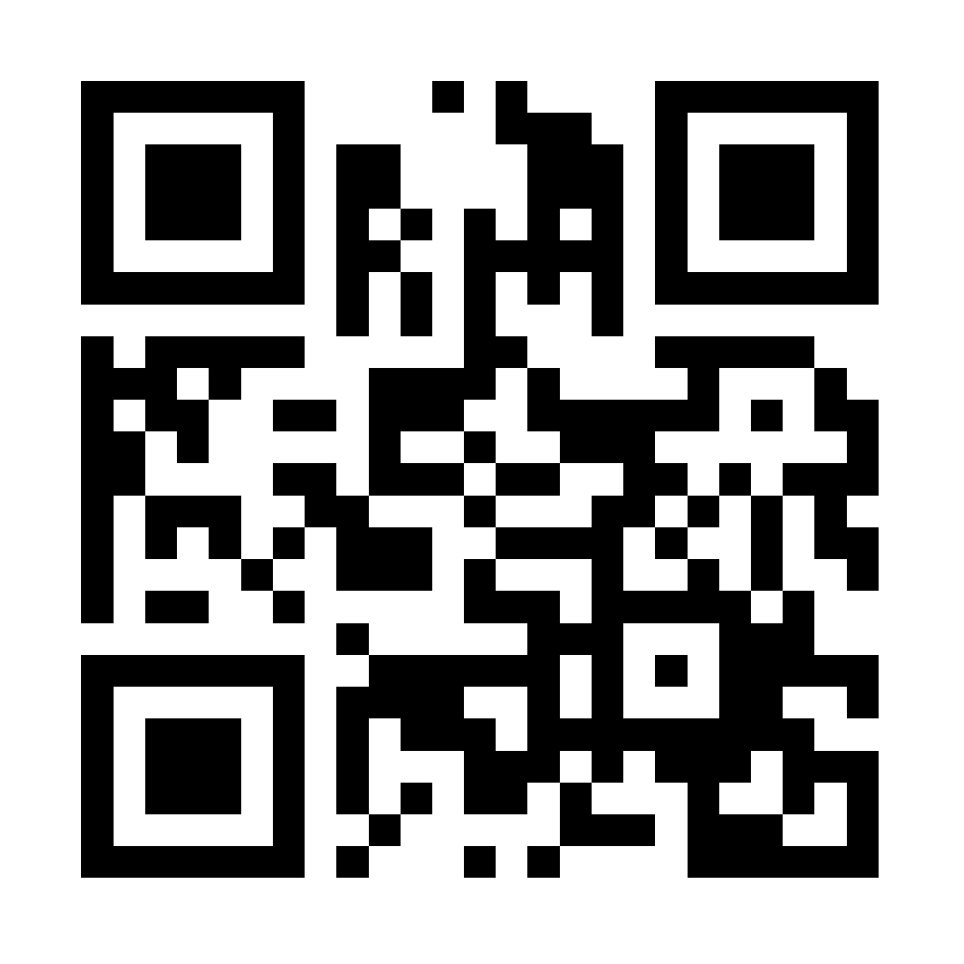
Please evaluate this session
Your feedback is important to us!
Visit Myignite at http://myignite.microsoft.com or download and use the Ignite Mobile App with the QR code above.

