Slide 2
Getting to Skype for Business:
Everything You Need to Know to Upgrade from Lync
BRK3138
Scott Stubberfield
Program Manager, Microsoft

Slide 3
Agenda
Introduction to In-place Upgrade
  What is an in-place upgrade
  Benefits
Upgrade Path
  Upgrade Options
  Upgrade Order
Upgrade Process
Demo

Slide 4
Upgrading to Skype for Business Server 2015
In-Place Upgrade Overview

Slide 5
In-Place Upgrade
What is it?
  Upgrade from Lync Server 2013 to Skype for Business Server using existing hardware
Benefits
  Preserves existing hardware/server investments
  Smoother upgrade process without extensive planning
  Reduces the overall cost for deployment
  The goal of heading towards Smart Setup

Slide 6
Upgrade Path
Migrate-Users Mode (Minimal User Downtime)
Offline Mode
Original Topology | New Topology | In-Place Upgrade Supported ? | Priority
2013 | Skype For Business Server + 2013 | Yes. In-Place upgrade support from 2013 -> Skype For Business Server | P0
2010 | Skype For Business Server + 2010 | No. Upgrade from 2010 -> Skype For Business Server is the same process as 2010 -> 2013 | P1
2013 + 2010 | Skype For Business Server + 2013 | Mandatory migration from 2010 -> 2013 before deploying Skype For Business Server Then In-Place upgrade from 2013 to Skype For Business Server | P1

Slide 7
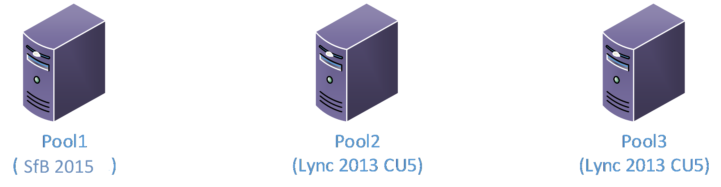
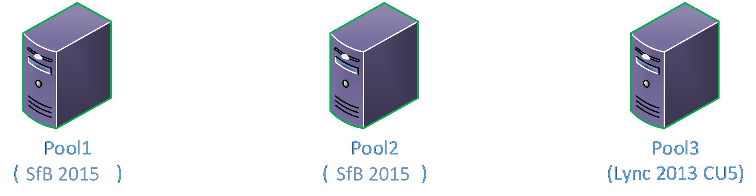
Upgrade Path
(Move Users):
Case1 Upgrade from Lync 2013 to
Skype For Business Server 2015
Move Pool1 Users
Upgrade to
Skype for Business Server
Move Back
Pool1 Users
Test
Functionality
Move Pool2
Users
Upgrade to
Skype for Business Server
Move Back
Pool2 Users

Slide 8
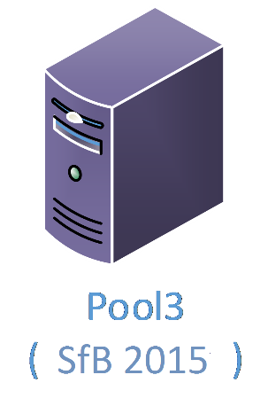
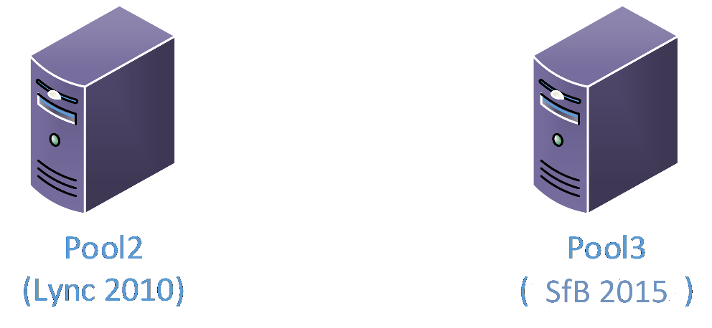
Upgrade Path (Move Users):
Case2
Upgrade from Lync 2010 to
Skype For Business Server 2015
Bring up a new
Skype for Business Server Pool
Move Users
from Pool1 to
Pool3
Decommission Pool1

Slide 9
Upgrade Path
(Move Users):
Case3
Upgrade from Lync 2010 + Lync 2013 to
Skype For Business Server 2015
Move Users
from Pool1 to
Pool3
Decommission Pool1
Move Pool3
Users
Upgrade to
Skype for Business Server
Move Back
Pool3 Users

Slide 10
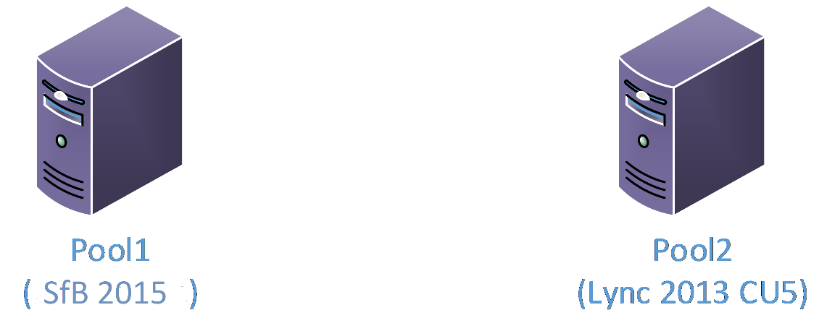

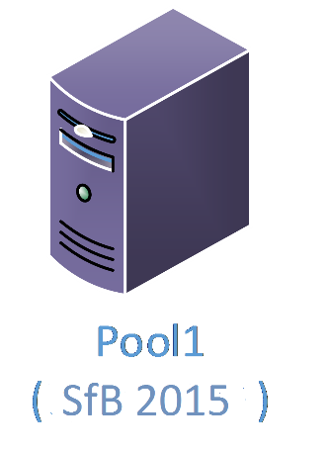

Upgrade Path
(Offline Mode):
Upgrade from Lync 2013
to
Skype For Business Server 2015
Send
Maintenance
Notice to Users
on Pool1
Upgrade to
Skype for Business Server
Ensure features are working
Send email to
Users that services are up
And running
Send
Maintenance
Notice to Users
on Pool2
Upgrade to
Skype for Business Server

Slide 11
Upgrade Path
Recommendations
  No In-Place Upgrade with Disaster Recovery (Pool-Failover)
  Don’t use the Invoke-CsPoolFailover cmdlets to failover the pool!
  Don’t start services in Mixed Mode (half upgraded pool)
  Don’t Un-Pair the Pools before Upgrade
  Ensure minimal time when the Pools are paired with different versions
Upgrade Order
  (Inside->Outside)
  User Pools first
  Shared components like
    Mediation Server, Director, Edge, CMS Pool

Slide 12
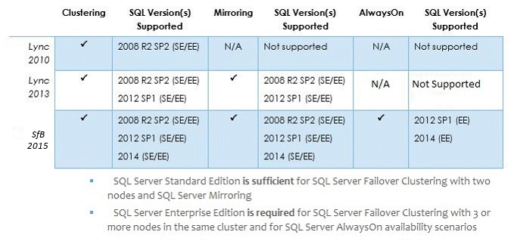
SQL Support with Lync / Skype For Business Server
In-Place Upgrade
  Seamlessly Upgrades SQL Express 2012 to SQL Express 2014
  Also upgrades all the local copies of the database

Slide 13
In-Place Upgrade
Customer Experience

Slide 14
Upgrade Process
Step 1: Install Prerequisites
Step 2: Upgrade, publish topology and upgrade databases using Topology Builder
Step 3: Stop the services on all the servers in the pool to be upgraded
Step 4: Run Setup.exe which will launch In-Place Upgrade UI
Step 5: Start services on all the servers in the upgraded pool at the same-time
(Use the Start-CsPool cmdlet)

Slide 15
Upgrade Process
Step 1: Install Prerequisites
Step 2: Upgrade, publish topology and upgrade databases using Topology Builder
Step 3: Stop the services on all the servers in the pool to be upgraded
Step 4: Run Setup.exe which will launch In-Place Upgrade UI
Step 5: Start services on all the servers in the upgraded pool at the same-time
(Use the Start-CsPool cmdlet)

Slide 16
Step 1 – Install Prerequisites
Always Install Prerequisites!
Install CU5+ latest hotfix to Lync 2013 Topology
PowerShell RTM version (6.2.9200.0) or later
Have at least SQL Server 2012 SP1 installed
You will also need one of the following:
    Kb2533623 - Windows Server 2008 R2
    Kb2858668 - Windows Server 2012
    KB2982006 – Windows Server 2012 R2

Slide 17
Upgrade Process
Step 1: Install Prerequisites
Step 2: Upgrade, publish topology and upgrade databases using Topology Builder
Step 3: Stop the services on all the servers in the pool to be upgraded
Step 4: Run Setup.exe which will launch In-Place Upgrade UI
Step 5: Start services on all the servers in the upgraded pool at the same-time
(Use the Start-CsPool cmdlet)

Slide 18
Upgrade Process
Step 1: Install Prerequisites
Step 2: Upgrade, publish topology and upgrade databases using Topology Builder
Step 3: Stop the services on all the servers in the pool to be upgraded
Step 4: Run Setup.exe which will launch In-Place Upgrade UI
Step 5: Start services on all the servers in the upgraded pool at the same-time
(Use the Start-CsPool cmdlet)

Slide 19
Upgrade Process
Step 1: Install Prerequisites
Step 2: Upgrade, publish topology and upgrade databases using Topology Builder
Step 3: Stop the services on all the servers in the pool to be upgraded
Step 4: Run Setup.exe which will launch In-Place Upgrade UI
Step 5: Start services on all the servers in the upgraded pool at the same-time
(Use the Start-CsPool cmdlet)

Slide 20
Upgrade Process
Step 1: Install Prerequisites
Step 2: Upgrade, publish topology and upgrade databases using Topology Builder
Step 3: Stop the services on all the servers in the pool to be upgraded
Step 4: Run Setup.exe which will launch In-Place Upgrade UI
Step 5: Start services on all the servers in the upgraded pool at the same-time
(Use the Start-CsPool cmdlet)

Slide 21
Demo
In-place upgrade live

Slide 22
Move Towards - Smart Setup
Allows product updates to be installed as part of the setup process
Setup will include the option:
    Check with Microsoft Update for Skype for Business Server Updates
    Download the Updates
    Install them (Prior to finishing the installation process. )
Note: This doesn’t replace the Skype For Business Server Server Update Installer. That will still be useful for our customers who don’t have connection to access the internet

Slide 23


Please evaluate this session
Your feedback is important to us!
Visit Myignite at http://myignite.microsoft.com
or download and use the Ignite Mobile App
with the QR code above.

