Slide 2
The Voice of Skype for Business
BRK3140
Jamie Stark
Product Manager
@nomorephones

Slide 3


Skype for Business
A complete platform for all your voice communications needs
The full set of critical IP-PBX features,
designed for high availability
Deeply integrated with Office 365
Broad choice of devices including tablets, IP phones, headsets & smartphones
Active Directory, SharePoint & other existing infrastructure with standards-based interop

Slide 4
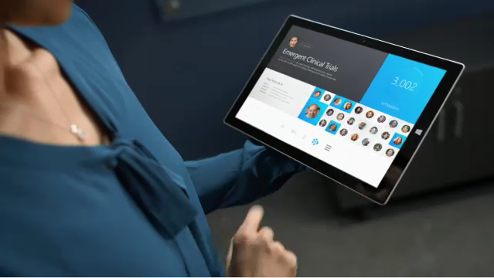
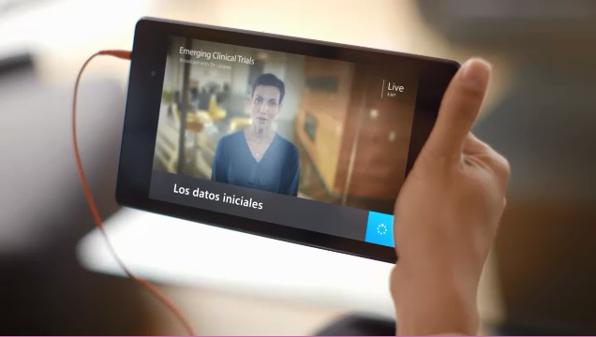

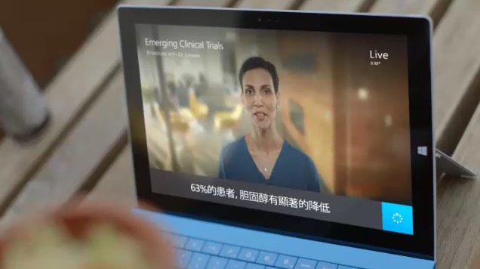
Translator Image

Slide 5


Skype.com/Translator

Slide 6
Demo
Skype (for Business) Translator

Slide 7
X
38%
Placed in Leaders’ Quadrant in Gartner 2014 Unified Communications and Corporate Telephony
Magic Quadrants. **
“Microsoft Lync voice adoption is accelerating and notably shifting the global telephony competitive landscape.”***
of US enterprises prefer Microsoft for voice; more than any other vendor*
*T3i Research, Impact of Microsoft Lync on the Enterprise Voice Market
**Gartner Magic Quadrant for Unified Communications, Bern Elliot and Steve Blood, Aug. 4, 2014
**Gartner Magic Quadrant for Corporate Telephony, Sorell Slaymaker and Steve Blood, Oct. 21 2014
*** Gartner: "Microsoft Lync (Skype for Business): What Do Adoption Trends Mean for Your Organization?"
Gartner does not endorse any vendor, product or service depicted in its research publications, and does not advise technology users to select only those vendors with the highest ratings or other designation. Gartner research publications consist of the opinions of Gartner's research organization and should not be construed as statements of fact. Gartner disclaims all warranties, expressed or implied, with respect to this research, including any warranties of merchantability or fitness for a particular purpose.

Slide 8




Peer-to-peer calling
PSTN calling
Eliminate the need for separate PBX systems
Enterprise calling features
On-site networking

Slide 9


Easy-to-use features
Connecting everywhere
Superior audio and video experience
Peer-to-peer calling

Slide 10

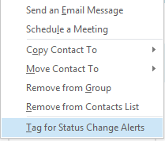
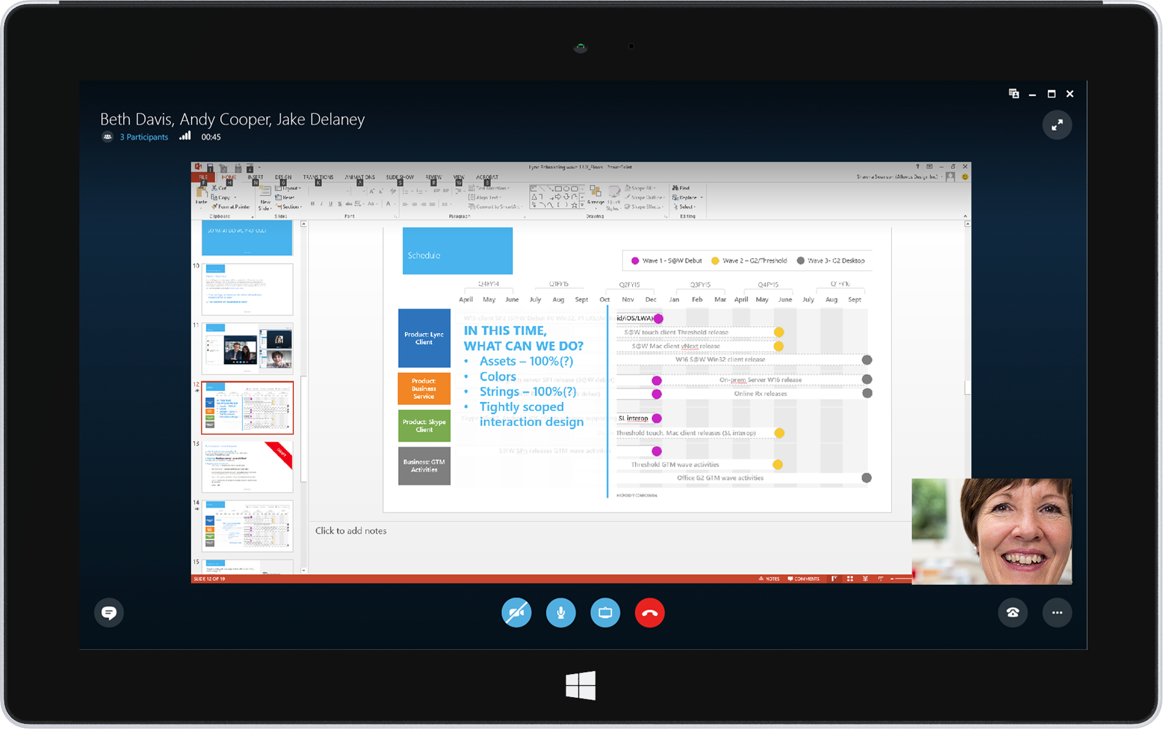
Easy-to-use features
A familiar design centered on the user
that facilitates adoption and usage
  Native Skype look-and-feel
  Anywhere access without a
  Virtual Private Network (VPN)
  Fast redial and recent conversations
  with meetings & missed calls
  Extension camp-on
  & tagging with presence

Slide 11
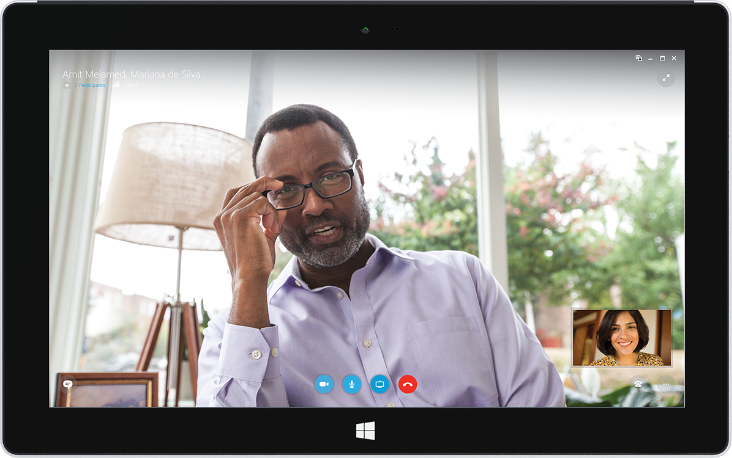
Reach nearly everyone using Skype— customers, suppliers, partners, prospective employees
Connecting everywhere
Full federation with Skype for Business
IM/P, audio, and video
with Skype consumer
Anyone can join Skype for Business meetings on Android, iOS,
Windows, and Mac
Browser experience powered by Skype
for customer contact from web pages

Slide 12
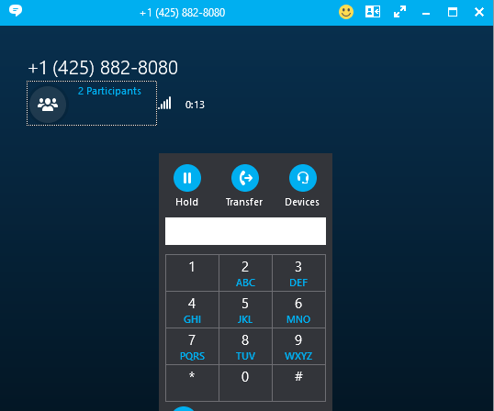
Designed for the internet, providing uncompromised quality across devices
Superior audio
and video experience
  Video call monitor with call control
  USB device switching and optimization
  Optimized media with SILK,
  wideband audio, and HD video
  Call quality application with
  real-time network & quality indicator
  Network health monitor
  Fast in-call
  device switching

Slide 13
Demo
Jabra Intelligent Call Transfer

Slide 14


Simple call management
Emergency and location awareness
Completely integrated PSTN dialing
PSTN calling

Slide 15
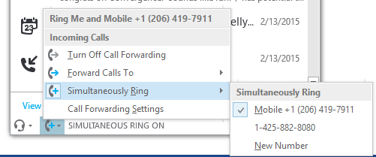
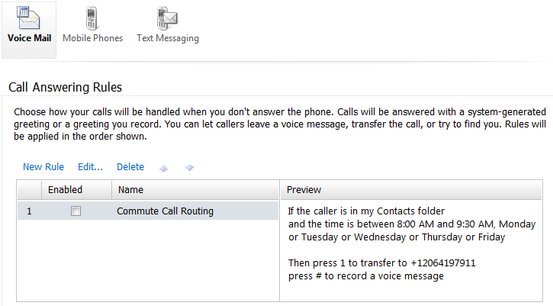
Simple call management
Great call management for users,
from PBX phones to Skype endpoints
  Extending voice interoperability to the PBX phone with Call via work
  Call forwarding and simultaneous ringing to other users and numbers
  Personal call handling with Exchange Unified Messaging

Slide 16
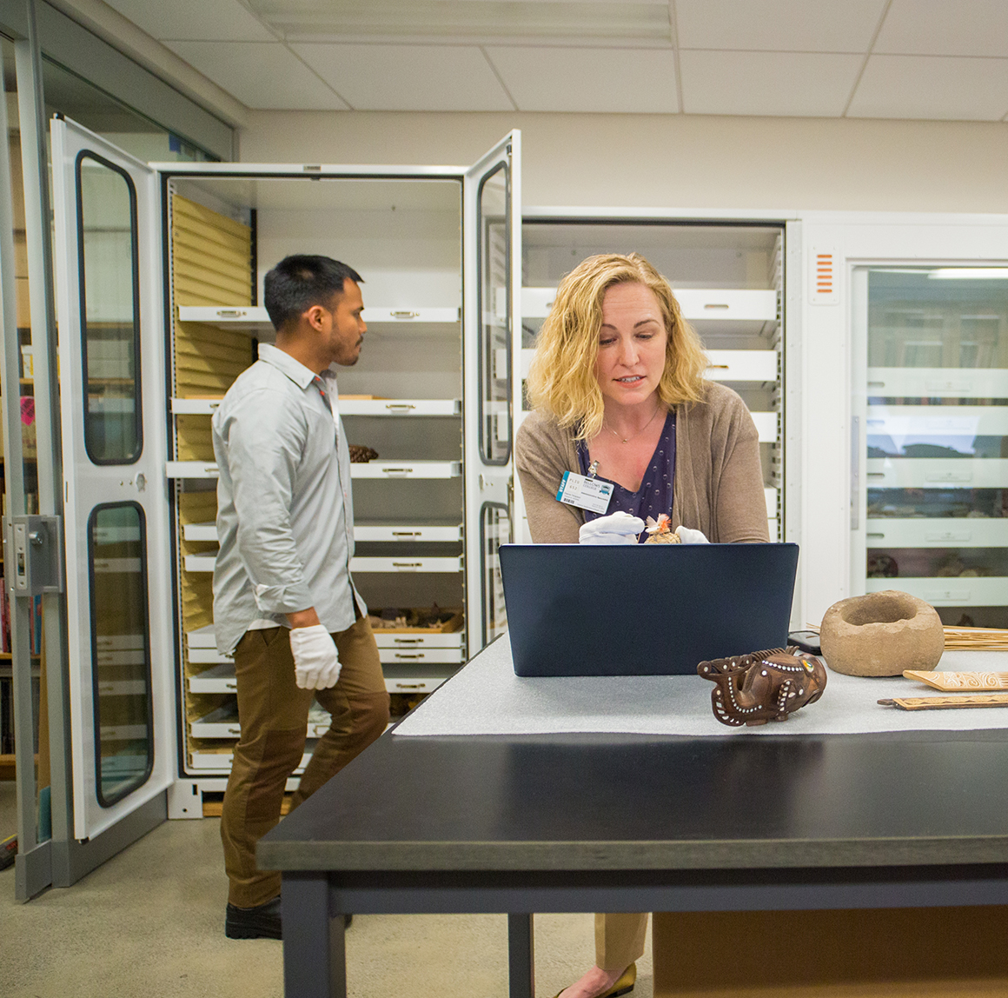
Emergency and
location awareness
Supporting worldwide emergency calling and location-based services
  Emergency dialing with location
  using SIP trunking and ELIN
  gateway capabilities
  Location-based number translation
  Malicious call tracing
  Integrated location discovery

Slide 17
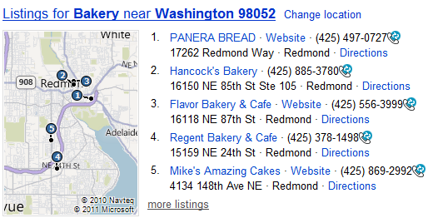
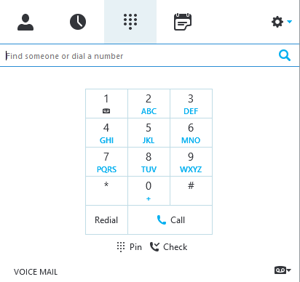
Completely integrated PSTN dialing
Complete PSTN dialing easily available on web, mobile, and rich clients
  Dial by name and by number
  Integrated dial pad
  Inbound DIDs for users & support for extension based dialing
  Calling from Office apps & browser

Slide 18


Essential features for end-users
Advanced call handling
Automated call distribution
Enterprise
calling features

Slide 19
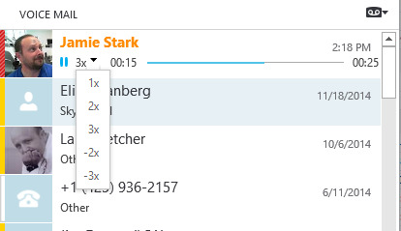
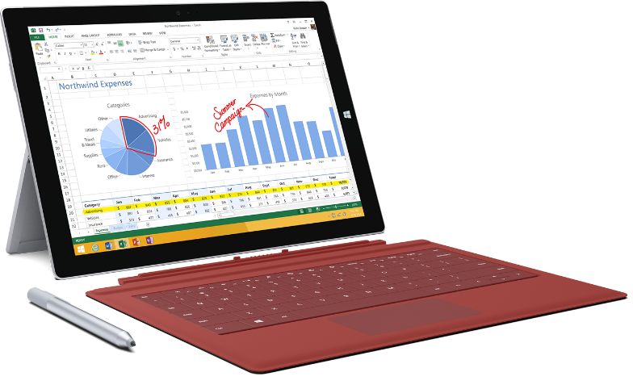
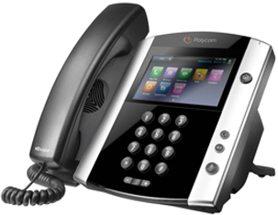

IP phone experience and Unified Messaging deeply integrated
Essential features
for end-users
  Integrated calendar, voice mail,
  and Unified Messaging
  Wide selection of IP phones, headsets, conference room & speakerphones across a variety of price points.
  User-based and PIN-based
  IP phone authentication

Slide 20
Demo
Yealink T22

Slide 21
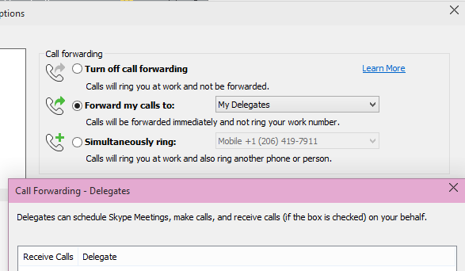
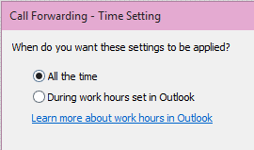
Sophisticated call management capabilities designed for
information workers
Advanced call handling
  Enterprise calendar based call routing
  Delegation and shared line appearance
  Call parking
  Group pickup with team calling

Slide 22
Shared Line Appearance
PSTN
  Allows for multiple devices to share calls & state information
  Easy call pickup between phones
  Great for cases where users operate groups of devices
  Requires updated phone firmware, first on Polycom
  Available Fall 2015 in Skype for Business & Lync Server 2013
SLA App 1-425-555-1200
Device 1
Device 2
…..
Device n

Slide 23
Shared Line Appearance
PSTN
  Inbound calls arrive at DID & activate SLA application
  All endpoints presented w/call simultaneously
  Line state shown on other devices via visual indicator
SLA App 1-425-555-1200
 |  |  | ….
Ext # | x3001 | X3002 |  | x3009
SLA 1
SLA 2
SLA 3

Slide 24
Shared Line Appearance
PSTN
  Inbound calls arrive at DID & activate SLA application
  All endpoints presented w/call simultaneously
  Line state shown on other devices via visual indicator
  Move call by placing on hold & retrieving on another endpoint
SLA App 1-425-555-1200
 |  |  | ….
Ext # | x3001 | X3002 |  | x3009
SLA 1
SLA 2
SLA 3

Slide 25
Shared Line Appearance
PSTN
  Inbound calls arrive at DID & activate SLA application
  All endpoints presented w/call simultaneously
  Line state shown on other devices via visual indicator
  Move call by placing on hold & retrieving on another endpoint
  Calls arrive until limit is reached, overflow afterwards
SLA App 1-425-555-1200
 |  |  | ….
Ext # | x3001 | X3002 |  | x3009
SLA 1
SLA 2
SLA 3

Slide 26

Manage calls for groups of all sizes
built into Skype for Business
Automated call distribution
  Call treatment, queuing, routing,
  & formal / informal agent support
  Multiple language support for
  text-to-speech and speech recognition
  Time of day call routing
  Unassigned number handling

Slide 27


Resilient
Designed for interoperability
Complete administration
On-site networking

Slide 28
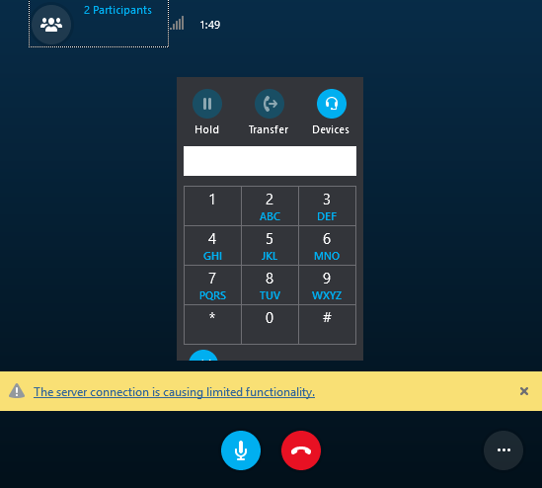
Resilient
Advanced signaling & media stack
and IT controls preserve operations
  Datacenter failover, high availability & branch office WAN survivability
  Internet-ready media stack
  with adaptive codecs for both managed & unmanaged networks
  Call admission control and QoS
  with DSCP marking

Slide 29
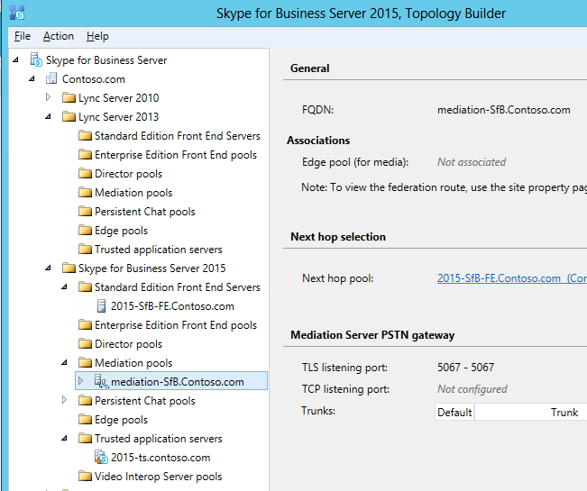
Design for interoperability
Engineered from the ground up to
work with existing infrastructure
  Built-in interoperability and integration through standards-based SIP
  Open qualification program for third party devices & infrastructure
  Complete virtualization support
  Centralized deployment

Slide 30
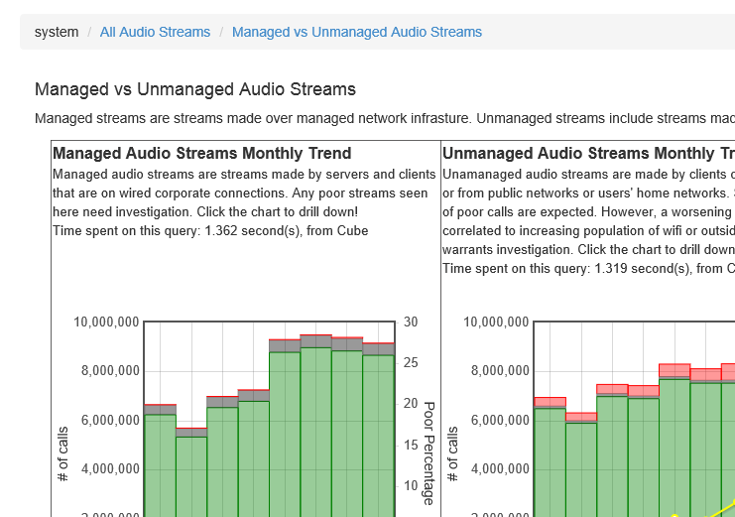
Complete administration
Providing visibility and control for operations and administration
  PowerShell and GUI-based operations
  Role-based admin access control
  Advanced quality monitoring with
  Call Quality Dashboard
30

Slide 31
Deployment Flexibility
Online
Hybrid
On Premises

Slide 32
Online
Hybrid
On Premises
Enterprise Voice in Office 365
PSTN services provided by Microsoft
User hosted in Office 365
Customer PSTN services integrated on-premises
End-user features & customer PSTN services integrated on-premises

Slide 33
Cloud Voice
Two core parts always in the cloud
- Cloud-based call control for end-users
- Tenant admin user experience for IT Pros
ExpressRoute
Public
Internet
Customer
Premises
Office 365

Slide 34

PSTN Calling in Office 365
Global calling for Office 365 customers based on Microsoft PSTN offers
  PSTN calling plans for Office 365
  Includes DIDs and number porting
  Available in US in 2H 2015.
  Followed in 2016 by countries in Europe
Online

Slide 35
Cloud Voice with Microsoft PSTN Service
Office 365
Media
PSTN Calls
PSTN
Signaling
Customer
Premises

Slide 36

On-premises PSTN Connectivity
Global calling for Office 365 customers
using existing telephony infrastructure.
  Enables users worldwide to use Office 365 voice features with existing trunks starting in 2016
  Hybrid offer uses Skype for Business Server technology for interconnection to PSTN and PBX assets
Hybrid

Slide 37
Cloud Voice with On-premises PSTN Connectivity
Office 365
Server Pool
Signaling
Split Domain
Media
PSTN Calls
PSTN
Existing Telephony Infrastructure
Customer Premises

Slide 38

Skype for Business Server
Complete On-Premises PBX replacement
for Enterprises of all sizes.
  Integrated on-site Networking with policy & SDN interfaces to ensure optimal quality
  Survivable across branch WAN and data center failure.
  Sophisticated dial-plan administration with least-cost & location-based routing
On-Premises

Slide 39
Skype for Business: Voice
A complete platform for all your voice communications needs
The full set of critical IP-PBX features,
designed for high availability
Deeply integrated with Office 365
Broad choice of devices including tablets, IP phones, headsets & smartphones
Active Directory, SharePoint & other existing infrastructure with standards-based interop

Slide 40
Curated list of highly relevant sessions
Mon
3:15PM | BRK4112 | Save Time! Automate Phone Number Management in Skype for Business | Ståle Hansen | E451a
9:00AM | BRK2146 | Getting Started with Skype for Business Online Voice and Audio Conferencing | William Verthein | S101
5:00PM | BRK3151 | From Voice to Video, All about Interoperability with Skype for Business | Adam Gent | E451b
Tues
1:30PM | BRK3142 | Planning and Deploying Call via Work for Enterprise PBX Users | Brian Ricks | E451a
Wed
9:00AM | BRK4107 | Enterprise Voice: An Experts Session | Doug Lawty | S501
3:15PM | BRK4129 | Hybrid Configuration Deep-Dive of Skype for Business | Cezar Ungureanasu; Ramesh Narayanan; Vivek Bhatnagar | E450
Thurs
10:45AM | BRK3200 | Deployment Strategies and Integration Scenarios with Microsoft Exchange and Skype for Business | Lynn Roe | E253
12:30PM | BRK4118 | Skype for Business: Call Quality Management and Operations | Aaron Steele | E352
Friday

Slide 41


Please evaluate this session
Your feedback is important to us!
Visit Myignite at http://myignite.microsoft.com
or download and use the Ignite Mobile App
with the QR code above.

Slide 42
© 2015 Microsoft Corporation. All rights reserved. Microsoft, Windows, Windows Vista and other product names are or may be registered trademarks and/or trademarks in the US. and/or other countries.
The information herein is for informational purposes only and represents the current view of Microsoft Corporation as of the date of this presentation. Because Microsoft must respond to changing market conditions, it should not be interpreted to be a commitment on the part of Microsoft, and Microsoft cannot guarantee the accuracy of any information provided after the date of this presentation. MICROSOFT MAKES NO WARRANTIES, EXPRESS, IMPLIED OR STATUTORY, AS TO THE INFORMATION IN THIS PRESENTATION.

