Slide 2
How to Deploy Microsoft Project: Online and Server
BRK3143
Nadin Merali
Chris Boyd

Slide 3



Introduction
Chris Boyd
Nadin Merali
Program Manager II
Works on Project Online and Security
On Project 2 years
PMP Certified
Software Consultant 8+ years
Senior PM Manager
Project Online and Task Service
On Project team ~10 years

Slide 4
Objectives
Setting up Project Server
Getting Started with Project Online
First Steps to configuring Project Web App
1
2
3

Slide 5
“I always like to look on the optimistic side of life, but I am realistic enough to know that life is a complex matter.” - Walt Disney

Slide 6
Quick Survey
Are you a wizard at all the functionality Project Server has to offer?
1
2
Who here has setup SharePoint?
How many of you have setup a Project Server before?
3

Slide 7
What you need to get going with Project Server
Windows Server 2008 R2 SP1
Microsoft SQL Server 2008 R2 SP1
IE8 or latest version of Firefox, Chrome or Safari
Project Professional Windows 7 or later
2012 R2 requires 2013 SP1
Project Pro
for O365
SharePoint Server 2013 Enterprise
Exchange Server 2013 (Optional)
TechNet
Lync or Skype for Business (Optional)
Hardware and software requirements for Project Server 2013

Slide 8
Topology
P
P
P
P
P
P
-Web
-Application
-Web
-Web
-Application
-SQL
P
P
P
-Application
-SQL
-SQL
Dev/Test
Project Server 2010
Project Server 2013

Slide 9
Setting up Project Server
Nadin Merali

Slide 10



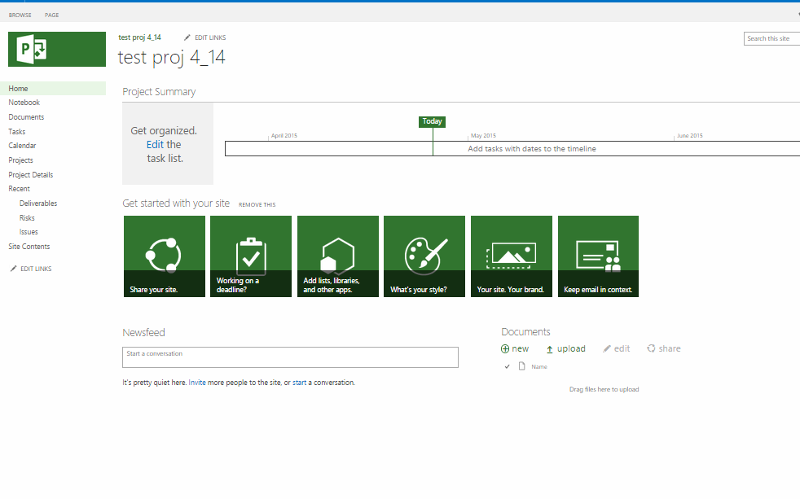
SharePoint 2013 Farm
+ Project Server
Service Applications
Config
Service Applications
Excel
Content
Project
Content
Project
PerformancePoint
Contoso.com/sites/medical
Contoso.com/sites/pwa
Secure Store
/lab
/lab
State Service
/trials
/trials
Project
/legal
/legal
Search
/vaccine
Search
/pwa
/vaccine

Slide 11

Upgrade to Project Server 2013
Only Support from 2010 → 2013
Build a new Project Server 2013 Farm
Backup and restore Project Databases
Publish projects for issue, risks and related documents
Add new EPTs
Enable the Backup and Restore Timer Job

Slide 12
Additional Resources
  Get started with Project Online
  Deploy Project Server 2013 to a server farm environment
  Upgrade to Project Server 2013
  Test Lab Guide: Install Project Server 2013
  Hardware & software requirements for Project Server 2013
  Plan for performance and capacity in Project Server 2013
  Brian Smith’s Project Support Blog
  “From the Trenches” 3rd party white papers
  Project TechNet forums
  Please contact projdocs@Microsoft.com to provide us with any content feedback.

Slide 13
Getting Started with Project Online

Slide 14
“Times and conditions change so rapidly that we must keep our aim constantly focused on the future.” – Walt Disney

Slide 15
On-premise vs. Online
Self hosting
on-premise
Infrastructure
(as a Service)
Software
(as a Service)
Hosting Project Server Yourself
Project Online
Applications
Applications
Applications
Data
Data
Data
Runtime
Runtime
Runtime
Project Server
Middleware
Middleware
Middleware
O/S
O/S
Managed by us
O/S
Virtualization
Virtualization
Managed by vendor
Virtualization
Servers
Servers
Servers
Storage
Storage
Storage
Networking
Networking
Networking

Slide 16
Getting Started with Project Online
Chris Boyd

Slide 17
What is the version number of Project 2013?
How often are tenants upgraded?
What is the version number of Project 2013?
15
How many databases does the Project Online Team maintain?
What is the version number of Project Online?
How many databases does the Project Online Team maintain?
0
What is the version number of Project Online?
16
How often are tenants upgrade?
Daily
PROJECT
ONLINE
How many PWA instances per tenant?
How many PWA instances per tenant?
7
How much storage per PWA instance?
10GB
What is the financially-backed uptime guarantee?
99.9%
How much storage per PWA instance?
What is the financially-backed uptime guarantee?
TRIVIA
Where does the admin learn about issues?
Is Project Online FedRAMP Compliant?
Where does the admin learn about issues?
Message Center
Is Project Online FedRAMP Compliant?
Yes
Where to learn about future updates?
Where to learn about future updates?
http://office.com/roadmap

Slide 18
Additional Resources
Project Online: software boundaries and limits
Add Project Online to your Office 365 account
Add Project Online to a site collection

Slide 19
First Steps to configuring Project Web App

Slide 20
First Steps
Setup Resource Pool Sync
Create Custom Fields
Create a Project
Share a Project
Setup Timesheet Periods
1
2
3
4
5

Slide 21
First Steps to configuring Project Web App
Nadin Merali

Slide 22


Please evaluate this session
Your feedback is important to us!
Visit Myignite at http://myignite.microsoft.com
or download and use the Ignite Mobile App
with the QR code above.

