Slide 2
Building Tenant-Wide Apps with the New Exchange REST APIs
BRK3145
Venkat Ayyadevara, Shreedevi Padmasini

Slide 3
Agenda
Session objectives
  Why are Office 365 REST APIs important?
  Deep dive into the APIs
  Best practices
  Compare with existing APIs like Exchange Web Services (EWS)
  Sneak-peek into what is coming
Key takeaways
  APIs that allow you to create end-to-end Office 365 apps with targeted scopes TODAY
  Lightweight and quick to learn and develop
  Work planned to make this THE API for Office 365, outlook.com, Exchange hybrid & on-premises.

Slide 4
Overview

Slide 5

Why do these REST APIs matter?
100’s of millions of users
  Office 365 (now)
  Outlook.com (soon)
  Hybrid and on-premises Exchange on our roadmap
Engaged Users
Powerful, intuitive way to access/manipulate Office 365 data
Granular, tightly scoped permissions to access user data
Based on open standards – OAuth 2.0, JSON, ODATA v4.0

Slide 6
What REST APIs do we offer?
Active Directory
Exchange & Outlook.com
SharePoint
OneDrive
Sites
Users
Mail
OneDrive for Business
Calendar
Client API
Contacts
Sites, Lists and Libs
Taxonomy
Groups
Workflow
BCS
Unified Groups
Search
…

Slide 7
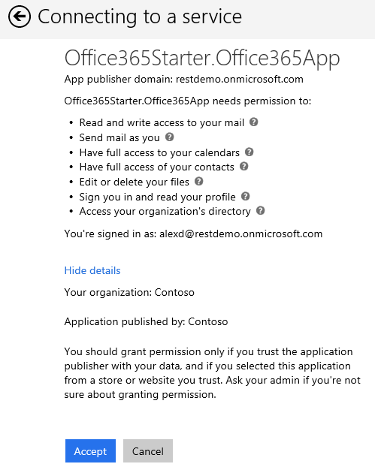
Common Consent Framework for Office 365
Single authentication flow for Office 365
  Azure AD Graph, Exchange, SharePoint
  Device apps and web apps
  Admin and end-user consent
Secure protocol
  OAuth 2.0
  No capturing user credentials
  Fine-grained access scopes
  Supports Multi-factor authentication (MFA) and federated user sign-in
  Long-term access through refresh tokens

Slide 8
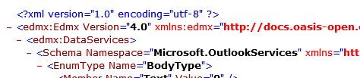
Discovering endpoints and APIs
Office 365 discovery services
  Automatically determine URL of Office 365 services
  Supports device app and website flows
  Secured using Azure AD authentication
  Serves information stored about services in AAD
Rich service metadata
  Lists all entities, collections, actions, complex Types, enums and their properties
  e.g. https://outlook.office365.com/api/v1.0/$metadata

Slide 9




Rich tooling
.NET SDK to build many types of apps using Visual Studio
  .NET Windows Store Apps
  Windows Forms Application
  WPF Application
  ASP.NET MVC Web Application
  ASP.NET Web Forms Application
  Xamarin Android and iOS Applications
  Multi-device Hybrid Apps (Cordova)
Android SDK & iOS SDK

Slide 10
















Partners already using our APIs

Slide 11
Mail, Calendar & Contacts APIs

Slide 12
Some basics first …
Endpoint
  Office 365: https://outlook.office365.com/api
  Office 365 for China: https://partner.outlook.cn/api
Auth
  Open ID Connect for single sign on (SSO)
  OAuth2 code flow support for interactive apps
  OAuth2 client credential flow support for service or daemon apps
  OAuth2 implicit grant flow for web apps
  OAuth2 on-behalf flow for web apps
Users and “Me”
  User’s mailbox: .../api/v1.0/users/sarad@contoso.com/
  Shortcut for signed in user’s mailbox: …/api/v1.0/Me/
Versioning
  Version is explicitly mentioned in the path: …/api/<Version>/
  Production version is https://outlook.office365.com/api/vX.Y/
    No breaking changes based on OData 4.0 versioning guidelines.
    One production version available today: v1.0
  Beta version is https://outlook.office365.com/api/beta/
    New APIs introduced in Beta to solicit feedback. Not intended for production.
    Might make breaking changes based on feedback.
    Promoted to a production version within 3 months.

Slide 13

You’ve got mail!
Permissions
  Read, Read+Write, Send
Entities, Collections, Actions
Samples
  https://outlook.office365.com/api/v1.0/Me/Folders/Inbox
  https://outlook.office365.com/api/v1.0/Me/Folders/Inbox/Messages?$top=1
  https://outlook.office365.com/api/v1.0/Me/SendMail/
Entity | Collection | Actions
Folder | Folders | CRUD, Copy, Move
Message | Messages | CRUD, Copy, Move, Reply, ReplyAll, Forward, Send, CreateReply, CreateReplyAll, CreateForward
Attachment | Attachments | CRUD
Entity
Collection
Intuitive Send API

Slide 14

Calendar – Coffee @ 4?
Permissions
  Read, Read+Write,
Entities, Collections, Actions
Samples
  https://outlook.office365.com/api/v1.0/Me/Calendar
  https://outlook.office365.com/api/v1.0/Me/Calendar/Events?$top=1
  https://outlook.office365.com/api/v1.0/Me/CalendarView
Entity | Collection | Actions
CalendarGroup | CalendarGroups | CRUD
Calendar | Calendars | CRUD
Event | Events | CRUD, Accept, Decline, TentativelyAccept
CalendarView | N/A | Read, Sync
Attachment | Attachments | CRUD
Entity
Collection
No client-side recurrence expansion required ☺

Slide 15
Introducing – Calendar Sync
Calendar sync builds on top of CalendarView
  Add "Prefer: odata.track-changes" header for initial or incremental sync
  First time sync
    First response returns a @odata.deltaLink to “next” page.
    Always follow this link to get additional items (if they exist) and a link.
    If the next link is a @odata.deltaLink, initial sync is complete.
    Else, keep following the @odata.nextLink till you get an @odata.deltaLink.
    Persist the @odata.deltaLink.
  Subsequent incremental sync
    Just follow the @odata.deltaLink to get incremental sync response.
    Change time window in the @odata.deltaLink for rolling window support
    Persist @odata.deltaLink on the client for subsequent incremental sync
Keep in mind …
  Using invalid/altered @odata.deltaLink causes new initial sync instead of an incremental one!
  Even if a single property is changed, sync returns the full entity.
  Meeting series response is different from regular CalendarView
    Full info for master (different from normal Calendar Sync)
    Only start and end time for instances, and full info for exceptions

Slide 16

Contacts – Your number again?
Permissions
  Read, Read+Write,
Entities, Collections, Actions
Samples
  https://outlook.office365.com/api/v1.0/Me/ContactFolders
  https://outlook.office365.com/api/v1.0/Me/Contacts
Use Unified Graph API to find users in a tenant
Entity | Collection | Actions
ContactFolder | ContactFolders | CRUD
Contact | Contacts | CRUD

Slide 17
Demo
Common REST API Requests
List Messages, Events, Contacts
How to filter, order by, select properties
Paging
Send mail, reply to an email

Slide 18
Rich query syntax using OData
Scenario | URL
Get 5 messages from Inbox | https://outlook.office365.com/api/v1.0/Me/Folders/Inbox/Messages?$top=5
Get the next 10 messages | ../Me/Folders/Inbox/Messages?$top=10&$skip=5
Get top 10 messages sorted by DateTimeCreated | ../Me/Folders/Inbox/Messages?$top=10&$orderby=DateTimeCreated
Get selective properties on messages | ../Me/Folders/Inbox/Messages?$top=5&$select=From,DateTimeCreated,Subject
Get events starting after a particular DateTime | ../Me/Events?$top=5&$select=Subject,Start,End&$filter=Start ge 2014-09-22T20:00:00Z
Get Inbox messages with subject and attachment info | ../Me/Folders/Inbox/Messages?$format=application/json;odata.metadata=none&$select=Subject&$expand=Attachments
Get # of messages with attachment(s) | ../Me/Folders/Inbox/Messages/$count?$filter=HasAttachments eq true
Get count and selective props on messages with attachment(s) | ..Me/Folders/Inbox/Messages?$format=application/json;odata.metadata=none&$select=Subject&$filter=HasAttachments%20eq%20true&$count=true
Get contact with a given name | ../Me/Contacts/?$filter=Givenname eq ‘John’

Slide 19
Unified Group APIs (Preview)

Slide 20





Groups building blocks
Office 365 Groups
Azure
Active Directory
Outlook
OneDrive
OneNote
Calendar
Skype
Dynamics CRM
Delve
Yammer
…
Apps

Slide 21
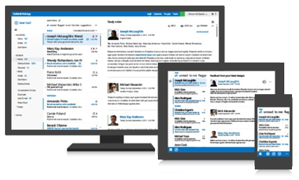
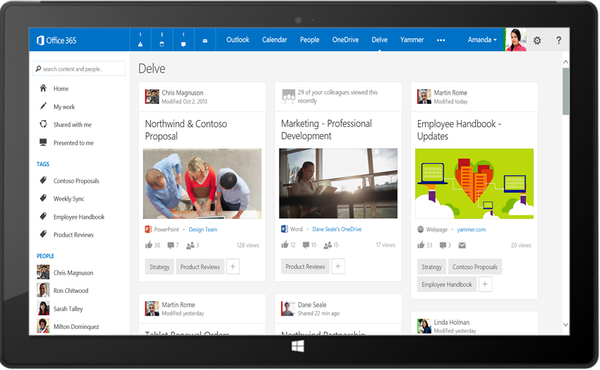
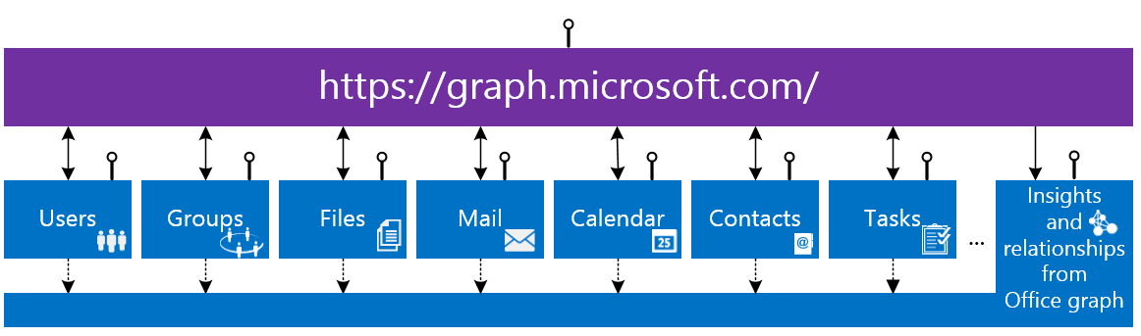
Office 365 unified API (preview)
Your
App
https://graph.microsoft.com/

Slide 22

Groups API (preview)
Permissions
  Groups.Read.All, Groups.ReadWrite.All
Entities, Collections, Actions
Entity | Collection | Actions
Group | Groups | CRUD, SubscribeByMail, UnsubscribeMyMail, AddFavorite, RemoveFavorite, ResetUnseenCount
User/Me | Users | JoinedGroups
Conversation | Conversations | Create, Read, Delete
Thread | Threads | Reply
Post | Posts | Reply, forward
Entity | Collection | Actions
Attachment | Attachments | CRUD
Calendar |  | Read
Event | Events | CRUD
CalendarView | N/A | Read
File | Files | CRUD, upload, download
Folders |  | CRUD, enumerate children

Slide 23
Groups API samples
Management
  https://graph.microsoft.com/beta/myorganization/groups/{id}/
  https://graph.microsoft.com/beta/contoso.com/groups/{id}/AddFavorite
Conversations
  https://graph.microsoft.com/beta/myorganization/groups/{id}/conversations
  https://graph.microsoft.com/beta/contoso.com/groups/{id}/threads/{id}/reply
Calendar
  https://graph.microsoft.com/beta/myorganization/groups/{id}/events
  ../calendarview?startdatetime=2015-05-01 & enddatetime=2015-05-30
Files
  https://graph.microsoft.com/beta/myorganization/groups/{id}/files
  https://graph.microsoft.com/beta/contoso.com/groups/{id}/files/{id}/

Slide 24
Common content queries
Scenario | URL
Get top 10 conversations sorted by LastDeliveryTime | /group/{id}/conversations?$top=10&$orderby=LastDeliveryTime
Get the next 10 conversations | /group/{id}/conversations?$top=10&$skip=10
Get selected properties on events starting after a particular Date/Time | /group/{id}/events?$top=10&$select=Subject,Start,End&$filter=Start ge 2014-09-22
Get selected properties on conversation threads | /groups/{id}/conversations/{id}/threads/{id}/posts?$select=body
Get files where the name starts with “c” | /group/{id}/files?$filter=startswith(name,+'c')
Get selected properties on files | /group/{id}/files?$select=dateTimeCreated

Slide 25
Demo
Group REST API Requests

Slide 26
Introducing – Webhooks (preview)
Permissions
  Uses existing Read or ReadWrite permission for Mail, Calendar, Contacts, or Groups
Supported entity collections
  Messages
  Events
  Contacts
  Groups (unseen count)
    Conversations
    Threads
    Events
Samples
  POST https://outlook.office365.com/api/beta/me/subscriptions
  Group subscription https://outlook.office365.com/api/beta/me/groups(‘mygroup@contoso.com’)/subscriptions
Notifications support for graph.microsoft.com coming soon …

Slide 27
Demo
Webhooks

Slide 28
Other notable new features
Time zone support for events
  Dealing with Start, StartTimeZone, End, EndTimeZone in V1.0
  Take special care with all-day events
Full text search ($search) for messages
  https://outlook.office365.com/api/v1.0/me/messages?$search=“foo”
  https://outlook.office365.com/api/v1.0/me/folders/inbox/messages?$search=“foo”
  https://outlook.office365.com/api/v1.0/me/messages?$search=“from:@contoso.com”
Get authenticated user’s picture.
  Get HD picture(s) if they exist, or else get the picture from Active Directory (AD)
  Picture of the best available resolution – https://outlook.office365.com/api/beta/me/UserPhoto
  Picture metadata vs. picture streaming – https://outlook.office365.com/api/beta/me/UserPhotos
Cross Origin Resource Sharing (CORS) support
  Build single page apps using frameworks such as AngularJS

Slide 29
Demo
Search, Photo

Slide 30
Developer Resources & Tips

Slide 31
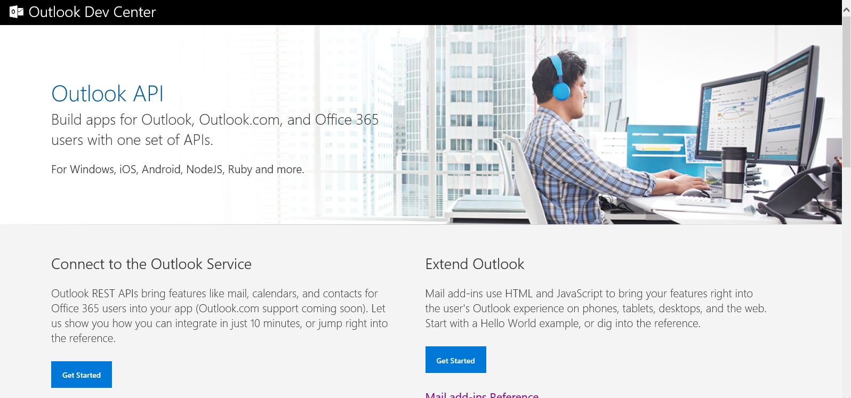
http://dev.outlook.com

Slide 32
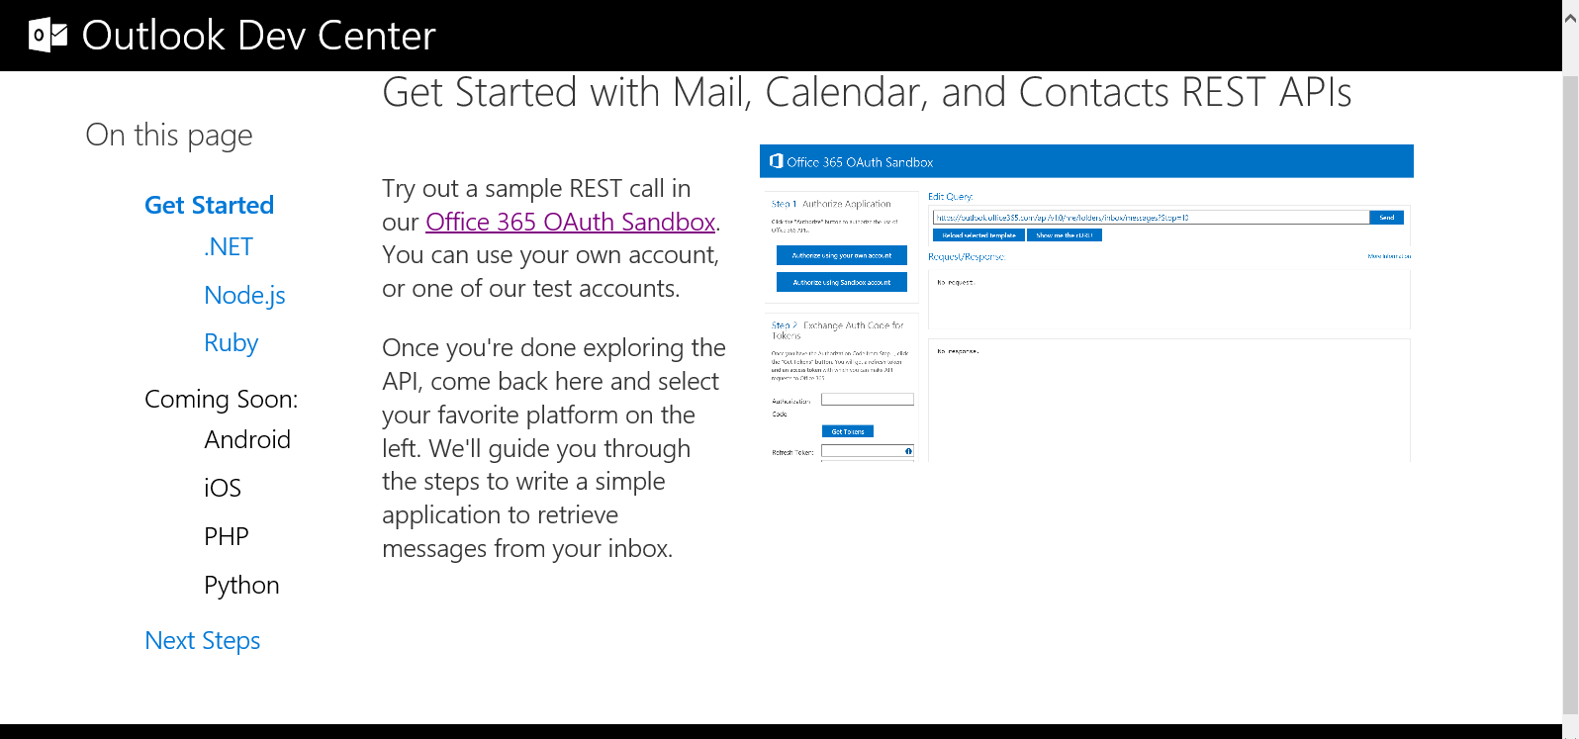
Get Started

Slide 33
Demo
Getting Started
Office 365 OAuth Sandbox
Get Started - .NET

Slide 34
Best practices
Provide instrumentation in your app
  Add header info like “user-agent”, “client-request-id”.
  Keep a failure log for troubleshooting.
  Include “client-request-id” and all HTTP response headers from the failed requests.
Tailoring requests for optimal app performance
  Use $top, $select, $filter to narrow requests.
  App performance depends on it.
  Keep your app responsive by not getting throttled - $select is your best friend!
  Be conservative with refresh requests/frequent polling
  Use exponential back off when dealing with “service unavailable” errors.

Slide 35
I am confused: REST API, EWS or EAS?

Slide 36
Roadmap
Enable end to end scenarios – web & mobile focus
  71% of work will done by web based, mobile apps by 2020
Features planned for 2015
  Contact pictures, pictures of other users in the organization
  Batching
  Custom properties and entities
  Sync mail and contacts
  Olson time zone support
  Free/busy & meeting suggestions
  Mail tips, OOF settings
  Delegate scenarios
Build once, use everywhere …
  Outlook.com – REST API + OAuth 2.0 support (2015)
  Hybrid Exchange deployments – REST API + OAuth 2.0 support (2015)
  Exchange 2016 on-premises – REST API support (at RTM) + OAuth 2.0 support
  Easy-to-use endpoint discovery for Hybrid and on-premises endpoint discovery made easy for REST API apps

Slide 37
Outlook API related breakout sessions & labs
Session | Code | Time | Room
Office Development Matters, and Here's Why... | FND2202 | Mon May 4, 1:30pm | E354B
Get Your Hands Dirty with the Office 365 RESTful APIs | BRK4117 | Tue May 5, 9:00am | N228
Building Solutions and Apps That Leverage OneDrive for Business | BRK3122 | Tue May 5, 9:00am | E351
Supercharging Your Custom Solutions with Office 365 Unified API Endpoint | BRK3199 | Tue May 5, 10:45am | N231
What’s New in Active Directory Domain and Federation Services in Windows Server vNext | BRK3871 | Tue May 5, 1:30pm | E450
Light Up Mobile Apps with the Office 365 APIs | BRK3157 | Tue May5, 5:00pm | N229
Office 365 Groups Deep Dive | BRK3114 | Tue May 5, 5:00pm | E253
Building Solutions with Office Graph | BRK3193 | Tue May 5, 5:00pm | N227
Extending Microsoft Office 365 Visibility, Security and Compliance: Office 365 Management APIs | BRK2180 | Wed May 6, 9:00am | N231
Build an Add-in for Outlook.com, Outlook and Office 365 That Reaches Over 400 Million Users! | BRK3156 | Wed May 6, 1:30pm | N228
Building Office 365 Apps with Xamarin | BRK3342 | Fri May 8, 9:00am | S105D
Overview of Office 365 Development | Lab

Slide 38
Developer Program Launch
1 YEAR FREE
E-mail
Newsletters
Free Developer Subscription
Free
Training
Free
Tools
Webinars
http://dev.office.com/devprogram

Slide 39
Call to action
Sign up for
Developer Program
Check out the
express talks
Collect your
stickers at //ignite

Slide 40
In review – session objectives and takeaways
Session objectives
  Why are Office 365 REST APIs important?
  Deep dive into the APIs
  Best practices
  Compare with existing APIs like Exchange Web Services (EWS)
  Sneak-peek into what is coming
Key takeaways
  APIs that allow you to create end-to-end Office 365 apps with targeted scopes TODAY
  Lightweight and quick to learn and develop
  Work planned to make this THE API for Office 365, outlook.com, Exchange hybrid & on-premises.

Slide 41


Please evaluate this session
Your feedback is important to us!
Visit Myignite at http://myignite.microsoft.com
or download and use the Ignite Mobile App
with the QR code above.

