Slide 2
Tame Your Inbox: Clutter in Office 365
BRK3149
Kumar Venkateswar

Slide 3
Agenda
What is Clutter?
How does it work?
How do users control it?
How do admins control it?
What is the result?
What comes next?

Slide 4
What is Clutter?

Slide 5
The User Dilemma
The average IW spends almost 50% of their week managing email and searching for information
62% of IWs can’t use information effectively for decision-making
Source: International Data Corporation (IDC); McKinsey Global Institute Analysis
Source: “Three Gaps for Employee Productivity and What They Mean for IT,” CEB Survey, April 2013.

Slide 6
Clutter helps manage email
With today’s constant rush of data, people sometimes miss the things they care about.
By learning your email habits and interests continuously, Clutter helps you prioritize what’s important to you by decluttering your inbox.

Slide 7
What is “Clutter”?
Mail you are highly likely not going to read right now
Patterns learned based on your personal behavior
No universal view of a given sender or message, unlike junk

Slide 8
Target Users for Clutter
Information Workers
Consumers receive large volumes of well known “types”
At work patterns are often unique to industry, company, and/or job
High Volume
For users that are “overwhelmed” by email volume
Not for users with comprehensive rules
Ultimately – You Decide
System will proactively enable users it believes will benefit
But, all users (and admins on their behalf) are able to enable/disable

Slide 9
What do users say?
“It's almost perfect out of the box. Nice.”
“I love opening up my inbox and only seeing a few messages!”
“Perfect for items that I rarely read, but still want!”
“It works like a charm - saves me at least 20 minutes in a day! “
“Excellent time-saving, efficiency-improving enhancement to my O365/Outlook experience.....and it gets better and smarter as it learns what is of importance (or not) to me.”
“Clutter is a life saver. It helps me focus on the important items in my Inbox.”

Slide 10
How does Clutter work?

Slide 11
How it works
Who Sent It?
Was it high importance?
Are you on the to line?
Training
Your actions teach the personalized model
Mail Content
Learning Summary
(Weights and threshold)
Analysis
Did you read it?
Did you reply to it?
Actions
Who Sent It?
Was it high importance?
Are you on the to line?
Mail Content
Classification
Applying that learning
Analysis
Clutter score (compared to threshold)
Will you treat the mail like clutter?
Learning Summary
(Weights)

Slide 12
Bayesian Probit Regression Model
Seed
Feature
Weights
w_{m} prior
w_{p} prior
Gaussian
Gamma
Daily Online Training:
Train on new user e-mails older than a fixed period of time (e.g. 1 week).
Compute e-mail features x.
Observe y by looking at action the user actually took.
Infer new weights w for each feature using current weights as priors.
w_{m}
w_{p}
User
Mailbox
Personal
Feature
Weights
Gaussian
E-mail
Message
w
x
Weight
Product
Sum
Classification:
Compute features x for each e-mail.
Use weights w learned for each user to date.
Infer y for each e-mail.
w_{m} : weight mean
w_{p} : weight precision
w : weight
t : score
x : feature data
y : label
noise
Gaussian
t
t $>0$
y

Slide 13
Per User Precision/Recall & Threshold
Good Experience:
Precision > 85
Recall > 50
Resulting Personal
Threshold Range:
46 – 91
Clutter will choose a threshold in the shaded zone

Slide 14
How do users control Clutter?

Slide 15
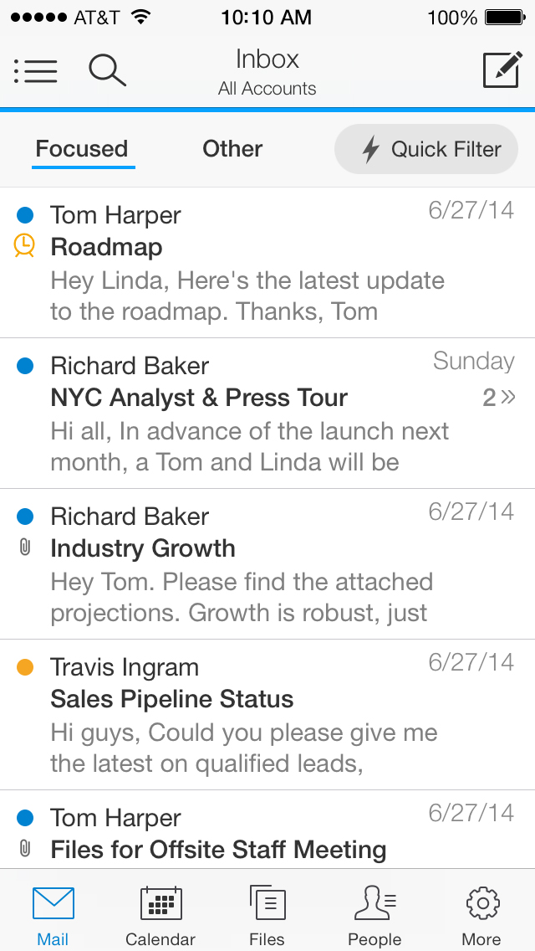
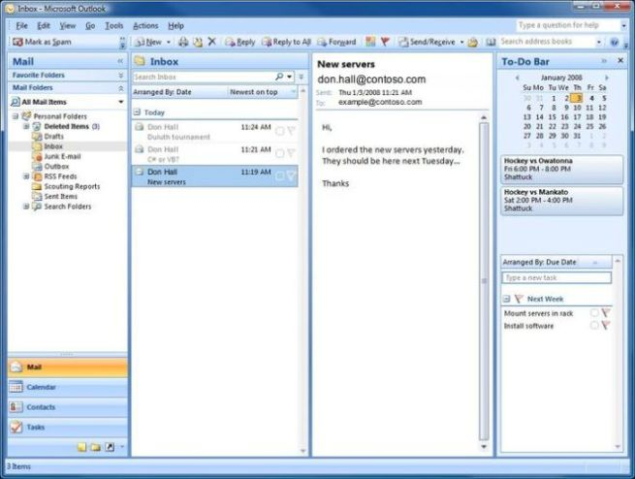
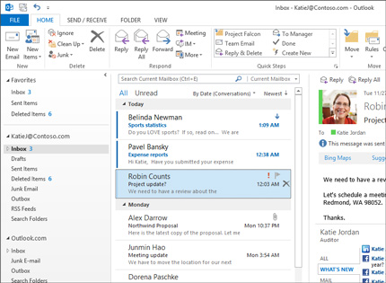
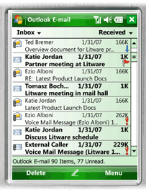
Backward Compatibility
One of the primary design goals for Clutter is compatibility with all email clients, in any version
How does this change the user experience?

Slide 16
Sorting and User Signals
Since folders are compatible with all clients, the clutter folder is where the clutter goes
Users can move messages to the inbox or clutter folder (in any client) to let the system know what they consider clutter

Slide 17
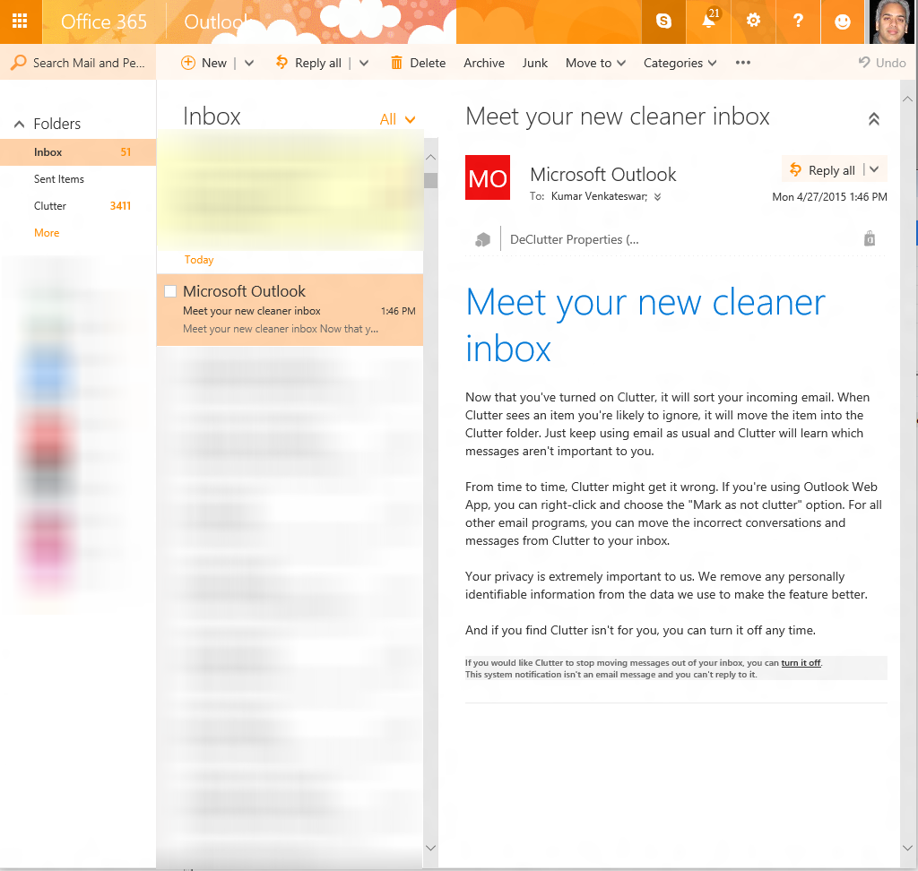
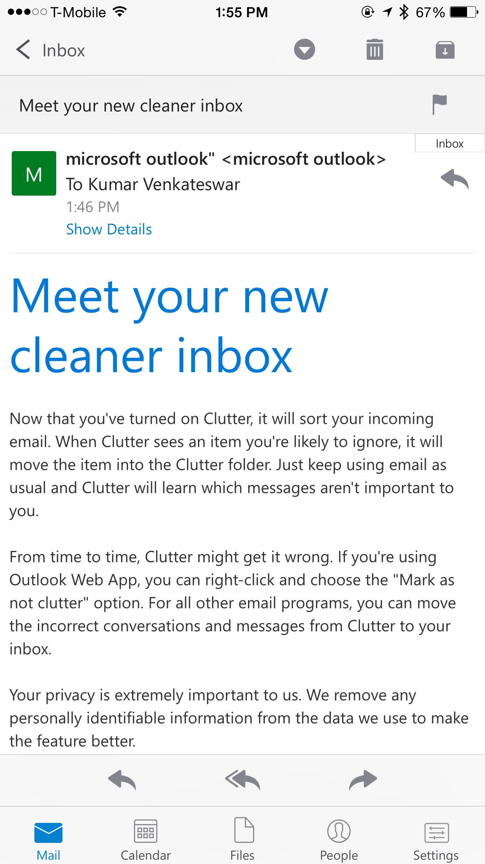
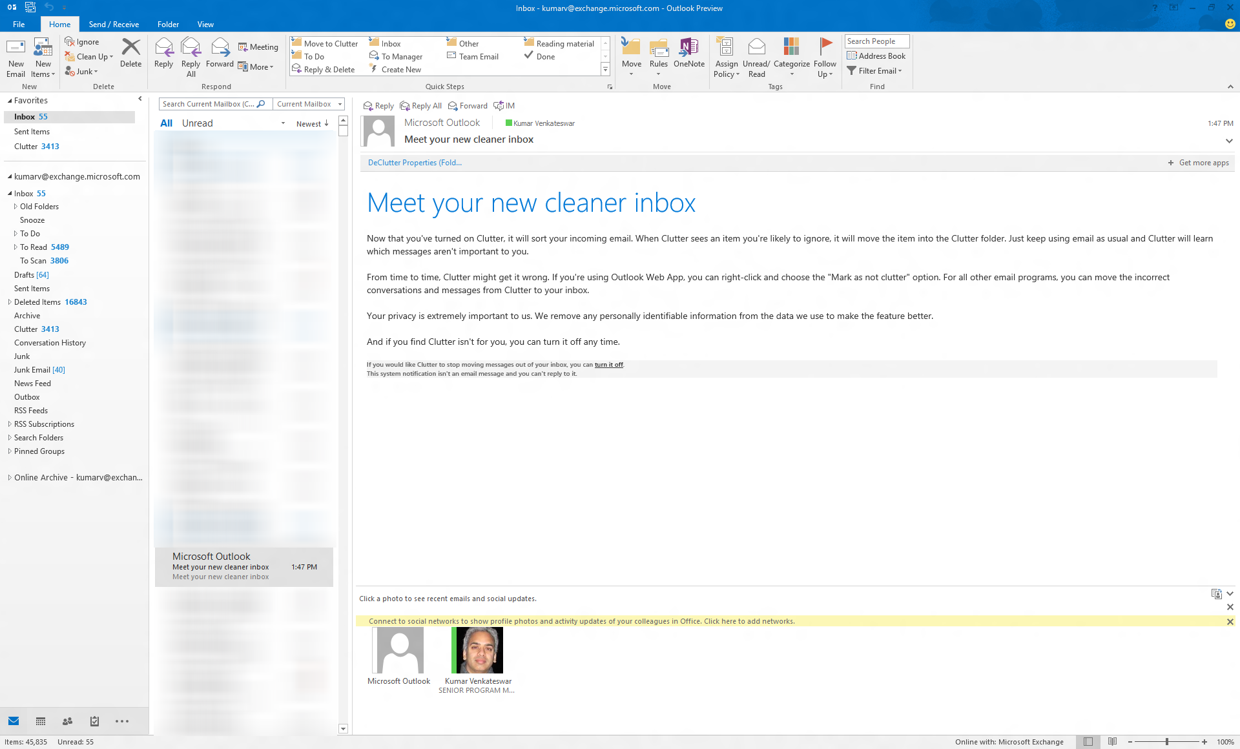
User notifications
Since inbox notifications are compatible with all clients, Clutter uses these
Users using non-web clients can use the links to provide feedback, turn Clutter off, or perform other actions

Slide 18
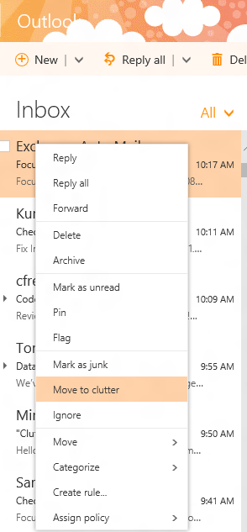
Premium client features
Right-click menus and quick steps for managing Clutter more easily
Popouts to provide in-context help with Clutter

Slide 19
Demo of User Controls
Kumar Venkateswar

Slide 20
How do admins control Clutter?

Slide 21
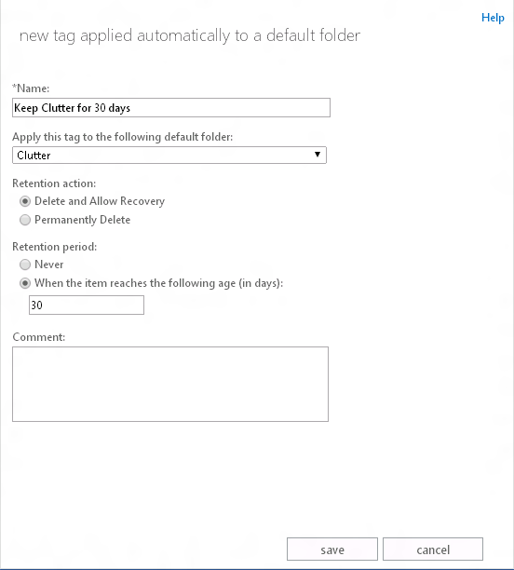
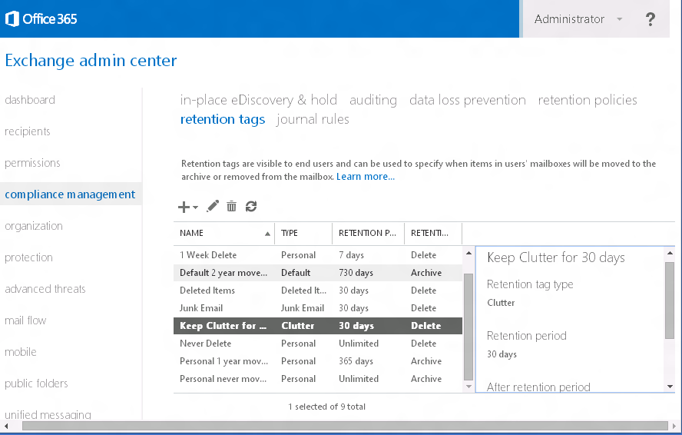
Retention Tag
The clutter folder now allows the creation of retention tags

Slide 22
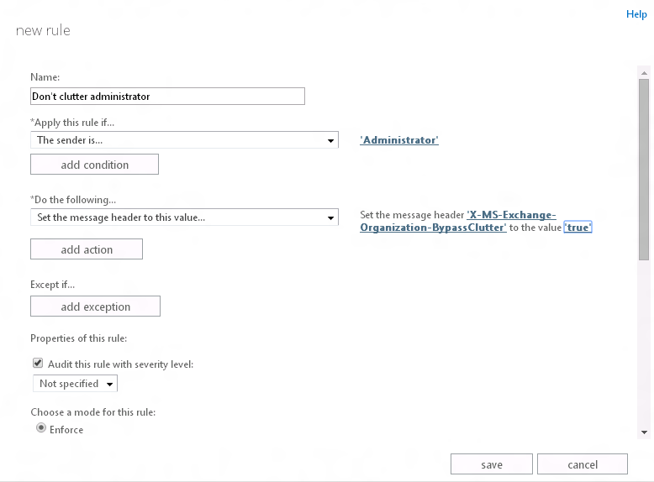
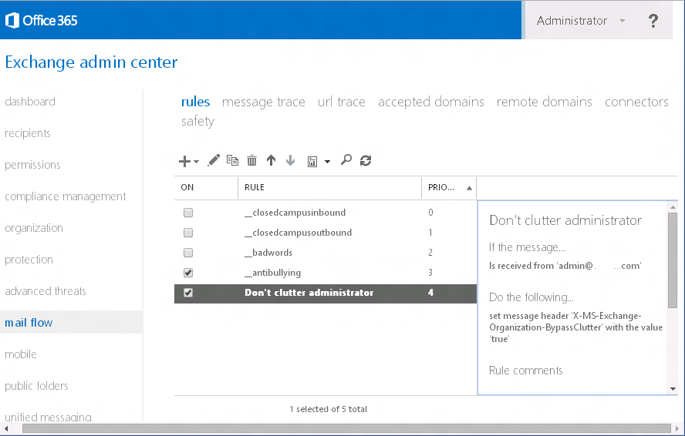
Clutter bypass
Essential organizational communication (legal, HR, leadership, etc.) can bypass Clutter processing

Slide 23
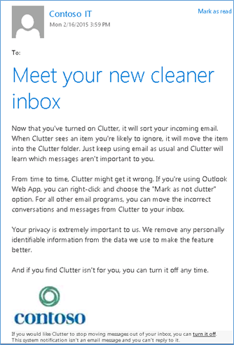
Notification branding
Notifications to end users can be custom branded
Display Name
Logo
Reply-To address (coming soon)

Slide 24
Demo of Notification Branding
Kumar Venkateswar

Slide 25
What is the result?

Slide 26
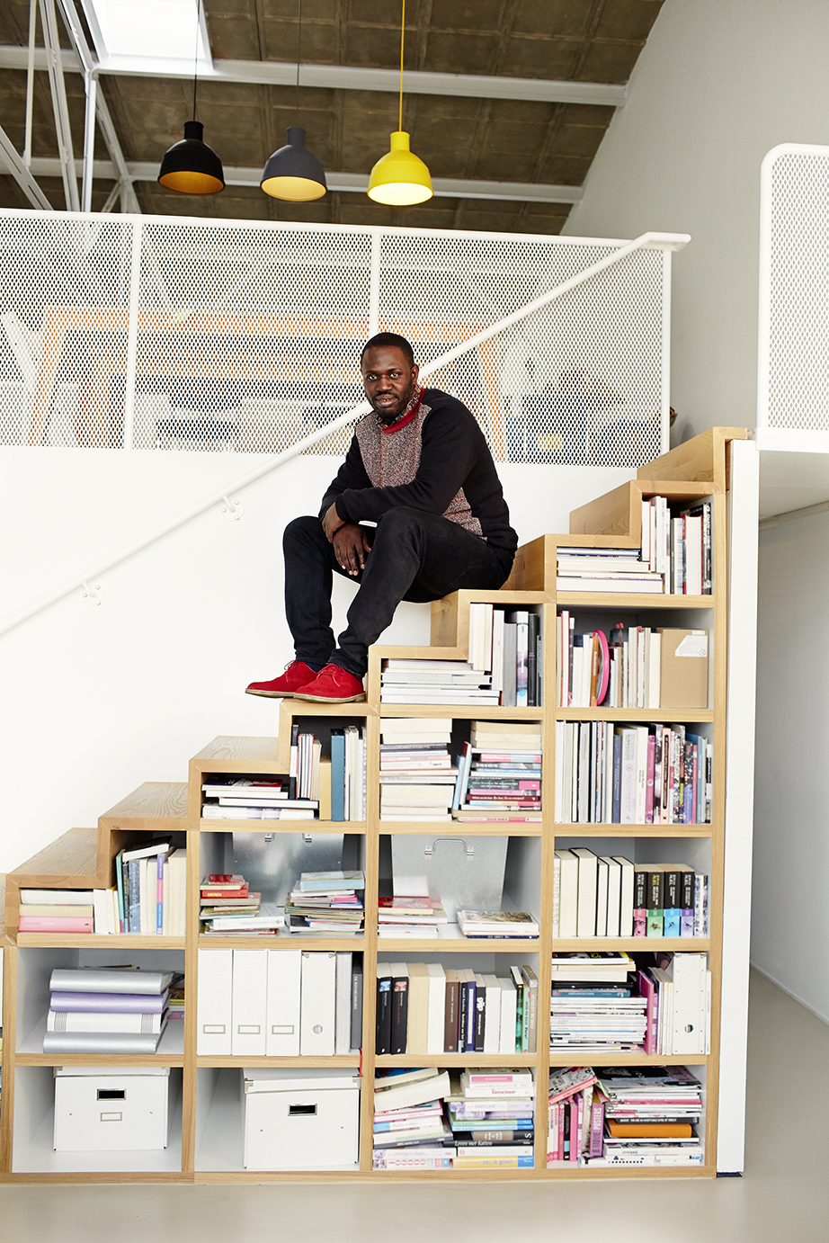
Office 365 decluttered!
Millions of clutter emails per day
Non-English language support rolling out
82 minutes saved per month on average per Clutter-enabled user
More than 168 minutes saved per month for 10% of users

Slide 27
What comes next?

Slide 28
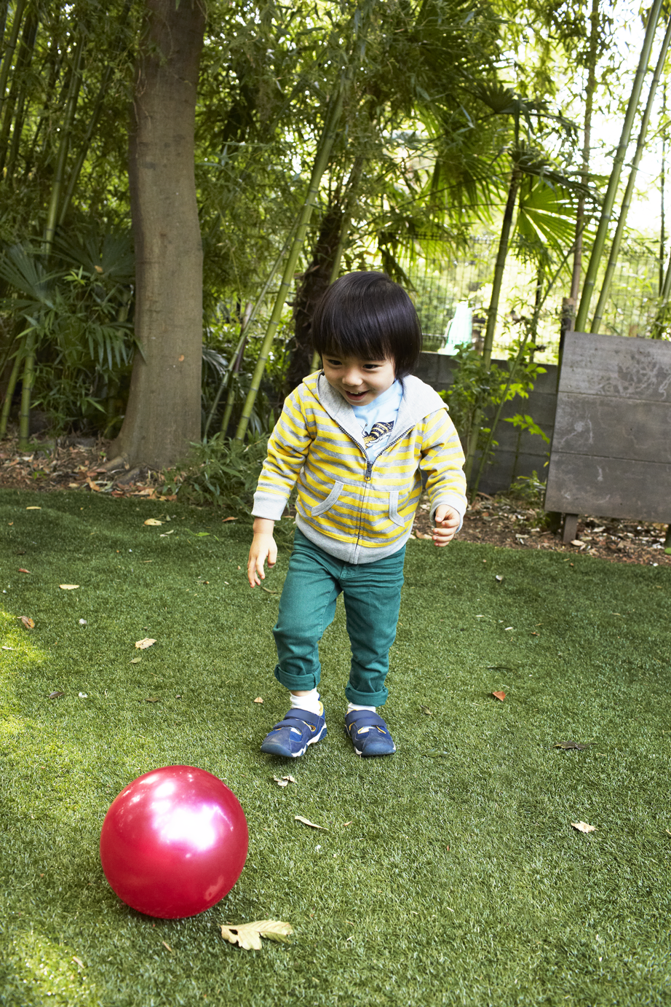
Default enablement on the way
Selected organizations and some internal Microsoft users have already been enabled by default
As a result, some changes in progress to improve the experience

Slide 29
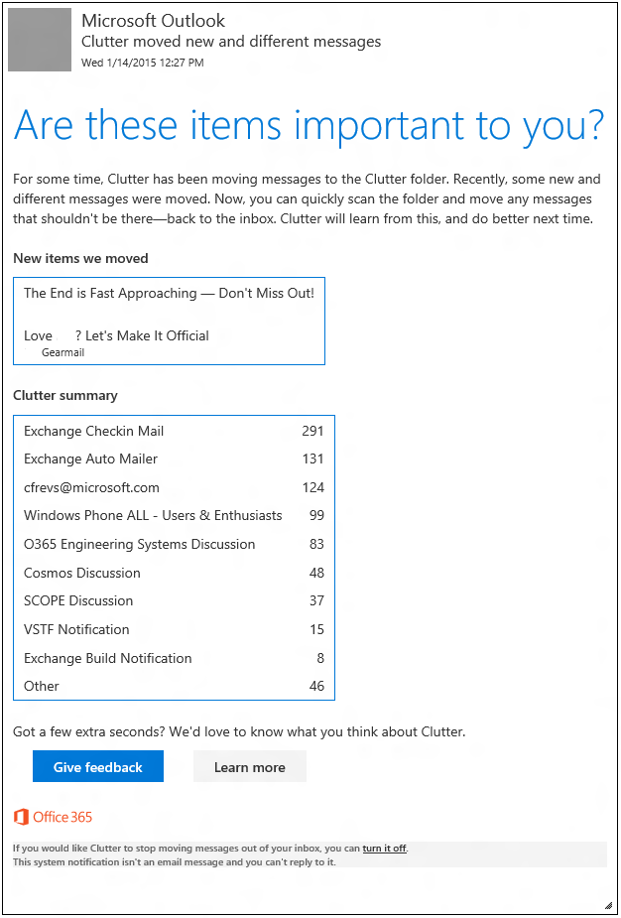
More advanced notifications on the way
Notification of new types of items in order to address rarely received items
Summary of the clutter folder for users that don’t visit the folder often
Replaces existing notifications
NOT FINAL DESIGN

Slide 30
More admin controls on the way
Get-Clutter -Identity <MailboxIdParameter> [-Credential <pscredential>] [-ResultSize <Unlimited[uint32]>] [-ReadFromDomainController] [-DomainController <Fqdn>] [-ProxyToMailbox <MailboxIdParameter>] [-ProxyToServer string>] [<CommonParameters>]
Set-Clutter -Identity <MailboxIdParameter> [-Enable <bool>] [-Credential <pscredential>] [-ResultSize <Unlimited[uint32]>] [-ReadFromDomainController] [-DomainController <Fqdn>] [-ProxyToMailbox <MailboxIdParameter>] [-ProxyToServer <string>] [<CommonParameters>]
Get-Mailbox | ?{-not (Get-Clutter -Identity $_.Alias).IsEnabled} | %{Set-Clutter -Identity $_.Alias -Enable $false}
Administrators can easily disable Clutter for users that have not enabled it already, to more gradually increase the number of Clutter users:

Slide 31
Demo of Admin Control
Kumar Venkateswar

Slide 32
Takeaways
Clutter greatly benefits end user productivity measurably
Default enablement coming soon Make sure to be prepared in terms of user education, notification branding, etc.

Slide 33
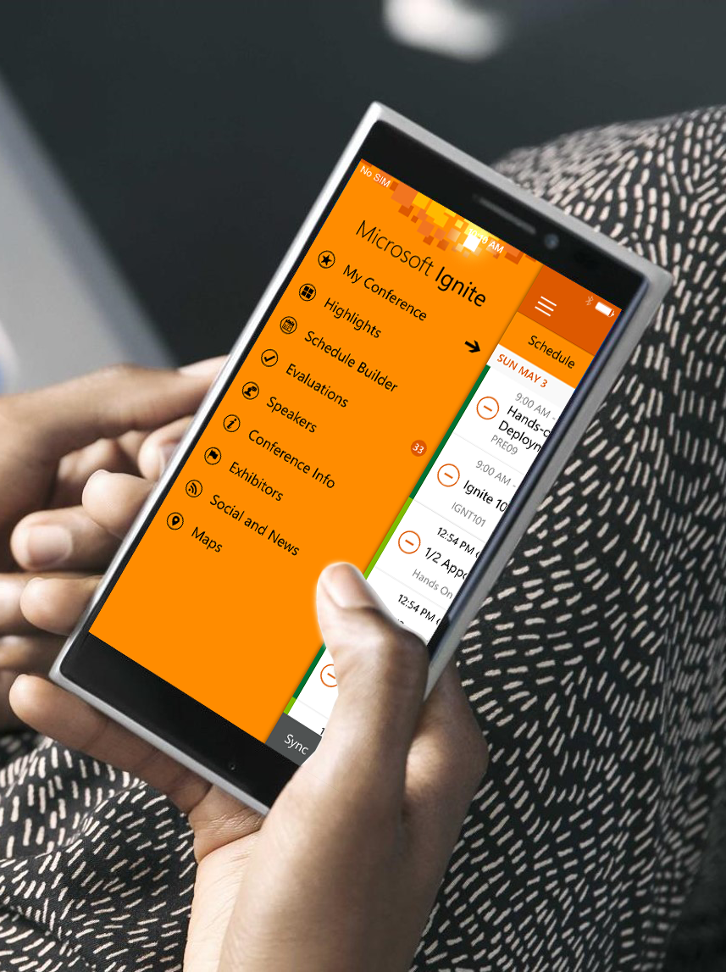
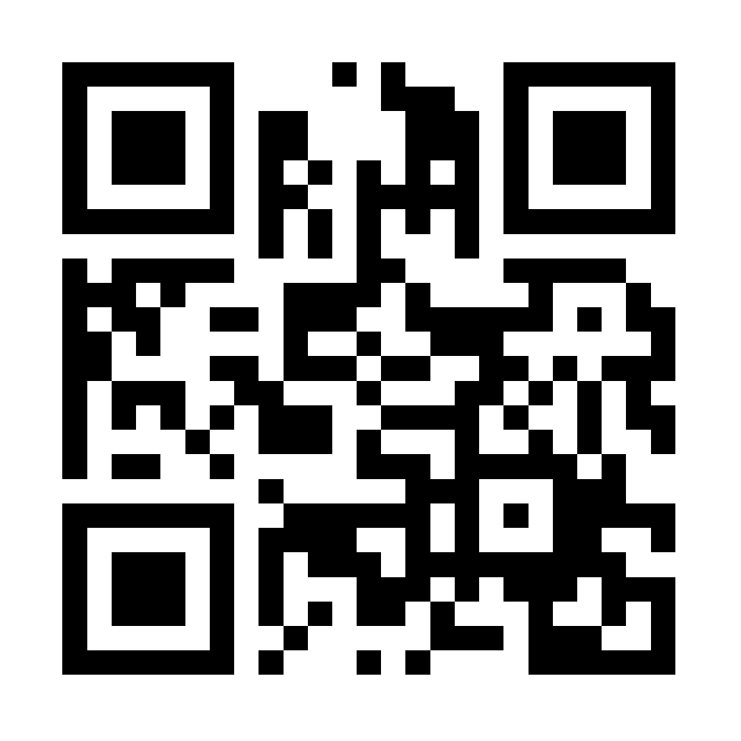
Please evaluate this session
Your feedback is important to us!
Visit Myignite at http://myignite.microsoft.com or download and use the Ignite Mobile App with the QR code above.

