Slide 2
Light Up Mobile Apps with the Office 365 APIs
BRK3157
Richard diZerega
@richdizz
http://www.richdizz.com

Slide 3
Session Objectives and Takeaways
Session Objective(s)
  Explore development options for building Office 365-enabled mobile applications
  Demonstrate patterns for authentication, discovery, and operations across mobile SDKs
  Investigate key decision criteria for selecting a development platform and APIs
  Illustrate key differences in building native vs. cross-platform mobile apps
Key Takeaway(s)
  The Office 365 APIs provide a consistent pattern for building Office 365-enabled mobile applications
  Developer SDKs and REST options exist across all the major mobile platforms (Windows, iOS, Android)
  Visual Studio provides the best experience for Office 365 development, but open platform is key pillar

Slide 4
Developer vision
USERS
DATA
HTML

Slide 5
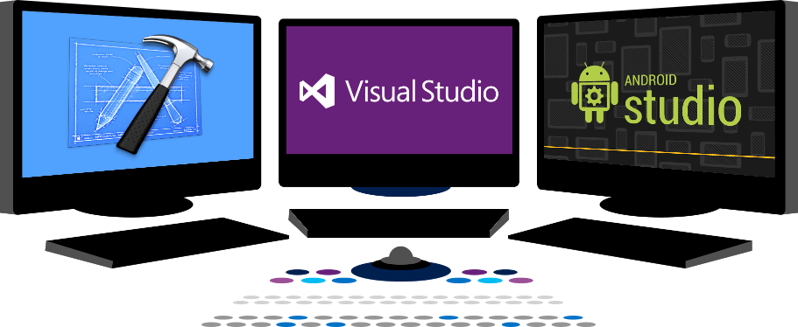














Office 365 Developer Vision
EXTEND OFFICE
EVERYWHERE
CONNECT TO
OFFICE 365 SERVICES
BUILD USING
AN OPEN PLATFORM
Delve
z
Users and
groups
Files
Mail
Calendar
My Apps
Video Portal
Contacts
Office Graph
Presentations
Documents
Spreadsheets
Lync
OneNote
Yammer

Slide 6
Mobile Platform Decision Tree

Slide 7
Office 365 APIs
What are they?
  Simple REST/OData Service APIs
  Many are wrapped in strongly-typed SDKs (SharePoint, Exchange, Azure AD)
  Part of Azure AD Common Consent Framework
  Leverages Azure AD OAuth
  Supports both delegated and application permissions
Launch Services
  MyFiles (OneDrive for Business)
  Sites (SharePoint Online)
  Calendar (Exchange Online)
  Contacts (Exchange Online)
  Mail (Exchange Online)
  Users/Groups (Azure AD)
NEW Services
  OneNote with Office 365
  User Profiles (SharePoint Online)
  Managed Metadata (SharePoint Online)
  Video Portals
  Office 365 Groups
  Office Graph
Not limited to Office 365
  Power BI
  Dynamics CRM Online
  3rd Party Applications/Services
  Your Own Applications/Services

Slide 8
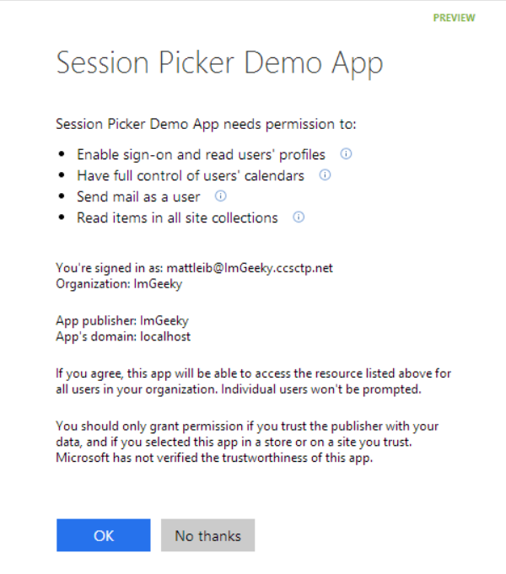
Azure AD OAuth in Office 365
Single authentication flow
  Across all Office 365 services
  Device apps and web sites
  Admin and end-user consent
Secure protocol
  OAuth 2.0 (no capturing user credentials)
  Fine-grained access scopes
  Supports MFA and federated user sign-in
  Long-term access through refresh tokens
Unique Considerations of “Native” Azure Apps
  Inherently multi-tenant
  No client/app secret (think about distribution)
  Leverage a web authentication broker (via ADAL)
  No application-only permissions (can go through proxy service)

Slide 9
Native Mobile Apps

Slide 10
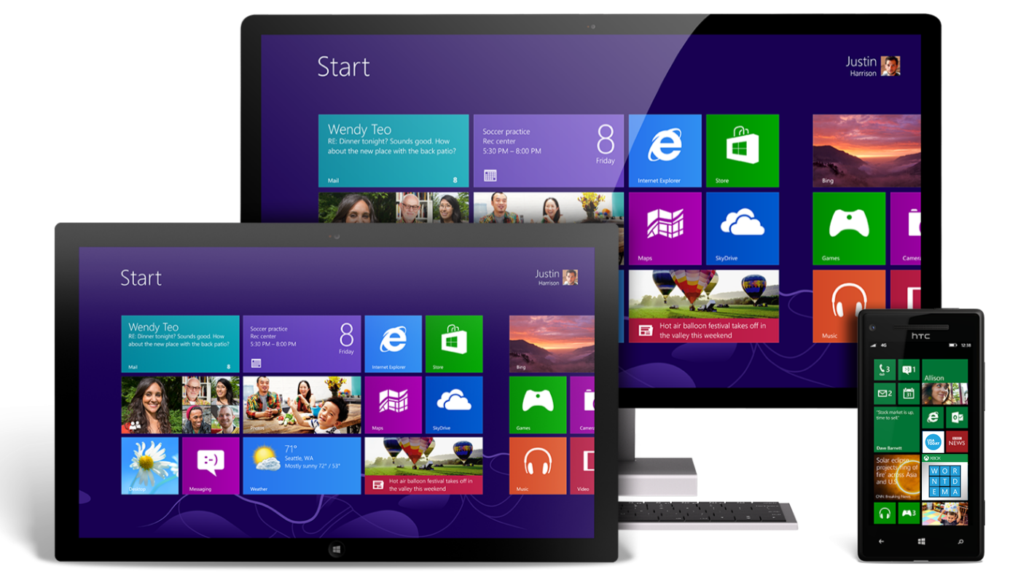
Universal Windows Apps
About
  Build application that runs across Windows Phones, tablets and PCs
  Introduced at //build 2014 for Windows 8.1 and Windows Phone 8.1
  Windows 10 realizes the convergence of Phone and PC
Development
  IDE: Visual Studio 2013 w/ Update 2+ and Windows Phone SDK
  App Registration: Add Connected Service Wizard
  SDK Integration: Add Connected Service Wizard
When to use
  Target device footprint is exclusively Windows
  Application needs unique device-specific capabilities
  Complex/Advanced user experience or visualizations
  Applications with strict enterprise requirements

Slide 11
Universal Windows Apps
Solution Structure
  8.1 projects contains 3 projects (Windows, Windows Phone, Shared)
  Shared Project contains no references (uses device-specific references)
  Windows 10 solutions are truly universal
Debugging
  Debug one device project at a time (set manually or active project)
  Template allow debugging against emulators or physical devices
Additional Tips
  Add connected service to BOTH device projects (8.1 only)
  Leverage partial classes on forms and device-specific switches as needed (ex: #if Windows_Phone_App and #if Windows_App)
  Web Authentication Broker is one example where code will differ
  Windows 10 can leverage token broker

Slide 12
Demo
Universal App Development with Office 365

Slide 13

Android
About
  Open source Office 365 SDK for Android by MS Open Tech (3/2014)
  Available on GitHub (http://bit.ly/14JCgWZ)
  Also requires ADAL for Android (http://bit.ly/1E7IfSi)
Development
  IDE: Android Studio (or Eclipse)
  App Registration: Azure Management Portal
  SDK Integration: build.gradle (similar to NuGet for dependencies)
When to use
  Target device footprint is exclusively Android
  Application needs unique device-specific capabilities
  Complex/Advanced user experience or visualizations

Slide 14
Android
Solution Structure
  Form design (UI) is defined in .XML files (app\src\main\res\layout)
  Form logic is defined in .java files deriving from Activity
  Build.gradle references dependencies
  AndroidManiest.xml is the app configuration file
Debugging
  Debug apps with emulators (warning: SLOW) or Android device
  Consider Genymotion emulators that install separate from IDE
  Visual Studio 2015 Emulator
Additional Tips
  Make sure you give the app permission to use the internet (in AndroidManifest.xml)
  Controls aren’t automatically referenced in form logic (must use findViewById)

Slide 15
Demo
Android Development with Office 365 in Android Studio

Slide 16

iOS
About
  Open source Office 365 SDK for iOS by MS Open Tech (10/2014)
  Available on GitHub (http://bit.ly/155NpCI)
  Also requires ADAL for iOS (http://bit.ly/1u9Mexa)
  Apple does not permit compilation of iOS apps without Mac
Development
  IDE: Mac and XCode (Objective C or Swift)
  App Registration: Azure Management Portal
  SDK Integration: Cocoapods or manual build/copy
When to use
  Target device footprint is exclusively iOS
  Application needs unique device-specific capabilities
  Complex/Advanced user experience or visualizations

Slide 17
iOS
Solution Structure
  Form design (UI) is defined in .storyboard files and logic is defined in view controllers
  References can be in the form of static libraries (.a) or frameworks (.framework), which include header files
  ADAL for iOS is a static library and the Office 365 SDK for iOS is a framework
Debugging
  XCode includes a really nice iOS emulator for debugging
  Registered Apple Developers ($99) can debug on physical iOS devices
Additional Tips
  Combine ADAL builds for emulator and physical device
  Use bridging header files for Objective-C references in Swift projects
  Println and Watch Expressions are really helpful tools for noobs

Slide 18
Demo
iOS Development with Office 365 in XCode

Slide 19
Cross-Platform Mobile Apps

Slide 20

Apache Cordova
About
  Platform for developing mobile apps with HTML, CSS and JavaScript
  Open source collection of JavaScript that abstracts device-specific APIs
  All web assets are copied local to the device and run “Chromeless”
  Foundation for PhoneGap, AppBuilder, Ionic, etc
Development
  IDE: Visual Studio 2013 w/ Update 4 and VS Tools for Cordova CTP3*
  App Registration: Add Connected Service Wizard
  SDK Integration: Add Connected Service Wizard
When to use
  Multi-tenant apps or apps that target multiple mobile platforms
  Developers are skilled in web development (HTML, CSS, JavaScript)
  Licensing costs prohibit other cross-platform frameworks

Slide 21
Apache Cordova
Solution Structure
  Office 365 assets installed under /services/office365
  Settings.js defines app details (client id, app redirect, etc)
  o365Loader.js dynamically adds Office 365 SDK references to pages
Debugging
  Debug in Ripple (in-browser emulator), emulators, or physical devices
  Debug iOS w/ remote Mac (can use emulator or remote/local device)
Additional Tips
  Numerous Cordova plug-ins exist for rich device integration (Custom with Git)
  Use NuGet to reference additional packages (Bootstrap, Angular, etc)
  Cordova renders HTML…no native controls (w/o additional references)

Slide 22
Demo
Cordova Development with Office 365

Slide 23

Xamarin
About
  Xamarin is a Company (ISV) and Development Platform (Licensed)
  Development based on .NET and complies to native platforms (Mono)
  Xamarin provides up-to-date versions of .NET for iOS and Android
Development
  IDE: Visual Studio 2013 with Xamarin Studio*
  App Registration: Add Connected Service Wizard
  SDK Integration: Add Connected Service Wizard
When to use
  Multi-tenant apps or apps that target multiple mobile platforms
  Development shop looking to leverage existing skills in C# and .NET
  Want cross-platform with a native UX feel (ie – native controls)
  Want cross-platform with full access to device capabilities

Slide 24
Xamarin
Solution Structure
  Xamrin project templates for device-specific platforms or shared
  Shared projects use shared portable libraries and device-specific projects (similar to Universal Windows Apps)
  Xamarin.Forms allows UI layouts to be shared but render native controls across Android, iOS and Windows (can also use native layouts)
Debugging
  Debug Android/Windows with emulators or physical devices
  Debug iOS w/ remote Mac and Xamarin.iOS (can use emulator or remote/local device)
Additional Tips
  Xamarin binding project allow ADAL/SDK references
  ADAL v3 can help with binding challenges

Slide 25
Demo
Xamarin Development with Office 365

Slide 26
Session Objectives and Takeaways
Session Objective(s)
  Explore development options for building Office 365-enabled mobile applications
  Demonstrate patterns for authentication, discovery, and operations across mobile SDKs
  Investigate key decision criteria for selecting a development platform and APIs
  Illustrate key differences in building native vs. cross-platform mobile apps
Key Takeaway(s)
  The Office 365 APIs provide a consistent pattern for building Office 365-enabled mobile applications
  Developer SDKs and REST options exist across all the major mobile platforms (Windows, iOS, Android)
  Visual Studio provides the best experience for Office 365 development, but open platform is key pillar

Slide 27
Questions???

Slide 28
Developer Program Launch
1 YEAR FREE
E-mail
Newsletters
Free Developer Subscription
Free
Training
Free
Tools
Webinars
http://dev.office.com/devprogram

Slide 29
Call to action
Sign up for
Developer Program
Check out the
express talks
Collect your
stickers at //build

Slide 30


Please evaluate this session
Your feedback is important to us!
Visit Myignite at http://myignite.microsoft.com
or download and use the Ignite Mobile App
with the QR code above.

