Slide 2
Mail Flow and Transport Deep Dive
BRK3160
Khushru Irani
Program Manager
Transport Team, O365

Slide 3
Session Objectives And Takeaways
Exchange 2010 vs. Exchange 2016 transport
Transport components shipping with Exchange 2016
Mail Routing Scenarios
Transport High Availability
Mail flow in Office 365

Slide 4
Exchange 2010 vs. Exchange 2016 transport

Slide 5





Mail Delivery Overview
Exchange 2010
Internet
SMTP
HUB
HUB
Site A
Site B
DAG
MBX
Site Boundary

Slide 6
Mail Delivery Overview
Exchange 2010
Internet
SMTP
HUB
HUB
Site A
Site B
MAPI
DAG
MBX
Site Boundary

Slide 7
Mail Delivery Overview
Exchange 2010
Internet
SMTP
HUB
HUB
Site A
Site B
DAG
MBX
Site Boundary

Slide 8
Mail Delivery Overview
Exchange 2010
Internet
SMTP
HUB
HUB
SMTP
Site A
Site B
DAG
MBX
Site Boundary

Slide 9
Mail Delivery Overview
Exchange 2010
Internet
SMTP
HUB
HUB
SMTP
Site A
Site B
MAPI
DAG
MBX
Site Boundary

Slide 10
Mail Delivery Overview
Exchange 2010
Internet
SMTP
SMTP
HUB
HUB
SMTP
Site A
Site B
MAPI
DAG
MBX
Site Boundary

Slide 11
Mail Delivery Overview
Exchange 2010
Exchange 2016
Internet
Internet
SMTP
SMTP
SMTP
Site A
Site B
DAG
HUB
HUB
SMTP
Frontend Transport
Frontend Transport
Site A
Site B
MAPI
DAG
Transport
Transport
MBX
Mailbox Transport
Mailbox Transport
Site Boundary
MBX
Site Boundary

Slide 12
Mail Delivery Overview
Exchange 2010
Exchange 2016
Internet
Internet
SMTP
SMTP
SMTP
SMTP
Site A
Site B
DAG
HUB
HUB
SMTP
Frontend Transport
Frontend Transport
Site A
Site B
MAPI
SMTP
DAG
Transport
Transport
MBX
Mailbox Transport
Mailbox Transport
Site Boundary
MBX
Site Boundary

Slide 13
Mail Delivery Overview
Exchange 2010
Exchange 2016
Internet
Internet
SMTP
SMTP
SMTP
SMTP
Site A
Site B
DAG
HUB
HUB
SMTP
Frontend Transport
Frontend Transport
Site A
Site B
MAPI
SMTP
DAG
Transport
SMTP
Transport
MBX
Mailbox Transport
Mailbox Transport
MAPI
Site Boundary
MBX
Site Boundary

Slide 14
Mail Delivery Overview
Exchange 2010
Exchange 2016
Internet
Internet
SMTP
SMTP
SMTP
SMTP
Site A
Site B
DAG
HUB
HUB
SMTP
Frontend Transport
Frontend Transport
Site A
Site B
MAPI
SMTP
DAG
Transport
SMTP
Transport
MBX
Mailbox Transport
Mailbox Transport
MAPI
Site Boundary
MBX
Site Boundary

Slide 15
Mail Delivery Overview
Exchange 2010
Exchange 2016
Internet
Internet
SMTP
SMTP
SMTP
Site A
Site B
DAG
HUB
HUB
SMTP
Frontend Transport
Frontend Transport
Site A
Site B
MAPI
DAG
Transport
Transport
MBX
Mailbox Transport
Mailbox Transport
Site Boundary
MBX
Site Boundary

Slide 16
Mail Delivery Overview
Exchange 2010
Exchange 2016
Internet
Internet
SMTP
SMTP
SMTP
Site A
Site B
DAG
HUB
HUB
SMTP
Frontend Transport
Frontend Transport
Site A
Site B
MAPI
SMTP
DAG
Transport
Transport
MBX
Mailbox Transport
Mailbox Transport
Site Boundary
MBX
Site Boundary

Slide 17
Mail Delivery Overview
Exchange 2010
Exchange 2016
Internet
Internet
SMTP
SMTP
SMTP
Site A
Site B
DAG
HUB
HUB
SMTP
Frontend Transport
Frontend Transport
Site A
Site B
MAPI
SMTP
DAG
Transport
Transport
Mailbox Transport
SMTP
Mailbox Transport
MBX
MAPI
Site Boundary
MBX
Site Boundary

Slide 18
Mail Delivery Overview
Exchange 2010
Exchange 2016
Internet
Internet
SMTP
SMTP
SMTP
SMTP
SMTP
Site A
Site B
DAG
HUB
HUB
SMTP
Frontend Transport
Frontend Transport
Site A
Site B
MAPI
SMTP
SMTP
DAG
Transport
Transport
Mailbox Transport
SMTP
Mailbox Transport
MBX
MAPI
Site Boundary
MBX
Site Boundary

Slide 19
Mail Submission Overview
Exchange 2010
Internet
HUB
HUB
DAG
Sub
Sub
Notify
MAPI
MBX

Slide 20
Mail Submission Overview
Exchange 2010
Internet
HUB
HUB
MAPI
DAG
Sub
Sub
Notify
MAPI
MBX

Slide 21
Mail Submission Overview
Exchange 2010
Internet
SMTP
HUB
HUB
MAPI
DAG
Sub
Sub
Notify
MAPI
MBX

Slide 22
Mail Submission Overview
Exchange 2010
Exchange 2016
Internet
Internet
SMTP
DAG
HUB
HUB
Frontend Transport
Frontend Transport
MAPI
Transport
Transport
DAG
Sub
Sub
Mailbox Transport
Mailbox Transport
Notify
MAPI
MBX
MAPI
MBX

Slide 23
Mail Submission Overview
Exchange 2010
Exchange 2016
Internet
Internet
SMTP
DAG
HUB
HUB
Frontend Transport
Frontend Transport
MAPI
Transport
Transport
DAG
SMTP
Sub
Sub
Mailbox Transport
Mailbox Transport
Notify
MAPI
MBX
MAPI
MBX

Slide 24
Mail Submission Overview
Exchange 2010
Exchange 2016
Internet
Internet
SMTP
SMTP
DAG
HUB
HUB
Frontend Transport
Frontend Transport
SMTP
MAPI
Transport
Transport
DAG
SMTP
Sub
Sub
Mailbox Transport
Mailbox Transport
Notify
MAPI
MBX
MAPI
MBX

Slide 25
Transport Components in Exchange 2016

Slide 26
Transport components
Transport ships 3 major components in Exchange 2016
  Frontend Transport – Stateless SMTP service
  Transport – Stateful SMTP service
  Mailbox Transport – Stateless SMTP service
Transport responsibilities (unchanged)
  Receive and deliver all inbound mail to the organization
  Submit and deliver all outbound mail from the organization
  Perform all message processing within the pipeline
  Support extensibility within pipeline
  Keep messages redundant until successfully delivered

Slide 27
Frontend Transport
Authenticated
SMTP
Handles inbound and outbound external SMTP traffic
  (Does not replace the Edge Transport Server Role)
Listens on TCP25 and TCP587 and TCP717. Supports TLS 1.0, 1.1 and 1.2.
Handles authenticated client submissions
Functions as a layer 7 proxy and has full access to protocol conversation (inbound)
Will not queue or bifurcate mail locally
Set FrontendProxyEnabled parameter of the Set-SendConnector using Powershell to route Outbound mail via Frontend transport
Anonymous
SMTP
External SMTP
Frontend Transport
:25
:587
SMTP Receive
SMTP Send
Protocol Agents
Mailbox Selector
:717
MSExchangeFrontendTransport.exe
SMTP from Transport Service
SMTP to
Transport Service

Slide 28
Benefits of Frontend Transport
Centralized, load balanced egress/ingress point for the organization
Mailbox locator – determines the DAG to deliver the message to (prefers a Mailbox server in its own site)
Provides unified namespace, for authenticated and anonymous mailflow scenarios
Scales based on number of connections
Supports various SMTP extensibility points

Slide 29
Transport*
SMTP from Frontend Transport & Transport
SMTP to Frontend Transport & Transport
Processes all SMTP mail flow for
the organization
Will queue and route messages in
and out of the organization
Performs content inspection
Supports extensibility in SMTP
and categorizer
Listens on TCP2525 (since Frontend Transport is listening on TCP 25)
*previously known as Hub Transport
Transport
:2525
SMTP Receive
:2525
Protocol Agents
SMTP Send
Submission Queue
Categorizer
Delivery Queue
Routing Agents
Pickup/Replay
Delivery Agents
*other protocols
Mail.que
Delivery Queue
Edgetransport.exe
SMTP from
MBX-Transport Submission
SMTP to
MBX-Transport
Delivery

Slide 30

Transport Pipeline
SMTP Receive
On Submitted
On Resolved
On Routed
On Categorized
:2525
Protocol Agents
External Delivery Queue
Resolve
Recipients
Find Route for Recipient
Content Conversion
& Bifurcation
Internal Delivery Queue
SMTP Send
Submission Queue
Categorizer
Mailbox Delivery Queue
Mail.que
All incoming mail is stored in the mail.que database
All mail passes through the various stages of the categorizer
There is exactly one submission queue but multiple delivery queues (one per destination)
Agents subscribe to various events along the pipeline – Transport rules agent; Journaling agent; Malware agent; 3rd party agents

Slide 31
Benefits of Transport
Performs all routing decisions for internal and external messages
Provides an extensibility platform for third-party agents to operate within the pipeline
Allows messages to be routed in or out through connectors for special handling
Protects messages by making messages highly available on ‘shadow’ servers

Slide 32
Mailbox Transport
SMTP from
Transport
SMTP to
Transport
SMTP to
Transport
Handles mail submission and delivery from/to Store using two separate processes
Does not have persistent storage
Performs MIME to MAPI conversion (and vice versa)
Combines Mailbox Assistant and Store Driver functionality
  (Supports all E2010 store driver extensibility events)
Leverages local RPC for delivery to and submission from Store
Does not support any extensibility
Mailbox Transport
:475
SMTP Receive
SMTP Send
SMTP Send
Delivery
Submission
Deliver Agents
Mailbox Assistants
MSExchangeDelivery.exe
MSExchangeSubmission.exe
MAPI
MAPI
Store

Slide 33
Benefits of Mailbox Transport
Brings together all transport scenarios that access mailbox store under one component
Helps realize the “every server is an island” vision by ensuring MAPI is not used across the server
Simplifies handling of mailbox DB *over scenarios

Slide 34







Exchange 2016 Server Role Architecture
Enterprise Network
DAG1
MBX
AD
Exchange Online Protection
MBX
…
DAG3
Load Balancer
MBX
MBX
External
SMTP
servers
DAG2
MBX
MBX
…
Mobile
phone
MBX
Web
browser
MBX
…
Outlook
(remote user)
MBX
Outlook (local user)

Slide 35
Exchange 2016 Server Role Architecture
Enterprise Network
DAG1
Frontend Transport
MBX
AD
Exchange Online Protection
MBX
Frontend Transport
…
DAG3
Frontend Transport
MBX
External
SMTP
servers
Load Balancer
MBX
Frontend Transport
MBX
DAG2
Frontend Transport
Frontend Transport
…
MBX
Mobile
phone
Frontend Transport
Frontend Transport
MBX
Web
browser
MBX
…
Outlook
(remote user)
Frontend Transport
MBX
Outlook (local user)

Slide 36

Exchange 2016 Server Role Architecture
1. Email enters the organization
2. Frontend Transport accepts the mail
3. Frontend Transport determines DAG for this recipient
4. Frontend Transport sends mail to a MBX server in the recipients DAG [prefers MBX server in its own site]
5. Transport service receives mail & delivers to MBX transport
Enterprise Network
DAG1
MBX
1
AD
Exchange Online Protection
3
MBX
Frontend Transport
2
…
DAG3
4
MBX
Transport
External
SMTP
servers
Load Balancer
MBX
DAG2
MBX
MBX
…
Mobile
phone
5
MBX
Mailbox Transport
Web
browser
MBX
…
Outlook
(remote user)
MBX
Outlook (local user)

Slide 37
Exchange 2016 Server Role Architecture
Edge Transport 2016
Used in perimeter network (non-domain joined) to accept mail
Same feature set as Edge role in 2010
New monitoring framework (like rest of Exchange 2013)
No AV; basic Anti-spam features; No Shadow copy
Client submission traffic doesn’t use Edge
Enterprise Network
DAG1
MBX
AD
Exchange Online Protection
Edge Transport
MBX
…
DAG3
Load Balancer
MBX
MBX
External
SMTP
servers
DAG2
MBX
MBX
…
Mobile
phone
MBX
Web
browser
MBX
…
Outlook
(remote user)
MBX
Outlook (local user)

Slide 38
Mail routing scenarios

Slide 39
Mail routing scenarios
Scenario 1 – Incoming mail on a single mailbox server
Scenario 2 – Incoming mail to two recipients
Scenario 3 – Originating mail to Internet
Scenario 4 – Originating mail to multiple recipients

Slide 40
Routing Overview
Frontend Transport will attempt to anchor on a recipient
Frontend Transport will lookup recipient in AD & find a DAG that recipient belongs to
Frontend Transport will attempt to route mail to a mailbox server in that DAG (preferably in the same site as the CAS server)

Slide 41
1 – Incoming mail on multi-role server
Frontend Transport receives message on port 25
  ... looks up where recipient’s mailbox exists and routes to a Transport service within the DAG for that mailbox
Transport receives message on port 2525
  … processes it and routes it to mailbox transport delivery on server where mailbox is active
Mailbox Transport Delivery receives the message on port 475
  … converts MIME to MAPI and delivers message to Store.
Internet
DAG
Server
MBX 2016
Frontend Transport
Transport
Mailbox Transport
Store

Slide 42
Scenario 1 – Protocol flow
EHLO
250
OK
MAIL FROM
250
OK
RCPT TO
250
OK
DATA
Internet
Frontend
Transport

Slide 43
Scenario 1 – Protocol flow
EHLO
250
OK
MAIL FROM
250
OK
RCPT TO
250
OK
(
TLS Session
DATA
)
EHLO
250
OK
(EXCHANGEAUTH)
XPROXYFROM
250
OK
MAIL FROM
250
OK
Internet
Frontend
Transport
RCPT TO
250
OK
Transport
DATA
250
OK

Slide 44
Scenario 1 – Protocol flow
EHLO
250
OK
MAIL FROM
250
OK
RCPT TO
250
OK
(
TLS Session
DATA
)
EHLO
250
OK
(EXCHANGEAUTH)
XPROXYFROM
250
OK
MAIL FROM
250
OK
Internet
Frontend
Transport
RCPT TO
250
OK
Transport
DATA
250
OK
250
OK
QUIT

Slide 45
Scenario 1 – Protocol flow
EHLO
250
OK
MAIL FROM
250
OK
RCPT TO
250
OK
(
TLS Session
DATA
)
EHLO
250
OK
(EXCHANGEAUTH)
XPROXYFROM
250
OK
MAIL FROM
250
OK
Internet
Frontend
Transport
RCPT TO
250
OK
Transport
DATA
250
OK
250
OK
QUIT
QUIT

Slide 46
Scenario 1 – Protocol flow
Mailbox
Transport
Transport
(
TLS Session
)
EHLO
250
OK
(EXCHANGEAUTH)
XSESSIONSPARAMS
250
OK
MAIL FROM
250
OK
RCPT TO
250
OK
DATA
250
OK
QUIT

Slide 47
Scenario 1 – Protocol flow
EHLO
250
OK
MAIL FROM
250
OK
RCPT TO
250
OK
(
TLS Session
DATA
)
EHLO
250
OK
(EXCHANGEAUTH)
XPROXYFROM
250
OK
MAIL FROM
250
OK
Internet
Frontend
Transport
RCPT TO
Mailbox
Transport
250
OK
Transport
DATA
250
OK
250
OK
(
TLS Session
QUIT
QUIT
)
EHLO
250
OK
(EXCHANGEAUTH)
XSESSIONSPARAMS
250
OK
MAIL FROM
250
OK
RCPT TO
250
OK
DATA
250
OK
QUIT

Slide 48
Scenario 1 – Received headers
Received: from EXHV-1889.EXHV-5245dom.extest.microsoft.com
(2001:4898:e8:3050:d9f3:8ace:7a2f:900b) by
EXHV-1889.EXHV-5245dom.extest.microsoft.com
(2001:4898:e8:3050:d9f3:8ace:7a2f:900b) with Microsoft SMTP Server (TLS) id
15.0.620.3 via Mailbox Transport; Sun, 27 Jan 2013 11:50:14 -0800
Received: from EXHV-1889.EXHV-5245dom.extest.microsoft.com
(2001:4898:e8:3050:d9f3:8ace:7a2f:900b) by
EXHV-1889.EXHV-5245dom.extest.microsoft.com
(2001:4898:e8:3050:d9f3:8ace:7a2f:900b) with Microsoft SMTP Server (TLS) id
15.0.620.3; Sun, 27 Jan 2013 11:50:13 -0800
Received: from Internet (172.18.140.30) by
EXHV-1889.EXHV-5245dom.extest.microsoft.com (10.176.198.88) with Microsoft
SMTP Server (TLS) id 15.0.620.3 via Frontend Transport; Sun, 27 Jan 2013
11:50:10 -0800
Subject: Incoming mail on all-in-one role
Message-ID: <0eecd3ae-f179-4852-bb5e-4b2a371cbb2c@woodgroveSVR145.com>
From: <internetuser@woodgrove.com>

Slide 49

2 – Incoming mail to two recipients
Internet
2 Recipients
DAG
MBX 2016
MBX 2016
Frontend Transport
Frontend Transport
Transport
Transport
Mailbox Transport
Mailbox Transport
Store
Site Boundary
Store

Slide 50

3 – Originating mail to Internet
Internet
DAG
MBX 2016
MBX 2016
Frontend Transport
Frontend Transport
Transport
Transport
Mailbox Transport
Mailbox Transport
Store
Store

Slide 51
Scenario 3 – Protocol flow
(
TLS Session
)
EHLO
250
OK
(EXCHANGEAUTH)
MAIL FROM
250
OK
RCPT TO
250
OK
DATA
250
OK
Mailbox
Transport
Transport
QUIT

Slide 52
Scenario 3 – Protocol flow
Frontend
Transport
(
TLS Session
Internet
)
Transport
EHLO
XPROXYTO
250
OK
250
OK
MAIL FROM
MAIL FROM
250
OK
250
OK
RCPT TO
RCPT TO
250
OK
250
OK
DATA
DATA
250
OK
250
OK
QUIT
QUIT

Slide 53
Scenario 3 – Protocol flow
(
TLS Session
)
EHLO
250
OK
(EXCHANGEAUTH)
MAIL FROM
250
OK
RCPT TO
250
OK
DATA
250
OK
Frontend
Transport
(
QUIT
Mailbox
Transport
TLS Session
Internet
)
Transport
EHLO
XPROXYTO
250
OK
250
OK
MAIL FROM
MAIL FROM
250
OK
250
OK
RCPT TO
RCPT TO
250
OK
250
OK
DATA
DATA
250
OK
250
OK
QUIT
QUIT

Slide 54

4 – Originating mail to multiple recipients
Internet
DAG 1
DAG 2
MBX 2016
MBX 2016
MBX 2016
Frontend Transport
Frontend Transport
Frontend Transport
Transport
Transport
Transport
Mailbox Transport
Mailbox Transport
Mailbox Transport
3 Recipients
Store
Site Boundary
Store
Store

Slide 55
Transport high availability

Slide 56
Shadow Messages
Shadow is done ONLY by the Transport service
Every message is redundantly persisted (shadowed) before its receipt is acknowledged to the sender
If shadow can’t be made, Transport service will reject sender with 450 4.5.1
Transport service will first attempt to shadow to an active server in another site (but in the same DAG); after which will try to shadow to any active server in DAG
Shadow server will periodically check with the primary server for a heartbeat; if no heartbeat for 3 hours, it will send message on behalf of primary
Duplicate delivery detection present in store; in case primary resends message

Slide 57

All messages to Transport are shadowed
Internet
DAG
MBX 2016
MBX 2016
Frontend Transport
Frontend Transport
S
S
Transport
SM TP
Transport
Mailbox Transport
Mailbox Transport
Store
Store
Site Boundary

Slide 58
Safety net
Transport service redundantly store all mail for a configured time span to protect against irrecoverable mailbox failures
Now has a “shadow” equivalent and is no longer a SPOF
Consolidates and improves E2010 Transport Dumpster functionality
  Safety Net retains data for a set period of time, regardless of whether the message has been successfully replicated to all database copies or delivered to final destination
Processes replay requests by resubmitting messages from “primary” or “shadow” Safety Net for mailbox fail overs or lag restores
To see various shadow & safety net values: get-transportconfig | fl *Shadow*,*safety* [ShadowHeartbeatFrequency; ShadowResubmitTimeSpan; SafetyNetHoldTime]

Slide 59
Scenario 1 – Protocol flow
EHLO
250
OK
MAIL FROM
250
OK
RCPT TO
250
OK
(
TLS Session
DATA
)
EHLO
250
OK
(EXCHANGEAUTH)
XPROXYFROM
250
OK
MAIL FROM
250
OK
Internet
Frontend
Transport
RCPT TO
250
OK
Transport
DATA
250
OK
250
OK
QUIT
QUIT

Slide 60
Scenario 1 – Protocol flow with shadow
EHLO
250
OK
MAIL FROM
250
OK
RCPT TO
250
OK
(
TLS Session
DATA
)
EHLO
250
OK
(EXCHANGEAUTH)
XPROXYFROM
250
OK
MAIL FROM
250
OK
Internet
Frontend
Transport
RCPT TO
Transport
(MBX Svr1)
250
OK
Transport
DATA

Slide 61
Scenario 1 – Protocol flow with shadow
EHLO
250
OK
MAIL FROM
250
OK
RCPT TO
250
OK
(
TLS Session
DATA
)
EHLO
250
OK
(EXCHANGEAUTH)
XPROXYFROM
250
OK
MAIL FROM
250
OK
Internet
Frontend
Transport
RCPT TO
Transport
(MBX Svr1)
Transport
(MBX Svr2)
250
OK
Transport
DATA
(
TLS Session
)
EHLO
(EXCHANGEAUTH)
XSHADOWREQUEST
MAIL FROM
250
OK
RCPT TO
250
OK
DATA
250
OK
QUIT

Slide 62
Scenario 1 – Protocol flow with shadow
EHLO
250
OK
MAIL FROM
250
OK
RCPT TO
250
OK
(
TLS Session
DATA
)
EHLO
250
OK
(EXCHANGEAUTH)
XPROXYFROM
250
OK
MAIL FROM
250
OK
Internet
Frontend
Transport
RCPT TO
Transport
(MBX Svr1)
Transport
(MBX Svr2)
250
OK
Transport
DATA
(
TLS Session
)
EHLO
(EXCHANGEAUTH)
XSHADOWREQUEST
MAIL FROM
250
OK
RCPT TO
250
OK
DATA
250
OK
250
OK
250
OK
QUIT
QUIT
QUIT

Slide 63
Shadow Message – SMTP ‘ping’
(
TLS Session
)
EHLO
(EXCHANGEAUTH)
XSHADOW
250 OK
XQDISCARD
250 OK (MSG ID)
250 OK (MSG ID)
QUIT
Transport
(MBX Svr1)
Transport
(MBX Svr2)
(
TLS Session
)
EHLO
(EXCHANGEAUTH)
XSHADOW
250 OK
XQDISCARD
250 OK (MSG ID)
QUIT

Slide 64
Message Tracking Log
Message Delivery
Message Submission
1
3
Frontend Transport
Frontend Transport
2
2
3
2
SMTP Receive
SMTP
HARedirect
SMTP HAReceive
SMTP Send
SMTP HAReceive
SMTP
HARedirect
SMTP Send
SMTP HADiscard
SMTP Receive
SMTP HADiscard
MBX Transport
MBX Transport
Transport
Transport
Storedriver Submit
Transport
Transport
3
2
Storedriver Deliver
Storedriver Receive
3
1
Store
Store
MBX SVR 01
MBX SVR 02
MBX SVR 03
MBX SVR 01
MBX SVR 02
MBX SVR 03

Slide 65
Mail flow in Office 365

Slide 66
What’s New in Mail flow in Office 365
New Connector Wizard UI experience + Outbound connector validation support (validate your connector before you turn it ON)
  BRK3159: Using Connectors And Mail Routing
Max message size is now 150MB
  It used to be 25MB (still the default)
  Message size is configurable (it can also decreased)
  You can do this per mailbox or configure it for all new mailboxes
  http://blogs.office.com/2015/04/15/office-365-now-supports-larger-email-messages-up-to-150-mb/
Support for SMTP using TLS 1.2
  Removed support for SSL 3.0 (and in the coming months RC4)
Enhanced NDRs (more precise, better fix it steps and better looking)
  http://blogs.office.com/2015/04/17/enhanced-non-delivery-reports-ndrs-in-office-365/

Slide 67
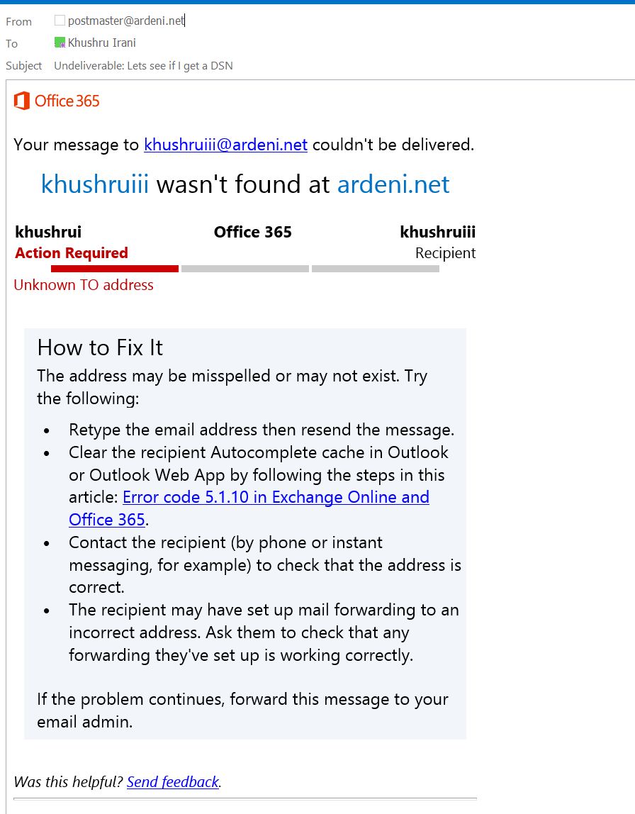
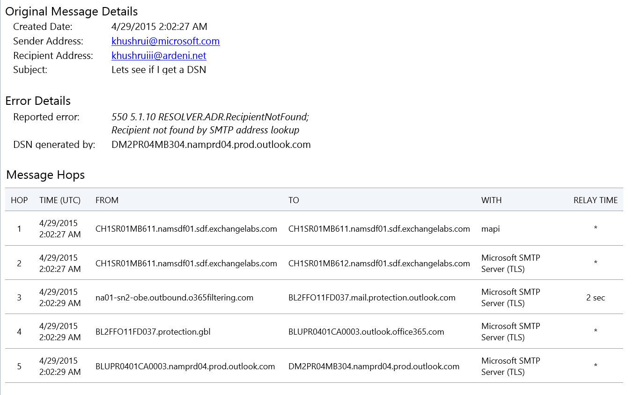
Enhanced NDRs in Office 365

Slide 68



Hybrid - Before the move to O365
MX Record
From: Bob@yahoo.com
To: John@contoso.com
Contoso.com
contoso.com MX preference = 20, mail exchanger = mail.contoso.com
contoso.com MX preference = 10, mail exchanger = mailbackup.contoso.com
mail.contoso.com internet address = 78.35.15.8
mailbackup.contoso.com internet address = 78.35.15.9

Slide 69
Hybrid
Add domain contoso.com in O365 and verify you own the domain by adding a txt record (at DNS provider)
Add users you want to host in O365
MX Record
Move MX to point to O365 (preferred method, since it avoids many issues with SPF, DKIM, DMARC, etc.)
Contoso.com
Contoso.com
contoso.com MX preference = 10, mail exchanger =
contoso-com.mail.protection.outlook.com
contoso-com.mail.protection.outlook.com internet address = 207.46.163.170
contoso-com.mail.protection.outlook.com internet address = 207.46.163.215
contoso-com.mail.protection.outlook.com internet address = 207.46.163.247
Contoso.com is registered as an accepted domain
Region based IPs

Slide 70
Hybrid – Primary reason for having connectors
You want one happy family organization
Cloud + On-premises appear as one organization (Exchange headers are retained between the two)
MX Record
Contoso.com
Contoso.com
Contoso.com is registered as an accepted domain

Slide 71
Hybrid – Connector From O365 To Your Org
MX Record
Receive Connector
(Firewall to accept mails from mail.protection.microsoft.com IPs)
Connector (Direction of mail flow)
From: O365
To: Your organization servers
(PSH: Outbound On-premise Connector)
For all Accepted domains
Point to your organization’s smarthost
Contoso.com
Contoso.com
Contoso.com is registered as an accepted domain

Slide 72
Hybrid – Connector From O365 To Your Org
From: Jim@contoso.com
To: John@contoso.com
From: Bob@yahoo.com
To: John@contoso.com
MX Record
Receive Connector
(Firewall to accept mails from mail.protection.microsoft.com IPs)
Connector (Direction of mail flow)
From: O365
To: Your organization servers
(PSH: Outbound On-premise Connector)
For all Accepted domains
Point to your organization’s smarthost
Contoso.com
Contoso.com
Contoso.com is registered as an accepted domain

Slide 73
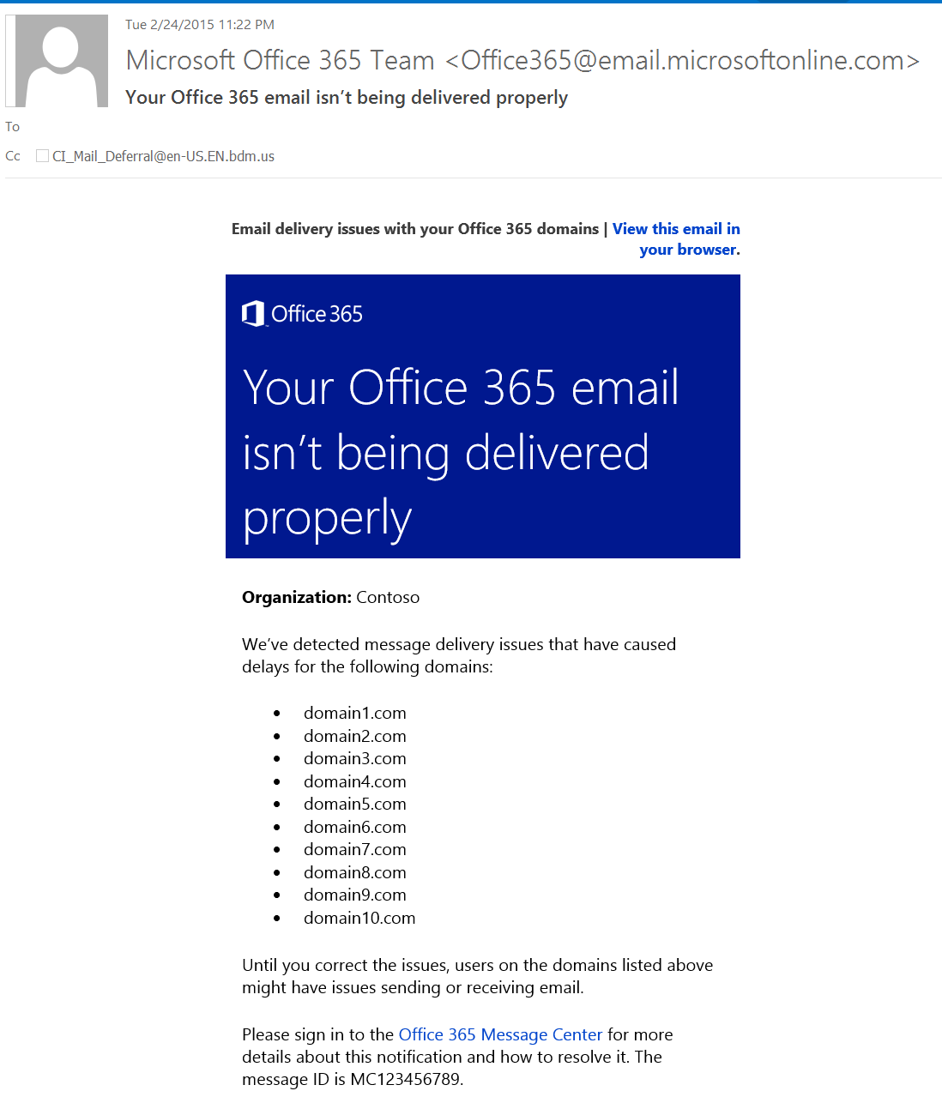
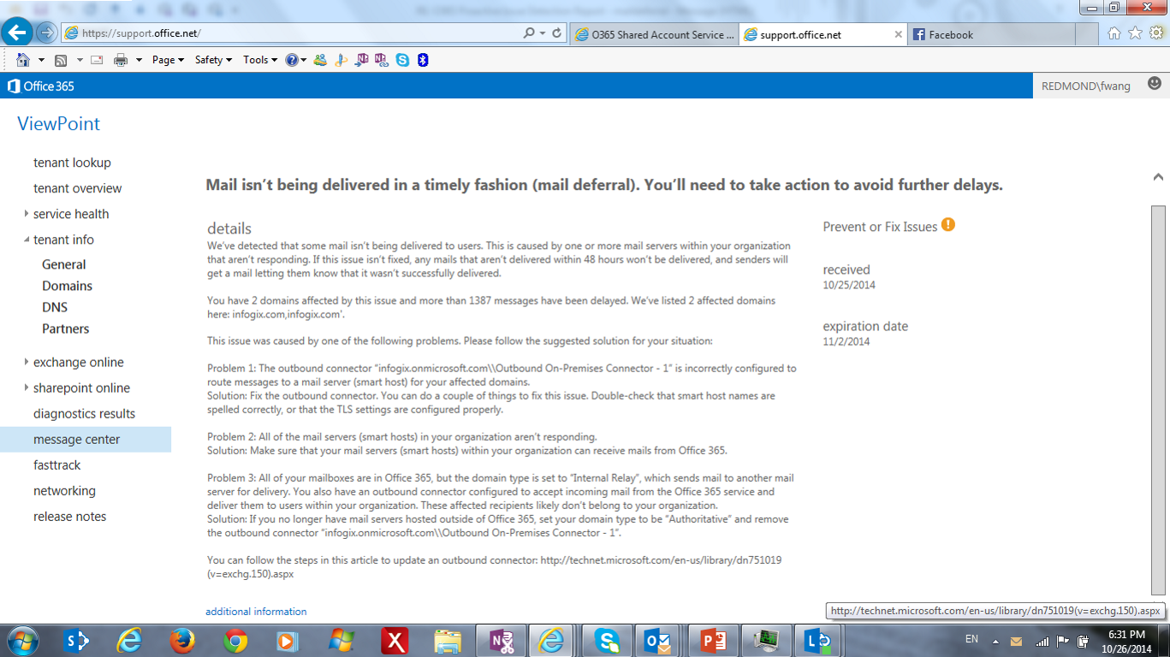
Hybrid – Mail queued to your org smart host
You will see a Message Center post + an email notification to your admin

Slide 74
Hybrid – Connector From Your Org To O365
From: John@contoso.com
To: Jim@contoso.com
Send Connector
(All mail goes via smarthost contoso-com.mail.protection.outlook.com)
Connector (Direction of mail flow)
From: Your organization servers
To: O365
(PSH: Inbound On-premise Connector)
Prove Identity using certificate or IP
[Sender domain must match Accepted domain]
Contoso.com
Contoso.com
Contoso.com is registered as an accepted domain

Slide 75
Hybrid – Connector From Your Org To O365
From: John@contoso.com
To: Bob@yahoo.com
"v=spf1 include:spf.protection.outlook.com –all”
SPF Record
Send Connector
(All mail goes via smarthost contoso-com.mail.protection.outlook.com)
Connector (Direction of mail flow)
From: Your organization servers
To: O365
(PSH: Inbound On-premise Connector)
Prove Identity using certificate or IP
[Sender domain must match Accepted domain]
Contoso.com
Contoso.com
Contoso.com is registered as an accepted domain

Slide 76
Hybrid – In Summary
You create 2 connectors because –
You want one happy family organization
Cloud + On-premises appear as one organization (Exchange headers are retained between the two)
Keep in mind –
You MUST have dedicated IPs (those IPs MUST belong to your organization)
More secure way of proving mail comes from on-premises is TLS using certificate (issued by well-known CA) vs. IPs
Sender domain MUST match accepted domain
Between O365 and your on-premises there MUST be no other service provider
SPF Record
MX Record
Contoso.com
Contoso.com
Contoso.com is registered as an accepted domain

Slide 77
Hybrid – Retain Exchange Internal Headers
For Mail flow between O365 and your org Exchange Servers
  Exchange internal headers are used by some Exchange components (such as DL permission management, calendar). Note: Transport rule no longer requires this.
  All Exchange internal headers (X-MS-Exchange-Organization-xxxx) are stripped off by O365 before coming into or leaving from O365
  To retain these headers between the two environments
Mailflow | In On-premises (Your organization email servers) | In O365
On-premises->O365 | Ex 2013: Sendconnector(CloudServicesMailEnabled) Ex 2010: RemoteDomain (TrustedMailOutboundEnabled) | UI: “Retain Exchange internal headers” Cmdlet: Inbound connector(CloudServicesMailEnabled)
O365->On-premises | Ex 2013: Default Frontend ReceiveConnector: TlsCertificateName <Subjectname> TlsDomainCapabilities:mail.protection.outlook.com:AcceptCloudServicesMail Ex 2010: RemoteDomain (TrustedMailInboundEnabled) | Outbound connector(CloudServicesMailEnabled)

Slide 78
Questions

Slide 79


Please evaluate this session
Your feedback is important to us!
Visit Myignite at http://myignite.microsoft.com
or download and use the Ignite Mobile App
with the QR code above.

