Slide 2
Identity Management is Easy in Office 365
BRK3169
David Brandt
Principal Program Manager
Office 365

Slide 3
Agenda
Terminology
Cloud Identity Model
Synchronized Identity Model
Federated Identity Model
New Identity Features

Slide 4

Office 365 Identity Models
Cloud identity
Synchronized identity
Federated identity
Zero on-premises
servers
Directory sync with
password sync
Federation
Directory
sync
On-premises
identity
On-premises
identity
Between zero and three additional on-premises servers depending on the number of users
Between two and eight on-premises servers
and networking configuration depending on
the sign-in availability requirements

Slide 5



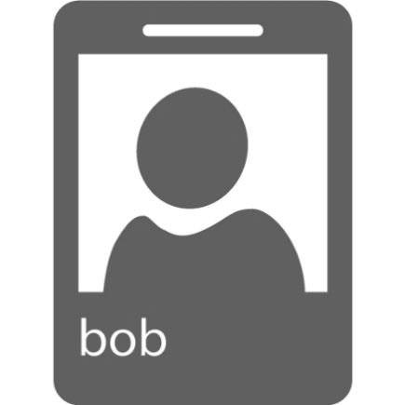
Identity Synchronization and Federation
Passive Auth
Authentication
WS-Federation
Azure Active Directory
SharePoint Online
WS-Trust
Exchange Web Access
Metadata
Authorization
Active Auth
Shibboleth
Exchange Mailbox Access
Graph API
SAML 2.0
Outlook, Lync, Word, etc
Synchronize accounts
Federated sign-in
On-Premises
Directory
Identity Provider

Slide 6
Cloud Identity Model

Slide 7

Cloud identity model http://portal.office.com
User accounts
User
Cloud identity
On-premises
directory

Slide 8
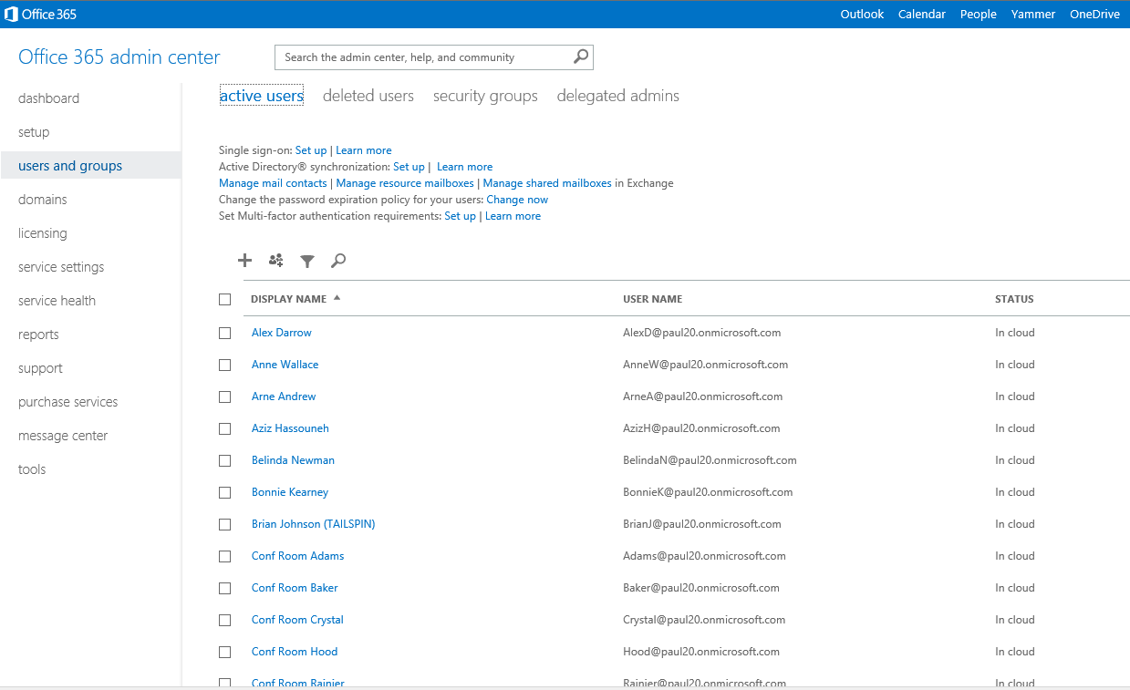

Slide 9
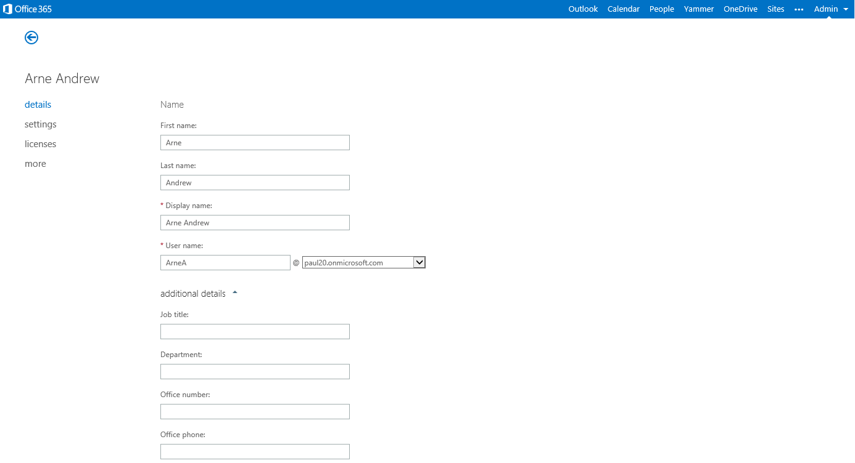

Slide 10
Synchronized Identity Model

Slide 11
Synchronized Identity Model
Password hashes
User accounts
Synchronized identity
Azure AD Sync
On-premises
directory
Sign-on
User

Slide 12
Password hash sync security
Password hash AD DS
  It is not reversible to
  get the users password
A Hash
  Hashes are mathematical
  functions that are nearly impossible
  to reverse
  The result of the hash algorithm is
  called a digest
Additional Processing
  We further process it with a one way hash SHA256 algorithm
  Connections are only to the Azure AD service
  Connections are SSL encrypted
Enables Azure AD to validate the
users password when they log in
Azure AD
Extra Security
Password
On-premises
directory
Hash
User

Slide 13

Choosing between sync tools
DirSync
Azure AD Sync
Azure AD Connect
Currently Linked from the Office 365 Admin Portal
No features that aren’t also available in Azure AD Sync
Remains supported following support policy
Installer that deploys Azure AD Sync and optionally AD FS
A superset of Azure AD
In preview now
Currently Linked from the Office 365 Admin Portal
No features that aren’t also available in Azure AD Sync
Remains supported following support policy
Includes sync from multiple forests including merging duplicate users in these forests
In addition to AD, can sync from LDAP v3, SQL Server (coming soon)
Enables selective OU sync with using UX in the setup
Enables selective attribute sync
Enables transforming of attributes using UX in the setup

Slide 14



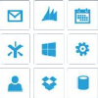
Azure AD Connect: Your Identity Bridge
Other identity stores
Azure AD Connect
(sync + sign on)
Your Custom Apps
SaaS Apps
LDAP directories
Box
Citrix
Concur
GoToMeeting
Concur
Docusign
DropBox
Google apps
Jive
Salesforce
Servicenow
Workday
…
Common
Sign on
Active Directory
User
Device

Slide 15
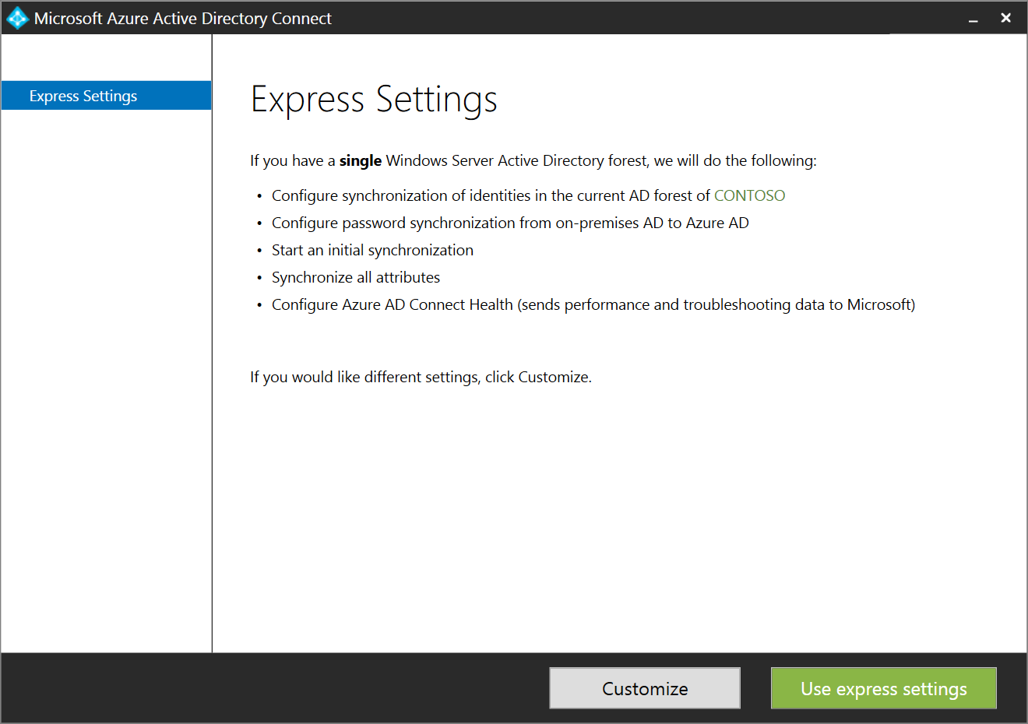
Making Hybrid Identity Simple
Azure AD Connect with Express Settings
  Use one tool instead of many
  Get up and running quickly (4 clicks)
  Start here, then scale up or add options
  Custom options to address more complex scenarios

Slide 16
Demo: Azure AD Connect Express Settings

Slide 17
Custom settings allows more advanced options
Multi forest topologies
Deploy a pilot using just a few users in a group
Don’t start sync right away (‘staging mode’)
Sign on using federation
Azure AD premium features (writeback passwords, users, groups, and devices from the cloud)
Sync custom directory attributes to the cloud

Slide 18
Deep Dive:
BRK3862 Extending On-Premises Directories to the Cloud Made Easy with Azure Active Directory Connect
Wednesday, May 6 10:45 AM - 12:00 PM
Andreas Kjellman

Slide 19
Federated Identity Model

Slide 20
Federated identity model
Password hashes
User accounts
Federated identity
Azure AD Sync
Sign-on
Authentication
AD FS
On-premises
directory
User
Authentication

Slide 21

Password Sync Backup for Federated Sign-In
Backup Password Hash Sync
This new backup option for Office 365 customers using federated sign-in provides the option to manually switch your domain in a short amount of time during outages such as on- premises power loss, internet connection interruption and any other on-premises outage.
Federated identity
User accounts
Azure AD Sync
On-premises
directory
AD FS

Slide 22
Making AD FS Easy
Use trained and experienced deployment staff
Use Azure AD Connect Tool
Read all the TechNet Deployment Guidance
  http://technet.microsoft.com/en-us/library/jj205462.aspx
Only implement the Office 365 requirements
  The only certificate required is the SSL certificate
Prepare with firewall update permissions

Slide 23
How to choose an identity model
Cloud identity
Synchronized identity
Federated identity
Zero on-premises
servers
Directory sync with
password sync
Federation
Directory
sync
On-premises
identity
On-premises
identity

Slide 24
Change between models as needs change
Cloud Identity to Synchronized Identity
  Deploy DirSync
  Hard match or soft match of users
Synchronized Identity to Federated Identity
  Deploy AD FS
  Can leave password sync enabled as backup
Federated identity to Synchronized Identity
  PowerShell Convert-MsolDomainToStandard
  Takes 2 hours plus 1 additional hour per 2,000 users
Synchronized Identity to Cloud Identity
  PowerShell Set-MsolDirSyncEnabled
  Takes 72 hours and you can monitor with Get-MsolCompanyInformation

Slide 25
Choose the simplest model for your needs
This is our recommendation
Cloud Identity is the simplest model
Choose cloud when
  You have no on-premises directory
  There is on-premises directory restructuring
  You are in pilot with Office 365

Slide 26
Choose synchronized identity if you have an on-premises directory
Password hash sync means federation is not required just to have the same password on the cloud
  Same sign-on – the username and password
  is the same in the cloud as on-premises
  Single sign-on – you log on to the PC and
  no password is required for cloud services
  Save credentials for later uses
  Windows Credential Manager
  Outlook does not support Single sign-on
Choose password hash sync unless you have one
of the scenarios that requires federation

Slide 27
Scenarios for choosing federation
Existing infrastructure
You already have an AD FS Deployment
You already use a Third Party Federated Identity Provider
You use Forefront Identity Manager 2010

Slide 28
Scenarios for choosing federation
Technical requirements
You have an On-Premises Integrated Smart Card or Multi-Factor Authentication (MFA) Solution
Custom Hybrid Applications or Hybrid Search is Required

Slide 29
Scenarios for choosing federation
Policy requirements
You Require Sign-In Audit and/or Immediate Disable
Single Sign-On minimizing prompts is Required
Require Client Sign-In Restrictions by Network Location
or Work Hours
Policy preventing Synchronizing Password Hashes
to Azure AD

Slide 30
Office 365 federation options
ADFS | Third party WS-* | Shibboleth (SAML 1.1) | SAML 2.0
Suitable for medium, large enterprises including educational organizations Recommended option for Active Directory (AD) based customers Single sign-on Support for web and rich clients Microsoft supported Works for Office 365 Hybrid Scenarios Requires on-premises servers, licenses & support | Suitable for medium, large enterprises including educational organizations Recommended where customers may use existing non-ADFS Identity systems with AD or Non-AD Single sign-on Support for web and rich clients Third-party supported Works for Office 365 Hybrid Scenarios Requires on-premises servers, licenses & support Verified through ‘works with Office 365’ program | Suitable for educational organizations Recommended where customers may use existing non-ADFS Identity systems Single sign-on Support for web clients and outlook (ECP) only Microsoft supported for integration only, no shibboleth deployment support Requires on-premises servers & support Works with AD and other directories on-premises | For organizations that need to use SAML 2.0 Recommended where customers may use existing non-ADFS Identity systems Single sign-on Support for web clients and outlook (ECP) only Microsoft supported for integration only, no identity provider deployment support Requires on-premises servers & support Works with AD and other directories on-premises

Slide 31









Works with Office 365 – Identity program
WS-Trust & WS-Federation
Customer Benefits
Flexibility to reuse existing identity provider investments
Confidence that the solution is qualified
by Microsoft
Coordinated support between the partner and Microsoft
What is it?
  Qualification of third party identity providers for federation with Office 365. Microsoft supports Office 365 only when qualified third party identity providers are used.
Program Requirements
  Published Qualification Requirements
  Published Technical Integration Docs
  Automated Testing Tool
  Self Testing work by Partner
  Predictable and Shorter Qualification
  http://aka.ms/ssoproviders
Active Directory with ADFS
RadiantOne
SAML (passive auth)
Shibboleth

Slide 32
New Identity Features

Slide 33
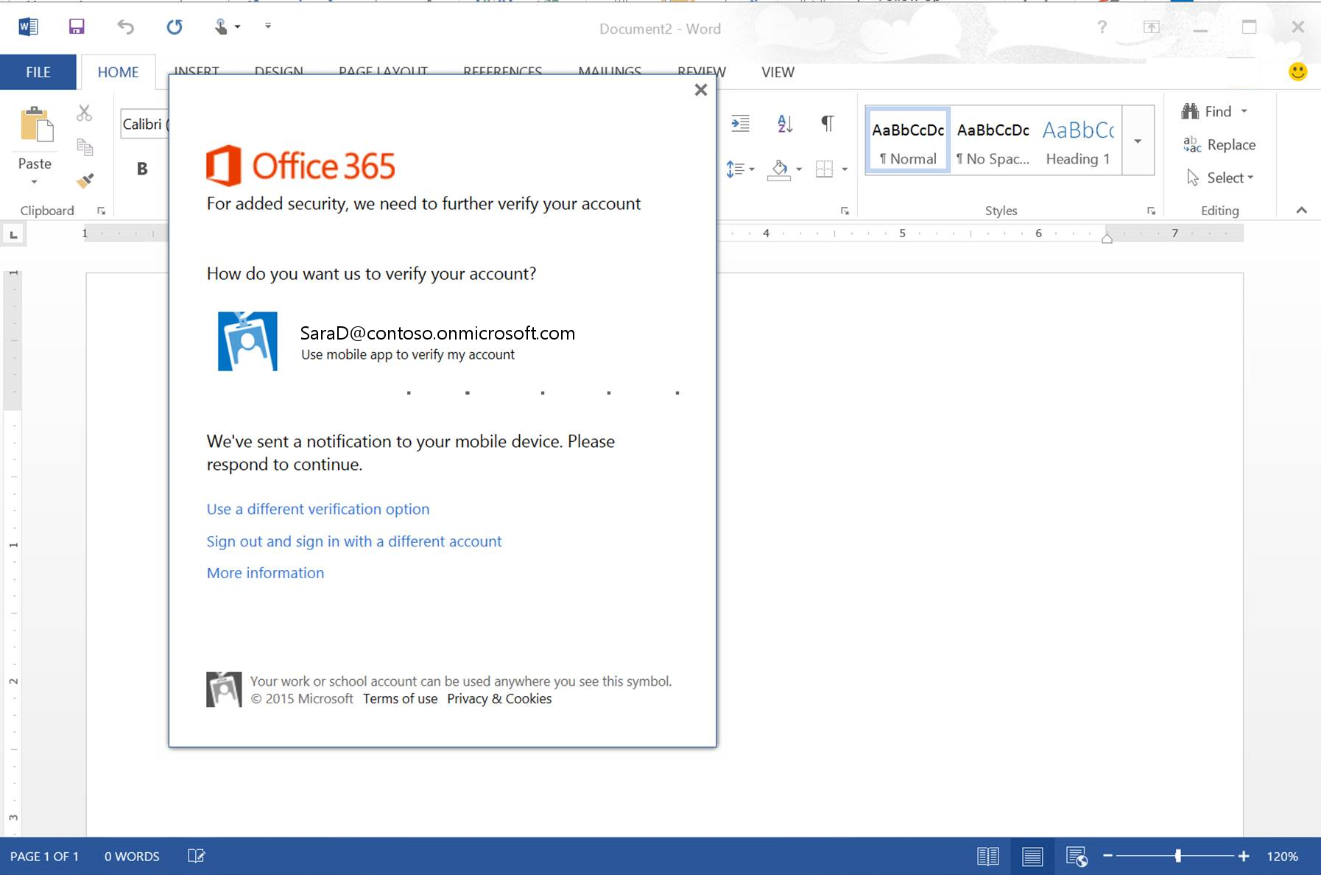
Public Preview
Office 2013 rich client ADAL based authentication
Targeted
March 2015
Enables these capabilities
  Multi-Factor Authentication
  SAML based identity providers
  Smart Card and Cert authentication
  Outlook doesn’t need Basic Authentication
The program is easier to join and production support is included for participants.
Some incomplete scenarios like IRM, External Sharing, AD FS Client Access Policies.
Updates in the coming months.
http://aka.ms/blogadalpreview

Slide 34

Sign-In Branding
Included in all Office 365 SKUs
Sign-in Page Branding enables an Office 365 customer to select custom colors, text and Imagery for their Office 365 sign-in page.
Previously available with the Azure AD Premium subscription.

Slide 35
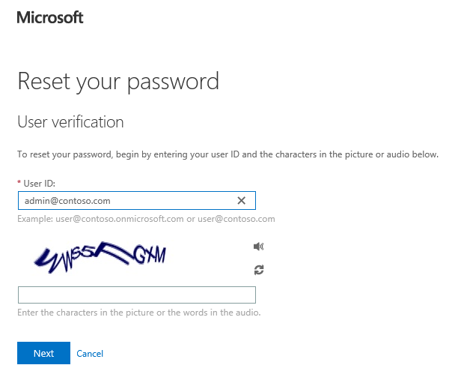
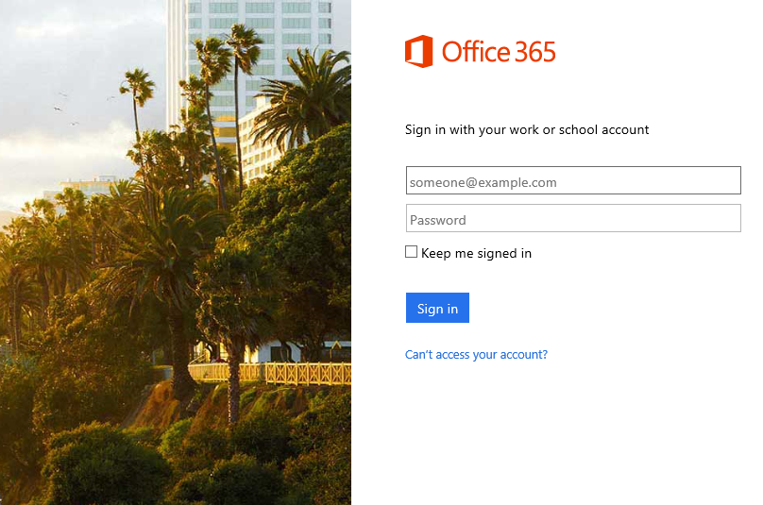
Cloud User Self Service Password Reset
Included in all Office 365 SKUs
Cloud User Self Service Password Reset allows a user who has forgotten their password to reset it based on prearranged alternative personal information.
Previously available with the Azure AD Premium subscription
Self Service Password Reset is available for cloud users.
For users synchronized to an on-premises directory an Azure AD Premium subscription is still required.

Slide 36
 | Azure AD Features | Office 365
Common features | Directory as a service | No object limit
 | User and group management using UI or Windows PowerShell cmdlets
 | Access Panel portal for SSO-based user access to SaaS and custom applications | Up to 10 apps per user
 | User-based application access management and provisioning
 | Self-service password change for cloud users
 | Directory synchronization tool – For syncing between on-premises Active Directory and Azure Active Directory
 | Standard security reports | 3 standard reports
Premium and Basic features | High availability SLA uptime (99.9%)
 | Group-based application access management and provisioning
 | Customization of company logo and colors to the Sign In and Access Panel pages
 | Self-service password reset for cloud users
 | Application Proxy
Premium-only feature | Self-service group management for cloud users
 | Self-service password reset with on-premises write-back
 | Microsoft Identity Manager (MIM) server licenses – For syncing between on-premises databases and/or directories and Azure Active Directory
 | Advanced anomaly security reports (machine learning-based)
 | Advanced application usage reporting
 | Multi-Factor Authentication service for cloud users | Limited features
 | Multi-Factor Authentication server for on-premises users
For Free and Premium see https://msdn.microsoft.com/en-us/library/azure/dn532272.aspx

Slide 37
Summary
Choose the simplest model for your needs
Change between models as needs change
Cloud identity model when there is no
on-premises directory
Synchronized identity model for most organizations
Federated identity model for one of the scenarios

Slide 38


Please evaluate this session
Your feedback is important to us!
Visit Myignite at http://myignite.microsoft.com
or download and use the Ignite Mobile App
with the QR code above.

Slide 39

© 2015 Microsoft Corporation. All rights reserved. Microsoft, Windows, and other product names are or may be registered trademarks and/or trademarks in the U.S. and/or other countries.
The information herein is for informational purposes only and represents the current view of Microsoft Corporation as of the date of this presentation. Because Microsoft must respond to changing market conditions, it should not be interpreted to be a commitment on the part of Microsoft, and Microsoft cannot guarantee the accuracy of any information provided after the date of this presentation. MICROSOFT MAKES NO WARRANTIES, EXPRESS, IMPLIED OR STATUTORY, AS TO THE INFORMATION IN THIS PRESENTATION.

