Slide 2
Configuring OneDrive for Business Deployment: Options and Best Practices
BRK3183
Spencer Harbar
Architect

Slide 3





About Spencer Harbar
Architect based in Edinburgh, UK
www.harbar.net | spence@harbar.net | @harbars
Technical Director for Fidra Consulting
Works with Microsoft’s largest enterprise customers
Works with SharePoint Product Group on Readiness
Author for MSDN & TechNet

Slide 4
Session Objectives And Takeaways
Session Objectives:
  Understand SharePoint Server 2013 advancements for integrating on-premises with OneDrive for Business in Office 365
  Position OneDrive for Business in Office 365 as a first and best workload in the cloud
  Architect and plan for OneDrive for Business integration and migration as a first step towards a cloud strategy for or customers
OneDrive for Business is a first and best cloud workload

Slide 5
Contents
Introduction to OneDrive for Business
Identity Scenarios
Redirection in SharePoint Server 2013
Office 365 Configuration
Migration
Roadmap

Slide 6

OneDrive for Business
Personal storage
in the cloud
Redirection support
in Service Pack 1

Slide 7
In SharePoint 2013
Discrete Document Library
Evolution of Shared and Personal My Site concepts
Simplifies sharing and versioning experience
Private by default, simple permissions management

Slide 8

Identity Considerations
Cloud Identity
Directory Synchronization
Active Directory Federation Services

Slide 9
Identity Options
Cloud Identity
Directory & Password Synchronization*
Federated Identity
Windows Azure Active Directory
Dirsync & Password Sync*
Federation
Directory Sync
On-Premises Identity
On-Premises Identity
  Single identity in the cloud
  Suitable for small organizations with no integration to on-premises directories
Single identity
Suitable for medium
and large organizations without federation*
Single federated identity
and credentials
Suitable for medium and large organizations

Slide 10
Cloud Identity
Single identity in the cloud with no affinity to on-premises Active Directory
Provided through Azure AD
Advantages
  Low TCO
  Rapid deployment and provisioning
  No new infrastructure requirements
Disadvantages
  No affinity with on-premises identity
  Requires separate username and password
  Does not support hybrid workloads

Slide 11



Cloud Identity
Office 365 Admin Portal
Windows Azure Active Directory
OAuth2
Office Activation Service
Metadata
Exchange Mailbox Access
SAML-P
Graph API
…
WS-Federation
Authorization
CSV Import
Spreadsheet

Slide 12
Directory Synchronization
Integrates with Azure AD replicating on-premises users, groups, and contacts
Provides use of on-premises user name across environments
  Enables password hash replication with Password Synchronization

Slide 13
Password Synchronization
Advantages
  Low barrier to entry
  Reduces TTS (Time to Solution)
  No changes needed to existing AD servers
  Extends Directory Synchronization to provide Same Sign-On experience
Disadvantages
  Does not provide Single Sign-On experience
  Requires additional authentication
  Does not support custom 2 factor authentication mechanisms deployed on-premises
  Does enable policy based access control decisions
  Single Point of Failure

Slide 14
Directory & Password Sync
Office 365 Admin Portal
Windows Azure Active Directory
OAuth2
Office Activation Service
Metadata
Exchange Mailbox Access
SAML-P
Graph API
…
WS-Federation
Authorization
DirectorySync
Active Directory
On Premises

Slide 15
AD FS
Provides an open and interoperable claims-based model for integration
Advantages
  Provides Web SSO (enables seamless partner federation) & mitigates partner user account management
  Claim mapping support
  Extensible
  Enables broader hybrid workload adoption and support (I.e. Search, BCS, etc.)
Disadvantages
  Infrastructure investment required
  Complex configuration
  Low ROI in limited support scenarios

Slide 16
AD FS
Office 365 Admin Portal
Windows Azure Active Directory
OAuth2
Office Activation Service
Metadata
Exchange Mailbox Access
SAML-P
Graph API
…
WS-Federation
Authorization
DirectorySync
Active Directory Federation Services
Active Directory
On Premises

Slide 17
Redirection in SharePoint Server 2013

Slide 18
Prerequisites
Service Pack 1
Office 365 (P1 + subscription)
Identity federation for seamless experience

Slide 19
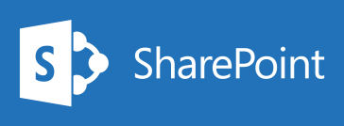


Redirection to OneDrive in Office 365
1
User authenticates on-premises
User clicks OneDrive for Business
in navigation
2
3
User is not in redirect audience
4
User is in redirect audience
On Premises

Slide 20
OneDrive for Business Redirection
Spencer Harbar

Slide 21
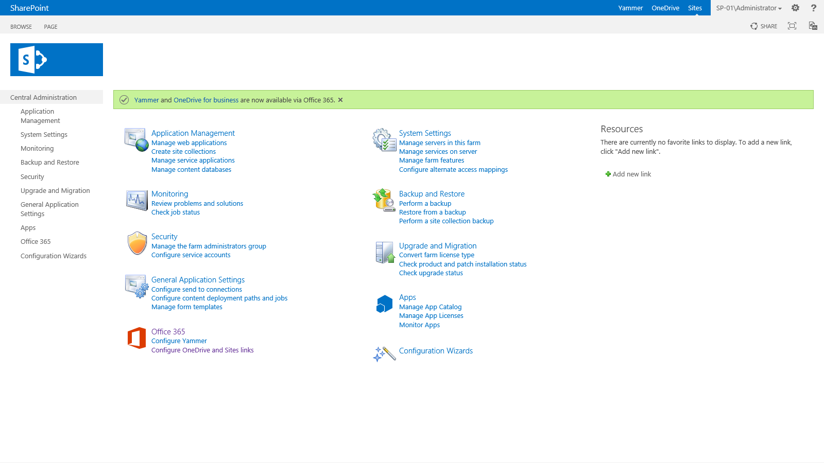

Slide 22
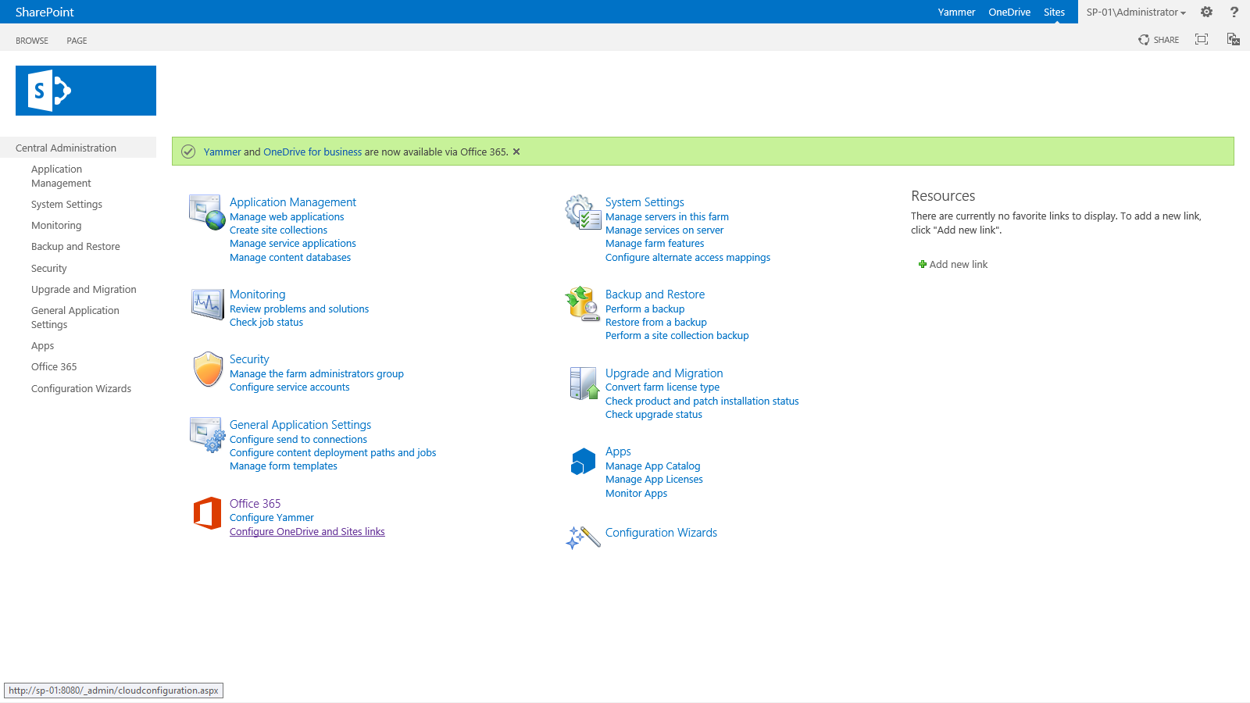
New options under the heading Office 365 Connections
on the home page of the SharePoint Central Administration
website

Slide 23
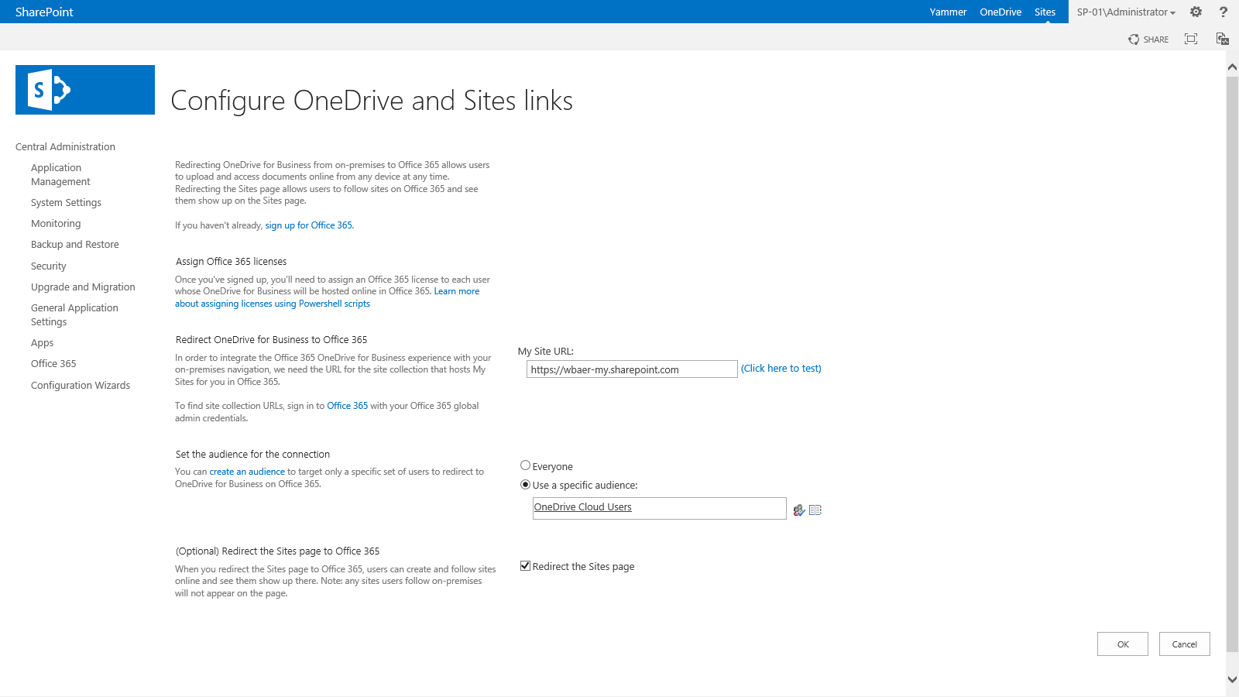
SharePoint Online My Site Host Url
Configure audience scoped redirection to
Office 365
Specifies where new SharePoint sites are created.

Slide 24
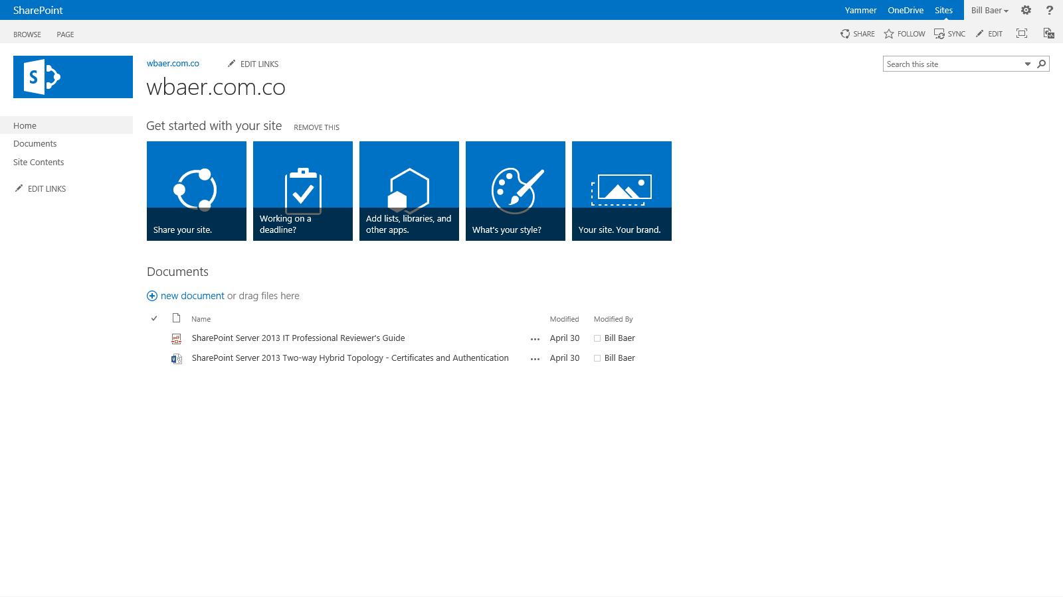
Redirects to OneDrive for Business in Office 365

Slide 25
Office 365 Configuration

Slide 26
Office 365 Configuration and Settings
User license assignment
Storage allocation
Navigation settings

Slide 27
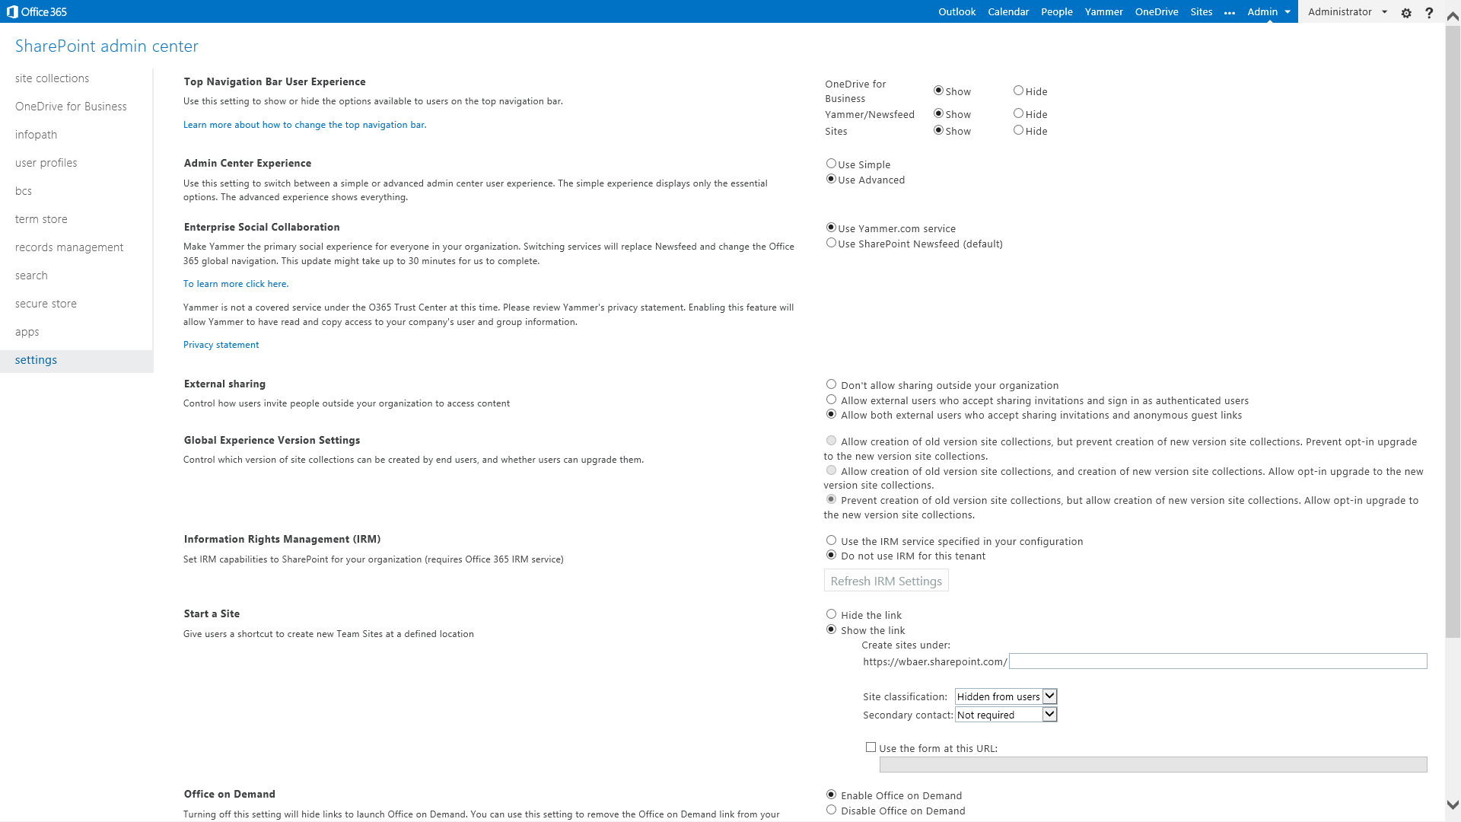

Slide 28
Deployment

Slide 29
Deploy Sync Client with Office Deployment Tool
Console application and configuration manifest
  Allows an administrator to customize and manage Office 2013 Click-to-Run deployments
Download client
  <Add SourcePath="\\server\share\C2R_deploy" OfficeClientEdition="32" >
  <Product ID="GrooveRetail">
  <Language ID="en-us" />
  </Product>
  </Add>
+
\\server\share\C2R_deploy\setup.exe /download \\server\share\C2R_Deploy\Download_OneDrive.xml
Install client
  <Add SourcePath="\\server\share\C2R_deploy" OfficeClientEdition="32" >
  <Product ID="GrooveRetail">
  <Language ID="en-us" />
  </Product>
  </Add>
  <Updates Enabled="TRUE" UpdatePath="\\server\share\C2R_updates" />
  <Display Level="None" AcceptEULA="TRUE" />
+
\\server\share\C2R_deploy\setup.exe /configure \\server\share\C2R_Deploy\Install_OneDrive.xml

Slide 30
Sync Client Updates
Automatic updates from Microsoft
  <Updates Enabled="TRUE“ />
  Patch Tuesday
  Daily Scheduled Task to check
Updates from an internal location
  <Updates Enabled="TRUE" UpdatePath="\\server\share\C2R_updates" />
No Automatic updates
  <Add SourcePath="\\server\share\C2R_deploy" Version="15.0.xxxx.xxxx" OfficeClientEdition="32" >
  Download a new build and create a new configuration file

Slide 31
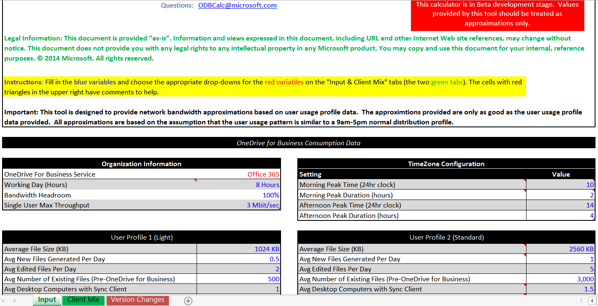
Bandwidth Planning
Download the OneDrive for Business Client Network Bandwidth Calculator
  http://www.microsoft.com/en-us/download/details.aspx?id=44541

Slide 32
Migration

Slide 33
IW-Led, IT-Managed
IT
  Manages OneDrive for Business sync client deployment
  Readiness
IW
  Managed migration

Slide 34

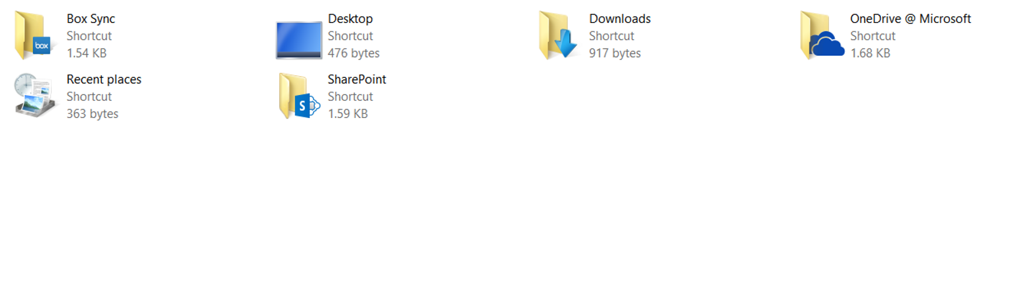

Drag and Drop
Scenarios
IW-led migration
No document metadata preservation needed

Slide 35
Migration of personal content (personal sites)
Prerequisites
  Personal sites are required (I.e. must be created) for migration
  Bulk provisioning options provided in Service Pack 1
Bulk site migrations require a migration account to be added to the personal sites

Slide 36
Bulk Provisioning
Limited to 200 in a batch for the queue
The queue is shared by tenants
  Throttling is possible if a single tenant is keeping the queue saturated
Provisioning speed varies based on farm activities
  Improvements have been made in provisioning speed
  Effort is underway to improve further

Slide 37
Bulk Site Creation: CSOM API
public IEnumerable<string> CreatePersonalSiteEnqueueBulk(
[Microsoft.SharePoint.Client.ClientCallableConstraint(Type = Microsoft.SharePoint.Client.ClientCallableConstraintType.MaxLength, Value = 200)]
string[] emailIDs
)

Slide 38
Calling CSOM from PowerShell
[System.Reflection.Assembly]::LoadWithPartialName("Microsoft.SharePoint.Client.UserProfiles")
$loader =[Microsoft.SharePoint.Client.UserProfiles.ProfileLoader]::GetProfileLoader($ctx)
#To enqueue Profile
$loader.CreatePersonalSiteEnqueueBulk(@(“JoeUser@contoso.com"))
$loader.Context.ExecuteQuery()

Slide 39
Assigning Permissions
$cred= Get-Credential
Connect-SPOService -Url https://contoso-admin.sharepoint.com -credential $cred
Connect-MSOLService -credential $cred
$AdminAccount= “migrationaccount@contoso.onmicrosoft.com"
$Users= Get-MSOLUser -All | Select UserPrincipalName
foreach ($User in $Users)
{
$strUser = $User.userprincipalname
$pos= $strUser.IndexOf("@")
$strUser = $strUser.SubString(0, $pos)
$SiteUrl= "https://contoso-my.sharepoint.com/personal/" + $strUser
$SiteUrl= $SiteUrl+ "_contoso_onmicrosoft_com"
Set-SPOUser -Site $SiteUrl -LoginName $AdminAccount -IsSiteCollectionAdmin $true –ErrorAction Continue
}

Slide 40
New Migration Pipeline SDK
Improved import API that implements Azure Blob Storage based on modern File APIs
Designed to improve migration performance and reduce load on Office 365 services such as SharePoint Online
SDK with sample pipeline solution (migration tool) in May 2015

Slide 41
ISV Solutions
Scenarios
  IT-endorsed use of competitive FSS solutions
  Require metadata preservation, discovery, and compliance controls

Slide 42
File and Folder Restrictions
Windows Reserved Characters
  <, >, :, “, /, \, |, ?, * as identified by Path.GetInvalidFileNameChars Method
OneDrive for Business Considerations
  _ (marked as hidden in Explorer View)
  . (preceded or followed by)
  ~, #, %, &, [, ], {, }
  Posix semantics are not supported

Slide 43
File and Folder Validation
private static Regex pattern = new Regex(@"[\\\[\]\|~#%&*\:{}?/]+", RegexOptions.Compiled);
DirectoryInfo source = new DirectoryInfo(args[0]);
foreach (DirectoryInfo di in source.GetDirectories())
{
if (di != null)
{
FileInfo[] files = source.GetFiles("*.*", SearchOption.AllDirectories);
Download source code and app at http://blogs.technet.com/b/wbaer/archive/2014/05/24/file-and-folder-considerations-with-onedrive-for-business.aspx.

Slide 44
In Review: Session Objectives And Takeaways
Session Objectives:
  Understand SharePoint Server 2013 Service Pack 1 advancements for integrating on-premises with OneDrive for Business in Office 365
  Position OneDrive for Business in Office 365 as a first and best workload in the cloud
  Architect and plan for OneDrive for Business integration and migration as a first step towards a cloud strategy for or customers
OneDrive for Business is a first and best cloud workload

Slide 45


Please evaluate this session
Your feedback is important to us!
Visit Myignite at http://myignite.microsoft.com
or download and use the Ignite Mobile App
with the QR code above.

