Slide 2
Ten Ways to Secure Your Office 365 Tenants
BRK3191
Brian Reid
NBConsult
brian@nbconsult.co | +44 7973 428875

Slide 3
Introduction
Do you want to ensure that your data in Office 365 is protected?
In this session we will look at ten (or more, I’m not counting) ways to achieve that aim!
Any questions – add them to the Yammer second screen for this presentation (BRK3191)
https://www.yammer.com/microsoftignite/uploaded_files/32517088 (or http://j.mp/secure10)

Slide 4
Password Policy
Use a policy and password expiry to help secure data and service access
Different settings for different types of identity
Cloud users default to passwords expiring after 90 days
Active Directory synced users password expires based on the on-premises policy
Self-service password reset
Cloud users can perform self-service password reset (free of charge in Office 365)
With Azure Active Directory Basic or Premium subscriptions, self-service reset can also apply to on-premises users
Azure Active Directory Premium provides for password write-back – to allow an on-premises synced used to change their password in the cloud

Slide 5
Self-Service Password Reset
In this demo we will look at the following:
Configuring authentication methods in Azure Active Directory
Setting the number of questions required to complete a password reset
Adding security questions that can be asked (up to 20 of them)
The number of questions needed to register for self service password reset
The number of questions to be answered correctly for password reset to occur
The process of password reset from the viewpoint of the end user
For the user to set the answers required, direct them to http://aka.ms/ssprsetup

Slide 6
Self Service Password Reset Demo
Also see session “BRK3863: Identity and Access Management Everywhere”

Slide 7
Data Loss Prevention (DLP)
To ensure that data of a confidential or personal nature cannot be uploaded, shared or emailed as required
Available in SharePoint Online and Exchange Online
Create policies to restrict content being saved to SharePoint Online or OneDrive for Business, or shared externally, or emailed. Enforced on create/edit and with during background search crawling
Can create document fingerprints to ensure standard company forms are not distributed
Can extend DLP templates to suit business requirements (Exchange only at present)
Reporting and incident management available
Built into the Office 365 portal and can have emailed incident reports

Slide 8
Data Loss Prevention
In this demo we will look at
Policy tips in Outlook/OWA and OneDrive for Business
A policy exists to block the external distribution of credit cards in Exchange and the uploading of content containing credit cards in SharePoint Online
1 to 9 credit cards in the document it will warn the site collection owner and last modifying user and send an incident report to the site admin
10 or more credit cards in a document then permissions to the document are blocked except for the site owner, document owner and last modifying user. Fix the compliance issue and all permissions return
Demo to show blocking content uploads
Demo to show DLP integrated into Enterprise Search
SensitiveType="Credit Card Number" OR SensitiveType="ABA Routing Number“ OR "U.S. / U.K. Passport Number"
SensitiveType="Credit Card Number|5.." to show documents with five or more credit card numbers in them

Slide 9
Data Loss Prevention Demo
Also see session “BRK3181: End-to-End Data Loss Prevention”

Slide 10
Rights Management
To protect documents and email with encryption and an associated usage policy
Document can only be used by the intended recipients for the intended purpose
Easy to create policy templates that users can protect documents with
Policies include a name (multi-lingual options available) with description, the usage rights and the group of users who can access the document along with validity periods
Office 365 includes per-file encryption at rest

Slide 11
Rights Management
In this demo we will look at
The setting up of the RMS service
Setting up the rights management configuration in the Office 365 admin portal
Enabling Exchange Online via PowerShell (Import keys and then running Set-IRMConfiguration)
Enabling SharePoint Online via the admin portal
Creating templates for document protection
Using RMS in the web based and Office applications
Using the RMS Sharing Application and protecting any document

Slide 12
Rights Management Demo
Also see session “BRK3172: Your Encryption Controls in Office 365: Across Devices and Platforms”

Slide 13
Office 365 Message Encryption
Provides the ability to “send” encrypted messages that require the recipient to login to read and reply to the message
Can customise the notification email and portal
Can provide one-time passcodes to avoid the recipient having the need to login
Requires that RMS is enabled and configured

Slide 14
Office 365 Message Encryption
In this demo we will look at:
The enabling of the feature
Ensuring that RMS is enabled for Exchange Online correctly
Configuring a transport rule to encrypt or decrypt messages
The end to end process
Sending an external email with a message classification that causes message encryption to occur
Configuring the email and the portal
Using Exchange Online remote PowerShell:
Set-OMEConfiguration "OME Configuration" -Image (Get-Content "C:\Temp\NBConsult\default-logo2.png" -Encoding Byte) -EmailText "You have received an encrypted message from the NBConsult secure messaging system." -PortalText "NBConsult secure email portal"

Slide 15
Message Encryption Demo
Also see session “BRK3172: Your Encryption Controls in Office 365: Across Devices and Platforms”

Slide 16
Mobile Device Management (MDM)
To show how a new feature to Office 365 can help you protect data on end user devices
Free with Office 365 commercial subscriptions from May 2015
Includes:
Conditional Access – device must be compliant with your rules before it can access corporate data
User level policies – therefore does not matter what device the user uses and can target policies to different groups and users
Device Management – policies to require different security settings and gain reports on the state of these devices
Selective Wipe – easy to remove corporate data from the device and leave personal data

Slide 17
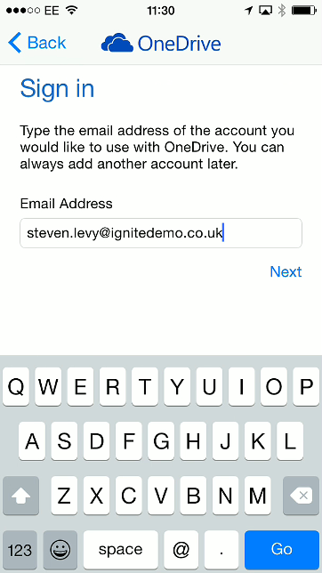
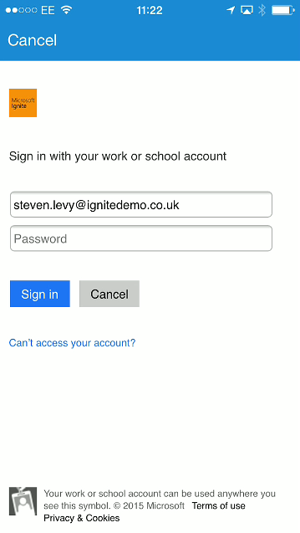
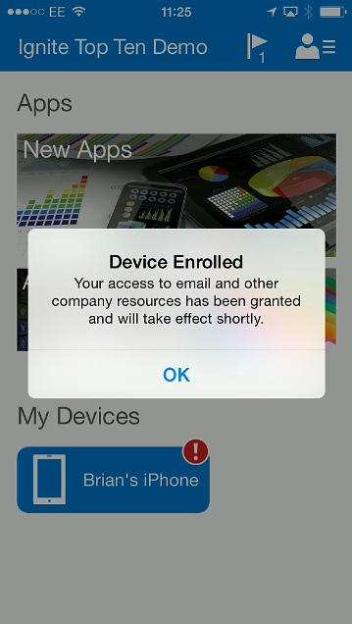
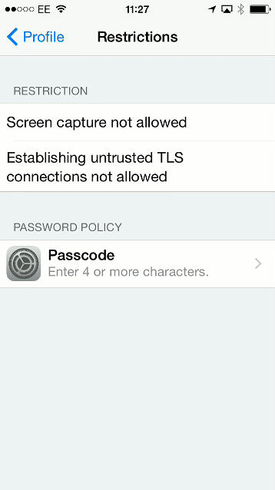
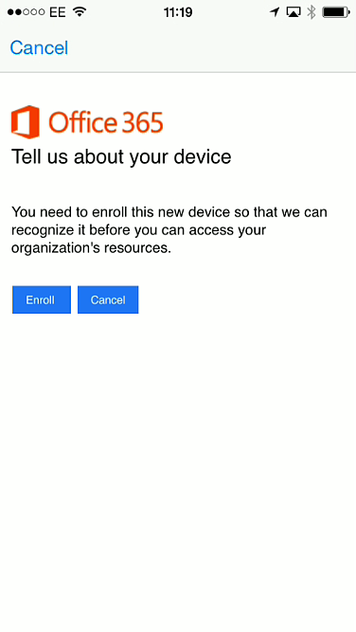
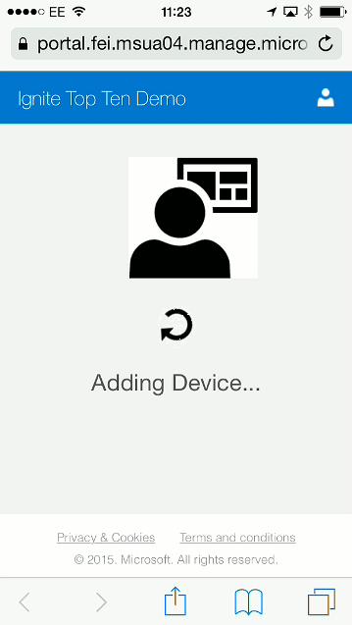
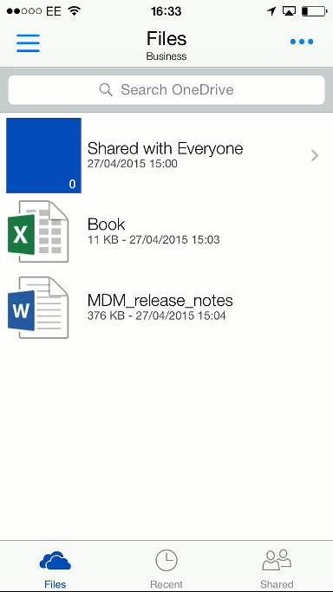
Mobile Device Management
In this demo we will configure corporate policies on an iPhone

Slide 18
Mobile Device Management Demo
Also see session “BRK3113: Device and Data Protection with Mobile Device Management in Office 365”

Slide 19
Multi-Factor Authentication
Provides the ability to require more than just a username and password to authenticate to Office 365
Second factors of authentication include a telephone call, as SMS text or validating the login via an app
Needs something you “know” (a password) and something you have “a mobile phone”
Free for Office 365 subscribers
Can extend into on-premises and other apps with Azure MFA

Slide 20
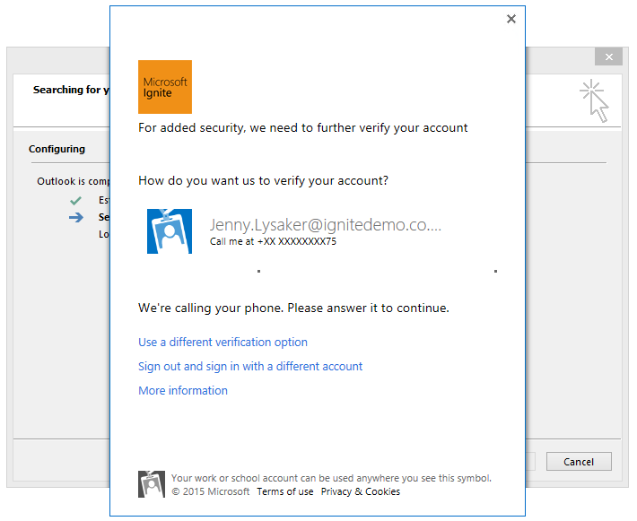
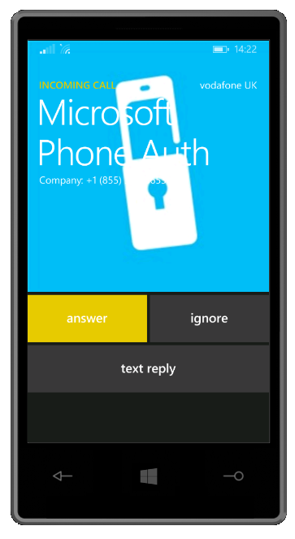
Multi-Factor Authentication (MFA) Demo
In this demo we will:
Configure Multi-Factor Authentication
Login with a browser to Office 365
Login with an Office 2013 app using “modern authentication”
“Modern Authentication” is new to Office 2013 and Office apps and will be in later versions. It allows the second factor of authentication to be used instead of just username and password
VCF File for phone available at http://1drv.ms/1AallXl

Slide 21
Multi-Factor Authentication Demo
Also see session “BRK3136: Modern Authentication for the Office 2013 Clients”

Slide 22
Advanced Threat Protection
All Exchange Online mailboxes are protected by Exchange Online Protection as part of the subscription price
Advanced Threat Protection (coming soon) is an additional subscription offering to protect against
Spear-phishing (the Safe Links feature)
Zero-day malware attacks (the Safe Attachments feature)

Slide 23
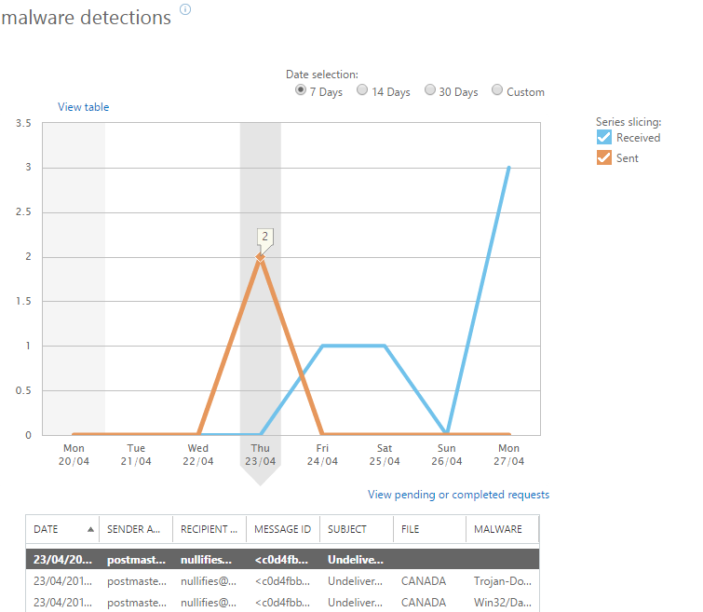
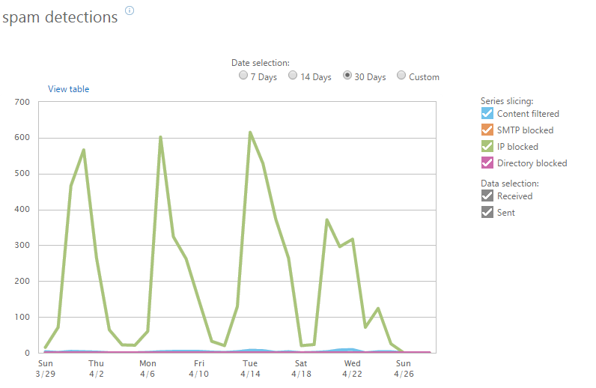
Advanced Threat Protection Demo
In this demo we will see the Advanced Threat Protection feature set
We will look at configuring settings and what the end user sees (or not) in their email client and the reports

Slide 24
Advanced Threat Protection Demo
Also see theatre presentation “THR0135: Advanced Threat Protection in Office 365”

Slide 25
Client Security
Provides the ability to authenticate into Office 365 from your Active Directory and not the Microsoft authentication platform
This also allows single sign-on and various client restrictions
Office 365 MDM Conditional Access will supersede this feature with various device controls and policies
“Modern Authentication” coming to Office 2013
Changes the way Outlook communicates with Exchange Online for authentication
A change from the Microsoft Sign-In Assistant to Active Directory Authentication Library (ADAL)
Support for web based authentication platforms across most client applications (i.e. SAML 2.0)

Slide 26
Client Security Demo
In this demo we will look at some AD FS Client Access Policies and see how they can restrict client access to Office 365
The policy will allow access only from a given range of IP addresses

Slide 27
Client Security Demo
Also take the Instructor Led Lab “ILL3851: Windows Server 2012 R2: New Features in Active Directory Federation Services”

Slide 28
Office Client Deployment
Providing the ability to stay up to date with feature and security updates
How to keep client versions of Office up to date
Getting the latest security changes
Ensuring that the latest releases don’t break the company
Flexibility with regard to updates (opt in to feature and bug fixes quarterly)
Control using an XML based deployment process
setup.exe /download \\server\share\config32ProPlus.xml
setup.exe /configure \\server\share\config32ProPlus.xml

Slide 29
Click2Run XML for Download and Deploy
<Configuration>
<Add SourcePath="\\server\share\Microsoft\Office\365\Software" OfficeClientEdition="32" >
<Product ID="O365ProPlusRetail">
<Language ID="en-us" />
<Language ID=“fr-fr" />
</Product>
</Add>
<Updates Enabled="TRUE" UpdatePath="\\server\share\Microsoft\Office\365\Software" />
<Display Level="Full" AcceptEULA="TRUE" />
<Logging Path="%temp%" />
<Property Name="AUTOACTIVATE" Value="1" />
</Configuration>
Also see session “BRK3144: Microsoft Office 365 ProPlus: Have It Your Way!”

Slide 30
Sharing Content
Can enable/disable sharing in the admin portal
Sites
Share by email address or anonymous link
Can share documents directly as well
Exchange
Calendar sharing
Skype For Business
Third Party Apps to access your data

Slide 31
Sharing Content Demo
In this demo we will configuring external sharing the and sharing of documents and sites to external users
We will look at how we can see what is shared externally and how we can revoke these rights

Slide 32
Sharing Content Demo
Also see session “BRK3135: OneDrive for Business for B2B External Sharing, IT-Lead Cross-Org Collaboration”

Slide 33
OneDrive For Business Sync Restrictions
Domain safe list restrictions is a new feature to Office 365 (currently rolling out)
Ensures that the OneDrive for Business client will only sync document libraries to machines joined to a given domain
Use Set-SPOTenantSyncClientRestriction in SharePoint Online remote PowerShell session to set the Active Directory Domain GUID client must belong to
$domains = (Get-ADForest).Domains; foreach($d in $domains) {Get-ADDomain -Identity $d | Select DistinguishedName,ObjectGuid}
Set-SPOTenantSyncClientRestriction -Enable -DomainGuids "786548DD-877B-4760-A749-6B1EFBC1190A; 877564FF-877B-4760-A749-6B1EFBC1190A"

Slide 34
SSL and TLS
All services are offered over HTTPS
Secure options provided for all protocols (such as POP/IMAP)
Email connectors to and from EOP can be set to opportunistic TLS
Opportunistic means “Go secure if you can, insecure if you cannot” – therefore consider your connector security options carefully
In hybrid modes, you are responsible for the security of your bit of the network.
Ensure you are not open to SSL attacks such as Heartbleed and POODLE.
SHA-1 Certificate issues in Chrome browser

Slide 35
Office 365 Reports
To provide you with lots of data on what is happening with your tenant
Report examples include:
Browser versions and operating system versions used
OneDrive For Business storage
Mailbox access by non-owners
Role group changes
Malware detections, spam catches and Advanced Threat Protection
Auditing administrator actions
Azure AD user activity
DLP policy and rule matches

Slide 36
Office 365 Reports Demo
In this demo we will look at some of the reports available and discuss what we can learn from them from a security perspective
Reports are available in the compliance center, the Office 365 portal and under individual services

Slide 37
Office 365 Reports Demo
Also see theatre session “THR0166: Building Custom Reports in the Office Telemetry Dashboard”

Slide 38
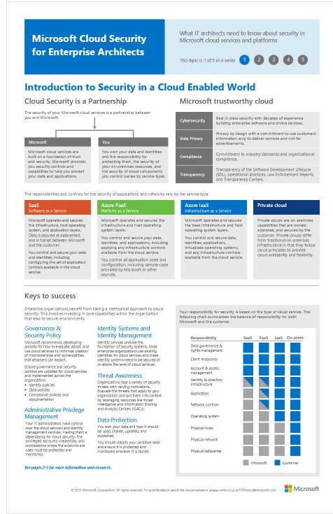
Microsoft Cloud Security for Enterprise Architects
Systematic approach to securing your identities, data, and applications in the cloud
Visio version
PDF version

Slide 39
Microsoft’s Enterprise Cloud Roadmap
Resources for IT decision makers
http://aka.ms/CloudArchitecture
Map of Microsoft SaaS, PaaS, IaaS, and private cloud offerings
Identity architecture
Security architecture
Deployment and integration options for Exchange, Lync, and SharePoint
Azure architecture blueprints
Cloud design patterns
Design stencils

Slide 40
Input from Yammer
I asked if anyone had any suggestions for this presentation on the Ignite network on Yammer
Version control and Holds
https://www.yammer.com/microsoftignite/#/uploaded_files/32517088?threadId=526833978

Slide 41
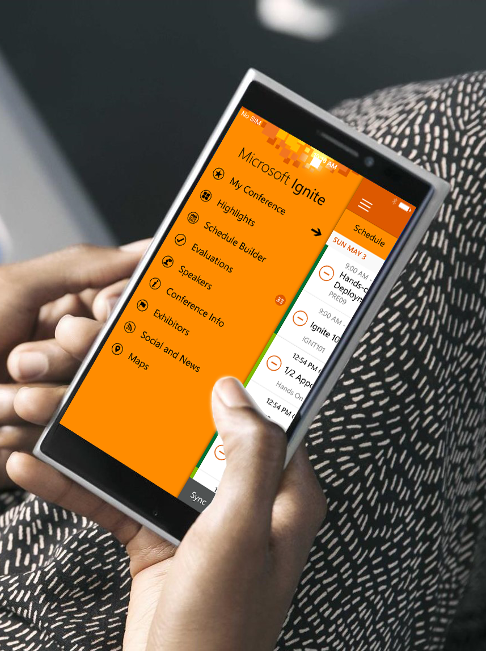
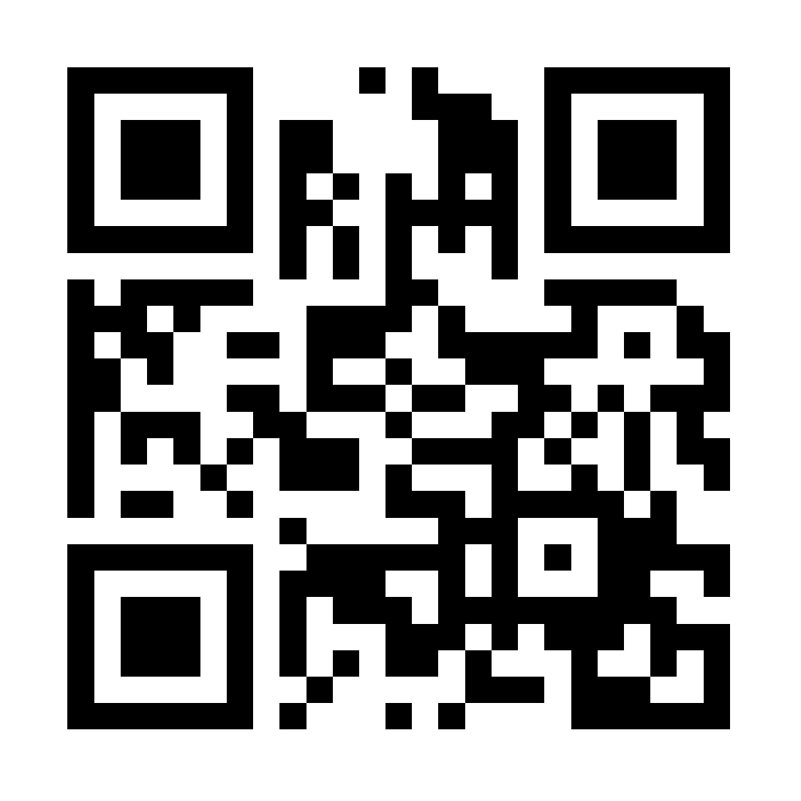
Please evaluate this session
Your feedback is important to us!
Visit Myignite at http://myignite.microsoft.com or download and use the Ignite Mobile App with the QR code above.

