Slide 2
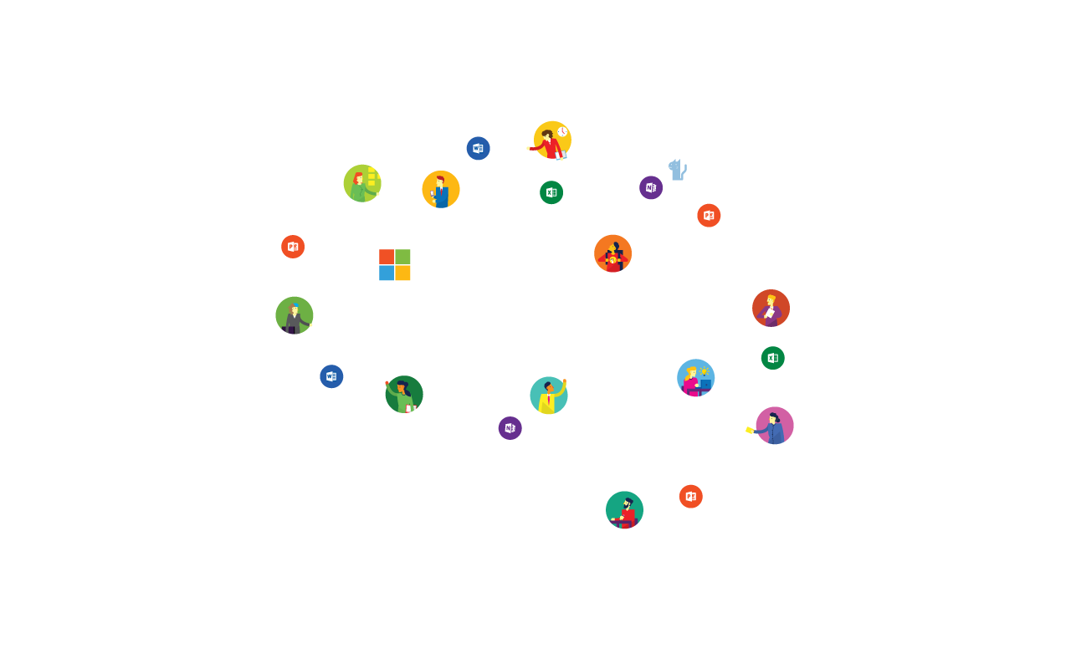
Building solutions with Office Graph
BRK3193
Helge Grenager Solheim, Jon Meling

Slide 3
SHARING EARLY What we show you here today, you can not test for a while. Sorry.

Slide 4
70 PETABYTES OF ENTERPRISE DATA
Office 365 in numbers
4 TRILLION NODES
8 BILLION RELATIONSHIPS
850 MILLION MEETINGS PER MONTH
60 BILLION ATTACHMENTS
25 PERCENT RELATIONSHIPS ARE PERSON-TO-PERSON

Slide 5
Agenda
Capabilities of Delve today
The future of Office Graph
Connect Salesforce to Delve
Build your own Office Graph app

Slide 6
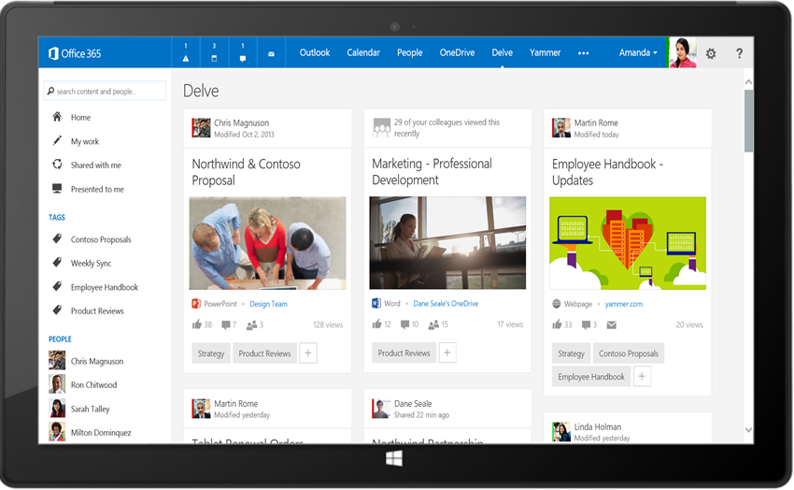
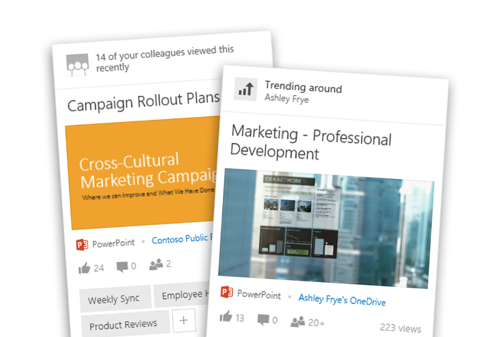
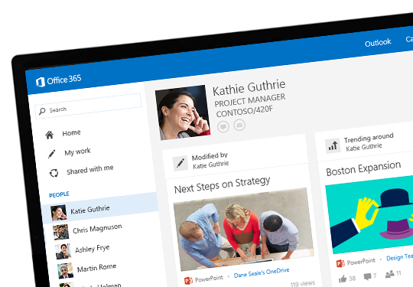
Delve
Search and discovery across Office 365
Stay in the know
Find what you need
Discover new connections
Discover information tailored to you from your network.
Find the right results from any source and take action
Connect with the right experts and learn more about their content

Slide 7
Silos in enterprises
User
Files
Conversations
People & Groups
Events

Slide 8
Enterprise data organized around user
User
Files
Conversations
People & Groups
Events
FILES
MESSAGES
EMAILS
EVENTS
COLLEAGUES

Slide 9
Security and privacy
VIEWED BY ME
SHARED WITH ME
MEETING INVITE
PRIVATE EMAIL

Slide 10
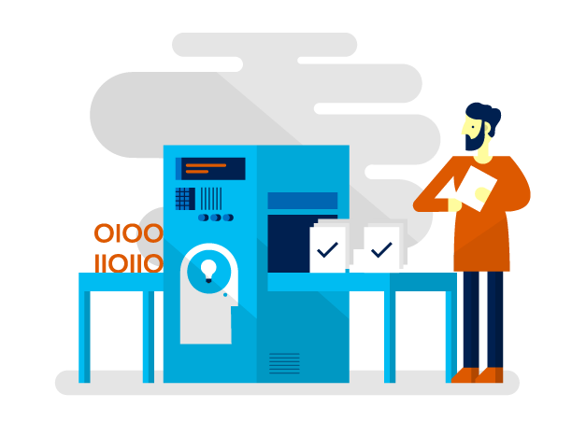
Delve demo

Slide 11
Delve and Office Graph summarized
User
Files
Conversations
People & Groups
Events
FILES
MESSAGES
EMAILS
EVENTS
COLLEAGUES

Slide 12
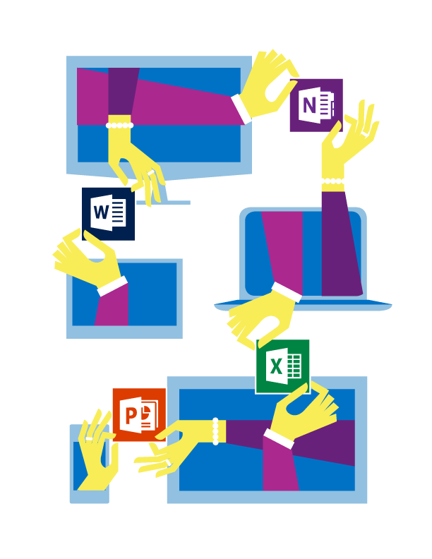
Office Graph next

Slide 13
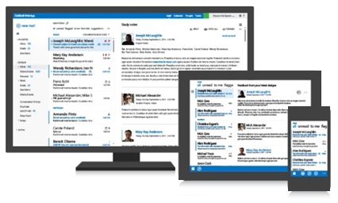
Unified API and Office Graph
Your App
All of O365
Authentication
Federation
graph.microsoft.com
USERS
GROUPS
FILES
MAIL
CALENDAR
TASKS
Insights and relationships from Office Graph

Slide 14
Types of data
Files
Conversations
People & Groups
Events
Actions and relationships
Share Action
Like Action
Access Action
Follow Action
Modify Action

Slide 15
Modeling concepts
File
Title: String
URL: String
Author: User
User
Name: Jane Doe
Alias: JDoe
FILES
USERS
Document
PageCount: Int
Employee
Title: Sales Mgr
CreateAction
TimeStamp: Date
CreatedBy: User
Created: File
CREATE
ACTION

Slide 16
REST / OData queries
GET /Users(‘jane’)/Actions/Liked
GET /Users(‘jane’)/Actions/Liked?$expand=Object
{
value: [
{
@odata.Id: “objects/Microsoft.OutlookServices.LikeAction(‘1234-ABCD’)”,
@odata.Type: “Microsoft.OutlookServices.LikeAction”,
User : "/Users(‘jane')",
Object : "/Users(‘alice')/Files(‘sales')",
Time : "2015-03-11 12:34:56"
},
{
@odata.Id: “objects/Microsoft.OutlookServices.LikeAction(‘5678-EFGH’)”,
@odata.Type: “Microsoft.OutlookServices.LikeAction”,
User : "/Users(‘jane')",
Object : "/Users(‘ken')/Files(‘bonus')",
Time : "2001-10-02 12:33:21"
}
]
}
{
value: [
{
@odata.Id: “objects/Microsoft.OutlookServices.LikeAction(‘1234-ABCD’)”,
@odata.Type: “Microsoft.OutlookServices.LikeAction”,
User : "/Users('jane')",
Object :
{
@odata.Id: “ objects/Microsoft.OutlookServices.File(‘IJKL-1234’)”,
@odata.Type: “Microsoft.OutlookServices.File”,
Name : “All sales closed by my team"
},
Time : "2015-03-11 12:34:56"
},
{
@odata.Id: “objects/Microsoft.OutlookServices.LikeAction(‘5678-EFGH’)”,
@odata.Type: “Microsoft.OutlookServices.LikeAction”,
User : "/Users(‘jane')",
Object :
{
@odata.Id: “objects/Microsoft.OutlookServices.File(‘MNOP-5678’)”,
@odata.Type: “Microsoft.OutlookServices.File”,
Name : "Revised incentive plan"
},
Time : "2001-10-02 12:33:21"
}
]
}

Slide 17
Search + Graph combined
Items I’ve modified
/me/Actions/Modified?$search=Title:windows
+
=
“windows” in title

Slide 18
The question of whether machines can think… is about as relevant as the question of whether submarines can swim.
Edsger Wybe Dijkstra

Slide 19
Office Graph and Analytics
FILES
EXCHANGE
SHAREPOINT
YAMMER
LYNC
SOCIAL
Content and signals across O365 auto-populating the Office Graph insights.
Insights derived with machine learning for proactive and intelligent experiences.

Slide 20
Bob
Alice
graph.microsoft.com
Reactive Analytics
Working with
Working with

Slide 21
Delve and Office Graph extensibility
Boards
Cards
Office Graph
Data types
Analytics
DATA
NOTIFICATIONS
ACTIONS
3rd party data
3rd party app

Slide 22
Extensibility
with Extensions
Enrich existing data
Define your own extension

Slide 23
External Service
SALESFORCE, DROPBOX, WORKDAY, TRELLO, ASANA, ETC.
Office Graph SDK
Microsoft Hosted Service
3rd Party Hosted Service
WEB HOOK, POLL TIMER
EXTERNAL CONTENT SERVICE
REST
CUSTOM DATA PUMPER
Office Graph SDK
Office Graph SDK
REST
REST
OFFICE GRAPH
Office Graph API

Slide 24
Getting external data into the graph
Surfacing external data in Delve

Slide 25
FILES
EXCHANGE
SHAREPOINT
SALESFORCE
Office Graph

Slide 26
Extensibility demo

Slide 27
Demo Scheduler scenario
Presentations
Office 365
Submission deadlines
SharePoint
White papers
Ignite
?
Outlook
App code
Presenters
Dry-run
//Build/
Approvers
Travel plans
1:1 customer meetings
Reviewer
Booth-duty

Slide 28
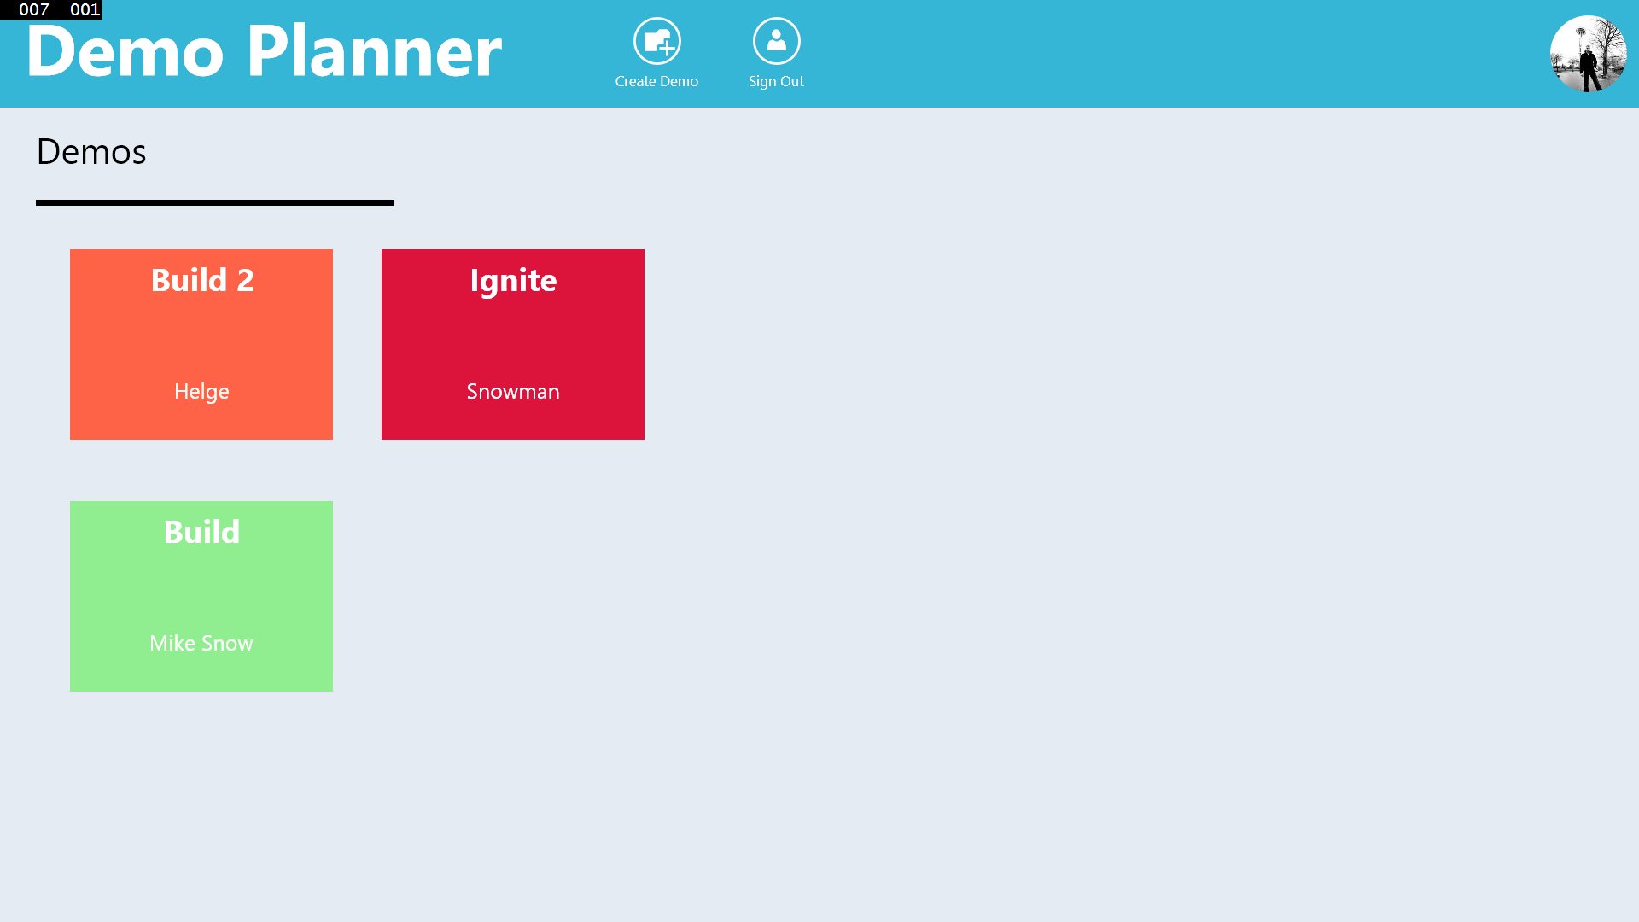
Architecture for Demo Scheduler App
Win 8 App
Unified API
graph.microsoft.com
SPO/ODB
Files
Outlook
Calendar
AD
Users
Office Graph
Demos
Conferences
C
D

Slide 29
Demo Scheduler App

Slide 30
Using the new Office Graph API
Examples
version: /beta
entity-set: /me/actions/liked /users(‘johndoe@outlook.office365.com’)/actions/liked
/groups(‘ignite’)/demos
id: msnow@outlook.office365.com AAMkAGI2NGVhZTVlLTI1OGMtNDI4My1iZmE5LTA5OGJiZGEzMTc0YQ
property conferencename
location
https://outlook.office365.com/api
/
/{version}/{entity-set}({id})/{property}

Slide 31
Working with extensions
Get all extensions available: GET /beta/me/extensiontypes
Define a new extension: POST /beta/me/extensiontypes
{ "Name": "Conference",
"Properties": [
{ "Name": "ConferenceName",
"TypeName": "String" },
{ "Name": "Location",
"TypeName": "String" },
{ "Name": "SubmissionDeadline",
"TypeName": "String"}
],
"PreferredPropertyName": "Conference",
"EntityName": "Conference"
}

Slide 32
Using your own extensions (or the build-in ones)
GET conferences: /beta/me/conferences /beta/conferences
{"value": [
{
"@odata.id": "https://outlook.office365.com/api/beta/Users(‘johndoe@outlook.office365.com')/conferences('df5691f2-53dd-4dd1-a427-b5ada6bbdd08')",
"Name": "Ignite",
"Location": "Chicago",
"SubmissionDeadline": "4/28/2015 5:00:00 PM"
}
]
}

Slide 33
Roadmap and next steps

Slide 34
Roadmap
REST/Odata API
Client SDKs
Type extensibility
Connectors
Custom analytics
Notifications
Licensing

Slide 35
Call to action
Read about the Office Graph http://dev.office.com/officegraph
Build apps with the Office 365 REST API and the Unified API
WorkingWith and TrendingAround
https://msdn.microsoft.com/en-us/office/office365/api/api-catalog
Test the Office Graph preview API
http://msdn.microsoft.com/en-us/library/office/dn783218(v=office.15).aspx
Watch out for a public beta
Tweet or Yam about what you will do with the Office Graph using the hashtag #officegraph

Slide 36
Related Sessions
Session | Code | Time | Room
Team Collaboration in the Connected Workplace | BRK1106 | Mon May 4, 1:30pm | S104
Microsoft Office 365 Groups Overview and Roadmap | BRK2114 | Tue. May 5, 9:00am | S103
Office Delve and Office Graph Vision and Roadmap | BRK1105 | Tue. May 5, 10:45am | S102
Building Solutions with Office Graph | BRK3193 | Tue. May 5, 5:00pm | N227
A New People Experience in Delve: Discover People Through Content, and Content Through People | BRK2176 | Wed. May 6, 10:45am | E353
Break Down Organizational Silos and Gain New Insights with Office Graph and Office Delve | BRK2107 | Wed. May 6, 3:15pm | S103
MVP Panel: Sample Apps and Intelligent Solutions Showcasing Office Graph and Delve Extensibility | BRK3154 | Wed. May 6, 5:00pm | E351
Big Bang: The New Universe of Findability and Discoverability | BRK3165 | Thur. May 7, 1:30pm | E451B

Slide 37
Summary
Delve and Office Graph - Recently released in Office 365
- Insights and intelligence for all your work
Office Graph improvements coming up - Add your own content and
- Enrich existing content
- Build amazing Apps and experiences across Office 365
Release roadmap - Public beta with new features upcoming

Slide 38
The only way of discovering the limits of the possible is to venture a little way past them into the impossible.
Arthur C. Clarke

Slide 39
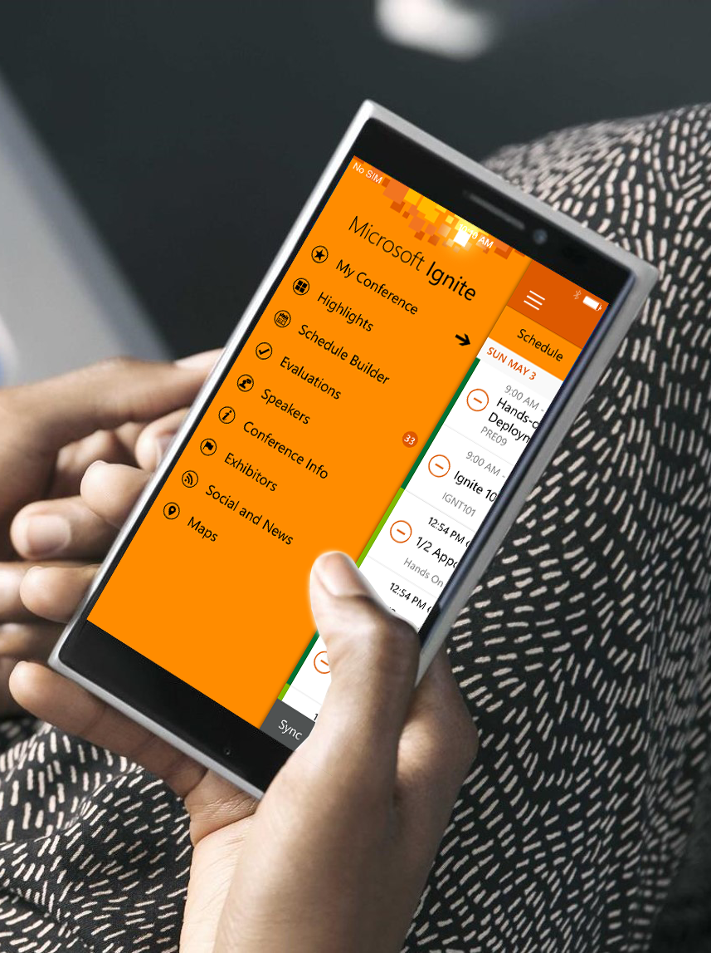
Please evaluate this session
Your feedback is important to us!
Visit Myignite at http://myignite.microsoft.com or download and use the Ignite Mobile App with the QR code above.

