Slide 2
Windows 10 for mobile devices Secure by design
BRK3309
Alan Meeus
Architect, Microsoft Services
Center of Excellence Modern Devices & Mobility

Slide 3
Security challenges
Familiar
Modern
Script Kiddies; Cybercrime
Cyber-espionage; Cyber-warfare
Cybercriminals
State sponsored actions; Unlimited resources
Software solutions
Hardware rooted trust the only way
Secure the perimeter
Assume breach. Protect at all levels
Attacks on fortune 500
All sectors and even suppliers getting targeted
Company owned and tightly managed devices
Bring your own device, varied management
Hoping I don‘t get hacked
You will be hacked. Did I successfully mitigate?

Slide 4
Windows 10 Mobile: Layers of security
App security
Store Apps
Cloud Services
Business Store Portal
Browser security
Data protection
Enterprise Data Protection
IRM & S/MIME
01011
01101
Device encryption
Mobile Device Management
Access Control
Microsoft Passport
Windows Hello
Two Factor authentication
Network security
Windows One Core
OS Services
App Platform
Trusted Boot
Single source updates
Secure Hardware
Only signed binaries
Attestation
UEFI Secure Boot
TPM 2.0

Slide 5
Secure UEFI is a Windows requirement
What is UEFI?
  Hardware initialization and management platform that integrates with the OS
Key Benefits
  Hardware architecture-independent
  It’s an app platform (mouse, pre-os apps, menus)
  Secure Boot specification
  Integrates with the OS
A Windows Certification Requirement
http://www.uefi.org/specs/

Slide 6
Secure boot process
Power On
Secure UEFI
Windows OS boot
Firmware boot loaders
OEM UEFI applications
Windows boot manager
Windows update OS boot
Boot to flashing mode
SoC Vendor
OEM
MSFT

Slide 7
Trusted boot and code signing
During manufacturing
  The hash of the public key used to sign the initial loaders & blow appropriate fuses
  Provisioning of the UFEI key databases
UEFI is secure by design
  UEFI firmware, drivers, applications, and loaders must be trusted (i.e. signed)
  UEFI database lists trusted and untrusted keys, ca’s, and image hashes
  Secured rollback feature prevents rollback to insecure version
  Untrusted (unsigned) option binaries (firmware) can not run
  UEFI able to execute UEFI firmware integrity check and self-remediate
Maintaining UEFI with Windows update
  Updates to UEFI firmware, drivers, applications, and loaders
  Revocation process for signatures and image hashes

Slide 8
TPM
TPM Value Proposition
  Enables commercial-grade security via physical and virtual key isolation from OS
  TPM spec: mature standard, years of deployment and hardening
  Improvements in TPM provisioning lowers deployment barriers
TCG Standard evolution: TPM 2.0
  Algorithm extensibility allows for implementation and deployment in additional countries
  Security scenarios are compatible with TPM 1.2 or 2.0
TPM 2.0 support enables implementation choice
  Discrete TPM Firmware-based (ARM TrustZone® ; Intel’s Platform Trust Technology (PTT))
  Windows Logo Requirement
Health attestation

Slide 9
Windows 10 Mobile: Layers of security
App security
Store Apps
Cloud Services
Business Store Portal
Browser security
Data protection
Enterprise Data Protection
IRM & S/MIME
01011
01101
Device encryption
Mobile Device Management
Access Control
Microsoft Passport
Windows Hello
Two Factor authentication
Network security
Windows One Core
OS Services
App Platform
Trusted Boot
Single source updates
Secure Hardware
Only signed binaries
Attestation
UEFI Secure Boot
TPM 2.0

Slide 10

App platform security model
Dynamic
Permissions
(LPC)
Policy system
Least Privilege Chamber (LPC)
Central repository of rules
3-tuple {Principal, Right, Resource}
Chamber Model
Chamber boundary is security boundary
Chambers defined using policy rules
Trusted Computing Base (TCB)
Capabilities
Fixed
Permissions
Chamber
Expressed in application manifest
Disclosed in Windows Store
Defines app’s security boundary on device

Slide 11
Microsoft universal Windows apps
Store
Photos
Music
Video
Bing Apps
Maps
Skype
Project Spartan
Xbox Games
Mail & Calendar
Word, PowerPoint, Excel
OneNote
File Explorer
Settings
Alarms, Calculator, etc.
RDP
(Skype for Business)

Slide 12
Windows 10 Mobile: Layers of security
App security
Store Apps
Cloud Services
Business Store Portal
Browser security
Data protection
Enterprise Data Protection
IRM & S/MIME
01011
01101
Device encryption
Mobile Device Management
Access Control
Microsoft Passport
Windows Hello
Two Factor authentication
Network security
Windows One Core
OS Services
App Platform
Trusted Boot
Single source updates
Secure Hardware
Only signed binaries
Attestation
UEFI Secure Boot
TPM 2.0

Slide 13
Identity challenges today
Windows Mobile Devices have to be activated with an MSA
  Impossible to manage
Users don’t like complex unlock PIN to access the device
Passwords
  Not enough to protect against modern security threats
  Users are required to provide their identity to more places than ever
Organizations want greater control over the way users provide their identity
  IT has a need to understand patterns, identify potential threats and proactively detect suspicious activity

Slide 14

Windows Hello
Biometrics Authentication
  Using fingerprint, face, iris
  Integrated Biometrics Framework
  False Acceptance Rate 1/100,000
  False Rejection Rate 2-4%
  Live-ness and anti-spoof measures, detection (3D/infrared)
  Regular password/PIN is still available
  MDM managed

Slide 15
Microsoft Passport
Replace passwords with a private key
  Unlocked with solely through a “user gesture” (PIN, Windows Hello)
  To IT it’s familiar as it’s based on asymmetrical key pair or certificate
  To the user, it’s familiar (Windows Hello or PIN)
  Choice of Identity Providers
  Identity providers validate and proof user by OTP, PhoneFactor …
  IDPs map Passport public key to a user account
Private key is never shared
  Keys are ideally generated in hardware (TPM)
  Hardware bound keys are attested (Trusted Computing Group Protocols)
  Single “unlock gesture” aka “Windows Hello” provides access to multiple credentials (origin isolated)

Slide 16
Authentication for Orgs & Consumers
IDP
Active Directory
Azure Active Directory
Microsoft Account
Other IDP’s
Create Account or proves identity
Create and trust unique key
User Unlock Windows identity container w/ PIN or Hello
1
Authentication by validating this signed request
2
Authentication token
Trusts tokens from IDP
3
Token binding
Access Token
Resource
4
Relying Party
So do I

Slide 17
Two-Factor Authentication
Passport as Virtual Smart
  TPM virtualized as a Smart Card
  For authentication, encryption, signing, etc.
  MDM managed
Overcomes top challenges for BYO
  Enrollment process for BYOD (non-domain joined)

Slide 18
Windows 10 Passport scenarios
User (BYO)
  Activates with MS Account
  Adds Azure AD Account
  User uses MS Account to register with MS
  Users use Org Id to register with Azure AD
  Mobile device registration establishes trust for remote resource access
  User signs in with a Microsoft account, associates an Azure AD account
  Intune/MDM to configure the device and manage apps
  Settings roaming with MS Account
IT (Organization owned)
  Azure AD
  Users use Org ID to register with Azure AD
  Computer joins Azure AD to establish trust
  Mobile device registration establishes trust for remote resource access
  User signs in with a Microsoft account, associates an Azure AD account
  Intune/MDM to configure the device and manage apps
  Settings roaming with Azure
  MS Account
  Can be added if allowed (Cortana)

Slide 19
Demo Passport and MDM

Slide 20


Enterprise expectations for corporate access
Anytime, anywhere, secure remote access
Access from anywhere using any device
Protect Access to corporate resources
Easy Management & Deployment
Audit usage and protect against data leak

Slide 21

Expanded VPN capability set
Per-Application VPN
  MDM managed app list and port restrictions
  Integrated with Enterprise Data Protection
Always ON support
  Always connected until user disconnects
  MDM managed
Ease of deployment and management
  MDM solutions can uniformly manage both Windows and Windows Phone VPN based remote connectivity. User experience integrated across mobile devices
Uniformity in Store based distribution
  Open to all VPN solution providers, always up-to-date
  Microsoft SSTP client also available as a Store application

Slide 22
Windows 10 Mobile: Layers of security
App security
Store Apps
Cloud Services
Business Store Portal
Browser security
Data protection
Enterprise Data Protection
IRM & S/MIME
01011
01101
Device encryption
Mobile Device Management
Access Control
Microsoft Passport
Windows Hello
Two Factor authentication
Network security
Windows One Core
OS Services
App Platform
Trusted Boot
Single source updates
Secure Hardware
Only signed binaries
Attestation
UEFI Secure Boot
TPM 2.0

Slide 23
Basics: BitLocker
Protects data when a device is lost or stolen using full disk encryption
Provides protection from cold boot attacks
Market leading integration, performance, and reliability
  Secure boot is required
  All internal storage is encrypted
  Key is discarded when device is on standby.
  Encryption is available on all phones and tuned on by IT Professional or user

Slide 24

Enterprise data protection
Provides user friendly data separation and containment (corporate v. personal)
Enables data protection wherever the data is
Ensures only trusted apps can access your data
Sharing of EDP content protected with IRM

Slide 25
Enterprise Data Protection
IDP
Active Directory
Azure Active Directory
Microsoft Account
Other IDP’s
User Unlock Windows identity container w/ PIN or Hello
Create Account or proves identity
Create and trust unique key
1
EDP Policies
Key Management
Enterprise allowed apps
Network / Storage
App data flow management
Block or Allow/Audit controls
Selective wipe on un-enroll
MDM enrollment
2
Authentication token
MDM
4
So do I

Slide 26
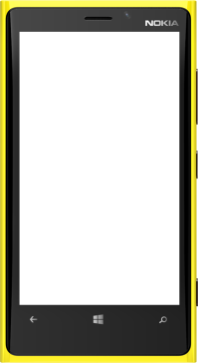
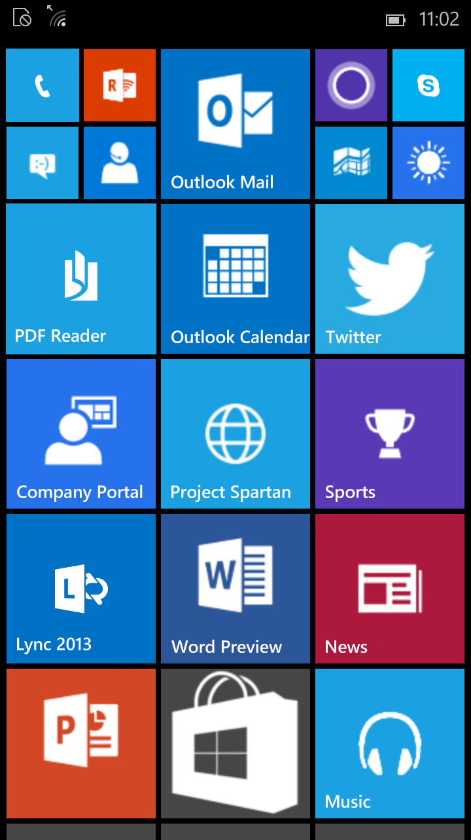
Enterprise Data Protection
One experience
  Data is isolated
  Data is encrypted at rest
  Block/audit data exchange
  Organization holds keys
  Enlightened apps
  APIs for 3rd party apps
MDM managed
Business Apps & Data
(Managed)
Personal Apps & Data
(Unmanaged)
Data exchange is controlled

Slide 27
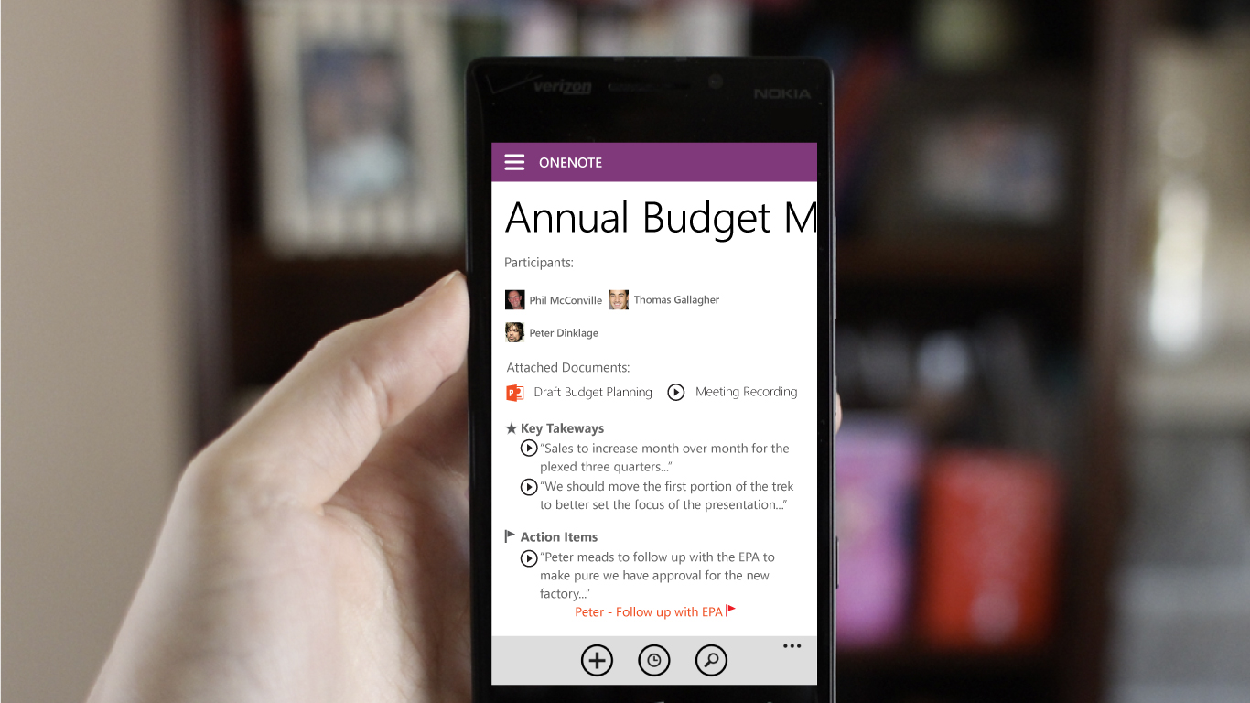


UPDATE ARTWORK
Cortana assets from Shane
Early Designs Not Final UI

Slide 28
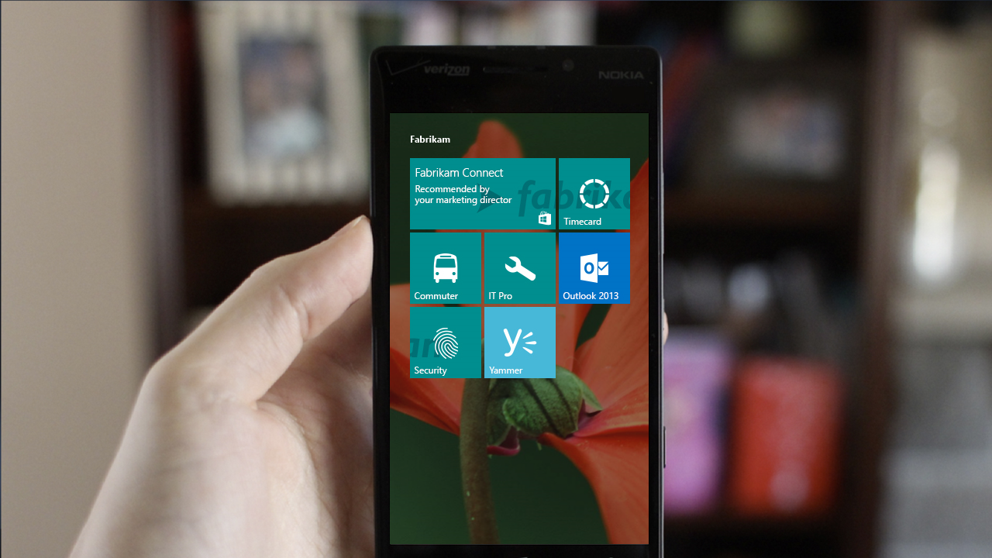


Early Designs Not Final UI
Office

Slide 29
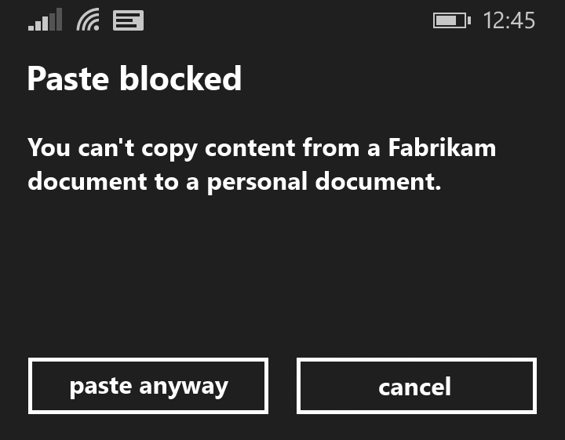
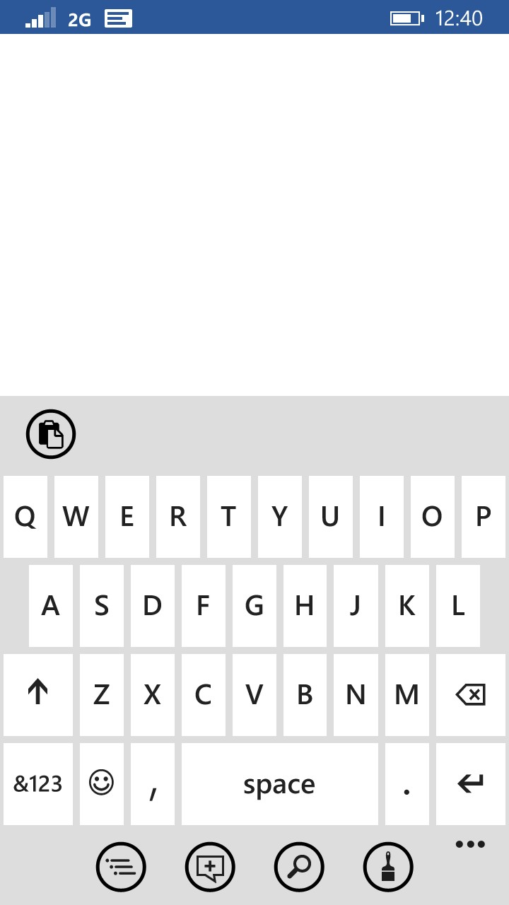
UPDATE ARTWORK
Cortana assets from Shane
Early Designs Not Final UI
Pasting content from a Fabrikam file to a personal file is discouraged, and if you choose “paste anyway” your action and the content will be logged for IT review.

Slide 30
Mobile device management
Un-enrollment with alerts
Removal of configuration
& EDP protected data
Provisioning
Bulk enrollment
Simple bootstrap
Converged protocol
Azure AD Integration
ENROLLMENT
UNENROLLMENT
One consistent set
of MDM capabilities across Mobile, Desktop, and IoT
Remote Lock, PIN reset, Ring, Find
Full device wipe
INVENTORY
Enhanced inventory for compliance decisions
Curated Windows Store
Volume Purchase Program and app distribution
License reclaim/re-use
Enterprise App management
LOB app management
App inventory (MDM/Store)
App allow/deny list
Enterprise data protection
Extended set of policies
Context based policies
Client certificates – Direct install (PFX)
Enterprise Wi-Fi profiles
VPN profiles
Email provisioning
MDM Push when user not logged in
Kiosk Mode, Start screen configuration and control
REMOTE ASSISTANCE
DEVICE CONFIGURATION AND SECURITY
APPLICATION MANAGEMENT

Slide 31
Windows 10 Mobile: Layers of security
App security
Store Apps
Cloud Services
Business Store Portal
Browser security
Data protection
Enterprise Data Protection
IRM & S/MIME
01011
01101
Device encryption
Mobile Device Management
Access Control
Microsoft Passport
Windows Hello
Two Factor authentication
Network security
Windows One Core
OS Services
App Platform
Trusted Boot
Single source updates
Secure Hardware
Only signed binaries
Attestation
UEFI Secure Boot
TPM 2.0

Slide 32
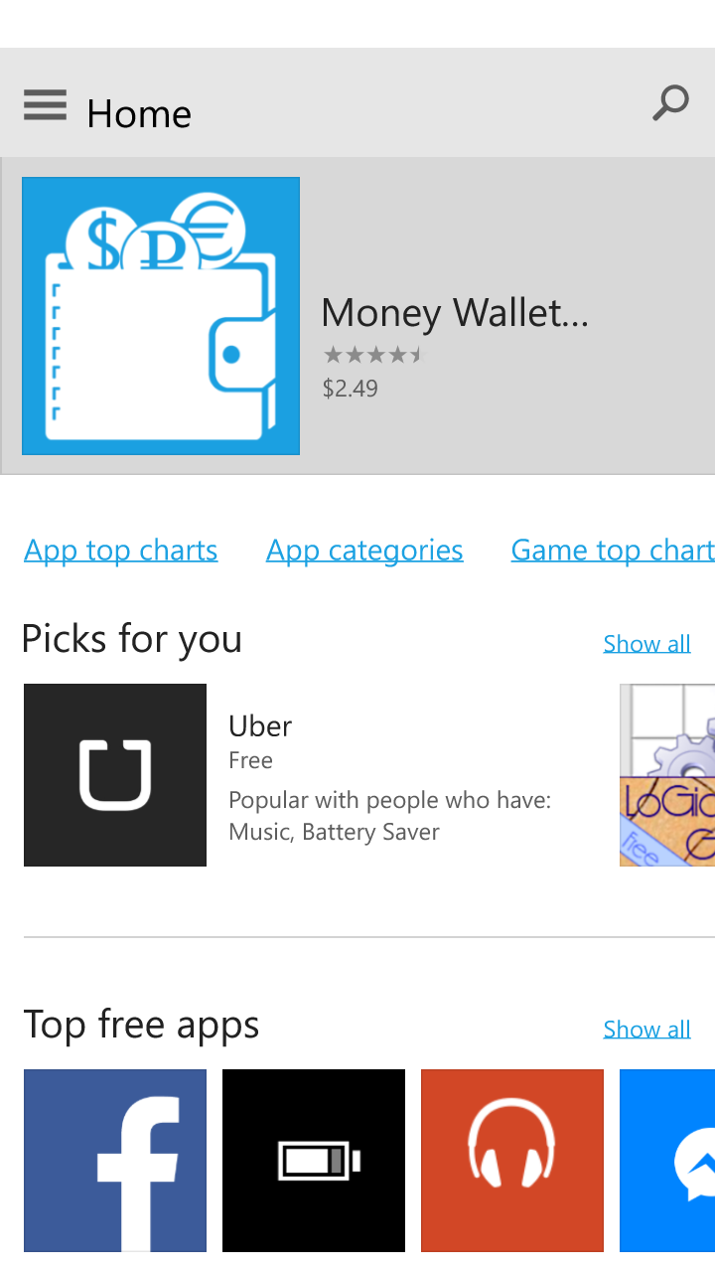
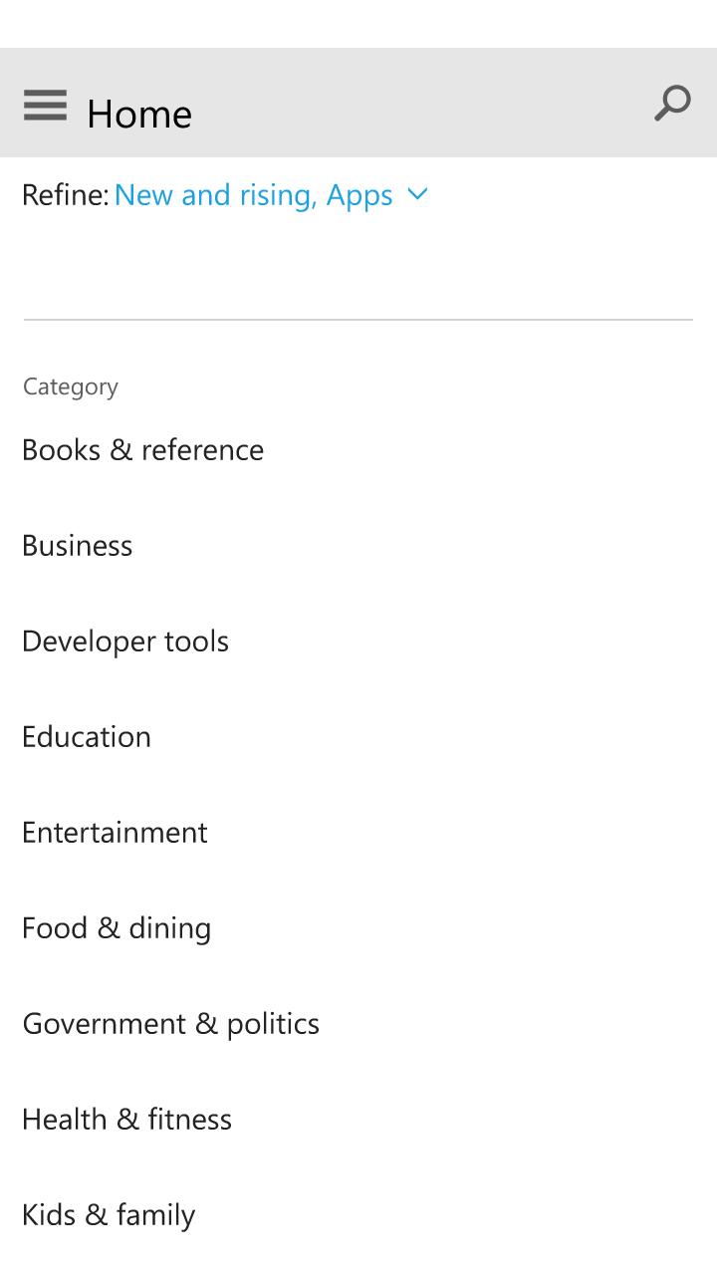
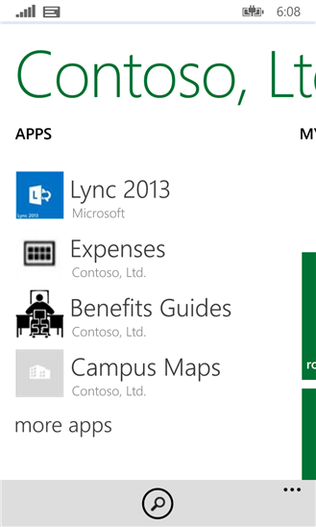
Windows 10 at a Glance
Windows Store
  Modern apps
  Sign in with MSA
  Pay with credit card, gift card,
  PayPal, mobile operators
Business Store
  Modern apps
  Leverages Azure Active
  Private store in the store for Store and LOB apps
  Pay with credit card or PO/invoice
  Modern app license management
Company Portal
  MDM-driven
  Deploy Line-of-business modern apps from catalogue
  Deploy Windows Store apps (even when the Store UI is disabled) and as well as uploaded LOB apps through BSP integration

Slide 33

Business Store
A web site for businesses, schools, or other organizations
  Free to use, easy to sign up
  Used by IT administrators, purchasers
Provides key functionality for acquiring, using, and deploying apps in an organization
  Including line-of-business apps
Complements the existing management solutions
  Flexible scenarios for any need

Slide 34
Private online store
Scenario
IT Manager
Sign in to Business Store
  Uses Azure AD account
Acquire apps
  Free apps
  Purchased using a PO, invoice, or credit card
Create private store
  Add apps
Infrastructure
  Cloud-based
  No on-premises infrastructure requirements
  No MDM service required
  Apps automatically updated from the Windows Store
  Can include LOB apps
End User
Log into windows
  Using Azure AD account
Open Windows Store app
  Private store and public categories available
Install apps as needed
  Selected from the Private Store using Azure AD, or public categories using MSA

Slide 35
Online with Mobile Device Management
Scenario
IT Manager
Sign in to Business Store
  Uses Azure AD account
Acquire apps
  Free apps
  Purchased using a PO, invoice, or credit card
Add apps to MDM
  Link to the app in the Business Store
Infrastructure
  Cloud-based or on-premises (depending on the MDM service used)
  Store Apps automatically updated from the Windows Store
  The Windows Store app can be disabled if desired
  APIs available to ISVs to automate the BSP interactions
End User
Log into windows
  Using Azure AD account
Open Company Portal app
  Selected Windows Store apps and private LOB apps available
Install apps from Company Portal
  Install public Windows Store apps using MSA

Slide 36
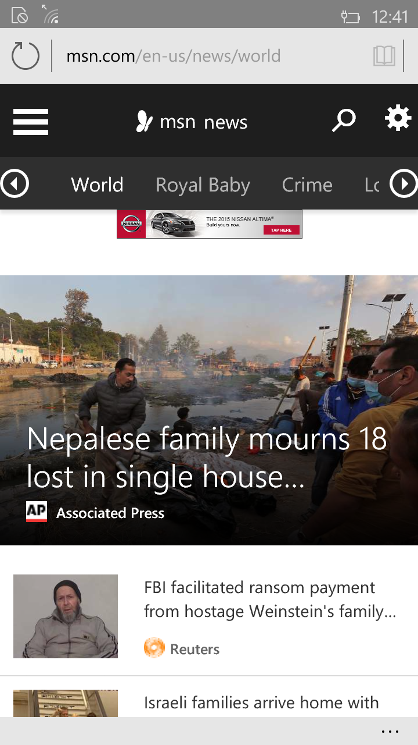
Edge
Only browser on Mobile
Modern Browser
Managed by MDM
  Allow Browser
  Default Browser
  Allow pop-ups
  Allow Cookies
  Configure SmartScreen
  Allow Active Scripting
  Configure Home Page
  Configure Multi Media
  Allow Autofill
  Configure password manager

Slide 37
Windows 10 Mobile: Layers of security
App security
Store Apps
Cloud Services
Business Store Portal
Browser security
Data protection
Enterprise Data Protection
IRM & S/MIME
01011
01101
Device encryption
Mobile Device Management
Access Control
Microsoft Passport
Windows Hello
Two Factor authentication
Network security
Windows One Core
OS Services
App Platform
Trusted Boot
Single source updates
Secure Hardware
Only signed binaries
Attestation
UEFI Secure Boot
TPM 2.0

Slide 38
Security takeaways

Slide 39
Built for real world IT
Windows Security
Microsoft Cloud
Enterprise Mobility Suite + Office 365 + Azure AD
Simplified and Interated
Flexible options
Reduced complexity
Solid identities
Enabled By
Data protection
Secured devices
Application controls

Slide 40

Next Steps
Evaluate Windows 10 for your business
  Windows Insider Program insider.windows.com
Evaluate your readiness for Windows 10
  BYO mobility Lab
Investigate developing Universal Windows app
  //BUILD channel9.msdn.com
Complete your eval
  Appreciated, thanks

Slide 41


Please evaluate this session
Your feedback is important to us!
Visit Myignite at http://myignite.microsoft.com
or download and use the Ignite Mobile App
with the QR code above.

