Slide 2
Managing Windows 10 with
Microsoft Intune and System Center Configuration Manager
BRK3310
Jason Githens – Principal PM Manager
Mark Florida – Principal PM Manager

Slide 3
Session Overview
Windows 10 in the Enterprise
Deploying Windows 10
Managing Windows 10
Configuration Manager and Microsoft Intune

Slide 4
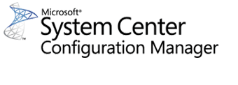

Windows 10 in the Enterprise
Simplified Provisioning
Platform
Unification
Rich Enterprise Features
Dynamic
Servicing

Slide 5
Simplified Provisioning

Slide 6
Deploying Windows Today
Plan
Build Custom Image (Drivers, Apps, Updates)
New Hardware
In-Place (Refresh)
Wipe
Reimage
New Windows Version or Major Image Revision

Slide 7
Deploying Windows 10 – In Place Upgrade
Plan
Upgrade (Improved, deeply integrated with Task Sequence for Windows 7+)
Future updates through Windows Servicing Model

Slide 8
Why Upgrade?
Preserve applications, drivers, user data and settings
  Reduce upfront testing and deployment prep
Compared to refresh, upgrade is…
  Faster – 30 to 60 minutes, on average, to upgrade
  Smaller – file size is just the default OS media, no applications
  More robust – “bulletproof” rollback on failure to functional downlevel system
Zero ADK dependencies
Use it to supplement existing deployment scenarios
  Refresh, replace, and bare metal
  Another tool in the OS deployment toolbox

Slide 9
Deploying Windows 10 – New Hardware (IT)
Build Provisioning Package (through WICD/CM/Intune)
New Hardware
(Standard Pro Image)
Apply Provisioning Package
Future updates through Windows Servicing Model
Plan

Slide 10
What can be Provisioned (WICD)
Initial Setup
Edition Upgrade
Certificates
Connectivity Profiles
Management Enrollment
Modern
Applications
Win32 Applications
Scripts
Enterprise Policies
Offline content
Browser Settings
Start Menu Customization
Assigned Access

Slide 11
What can be Provisioned
Specify volume license key for edition upgrade
After upgrade is completed, provisioning can configure advanced settings not available on the original SKU
No need for re-imaging!
Edition Upgrade

Slide 12

Management Enrollment
Domain Join and Install the ConfigMgr Client
PPKG
“Vanilla” Device
OR
Azure Directory Join and Intune Enroll

Slide 13

Applying a package
First Run Experience – 5 taps on button
  Removable media (SD/USB) on Desktop and Mobile
  NFC on Mobile devices
During runtime
  Click on .PPKG file (from email, local storage, media, URL) – all platforms
  USB tether to Mobile devices
Embedded in the image – all platforms
  Can be integrated with ConfigMgr OSD, MDT and WDS

Slide 14
Provisioning Package:
Edition Upgrade
Jason Githens

Slide 15
Provisioning Profile Creation through ConfigMgr and Intune
Basic profile creation for enrollment
  “Lifeline” Configurations like WiFi and SKU upgrade for forced enrollment into ConfigMgr MDM or Intune MDM
  Create the profile directly in the admin console (no need to use the Windows and Image Configuration Designer unless you need a more robust provisioning package)

Slide 16
Provisioning Profile Creation through ConfigMgr and Intune
Mark Florida

Slide 17
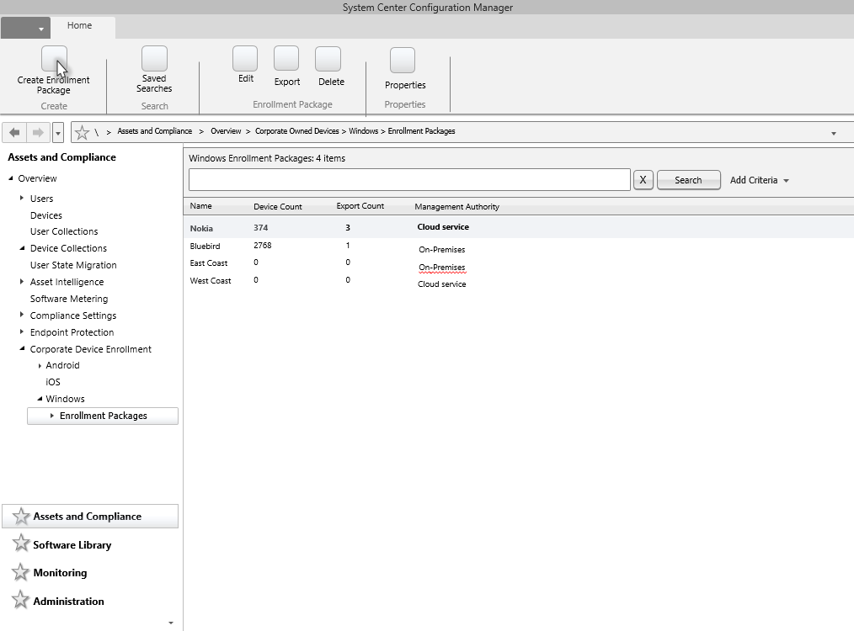

Slide 18
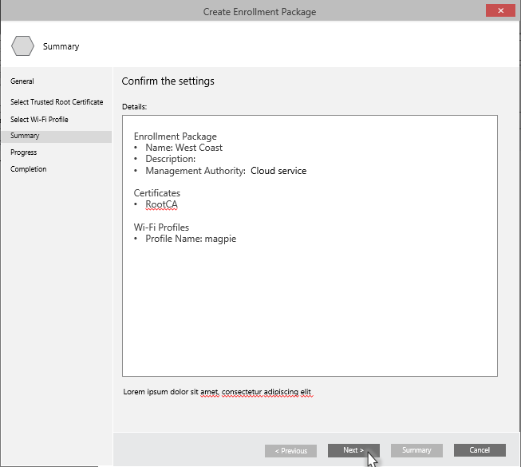
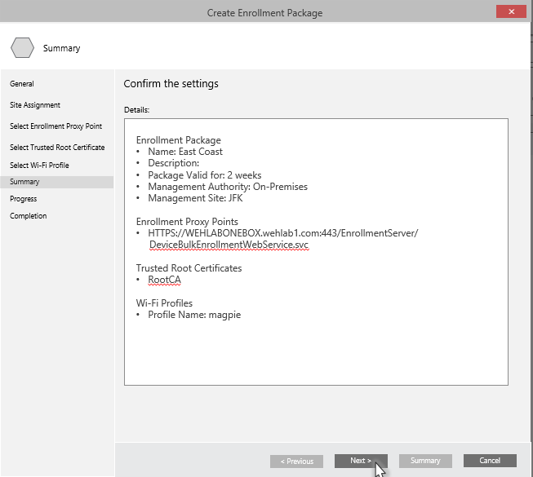
Intune (Hybrid) Profile
ConfigMgr on-premises MDM Profile

Slide 19
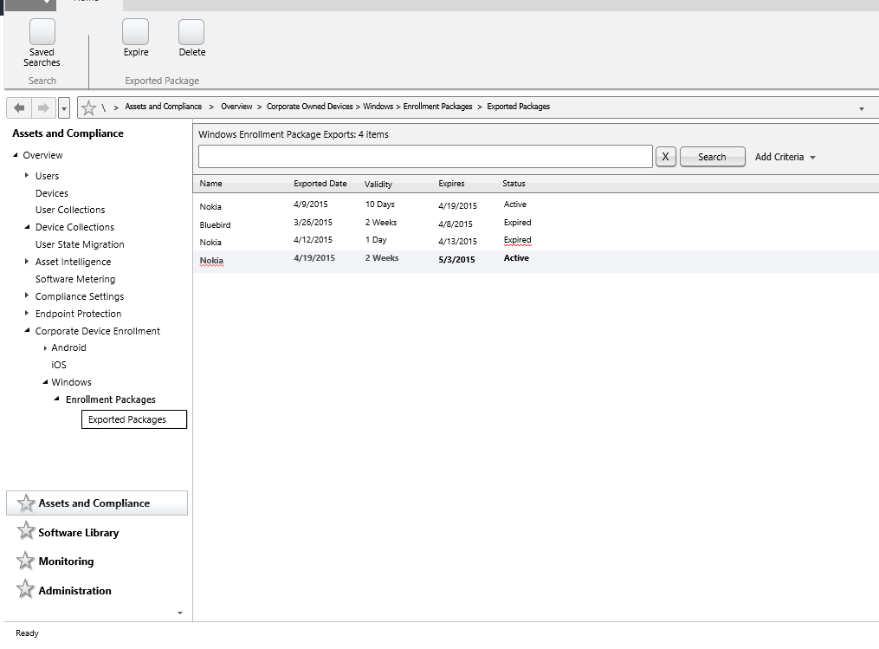
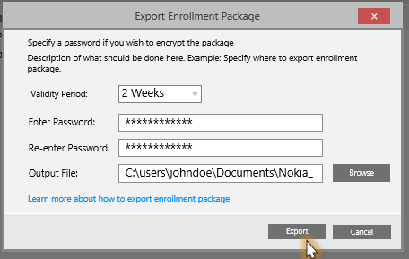

Slide 20
Deploying Windows 10 – New Hardware (User)
New Hardware
(“Vanilla” Image)
Azure Active Directory Join
Intune Enroll Apply Policies
Windows Updated through Servicing Model
Plan

Slide 21
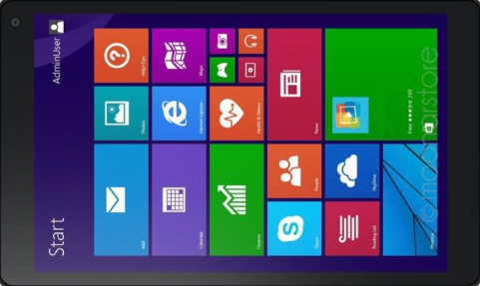

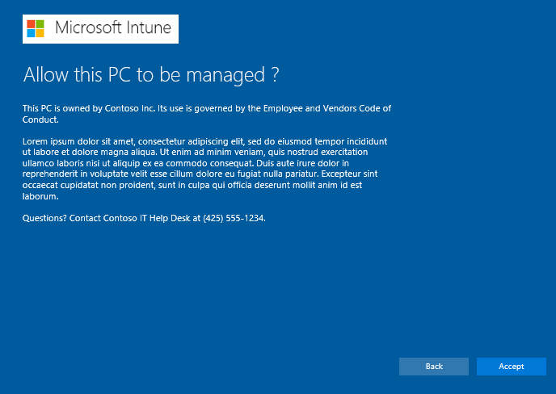
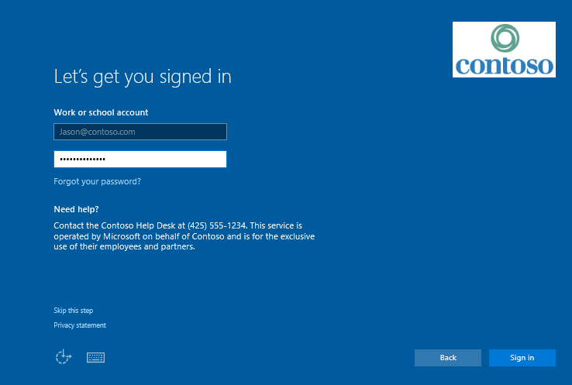
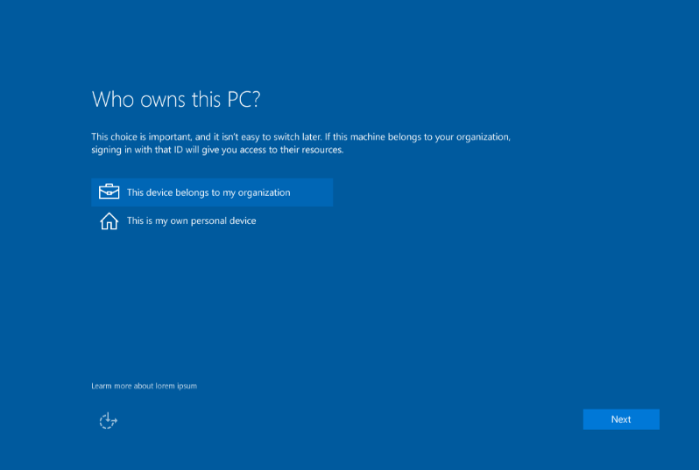
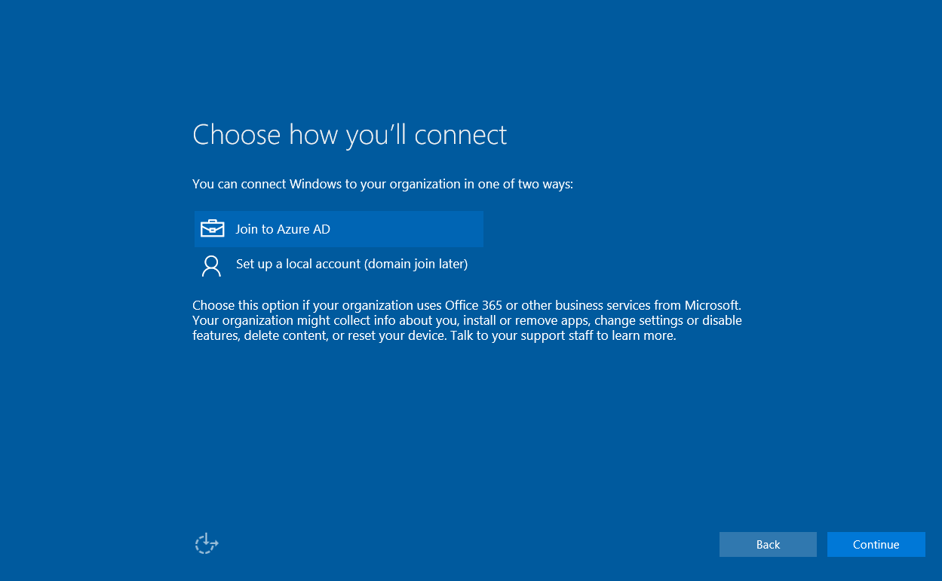


Azure Active Directory Join
Register Device in AAD
Auto enroll into Intune
Other Workflow Features
User can be set as standard
Multi-factor authentication
Passport Configuration
Immediate policy and app delivery through Intune
When completed, user can login to a business-ready device with their AAD account

Slide 22
Azure Active Directory Join and Intune Enrollment
Jason Githens

Slide 23
Platform Unification

Slide 24
Customer value of Platform Unification
Unified management stack across all SKUs with over 100 policies configurable by MDM
All new features supported through MDM and ConfigMgr Client
Universal Windows App and Business Store simplifies cross-plat provisioning and deployment through ConfigMgr and Intune
Simplifies decisions on management solutions (ConfigMgr, Hybrid, or Intune)

Slide 25
Convergence Reduces Manageability Gaps across Management Solutions

Slide 26
Demo: Windows MDM Policy
Jason Githens

Slide 27
Rich Enterprise Features

Slide 28
Corporate Owned Devices– Manage Windows 10
Enterprise Data Protection provides a platform-based way to protect your company from data leakage (DEMO)
Device lockdown (Kiosk mode, task worker) (DEMO)
Users can easily access corporate data from anywhere with per application VPN
Microsoft Passport provides enhanced options for authentication such as PIN or Biometrics
Business Store to support licensing and distribution of
apps to enterprise customers, redistributable through
ConfigMgr and Intune

Slide 29
Enterprise Data Protection
User enrolls into Intune or domain join
PROVISIONING: KEYS AND POLICIES
1
Intune or SCCM provisions policy and encryption keys
2
User
Policies:
Enterprise allowed apps
Network policies
App restriction policy

Slide 30
Enterprise Data Protection
DATA INGRESS
Data coming in from an enterprise network location is encrypted on device
Examples: OneDrive For Business, Corporate Exchange mail, file, etc.
User

Slide 31
Enterprise Data Protection
DATA SEGMENTATION
Users can save to enterprise folders, encryption will be automatically applies.
Users are given an option to save data as personal or corporate
IT admin can configure which apps should automatically protect data
User

Slide 32
Demo: Enterprise Data Protection with ConfigMgr and Intune
Jason Githens

Slide 33
Dynamic Servicing

Slide 34
Windows as a Service + ConfigMgr and Intune
Windows will offer a Long Term Servicing Branch, a Current Branch, and a Current Branch for Business
The Windows Current Branch and Current Branch for Business will deliver new Windows features on an iterative basis
System Center Configuration Manager which will be generally available in Q4 2015 will be more easily updatable to support these iterative Windows 10 updates
Intune will also iteratively stay up-to-date to manage these new Windows 10 features

Slide 35
Deployment choices for ConfigMgr, Hybrid, and Intune to Manage Windows 10

Slide 36


Current deployment options
Intune standalone (cloud only)
Configuration Manager integrated with Intune (hybrid)
IT
IT
Intune web console
Configuration Manager console
System Center Configuration Manager
Windows PC, Windows Phone, iOS, Android
Windows PC, Mac, Linux, Windows Phone, iOS, Android

Slide 37

New hybrid option to manage Windows 10 devices via MDM with on-premises infrastructure
On-premises network
Functionality available in ConfigMgr Technical Preview
Ability to manage Windows 10 Mobile
Per-user device enrollment
Settings and policies
Device wipe and retire
New features
Policies
Data
SQL
Windows 10 PCs and mobile devices
(with MDM-style management of PCs)
ConfigMgr
Coming soon
Ability to manage Windows 10 PCs with MDM-style management
Software and app deployment
Resource access profiles
Bulk enrollment
ConfigMgr console
Example scenarios: IoT/embedded devices, highly regulated customers

Slide 38
Overview: Windows 10 management with ConfigMgr and Intune
Product Version | Release Vehicle | Release Timing | Windows 10 Features Supported | Windows Servicing Model Supported
ConfigMgr | Technical Preview | 5/4 | New and existing features | Current Branch & Long-Term Servicing Branch
 | Generally Available | Q4 CY2015
ConfigMgr 2012 SP2 and ConfigMgr 2012 R2 SP1 | Service Packs | 5/14 | Existing features | Long-Term Servicing Branch
ConfigMgr 2007 | Hotfix | Q4 CY2015 | Existing features (management only, no OSD) | Long-Term Servicing Branch
Microsoft Intune | Monthly Service Updates | 5/4 app compatibility and management of new Windows 10 features via custom policies with incremental updates to deliver full support | New and existing features | Current Branch & Long-Term Servicing Branch

Slide 39
Windows 10 Will Change the Way
You Deploy and Manage Windows
Configuration Manager & Intune,
We’ve Got You Covered

Slide 40
Bringing it All Together
Deploying and managing Windows has been challenging.
With Windows 10, and ConfigMgr & Intune it gets easier
Deployment and Management enhancements to Windows 10 and supported by ConfigMgr & Intune provide deep enterprise value to all the corners of device management

Slide 41


Please evaluate this session
Your feedback is important to us!
Visit Myignite at http://myignite.microsoft.com
or download and use the Ignite Mobile App
with the QR code above.

