Slide 2
Deploying Microsoft Surface in the Enterprise
BRK3327
Brett Muzzey Milad Aslaner Joao Botto
Director of PM Program Manager Program Manager
Surface Surface Surface

Slide 3
Engineering Team

Slide 4
Surface Engineering Team
About Us:
Post Launch Engineering is responsible for sustaining all shipped Surface devices
Commercial Engineering is part of future-product team to ensure great commercial experience

Slide 5
Data Driven
Being Data Driven:
There is lot of data that starts streaming in prior to launch and increases beyond product launch
Data returns in different channels enabling a
real view of the state of the product
Resulted in PLE publishing at least monthly targeted updates following launch

Slide 6
Focus
Looking back: Surface Pro 3
Wi-Fi
Connected Standby/InstantGo
Enterprise Applications
Firmware and Driver Updates

Slide 7
Focus
Looking forward: Surface 3 & Windows 10
Wi-Fi
LTE
Same Update and Deployment Model
Pro 1/2/3 and Surface 3 - all Fully Support Windows 10

Slide 8
NOW

Slide 9
Deployment recommendations
Make sure you are installing the right drivers – if using MDT filter your deployment share
Add packages for hibernation, firmware installation, and quick note-taking
Make the device hibernate after 4h of sleep
Enable UEFI management from the OS
Install Surface App

Slide 10
Demo
Deployment

Slide 11
THE MSI
A technology you know to:
Supply deployment drivers
Improve device reliability and performance
Deliver new features
Big benefits in an easy to deploy package

Slide 12
FUTURE

Slide 13
Challenges
New buzz words are all over the place – BYOD, CoIT, CYOD and more…
Manageability is getting very complex, every day more devices popping up
Traditional deployment and manageability processes are not sufficient anymore

Slide 14
Solution
Windows becomes more mobile with Windows 10, it can now be provisioned just like a smartphone….
Regardless of form factor, SKU etc. it just works
Perfect for all those weird buzz words ☺

Slide 15
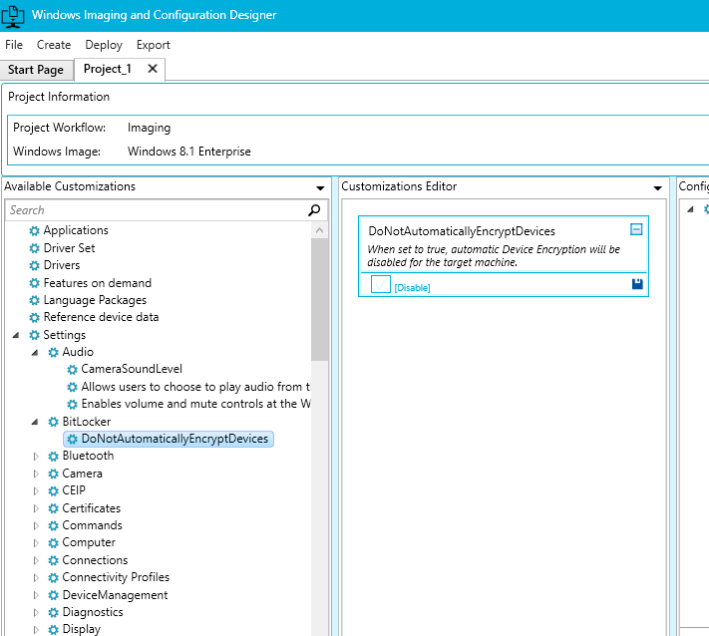
Solution
Easy way to create images and provisioning packages
Automated process for generating images and medias
Flexible imaging and configuration support
It’s free, comes with Windows 10 ADK and is project driven

Slide 16
Demo
Provisioning

Slide 17
Recommendations
Small
Organization
Mid-sized
Organization
Large
Organization
ICD to create full image media
ICD to create provisioning package
MDT/SCCM to create and deploy custom image
ICD to create media
ICD to create provisioning packages
MDT/SCCM to create and deploy custom image
ICD to create provisioning packages
Note: Combinations of tools are possible, such as putting ICD provisioning package in custom SCCM, MDT or OEM image

Slide 18

Deploy Microsoft Surface Today!
Surface Deployment Guide
Surface for IT Pro Blog
Surface Blog

Slide 19
Surface Breakout Sessions
Timeslot | Title | Primary Speaker/s | Room
Tues, May 5 9:00am - 10:15am BRK2340 | Why Surface IS your next company device! | Cyril Belikoff | S106
Tues, May 5 3:15 - 4:30pm BRK3327 | Deploying Microsoft Surface Pro 3 in the Enterprise | Brett Muzzey; Joao Botto; Milad Aslaner | E450
Wed, May 6 9:00 - 10:15am BRK2326 | Design Matters for Surface Devices | Ralf Groene | S504
Wed, May 6 3:15 - 4:30pm BRK3302 | Building Microsoft Surface Pro 3 | Vineet Thuvara | N427
Thurs, May 7 5:00 - 6:15pm BRK4300 | Scratching the Surface: Lessons from Support | Scott McArthur; Kyle Blagg, Antonio Vasconcelos | E352

Slide 20


Slide 21


Please evaluate this session
Your feedback is important to us!
Visit Myignite at http://myignite.microsoft.com
or download and use the Ignite Mobile App
with the QR code above.

