Slide 2
Microsoft Azure Marketplace
BRK3450
Asim Mitra, Christine Avanessians

Slide 3
Agenda
Overview of Microsoft Azure Marketplace and its benefits
Review of Breadth, Depth, and Quality of Marketplace Content
Deep Dive with use cases for Marketplace content with Compute on Azure Resource Manager

Slide 4
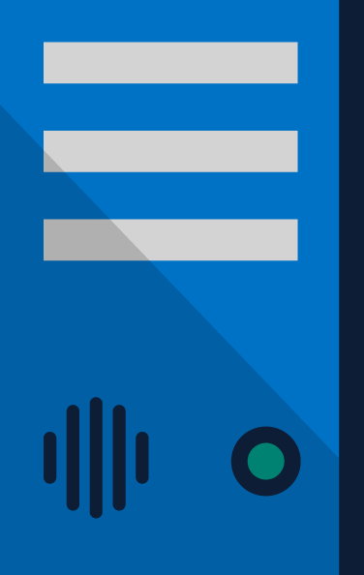


Enterprise Environments
Hybrid
Customer IT Budget Allocations in 2015⁴
50%
“Nearly of large enterprises will likely have hybrid cloud deployments by the end of 2017.”¹
SaaS
15%
45%
PaaS
9%
Public
of total IT services spent on cloud services by 2020²
62%
Hybrid & pubic cloud services
Hosted Infrastructure Services (IaaS)
18%
13%
Outsourcing Services
Partners expect
of revenue to come from cloud-related products & services in 2-years time³
Colocation
6%
40%
On-Premise
38%
On-premises
In datacenters or sites your organization operates
38%
¹Gartner, Inc. 2013. Press Release: http://www.gartner.com/newsroom/id/2599315
²2020: Transform Your IT Infrastructure And Operations Practice, Forrester Research, Inc., October, 2012
³Sources: IDC, 2014, Successful Cloud Partners 2.0: What IT Solution Providers Need To Know To Build Profitable Cloud Practices
⁴Source: 451 Research, 2014. Hosting and Cloud Study 2014 Hosting and Cloud Go Mainstream

Slide 5
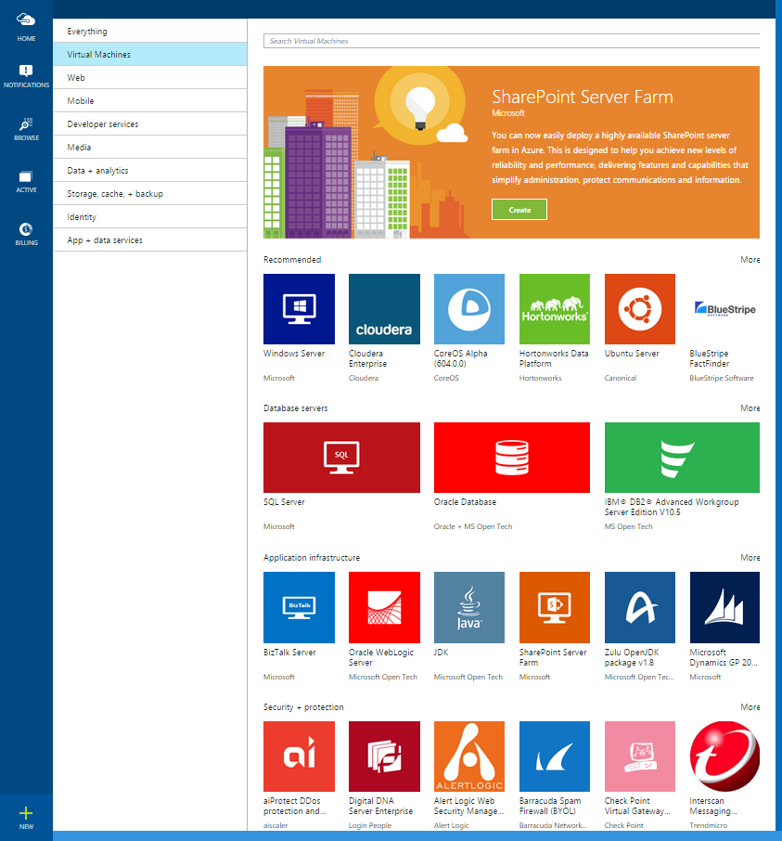
Microsoft Azure Marketplace
An online store for integrated applications and services ready to deploy on Microsoft Azure
Manage
Transact
Manage
Discover
Transact
Discover
Deploy
Solve
Deploy
Solve
MARKTPLACE

Slide 6








































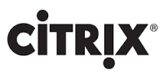















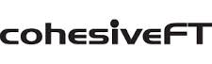















Customer Benefits
GROWING ECOSYSTEM
BILLING ON YOUR TERMS
Virtual Machines
Data
Services
Application
Services
INTEGRATED & CONSISTENT MANAGEMENT XP
AAD
Applications
Web Applications
DEPLOY MULTI-RESOURCE SOLUTIONS WITH A CLICK

Slide 7
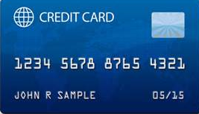
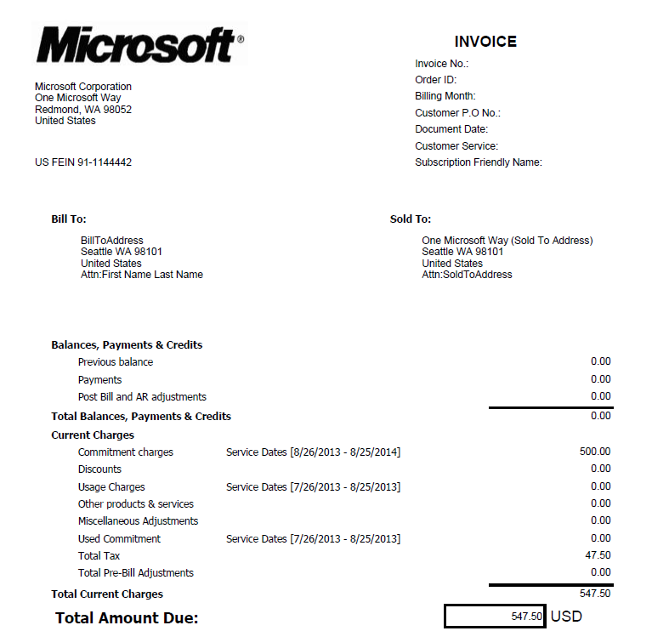
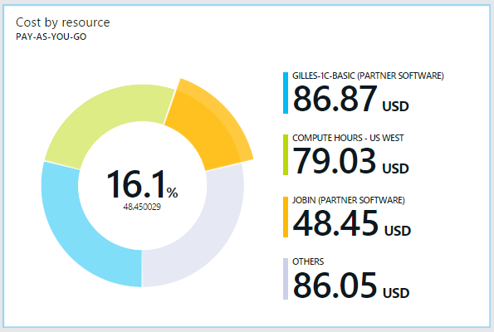

Customer Benefits
GROWING PORTFOLIO OF SOLUTIONS
PLANS
PAYMENT MECHANISMS
FREE
TRIALS
BILLING ON YOUR TERMS
BUYER INSIGHTS
BYOL
HOURLY RATES
INTEGRATED & CONSISTENT MANAGEMENT XP
MONTHLY PLANS
ANNUAL PLANS
87 COUNTRIES
PROMO MODELS
CUSTOM EA
DEPLOY MULTI-RESOURCE SOLUTIONS WITH A CLICK

Slide 8
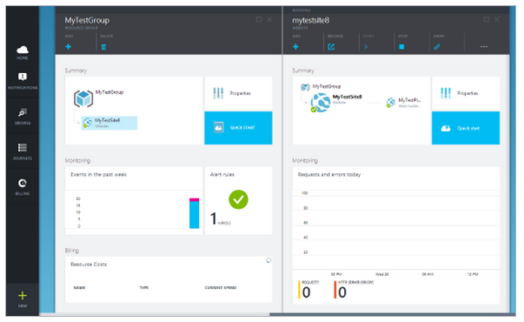
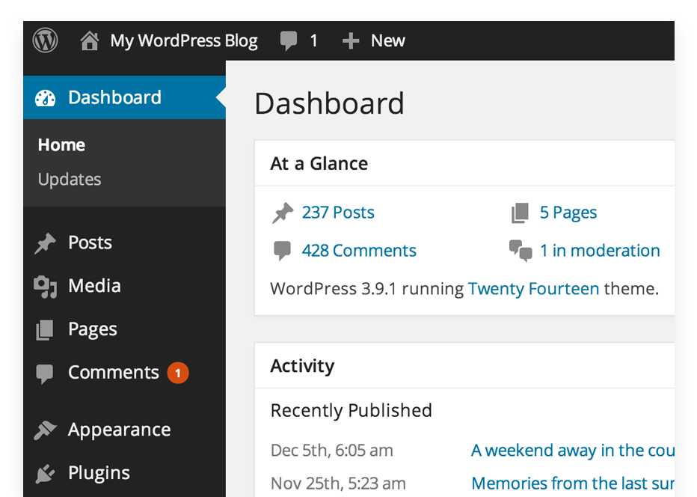
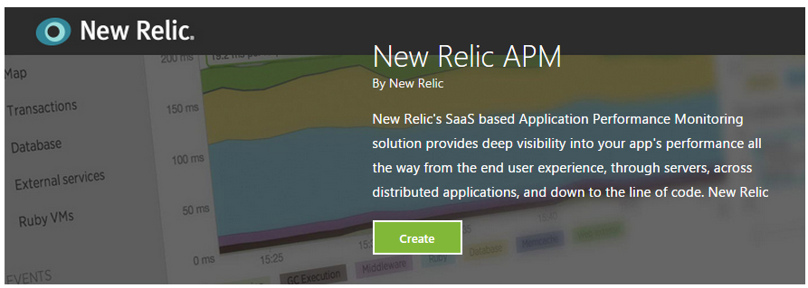
Customer Benefits
GROWING PORTFOLIO OF SOLUTIONS
BILLING ON YOUR TERMS
INTEGRATED & CONSISTENT MANAGEMENT XP
DEPLOY MULTI-RESOURCE SOLUTIONS WITH A CLICK

Slide 9
Demo

Slide 10
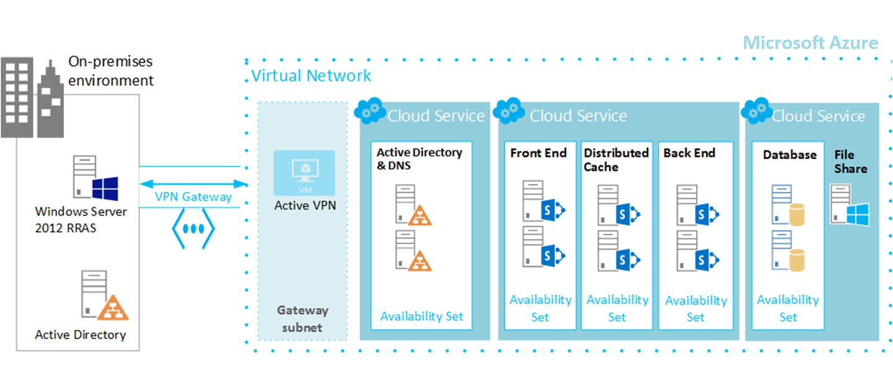
Customer Benefits
GROWING PORTFOLIO OF SOLUTIONS
BILLING ON YOUR TERMS
INTEGRATED & CONSISTENT MANAGEMENT XP
DEPLOY MULTI-RESOURCE SOLUTIONS WITH A CLICK

Slide 11
IaaS Ecosystem
Bryon Surace

Slide 12
Azure Marketplace and Virtual Machines
VM Depot: A community managed repository of Linux and Free BSD virtual machine images
Azure OS Images: First and Third Party Operating Systems ready to run on Azure
Azure Certified: Certified, production ready VMs w/ complete billing mechanism

Slide 13
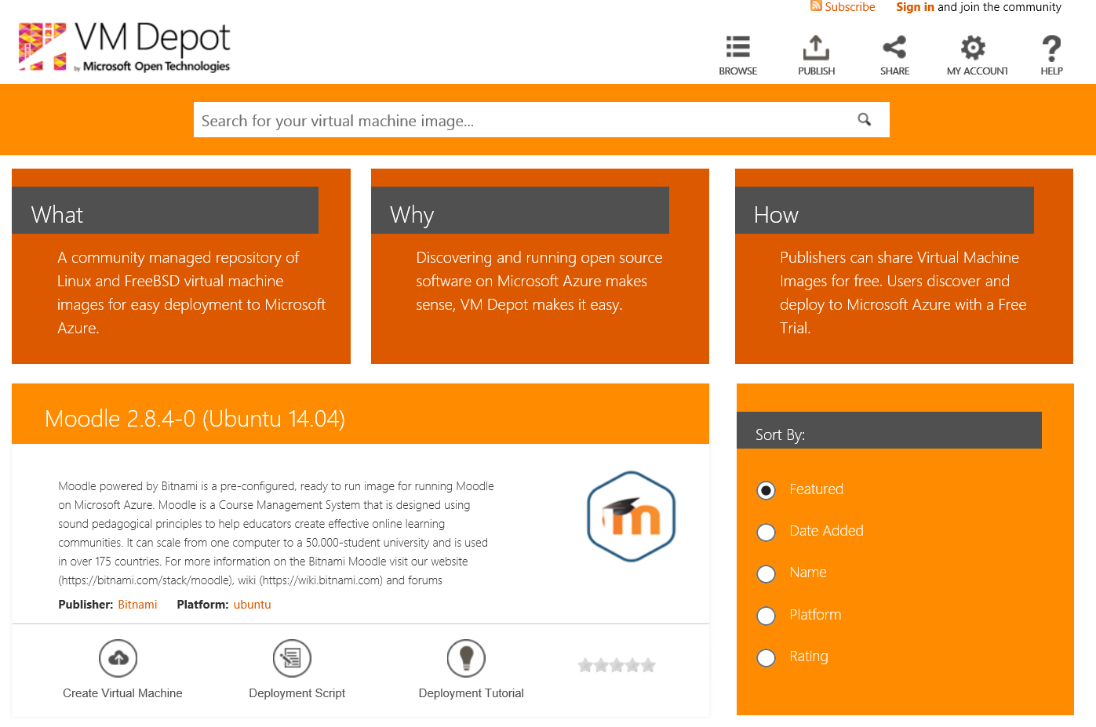
VM Depot
A community managed repository of Linux and Free BSD virtual machine images.
https://vmdepot.msopentech.com/List/Index

Slide 14
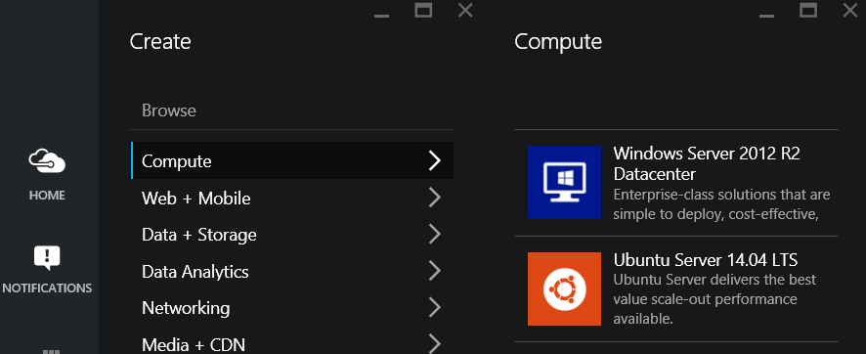
Azure OS Images
Operating Systems and Platform Images from Microsoft and 3rd party.

Slide 15
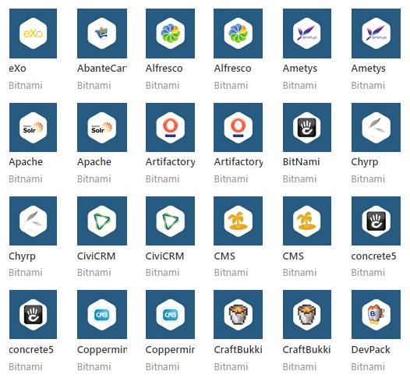
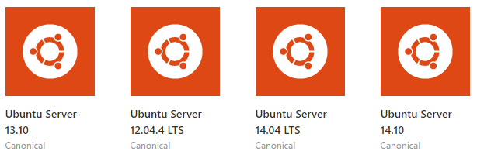


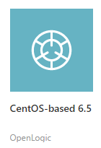
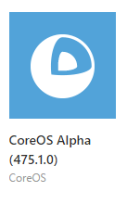
Linux Distributions
Ubuntu
Oracle Linux
SUSE
CentOS-Based
CoreOS
Community

Slide 16
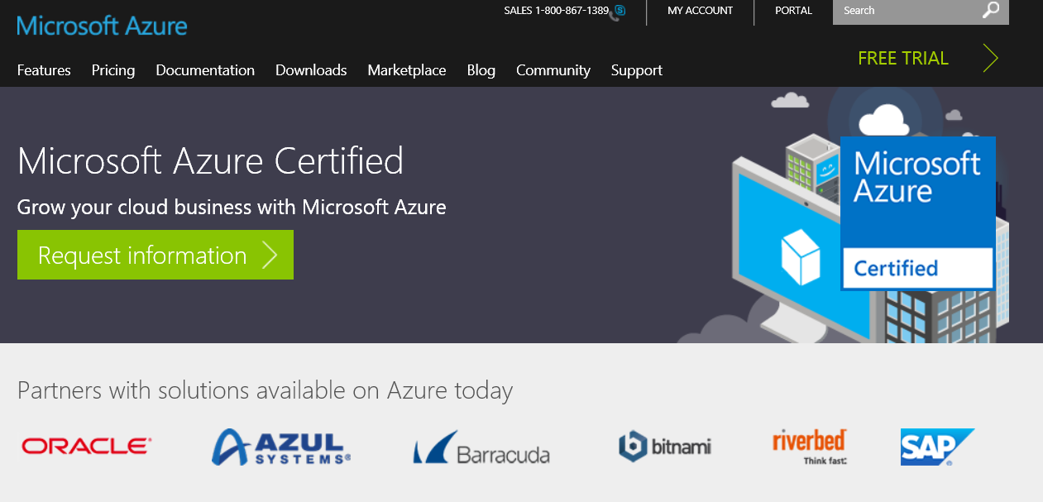
Azure Certified
Certified, production ready VMs w/ complete billing mechanism
www.azure.com/certified

Slide 17

The role of Azure Certified – Software Provider
1
Enables you to sell your application in the
Azure Marketplace
2
Reassures customers that your applications and services are compatible with Microsoft Azure
3
Gives you access to sales and marketing
resources to help drive business growth

Slide 18
The role of Azure Certified – Customer/Consumer
1
Enabling a large ecosystem of applications and workload that you can leverage to build your business on Azure
2
Built and maintained by the ISV to ensure proper configuration and integration. ISV backed support
3
Production ready solutions that have billing enabled (BYOL and/or Hourly)
4
Certified and validated by Microsoft

Slide 19
So what can I do and how can I do it?
Christine Avanessians
Senior Program Manager
Compute VM Team

Slide 20
Deep Dive Topics
Basic Building Block Overview
Creating & Debugging a Single Marketplace VM
Multi-VM Template: SharePoint
Putting it altogether: Highly Available File Share

Slide 21
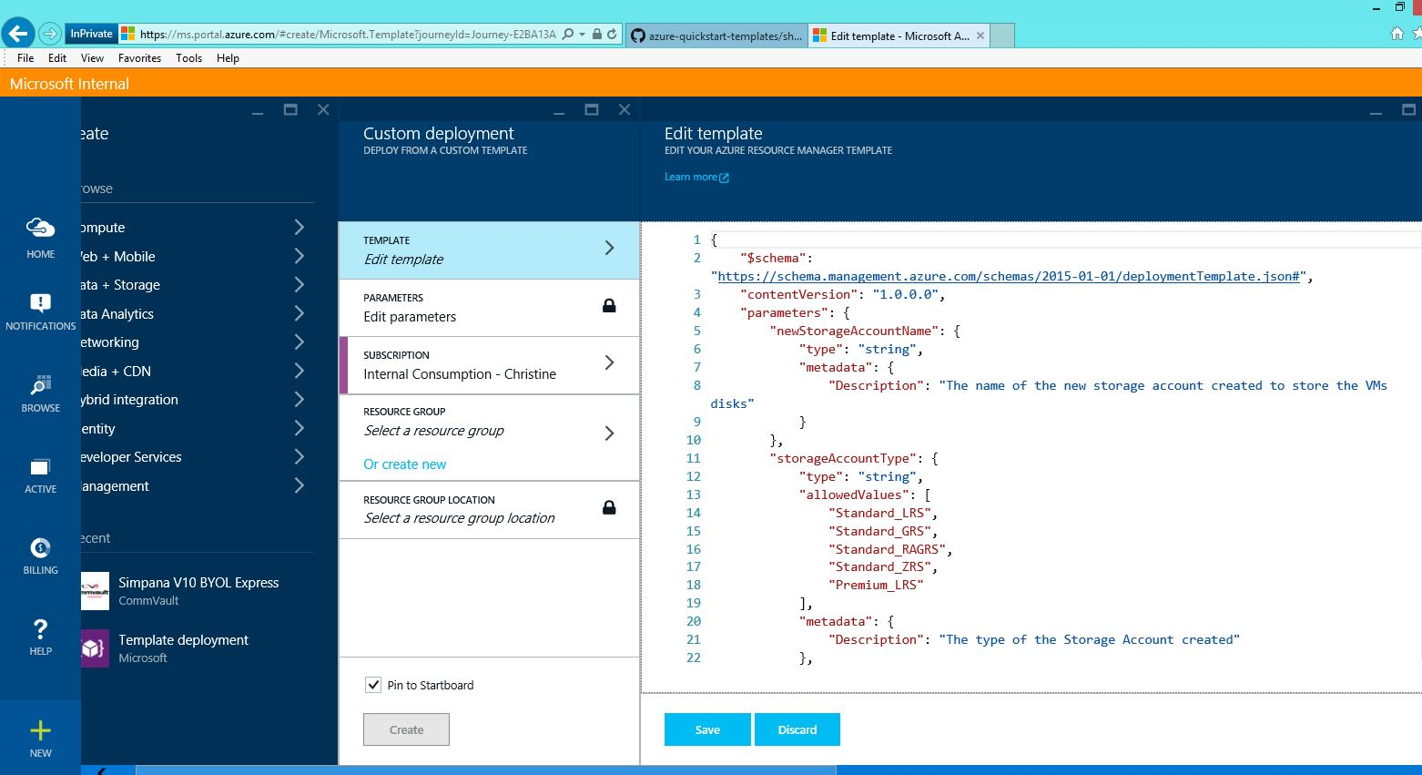

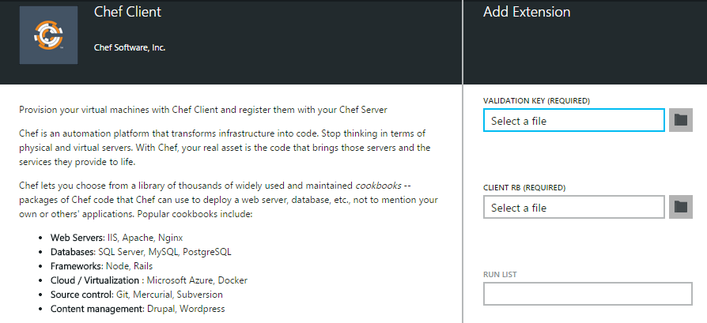
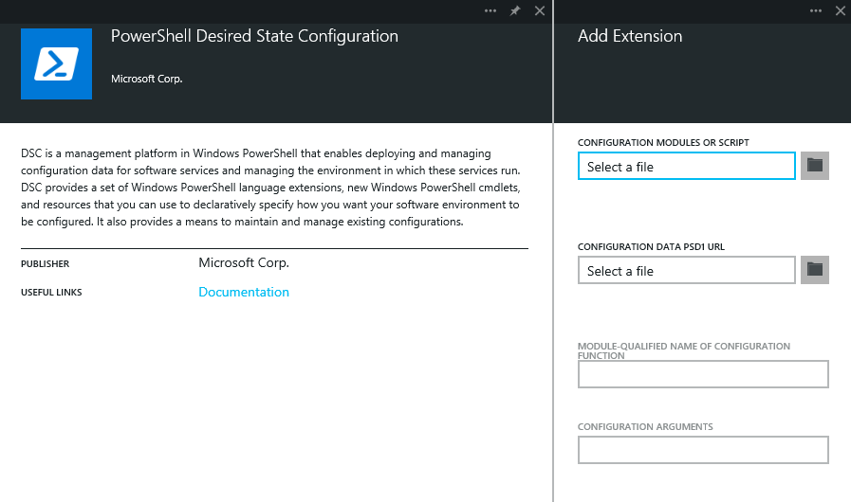
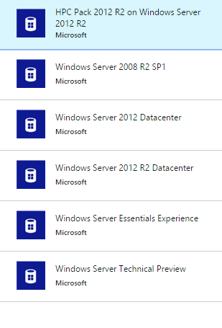
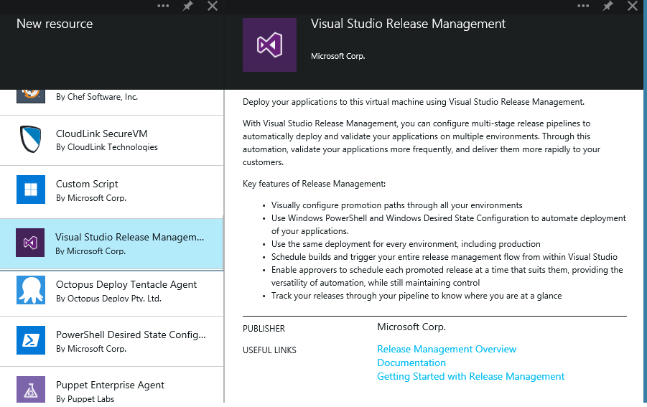

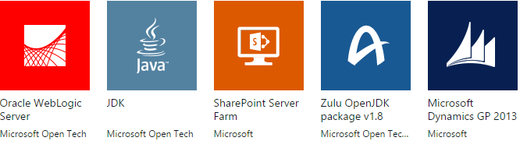
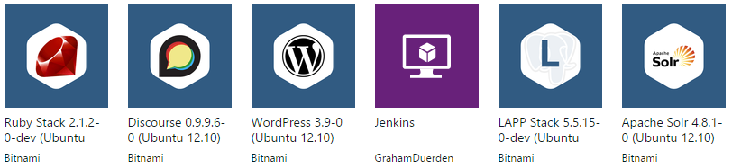

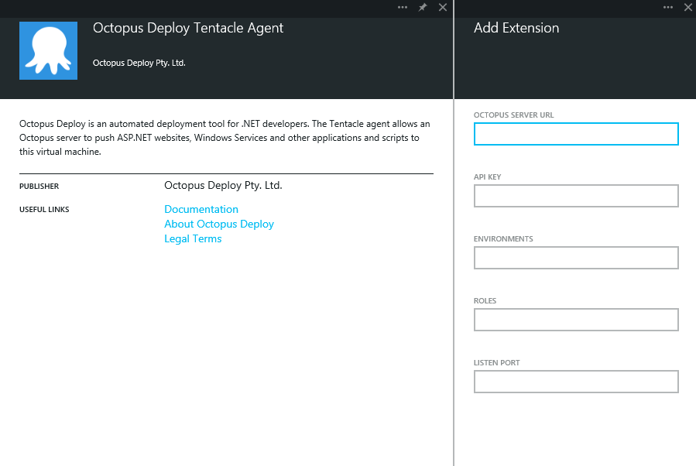

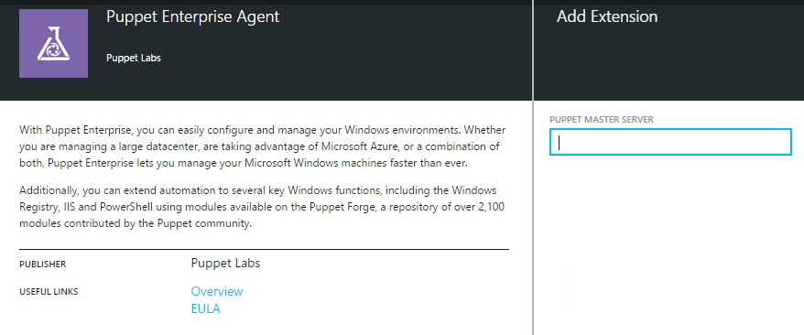
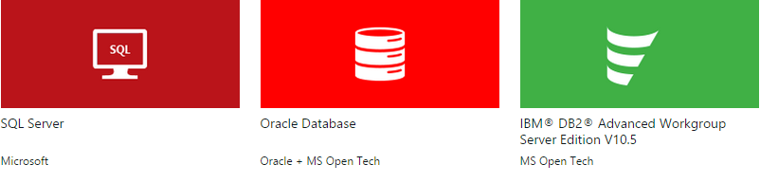
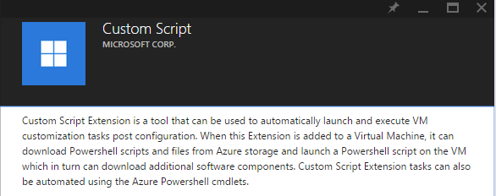
Your ingredients
VM Images
  Windows base OSs
  Linux base OSs
  Pre-installed application
  Community images
VM Extensions
  Security
  Deployment
  Configuration
  Others
  ARM Templates
  Single VM deployment
  Multi VM solution
  Multi-application solutions
Visual Studio debuggers
Diagnostics agents
Monitoring agents
Access recovery
Docker extension
Backup helper

Slide 22
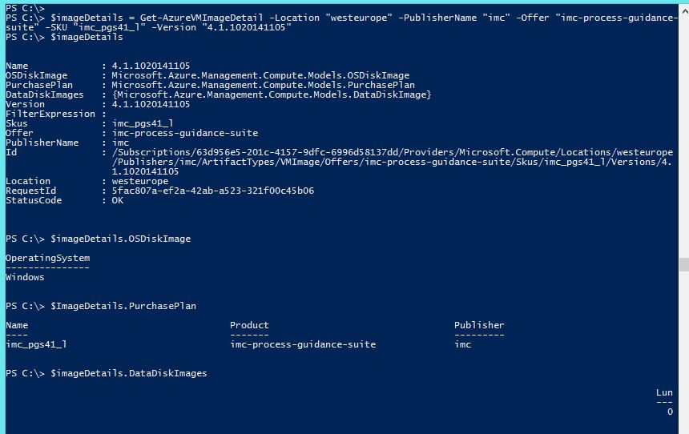
VM Images
Entity that encapsulates complete storage profile of a virtual machine from which to create a single VM

Slide 23



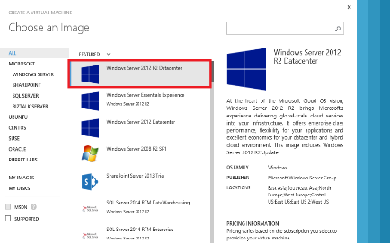
VM Extensions
Extending the power of your VM
Enable easier management
Support partner ecosystem
Full control still with you!
IaaS extended
Curated
Marketplace of Extensions
Agent
Azure

Slide 24
Azure Resource Manager & Templates
Deploy and manage the lifecycle of a collection of resources through declarative, model-based template language
Resource Group
Domain
Controller
Depends On
SharePoint
Server
Depends On
Depends On
SQL
Server
Resources: 1 VNet, 3 VMs

Slide 25
Deep Dive Topics
Basic Building Block Overview
Creating & Debugging a Single Marketplace VM
Multi-VM Template: SharePoint
Putting it altogether: Highly Available File Share

Slide 26
Demo:
Create a VM from Marketplace VM Image in PowerShell

Slide 27
Snippet of Create VM PS script
$vm = New-AzureVMConfig -VMName $vmName -VMSize $vmSize
$vm = Set-AzureVMOperatingSystem -VM $vm -Windows -ComputerName $computerName -Credential $cred -ProvisionVMAgent -EnableAutoUpdate$vm = Set-AzureVMSourceImage -VM $vm -PublisherName "imc" -Offer "imc-process-guidance-suite" -Skus "imc_pgs41_l" -Version "latest"
$vm = Add-AzureVMNetworkInterface -VM $vm -Id $nic.Id
$osDiskUri = $storageacc.PrimaryEndpoints.Blob.ToString() + "vhds/" + $osDiskName + ".vhd"
$vm = Set-AzureVMOSDisk -VM $vm -Name $osDiskName -VhdUri $osDiskUri -CreateOption fromImage
$dataDiskUri = $storageacc.PrimaryEndpoints.Blob.ToString() + "vhds/" + $dataDiskName + ".vhd"
$vm = Add-AzureVMDataDisk -VM $vm -Name $dataDiskname -VhdUri $dataDiskUri -CreateOption fromImage -Lun 0 -DiskSizeInGB 100

Slide 28
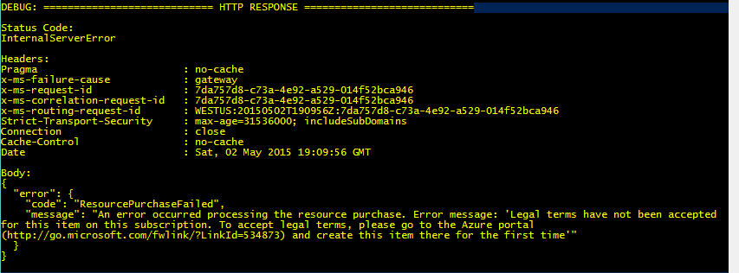
Snippet of Create VM PS script
$vm.Plan = New-Object Microsoft.Azure.Management.Compute.Models.Plan;
$vm.Plan.Name = "imc_pgs41_l";
$vm.Plan.Publisher = "imc";
$vm.Plan.Product = "imc-process-guidance-suite";
$vm.Plan.PromotionCode = $null;
New-AzureVM -ResourceGroupName $rgName -Location $location -VM $vm

Slide 29
Demo:
Add an extension to a VM using an ARM Template

Slide 30
Template Snippet
{
"$schema": "http://schema.management.azure.com/schemas/2015-01-01/deploymentTemplate.json",
"contentVersion": "1.0.0.0",
...
"resources": [
{
"type": "Microsoft.Compute/virtualMachines/extensions",
"name": "[concat(variables('vmName'),'/', variables('extensionName'))]",
"apiVersion": "2015-05-01-preview",
"location": "[variables('location')]",
"properties": {
"publisher": "[variables('extensionPublisher')]",
"type": "[variables('extensionType')]",
"typeHandlerVersion": "[variables('handlerVersion')]"
}
}
]
…
}

Slide 31
Deep Dive Topics
Basic Building Block Overview
Creating & Debugging a Single Marketplace VM
Multi-VM Template: SharePoint
Putting it altogether: Highly Available File Share

Slide 32
More interesting, complicated topologies
Remember SharePoint?
Domain
Controller
Depends On
SharePoint
Server
Depends On
Depends On
SQL
Server

Slide 33
Demo:
Azure QuickStart Templates - Review and Deploy 3 VM SharePoint Farm

Slide 34
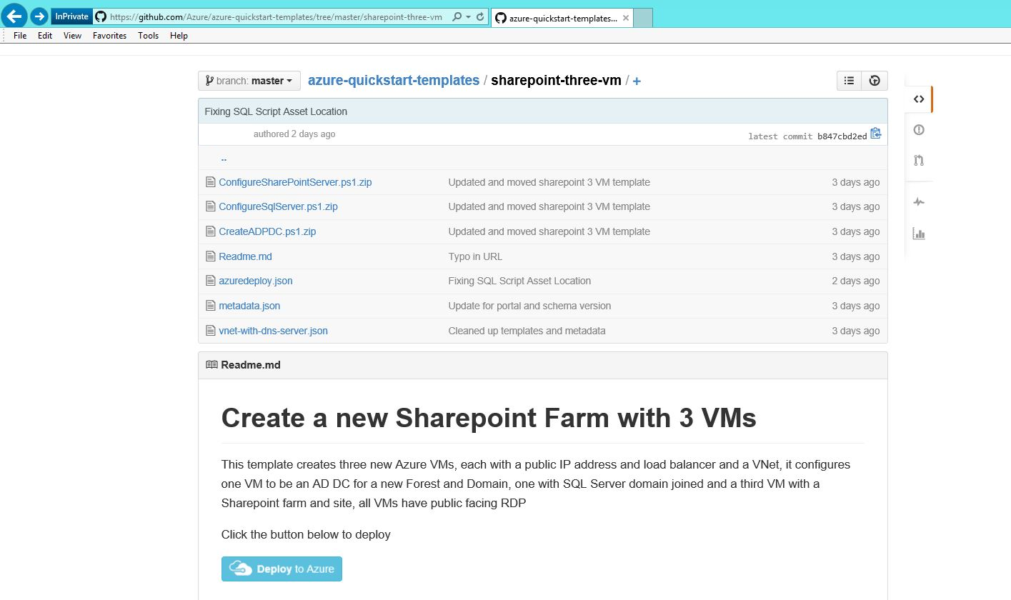

Template Community in GitHub & Deploy To Azure

Slide 35
Deep Dive Topics
Basic Building Block Overview
Creating & Debugging a Single Marketplace VM
Multi-VM Template: SharePoint
Putting it altogether: Highly Available File Share

Slide 36
High Availability for a File Share with Marketplace App: SIOS DataKeeper Cluster Edition
VNet
SN2
ILB2
SN1
ILB1
Witness
Domain
Controller
Windows Server
Failover Cluster
SIOS DataKeeper Cluster Edition

Slide 37
Our Tool Box
Pre-existing ARM Templates as a starting point +
Template Linking Construct +
Windows Server Image +
SIOS DataKeeper Cluster Edition VM Image +
Desired State Configuration (DSC) Extension +
Scripts +
Our Own ARM Template =
One Awesome Multi-VM deployment ☺

Slide 38
Demo:
Develop and Deploy a Highly Available File Share

Slide 39


Have Questions? Want to help us define our Marketplace roadmap?
Come chat with us at the Azure Marketplace booth
Organizational Gallery
SI Partner Program
SI
ISV
End User

Slide 40
Related Sessions
Session Code | Session Title | Date | Time
BRK2491 | Getting Started with Microsoft Azure IaaS | Tuesday, May 5 | 01:30PM – 2:45PM
BRK3733 | Deploying and Managing Hyper Scale Applications on Azure VMs | Wednesday, May 6 | 09:00AM - 10:15AM
BRK3725 | Deploying and Running Linux and Non Microsoft Solution Stack on Azure | Wednesday, May 6 | 3:15 PM - 4:30 PM
BRK3722 | Managing Linux and Windows on Microsoft Azure with Chef | Thursday May 7th | 09:00AM - 10:15AM
BRK3702 | Running Docker Containers on Microsoft Azure | Thursday, May 7th | 10:45 AM - 12:00 PM

Slide 41
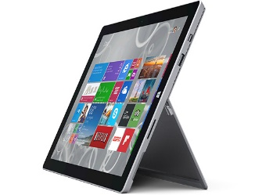

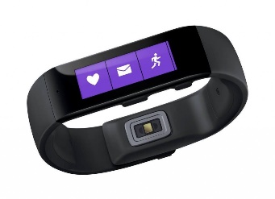

Ignite Azure Challenge Sweepstakes
Attend Azure sessions and activities, track your progress online, win raffle tickets for great prizes!
Aka.ms/MyAzureChallenge
Enter this session code online: “DNPS”
(10) - Microsoft Surface Pro 3
Core i5 256GB
(30) – Xbox One Master Chief Collection Bundle
(55) – Microsoft Band
Offers throughout the week
NO PURCHASE NECESSARY. Open only to event attendees. Winners must be present to win. Game ends May 9th, 2015. For Official Rules, see The Cloud and Enterprise Lounge or myignite.com/challenge

Slide 42


Please evaluate this session
Your feedback is important to us!
Visit Myignite at http://myignite.microsoft.com
or download and use the Ignite Mobile App
with the QR code above.

Slide 43
Thank you!

