Slide 2
Metalogix: Using DLP to Identify and Secure Sensitive Content from Insider Threats
BRK3454
Trevor Hellebuyck
Jai Dargan

Slide 3
Introductions
Trevor Hellebuyck
Chief Technology Officer
thellebuyck@metalogix.com
@thellebuyck
Jai Dargan
Product Manager
jdargan@metalogix.com
@Jai_Dargan

Slide 4
About Metalogix
Move, Manage, and Secure Collaboration Content for SharePoint, Exchange, On-Premises, Office 365, Private & Hybrid Cloud

Slide 5
Overview
Why Should I care about sensitive content in SharePoint?
Office 365 and OneDrive for Business Data Loss Prevention Capabilities
Extending and Enhancing Data Loss Prevention Capabilities for SharePoint

Slide 6
2014 – The Year of the Data Breach
1238 Reported Incidents
580m records compromised
59% Contained PII
46% of breaches were malicious
42% were inadvertent misuse
*Forrester: Instill a Culture of Data

Slide 7
Data Breaches Take Their Toll
Financial Impact
$52,000 - $87,000 is the average loss for every 1,000 records breached*
$114 billion – the global market for stolen credit card data⁺
Reputation Impact
Resignations and Job losses
Public Relations and Customer Confidence
Legal Implications
Data Privacy Law Prosecutions (and Fines)
Class Action Law Suits
*Source: Verizon 2015 Data Breach Investigation Report
⁺Source: Forbes - What The Verizon Data Breach Report Means To Corporate Data Security

Slide 8
How Can We Protect Our Sensitive Content?
Lock Down with Access Controls and Permissions
Compromised Credentials Involved with Majority of Data Breaches
Protecting the Castle Walls vs Losing the Keys to the Kingdom
Rights Management
Improving Technology
Lacking Mainstream Adoption
“Traditional” Data Loss Prevention Solutions
Customer Dissatisfaction - Noise of False Positives Drowns out Data Losses
Enterprise DLP is Shrinking in favor of Niche Solutions - Gartner

Slide 9
Challenges of Protecting Sensitive Content
Location vs Content
Are we sure where our sensitive content is located?
What happens when someone moves the sensitive content?
Partial Protection & Check Box Mentality
Will our policies, procedures and implementation stand up to scrutiny?
Are we truly protecting our sensitive content or checking a feature box?
Users, Users, Users
Productivity Hindrance
Using “Shadow IT” to get their jobs done

Slide 10
Office 365 & Data Loss Prevention

Slide 11
Office 365 Data Loss Prevention
Available for Exchange and SharePoint in O365
Exchange announced in late 2014
Phase 2 Public Preview for SharePoint Online rolling out now
Includes 51 Sensitive Data Types
Personally Identifiable Information (PII), financial and health information
Regional variations of data types including US, Canada, EU, Australia etc.
Sensitive Data Types can be Customized
Adjust sensitivity levels for the out-of-the-box data types
Create your own specialized sensitive data types

Slide 12
http://blogs.office.com/2015/04/21/evolving-data-loss-prevention-in-sharepoint-onlineonedrive-for-business-and-office-applications/

Slide 13
What’s Available Now, What’s Later?
Phase 2 Public Preview
Create automated policies for built-in information types
Apply policies in conjunction with External Sharing
Policies can be applied to specific sites or locations
Block or restrict access to sensitive content
Admin facing incident reports
Phase 3
Location or condition policy exceptions
Encryption as an action to be applied to content
Additional content types and greater enforcement at endpoints e.g. Office 2016
Support for custom classifications
More features to be announced

Slide 14
Office 365 Compliance Center

Slide 15
Includes Policy Tips for End User Education

Slide 16
Integration with Office 2016

Slide 17
Customizing DLP in Office 365
Customize Built-in Information Types
Export existing 51 rules using PowerShell
Adjust confidence levels
Add or remove corroborating evidence e.g. proximity of keywords
Customize DLP Policy
Create a custom Policy Template
Incorporate custom Information Types
Custom Classification Rule Package
Rule Type – Entity or Affinity
Supporting Elements – Regex, Keyword, Function
Pattern Proximity Window
Confidence Level

Slide 18
Limitations of O365 Data Loss Prevention
RegEx
Regular expressions are excellent at identifying patterns you know
But they can't identify the unknowns
Do you know every possible pattern for PII?
Environment
This only covers information in your Office 365 tenancy
DLP does not cover your on premises SharePoint installations
ControlPoint centralizes administration of all your Farms regardless of type
Remediation Actions
Downstream actions limited to permissions locking and notifications

Slide 19
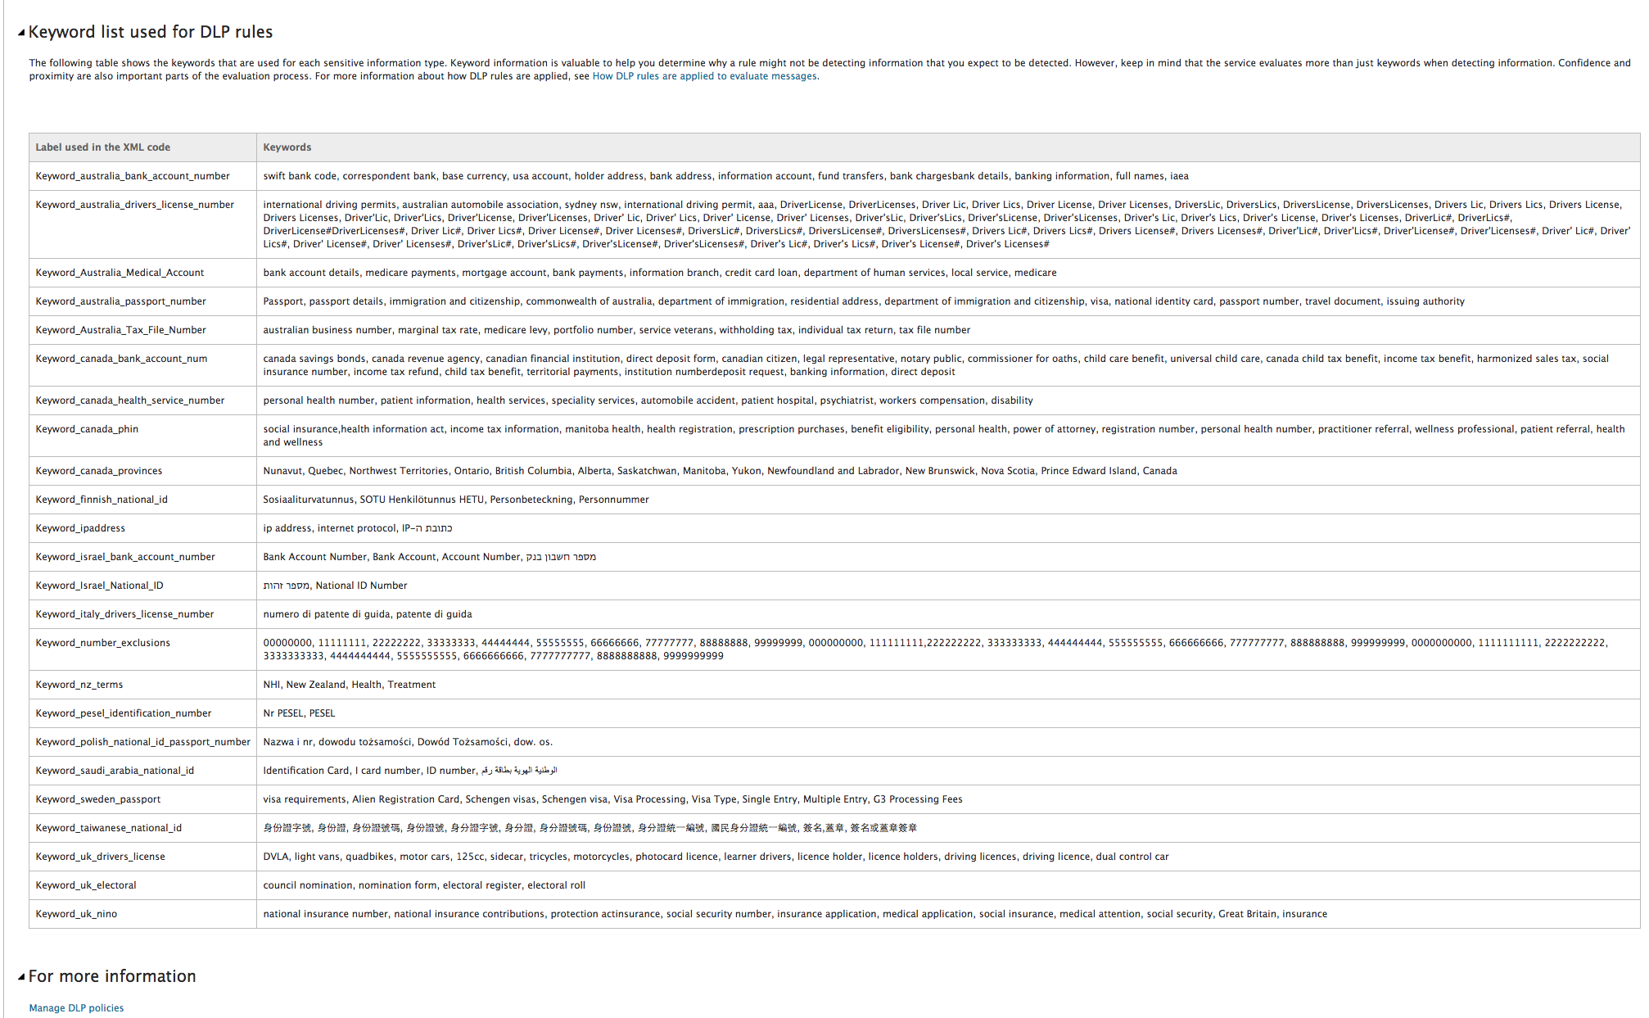
RegEx: In Depth

Slide 20
Sensitive Content Manager with ControlPoint
Machine Learning
What is Machine Learning?
How do we do it?
Neural Networks
Cloud First Architecture
Metalogix Cloud Services

Slide 21
Extending & Enhancing DLP for SharePoint
Machine Learning for Content Detection and Analysis
Flexibility: machine learning enables identification of patterns beyond complexity that humans can assume
Data-Driven: Machine Learning models are created by data -- not by intuition
Accuracy: Machine Learning can control rates of false positives and false negatives
On-premises, Online and Hybrid
ControlPoint centralizes management of SharePoint content across enviornments and versions
PII influences data migration decisions and strategy
Take Action
Variety of remediation actions to govern content
Real Time Scanning: Enhanced Situational Awareness

Slide 22
Securing SharePoint with Sensitive Content Manager and ControlPoint

Slide 23
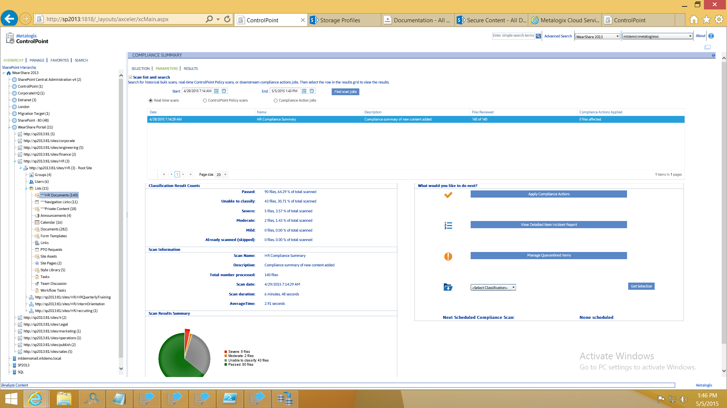

Slide 24
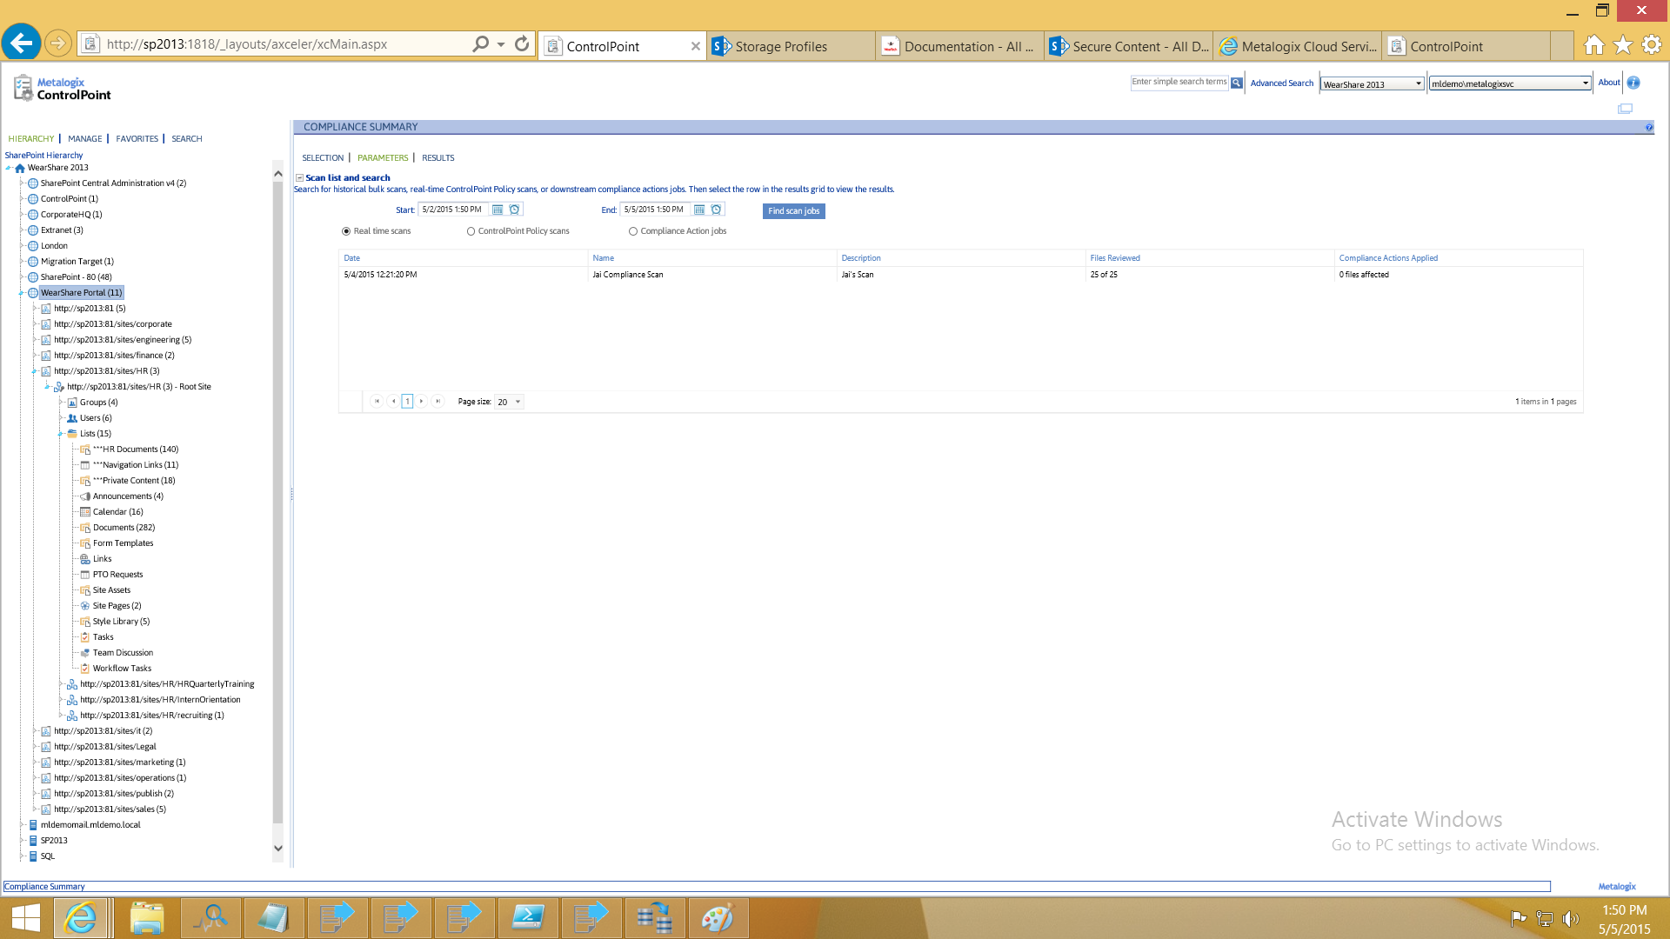

Slide 25
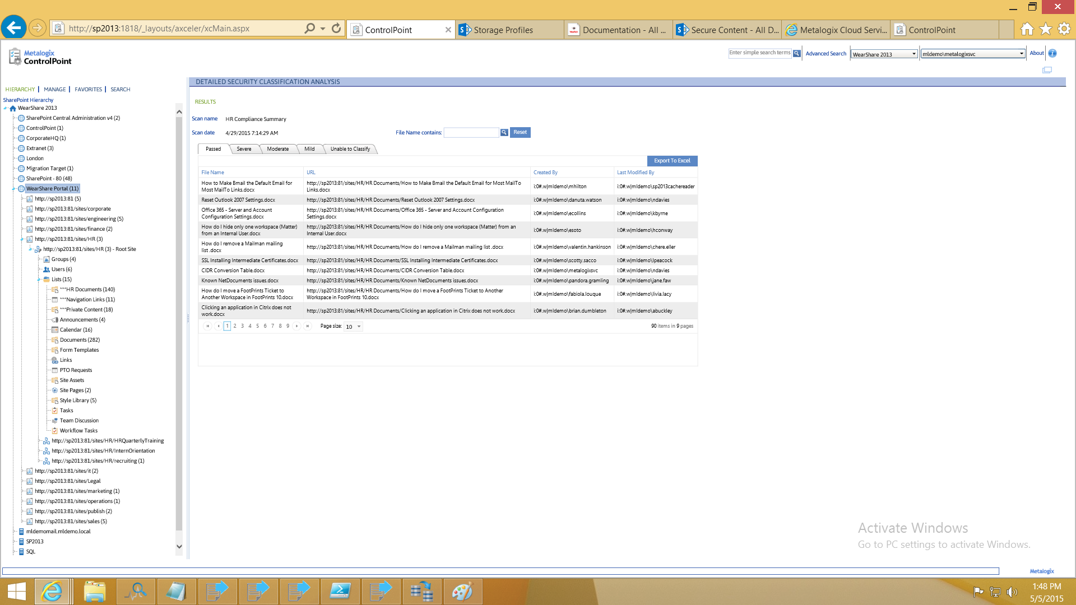

Slide 26
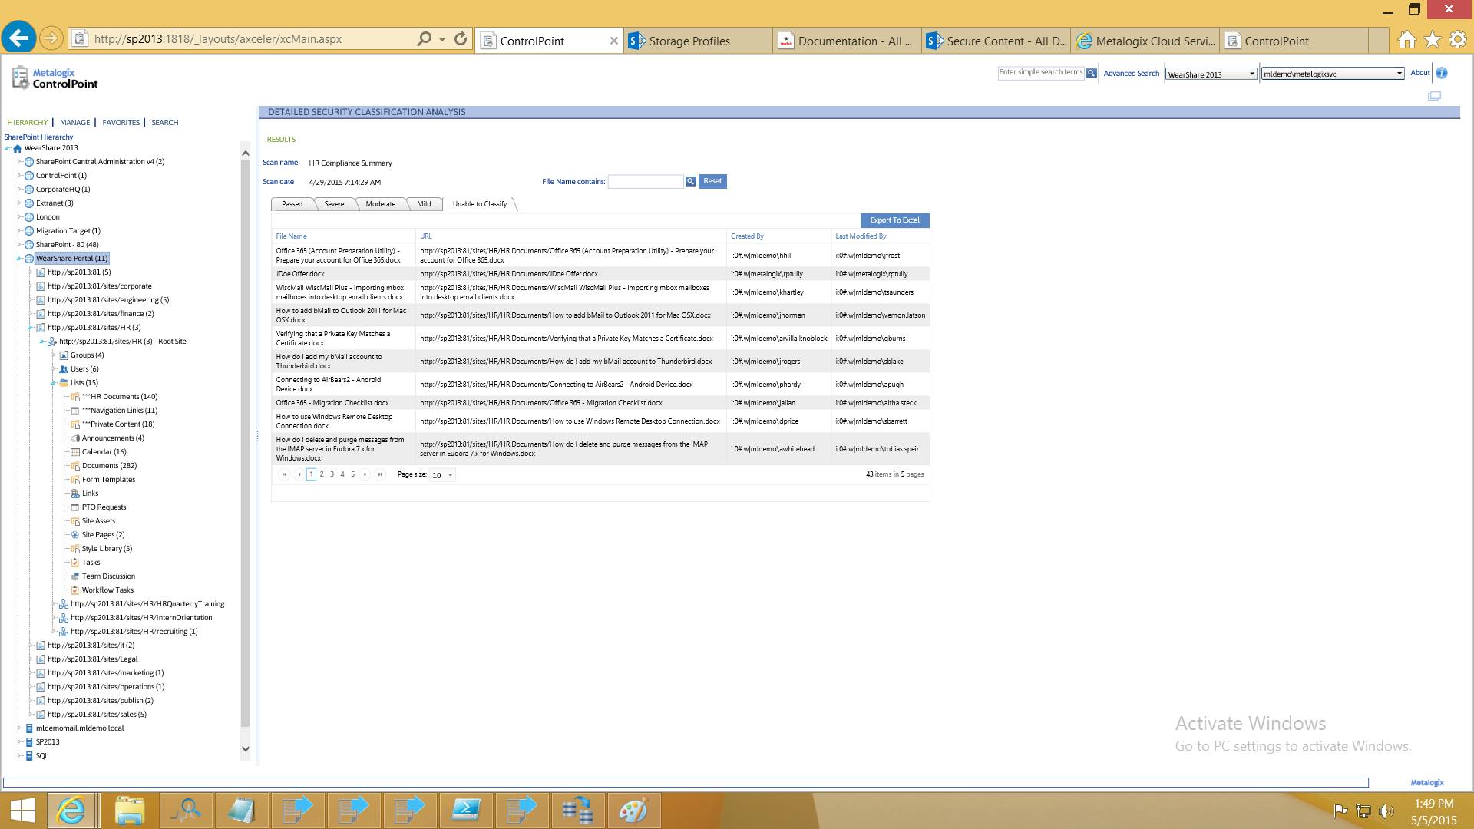

Slide 27
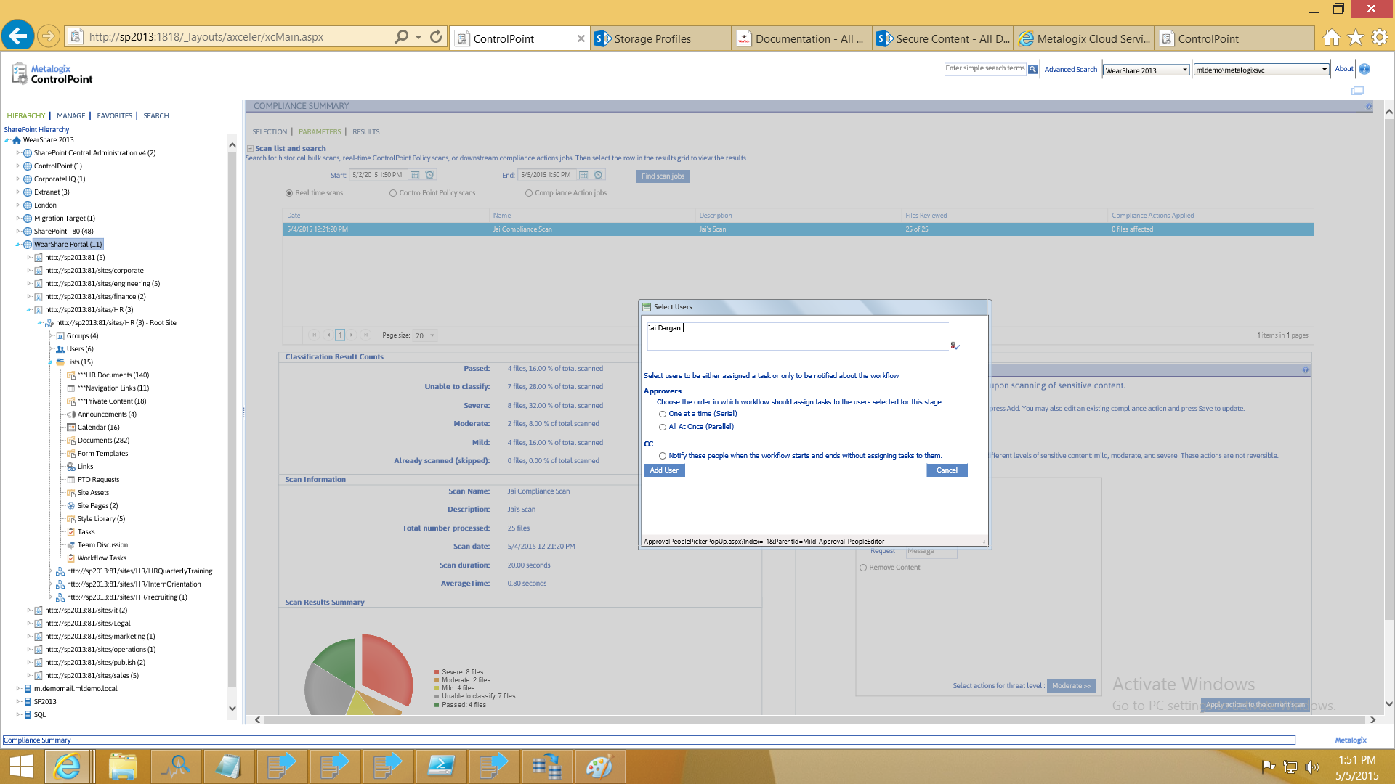

Slide 28
Summary
Metalogix: content and context aware for detection and classification of sensitive content
Machine Learning / Neural Networks: higher accuracy beyond RegEx
Deployable across environments

Slide 29
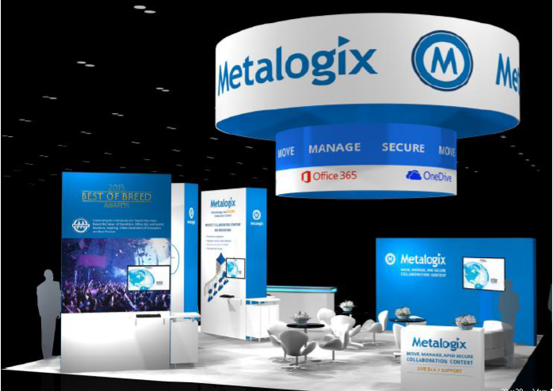
Visit us at Booth 609
Trevor Hellebuyck
thellebuyck@metalogix.com
@thellebuyck
Jai Dargan
jdargan@metalogix.com
@Jai_Dargan

Slide 30
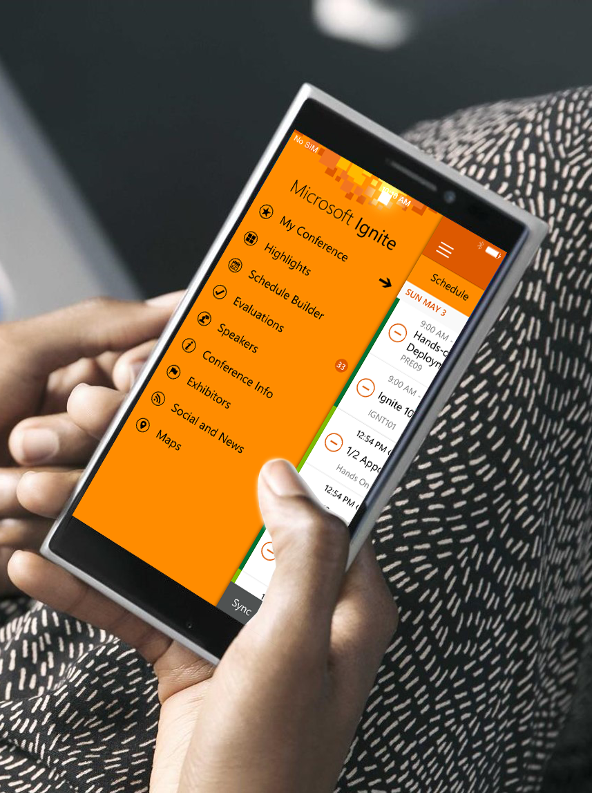
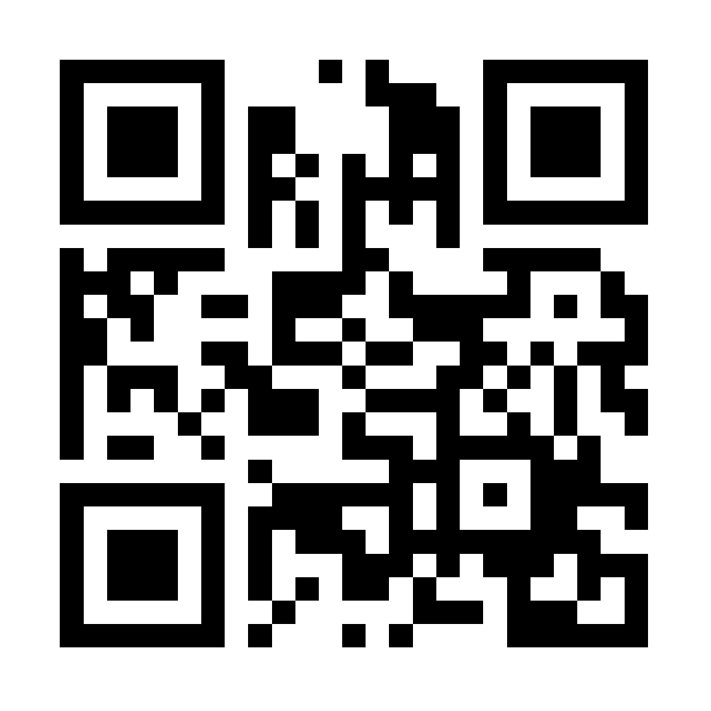
Please evaluate this session
Your feedback is important to us!
Visit Myignite at http://myignite.microsoft.com or download and use the Ignite Mobile App with the QR code above.

