Slide 2
Azure Operations Adoption
Enabling IT Organizations to leverage Azure
BRK3475
Niels Nijweide
Kathleen Wilson

Slide 3
Session overview
Organizational challenges adopting cloud
Microsoft cloud vision
Cloud Services Foundation Reference Model
Takeaways for Organizations using Azure

Slide 4
Audience Poll
What is your role?
Are currently using Azure?
Do you use O365?

Slide 5
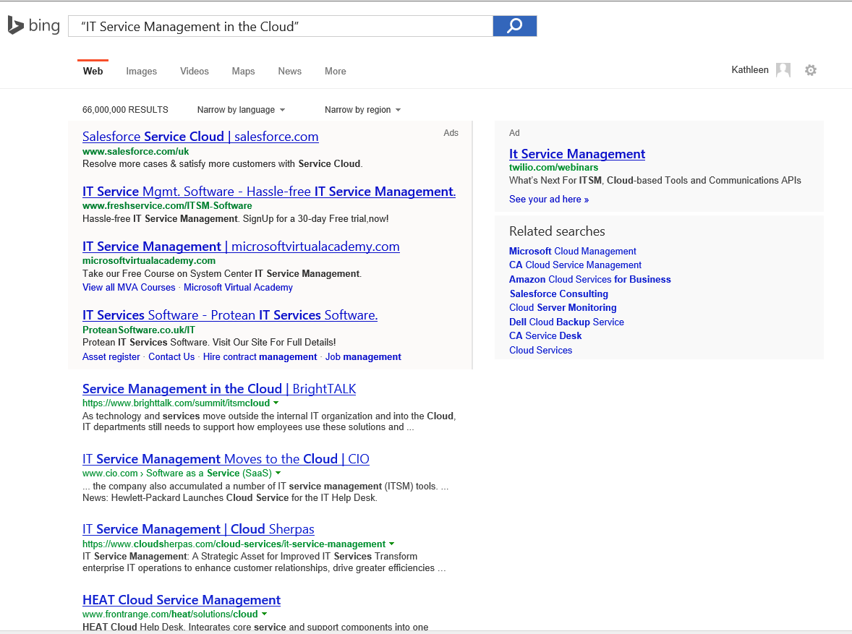
Why this Session?
Customer feedback
Lack of “prescriptive guidance”
Cloud need Modern Service Management
Lean and mean
Need to continuously show back value to the business

Slide 6
Organizational Challenges

Slide 7

Why Organizations move to the Cloud
Innovation
Move away from Outsourcing models
Shadow IT is here to stay
Datacenter is at capacity
Cost – pay for use
It is an industry trend
…and more

Slide 8
Cloud Challenges
Chargeback and or showback
Requires process & organizational maturity
IT must become a Service Provider
Enable innovation with Lifecycle Management
Manual on premise work not automated
Cloud Consumers/Customers new responsibilities; tenant ownership, service relationship management, service catalog

Slide 9
Microsoft Cloud Vision

Slide 10
Microsoft Cloud Vision
Virtualization
Identity
Data
Management
Development

Slide 11
Cloud Principles & Concepts - MSM
Principles
Achieve Business Value through Measured Continual Improvement
Perception of Infinite Capacity
Perception of Continuous Service Availability
Take a Service Provider’s Approach
Optimization of Resource Usage
Take a Holistic Approach to Availability Design
Minimize Human Involvement
Drive Predictability
Incentivize Desired Behavior
Create a Seamless User Experience
Concepts
Favor Resiliency Over Redundancy
Homogenization of Physical Hardware
Pool Compute Resources
Virtualized Infrastructure
Fabric Management
Elastic Infrastructure
Multitenancy
Partitioning of Shared Resources
Resource Decay
Service Classification
Cost Transparency
Consumption-Based Pricing
Security and Identity
http://aka.ms/Ndgk6d

Slide 12
Cloud Principles & Concepts - MSM
Principles
Achieve Business Value through Measured Continual Improvement
Perception of Infinite Capacity
Perception of Continuous Service Availability
Take a Service Provider’s Approach
Optimization of Resource Usage
Take a Holistic Approach to Availability Design
Minimize Human Involvement
Drive Predictability
Incentivize Desired Behavior
Create a Seamless User Experience

Slide 13
Cloud Principles & Concepts - MSM
Concepts
Favor Resiliency Over Redundancy
Homogenization of Physical Hardware
Pool Compute Resources
Virtualized Infrastructure
Fabric Management
Partitioning of Shared Resources
Resource Decay
Service Classification
Cost Transparency
Consumption-Based Pricing
Multi-tenancy
Elastic Infrastructure
Security and Identity

Slide 14
Service Delivery Models

Slide 15

Cloud Services Foundation Reference Model
Required Processes
Service Delivery
Service Manager
Reliability Manager
Architect
Cloud Service
Required Capabilities
Required Processes
Application
Management & Support
Service Operations
Developer
Operator
Mgmt & Sup Administrator
Operations Manager
Platform
Platform Administrator
Author
Fabric
Fabric Administrator
http://aka.ms/Xzpey8

Slide 16

Required Roles for each model
Software as a Service
Platform as a Service
Infrastructure as a Service
Service Provider
Service Consumer
Service Consumer
Service Manager
Reliability Manager
Architect
Mgmt & Sup Administrator
Developer
Operator
Author
Developer
Operator
Application
Office 365
Cloud Provider
Developer
Operator
Service Provider
Service Manager
Reliability Manager
Architect
Mgmt & Sup Administrator
Platform Administrator
Author
Platform
Azure
Platform Administrator
Cloud Provider
Platform Administrator
Service Provider
Service Manager
Reliability Manager
Architect
Mgmt & Sup Administrator
Fabric
Azure
Fabric Administrator
Operations Manager
Fabric Administrator
Operations Manager
Cloud Provider
Fabric Administrator
Operations Manager

Slide 17
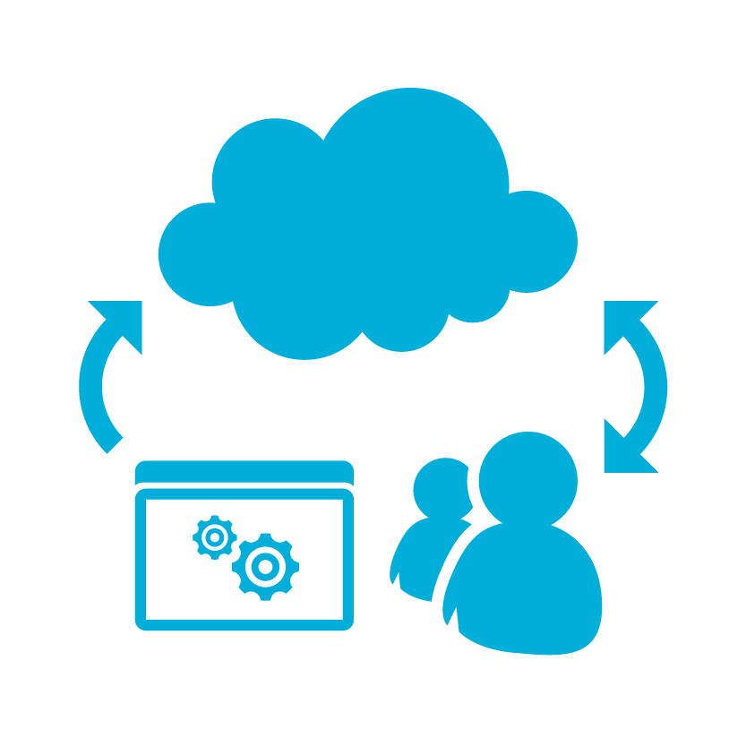

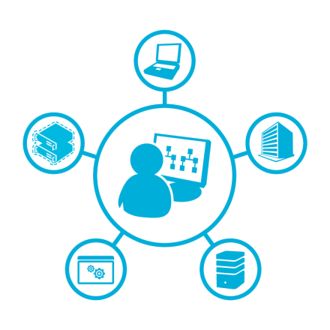

Organizational Considerations for Azure
Shift of Responsibilities & Accountabilities
New roles & skills sets
Cloud
People
Process
Impact current ITSM processes
Separation of dependencies

Slide 18

Cloud
Lift and shift is IaaS only
Rationale
You must consider PaaS, versus lift and shift. PaaS provide reduced complexity, management and cost.
Action
Business cases need to consider rationalizing VM hosting costs (PaaS is cheaper then IaaS). Include licensing, (extended) support, compliance and time to market. Setup a migration factory to smoothly transition Services to new PaaS platforms.

Slide 19
Cloud
Subscription management is critical
Rationale
Subscriptions drive access to the management of resources, applications, security, network, configuration management, chargeback and showback
Action
Master subscriptions management for Azure, before shifting Services to Azure. You need to have a subscription strategy and operating plan to consume Azure at large scale. Define your outcomes first.

Slide 20
People
Think big, start small
Rationale
Clouds demand maturity. Organizations must increase their maturity in order to deliver the promised value
Action
Shift to the Cloud with start with a small, reliable service. Gain maturity in small steps, an think bimodal IT. Leave traditional practices on premise,
treat cloud as Greenfield

Slide 21

People
Shift responsibilities for cloud
Rationale
Cloud removes organizational silos, for example, Fabric Management requires cross domain expertise versus deep silo expertise
Action
Using cloud principles and (IaaS / PaaS / SaaS) IT must shift their responsibilities to fit into Cloud architecture and services (SharePoint, fabric, platform, etc.)

Slide 22
Process
Cloud is not one size fits all
Rationale
Processes, roles and responsibilities will change depending what type of service you delivering in the Cloud (waterline).
Action
Understand the cloud model you will deliver (IaaS / PaaS / SaaS). Align your service delivery and cloud processes into the NEW cloud organization.

Slide 23

Process
Manage Services versus components
Rationale
Cloud Service Consumers are focused on the delivery of services (think containers) and IT fails when trying to manage components in the cloud
Action
Focus on Services when using the Cloud, make sure that you monitor Service delivery and manage Services from the Consumer point of view

Slide 24
In closing
Define standard changes
Tiered SLAs disappear, SLAs are set by the Cloud provider
Service Catalog maturity
Automation, efficiency (IT will be bypassed)
Culture needs to shift, Cloud is a disrupter
Processes need to be lean and mean

Slide 25


Q & A
@mkathleenwilson
kawilson@microsoft.com
For Microsoft Service Offerings for Cloud Operations visit
http://www.microsoft.com/en-us/microsoftservices/datacenter_services.aspx

Slide 26
Learn more with FREE
IT Pro Resources
Free technical training resources:
  On-demand online training: http://aka.ms/learnhybrid
Free ebooks:
  Rethinking Enterprise Storage: A Hybrid Cloud Model: http://aka.ms/hybrid-storage-ebook
  Microsoft Azure Essentials: Fundamentals of Azure: http://aka.ms/azure-fundamentals-ebook
Expand your
Hybrid Infrastructure Knowledge
Join the IT Pro community:
  Twitter @MS_ITPro

Slide 27
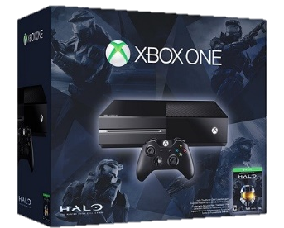
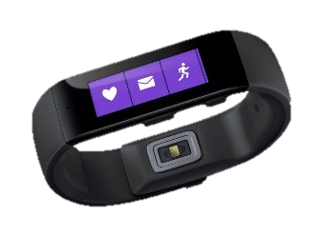
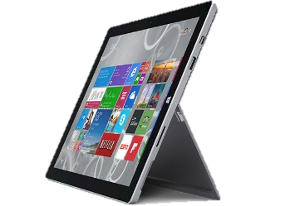

Ignite Azure Challenge Sweepstakes
Attend Azure sessions and activities, track your progress online, win raffle tickets for great prizes!
Aka.ms/MyAzureChallenge
Enter this session code online:
NO PURCHASE NECESSARY. Open only to event attendees. Winners must be present to win. Game ends May 9th, 2015. For Official Rules, see The Cloud and Enterprise Lounge or myignite.com/challenge
Enter session code and remove this box

Slide 28

Free Resources for DevOps Practices
Optimize your
DevOps practices & tools:
  Get started on your DevOps journey: aka.ms/devops
Accelerate your application
delivery lifecycle
Download the Forrester Infrastructure-as-Code whitepaper:
  Complexity kills. Automate with Infra as code: aka.ms/iac_tlp
Technical resources for Practitioners:
  Get access to free online training, evals and HOLs: aka.ms/devopsmva
RSVP here
Join the Community conversations:
  Use #TalkDevOps on Twitter

Slide 29


Please evaluate this session
Your feedback is important to us!
Visit Myignite at http://myignite.microsoft.com
or download and use the Ignite Mobile App
with the QR code above.

