Slide 2

Veeam Software: Availability Strategies for Microsoft Azure and Hyper-V,
A Deep Dive
BRK3575
Chris Henley
Sr. Manager Microsoft Global Alliance

Slide 3
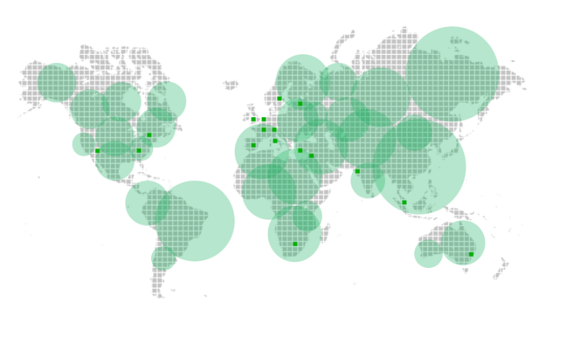
About Veeam (rhymes with Team)
Veeam is a global company with headquarters in Baar, Switzerland
Veeam was founded in 2006
1,750 Veeam employees
Veeam customers in 200 countries
70% of Fortune 500 are customers
8.4M virtual machines worldwide ensured by Veeam availability solutions
8.4M virtual machines worldwide ensured by Veeam availability solutions
1,750 Veeam employees
Veeam customers in 200 countries
70% Fortune 500 are customers
145,000
customers
worldwide
Over
30,000
ProPartners

Slide 4
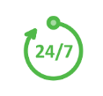


No patience for downtime and data loss
Growing amount of data
24/7 operations
Enable the Always-On BusinessTM
Modern Data Center
Virtualization
Modern storage
Cloud

Slide 5
No patience for downtime and data loss
Growing amount of data
24/7 operations
Enable the Always-On BusinessTM
Legacy backup
RTO and RPO of hours/days
Less than 6% tested quarterly
Failure in more than 16%
Backup data not leveraged
No visibility
Modern Data Center
Virtualization
Modern storage
Cloud

Slide 6
No patience for downtime and data loss
Growing amount of data
24/7 operations
Enable the Always-On BusinessTM
Legacy backup
Availability requirements
RTO and RPO of hours/days
Less than 6% tested quarterly
Failure in more than 16%
Backup data not leveraged
No visibility
RTPOTM < 15min
100% tested
Failure rate 0%
Testing every upgrade or patch
Proactive visibility
Modern Data Center
Virtualization
Modern storage
Cloud

Slide 7
No patience for downtime and data loss
Growing amount of data
24/7 operations
Enable the Always-On BusinessTM
Legacy backup
Availability requirements
GAP
RTO and RPO of hours/days
Less than 6% tested quarterly
Failure in more than 16%
Backup data not leveraged
No visibility
82% of CIOs say there is a gap between the level of availability legacy backup solutions provide and what end users demand
RTPOTM < 15min
100% tested
Failure rate 0%
Testing every upgrade or patch
Proactive visibility
Modern Data Center
Virtualization
Modern storage
Cloud

Slide 8
No patience for downtime and data loss
Growing amount of data
24/7 operations
Enable the Always-On BusinessTM
Legacy backup
Availability requirements
GAP
Impact
Lost business
Loss of reputation
11.9 hr unplanned downtime
$880K downtime cost
Modern Data Center
Virtualization
Modern storage
Cloud

Slide 9

No patience for downtime and data loss
Growing amount of data
24/7 operations
Enable the Always-On BusinessTM
Legacy backup
Availability requirements
Impact
Lost business
Loss of reputation
11.9 hr unplanned downtime
$880K downtime cost
Modern Data Center
Virtualization
Modern storage
Cloud

Slide 10




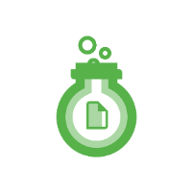

No patience for downtime and data loss
Growing amount of data
24/7 operations
Enable the Always-On BusinessTM
How quickly can you recover what you need?
How do you reduce the risk of data loss?
How do you verify data recoverability?
How do you mitigate deployment risks?
How do you gain visibility?
High-speed recovery
Data loss Avoidance
Verified Protection
Leveraged Data
Complete visibility
Modern Data Center
Virtualization
Modern storage
Cloud

Slide 11


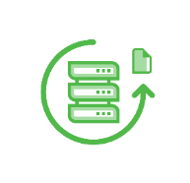





No patience for downtime and data loss
Growing amount of data
24/7 operations
Enable the Always-On BusinessTM
High-Speed Recovery
Data Loss Avoidance
Verified Protection
Leveraged Data
Complete Visibility
Modern Data Center
Virtualization
Modern storage
Cloud

Slide 12
Integrated Solutions for Microsoft

Slide 13
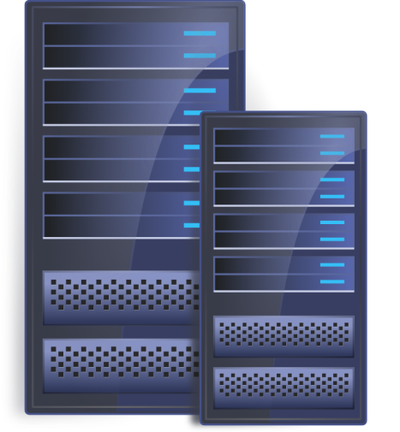

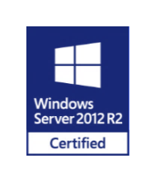

Veeam Management Pack v7 for System Center
System Center 2012 SP1 and R2 Rollups
Hyper-V and vSphere management parity
Reports, heat maps, and real-time dashboards, including:
Compute and storage usage heat maps
Capacity planning for Azure hybrid cloud
Support for customizable widgets
Veeam Task Manager for Hyper-V for
proper VM resource usage reporting

Slide 14

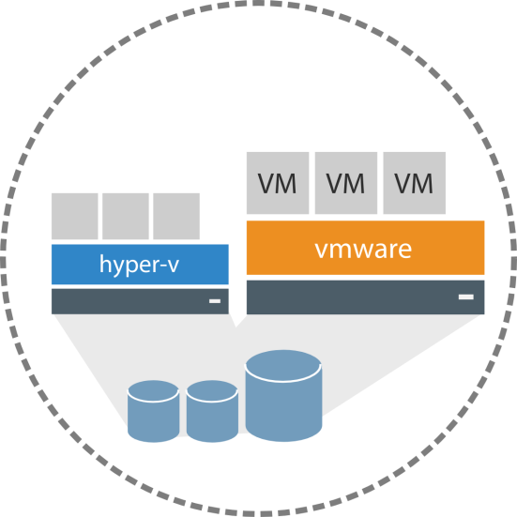

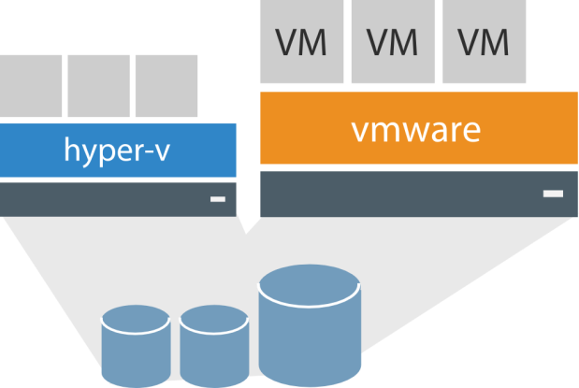

Capacity Planning for Azure
Review requirements for Azure and other cloud providers
Report on-premises resource usage (Hyper-V & vSphere) to plan for a hybrid deployment in Microsoft Azure
Know how many VMs of each profile you require
Drill-down into individual VM performance

Slide 15
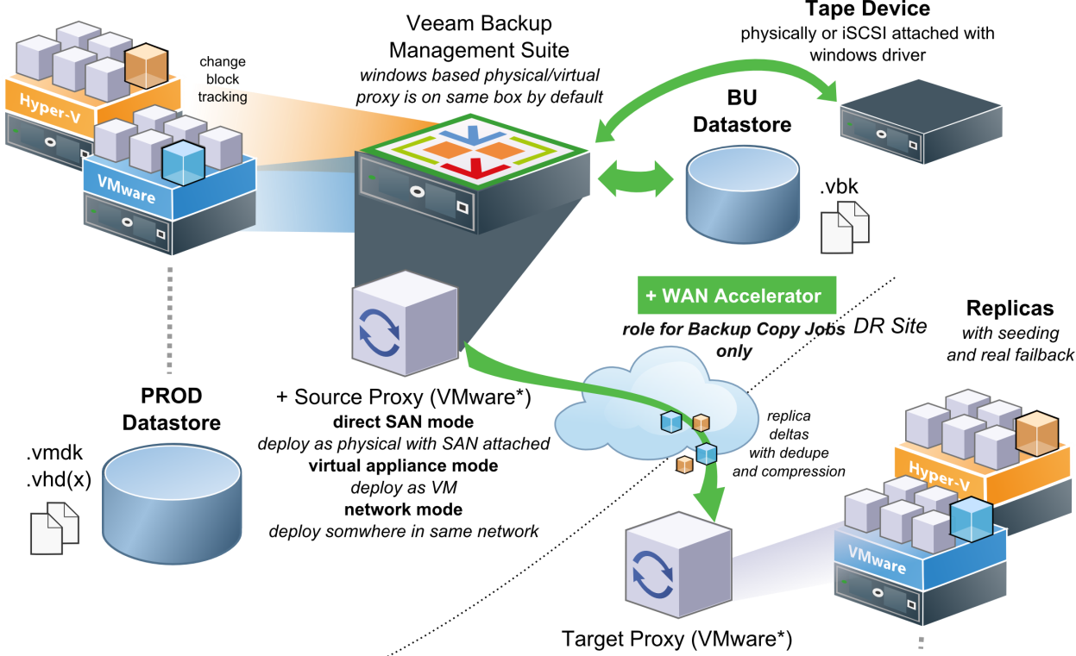
Veeam for Hyper-V data protection
No agents
Designed for virtualization
Change block tracking
Virtual Lab
SureBackup
Built-in WAN Acceleration

Slide 16







Instant VM Recovery
Back to work in 2 minutes!
Hypervisor
Compressed/
Deduplicated
Backup File
vPower
Migrate online
Production storage
Backup storage

Slide 17
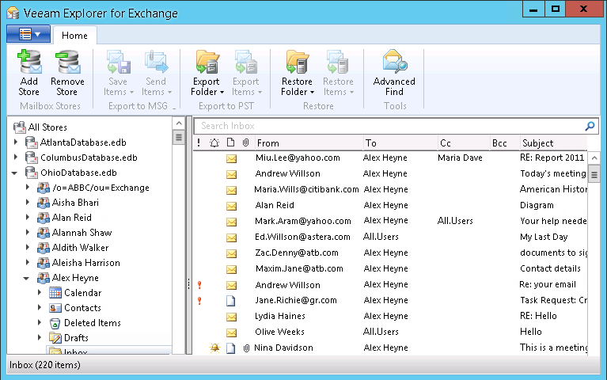
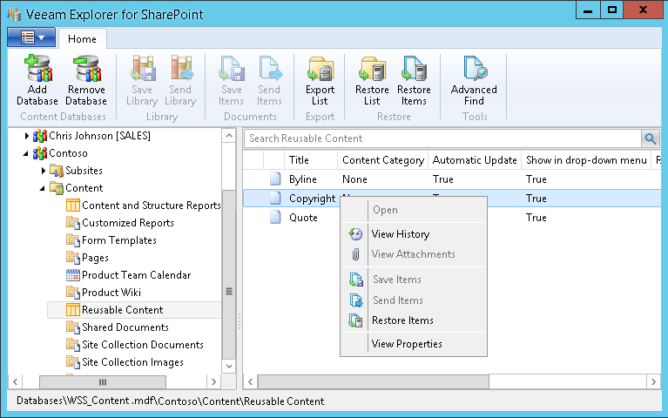
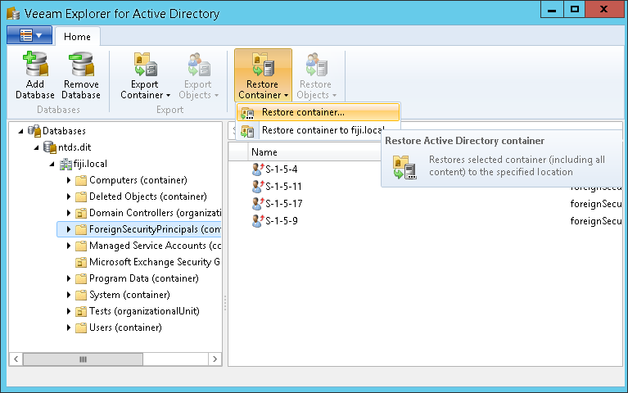
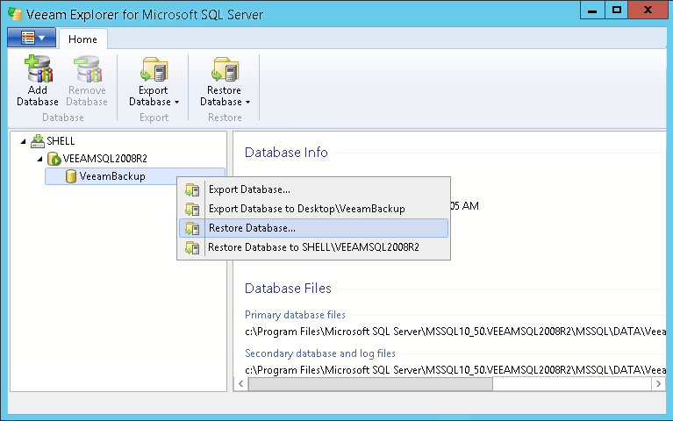
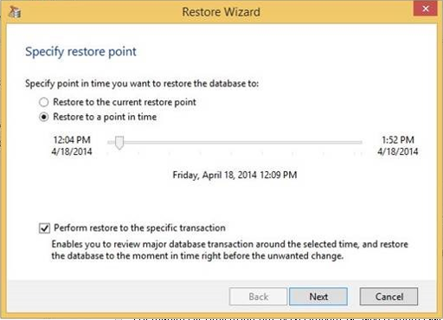
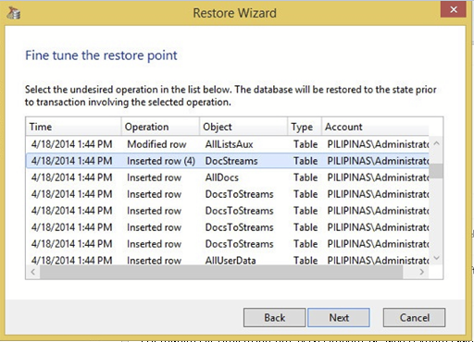
Exchange:
Restore any Exchange object to same or different location, export, or Office 365
All without agents!
SharePoint:
Browse for object to restore, including shredded files
Active Directory:
Browse, compare and restore Active Directory objects, to the same or different location.
Including original Passwords
SQL Server:
Browse and restore SQL databases to a specific point in time via transaction log replay

Slide 18
Demo
Chris Henley

Slide 19
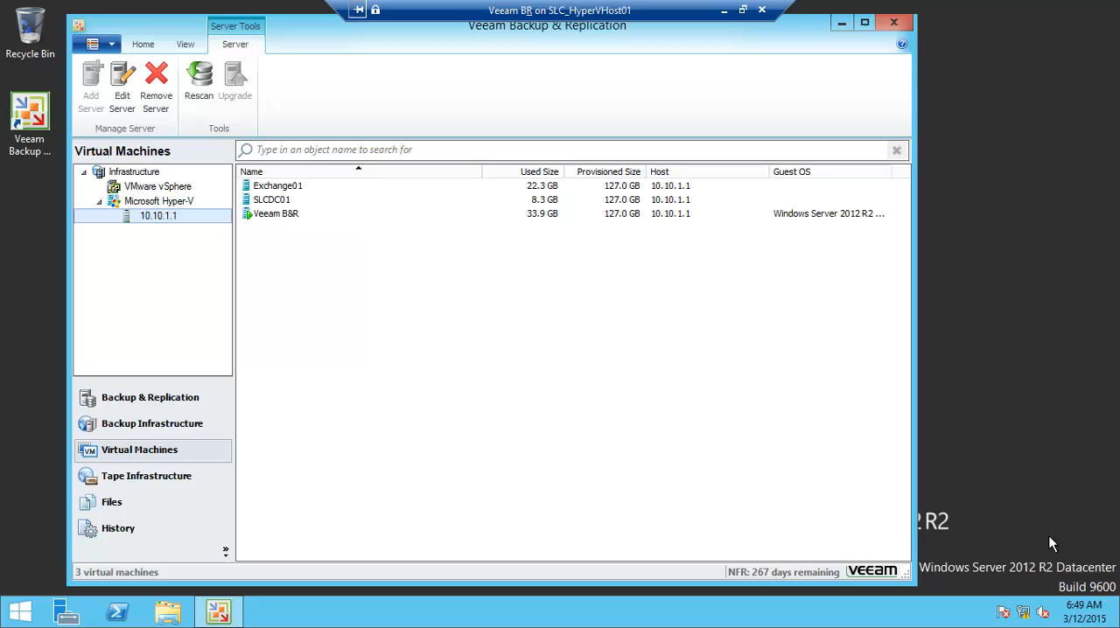

Slide 20
The Azure + Veeam Opportunity
By the numbers
30,000 Veeam ProPartners…
Provide Availability Solutions for
145,000 Veeam Customers…
Who protect
8.4 million VMs…
That should be backed up in Azure
Over
30,000
ProPartners
145,000
customers
worldwide

Slide 21

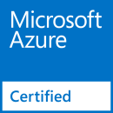
Veeam enables Azure Hybrid Cloud
StorSimple as Repository
Optimized Transfer to Azure
StorSimple
Microsoft Azure
Veeam Fast SCP for Microsoft Azure
On-premises
infrastructure
VPN
Service Providers use Veeam Cloud Connect in Azure Marketplace

Slide 22
Veeam FastSCP for Microsoft Azure

Slide 23
Key Functionality
Veeam Fast SCP for Microsoft Azure provides:
Simple, reliable copy of local files to Azure VMs, and files in Azure VMs to on-premises
Secure file copy with no independent encryption or VPN needed
Manual file copy to/from Azure VMs – without the need to keep the UI open until the file copy completes
Automatic scheduling of file copy jobs for nightly or weekly copies to/from Azure VMs
Copy files in just a few clicks inside a wizard-driven UI – no scripting needed

Slide 24
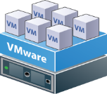





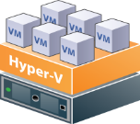
Veeam and StorSimple
Veeam StorSimple integration
Mid to enterprise customers
Backup
Backup copy
Production
storage
Primary
backup storage
Microsoft
StorSimple
View the case study with Mazda https://customers.microsoft.com/Pages/CustomerStory.aspx?recid=10939
View the TechEd Session with Veeam, Microsoft and Fortescue Metals http://tena2014.eventpoint.com/topic/details/DCIM-B250

Slide 25
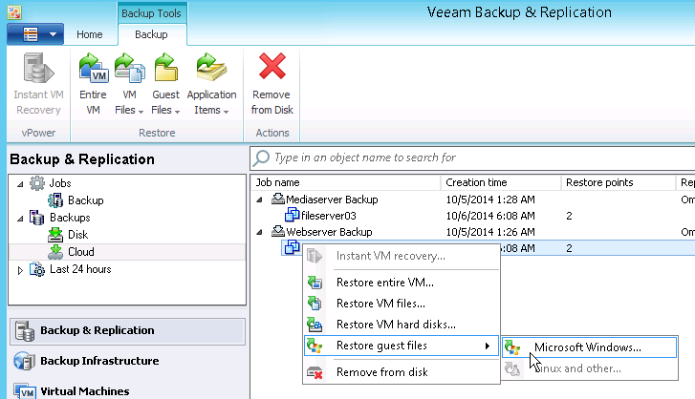
Veeam Cloud Connect – Customer View
Built into core commercial editions of Veeam Backup & Replication
Simple to connect to authorized Veeam Cloud Providers’ offerings
Service location
Credentials

Slide 26


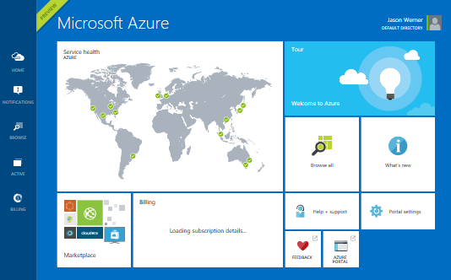
Veeam Cloud Connect – Service Provider
Only via authorized Veeam Cloud Providers
Microsoft Azure Marketplace
  Preconfigured Veeam VM
  Azure Certified
Extending Veeam backup
infrastructure to the cloud
Data Loss Avoidance

Slide 27









Service provider setup
Install Veeam infrastructure: backup server, repository and cloud gateway
Create a “tenant” and allocate resources to it
Give customer connection information
Repeat
Service Provider
Veeam Backup & Replication
SSL
Customer
SSL
WAN
Customer
Cloud repositories
SSL
Cloud gateway
WAN
accelerator
(optional)
Customer
WAN
accelerator
(optional)
Backup repository

Slide 28
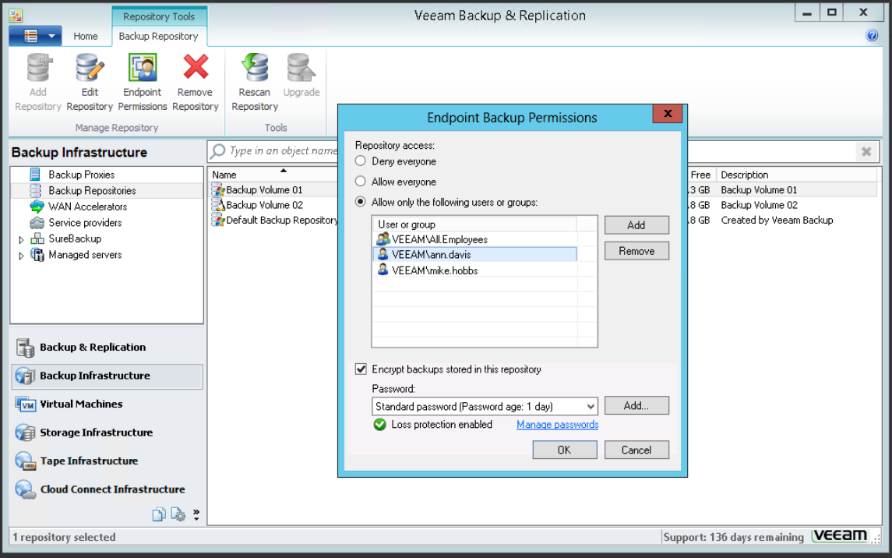
Veeam Endpoint Protection Free
Backup and Recover physical endpoints
Bare Metal Recovery
File Level Recovery
Integrated with Veeam Backup & Replication

Slide 29
No patience for downtime and data loss
Growing amount of data
24/7 operations
Enable the Always-On BusinessTM
High-Speed Recovery
Data Loss Avoidance
Verified Protection
Leveraged Data
Complete Visibility
Modern Data Center
Virtualization
Modern storage
Cloud

Slide 30
Call to Action
Come to the Veeam booth for a one-on-one discussion
www.veeam.com for Detailed information, Videos, Webcasts and other resources
Email us at Azure@Veeam.com
http://www.veeam.com/veeam-propartner-network.html
Sign up as a Reseller
Sign up as a Veeam Cloud Provider

Slide 31


Please evaluate this session
Your feedback is important to us!
Visit Myignite at http://myignite.microsoft.com
or download and use the Ignite Mobile App
with the QR code above.

