Slide 2
Building ASP.NET with Microsoft Azure
BRK3711
Jeff Fritz
Microsoft Senior Program Manager – Web Platform
@csharpfritz

Slide 3
Assumptions
Familiarity with ASP.NET structures and concepts
No network knowledge
No hardware/operations knowledge
No server configuration knowledge
You have a connection to Azure
If you’re an ASP.NET developer, you should be comfortable

Slide 4
Introducing our sample web application
Ignite Photo Album

Slide 5

Azure App Service
Web Apps
LOGIC Apps
Mobile Apps
Api Apps

Slide 6
Web Apps
Evolution of Azure Web Sites
Strictly a name change
“Web Hosting Plan” “App Service Plan”
All existing web sites are now web apps
in the portal

Slide 7
Mobile Apps
Formerly “Azure Mobile Services”
New features
  Integration with on-prem and SaaS services
  Staging slots
  Webjobs
  Scaling options
Easy migration steps to convert Mobile Services to Mobile Apps

Slide 8
Logic Apps
New App Type – Automate data access across the cloud without writing code
  In Preview Mode
Features Visual Designer to Compose Business Processes
Automate SaaS actions based on external triggers
  Create tasks in CRM based on Facebook activity or Twitter account activity
  Connect cloud marketing solution to on-prem billing system

Slide 9
Azure Portal
Reviewing apps and resource groups

Slide 10
Azure Web Jobs
Run a task
  On demand
  On a schedule
  Continuously
Runs these types of files
  EXE, CMD, BAT, PS1
  SH (using bash)
  PHP
  PY
  JS (using node)
  JAR (using Java)

Slide 11
Azure Storage
4 types of storage
  Blob
  Table
  Queue
  File
Easily accessed through stream APIs
Replication available locally and geographically

Slide 12
Uploading and Resizing

Slide 13
Diagnostics
Streaming Logging
Remote Debugging
Application Insights
Staging Slots

Slide 14
Azure Diagnostics
Logging, Debugging, AppInsights, Staging Slots

Slide 15
API Apps
New App Type – Upgrade your API to cloud scale with no code changes
Simple Access Control through the Azure Portal
Public gallery of APIs
Automatic SDK Generation

Slide 16
Adding a Photos API

Slide 17
Resources
Jeffreyfritz.com
Portal.azure.com
www.asp.net
Twitter.com/csharpfritz

Slide 18
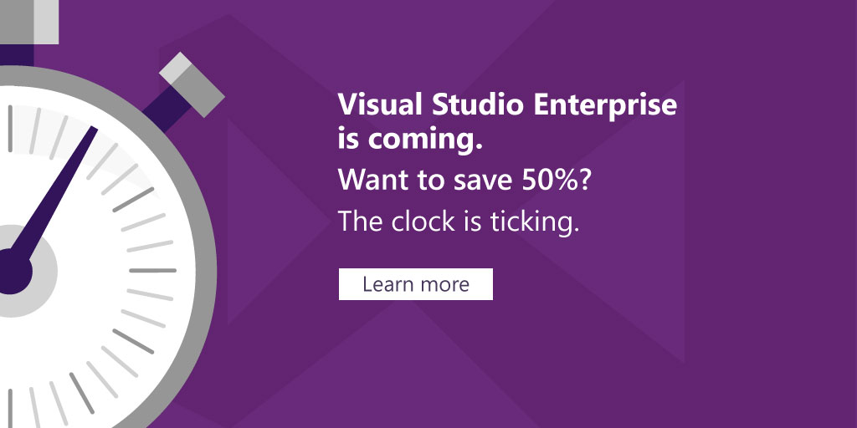
FREE UPGRADE to Visual Studio Enterprise with MSDN
There’s no better time than now to get ready for the release of Visual Studio 2015!
For a limited time, get a free upgrade to Visual Studio Enterprise with MSDN
Learn more about this offer: http://aka.ms/nbtbvs
Learn more about Visual Studio 2015 at our in-person or online events: http://aka.ms/nbtbevents

Slide 19


Please evaluate this session
Your feedback is important to us!
Visit Myignite at http://myignite.microsoft.com
or download and use the Ignite Mobile App
with the QR code above.

