Slide 2
Integration: Extend Mission-Critical to the Cloud
BRK3734
Guru Venkataraman
Guru.Venkataraman@Microsoft.com
Mark Mortimore
Mark.Mortimore@Microsoft.com

Slide 3
About this Session
Introducing App Service
  What is App Service
  What are the various components that make up App Service?
  Web Apps, Mobile Apps, Logic Apps, API Apps
Why is it relevant to Hybrid connectivity
  Connectors as API Apps
Examples of extending/customizing App Services

Slide 4
Azure Websites
Mobile Services
BizTalk Services
Key app services in Azure today

Slide 5


Azure App Service - One integrated offering
Web Apps
Mobile Apps
Web apps that scale with your business
Build Mobile apps for any device
LOGIC Apps
Api Apps
Automate business process across SaaS and on-premises
Easily build and consume APIs in the cloud

Slide 6
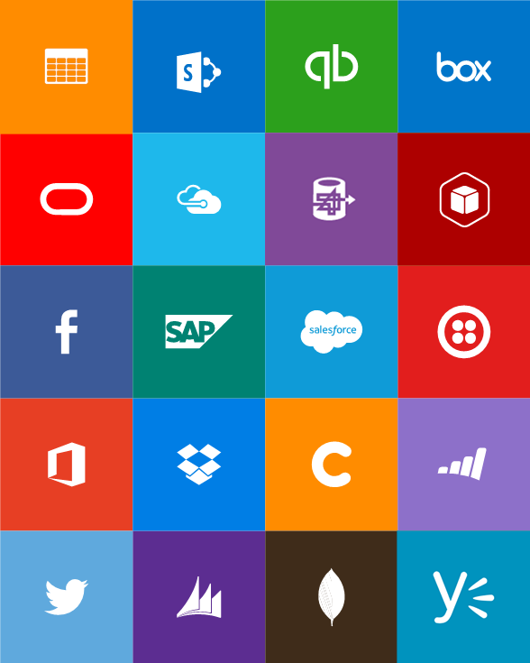

Azure App Service
Enables Integration

Slide 7
Full capability set available including:
  .NET, Node.js, Java, PHP, and Python
  WebJobs for long running tasks
  Integrated Visual Studio publish, remote debug…
  Continuous Integration (CI) with GitHub, BitBucket, Visual Studio Online (VSO)
  Auto-load balance, AutoScale, Geo Replication supports Disaster Recovery
  Virtual networking and hybrid connections
  Site slots for staged deployments
Web Apps
Web apps run as-is
no changes required

Slide 8
New capabilities for Mobile apps:
  Webjobs for long running tasks
  CI with GitHub, BitBucket, VSO
  Auto-load balance, Autoscale, Geo Disaster Recovery
  Virtual networking and hybrid connections
  Site slots for staged deployments
Mobile Apps
Mobile services plus
a whole lot more

Slide 9
Easily use cloud or custom APIs:
  Dozens of built-in APIs for popular SaaS
  An ecosystem of APIs for any need
  Create and publish custom, reusable APIs
  Visual Studio tooling with one click publish and remote debugging
  Automatic client SDK generation for many languages
Api Apps
Create, consume and
host APIs more easily

Slide 10
App Service
Web Apps
Mobile Apps
Web apps that scale with your business
Build Mobile apps for any device
LOGIC Apps
Api Apps
Automate business process across SaaS and on-premises
Easily build and consume APIs in the cloud

Slide 11
New Logic Apps for easy automation
  No code designer for rapid creation
  Dozens of pre-built templates to get started
  Out of box support for popular SaaS and on-premises apps
  Use with custom API apps of your own
  Biztalk APIs for expert integration scenarios
LOGIC Apps
Automate SaaS and
on-premises systems

Slide 12
Workflow engine and Web-based process designer
JSON based workflow definition
Orchestrates API execution
Supports long running processes and control flows
Provides rich logging, diagnostics
Enables developers and business users to easily define and track business process

Slide 13
App Service
Web Apps
LOGIC Apps
Mobile Apps
Api Apps

Slide 14



App Service
Web Apps
LOGIC Apps
Mobile Apps
Customer site
Service Advisor
Customer
Appointment
Technician App
Web Apps
LOGIC Apps
Mobile Apps
Api Apps
Api Apps
http
SQL

Slide 15
Web Apps
LOGIC Apps
Mobile Apps
Customer site
Service Advisor
Customer
Appointment
Technician App
Api Apps
http
SQL

Slide 16
BizTalk Integration features as API Apps
Connectors
Validation
Batching/Debatching
Format Conversion (XML, JSON, FlatFile)
Extract
Transform
Mediation Patterns (Request Response, One Way etc)
Message Routing
Business Rules
Trading Partner Management
B2B - AS2/X12/EDIFACT

Slide 17


Microsoft Integration
+
BizTalk Server
BizTalk Services
Azure App Service
Leader in integration on-premises
Handles mission critical workloads for hundreds of customers
Renowned brand
First version of BizTalk build ‘cloud-up’
Already running mission critical workload for large customers
Includes BizTalk Services capabilities – evolved to benefit from App Service approach
Inherently extensible
More accessible to a broader audience, not just integration specialists
Takes BizTalk brand and capabilities forward

Slide 18

Hybrid Integration

Slide 19
Scenario overview
A mobile developer is asked to create a app for use by sales personnel in the org.
The app will need to access order details specific to a customer/region from their mobile device.
The order database is housed on a SQL server on-prem.
The data is sensitive and needs to be accessed only by authenticated users

Slide 20
Scenario Implementation
Challenges for the developer with the above scenario:
The developer is expected to be skilled in the following:
Accessing Enterprise SQL server (authentication, connection pooling, etc)
Connecting to on-prem resource (Firewall access, network management)
Create and host a scalable Web service to house the connection logic
Create a Rest head for SQL specific methods (CRUD operations)
Manage and secure access to the Web resource
Manage high availability of the endpoint

Slide 21
Demo
Accessing on-prem data from a mobile device
Guru Venkataraman

Slide 22
Built-in API Connectors
Connectors
Box
Chatter
Delay
Dropbox
Azure HD Insight
Marketo
Azure Media Services
OneDrive
SharePoint
SQL Server
Office 365
Oracle
QuickBooks
SalesForce
Sugar CRM
SAP
Azure Service Bus
Azure Storage
Timer / Recurrence
Twilio
Twitter
IBM DB2
Informix
Websphere MQ
Azure Web Jobs
Yammer
Dynamics CRM
Dynamics AX
Hybrid Connectivity
Protocols
BizTalk Services
HTTP, HTTPS
File
Flat File
FTP, SFTP
POP3/IMAP
SMTP
SOAP + WCF
Batching / Debatching
Validate
Extract (XPath)
Transform (+Mapper)
Convert (XML-JSON)
Convert (XML-FF)
X12
EDIFACT
AS2
TPMOM
Rules Engine

Slide 23
Opportunities for Partners/ISVs
Adaptors
Rule Sets & Policies
Custom Schemas
Transforms & functoids
Business Insight Dashboards
Application Mgmt Portals
Vertical Solutions

Slide 24
BizTalk - - Integration Innovation
App Service Preview launched March 23
B2B Features | v1 | v2
AS2 / X12 / EDIFACT
Agreement Decoupling
Batching / De-batching
Archiving
Transform
Trading Partner Management (API & Portal)
Vertical Extensibility
Tracking
Custom Code
Workflow Features | v1 | v2
Long Running
Browser Designer
Control Flow
Instance Management
Tracking
Large Messages (1GB)
Config Support
Expressions
EAI Features | v1 | v2
XML Transformation
Validation
Content Based Routing
Request Response
AD Auth
OAuth
Flat File
JSON
XML
Connector Extensibility
Custom Code
Other Features | v1 | v2
OOB Connectors
Marketplace
Hybrid Connectivity
Custom Code Isolation
Unified Portal
Auto Update with Opt Out
Rules Features | v1 | v2
Vocabulary
Policy
Sources (XML only today)
Test Policy
Browser Rule Editing
V1 = BizTalk Services
V2 = App Service (BizTalk + Logic + API)

Slide 25
Extensibility - Demo
Guru Venkataraman

Slide 26
Resources
Related Sessions at Ignite Chicago this week:
  BRK3719: Azure API Apps: API Backends for Enterprise Web, Mobile, and Logic Apps
  BRK1450: Microsoft Azure Logic Apps
2-Day Integration Summit April 13-14, Presentations and Videos available:
  www.biztalk360.com/biztalk-summit-2015-london
https://tryappservice.azure.com

Slide 27
Questions?
Answers!

Slide 28
Thank you!

Slide 29

Free Resources for DevOps Practices
Optimize your
DevOps practices & tools:
  Get started on your DevOps journey: aka.ms/devops
Accelerate your application
delivery lifecycle
Download the Forrester Infrastructure-as-Code whitepaper:
  Complexity kills. Automate with Infra as code: aka.ms/iac_tlp
Technical resources for Practitioners:
  Get access to free online training, evals and HOLs: aka.ms/devopsmva
RSVP here
Join the Community conversations:
  Use #TalkDevOps on Twitter

Slide 30


Please evaluate this session
Your feedback is important to us!
Visit Myignite at http://myignite.microsoft.com
or download and use the Ignite Mobile App
with the QR code above.

