Slide 2
Securing Access to O365 and other apps with Enterprise Mobility Suite
BRK3856
Dilip Radhakrishnan
Principal PM Manager, Microsoft Intune
Samuel Devasahayam,
Principal PM Manager, Azure Active Directory
Christopher Green
Senior PM, Microsoft Intune

Slide 3
Agenda
Access control in the new world of cloud and mobility
Secure access to O365 services
Secure access to SaaS apps
Secure access to on premise resources
Roadmap

Slide 4


Access control to corporate data today
CORPORATE
NETWORK
DMZ
INTERNET
Active
Directory
Mobile
devices
PCs
Policies
Filter EAS
Filter web access
Filter or block mobile app access
Block unmanaged devices
Prevent downloads
Force multi-factor authentication
Require domain joined
Force traffic via proxy/VPN
Browsers
Exchange Server
SharePoint
Server

Slide 5















The current reality…
EC2
On-Premises
Managed devices
Private Cloud

Slide 6



Protecting data in a mobile first, cloud first world
CORPORATE
NETWORK
DMZ
INTERNET
Active
Directory
Mobile
devices
SaaS Apps
Challenge
The perimeter can not help protect data
PCs
Solution
Access control and data containment integrated natively in the apps, devices, and the cloud.
Browsers
Exchange Server
SharePoint
Server

Slide 7
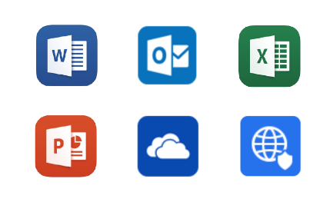
Data protection with EMS
Extensibility: Enable business apps to interoperate with Office Mobile
SaaS Apps
Intune App SDK/Tool
AD Authentication library
SharePoint
Online
Native cloud integration
O365: Mobile productivity
Azure AD: Identity and Access control to O365, SaaS apps and on prem apps.
Intune: Data container for Office mobile apps
Azure RMS: Information protection at file level
Managed Office productivity and security
CORPORATE NETWORK
Perimeter
network
Standard on-premises integration
Native device MDM
Active Directory
Intune: Mobile device management
Firewall
Firewall
Exchange Server
SharePoint
Server

Slide 8

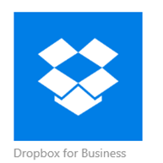


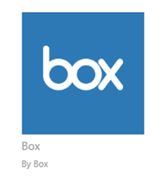
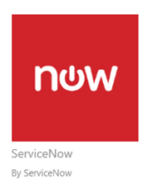
Introducing ‘Conditional Access Control’
User attributes
User identity
Group memberships
Auth strength (MFA)
Devices
Authenticated
MDM Managed
Compliant with policies
Not lost/stolen
Application
Business sensitivity
Conditional access control
Other
Network Location
Risk profile
On-Premises applications

Slide 9
Secure O365 Email & Collaboration services

Slide 10

Securing O365 Services with EMS
Control Access
Block Email/SharePoint until enrolled and Compliant to IT policies
Simple end user experience
Revoke access on policy violations
Prevent data leaks
Encrypt application data at rest
Restrict data sharing to managed apps
Enforce application level policies
Built in data protection for Office apps
Revoke Access
Revoke company resource access from lost/stolen devices or ex employee scenarios
Selectively wipe corp data
Employees
Secure Data in Transit
Encrypt emails/attachments shared externally
Track/Audit Rights protected document usage
Remote kill document access

Slide 11
Demo – Secure email & Collaboration in O365
Chris Green

Slide 12


Access control to Outlook clients on iOS/Android
Office 365
EAS Service
Device object
device id
isManaged
MDMStatus
Set device management/ compliance status
Get Corporate email
9
5
Get EAS service access token for user
Outlook
Cloud Service
8
Intune
4
Register device in
Azure AD
Azure AD
Access Outlook Cloud service with
AAD token
10
Issue Access token
2
6
Enroll into Intune
Authenticate User and Device
Redirect to
Intune
4
7
Email delivered
Unified Enrollment
1
Quarantine Website
Step 1: Enroll device
(Workplace Join + management)
Outlook App
3

Slide 13
Access control to SharePoint from OneDrive mobile apps
Device object
device id
isManaged
MDMStatus
Set device management/ compliance status
Office 365 SharePoint Online service
5
Intune
4
Register device in
Azure AD
Azure AD
Documents Synced
Access SPO service with
AAD token
Issue Access token
2
7
6
Enroll into Intune
8
Authenticate User and Device
Redirect to
Intune
4
Unified Enrollment
1
Quarantine Website
Step 1: Enroll device
(Workplace Join + management)
OneDrive App
3

Slide 14
Secure SaaS apps

Slide 15
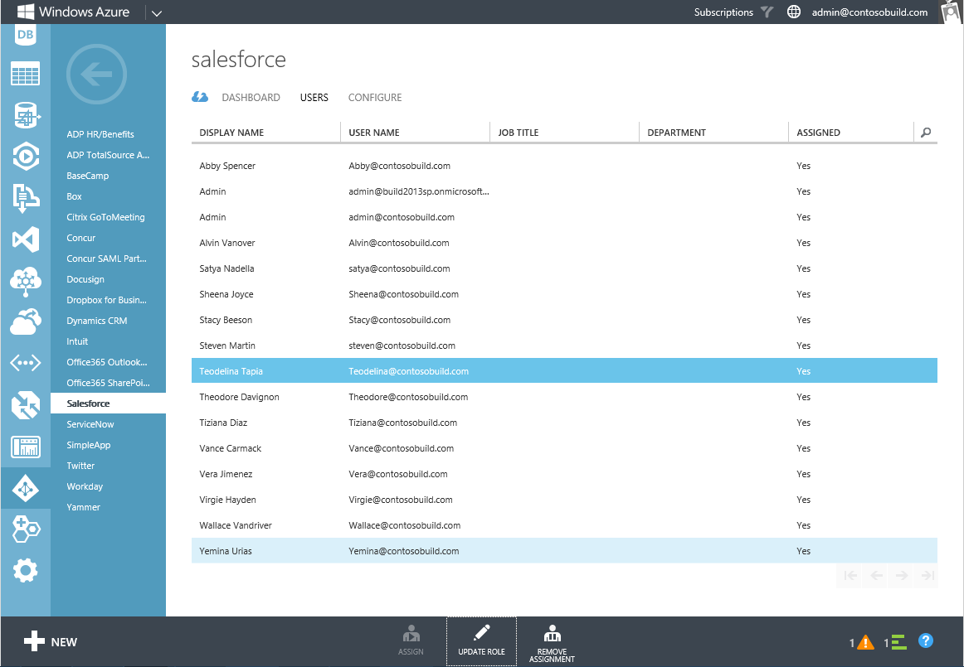
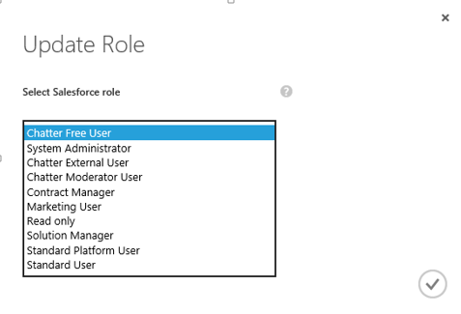
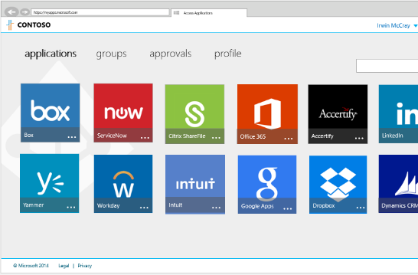

Conditional access to Azure AD connected applications
2000+ applications pre-configured in Azure AD. Secure access with:
Per-app MFA
Per-app MFA from extranet
Block extranet
Target specific groups of users or exclude specific groups of users
  Targeting can be standard groups or dynamic groups in Azure AD

Slide 16

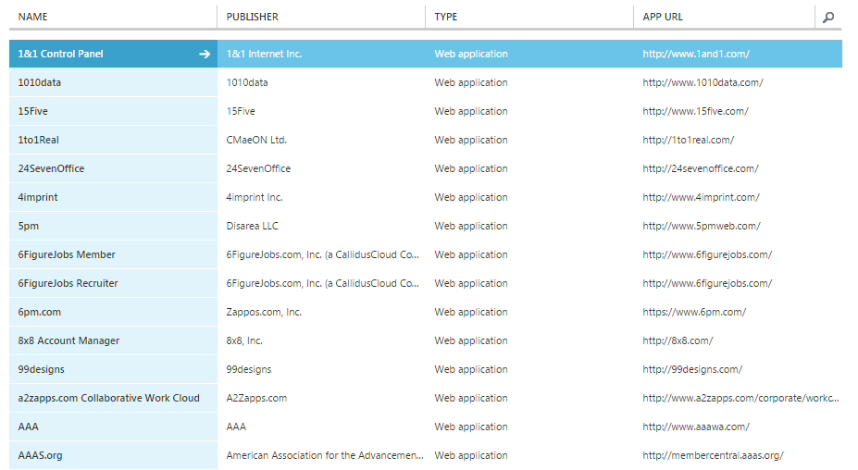


fabrikam
DASHBOARD | USERS | GROUPS | DEVICES | APPLICATIONS | REPORTS | CONFIGURE
ABAC
Microsoft
ADD

Slide 17

1&1 control panel
DASHBOARD | CONFIGURE | ACCESS RULES |  | OWNERS
Access Rules
1&1 Control Panel
1010data
15Five
1to1Real
24SevenOffice
4Imprint
5pm
etc…
Apply to
All Users
Selected Groups:
None Selected
Add Group
Remove Group
None Selected
Except:
Add Group
Remove Group
RULES
Require multi-factor authentication
Require multi-factor authentication when not at work
Require multi-factor authentication when device is not authenticated
Require a compliant device
Block access when not at work
Configure “work” network location.
STATUS
OFF | MONITOR | ON
Monitor will generate statistics but not impact user access.

Slide 18
Demo
Owner: uday
Presenter: sam
Conditional access to apps connected to Azure AD

Slide 19
Secure on-premises resources

Slide 20




Azure AD Proxy - SSO from the cloud
  Single Sing-on experience from Azure Active Directory to on-prem applications
  Same conditional access policies available to other SaaS applications using Azure AD
  Connectors use the AAD token data to impersonate as the end user to the backend applications using Kerberos Constrained Delegation (KCD)
  Support any application that uses Integrated Windows Authentication (IWA) such as SharePoint, Outlook Web Access and CRM.
  No need to change the application, install agents on the application or expose it directly to the Internet
Azure Active Directory
Application Proxy
AAD Token: UPN=joe@contoso.com
DMZ
Corporate Network
Connector
Connector
Kerberos Ticket: joe@contoso.com
Resource
Resource
Resource

Slide 21
AD FS and Hybrid Conditional Access
Azure AD registered devices write-back
Device MDM compliance
Intune
Active Directory
Azure AD
Register device in Azure AD
Enroll device in Intune
Conditional access policy
(claim rules)
Device AuthN
MFA adapter
AD FS 2012 R2 or higher
User
User
Device
Device

Slide 22
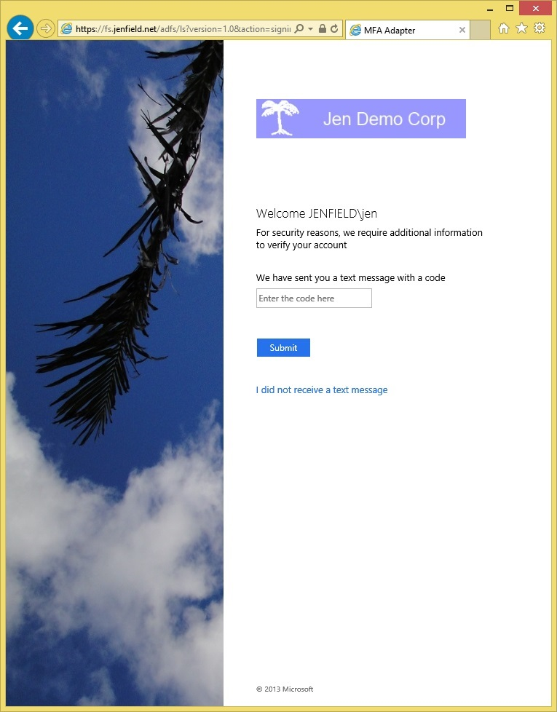
Device based conditional access on premises
Check device object
Active Directory
MFA required for un-registered device
On prem apps
Permit
Application access
Conditional access policy
(claim rules)
Inspect device certificate
Prompt MFA if device not registered
Device AuthN
MFA adapter
AD FS 2012 R2 or higher
User
Device

Slide 23
Device Conditional Access
Enable Access only from devices that are managed and/or compliant as reported by Intune
Support for down-level managed PC’s
  Auto-Workplace join for Win7/Win8.1 domain joined PC’s now will be marked with DJ flag and marked as ‘managed’
Revocation of Access & SSO when device attributes change
  User prompted for fresh credentials
Support Web Application Pre-authentication for EAS with both Username/Pwd & Device credential

Slide 24
Demo – Secure access using ADFS
Owner: Sam
Presenter: sam

Slide 25
VPN & Wifi Management
  Support for major SSL VPN vendors:
    Cisco
    Juniper
    Checkpoint
    SonicWall
    F5
    Custom VPN Payloads
  Support for Native VPN standards
    PPTP
    L2TP
    IKEv2
  Automatic VPN connection
    App-triggered VPN: Windows 8.1 and Windows Phone 8.1
    Per-app VPN for iOS
  Support multiple Wifi Authentication types:
      WEP
      WPA/WPA2 Personal
      WPA/WPA2 Enterprise
  Specify certificate to be used for Wi-Fi connection

Slide 26
Certificate management lifecycle with Intune
Deployment
Usage with Resource Access profiles
Renewal
Revocation

Slide 27

Certificate Deployment – SCEP approach
Deploy SCEP certificate profile. Intune generates a challenge string.
Device gets SCEP profile that contains URI for NDES. Device contacts NDES and presents challenge.
NDES forwards to NDES Connector policy module, which validates the request
If valid, NDES passes on request to issue Cert “on behalf”
Cert is delivered to the device and event is reported back to Intune
NDES Connector reports event back to Intune
6
Intune
4
3
1
5
2
CA
SCEP Server(NDES) +
Intune Connector
5

Slide 28

Certificate Deployment – PFX approach
Intune cloud service contacts on premise Certificate connector.
Intune connector requests certificate on behalf of user
CA issues certificate and private key
Connector sends it up to Intune service
PFX(Cert+Private key) is delivered to the device and event is reported back to Intune
Intune
1
2
4
5
3
CA
Intune Connector

Slide 29
Secure Email in On-Prem Exchange
Block non Managed devices
On Prem Exchange Server 2010/2013
1
Intune
Set device management/ compliance status
6
9
Device object
device id
isManaged
MDMStatus
EASIDs
Allow Managed device
5
Enroll into Intune
Attempt email connection
2
If not managed, Push device into quarantine
3
Azure AD
Unified Enrollment
5
Azure AD DRS
8
Who does what?
Intune: Evaluate policy, manage device state and mark device record in AAD
Exchange Server: Provides API and infrastructure for quarantine
Quarantine
Register device in
Azure AD
Create EASID to device ID binding
10
(Workplace Join + management)
4
If managed, email access is granted
Quarantine email
Step 1: Enroll device
Step 2: Register EAS client
EAS Client
7
Register EAS
email client

Slide 30
Road Ahead

Slide 31



Road ahead
Desktop Conditional access
  Restrict Outlook 2013/OneDrive PC apps to sync only from Domain joined PCs or Intranet locations
Browser access to O365 services
  Restrict OWA/SP access to only Intune managed/compliant mobile devices or domain joined PCs
Mac support
  Restrict Outlook on Mac to sync only from Intune managed and compliant devices.
Windows 10 management
  Enhanced access control and data protection

Slide 32
Win10 – Conditional access enhancements
  Windows Device health attestation service
  Unified enrollment experience
  Auto enroll with Intune & AzureAD
  New Compliance Rules
  Is device patched?
  Is Firewall enabled?
  Is Antivirus & real time protection enabled?
Intune, AAD & Windows Attestation Service
Request
3
4
Approved
Company
resources
5
Documents
Here is my proof
2
Prove to me you are healthy
Email
1
Access please
Refer session @ Microsoft Ignite on “Securing Access to Microsoft Exchange and SharePoint Online services with Microsoft Intune“ by Dilip Radhakrishnan & Chris Green

Slide 33









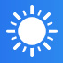

Win10 – Enterprise Data protection
  “Enterprise data protection”
  User friendly work-personal separation
  Manage what data is “Enterprise”
  Audit intentional data disclosure
Data exchange is blocked or audited
Business Apps & Data
Managed
Personal Apps & Data
Unmanaged
for business
personal

Slide 34
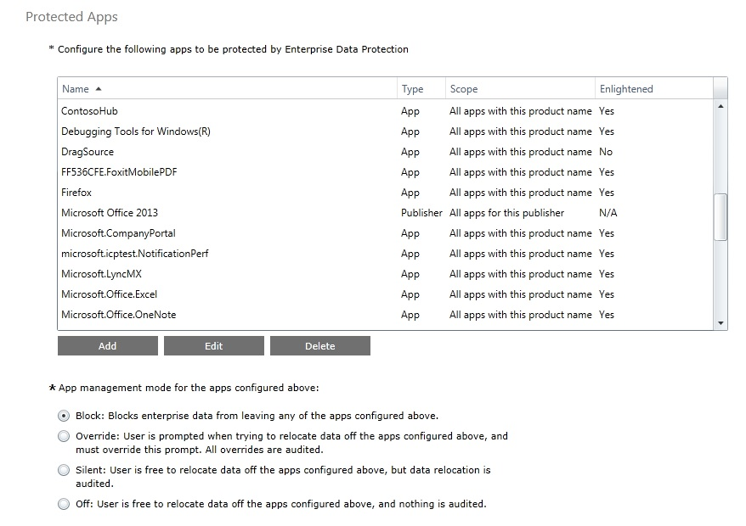
EDP Policy in Intune

Slide 35
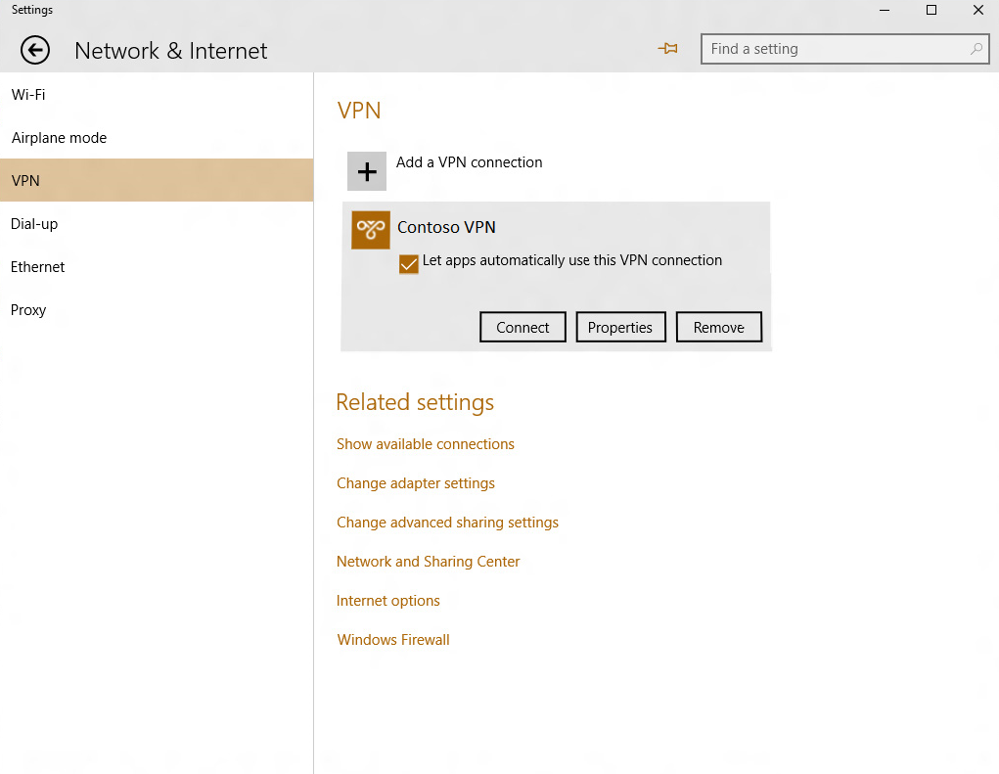
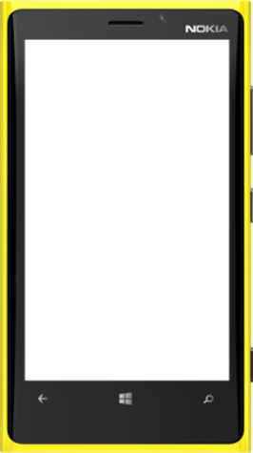
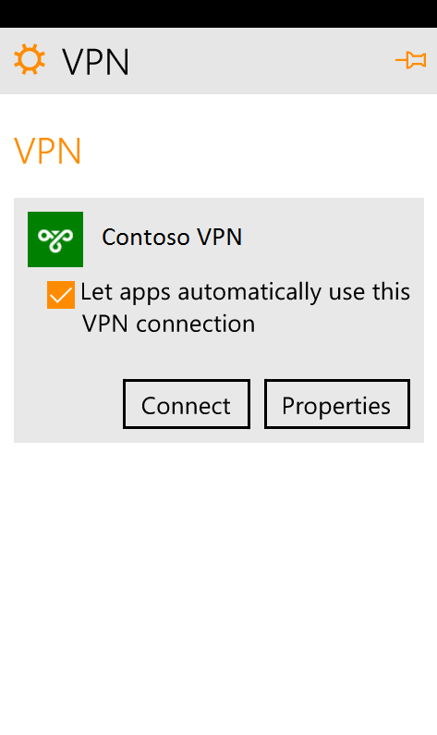
Windows 10 - Better VPN management
  Auto connect VPN
  VPN traffic filters
  Application based filters
  Unified platform
  VPN: open to 3rd party plug-ins

Slide 36
Conclusion

Slide 37
Security and Access control: Architecture matters
Azure AD
Identity and Access
Office 365
Productivity
Intune
Device & App Management
Always up to date
Continuous feature upgrades
Always available and reachable
Easy to adopt and deploy
Easy to try and buy
Designed to work together
Built from the ground up: Datacenter, Fabric, SaaS
Built using world class engineering & security
Compliant and certified
Financially backed Service Level Agreements

Slide 38
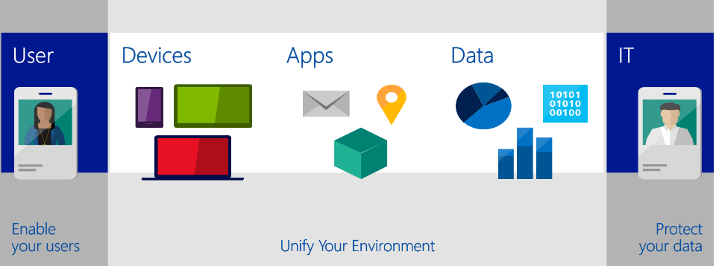
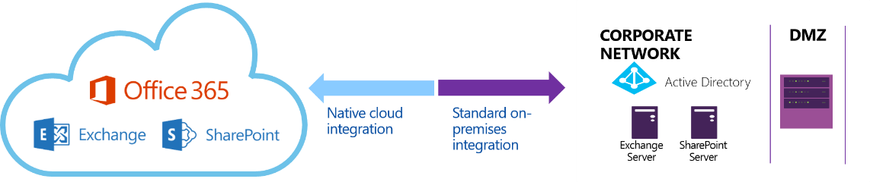







Microsoft’s Differentiators
Complete solution for application and device management, access, identity, productivity, and data protection
Cloud-hosted corporate data protection
Azure AD
Integrated cloud services
Best end-user experience for mobile productivity
World-class engineering and security with a single support system and 3rd-party ecosystem

Slide 39


Please evaluate this session
Your feedback is important to us!
Visit Myignite at http://myignite.microsoft.com
or download and use the Ignite Mobile App
with the QR code above.

