Slide 2
Fundamentals of Azure RemoteApp management and administration
BRK3868
Eric Orman - Senior Program Manager
Thomas Willingham – Technical Product Manager

Slide 3
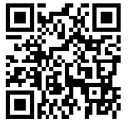

Fundamentals of Azure RemoteApp management and administration
http://www.remoteapp.windowsazure.com
Scan and download RD Client
Sign in using Microsoft Account or OrgID
10 minute access to Demo deployment apps
Eric Orman - Senior Program Manager
Thomas Willingham - Technical Product Manager

Slide 4

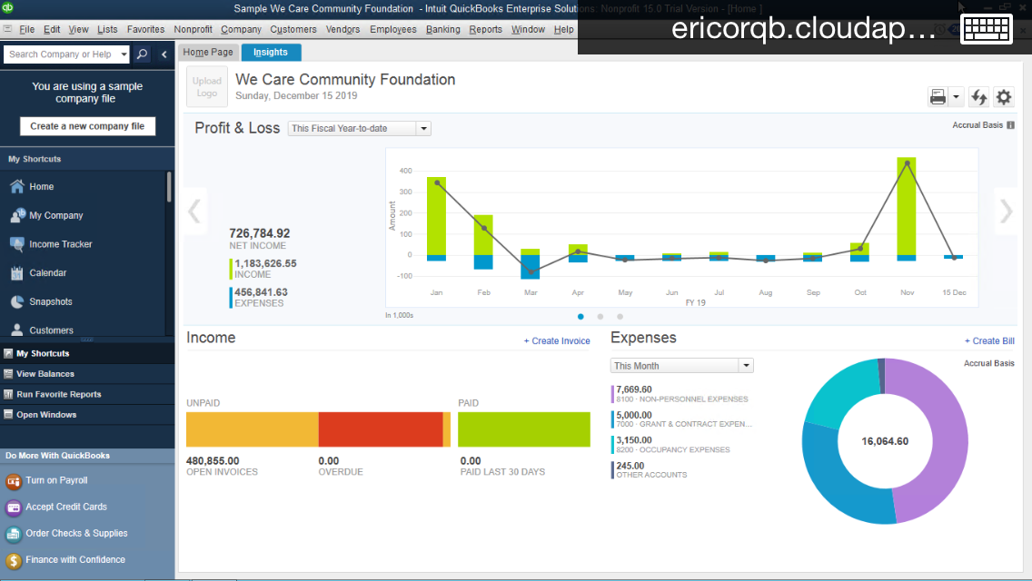
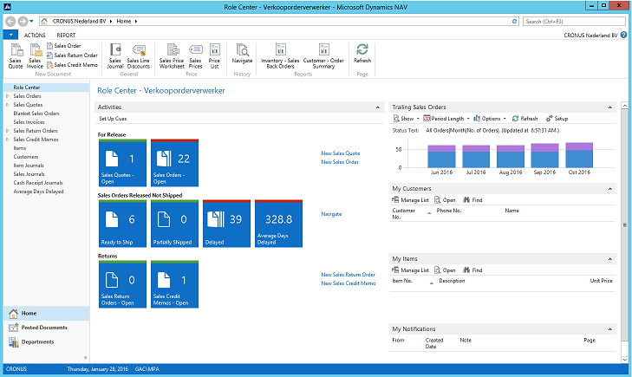
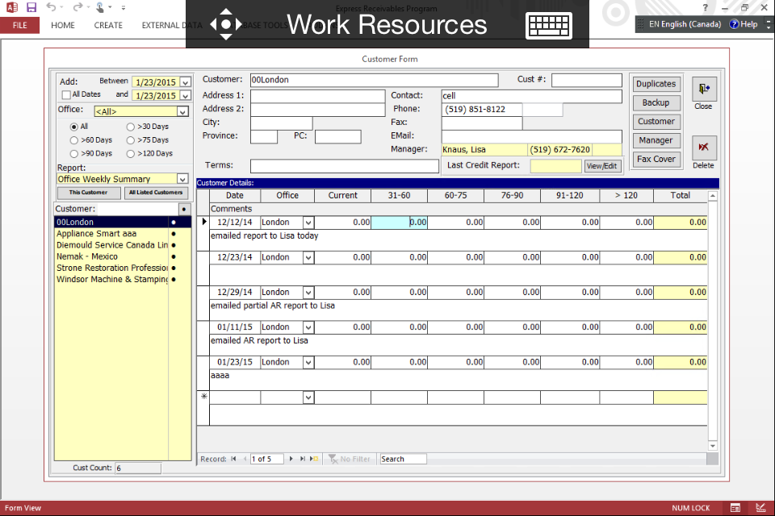
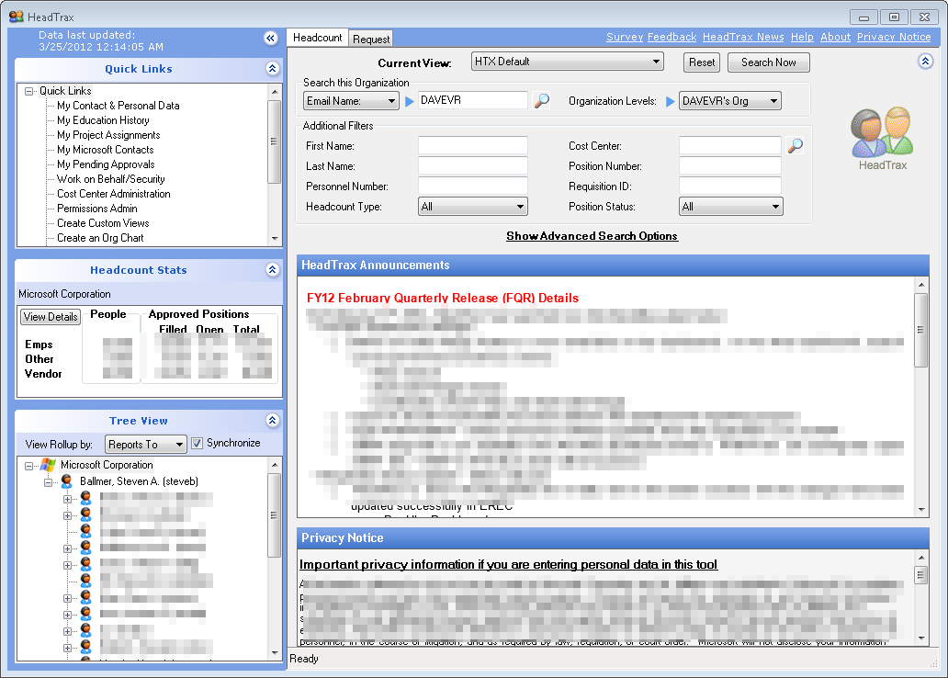
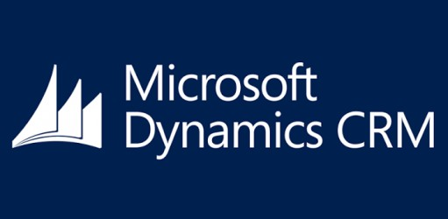
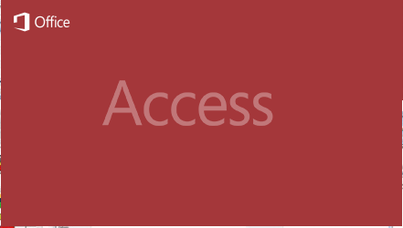

Azure RemoteApp is your
Windows application anywhere on any device
“Enable users to be productive on the devices they love, while protecting the company. ” Brad Anderson
LOB
app

Slide 5

Today’s challenges
Deliver applications to mobile platforms (BYOD)
Respond to dynamic business requirements for IT:
  Seasonal/temporary workers
  Vendors
  New employees (mergers and acquisitions)
Reduce infrastructure costs (move CAPEX to OPEX)
Provide access to legacy applications
Protect corporate resources and ensure compliance

Slide 6

Desktop Virtualization solution progression
Session-based desktops
and RemoteApp
Cost-effective, easy to manage
Access to pooled or personal Virtual Desktops running Windows Client OS
High performance, app compatibility
Remote Desktop Session Host deployed on cloud infrastructure services
Customizable with minimum capital expenditure
Windows Server session-based applications delivered from the Azure Cloud
Turnkey solution, scale without large CAPEX
Session-based computing
Virtual Desktop Infrastructure
RDS
on IaaS
Azure
RemoteApp
User
On-premises
In cloud

Slide 7
One year ago….
Preview
May 2014
GA
December 2014
Today
Create Custom image from Azure VM
Bulk user import
Windows Phone
Reuse existing VNET
Australia DC
Microsoft Image for Hybrid
Custom apps in Cloud
ExpressRoute
Secure WebSockets
PowerShell & SDK

Slide 8
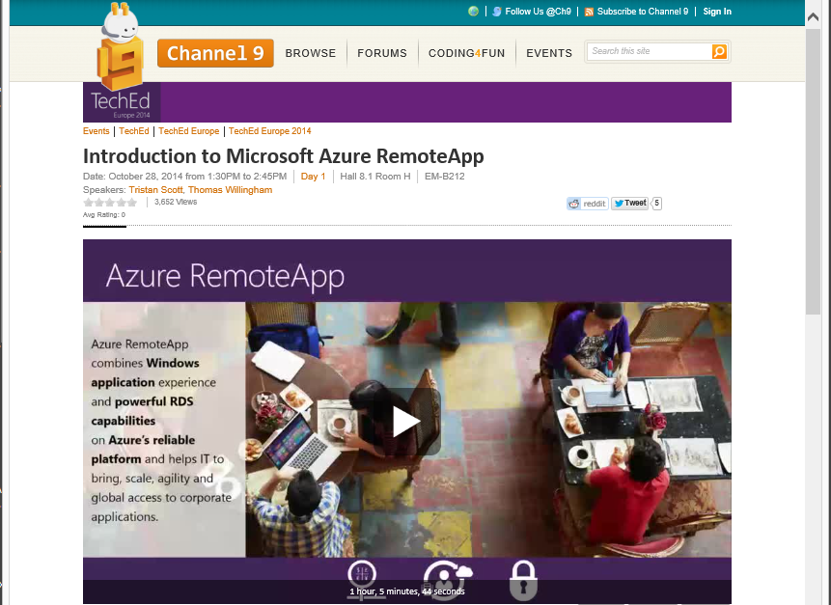
Azure RemoteApp Overview
http://channel9.msdn.com/Events/TechEd/Europe/2014/EM-B212

Slide 9
Two deployment options
RemoteApp
cloud deployment
RemoteApp
hybrid deployment
Image available with Microsoft Office Professional Plus 2013 preinstalled
Rapid provisioning: apps quickly available
Automatic maintenance of platform image: OS and apps
always up-to-date, Microsoft antimalware
User logon with Microsoft account or corporate credentials federated with Azure Active Directory
Fully customizable apps, OS, and settings
IT can manage template images and apply
updates via Azure Portal
Full access to on-premises network
User logon with corporate credentials federated
with Azure Active Directory
Windows Server 2012 R2 session virtualization
Dynamic scalability
Global
presence
High fidelity
with RDP
Secure,
WAN-ready connectivity
Clients for Windows, Mac, iOS, Android

Slide 10
Cycle of Management
Eric Orman
Senior Program Manager

Slide 11

Outline
Overview of Azure RemoteApp
Cycle of management and administration
Will my app work on Azure RemoteApp?

Slide 12
Cycle of management and administration of Azure RemoteApp
Select Image
Publish Apps
Assign Users
Update & upload image
Utilize
Evaluate
Consume

Slide 13
Cycle of management and administration of Azure RemoteApp
Outline:
Select an image
Use custom apps
Which apps work on ARA
Best practices for Windows app
Create a custom image
Select Image
Publish Apps
Assign Users
Update & upload image
Utilize
Evaluate
Consume

Slide 14
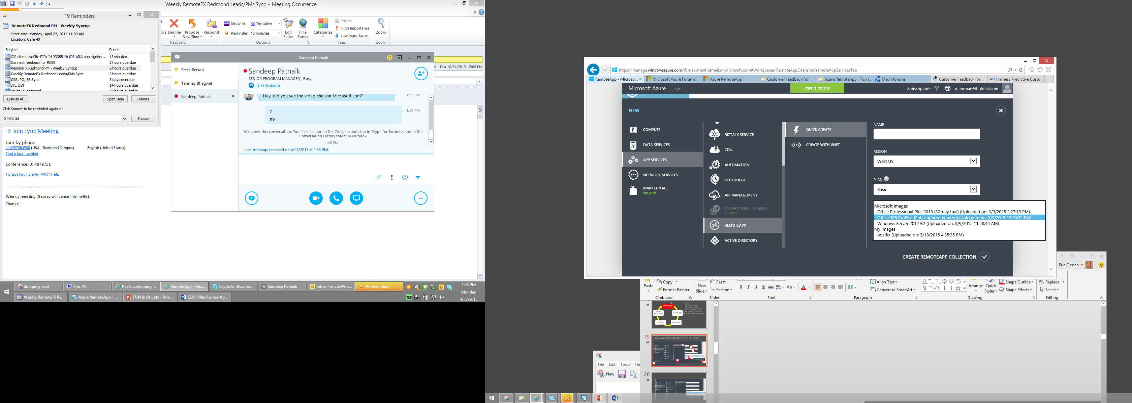

Create Azure RemoteApp Cloud collection
3
4
5
6
7
2
1
8
http://azure.microsoft.com/en-us/documentation/articles/remoteapp-create-custom-image

Slide 15
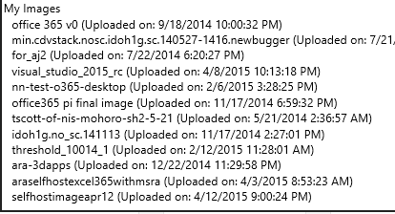
Choose the image that’s right for you
You can only publish apps that are on the selected image
Custom apps require a custom image
Differences between Microsoft Images vs custom images
Submit feature requests for Microsoft images on Feedback site
Capabilities | Microsoft images | Custom
Allowed to make changes
Preconfigured and optimized
Allows custom apps
Admin access
Microsoft managed
MS Images
Custom
What is in the RemoteApp template images?
Earlier explained how autoscale works

Slide 16
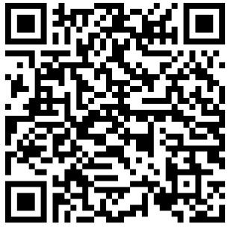
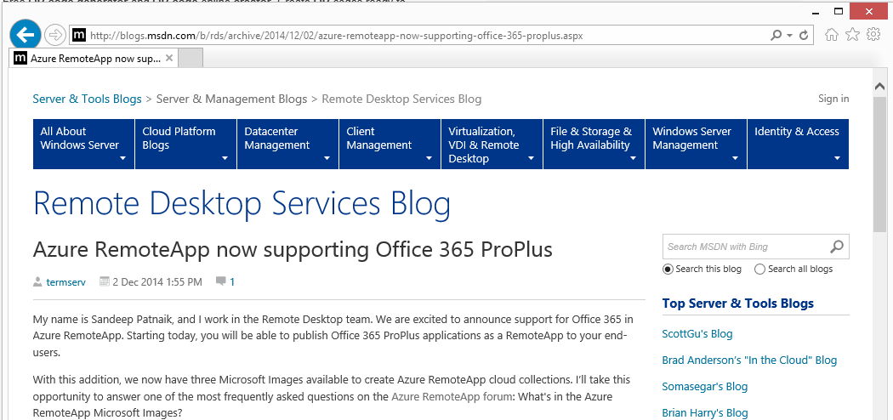
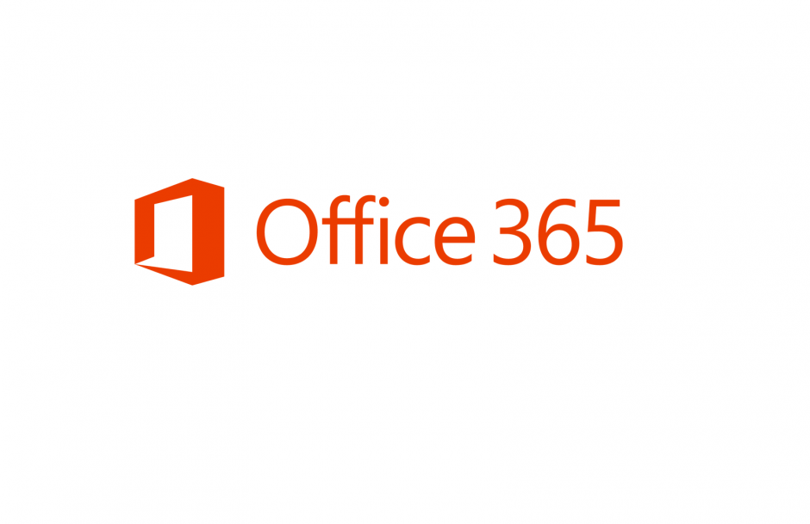
http://blogs.msdn.com/b/rds/archive/2014/12/02/azure-remoteapp-now-supporting-office-365-proplus.aspx
Using Office in Azure RemoteApp
Only way to use Office in RemoteApp is to have an “O365 ProPlus” plan which supports Shared Computer Activation (SCA)
Note: All E3 or E4 O365 subscription include “Office 365 ProPlus”
http://technet.microsoft.com/en-us/library/office-365-plan-options.aspx

Slide 17
Create custom image from Azure VM
DEMO

Slide 18
Application compatibility & testing
  Differences between Windows Server and Windows Client.
    ~85% compatibility
    Typically apps that support fast user switching and no SKU check are compatible
    Follow standard Windows application best practices
  Multi-user awareness
  Resource utilization
  Be aware of any remoting nuances
  Note: Windows Store apps not supported
  Testing apps to determine compatibility
    Install on Windows Server 2012 R2
    Check multi-session compatibility
    Validate app behavior
Additional references
Application Compatibility Best Practices for Remote Desktop Services
http://azure.microsoft.com/en-us/documentation/articles/remoteapp-appreqs/
http://msdn.microsoft.com/en-us/library/windows/desktop/hh749939.aspx

Slide 19
Template image creation tips
Ensure start menu shortcuts exist for ease of publishing later
Add a local administrator to custom image local administrators group to allow permission elevation for investigations
Keep images up to date regularly
Scheduled tasks do persist after sysprep
Disable automatic software updates for published applications
Install the RDSH role before installing applications to ensure that any issues with application compatibility are discovered before the image is uploaded to RemoteApp
Create and test to validate before import/upload
http://azure.microsoft.com/en-us/documentation/articles/remoteapp-create-custom-image

Slide 20
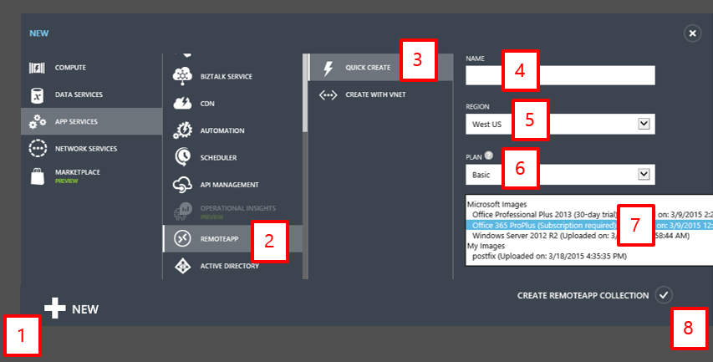

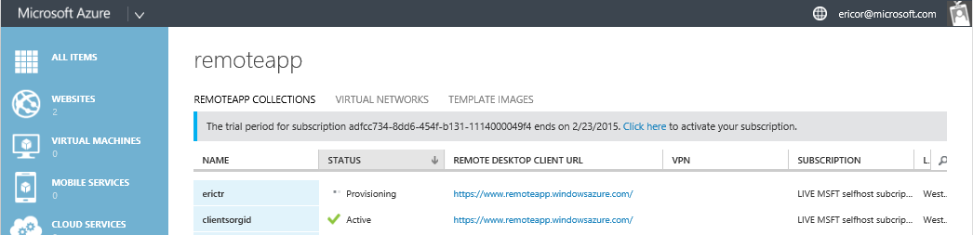
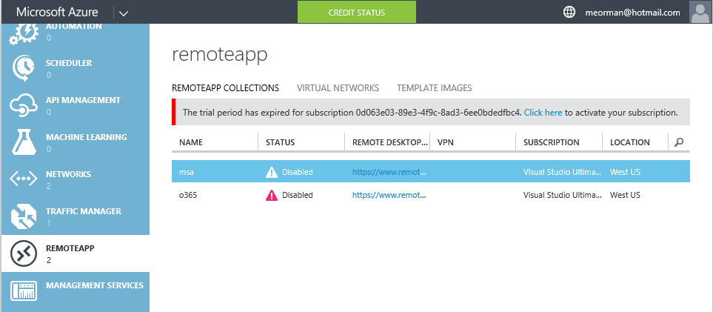
Create Azure RemoteApp collection
SHOW PICTURE
1. Create collection
2. Collection is provisioned
1234-567-890-1112131-4151617
http://azure.microsoft.com/en-us/documentation/articles/remoteapp-create-custom-image

Slide 21



Provisioning Azure RemoteApp collections
What happens during collection creation?
Copies of your imaged called “instances” are created
Service dynamically scales (Elastic runtime)
Important:
Instances are OS hosts for the apps
Never store data on instances
Remember only charged for active sessions
Master
Cloned instances (endpoints)
1
2
3
4
5
6
7
8
Key points:
Never store persistent data on instances
Never worry about COGS
Scales to meet capacity
Instances are dumb hosts
Any changes require updating image

Slide 22
Cycle of management and administration of Azure RemoteApp
Outline:
Publish via Start menu & path
Demo
Select Image
Publish Apps
Assign Users
Update & upload image
Utilize
Evaluate
Consume

Slide 23
Demo
How to publish Applications

Slide 24

App-V in Azure RemoteApp
“Is App-V supported?” = YES!
App-V is only supported on Hybrid deployments of Azure RemoteApp since App-V licensing requires domain joined.
Types of App-V deployment configuration
Configuration options |  | Positive |  | Negative
Delivery method | Streaming (on demand) | App is always the latest and fresh |  | First time latency
 | Mounted | Fastest, app is already present on the VM |  | Bloat – takes up image space (127gb limit)
App location storage | Shared Content | App runs in memory of Azure RemoteApp instance |  | Eats memory and good connection to streaming (file) server where the app resides
 | Disk (Cached) | Fast execution App not dependent on availability of Content Source |  | Bloat – takes up image space (127gb limit)
Targeting | User | Requires full standalone App-V infrastructure
 | Global (machine) | Pre-publish or target using Publishing server | Need to update your Azure image if you want to update the app. (huge) Takes up space on image

Slide 25
Cycle of management and administration of Azure RemoteApp
Select Image
Publish Apps
Assign Users
Update & upload image
Utilize
Evaluate
Consume
Outline:
Authentication methods
Hybrid deep dive

Slide 26
Supported authentication methods
User Accounts | Azure Remote Deployment methods
 | Cloud | Hybrid
Microsoft Account
Azure Active Directory (AAD)
AAD cloud only
AD Connect with password sync
AD Connect without password sync
AD Connect with ADFS
3rd Party Azure supported identity providers (example Ping)
Multi-factor Authentication
O365 accounts are AAD accounts

Slide 27
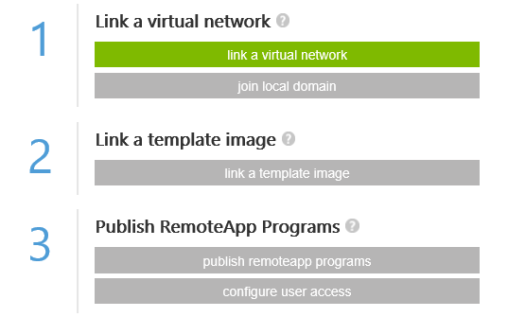
Hybrid architecture
Azure VNET
On Premises
Azure
RemoteApp
Instances
Express Route / VPN
Domain
Controller
Domain Controller

Slide 28
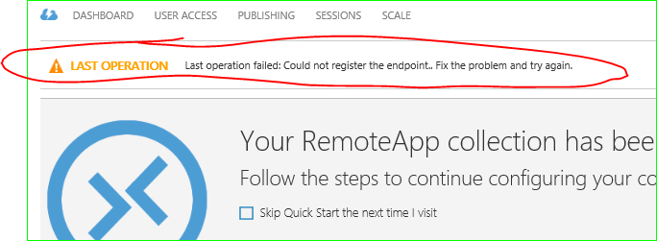
Common hybrid misconfigurations
Collection creation failures are most often caused by VNET not being configured properly.
Ensure the following
The minimum subnet size requirement is 30 IP addresses (/27)
Recommend sizing is 100 IP address reserved for maximum capacity
Ensure DNS can properly resolve domain controller to allow Azure RemoteApp instances to domain join
Forced tunneling is not supported
VNET requires Internet access to allow Azure RemoteApp instances to communicate outbound
Other
Custom image validation checks were bypassed
Troubleshooting
Create an Azure VM in the same VNET and attempt to domain join, if that works then collection creation should also

Slide 29

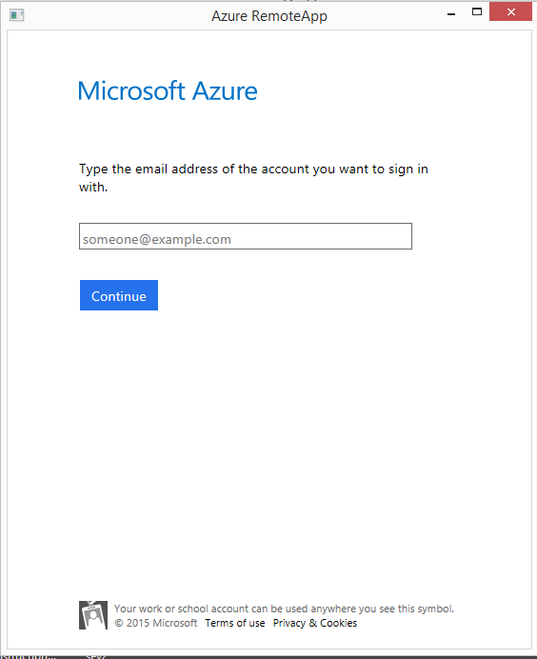
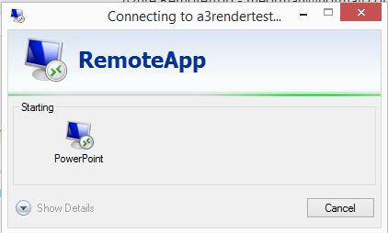
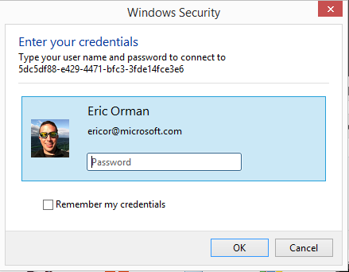
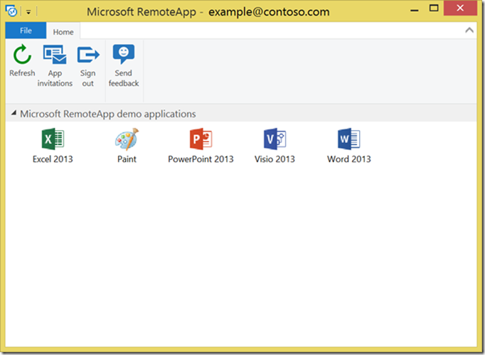

Hybrid app launch storyboard
Azure Active Directory
Azure VNET
AD connect
On Premises
Azure
RemoteApp
Instances
Domain Controller
Express Route / VPN
3. Perform domain login
(AD Login)
2. Launch App
Sign in to Client (AAD)

Slide 30
Differences between Cloud and Hybrid
 | Cloud | Hybrid
Deploy to existing VNET | Yes (Coming soon) | Yes
Requires AD-connected (DirSync) accounts | No | Yes
Requires domain join | No | Yes
Requires domain controller to be accessible from the VNET | No | Yes

Slide 31
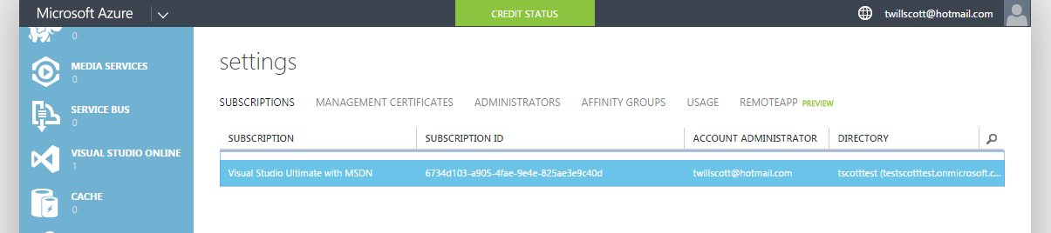
Assigning users from a different AAD directory
    You can only use one (1) AAD directory with Azure RemoteApp at a time; the one that’s linked to the Azure subscription
    Some non-obvious factoids:
      In the Azure Management Portal, in the “Active Directory” tab you see all of the AAD directories that the currently logged in user is a member of. These AAD directories don’t necessarily have anything to do with the Azure Subscription.
      If you have Office 365 you already have an AAD directory set up.
eric@contoso.com
8349-7y5fwctf-u8w-394y7cndf-jdkfdfdf eric@contoso.com Default Directory (contoso.com
    http://msdn.microsoft.com/en-us/3d6c4fd1-c981-4c57-9402-59fe31b11883

Slide 32
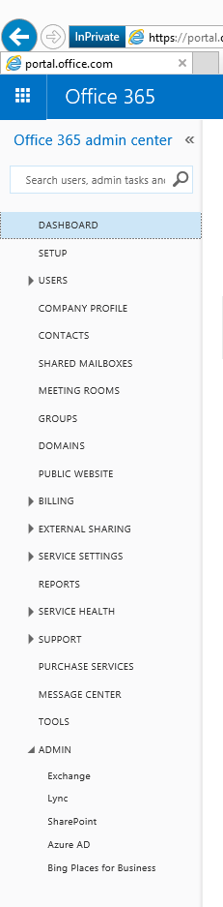
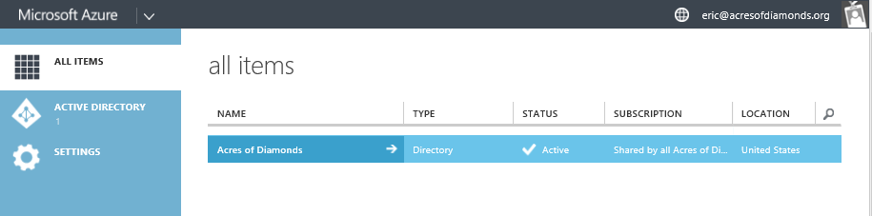

Understanding Office 365 identities in ARA
Office 365 user identity are Azure Active Directory users
Delegate access or convert the Office 365 Azure subscription to full Azure subscription.
eric@contoso.com
Contoso Corp

Slide 33
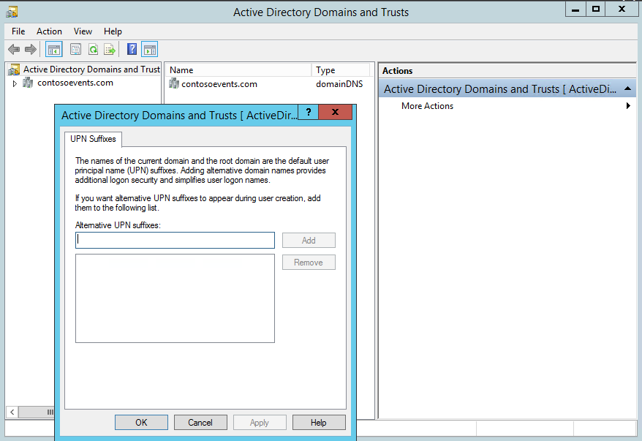
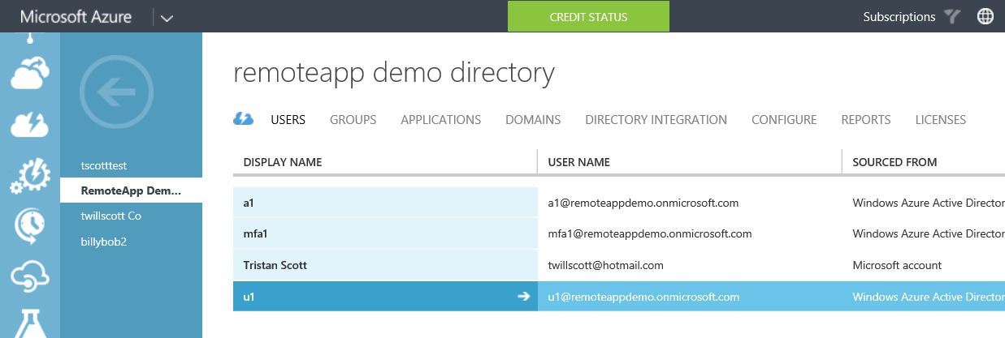
Common misconfiguration for hybrid
UPN mismatch – will cause login failures
  UPN of user in Azure Active Directory doesn’t match UPN in the on-premises Active Directory
    Example: Can’t have user1@mydomain.com in AD be synced to AAD as user1@mydomain.onmicrosoft.com
remoteappdemo.onmicrosoft.com
Domain.local UPN’s also

Slide 34

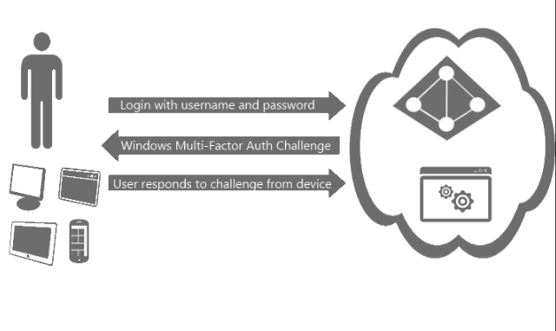
Multi factor authentication
Azure RemoteApp integrates seamlessly with Azure Multi-Factor Authorization services
Follow standard Azure guidance to enable
Can enforce MFA per user
  PhoneFactor by default
  Or rely on ADFS federation if enabled
https://msdn.microsoft.com/en-us/library/azure/dn249466.aspx

Slide 35
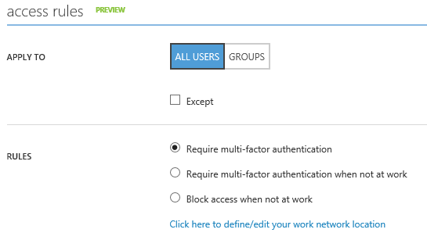
‘Conditional Access’ with RemoteApp
Since RemoteApp relies on AAD, all the AAD Premium conditional access policies are available today!
  Require Multi-Factor Authentication always
  Require Multi-Factor Authentication for access from extranet
  Block access from extranet
How (all via Azure Portal)
  In “RemoteApp” tab, create a collection
  and assign at least 1 AAD user access
  In “Active Directory” tab, select
  AAD tenant → Applications →
  Microsoft Azure RemoteApp → Configure

Slide 36
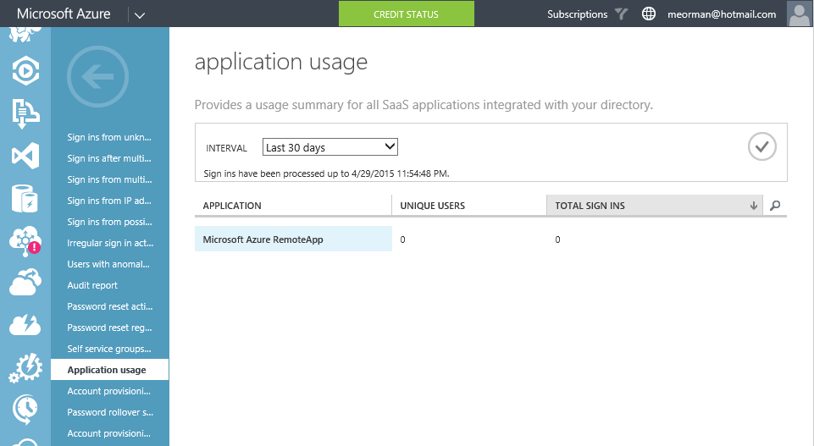
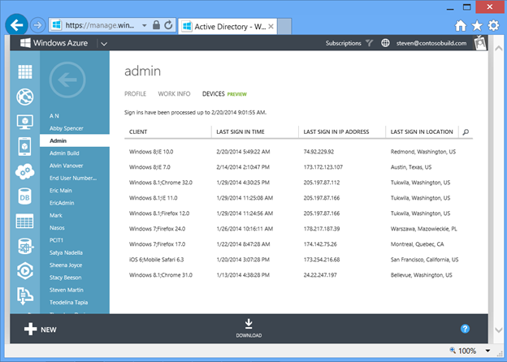
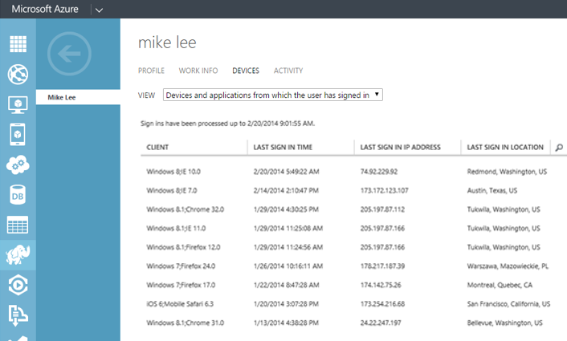
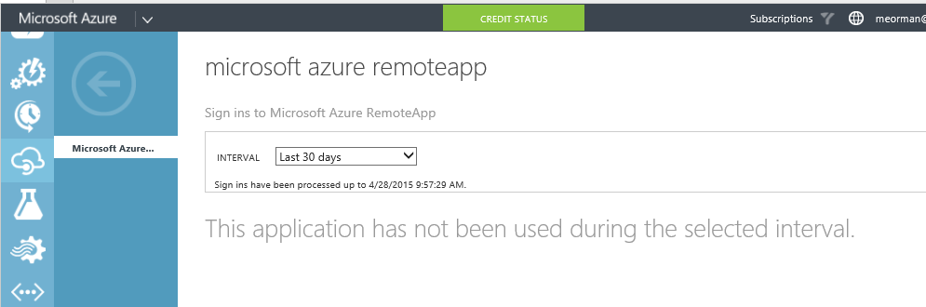
Azure Application Usage with RemoteApp
By App Service
Per User
Restrict access by location
AAD auth logging
Block access on unmanaged device
2 13

Slide 37
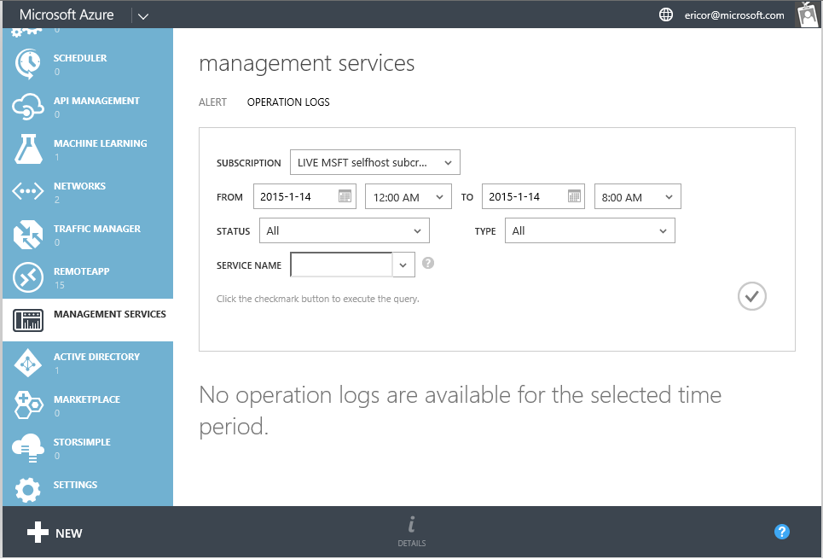
Who moved my cheese?
Auditing changes to your Azure RemoteApp collection using Azure Operations Logs
Operation Logs is a Windows Azure Management portal feature which allows you to view historical logs of all Create/Update/Delete (CUD) operations performed on your Azure services in last 90 days
Eric@contoso.com
Question: Can we access Operations Logs programmatically such as using .NET? No not at this time.

Slide 38
Cycle of management and administration of Azure RemoteApp
Select Image
Publish Apps
Assign Users
Update & upload image
Outline:
Supported Clients
Data storage & file sharing
Session states
Client best practices
Redirection
User Profile Disk (UPD)
Utilize
Evaluate
Consume

Slide 39

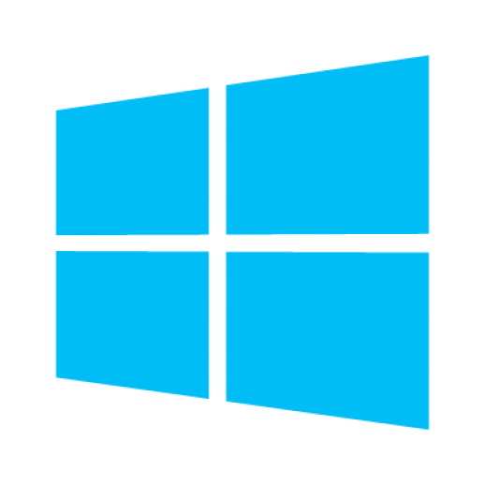



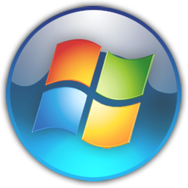

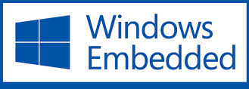
Devices and Clients

Slide 40
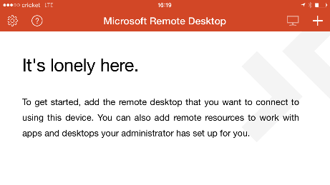
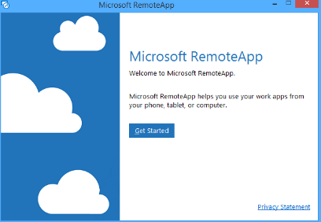
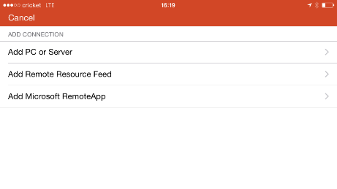
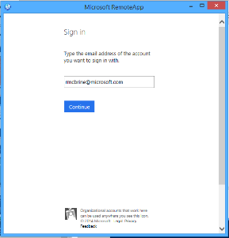
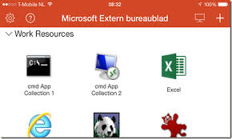
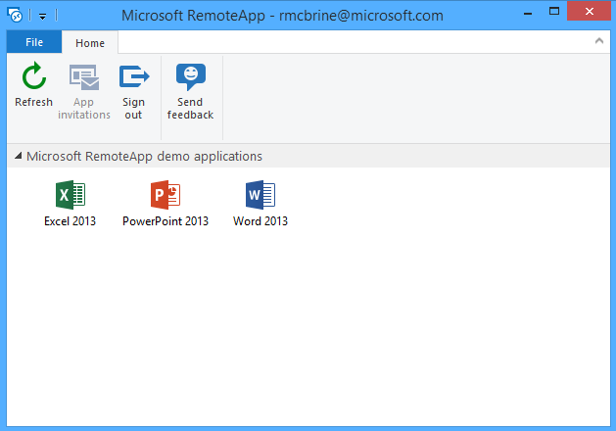
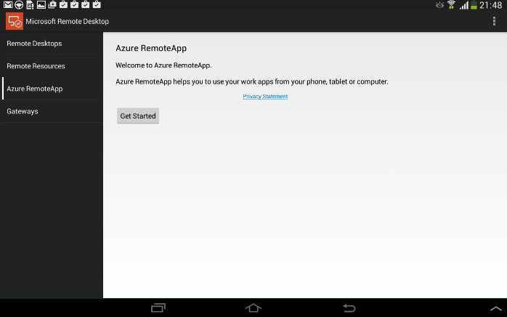
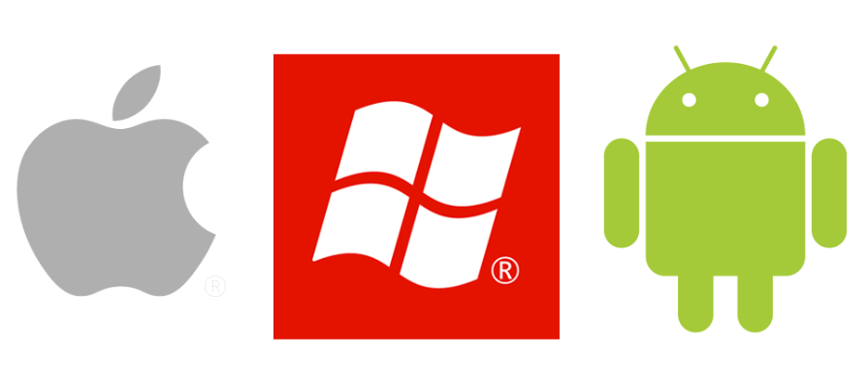
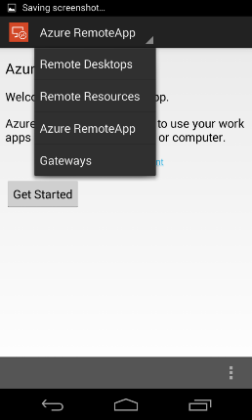
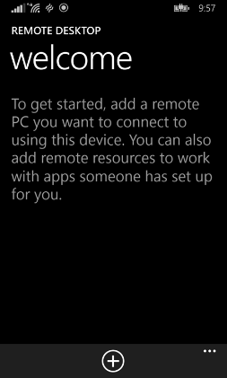
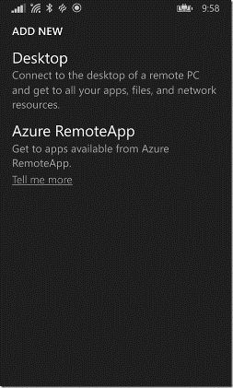
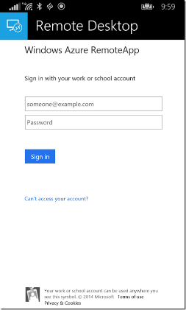
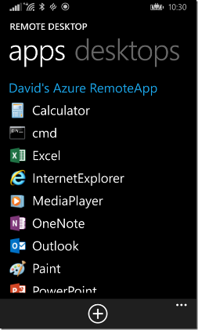


Slide 41
Embedded and Thin Clients
Supported Windows Embedded versions
  Windows Embedded Standard 7 with Service Pack 1
  Windows Embedded POSReady7
  Windows Embedded Thin PC
  Windows Embedded 8.1 Industry
No support for 3rd party RDP implementations

Slide 42






Client best practices
Always close apps to avoid potential data loss
Enable auto app update to ensure clients are the latest version

Slide 43



Understanding client session states
Only charge for active sessions
Three non-active states
Idle input logoff
  Disconnected after 4 hour of no input
Disconnected logoff
  Local session logged off after 4 hours of inactivity
Logged-off
  No local session

Slide 44

Redirection
Redirection = providing local device capabilities in the remote session
Redirection capabilities in RemoteApp are the same as a local PC
 | Default setting in ARA | Local device to RemoteApp session
 |  | Windows ClickOnce | iOS | Android | Windows Mobile | Mac
Clipboard (copy/paste) |  |  |  |  |  | *
Audio |  |  |  |  |  | *
Drive redirection
USB
Printer
Serial Ports
Com ports
Plug and Play
Smart Cards
How to change these:
No UI Azure Management Portal, it is in backlog
Using Azure RemoteApp PowerShell modules and SDK
http://azure.microsoft.com/en-us/documentation/articles/remoteapp-redirection/
http://azure.microsoft.com/en-us/documentation/articles/remoteapp-tutorial-arawithpowershell/

Slide 45


Redirected drives
  Local PC drives available in remote session
  Ability to access PC content
  Access locally mapped network shares
  Not enabled by default
  Only available for Mac and Windows

Slide 46


User Profile Disk (UPD)
Each user gets:
50 GB persistent storage
UPD:
Tied to collection
Contains user data and app settings
Geo-replicated
Considerations
Removing user will not delete UPD
Never configure files with Windows Sharing
Only available during active session
Need user data accessible in read-only format while offline? Contact Azure support.
User Profile Disk (UPD) is a VHD that holds a user’s profile
Same as VDI or specifying path in user account

Slide 47






Data storage and file sharing
Mapped Drives & Network Locations
Not supported
*Verify support for Windows Server 2012R2

Slide 48
considerations
Downloads all files - there's no selective sync
This could flood the 50 GB limit on your UPD, which will cause connection failures
For the best experience sign into Office before launching OneDrive for Business

Slide 49



Customize workspace name
Change Settings>RemoteApp

Slide 50
Cycle of management and administration of Azure RemoteApp
Select Image
Publish Apps
Assign Users
Update & upload image
Outline:
Image creations solutions
Updating your image flow
Utilize
Evaluate
Consume

Slide 51



Image creation options
On-Prem
Hyper-V
Configuration Manager 2012 R2
  Create Task Sequence to VHD
Azure VM
  Create in Azure VM
  Direct Import without upload
  Import any VM’s from gallery
R2
https://technet.microsoft.com/en-us/library/dn448591.aspx

Slide 52
Template image creation manual steps
To create a new template image from scratch:
Locate a Windows Server 2012 R2 DVD or ISO image.
Create a VHD file.
Install Windows Server 2012 R2.
Install the Remote Desktop Session Host (RDSH) role and the Desktop Experience feature.
Install additional features required by your applications.
Install and configure your applications.
Perform any additional Windows configurations required by your applications.
Disable the Encrypting File System (EFS).
REQUIRED: Install KB 2977219 on your image. This KB is required for all Azure RemoteApp template images. Uploading your image will fail if you do not install this KB.
SYSPREP the image.
http://azure.microsoft.com/en-us/documentation/articles/remoteapp-create-custom-image/

Slide 53


Update your collection with a new image
To "update," you replace an existing collection image with a new one.
Steps
  Modify existing image and import/upload
  Click “Update” option at bottom
  Select Image
  Set User Options
Considerations
  You can only update one collection at a time.
  The more users, the longer the update will take. Estimate 15 minutes per 10 users.

Slide 54
Cycle of management and administration of Azure RemoteApp
Selecting an image
Using custom apps
Which apps work on ARA
Best practices application
Custom image creation steps
Select Image
Publish Apps
Assign Users
Update & upload image
RECAP
Image creations solutions
Updating your image flow
Publish via Start menu & path
Demo
Supported Clients
Data storage & file sharing
Session states
Client best practices
Redirection
User Profile Disk (UPD)
Utilize
Evaluate
Consume
Authentication methods
Hybrid deep dive

Slide 55

Outline
Brief recap of what we know thus far from Azure RemoteApp Overview presentation (~2 minutes)
Cycle of management and administration (~60 minutes)
Will my app work on Azure RemoteApp? (~15 minutes)

Slide 56
Best Practices and tip for Azure RemoteApp
Test your custom images before importing/uploading
Test your apps locally before using in Azure RemoteApp
Never store data on instances (c:\ drive)
Use file sharing solution like OneDrive for Business to allow anytime access of your files
Enable app auto update for RD clients on your device
Properly close apps to avoid potential data loss
Follow our blog and roadmap -lots of new things coming

Slide 57
Recap
Instances are OS host for apps
Only one Directory can be associated per subscription
Hybrid collections require AD connected accounts
USB and Drive redirection are disabled by default

Slide 58




Azure RemoteApp prices
 | Basic | Standard
Target user | Task worker | Information worker
Application types | Lightweight LOB / data entry applications | Productivity applications
Example Apps | Simple web apps, web browsing | Office
Starting price (user/month) | $10 | $15
Hours included in starting price (month) | 40 | 40
Hourly overage rate (Hour) | $0.175 | $0.20
Cap price (user/month)* | $17 | $23 (Office price is not included)
What is an App Collection?
RemoteApp template image that contains the applications or programs shared by a set of users.
MS Office price is not included in the above price points.
Rounded off to nearest integer; might vary depending on your currency.
Above prices are per user per month and per application collection

Slide 59




How to try Azure RemoteApp
End users
Or
Administrators
Download client
Sign in using Microsoft Account
Launch app for 10 minutes
Full management experience on Azure
30 day trial before you buy

Slide 60




It’s all about the Apps….

Slide 61
Demo
ClickOnce apps
Excel doc as app (If time permits)
Troubleshooting (if time permits)
MS Access with Azure Files (Theater Show)
QuickBooks
Wed @ 12:05pm
Thurs @ 2:50pm
Name

Slide 62




QuickBooks 2015 Enterprise
Supported on Windows Server 2012 (Link)
Three deployment options of Quickbooks;
  Central Server, Peer-to-Peer, Remote Desktop Services
Fact: All three require the Company File to be located on same workstation as QuickBooks Database Manager server (QuickBooks deployment guide)
Central Server
Peer-to-Peer
Remote Desktop Service (RDSH)

Slide 63





Will my app work?
AppCompat
Licensing Plan
Where is data
What identity to grant access

Slide 64
Is QuickBooks supported?
Is QuickBooks installed on a Microsoft image?
Review QuickBooks deployment options. (QuickBooks deployment guide)
Verify application support on Windows Server 2012 R2?
Where is QuickBooks data stored?
Is the data accessible over Internet, local file system or private network?
Cloud or Hybrid collection
  Install QuickBooks database server that has Company File on Azure VM
  Create either a Cloud or Hybrid collection in the same VNET as the Azure VM with QuickBooks database server
  Consideration: QuickBooks doesn’t need domain join so hybrid is not needed.
No, need custom image
Yes
On QuickBooks Database Server in Company File (*.qbb)
On private (Intranet) network using standard windows networking

Slide 65

QuickBooks recap

Slide 66




Staying engaged…
Feedback forum
Discussion Forum
Documentation
Weekly “Ask the Experts”

Slide 67





Microsoft Enterprise Mobility
for your chance to discover great
prizes along the way!
PLAY NOW
msmobilityquest.com
(see website for complete details)
Learn more about the Microsoft Enterprise Mobility Suite
http://www.microsoft.com/ems
AZURE ACTIVE DIRECTORY PREMIUM
MICROSOFT INTUNE
AZURE RIGHTS MANAGEMENT
AZURE REMOTEAPP
NO PURCHASE NECESSARY. Open only to event attendees who are 18+ years old, legal residents of the 50 U.S. or D.C., and non-government employees. Winners must be present to win. Game ends May 8, 2015. For Official Rules, see msmobilityquest.com.

Slide 68
ericor@microsoft.com
Meet me and others at the Booth immediately after this session
Wed @ 12:05pm
Thurs @ 2:50pm
Theater shows
“Will my app work on ARA?”
Microsoft Access using Azure Files
Publish Office doc from OneDrive consumer

Slide 69
Troubleshooting
Azure RemoteApp

Slide 70


Image upload troubleshooting
Use Windows PowerShell not Azure PowerShell
Launch PowerShell elevated, “Run As Administrator”
Never alter the script, validations are there for your protection
File is locked

Slide 71


Investigating VM issues
Run Task Manager
  Perform CTRL+ALT+END during active session
Launch MMC
Specify Admin account at UAC
Admin account can be set:
  via GPO for Hybrid deployment on OU
  During custom image creation creating local admin account and adding to Administrators Group

Slide 72




Ignite Azure Challenge Sweepstakes
Attend Azure sessions and activities, track your progress online, win raffle tickets for great prizes!
Aka.ms/MyAzureChallenge
Enter this session code online: BRK3868
NO PURCHASE NECESSARY. Open only to event attendees. Winners must be present to win. Game ends May 9th, 2015. For Official Rules, see The Cloud and Enterprise Lounge or myignite.com/challenge

Slide 73


Please evaluate this session
Your feedback is important to us!
Visit Myignite at http://myignite.microsoft.com
or download and use the Ignite Mobile App
with the QR code above.

