Slide 2
Configuring Hybrid Business Connectivity Services with SharePoint 2013
BRK4113
Manas Biswas
Snr SEE
Microsoft India
Neil Hodgkinson
Snr PM
O365 CXP CAT
Sam Hassani
Principal Consultant
BrightStarr

Slide 3
Session Objectives And Takeaways
Session Objectives:
Configure outbound Hybrid Business Connectivity services with Odata service in Onpremise environment.
Understand hybrid infrastructure configuration key components like server to server authentication, OAuth , and how each of these plays a vital role in enabling Business Connectivity services.
Demonstrating how BCS works with Office 365 and search to develop a real world use case
Key Takeaways:
Discuss the configuration experience for Inbound BCS Hybrid and understand the critical components in the setup

Slide 4
Agenda
Overview of Hybrid and BCS
Understand BCS key concepts
Configure Hybrid BCS for a Real World Scenario

Slide 5
Overview of Hybrid and BCS

Slide 6
SharePoint Hybrid Overview
Two scenarios of hybrid model in an Enterprise
  Migration to the Cloud
  Maintaining a hybrid model
  Migrate at their own pace to the Cloud with little or no disruption to existing service
  Pilot Online Service with a subset of users
  Continue to maintain hybrid model providing services on-premises or online based on the organization needs
  Continue to use existing customizations on-premise
  Easily off-board exchange mailboxes from Cloud to on premises
Migrate remote users physically distant from On-Premise deployment to Online for better experience
Host certain data in particular locations Online for Compliance or data sovereignty reasons
Advantage of moving to cloud infrastructure ((TCO) where ever possible

Slide 7
Business Connectivity Services overview
What is Business Connectivity Services?
  SharePoint infrastructure that supports solutions for integrating data that resides
  outside of SharePoint, such as a database or data published from OData source, into SharePoint by using external content types or apps
Types of Business Connectivity Services
  On-premises: typically integrates data from data sources that reside
  on-premises
  Hybrid: integrates data from on-premises sources through reverse-proxy and on-premises Business Connectivity Services
  Cloud-only: integrates data from SQL Azure and other public OData services

Slide 8
Identity crisis
Cloud identity
Directory & password synchronization*
Federated identity
Windows Azure Active Directory
Dirsync & Password Sync*
Federation
Directory Sync
On-premises identity
On-premises identity
  Single identity in the cloud
  Suitable for small organizations with no integration to on-premises directories
Single identity
Suitable for medium
and large organizations without federation*
Single federated identity
and credentials
Suitable for medium and large organizations

Slide 9
Configure SharePoint 2013 Services
Configure User Profile Service (UPA)
  Synchronizes user and group profiles from
  on-premises Active Directory
  STS service uses metadata from UPA to construct security tokens for gaining access to hybrid resources
❶
❷
Configure App Management and Subscription Settings services
  Supports some configuration procedures
  Supports registration of SharePoint Online
  as a high-trust app in SharePoint Server 2013
Enable SharePoint Services that are required for hybrid environments

Slide 10
Configure SharePoint 2013 for inbound requests
Select a primary web application
  It receives requests from SharePoint Online to accept inbound connections, configure services, and connect objects
  You can create a new web application or configure an existing web application
  Nothing to configure on the web app per se, but you will use it when you set up the trust
  All users need at least Read access to root site
❶
❷
Handle outbound requests
  Make outbound connections from any
  on-premises SharePoint Server 2013 web application; no configuration required

Slide 11
SharePoint Hybrid Infrastructure
Customer network
Microsoft data center
Perimeter network
Internet
Intranet
Microsoft Office 365 tenant
SharePoint Server 2013
Search: Bidirectional
Business Connectivity Services: Supported
Duet Enterprise for SharePoint and SAP: Supported
SharePoint Online
Outbound
SharePoint
Federated search results
Site collection
Inbound
Primary
web app
Federated search results
SharePoint Online can query SharePoint Server
SharePoint Server can query SharePoint Online

Slide 12
Reverse Proxy Device
Reverse Proxy - Retrieves resources on behalf of a client from one or more servers
Documented Reverse Proxy solutions
  TMG
  Web Application Proxy
  F5 Big-IP
Validated Reverse Proxy solutions
  TMG
  Web Application Proxy
  F5 Big-IP
  Citrix Netscaler

Slide 13
Demo: Validate S2S Trust
Configuring a Server-to-Server (S2S) trust relationship between SharePoint On-premises and SharePoint Online

Slide 14
Understanding BCS Key Concepts

Slide 15
External content types
What is an external content type?
  Defines data from a source external to SharePoint for use in SharePoint products
  Describes data structure and security, and identifies the portion of data SharePoint interacts with and what operations are permitted
How does SharePoint use external content types?
  External Lists
  SharePoint Apps
  Hybrid: supports only OData sources
How do I create an external content type?
You can use Microsoft Visual Studio 2012 or 2013

Slide 16
Business Connectivity Services on-premises
Configure the target application for the Secure Store Service
Create a Business Data Connectivity service application in SharePoint
on-premises
Configure the Business Connectivity Services Metadata Store
Define the external content type for external data
Create the external list and configure permissions

Slide 17
On Premises BCS Auth and Data Flow
A user in need of on-premises data goes to an on-premises application or external list
The external list or application requests data and sends it to Business Connectivity Services
Business Connectivity Services accesses the external content type to determine how to gain access to the external data and what credentials to use
Business Connectivity Services passes a request to a connector that retrieves the data by using either the user’s credentials or credentials from a secure store
Optional: The user uses Connect to Outlook to take data offline
The Click Once installation installs the Business Connectivity Services model on the client
Microsoft Outlook connects to the external data and synchronizes to the Outlook SharePoint external list (formatted as a contact list)
The user interacts with the data, and synchronizes changes with the external data source manually or automatically
Business Connectivity Services on-premises deployment
❶
❽
Client layer
❺
❻
SharePoint service layer
❷
SharePoint 2013 Business Connectivity Services and Secure Store Service
❼
❸
❹
External system layer
External data source

Slide 18
Introduction to Hybrid Business Connectivity Services
Enables users to publish on-premises data to a list or application external to SharePoint Online
Enables federated users to gain access to on-premises data from SharePoint Online
Requires a two-way authentication topology using an external URL published by reverse proxy
Connects only through OData source

Slide 19
Cloud-only solution overview
Enables integration of data into SharePoint Online from SQL Azure
Enables external users to gain access to data published online
Does not require a hybrid environment or hybrid identity management infrastructure

Slide 20
Cloud-only authorization and data flow
Users who need online data go to the online application or external list
The external list or online application creates a request for data and sends it to Business Connectivity Services
Business Connectivity Services accesses the external content type to determine how to access the external data
The external content type tells Business Connectivity Services the credentials to use, in this case, credentials from the secure store
Business Connectivity Services passes the request to the endpoint of SQL Azure Windows Communication Foundation Service
SQL Azure returns the data
SharePoint Online displays the data in the browser
❶
SQL Azure
❷
❼
❹
❻
❺
❸
SharePoint online

Slide 21
Configure Hybrid BCS for a Real world scenario

Slide 22
Real world scenario
  All Contoso employees use SPO for majority of their workloads OneDrive, Team Site collaboration etc.,
  Big investments in on-prem legacy LOB applications (customer and sales data)
  Sales guys need to update data on the move (customers, orders, etc.)

Slide 23
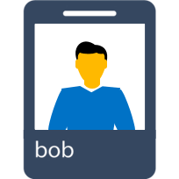
The Solution
Customer network
Microsoft data center
Perimeter network
Internet
Internal Network
Microsoft Office 365 tenant
SharePoint Online
Outbound
SharePoint 2013
LOB Systems
Sales Sites & External Lists
Team Sites. Etc.
Inbound
Sales Sites, External Lists
Federated search results
SharePoint Online surfaces BCS data from On-premises
Internal Users
Bob

Slide 24
Prerequisites for Hybrid Business Connectivity Services
Business Connectivity Services must be installed on-premises
On-premises instance must have connectivity to the external data source
Two-way authentication topology must be configured
External URL
to SharePoint
on-premises must
be configured

Slide 25
Hybrid BCS Auth and Data Flow
Using federated credentials, a user in need of on-premises data logs on to the online app or external list
The app or external list creates a request for data and sends it to Business Connectivity Services
Business Connectivity Services gains access to the external content type to determine how to access the external data and what credentials to use
Business Connectivity Services retrieves a secure-channel certificate from the secure store and an OAuth token from Windows Azure Active Directory for user authentication
Business Connectivity Services sends an HTTPS request to the published endpoint for the data source with the certificate and token
The reverse proxy authenticates the request and forwards it to SharePoint on-premises
SharePoint on-premises retrieves the identity from the token and maps it to the on-premises identity that has access to the data
On-premises Business Connectivity Services forwards the request to the OData service endpoint
The OData endpoint authenticates the request viaInternet Information Services and returns the data
❶
SharePoint Online tenancy
❷
❸
❹
Secure store and Access Control Service
External list
Business Connectivity Services
Perimeter
network
❺
Reverse proxy
❻
Internal network
❼
❽
❾
On-premises SharePoint farm
External data source
Authentication flow
Data flow

Slide 26
Steps to configure Hybrid Business Connectivity Services
Use an existing or create a new OData data source
❶
❷
Create an external content type based on your OData source
Make your ECT file “tenant ready”
❸
❹
❺
❻
Create a connection to your on premises service
Upload your model (.ECT) to o365
Create an external list and validate the hybrid Business Connectivity Services solution

Slide 27
Steps to configure Hybrid Business Connectivity Services
Use an existing or create a new OData data source
❶
❷
Create an external content type based on your OData source
Make your ECT file “tenant ready”
❸
❹
❺
❻
Create a connection to your on premises service
Upload your model (.ECT) to o365
Create an external list and validate the hybrid Business Connectivity Services solution

Slide 28
1 Use an Existing or Create a new OData Source
If you already have an OData HTTPS endpoint for LOB apps, use those. Otherwise, create an empty ASP.NET project in VS.NET
Add an ADO.NET Entity Data Model
Add a WCF Data Service
Configure your WCF Data Service; see http://blogs.technet.com/b/speschka/archive/2012/12/06/using-odata-and-ects-in-sharepoint-2013.aspx
❶
❷
❸
❹

Slide 29
Steps to configure Hybrid Business Connectivity Services
Use an existing or create a new OData data source
❶
❷
Create an external content type based on your OData source
Make your ECT file “tenant ready”
❸
❹
❺
❻
Create a connection to your on premises service
Upload your model (.ECT) to o365
Create an external list and validate the hybrid Business Connectivity Services solution

Slide 30
2 Create an External Content Type
Create a new App for SharePoint In Visual Studio 2013
  For URL, enter an on premise SharePoint 2013 server
Add “Content Types for External Data Source” to project
On the Specify OData Source page enter the Url to your OData source
Select one or more entities from the list that is displayed for that OData source; the wizard creates a .ECT file for each entity
  For more details see http://msdn.microsoft.com/library/office/jj163967.aspx
❶
❷
❸
❹

Slide 31
Steps to configure Hybrid Business Connectivity Services
Use an existing or create a new OData data source
❶
❷
Create an external content type based on your OData source
Make your ECT file “tenant ready”
❸
❹
Upload your model (.ECT) to o365
Create an external list and validate the hybrid Business Connectivity Services solution
Create a connection to your on premises service
❺
❻

Slide 32
3 Make Your ECT “Tenant Ready”
Make a backup of your .ECT file; this is the file you will modify before uploading to o365
Right-click on the ECT file in Visual Studio and select Open With... then select XML (Text) Editor.
Find the “Name” attribute in the “Model” element at the top of the doc and change it something unique for your entire tenant
Delete the ODataServiceMetadataUrl and ODataServiceMetadataAuthenticationMode properties from the LobSystem property list
❶
❷
❸
❹
Delete the ODataServiceUrl and ODataServiceAuthenticationMode properties from the LobSystemInstance property list
Add property for both LobSystem and LobSystemInstance: <Property Name="ODataConnectionSettingsId" Type="System.String">yourConnectionName</Property>
5
❻
❺
6

Slide 33
Steps to configure Hybrid Business Connectivity Services
Use an existing or create a new OData data source
❶
❷
Create an external content type based on your OData source
Make your ECT file “tenant ready”
❸
❹
❺
❻
Create a connection to your on premises service
Upload your model (.ECT) to o365
Create an external list and validate the hybrid Business Connectivity Services solution

Slide 34
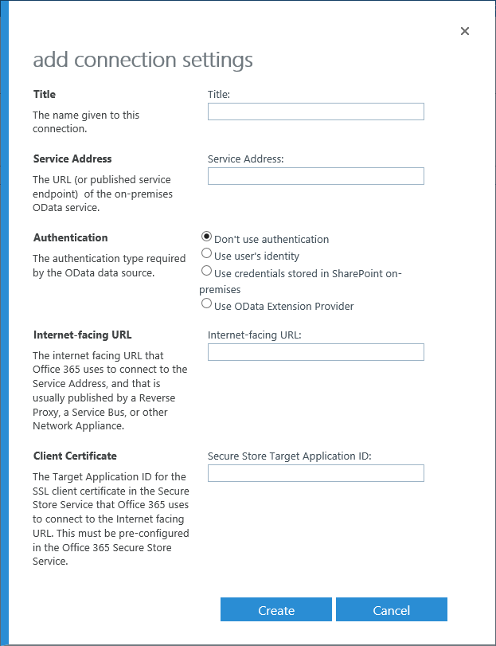
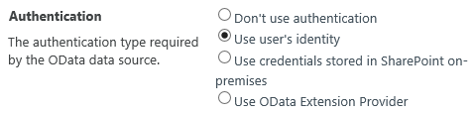
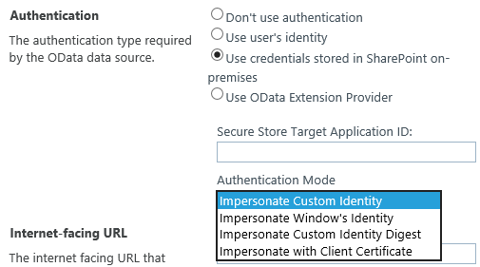
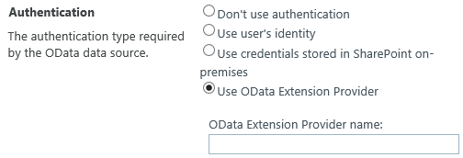
4 Create a BCS Connection
Kerberos
Connection Title
(put what you used in 3.6)
Internal OData Url
Auth Options
Anonymous Authentication
SSS plus Impersonate
Public Url (the reverse proxy)
<proxy url>/_vti_bin/client.svc
(always add /_vti_bin/client.svc to the end)
SSS Id for cert used with reverse proxy
(use same one as Search)
Custom OData Extension

Slide 35
BCS Connection Security
If you use “credentials stored in SharePoint on-premises”, there is an additional change you need to make to web.config of your on prem web app:
<dependentAssembly xmlns="urn:schemas-microsoft-com:asm.v1">
<assemblyIdentity name="Microsoft.Office.SecureStoreService" publicKeyToken="71e9bce111e9429c" culture="neutral" />
<bindingRedirect oldVersion="16.0.0.0" newVersion="15.0.0.0" />
</dependentAssembly>
Without this you will get an error when you import your model: “The Type name for the Secure Store provider is not valid”

Slide 36
Steps to configure hybrid Business Connectivity Services
Use an existing or create a new OData data source
❶
❷
Create an external content type based on your OData source
Make your ECT file “tenant ready”
❸
❹
❺
❻
Create a connection to your on premises service
Upload your model (.ECT) to o365
Create an external list and validate the hybrid Business Connectivity Services solution

Slide 37
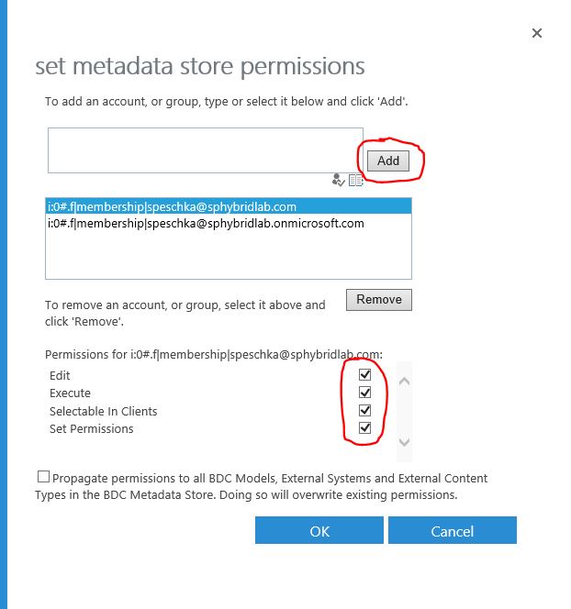
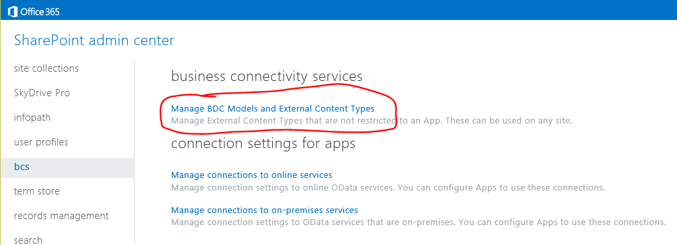
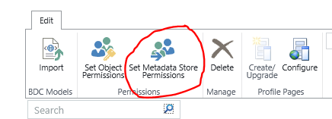
5 Configure Metadata Store Permissions for Admins
Before you try importing your BCS model into the o365 tenant you need to grant rights to current user to add models first, or you will get an “access denied at 0,0” error when importing the model
❶
3
1
2

Slide 38
5 Import the Business Data Connectivity model file into SharePoint Online
Open Business Connectivity Services
❶
❷
Click Manage BDC Models and External Content Types
Click the Edit tab, and then click Import
❸
❹
Click Import
  During the import, Business Connectivity Services validates the markup language in the model, queries the connection settings object, and connects to the on-premises OData source
Browse to the location of your .ECT file
❺

Slide 39
5 Configure Metadata Store Permissions for Users
In the online Metadata Store for Business Connectivity Services, select the model you just imported and grant execute permissions to all authenticated users
  For users who authenticate to your SharePoint Online tenancy, this setting allows use of external content types stored in the Metadata Store
Set permission for propagation for all Business Connectivity Services models, external systems, and external content types
  This setting replaces existing permissions
❶
❷

Slide 40
Steps to configure hybrid Business Connectivity Services
Use an existing or create a new OData data source
❶
❷
Create an external content type based on your OData source
Make your ECT file “tenant ready”
❸
❹
❺
❻
Create a connection to your on premises service
Upload your model (.ECT) to o365
Create an external list and validate the hybrid Business Connectivity Services solution

Slide 41
6 Create a SharePoint External List
Open the online site that you prepared earlier
❶
❷
Click Site Contents, and then click Add an App
Click External List, and then enter a descriptive name
❸
Click Select External Content Type, and then select the external content type that you imported previously
❹
Open the external list and confirm that the external data is visible
❺

Slide 42
Demo: A Real World Application
Configure BCS Hybrid, and ensure sales guys on the move can update data through SPO, and back office staff see this reflected on-premises.

Slide 43
What about Azure?
Using SQL Azure as a data source

Slide 44
Cloud-only authorization and data flow Recap
Users who need online data go to the online application or external list
The external list or online application creates a request for data and sends it to Business Connectivity Services
Business Connectivity Services accesses the external content type to determine how to access the external data
The external content type tells Business Connectivity Services the credentials to use, in this case, credentials from the secure store
Business Connectivity Services passes the request to the endpoint of SQL Azure Windows Communication Foundation Service
SQL Azure returns the data
SharePoint Online displays the data in the browser
❶
SQL Azure
❷
❼
❹
❻
❺
❸
SharePoint online

Slide 45
Steps to configure SQL Azure as a data source in SharePoint Online
Create a SQL Azure database (and optionally an OData service
❶
❷
Create an external content type based on the data source
Make your ECT file “tenant ready”
❸
❹
❺
❻
Create Secure Store Target Application and a connection to your data source in o365
Upload your model (.ECT) to o365
Create an external list and validate the hybrid Business Connectivity Services solution

Slide 46
Demo : Hybrid BCS using SQL Azure Data Source

Slide 47
Session Objectives And Takeaways
Session Objectives:
Configure outbound Hybrid Business Connectivity services with Odata service in Onpremise environment.
Understand hybrid infrastructure configuration key components like server to server authentication, OAuth , and how each of these plays a vital role in enabling Business Connectivity services.
Demonstrating how BCS works with Office 365 and search to develop a real world use case
Key Takeaways:
Discuss the configuration experience for Inbound BCS Hybrid and understand the critical components in the setup

Slide 48


Please evaluate this session
Your feedback is important to us!
Visit Myignite at http://myignite.microsoft.com
or download and use the Ignite Mobile App
with the QR code above.

