Slide 2
A Deep Dive into Skype for Business Mobility
BRK4128
Kaushal Mehta
Mirunan Gunarajah

Slide 3
Skype for Business Trivia
Test your Skype for Business knowledge with questions created by MVPs and enjoy the trivia fun tomorrow night with complimentary food & drinks, and the chance to win great prizes!
Tweet a photo from any Skype for Business session using the hashtag #Skype4BTrivia and be entered into a drawing to win a ticket to this invite-only Trivia game for you and a guest. One entry will be randomly selected each day.*
If you don’t score an invite, you can still compete on Twitter with @SkypeBusiness Wednesday at 8:30pm for your chance to win a Surface Pro 3!**
*No purchase necessary. Open only to event attendees. Game ends 5/7/2015. See Skype for Business Facebook for full Official Rules.
**No purchase necessary. Open only to legal residents of any country where Surface Pro 3 is certified for distribution. Game ends 5/7/2015. See Skype for Business Facebook for full Official Rules.
Microsoft Ignite #Skype4BTrivia

Slide 4
Session Scope, Objectives and Key Takeaways
Scope
  Familiar with Lync Server 2013
  Mobility features enabled in Skype for Business Server 2015
  400 level session
Objectives
  Understand new mobility features
  Understand how to configure these features
Key Takeaways
  Troubleshooting methodology for mobility scenarios

Slide 5
Agenda
Synchronized Conversations & Auto-Accept
  Background
  Demo
  Configuration & Deep Dive
Mobile Authentication Options
  Background
  Configuration & Deep Dive
Q & A

Slide 6
Synchronized Conversations & Auto-Accept

Slide 7
Synchronized Conversations & Auto-Accept
Background
  Conversations on the mobile devices have been independent of the desktop clients.
  Mobile clients required users to manually accept messages in a short amount of time
  Solution
  Synchronized conversations allow users to maintain their conversations across all of their devices
  Auto-Accept allow the mobile client to accept incoming messages on the users behalf
  Server requirements
  Skype for Business Server 2015 with Exchange 2013 on prem/Exchange Online
  Skype for Business Online with Exchange 2013 on prem/Exchange Online

Slide 8
Demo

Slide 9
Conversation History
Deep Dive

Slide 10



Before we deep-dive…Skype for Business Server 2013 Mobility Deployment
PSTN/ GSM
Internet
MPNS
Exchange Online
Forward Proxy
Reverse Proxy
EDGE (SIP)
EDGE (SIP)
DMZ
SIP Federation (push.lync.com)
Enterprise
Media Gateway
PNCH Services
FE Pool 1, Mediation Server
FE Pool 2,
Mediation Server
FE Pool 3,
Mediation Server
Lync Server
(with Skype for Business Web Components: UC Web API, Discovery)
HTTP
SIP

Slide 11
IP addresses
FE – 172.16.0.5
RP – 172.16.0.10 and 192.168.1.131
Desktop Client – 172.16.0.101
Edge – 192.168.1.128

Slide 12
Design – writing IM conversations
CTRL + S
Exchange mailbox
Outlook Conv
History folder
FE Pool
TL_INFO,History::CEwsConversationHistoryProvider::WriteMessageToMailbox[CEwsConversationHistoryProvider_cpp166],<O_TRC><ADR>0x08C8C8D8</ADR>Entry</O_TRC>

Slide 13
Mobility flows
Exchange
Voicemail, meetings
Contact Search
Reverse proxy
UCWA
FE
Sign in/Registration Traffic
EWS Traffic
Search Traffic

Slide 14
Mobility flows for conversation history (SSCH)
Exchange
Voicemail, meetings
Contact Search
LYSS
Reverse proxy
UCWA
FE
SSCH Traffic
Sign in/Registration Traffic
EWS Traffic
Search Traffic

Slide 15
LYSS – Lync Storage Service
SKYPE FOR BUSINESS SERVER FRONT END
UCWA
Free/busy/voicemail/etc.
Internet
Lync storage APIs (real time)
Lync storage APIs (real time)
Read/write
Storage queue processors
Raw session data
Read/write
Missed IM
Storage service queue
Auto-accept
Cache
Intra-pool storage queue backup module
FEs in the same pool
Conversation
history processor
Read/
write/
search/
notify
Archiving processor
Inter-pool storage queue backup module
Web conferencing processor
FEs in another pool
Monitoring processor
Exchange data transport
SQL data transport
LYNC STORAGE SERVICE
Exchange web services
SQL
SQL
CDR DB
QoE DB
Exchange server

Slide 16
Configuration
Environment Prerequisites
  In order to leverage this feature, user must be homed on Skype for Business Server 2015
  Users must have a mailbox homed on Exchange 2013 (either on premise or online)
  Skype for Business Server Preview has OAuth setup with the Exchange 2013 environment
Exchange specific prerequisites
1) Verify OAuth is configured on Skype for Business Server Preview
Get-CsCertificate -Type OAuthTokenIssuer
2) Verify Exchange Server 2013 is configured to use OAuth with Skype for Business Server 2015
Get-PartnerApplication
3) Verify the configuration for Exchange 2013
Get-CsPartnerApplication
4) Verify OAuth setup between Skype for Business and Exchange
Test-CsExStorageConnectivity –SipUri user@contoso.com -Verbose

Slide 17
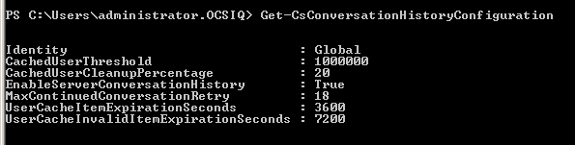
Configuration
Enable Server Side Conversation History
Set-CsConversationHistoryConfiguration -EnableServerConversationHistory $true -verbose
Set-CsClientPolicy –identity “policy_name” –EnableServerConversationHistory $true -verbose
Verify replication and restart the front end service
Get-CsManagementStoreReplicationStatus
Restart the SfB Services (assuming this is the first time Lync-Exchange auth has been configured)
Required settings
  CsMobilityPolicy – AllowSaveIMHistory flag = True
  CsClientPolicy – DisableSavingIM = False

Slide 18
Troubleshooting scenario
Scenario
Symptom: SSCH for mobile not working
Environment: SfB Server 2015 onprem and Exchange online
Troubleshooting Methodology
Get-CsAccessEdgeConfiguration
Get-CsHostingProvider –LocalStore
Get-CsHostingProvider
Test-CsExStorageConnectivity -SipUri name@contoso.com –Verbose
Opens a connection to LYSS
Creates a test message
Initiates Exchange storage request
Lookup for Exchange mailbox (Autodiscover)
Find mailbox settings
Oauth handshake
Message creation response (success, failure)
Get-CsConversationHistoryConfiguration (EnableServerConversationHistory = true)
Get-CsClientPolicy
EnableServerConversationHistory = true
Components
UCWA
WebInfrastructure
LYSS
Level
All
Flags
All

Slide 19
Auto-accept – deep dive

Slide 20
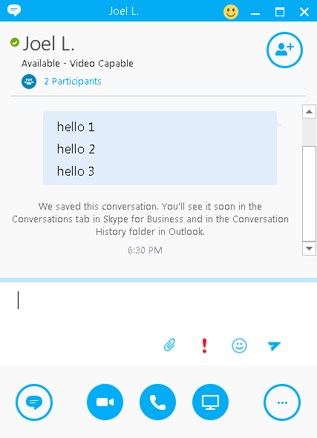
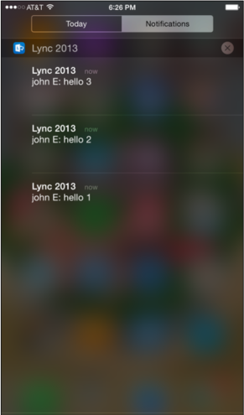
Auto-accept logic - SPOP
Reverse Proxy
t = 0
FE Pool, UCWA & Exchange
t = 25

Slide 21
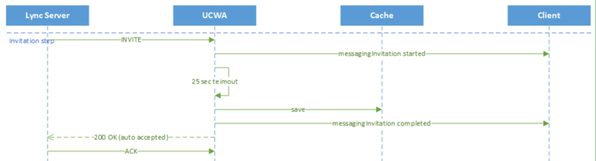
Auto-accept logic - cache

Slide 22
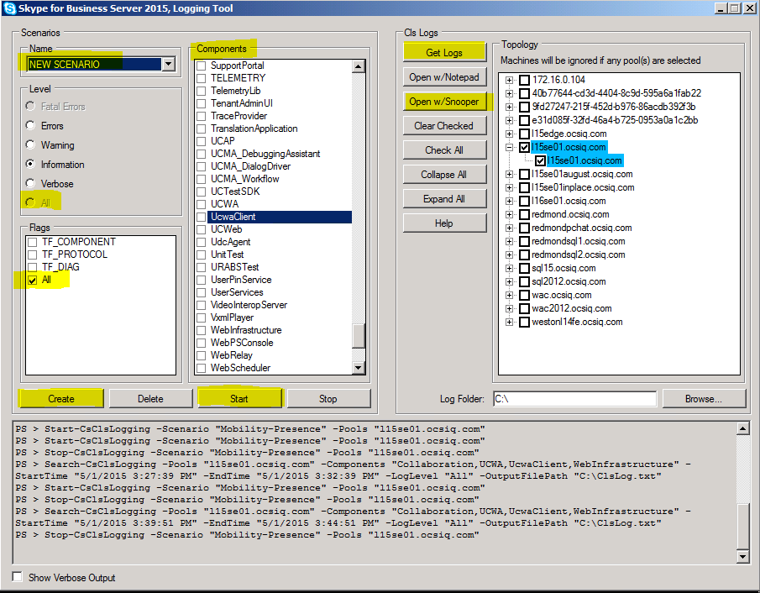
Auto-accept logic – SPOP – logs demo
Components
UCWA
WebInfrastructure
Collaboration
SIPStack
S4
Level
All
Flags
All

Slide 23
Auto-accept logic
Desktop | Mobile | Preferred Endpoint for Auto-accepting IMs
Available | Available | Desktop
Inactive | Available | Mobile
Available | Inactive | Desktop
Inactive | Inactive | Desktop
Away | Inactive | Mobile
Offline | Inactive | Mobile
Endpoint → State ↓ | Desktop | Mobile
Available | 3500 | ?
Inactive | ? | ?
Away | ? | 15450

Slide 24
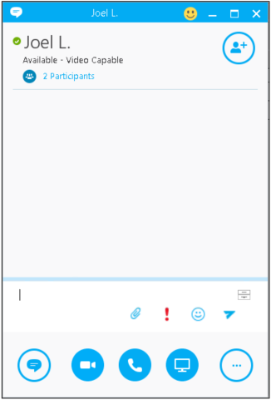
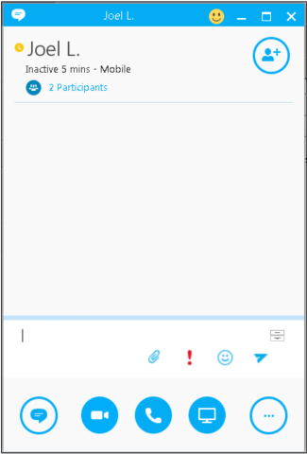
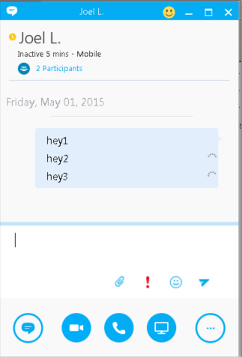
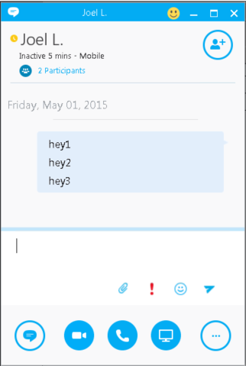
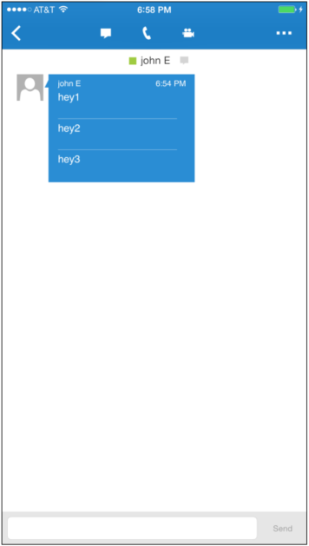
Auto-accept logic - MPOP
John is the sender
Joel is the receiver – MPOP’ed into desktop and mobile
t = 0 seconds
t = 10
t = 20
t = 45
Joel on mobile
John’s view

Slide 25
Auto-accept logic – MPOP – logs demo
Components
UCWA
WebInfrastructure
Collaboration
SIPStack
S4
Level
All
Flags
All

Slide 26
How does client know SPOP vs MPOP?

Slide 27
Auto-accept logic - MPOP
Reverse Proxy
t = 0
EDGE (SIP)
FE Pool, UCWA & Exchange
Reverse Proxy
t = 25
EDGE (SIP)
FE Pool, UCWA & Exchange

Slide 28
Mobile Authentication Options

Slide 29
Mobile Authentication Options – pre SfB Server
Pool-level WebServiceConfiguration
WindowsAuth
UseCertAuth
UsePinAuth
UseWsFedPassiveAuth
Lync desktop
Lync Mac
WP
IP-Phones

Slide 30
Mobile Authentication Options – new in SfB Server
Pool-level WebServiceConfiguration
WindowsAuth
UseCertAuth
UsePinAuth
UseWsFedPassiveAuth
MobilePreferredAuthType
Lync desktop
Lync Mac
WP
IP-Phones

Slide 31
Configuration
Set-csWebServiceConfiguration –UseWsFedPassiveAuth $TRUE
Set-csWebServiceConfiguration –WsFedPassiveMetadataUri [URL]
additional config for mobile to use passive auth:
Set-CsWebServiceConfiguration -MobilePreferredAuthType WsFedPassive

Slide 32
Fiddler Demo

Slide 33
Q & A

Slide 34
Launching New Skype for Business Insider Program
http://www.aka.ms/sfbinsider

Slide 35
Related sessions
Wednesday
3:15PM | BRK3208 | Mobility Deployment and Security with Skype for Business | Barak Manor; François Dorémieux; Girija Bhagavatula | S104
Thursday
9:00AM | BRK4120 | Troubleshooting Skype for Business Scenarios | David Howe; Mohamad Saleem | S404
Friday
12:30PM | BRK4102 | SIP Signaling, Negotiation and Media Flows in Skype for Business, Explained | Johan Delimon | S404

Slide 36


Please evaluate this session
Your feedback is important to us!
Visit Myignite at http://myignite.microsoft.com
or download and use the Ignite Mobile App
with the QR code above.

