Slide 2
Developing Web and Cross Platform Mobile Apps with Azure Active Directory
BRK4850
Vittorio Bertocci
@vibronet
www.cloudidentity.com

Slide 3
Agenda
Develop Cross Platform Mobile Apps with Azure Active Directory
Develop Web Apps with Azure Active Directory

Slide 4
Azure AD by the Numbers
86%
of Fortune 500 companies on Microsoft Cloud (Azure, O365, CRM Online and PowerBI)
Azure AD manages identity data for
>5 M organizations
More than
500 M objects hosted on Azure Active Directory
1 Trillion
Azure AD authentications since the release of the service
50 M
Office 365 users active every month
>1 Billion authentications every day on Azure AD
Every Office 365 and Microsoft Azure customer
uses Azure Active directory

Slide 5
Native Apps

Slide 6


Going Native or Multi Target Stacks?
Thanks Will Huang and Stay Liao for taking this pic for this session!

Slide 7


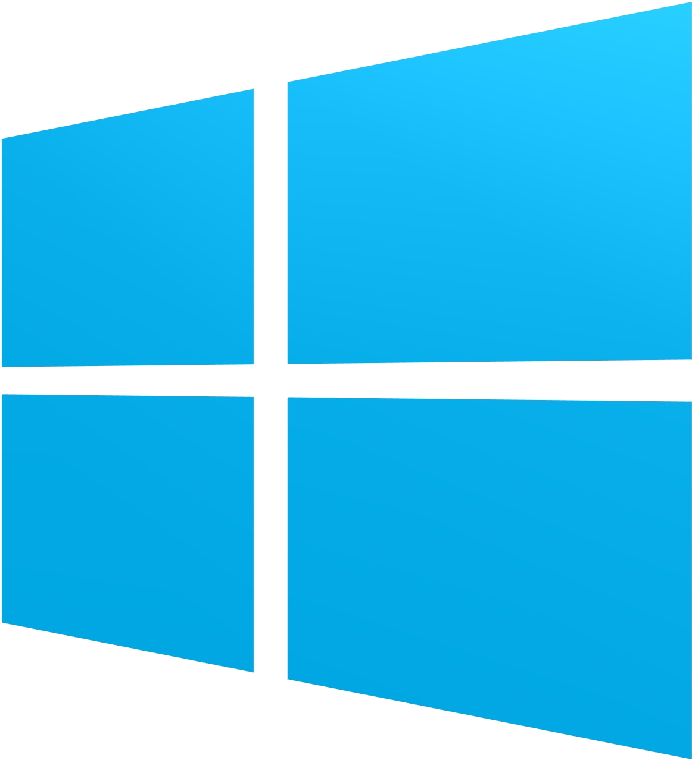
Choose any platform or dev stack…
iOS
Android
Windows
ADAL .NET + Xamarin
C#/JS
Apache Cordova Plugin for ADAL
ADAL Obj-C
ADAL Android
ADAL .NET
Native
WebAccountManager
…Azure AD has your back.

Slide 8

Native Apps - Agenda
The Token Requestor Pattern
Going Native
  Windows 10, Windows 7+,iOS, Android
Going Multitarget
  Xamarin, Cordova

Slide 9
Identity, Native Clients, and Azure AD

Slide 10
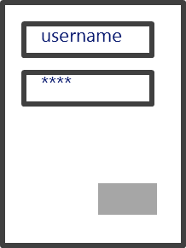

Native Clients and Identity
R1
App1

Slide 11
Native Clients, Identity and Azure AD
R1
App1
R2
OAuth-A
contoso.onmicrosoft.com
OAuth-T
SAML
R1
WS-Fed
App1
R2

Slide 12
Going Native

Slide 13
Going Native
Windows 10 – WebAccountManager
Windows 7+– ADAL .NET
iOS – ADAL ObjC
Android – ADAL Android

Slide 14
Windows 10 WebAccountManager
R1
App1
Web Account Manager
Windows
Web Account Provider 1
Web Account Provider 1
<<<
<<<
System accounts

Slide 15
WebAccountManager API and Azure AD
General token acquisition pattern
FindAccountProviderAsync
<WebTokenRequest>
RequestTokenAsync / GetTokenSilentlyAsync
WebTokenRequestResult

Slide 16
DEMO
Getting Azure AD tokens via WebAccountManager

Slide 17
Registering a Universal App with Azure AD
Every app must
  be registered in Azure AD
  declare in advance what resources it wants to access
To register your app to use WAM, you need its SID
  Execute WebAuthenticationBroker.GetCurrentApplicationCallbackUri().ToString();
  The SID is the red part: ms-app://s-1-15-2-976907911-141810403-2436685389-2899494419-3003676602-2661416415-1464266181
  Important: change the ‘s’ in the SID to UPPERCASE
  You need to use the SID at registration time to build a redirect uri as follows:
  ms-appx-web://Microsoft.AAD.BrokerPlugIn/S-1-15-2-976907911-141810403-2436685389-2899494419-3003676602-2661416415-1464266181

Slide 18
Targeting Windows 7 onward
Redistributable libraries help you to prompt users, perform requests, handle sessions

Slide 19
Active Directory Authentication Library (ADAL)
Available on multiple platforms
  .NET, Windows Store, Windows Phone 8.1, iOS, Android, Node.JS, Java
Open source
Consistent primitives, native programming models
Sophisticated features
  Works across Windows Server and Azure Active Directory
  Cache and automatic refresh
  Multi user support
NOT a protocol library

Slide 20
ADAL – Main Token Acquisition Pattern
Abstracts away most protocol considerations
Handles tokens persistence & refresh automatically
AuthenticationContext ctx=
new AuthenticationContext("https://login.microsoftonline.com/contoso.com");
AuthenticationResult rez = await ctx.AcquireTokenAsync(
"https://outlook.office365.com/",
"5fc4a5a2-78d5-4d94-b890-a6e6b3341081");

Slide 21
DEMO
Getting Tokens via ADAL .NET

Slide 22
ADAL .NET
Current supported version: V2.x
Desktop
  Default cache in-memory
  Extra flows for public clients only:
  Windows integrated authentication
  Direct use of username & password
Windows Store, Windows Phone 8.1
  Persistent per-app cache
  Windows Runtime Components
    Works with C#, WinJS, C++

Slide 23
ADAL or WebAccountManager?
WebAccountManager
  If you are targeting Windows 10 onward exclusively
  For apps that use more than one provider type
ADAL .NET
  For Azure AD and ADFS only
  If you are targeting all versions of Windows from Win7 onward
  If you want to target iOS and Android via Xamarin
  If you need authentication flows not covered by WebAuthenticationBroker
    direct username/password, app identity
A future ADAL .NET release will use WAM on Win10

Slide 24
ADAL iOS
OSS Objective C library
How to get it: source ZIP, Cocoapods
Persistent cache via KeyChain
  Apps from the same publisher can share tokens
NTLM

Slide 25
ADAL Android
OSS Java library
How to get it: source ZIP, git clone, Gradle, Maven
Persistent cache on shared preference file
  Encrypted via AndroidKeyStore
Integrated with the Account Manager
  Via Azure Authenticator app - https://play.google.com/store/apps/details?id=com.azure.authenticator
NTLM

Slide 26
Targeting Multiple Platforms at Once:
Xamarin, Apache Cordova

Slide 27
Xamarin
Use C# to target popular mobile platforms
Reuse code across multiple platforms
iOS
Android
Win8+ Store
Shared C# code

Slide 28
ADAL v3 and Xamarin
A PCL containing all the main primitives
Platform specific assemblies handling presentation, token storage
Dynamic dependency injection
ADAL .NET v3 Nuget
C# iOS Project
C# Android Project
C# Windows Project
PCL
iOS
PCL
iOS
.NET Desktop
Android
PCL Project
Windows Store
Windows Phone
8.1 Store
PCL

Slide 29
DEMO
Getting Azure AD tokens for a C# iOS app

Slide 30

Apache Cordova Plugin for ADAL
JavaScript façade to native ADALs
App1
R1
Cordova Frame
JS App
Adal Cordova Plugin
Adal Native

Slide 31
DEMO
Getting Azure AD Tokens from a Cordova JavaScript App

Slide 32
Choose any platform or dev stack…
iOS
Android
Windows
ADAL .NET + Xamarin
C#/JS
Apache Cordova Plugin for ADAL
ADAL Obj-C
ADAL Android
ADAL .NET
Native
WebAccountManager
…Azure AD has your back.

Slide 33
Web Apps

Slide 34



Web Apps, Web API, Single Page Apps…
OpenID Connect
MW
Web APP
ADAL .NET
OAuth2MW
Web API
OAuth2MW
Web API
ADAL JS
ADAL .NET
ADAL*
…Azure AD has your back.

Slide 35
Web Apps - Agenda
Sign In with OpenId Connect
Invoke Web API from a Web App
Single Page Apps (SPAs)

Slide 36
Sign Users In with OpenId Connect

Slide 37
Roundtrip apps and Azure AD
SAML
Fabrikam.onmicrosoft.com
WS-Fed
OAuth-A
OAuth-T
OpenID Connect
MW
Web APP

Slide 38
Securing Roundrip Web Apps (1/2)
Add interception layer to enforce protocol compliance
ASP.NET OWIN Security Components
  WS-Federation
  OpenId Connect ←
“Legacy”: Windows Identity Foundation in.NET 4.5

Slide 39
Securing Roundrip Web Apps (2/2)
Many possible entry points
VS2013
  Create a new ASP.NET project, choose “Organizational Account”
VS2015
  Create a new ASP.NET project, choose “Work & School Account” OR
  Right click on project, choose Configure Azure AD Authentication
Both VS versions, or any other IDE
  Clone sample from http://github.com/AzureADSamples/<samplename>, follow readme

Slide 40
Registering your app in Azure AD (1/2)
Azure AD will NOT issue tokens for unknown apps
Various options
  Azure Portal
  Visual Studio tools

Slide 41
DEMO
OpenId Connect and VS2015

Slide 42
Authentication Middleware
Basic usage:
[optional] add session management middleware
add protocol middleware
  specify protocol coordinates via Options
  [optional] inject custom logic via Notifications

Slide 43
Minimal configuration
Startup.Auth.cs:
app.SetDefaultSignInAsAuthenticationType(CookieAuthenticationDefaults.AuthenticationType);
app.UseCookieAuthentication(new CookieAuthenticationOptions { });
app.UseOpenIdConnectAuthentication(new OpenIdConnectAuthenticationOptions
{
Client_Id = "d71c88d1-f3d3-47e9-8313-06bc9af9a991",
Authority = "https://login.microsoftonline.com/common/"
});
Resource:
[Authorize]
Resource

Slide 44
Invoke Web API from a Web App

Slide 45
Web Sign on + OAuth2
OAuth-T
OAuth2MW
Web API
OAuth-A
OpenID Connect
MW
Web APP
ADAL .NET

Slide 46
The Web API call pattern
Request a code at sign in time
Redeem the code with ADAL
save tokens in persistent cache
When you need to access a resource
Initialize ADAL with the same cache you used earlier
Ask for the token you need via AcquireTokenSilent
Upon failure, provide the user with UX for triggering reauth

Slide 47
Registering your app in Azure AD (2/2)
Azure AD will NOT issue tokens to an app for a given resource if the app did not declare its intent to do so

Slide 48
Redeem an Authorization Code
AuthorizationCodeReceived = (context) =>
{
var code = context.Code;
ClientCredential credential = new ClientCredential(clientId, appKey);
string userObjectID = context.AuthenticationTicket.Identity.FindFirst(objIdClaimType).Value;
AuthenticationContext authContext = new AuthenticationContext(Authority, new NaiveSessionCache(userObjectID));
AuthenticationResult result =
authContext.AcquireTokenByAuthorizationCode(code,
new Uri(HttpContext.Current.Request.Url.GetLeftPart(UriPartial.Path)),
credential,
graphResourceId);
return Task.FromResult(0);
}

Slide 49
DEMO
Invoke a Web API from a Web App

Slide 50
Other mid-tier topologies
Client Credentials
OnBehalfOf

Slide 51
Graph API
RESTful interface to Azure Active Directory
  Tenant Specific – queries are scoped to individual tenant context
  Programmatic access to directory objects such as Users, Groups, Contacts, Tenant Information, Roles
  Access relationships: members, memberOf, manager, directReports
Requests use standard HTTP methods
  GET, POST, PATCH, DELETE to create, read, update, and delete
  Response support JSON, XML, standard HTTP status codes
  Compatible with OData V3
OAuth 2.0 for authentication, role-based assignment for app and user authorization

Slide 52
Query Format
Graph URL (static)
Tenant of interest – can be tenant’s verified domain or objectId.
Specific entity type, such as users, groups, contacts, tenantDetails, roles, applications, etc.
https://graph.windows.net/contoso.com/users?api-version=1.5&$filter=state eq ‘WA’
API version – “1.5” is the Supported GA version
Optional Odata query arguments: $filter, $top

Slide 53
Protecting Your Own API with Azure AD
Big OAuth2 providers issue tokens for their own resources
  Facebook for the Facebook Graph, Azure AD for the Graph, Azure management, Office…
In addition, Azure AD allows you to secure your own API
Easy as 1-2-3
  Add an entry for your API in your Azure AD tenant
  Define which permissions your app recognizes
  Add middleware in front of your API to validate Azure AD access tokens

Slide 54
ASP.NET OWIN Security Components for Azure AD
OWIN middleware which automates
  Acquiring signing keys and issuer values
  Searching for a JWT in the request
  Validating it according to signature, issuer and audience value
Integrated in the VS2013 Web API templates
Very simple setup:
public void ConfigureAuth(IAppBuilder app)
{
app.UseWindowsAzureActiveDirectoryBearerAuthentication(
new WindowsAzureActiveDirectoryBearerAuthenticationOptions
{
Audience = “http://apps/mywebapi1/",
Tenant = “contoso.onmicrosoft.com"
});
}

Slide 55
Single Pages Applications (SPAs)

Slide 56
Single Page Apps and Azure AD
OAuth-T
OAuth-A
OAuth2MW
Web API
<HTML/JS>
ADAL JS

Slide 57
ADAL JavaScript
AngularJS module offering
Azure AD sign in support in few lines of code
Current user info
Secure Web API invocation via JS/CORS
The implicit grant is strictly opt-in for Azure AD apps

Slide 58
DEMO
ADAL JS and Single Page Apps

Slide 59
Web Apps, Web API, Single Page Apps…
OpenID Connect
MW
Web APP
ADAL .NET
OAuth2MW
Web API
OAuth2MW
Web API
ADAL JS
ADAL .NET
ADAL*
…Azure AD has your back.

Slide 60
Dig Deeper!
Start from http://aka.ms/aaddev
Find all samples in http://aka.ms/aadsamples
Find the source of our libraries in https://github.com/AzureAD
Questions? Hit us on StackOverflow:
http://stackoverflow.com/questions/tagged/azure-active-directory
http://stackoverflow.com/questions/tagged/adal

Slide 61


Please evaluate this session
Your feedback is important to us!
Visit Myignite at http://myignite.microsoft.com
or download and use the Ignite Mobile App
with the QR code above.

