Slide 2


DevOps as a strategy for business agility
Brian Harry

Slide 3

It’s tough out there …
Business is faster
Competition is fiercer
Time-to-market is key

Slide 4
Software delivery challenges
?
Frustration
Delays
Lack of insights

Slide 5






The consequences of inefficiency
40
%
… of implementations end up getting reworked because they don’t meet the users’ original requirements
IT drives business
success!
High IT performance correlates with strong business performance,
helps boost productivity,
market share and profit.
Outperforming
teams are
collaborate
54
%
extensively
more
likely to
41
%
… of development budgets for software, IT staff and external professional services will be consumed by poor requirements
with their
Collaboration blockers
counterparts
80
%
failure rate …
26.7%
No executive support
56.7%
Cultural inhibitors
43.3%
Fragmented processes
… for companies that try to adapt their existing tools for DevOps practices
Developers
IT Ops
%
Business
70
o
f
CIOs
Would
increase
risk
1 in
6
It takes on average 200 minutes to diagnose and repair a production issue
IT decision
makers is still
unfamiliar with
the term DevOps
to reduce
IT costs
and accelerate
business agility
3/4
of teams
DevOps was being initiated by
more development teams than IT Ops
teams by about a 40% to 33% margin
The average hourly cost of infrastructure failure is $100,000 per hour
A bug caught in production ends up costing
than if the same bug was found earlier in the development cycle
Responding to
ongoing needs for
efficiency and growth
100x more
have adopted
Agile methodologies
dual goals
Always keeping all
systems safe and secure

Slide 6
Our own journey
How we used to work
We did ask for feedback after each milestone – but we could not really react to it
For the most part, we would tell everybody “sorry” - and push things to the next release
We did find and fix bugs – without really knowing if we built the right thing in the first place
We had closed silos of information across different organizations, hurting collaboration
Planning
Code
Test & Stabilize
Code
Test & Stabilize
?
?
Beta
RTM
2.5 years!

Slide 7



Where we are today
How we work now
We ship frequently with minimum friction
Build>Deploy>Test reliably, hundreds of times a day
We continue to meet a rigorous on-premises quality bar
We build confidence through staging, exposure control & rich telemetry
Sprint
Planning Chat
Season
Vision
3 week
sprints
Every 3
sprints
6 month
season
18 month
vision
Visit http://stories.visualstudio.com to get the full story!

Slide 8




DevOps
1
4
Plan
Monitor + Learn
Development
Production
2
3
Develop + Test
Release

Slide 9
Plan
It starts with an idea – and a plan how to turn this idea into reality …
Project starts
Manage work
Develop + Test
1
Track progress
Plan

Slide 10

DEMO
Plan

Slide 11
Develop + Test
Once the iteration starts, developers turn great ideas into features …
2
Write Code
Unit Testing
Version Control
Build
Build Verification
Release

Slide 12
DEMO
Develop + Test

Slide 13
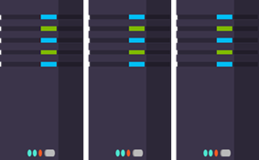
Release
When all tests pass, the build is deployed to testing environments for each stage in the release process
Cloud
Load Testing
Integration testing
environment
Staging
environment
3
Monitor + Learn
Automated functional testing environment
Pre-production environment

Slide 14
DEMO
Release

Slide 15
Monitor + Learn
Learn and understand how users use your app, how it reacts and quickly fix issues and bugs
Plan the next iteration
Feedback
Monitor
4

Slide 16
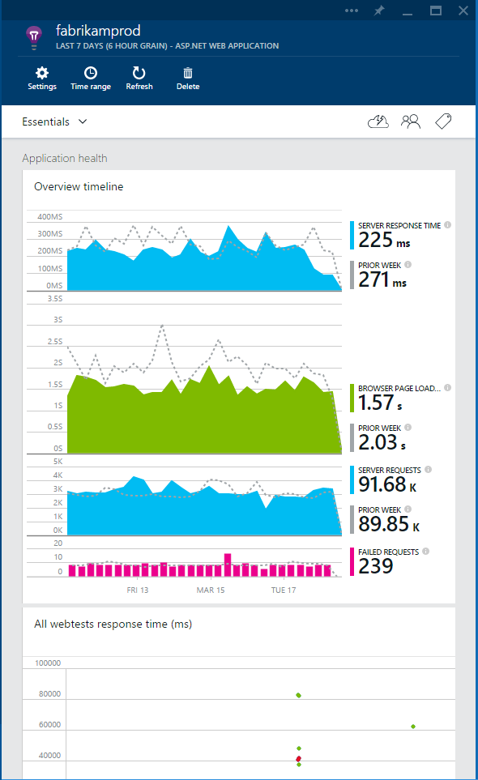
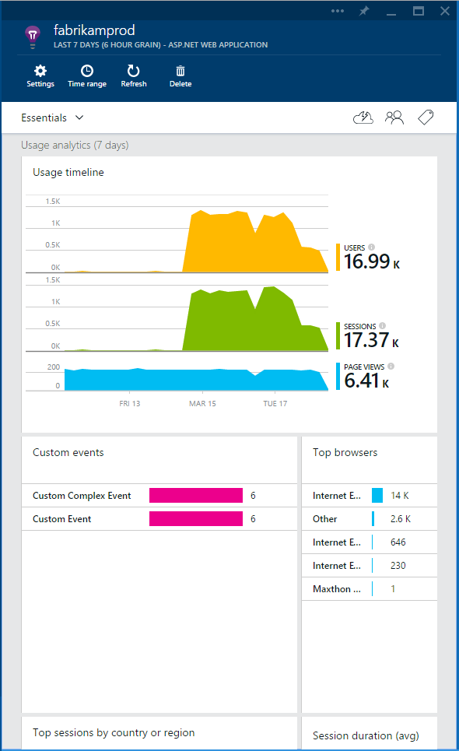
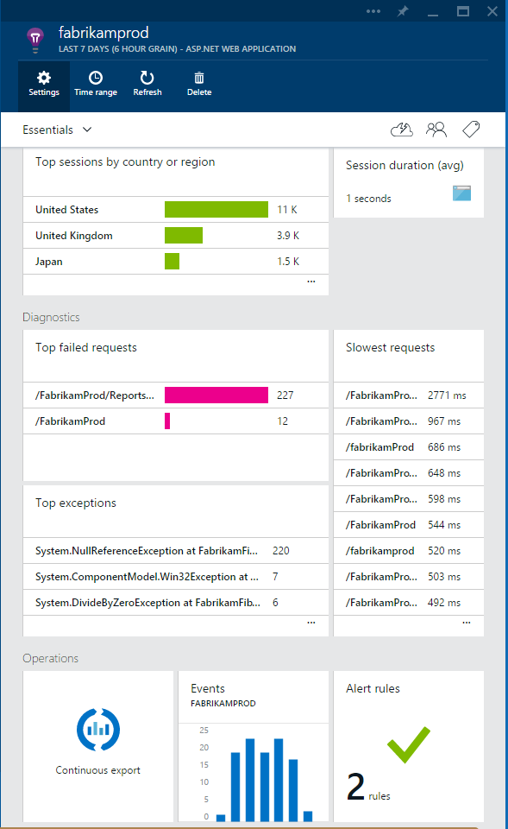

Visual Studio Application Insights
Detect issues, diagnose crashes and track usage in your web and mobile apps
Announcing: Public Preview on Azure Preview Portal
Monitor ASP.NET, Java and other web apps and services
Support for Android, iOS and Windows mobile apps
Pricing details available now including free tier
Check it out!
http://azure.microsoft.com/en-us/services/application-insights

Slide 17
DEMO
Monitor + Learn

Slide 18
Our solution
Source control
Agile planning
Test case management
Build automation
Continuous deployment
Release management
Load testing
Feedback management
Team collaboration
Application telemetry
Lab management
Project Server
Microsoft System Center
Microsoft Azure
SharePoint

Slide 19
Dashboarding
Futures
Support for
project K/ASP.NET 5
Application Insights
4
PowerBI support for Visual Studio Online
Release Management Service GA
Additional DCs for Cloud Load Testing
Agile at Scale
Open ALM GA
1
3
Extensions
Extensibility General Availability
Work Item Customization
Build vNext
General Availability
Dev/Test Lab Management in the Cloud
Cloud Load Testing in Azure Portal
2
Collaborate on Code
Code Policies
Continuous Delivery
Team Explorer Everywhere RTM
Distributed Test Execution and Automation
NuGet Feed Service

Slide 20


Call to Action
visualstudio.com
Create a Visual Studio
Online account
Try the Release Management
Service & Application Insights
msdn.microsoft.com
Download Visual Studio 2015
Take advantage of your Visual Studio Online & Azure benefits
www.visualstudio.com

Slide 21
Free Resources for DevOps Practices
Accelerate your application delivery lifecycle
Optimize your DevOps practices and tools:
  Get started on your DevOps journey: aka.ms/devops
Download the Forrester Infrastructure-as-Code whitepaper:
  Complexity kills. Automate with Infra as code: aka.ms/iac_tlp
Technical resources for Practitioners:
  Get access to free online training, evals and HOLs: aka.ms/devopsmva
Join the Community conversations:
  Use #TalkDevOps on Twitter

Slide 22

© 2015 Microsoft Corporation. All rights reserved.

