Slide 1
Overview for Enterprise
Jim Alkove

Slide 2
Do you have what it takes to succeed?
The digital economy
Are cybersecurity threats keeping you up at night?
Your people go everywhere with devices, do the apps and data they need go with them?
Can you adopt new technologies as fast as your business needs them?
Is it getting easier, or harder, to manage your infrastructure?

Slide 3
for Enterprise
Be more productive
Innovative devices for your business
Protection against modern security threats
Managed for continuous innovation

Slide 4
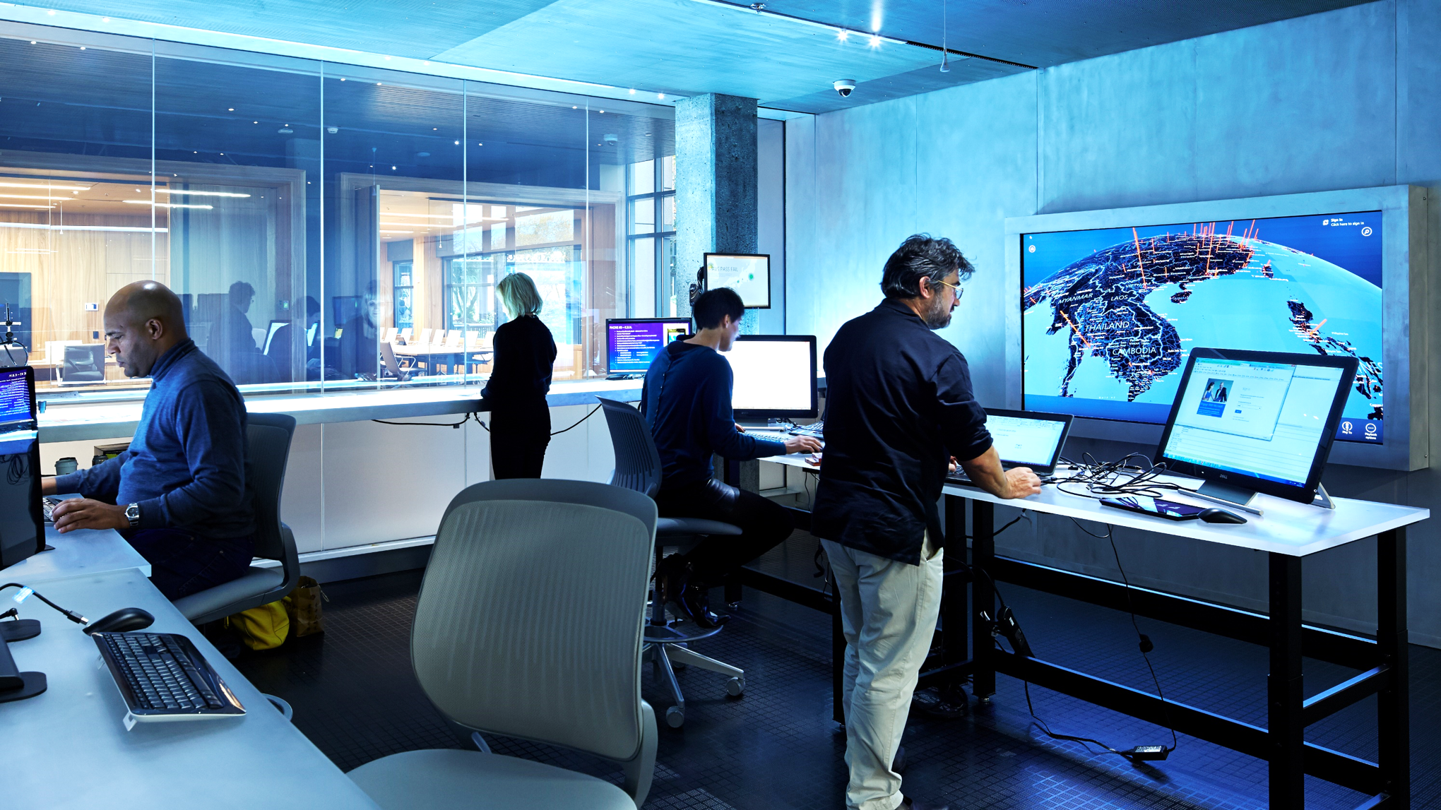
Protection against modern security threats

Slide 5
Windows 10 Security Approach
Identity Protection
Information Protection
Device Protection

Slide 6
Identity Protection

Slide 7
Microsoft Passport
Windows Hello
Hyper-V “Virtual Secure Mode (VSM)”
Identity Protection

Slide 8
Device-based multi-factor
USER CREDENTIAL
Utilize familiar devices
Secured by hardware
An asymmetrical key pair
Provisioned via PKI or created locally via Windows 10
Identity Protection

Slide 9
Microsoft Passport
1
User proves identity
2
A new approach
“Trust my unique key”
IDP
Active Directory
Azure AD
Google
Facebook
Microsoft Account
Intranet
resources
Windows10
4
3
“We trust tokens from IDP"
“Here is your authentication token”
Identity Protection

Slide 10
Accessing credentials
PIN
Biometrics
Simplest implementation option
Works on existing devices
User familiarity
Enables multi-factor
Ease of use
Impossible to forget
Identity Protection

Slide 11
DEMO
Microsoft Passport and Windows Hello

Slide 12
1.
Single IT Pro’s machine is compromised
IT Pro manages kiosks/shared devices on network
Attacker steals IT Pro’s access token
2.
Using IT Pro’s access token attacker looks for kiosk/shared devices and mines them for tokens
3.
Repeat
Today’s Security Challenge
Pass the Hash Attacks
Access to one device can lead to access to many
Identity Protection

Slide 13
OS
VSM
Virtual Secure Mode
Hyper-V
CPU with Virtualization Extensions
Identity Protection

Slide 14
Information Protection

Slide 15
DEMO
Enterprise Data Protection

Slide 16
Device Protection

Slide 17
Securing the device
Secure Boot
Device Guard
Device Health
Windows Defender
Windows Update for Business
Device protection

Slide 18
Introducing Windows Update for Business
Roll-out rings
Maintenance windows
Peer to peer delivery
Integration with your existing tools like System Center

Slide 19
Market Driven Quality: External and Internal
Users
10’s of thousands
Several Million
Hundreds of millions
Over 1 billion Windows users
Windows
Insider Preview Branch
Engineering Builds
Broad Microsoft Internal Validation
Current Branch
Current Branch for Business
Contoso Internal Ring 1
Contoso Internal Ring 2
Contoso Internal Ring 3
Contoso Internal Ring 4
Time
Device protection

Slide 20
Innovative devices for your business

Slide 21
One converged Windows platform

Slide 22
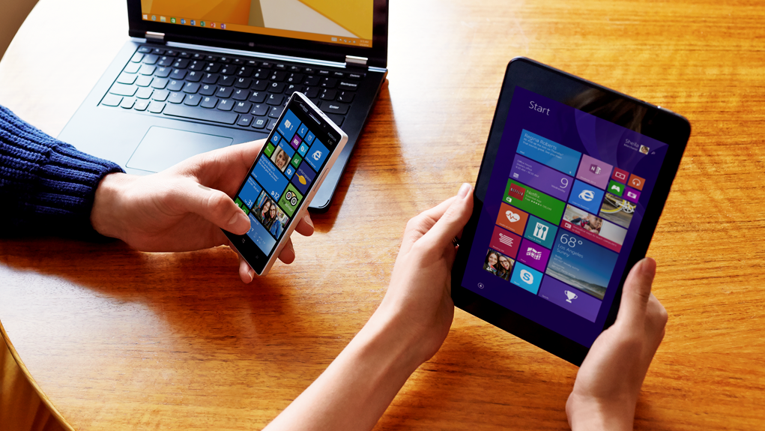
Works great on existing devices

Slide 23
Managed for continuous innovation

Slide 24
Deployment Choices
Wipe-and-Load
Traditional process
Capture data and settings
Deploy (custom) OS image
Inject drivers
Install apps
Restore data and settings
Still an option for all scenarios
In-Place
Let Windows do the work
Preserve all data, settings, apps, drivers
Install (standard) OS image
Restore everything
Recommended for existing devices (Windows 7/8/8.1)
Provisioning
Configure new devices
Transform into an Enterprise device
Remove extra items, add organizational apps and config New capability for new devices
App, web and device compatibility
Managed for Continuous Innovation

Slide 25
Management choices
Identity
Management
Updates
Infrastructure
Ownership
Active Directory
Azure Active Directory
Group Policy
System Center Configuration Manager
3rd party PC management
Intune
3rd party MDM
Windows Update
Windows Update for Business
Windows Server Update Services (WSUS)
Intune
3rd party MDM
On-premises
In the cloud
Corporate-owned
CYOD
BYOD
Organizations may mix and match, depending on their specific scenario
Managed for Continuous Innovation

Slide 26
DEMO
Automatic MDM with
Azure AD Join

Slide 27
Introducing the Business Store
Storefront designed for organizations
Acquire, deploy and manage apps
Easy for your users
Application Protection

Slide 28
DEMO
Business Store

Slide 29
This is what we hear your adoption needs are:
AGILITY
CONTROL
DVD
Access to new technology
Microsoft to quickly implement your feedback
Transparency on the roadmap
Enterprise-grade capabilities to help you address the latest trends in the market
Flexibility for mixed environments
Stability
Fewer upgrades
Long support lifecycle
Ample time to test and certify
Predictability
ISVs’ statement of Support
TENSION
Agili
PCMCIA
Parallel
Managed for Continuous Innovation

Slide 30
Windows as a Service
Consumer devices
Business users
Special systems
Updates installed via Windows Update as they arrive
Keeping hundreds of millions of consumers up to date
Large and diverse user base helps drive quality of the OS updates
BYOD devices are up to date & secure
Update their devices after features are validated in the market
Examples: Air Traffic Control, Emergency Rooms
No new functionality on long term servicing branch
Regular security updates
Control with WSUS

Slide 31
Release Deployment Options
Windows Update (WU)
Windows Update for Business
(WUB)
Windows System Update Services
(WSUS)
Consumer devices
BYOD Scenarios
Test Machines
Knowledge Workers
Salesforce
Non mission critical systems
Special Systems
Factory floor machines
Emergency Room systems
Managed for Continuous Innovation

Slide 32
Get ready for Windows 10
Test Windows 10 Preview
Join the Windows Insider Program
Give your feedback
Profile your systems for WU for Business
Start your deployment plan

Slide 33
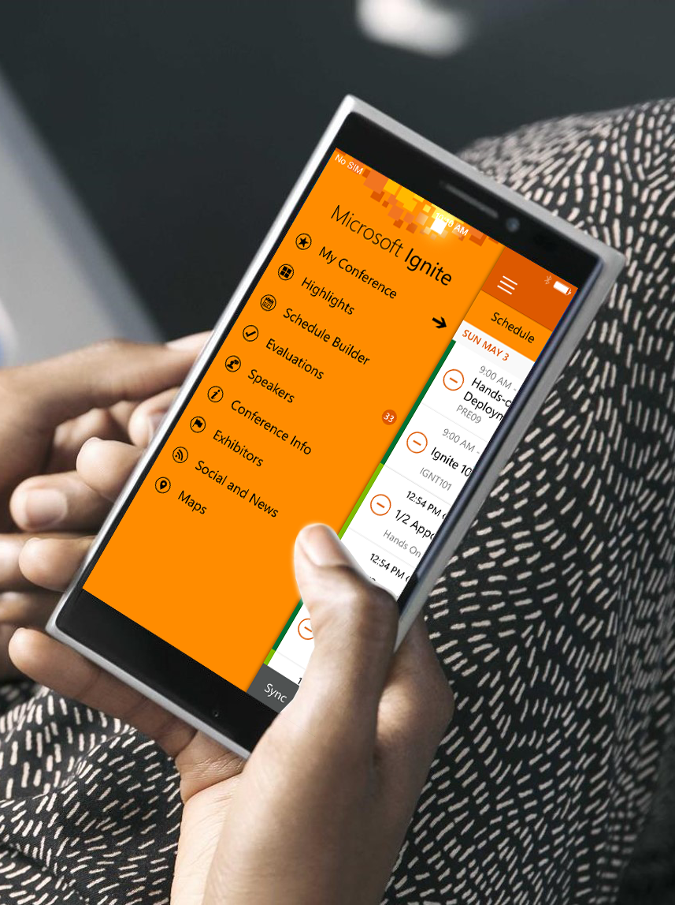
Please evaluate this session
Your feedback is important to us!
Visit Myignite at http://myignite.microsoft.com or download and use the Ignite Mobile App with the QR code above.

