Slide 2
SSDT for Visual Studio Bet you can’t tell what your database looked like 6 months ago
Hannah Gray, Development Team Lead, Xero
M222
Images: Can Stock Photo Inc. (under license) or openclipart.org (Public Domain CC1.0)

Slide 3
What is SSDT?

Slide 4
SQL Server Data Tools
Build, debug, maintain and refactor databases
Declarative SQL
Added functionality for Visual Studio
Version control

Slide 5
So, why?

Slide 6
Our Code vs Our Databases
Source control
Deployable
Versioning
Unit Testing
Continuous Integration
Continuous Deployment
No source control
Maintained
Production is the version
What’s that?
…
…

Slide 7
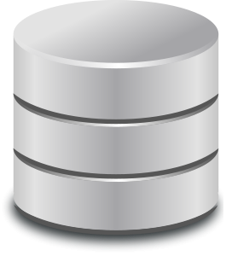
Commit changes to source control
Publish / run directly on server(s)

Slide 8
What did my schema look like a month ago?

Slide 9
I need to reproduce a bug we introduced last release

Slide 10
Could I have variations of my schema?

Slide 11
I’m a highly trained [DBA/developer] and I’m hand crafting ALTER scripts

Slide 12
Commit changes to source control
Deploy
Build solution

Slide 13
Sound familiar?

Slide 14
Reporting Services
Analysis Services
Integration Services
SQL Server Database Engine
Business Intelligence Development Studio
Visual Studio Database Edition for Professionals
SQL Server Data Tools
SQL Server Data Tools – Business Intelligence
SQL Server Data Tools – Database Project

Slide 15
SQL Server Data Tools for Visual Studio
Visual Studio 2012*+
Integrated
Enterprise
Professional
Community
SQL Server 2005 – 2016*, Azure
Frequently updated
Free

Slide 16
What’s new?

Slide 17
Things got better
.dbproj
.dbschema
vsdbcmd.exe
Deploy/comparisons
SQL Version-specific projects
.sqlproj
.dacpac
sqlpackage.exe
Numerous new options
Single project type
Better, faster, stronger

Slide 18
Things got cleaner and simpler
Server and Database projects
SQLCLR in separate project
Enforced folder, file structure
.sqlcmdvars, .sqldeployment
.sqlpermissions
.sqlsettings
One project to rule them all
One project to rule them all
Do what you want!
*.publish.xml files
Do what you want!
Project properties

Slide 19
Things got added
Live Database Debugging
T-SQL Object Editor

Slide 20
Let’s take a look
Hannah Gray

Slide 21
A note on order of operations
Schema Comparison
Script generation
(delta)
Deploy
Execute Pre Deployment
Execute generated script
Execute Post Deployment

Slide 22
You made it!

Slide 23
We’ve now got the ingredients…
Source control
Who did what when and why
Point-in-time view of schema
Output (.dacpac)
Command line tooling (sqlpackage.exe)
Automation anyone?

Slide 24
We can spice things up with…
Database Unit Testing
Code Analysis / DacFx
Composite Projects

Slide 25
Commit changes to source control
Deploy
Build solution

Slide 26
Commit changes to source control
Pull changes from source control
Test
Package the output
Build solution
Continuous Integration
Deploy

Slide 27
Demos vs. reality

Slide 28
We use it day in, day out
We use SSDT for
Schema
Logins, Users, Roles, Permissions
Reference Data
Linked Servers
SQL Agent Jobs, Schedules
One click deploy gives you a working database
See all changes to any line, any time
Automated deployment to any of our ~60 testing environments

Slide 29
Related Ignite NZ Sessions
1
Advanced SSDT and DACFx – Practical Techniques
Ballroom 1, Thu 4:30pm
4
The SQL Server Evolution: Overview
New Zealand 3, Wed 9:00pm
2
What’s new in VS2015 and ALM2015
New Zealand 2, Wed 1:55pm and 3:10pm
Find me later at…
Hub Happy Hour Wed 5:30-6:30pm
Hub Happy Hour Thu 5:30-6:30pm
Closing drinks Fri 3:00-4:30pm
3
The Microsoft DevOps Vision
New Zealand 2, Thu 9:00am

Slide 30
Resources
Microsoft Virtual Academy
TechNet & MSDN Flash
Free Online Learning
http://aka.ms/mva
Subscribe to our fortnightly newsletter
http://aka.ms/technetnz http://aka.ms/msdnnz
Sessions on Demand
http://aka.ms/ch9nz

Slide 31
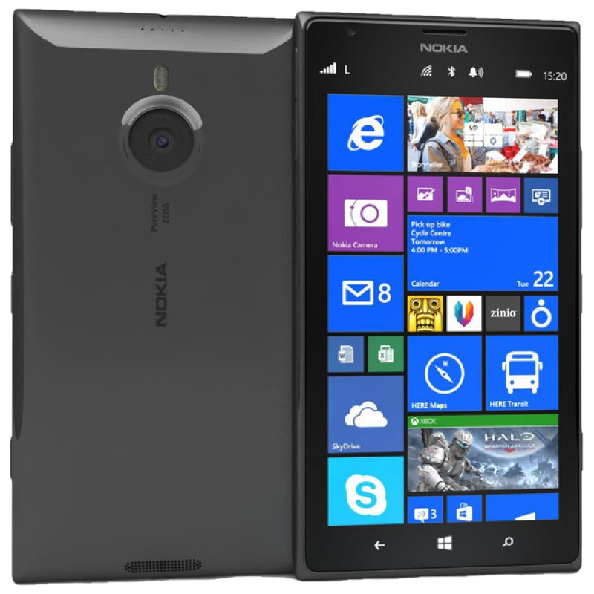
Complete your session evaluation now and be in to win!

