Slide 2
SQL Server BI Drill Down
Stuart Mackereth & Manpreet Gill
M236

Slide 3
Technical BI
Self service BI
End user BI
IT
End user
Analyst
End user
Everyone
SQL Server
Visual Studio Performance Point
Reporting Services
Report Builder
Power BI Designer
Excel
PowerPivot
Power BI
PowerView
Datazen

Slide 4
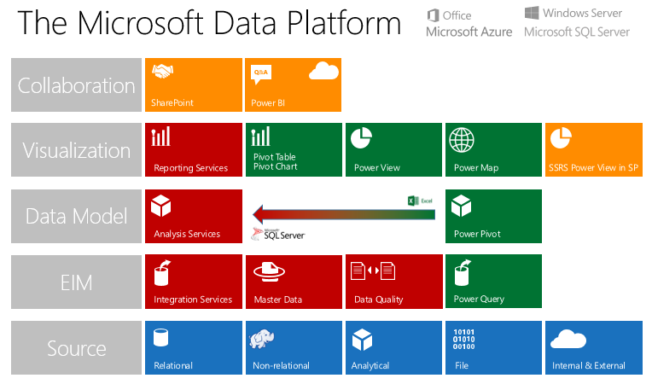

Slide 5
SQL Server
Business intelligence
Core investment areas
Mobile BI
Modern
Reports
Hybrid
BI
Enhanced
analysis
Self service BI
Rich
tools

Slide 6
SQL Server
Business intelligence
Core investment areas
Mobile BI
Modern
Reports
Hybrid
BI
Enhanced
Analysis
Self service BI
Rich
tools

Slide 7
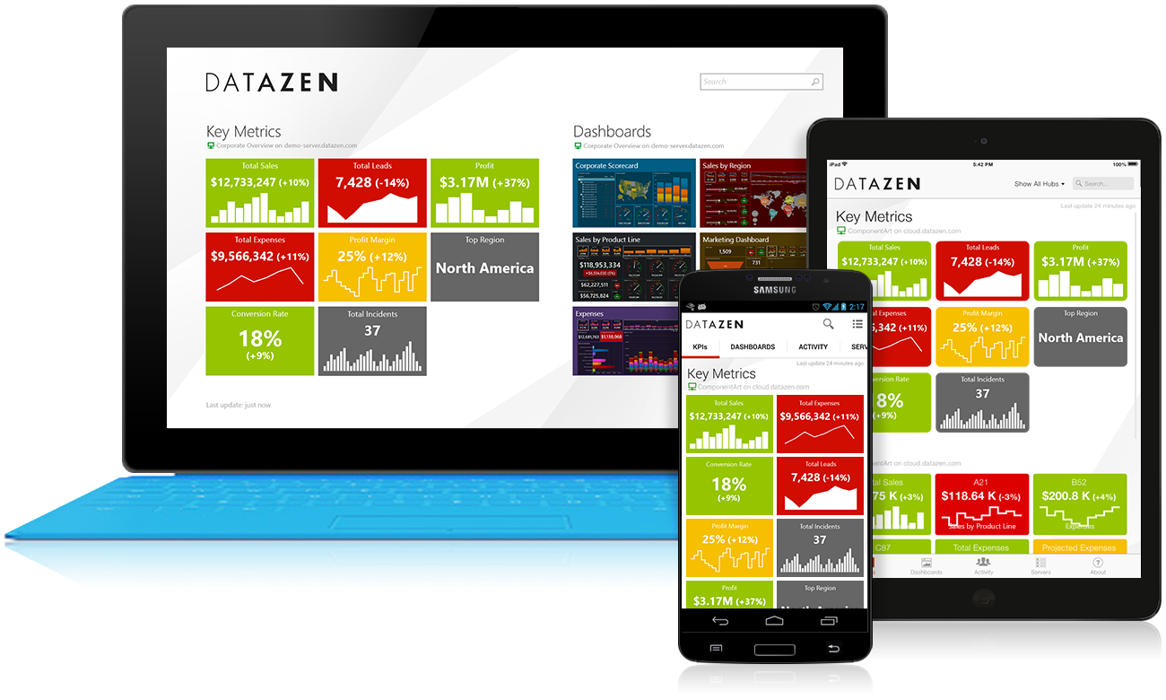
Datazen
Mobile BI apps for SQL Server
For on-premises implementations - optimized for SQL Server.
Rich, interactive data visualization on all major mobile platforms
No additional cost for
SQL Server Enterprise Edition customers 2008 or later and Software Assurance

Slide 8
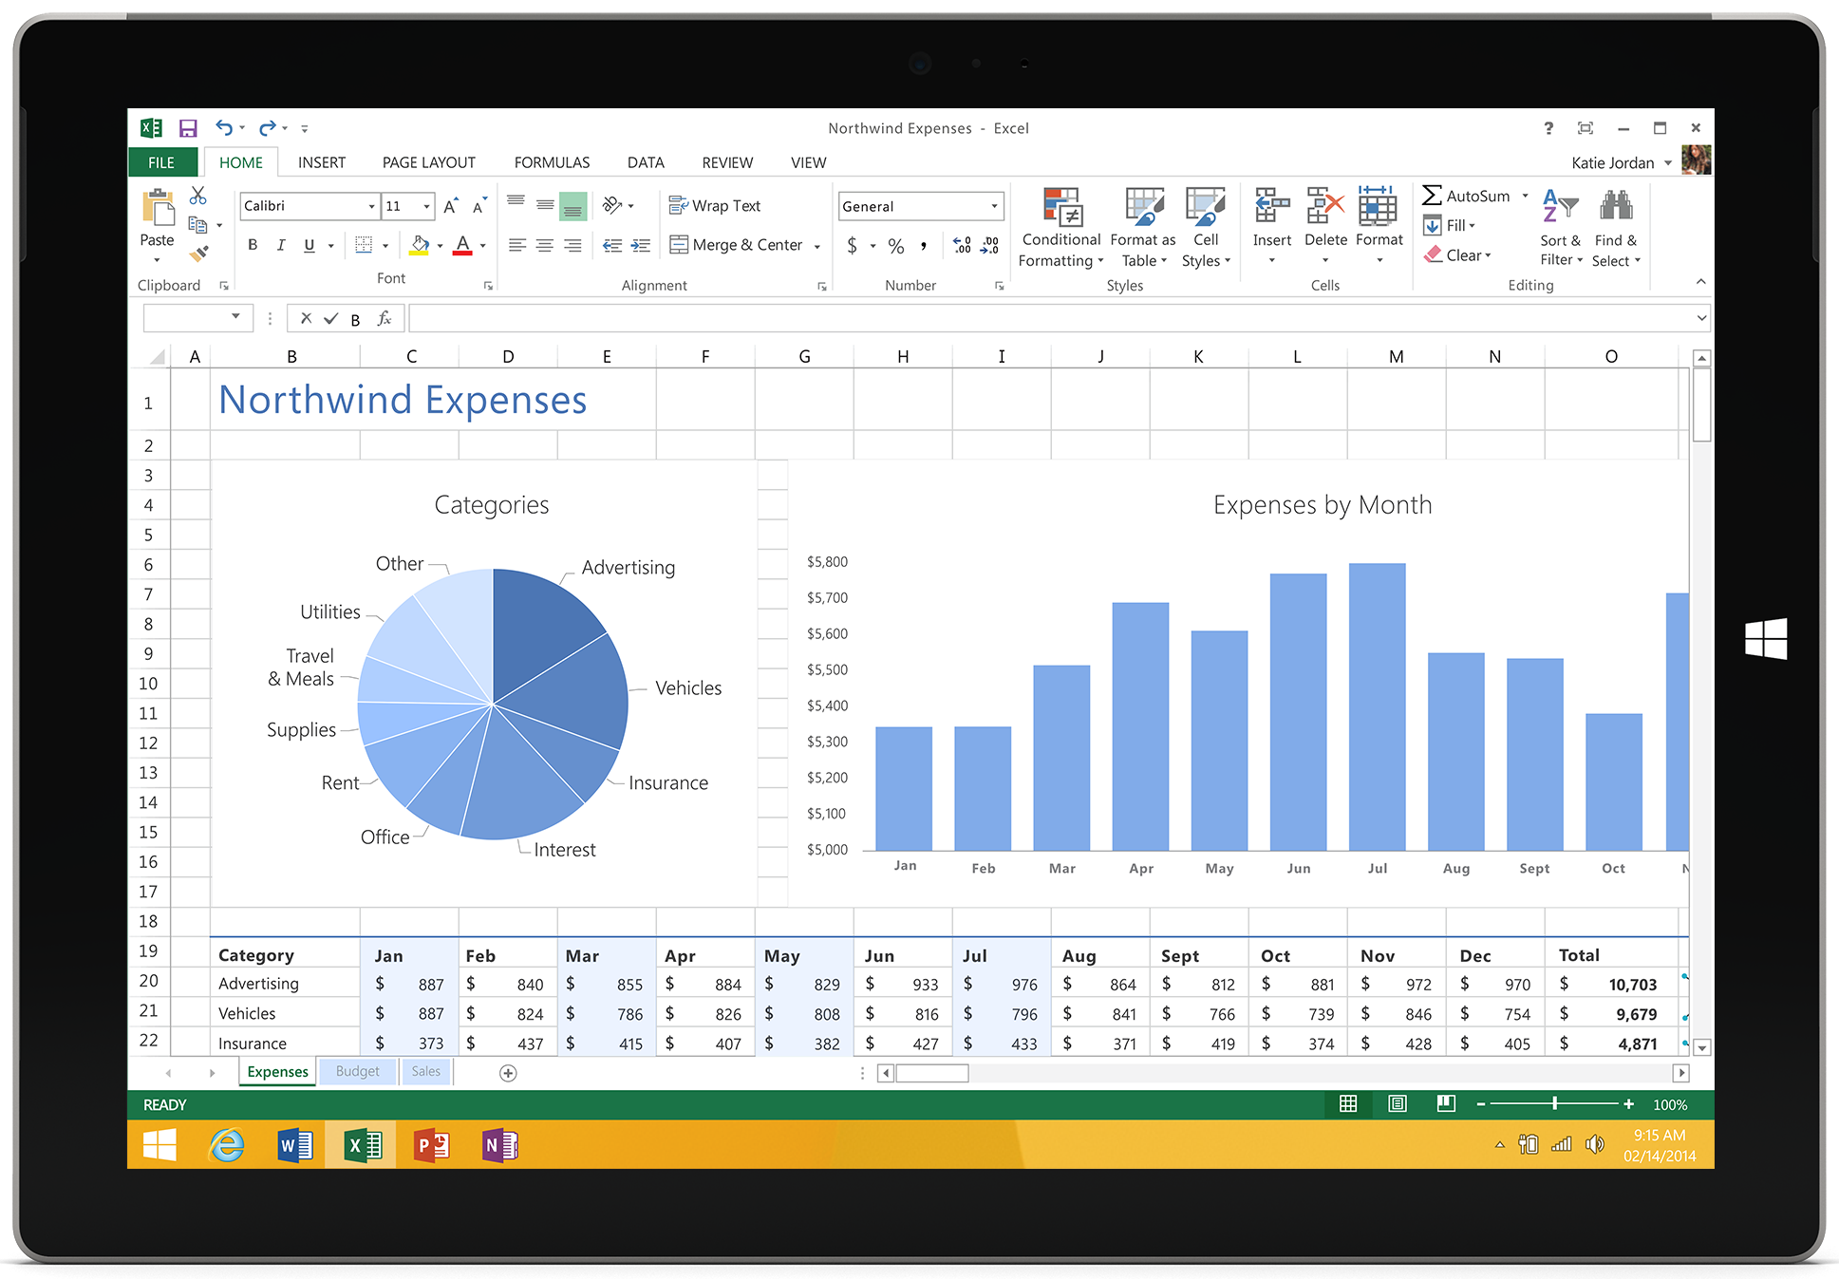
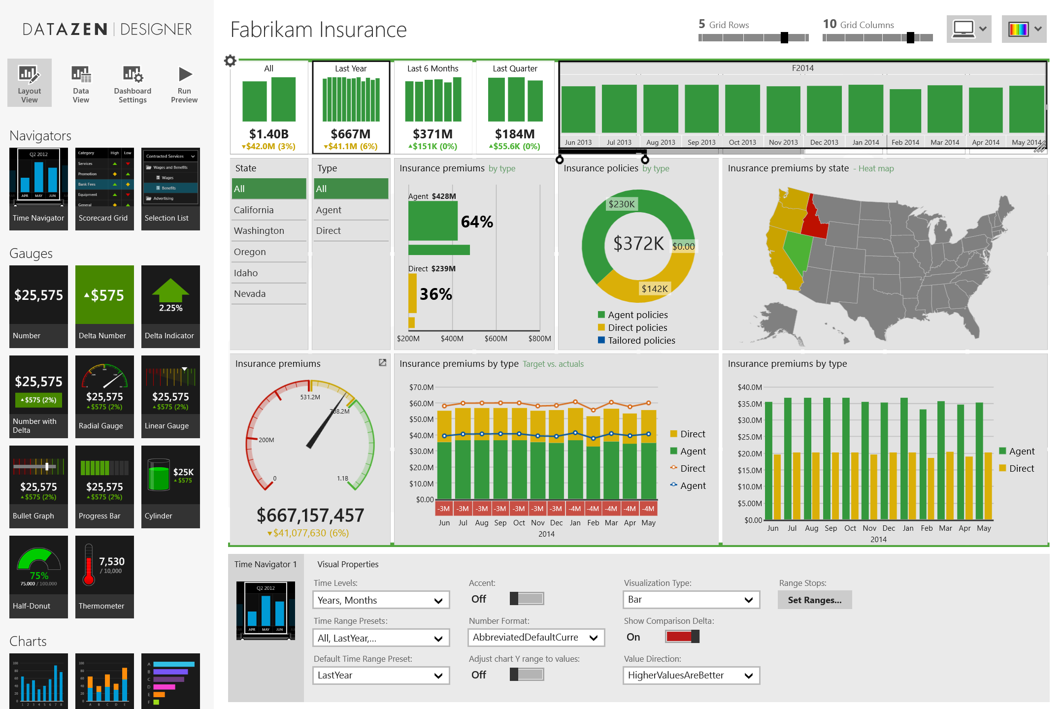
Datazen Publisher App
Data visualization and publishing
Create beautiful visualizations
and KPIs with a touch-based designer
Connect to Datazen Server to
access SQL Server data
Publish for access by others

Slide 9





Architecture overview
Datazen Server, Publisher and mobile apps
Enterprise environment
Internet boundary
Authentication
Publisher App
Active directory controller
Datazen Enterprise Server
Data sources
Viewer Apps
SQL Server
Core Service
Analysis Services
Data Acquisition Service
File
Web applications
Web browser

Slide 10
Demo
Mobile BI
Manpreet Gill

Slide 11

Where does Datazen fit in?

Slide 12
Mobile BI
Summary
Beautiful visualizations
KPI repository
Create once - publish to any device
Native apps for all platforms
Perfect scaling to any form factor
Custom branding
Collaborate on the go
No cost to enterprise users

Slide 13
SQL Server
Business intelligence
Core investment areas
Mobile BI
Modern
Reports
Hybrid
BI
Enhanced
analysis
Self service BI
Rich
tools

Slide 14
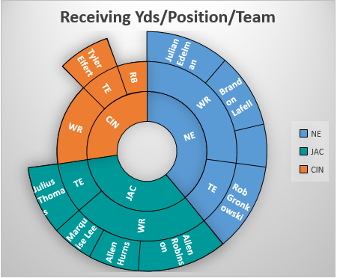
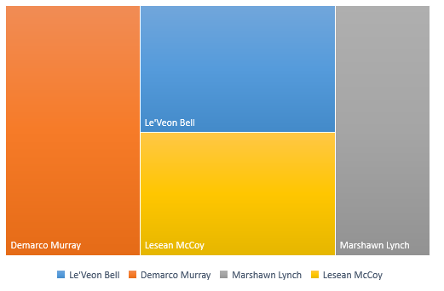
Modern reports
SQL Server Reporting Services
Report consumption from modern browsers
Improved parameters
Modern themes
New chart types
Built-in R Analytics
Improved DPI
Subscriptions

Slide 15
SQL Server
Business intelligence
Core investment areas
Mobile BI
Modern
Reports
Hybrid
BI
Enhanced
analysis
Self service BI
Rich
tools

Slide 16
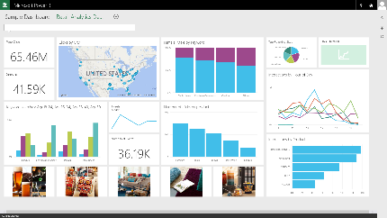
Hybrid BI
Continuous investments
  Power BI connectivity to on-premises Analysis Services (Tabular, OLAP coming)
  Pin on-premises SSRS report to Power BI Dashboard
Live Power BI reports & dashboards
Live
Query
Scheduled
Refresh
Cloud
On-premises
SQL Server
Analysis Services
Data

Slide 17
SQL Server
Business intelligence
Core investment areas
Mobile BI
Modern
Reports
Hybrid
BI
Enhanced
analysis
Self service BI
Rich
tools

Slide 18

Enhanced Analysis- Tabular
SQL Server Analysis Services
  Advanced modeling
  (M:M, BI Directional Cross Filtering)
  Time intelligence
  New DAX functions for
  data analysis
  Performance
  (Query and Metadata operations)
  Parallel Partition Processing
ADDMISSINGITEMS, CALENDAR, CALENDARAUTO, CONCATENATEX, DATEDIFFF, GEOMEAN, GEOMEANX, GROUPBY, ISEMPTY, ISONORAFTER, MEDIAN, MEDIANX, NATURALINNERJOIN, NATURALLEFTOUTERJOIN, PERCENTILE.EXC, PERCENTILE.INC, PERCENTILEX.EXC, PERCENTILEX.INC, PRODUCT, PRODUCTX, SUBSTITUTEWITHINDEX, SUMMARIZECOLUMNS, UNION, XIRR, XNPV

Slide 19
Enhanced Analysis - Multidimensional
SQL Server Analysis Services
  Netezza as a Data Source
  Performance improvements
  DBCC support

Slide 20
SQL Server
Business intelligence
Core investment areas
Mobile BI
Modern
Reports
Hybrid
BI
Enhanced
analysis
Self service BI
Rich
tools

Slide 21
Self service BI
With SharePoint
  Support for SharePoint vNext
  Edit Mode of PowerPivot workbooks with SharePoint vNext
  Support for Excel vNext Workbooks
J
u
s
ti
S
n
t
a
r
t

Slide 22
SQL Server
Business intelligence
Core investment areas
Mobile BI
Modern
Reports
Hybrid
BI
Enhanced
analysis
Self service BI
Rich
tools

Slide 23
Rich Tools
  SQL Server Data Tools for Visual Studio 2015
  XEvent-based Monitoring in SQL Server Management Studio
  Azure Data Factory can orchestrate SSIS packages
  ADF Task, Storage Task, Custom Logging, OData4 connector SSIS

Slide 24
Rich Tools
  MDS improved web application
  MDS is 15x faster
  Sync entities between models
  SCD Type 2 support
  Compound Key Support

Slide 25
SQL Server
Business intelligence
Core investment areas
Mobile BI
Modern
Reports
Hybrid
BI
Enhanced
analysis
Self service BI
Rich
tools

Slide 26

Related Ignite NZ Sessions
1
Microsoft Azure SQL Data Warehouse Overview
SKYCITY (Marlborough) Thu 11:55am
4
Introduction to Cortana Analytics
SKYCITY (Marlborough) Wed 4:30pm
2
5
Hybrid with SQL Server
SKYCITY (Marlborough) Wed 1:55pm
BI in Action – How MS uses Power BI
CROWNE PLAZA (Ballroom1) Thu 1:55pm
3
6
In-Memory OLTP: The Road Ahead
CROWNE PLAZA (Ballroom1) Wed 11:55pm
Telling Stories with Data – BI Tools
SKYCITY (Marlborough) Fri 9:00am

Slide 27





Resources
Microsoft Virtual Academy
TechNet & MSDN Flash
  Free Online Learning
http://aka.ms/mva
  Subscribe to our fortnightly newsletter
http://aka.ms/technetnz http://aka.ms/msdnnz
  Sessions on Demand
http://aka.ms/ch9nz

Slide 28


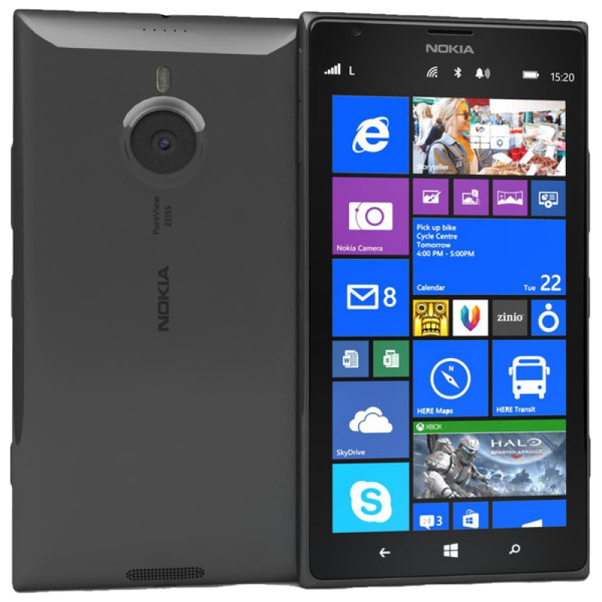


Complete your session evaluation now and be in to win!

