Slide 2
Microsoft Azure SQL Data Warehouse Overview
Matthew Winter
M242

Slide 3


Slide 4



Introducing SQL Data Warehouse
Fully managed relational data warehouse-as-a-service
The first elastic cloud data warehouse with enterprise-grade capabilities
Supports the smallest to largest data sets
Elastic scale
& performance
Market Leading Price
& Performance
Powered by the Cloud

Slide 5
Elastic Scale
Spin up for heavy workloads, cycle down for daily activity
Buy time to insight based on what you need, when you need it
Choose the combo of compute and storage that meets your needs
Elastic scale
& performance
Market Leading Price
& Performance
Powered by the Cloud

Slide 6
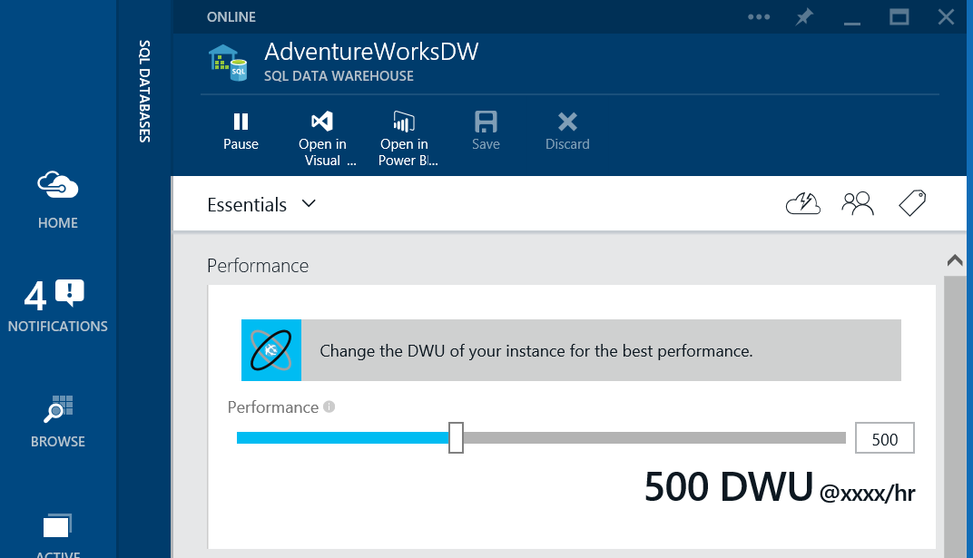
Example – Azure Portal

Slide 7
Example - PowerShell
C:\PS>$ServerName = “DemoServer”
C:\PS>$DatabaseName = “SampleDW”
C:\PS>$ServiceObjective = “B89B9C6A-4EC2-4EB8-99DB-6D2807E6AAB”
(DW1000)
C:\PS>$Database = Get-AzureSqlDatabase -ServerName $ServerName
-DatabaseName $DatabaseName
C:\PS>Set-AzureSqlDatabase –ServerName $ServerName
–ServiceObject $ServiceObjective

Slide 8
Example - TSQL
ALTER DATABASE [dbo].[SampleDW]
{
SET SERVICE_OBJECTIVE = 'DW1000'
};

Slide 9
Pause
Data remains in place – no reloading / restoring of data
When paused, cloud-scale storage is min cost
Automate via PowerShell/REST API
$$$$

Slide 10
Demo:
Let’s Scale

Slide 11
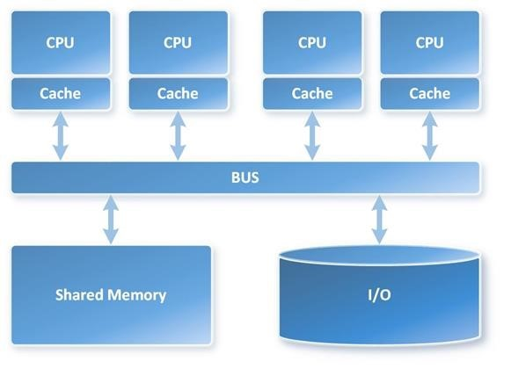
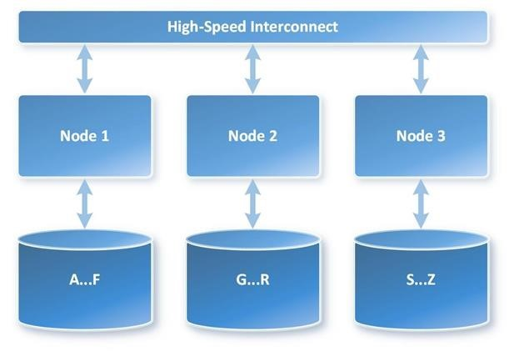
MPP vs. SMP Architecture
vs

Slide 12
SQL DW: Building on SQL DB Foundation
SQL DW
Elastic, Petabyte Scale DW Optimized
99.99% uptime SLA,
Geo-restore
Azure Compliance (ISO, HIPAA, EU, etc.)
SQL DB
Service Tiers
True SQL Server Experience;
Existing Tools Just Work

Slide 13
SQL Server Compatibility
Mature enterprise-ready SQL for sophisticated DW scenarios
Existing SQL Server scripts and tools just work
Continuous enhancements on language surface
User-Defined Functions & Stored Procedures
Table
Partitioning
Collations
Indices & Column-Store Support
Modular programming
(write once, execute multiple times)
Faster code execution
Encapsulated programming logic
Easier maintenance of large tables
Improves performance
Enhanced scalability and availability
Allows proper use and comparisons of characters in different languages
Mature Column-Store technology for best-in-class DW query performance

Slide 14
















Broad Ecosystem
Azure Event Hub
Leverage Azure ML, Power BI, ADF, Stream Analytics and more
Streamlined deployment with Azure Portal
Deep tool integration with top partners
Microsoft
Azure Stream Analytics
Power BI
Azure HDInsight
Azure ML
Azure SQL DW

Slide 15
Query Unstructured Data via Polybase
Capability
T-SQL for querying relational
and non-relational data across
SQL Server and Hadoop
Benefits
New business insights across
your data lake
Leverage existing skillsets
and BI tools
Faster time to insights and simplified ETL process
Quote:
************************
**********************
*********************
**********************
***********************
$658.39
T-SQL query
SQL Server
Hadoop
Name
DOB
State
Jim Gray
11/13/58
WA
Ann Smith
04/29/76
ME

Slide 16
Example – Setup Keys & Credentials
-- This is only one time for a database
CREATE MASTER KEY;
CREATE MASTER KEY ENCRYPTION BY PASSWORD = 'SecurePassword';
-- This is required once per a new credential.
CREATE CREDENTIAL ProdCreds ON DATABASE WITH IDENTITY = ‘StorageName', Secret = 'StorageKeyValueGoesHere';

Slide 17
Example – Data Source
-- Create a data source
CREATE EXTERNAL DATA SOURCE [WebLogSource]
WITH
(
TYPE = HADOOP,
LOCATION = 'wasbs://weblogs@sqldwdemo.blob.core.windows.net/',
CREDENTIAL = ProdCreds
);

Slide 18
Example – File Format
-- Create the file format
CREATE EXTERNAL FILE FORMAT [WebLogFormat] WITH
(
FORMAT_TYPE = DELIMITEDTEXT,
FORMAT_OPTIONS
(
FIELD_TERMINATOR = ‘|',
DATE_FORMAT = 'yyyy-MM-dd HH:mm:ss'
)
);

Slide 19
Example – External Table
-- Create the external Table
CREATE EXTERNAL TABLE [WebLogs]
(
url VARCHAR(50),
event_date DATE,
user_IP VARCHAR(50)
)
WITH
(
LOCATION='weblogs',
DATA_SOURCE = WebLogData,
FILE_FORMAT = WebLogFormat
);

Slide 20
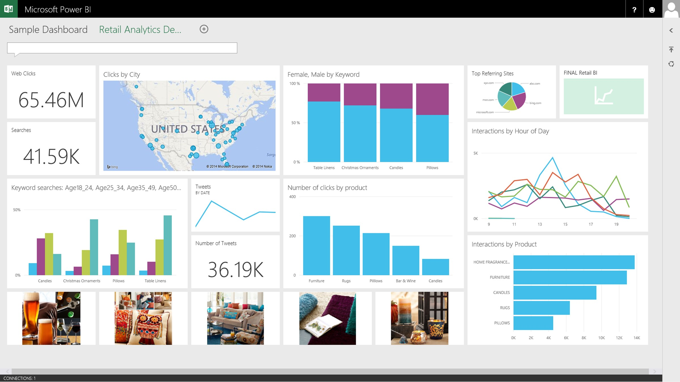
Symmetry
Integrated with Power BI, Azure Machine Learning, and Azure Data Factory
Power BI
Hadoop
App Service
Azure SQL Database
Azure SQL Data
Warehouse
Intelligent App
Azure Machine Learning

Slide 21
Data Warehouse Unit (DWU)
Measure of Power
Simply buy the query performance you need, not just hardware
Transparency
Quantified by workload objectives: how fast rows are scanned, loaded, copied
On Demand
First DW service to offer compute power on demand, independent of storage
Scan 1B rows
100 DWU | = | xx sec
400 DWU | = | xx sec
800 DWU | = | xx sec
1,600 DWU | = | xx sec
Scan Rate | xx M row/sec
Loading Rate | xx K row/sec
Table Copy Rate | xx K row/sec
100 DWU

Slide 22
Market-Leading Price/Performance
Best On-Demand Price/Performance
  Advantages in elasticity and pause to reduce customer cost
SQL DW start small, can grow to PB+
Pay for performance by scaling compute against storage
50
SQL DW High Performance
SQL DW Balanced
Performance
SQL DW High Capacity
100GB
1TB
2TB
1+PB

Slide 23
Demo:
Let’s Integrate

Slide 24






Cortana Analytics Suite
Transform Data into Intelligent Action
Information Management
Big Data Stores
Machine Learning
and Analytics
Dashboards and Visualizations
Business
apps
Power BI
Azure
Data Factory
Azure
Machine Learning
Personal Digital Assistant
Azure
Data Lake
Cortana
People
Custom
apps
Azure
Data Catalog
Azure
HDInsight (Hadoop)
Perceptual Intelligence
Azure
SQL Data Warehouse
Face, vision
Speech, text
Azure
Event Hub
Azure
Stream Analytics
Business Scenarios
Sensors
and devices
Recommendations,
customer churn,
forecasting, etc.
Automated
Systems
DATA
INTELLIGENCE
ACTION

Slide 25

Related Ignite NZ Sessions
1
Introduction to Cortana Analytics
M229 Wed 4:30pm
5
BI in the cloud, is it possible?
M352 Thu 3:10pm
6
Azure Machine Learning: From Design to Integration
M370 Fri 10:40am
2
Using Azure ML @ Trade Me
M225 Wed 1:55pm
3
Big Data for the SQL Ninja
M327 Wed 3:10pm
Find me later at…
Hub Happy Hour Wed 5:30-6:30pm
Hub Happy Hour Thu 5:30-6:30pm
Closing drinks Fri 3:00-4:30pm
4
Microsoft SQL Server BI Drill Down
M236 Thu 9:00am

Slide 26





Resources
Microsoft Virtual Academy
TechNet & MSDN Flash
  Free Online Learning
http://aka.ms/mva
  Subscribe to our fortnightly newsletter
http://aka.ms/technetnz http://aka.ms/msdnnz
  Sessions on Demand
http://aka.ms/ch9nz

Slide 27





Complete your session evaluation now and be in to win!

