Slide 2
How University of Otago tames 600 servers
Gareth Wood – g.wood@otago.ac.nz
M249

Slide 3
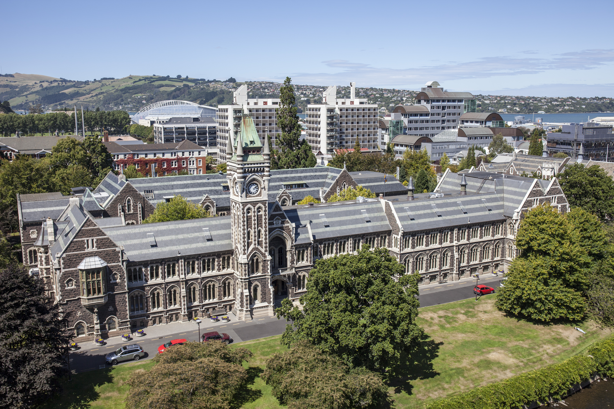

Slide 4
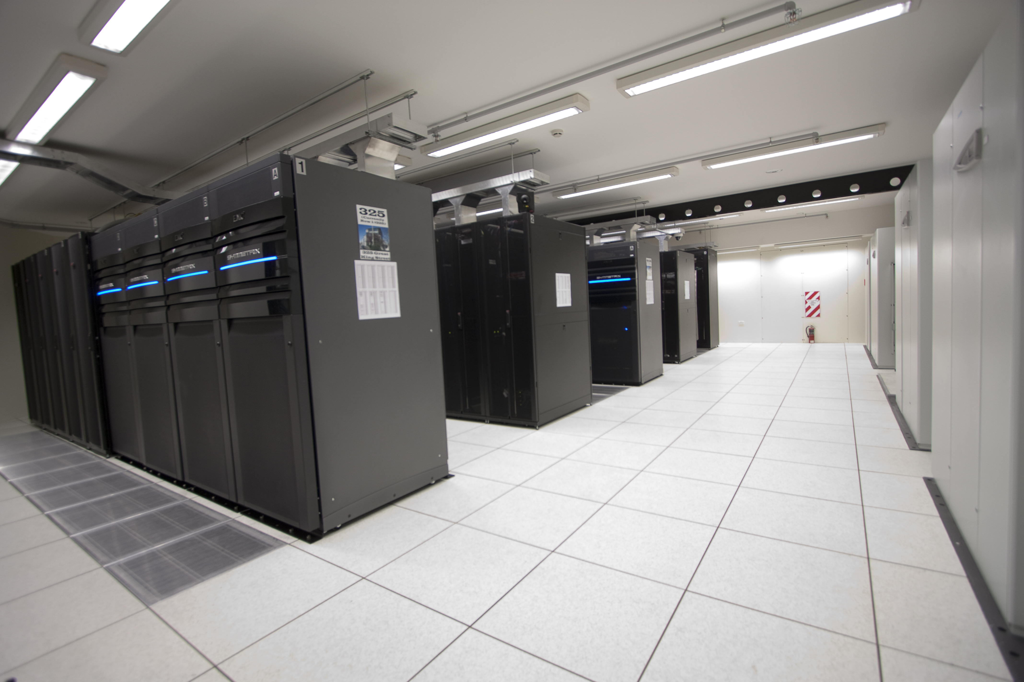

Slide 5
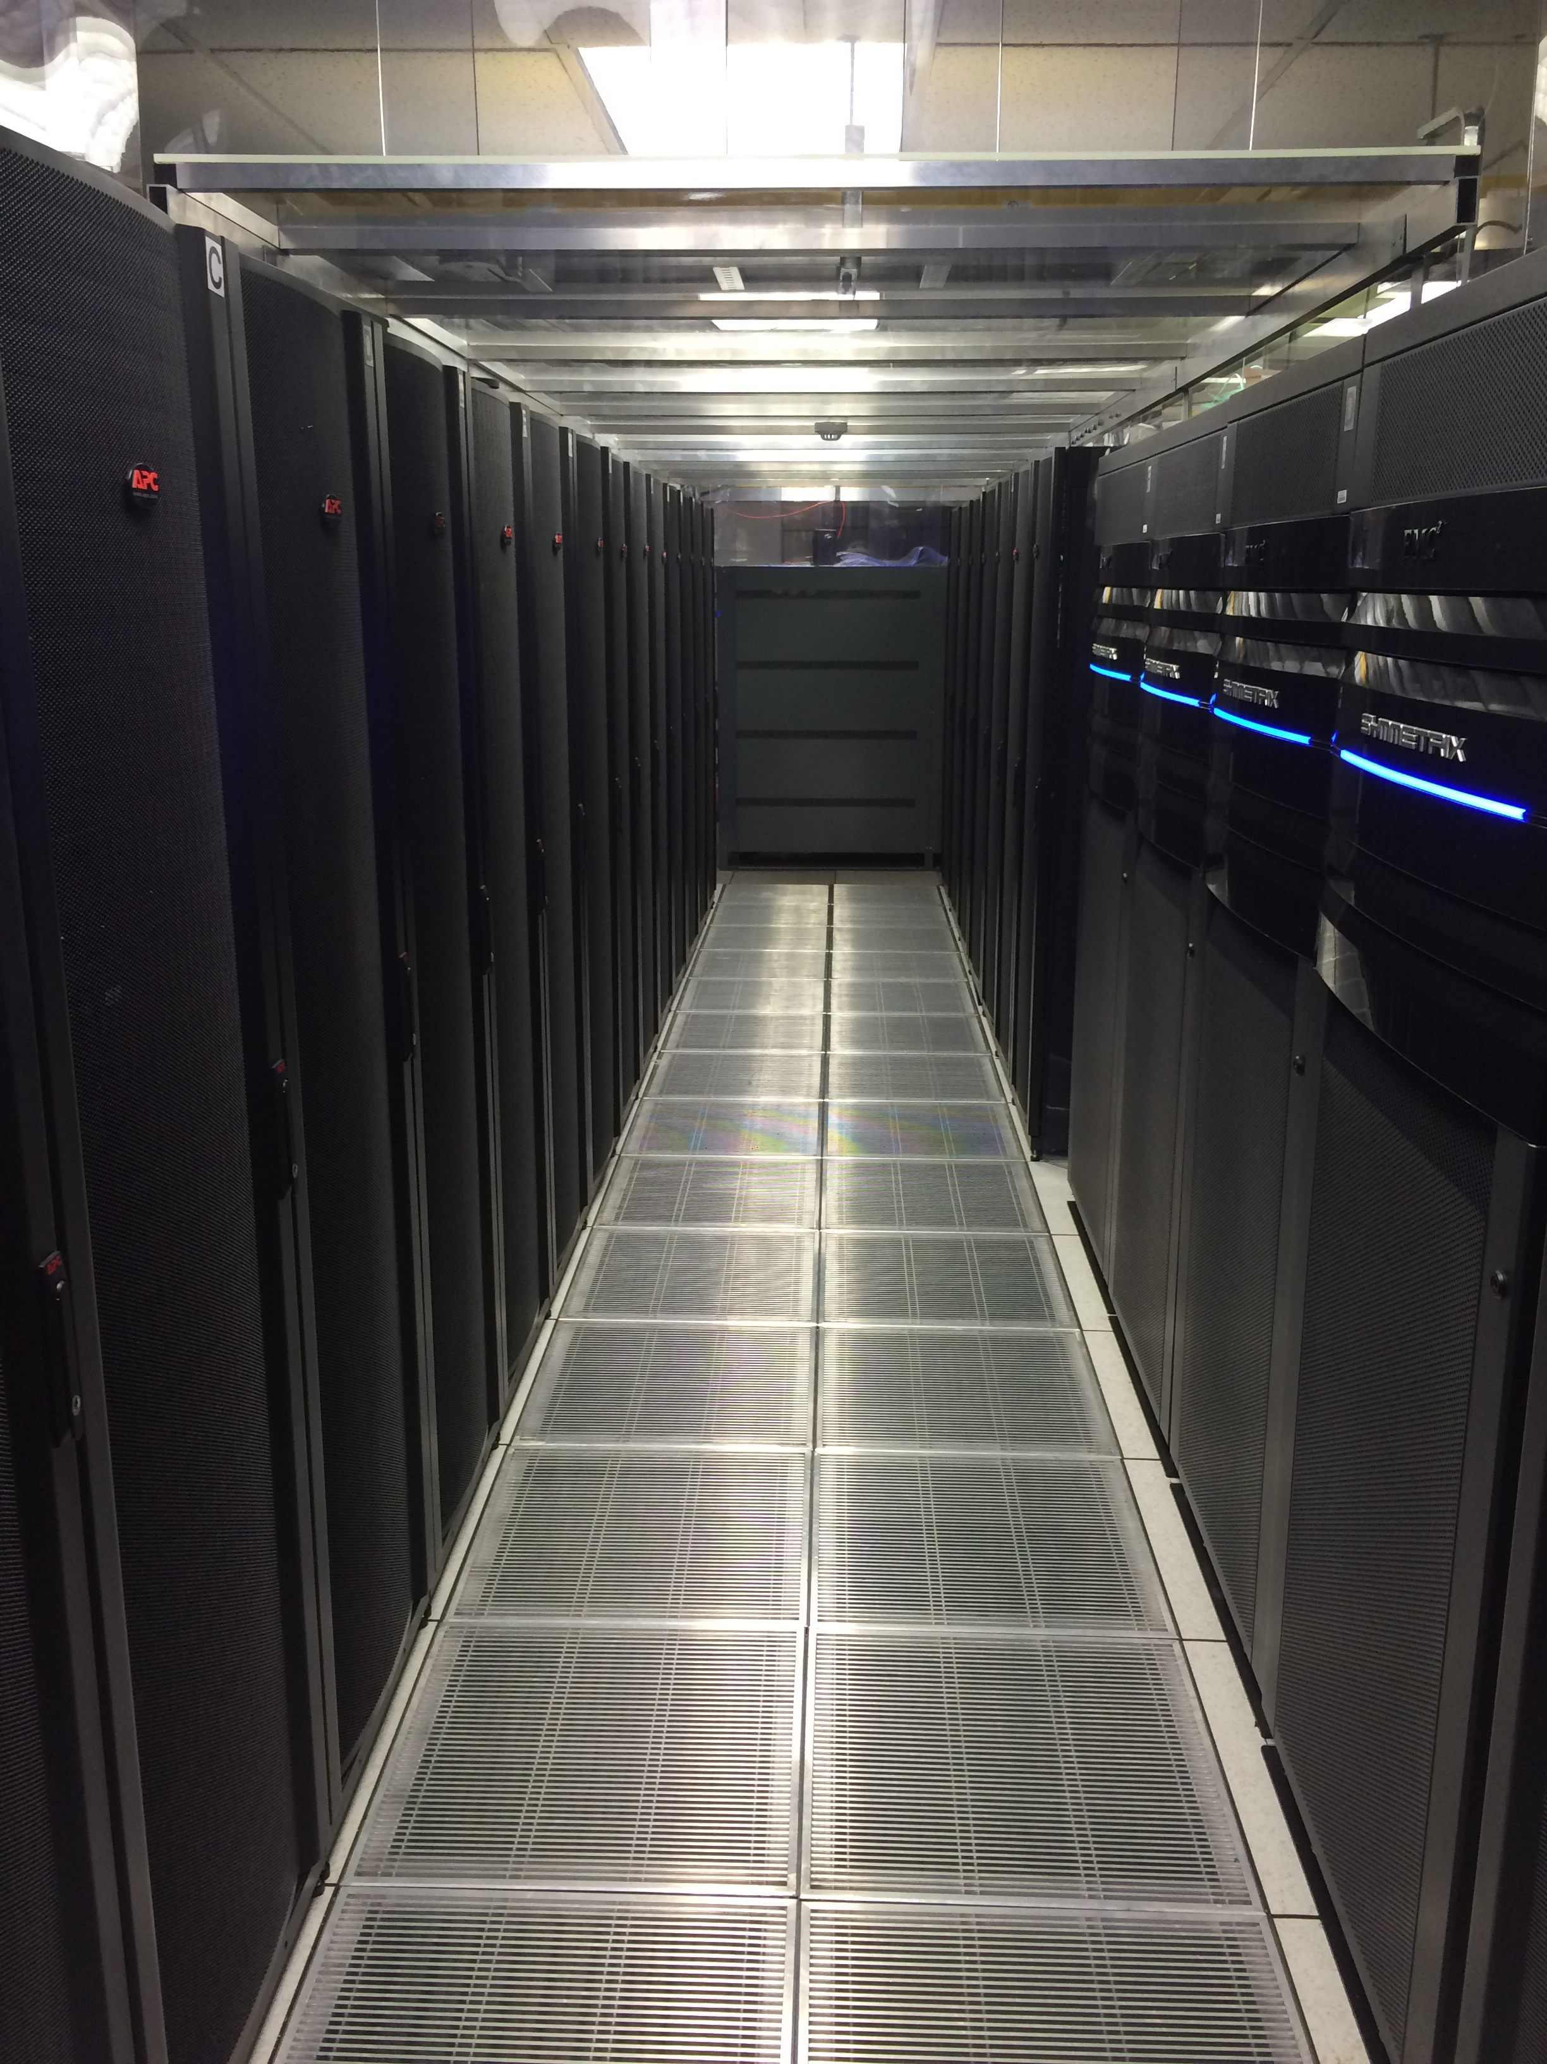
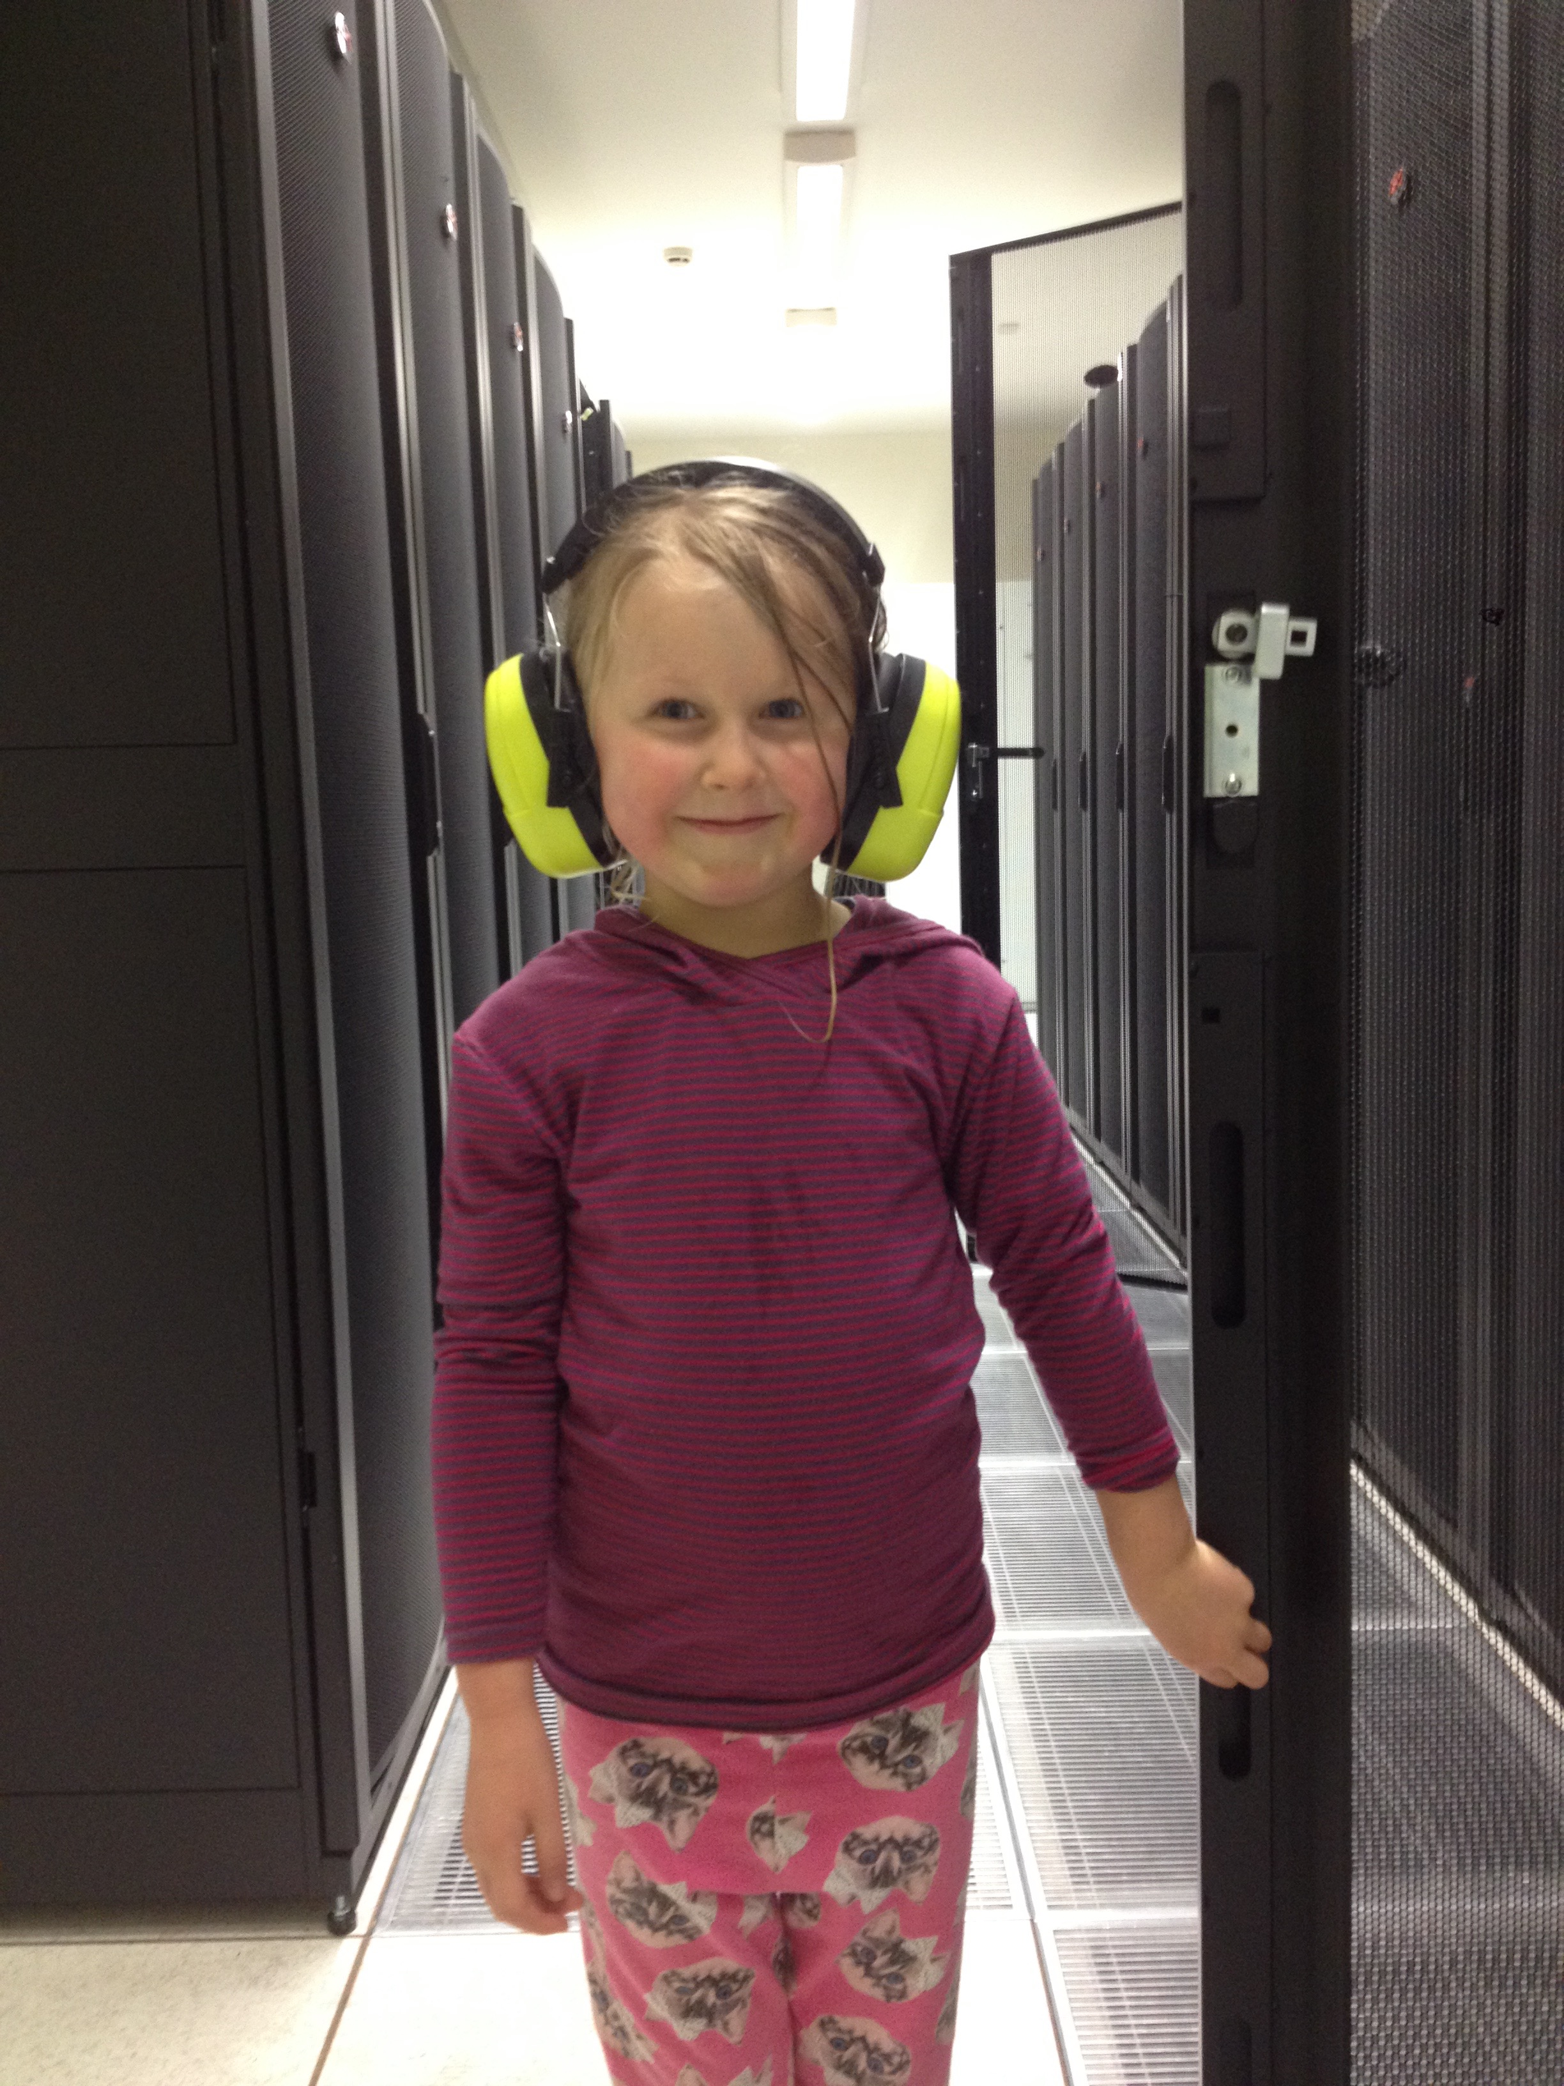

Slide 6
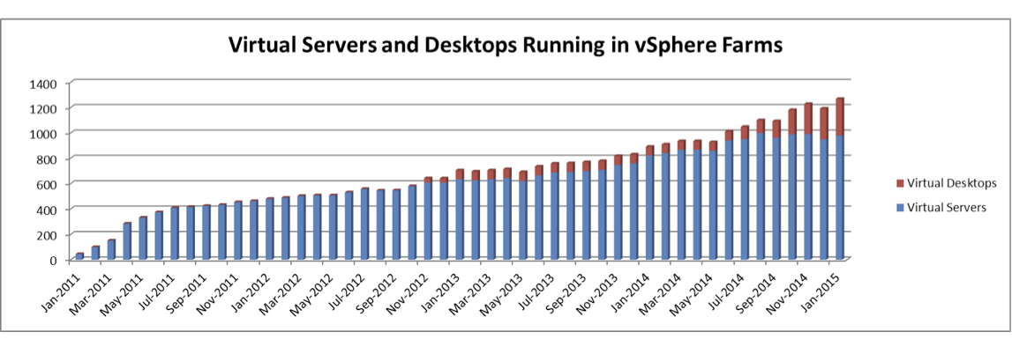
Server Virtualization

Slide 7
Diversity demands creativity

Slide 8
Where we came from
No formal or scheduled process
WSUS Server
Manual search and approval of updates
Engineers logging into all servers

Slide 9
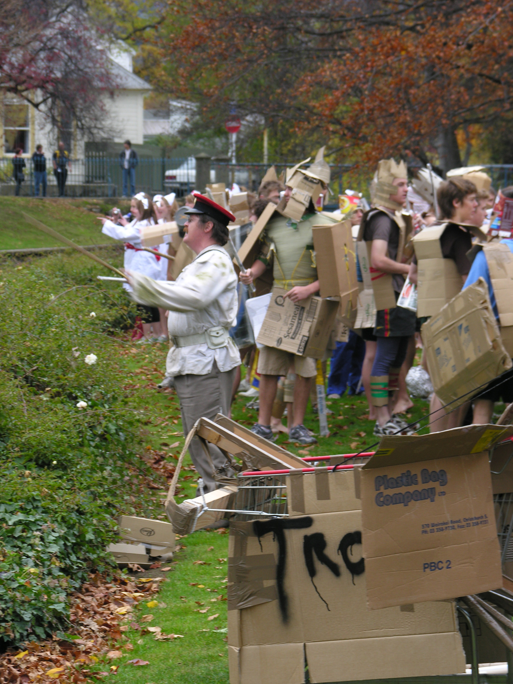
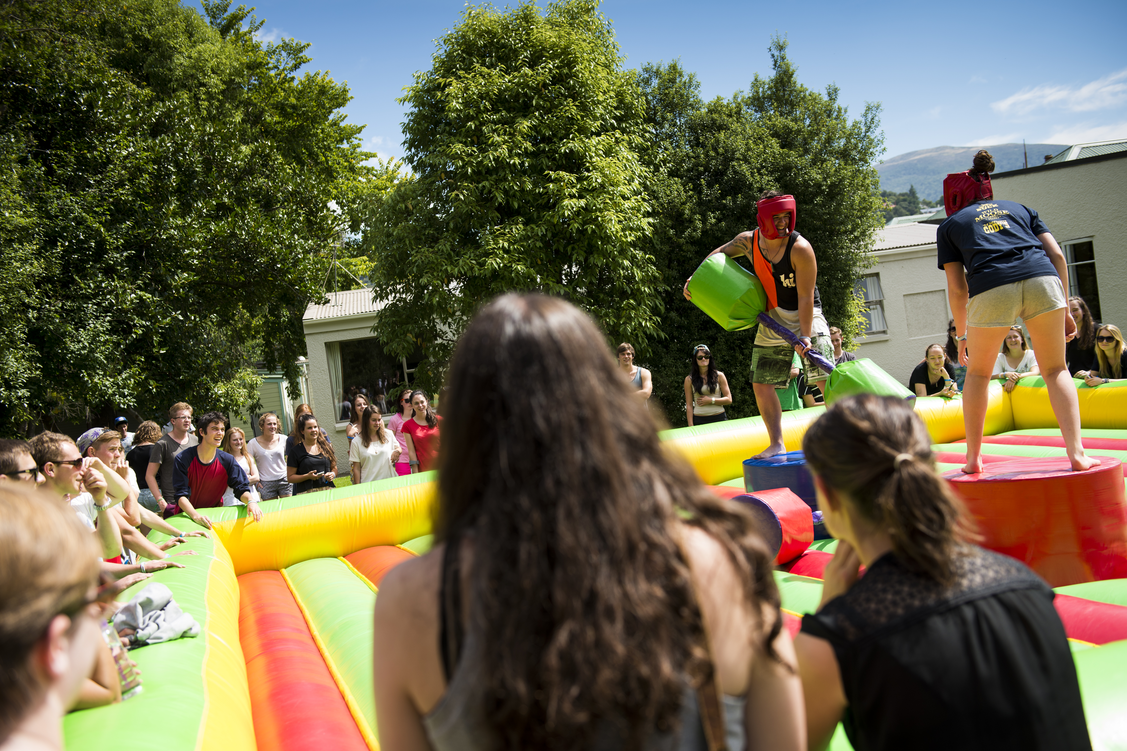

Slide 10
What we came up with
Monthly maintenance window
Patching groups with 2 hour windows
Flexibility to freely move server to new time as required
Reuse existing software install scripts
Reuse existing start-up/shutdown scripts

Slide 11
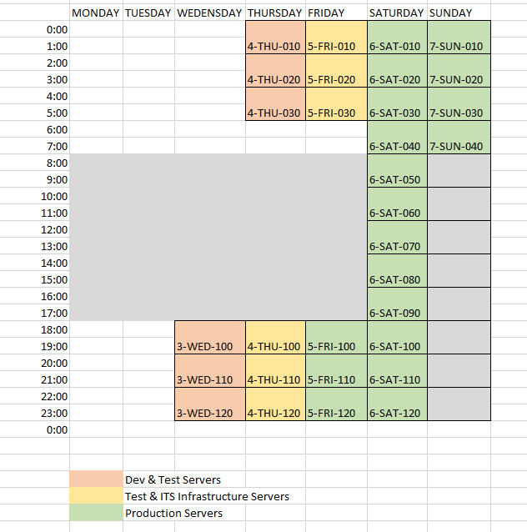

Slide 12
Key Components
SCOM Monitoring
SCCM Device Collections based on AD Groups
SCCM Task Sequence
Powershell Script on Servers
Powershell Script to deploy task sequence
Powershell Scripts for Reporting

Slide 13
Scheduled Task

Slide 14
Code to call Scheduled Task
writeToLog -message "Running scheduled task $TaskToRun"
schtasks.exe /Run /tn "$TaskToRun”
$mytaskstatus = ConvertFrom-Csv $(schtasks /query /tn "$TaskToRun" /v /fo csv)
while(($mytaskstatus.Status -ne "Ready") -or ($mytaskstatus.'Last Result' -eq 267045)){
Start-Sleep -Seconds 10
$mytaskstatus = ConvertFrom-Csv $(schtasks /query /tn "$TaskToRun" /v /fo csv)
}
if($mytaskstatus.'Last Result' -ne 0){
exitWithError -message "Error running $TaskToRun, return code: $($mytaskstatus.'Last Result')" -ExitCode $($mytaskstatus.'Last Result')
}
writeToLog -message "Successfully ran $TaskToRun"

Slide 15
Demo
Gareth Wood

Slide 16
Demo
Gareth Wood

Slide 17
Results
Servers patched manually is now at around 50
Error rate around 10-20 servers
Managers can see how patching is progressing!

Slide 18
Diversity demands creativity

Slide 19
Questions

Slide 20
Related Ignite NZ Sessions
1
30 Bad habits of Server Administrators
NZ2 Fri 10:40am
2
In-place Upgrade to Windows 10 Using
New SCCM Tech Preview
NZ1 Fri 11:55am
Find me later at…
Closing drinks Fri 3:00-4:30pm
Email g.wood@otago.ac.nz
3
Managing Linux with System Center
and PowerShell DSC
NZ3 Fri 1:55pm

Slide 21
Resources
Microsoft Virtual Academy
TechNet & MSDN Flash
Free Online Learning
http://aka.ms/mva
Subscribe to our fortnightly newsletter
http://aka.ms/technetnz http://aka.ms/msdnnz
Sessions on Demand
http://aka.ms/ch9nz

Slide 22
Complete your
session evaluation
now and win!

