Slide 2
Designing Innovative Consumer & LOB App Experiences
Atta Elayyan
M254

Slide 3
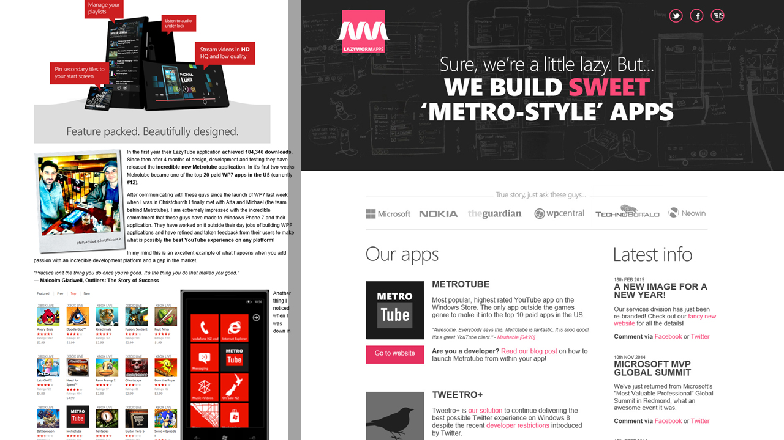

Slide 4
“I will always choose
a lazy person to do
a difficult job... because
he will find an easy way
to do it.”
-Bill Gates, Co-Founder, Microsoft

Slide 5
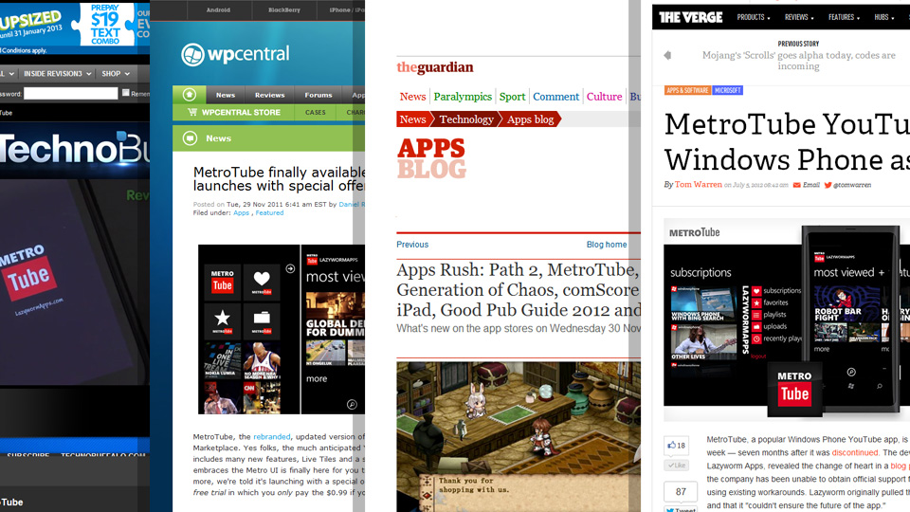

Slide 7
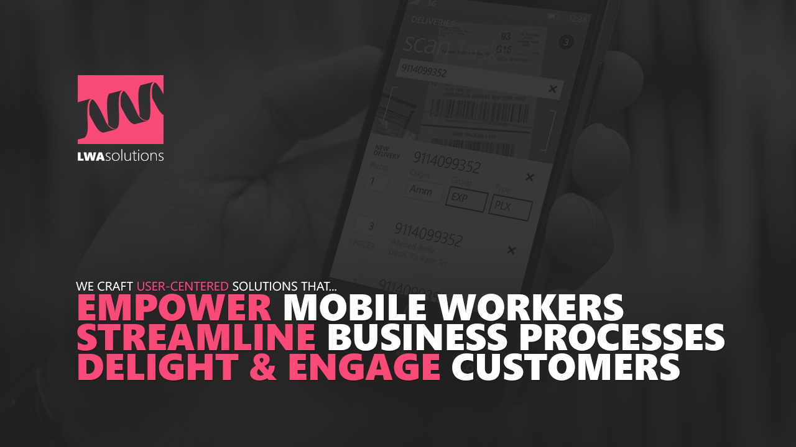

Slide 9
Session Overview

Slide 10
Why Windows Phone 7?
What inspired us to start building apps for Windows Phone?
Understanding consumers
We started small, listened to customers and iterated rapidly
A lesson in Metro
Mentorship and advise we got from the Windows Phone design team
A lesson in design process
Lessons we learnt from Microsoft’s AFT review

Slide 11
Challenges of a ‘hybrid’ app
Some challenges we began facing after delivering our first Windows 8 app
Understanding clients
Trade Me case study on design process we used working with them
Consumerization of enterprise software
Some LOB case studies showcasing the importance of UX in enterprise software

Slide 12
Why Windows Phone 7?

Slide 13
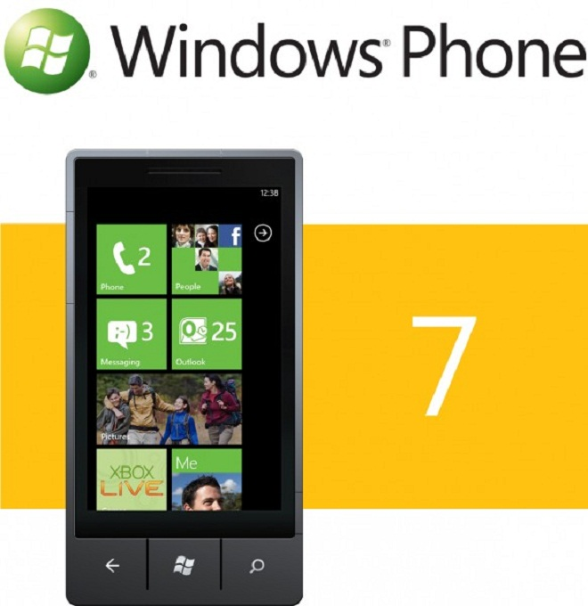
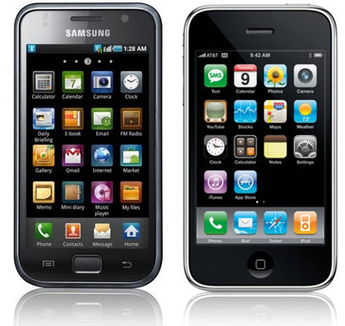

Slide 14
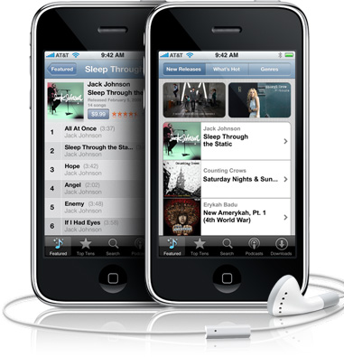
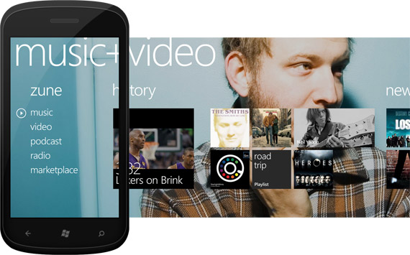

Slide 16
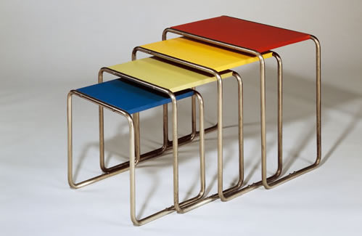

Slide 18
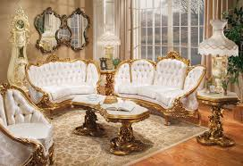

Slide 19
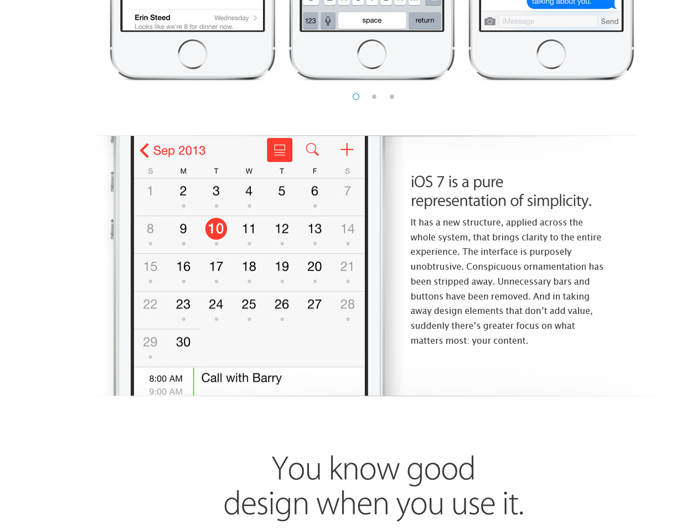

Slide 20
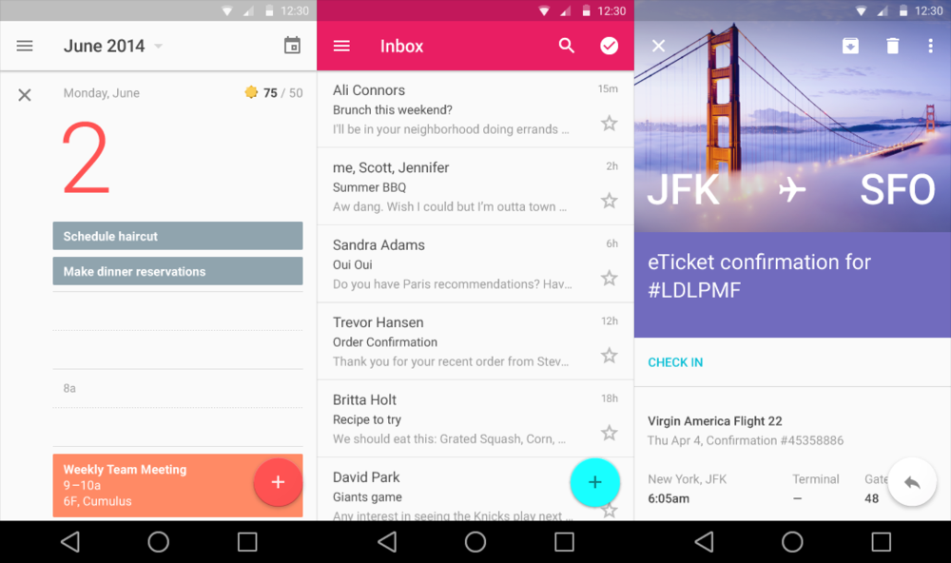

Slide 21
Understanding Consumers

Slide 22
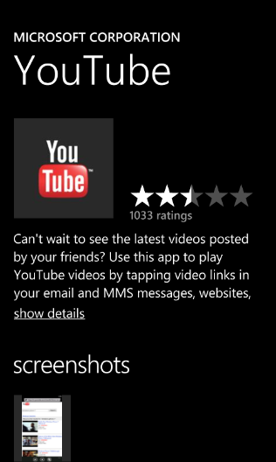
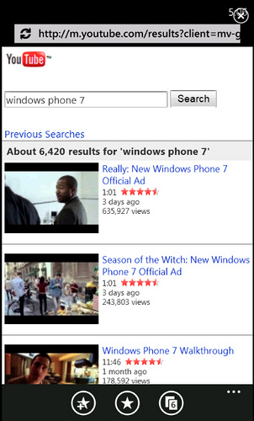
VS

Slide 23
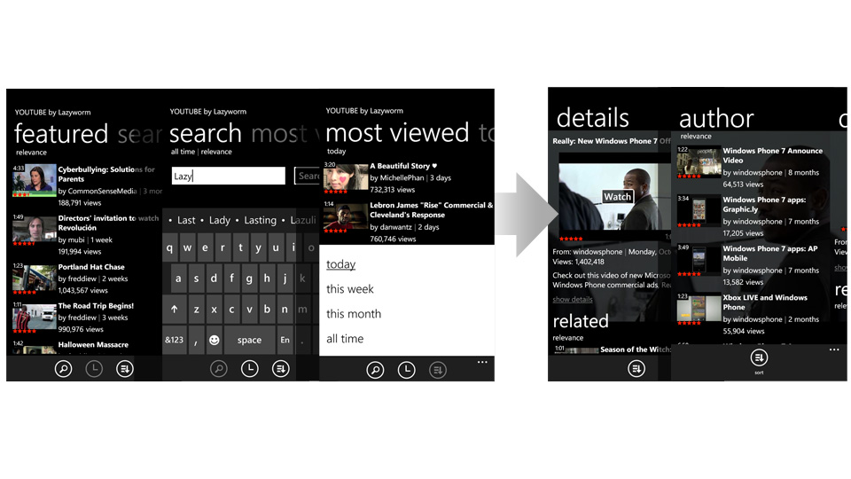
VS
Primary Pivot
Secondary Pivot

Slide 24
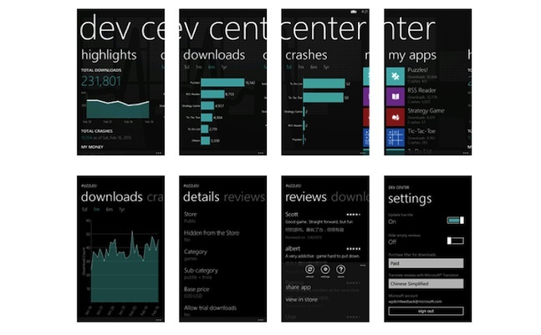

Slide 25
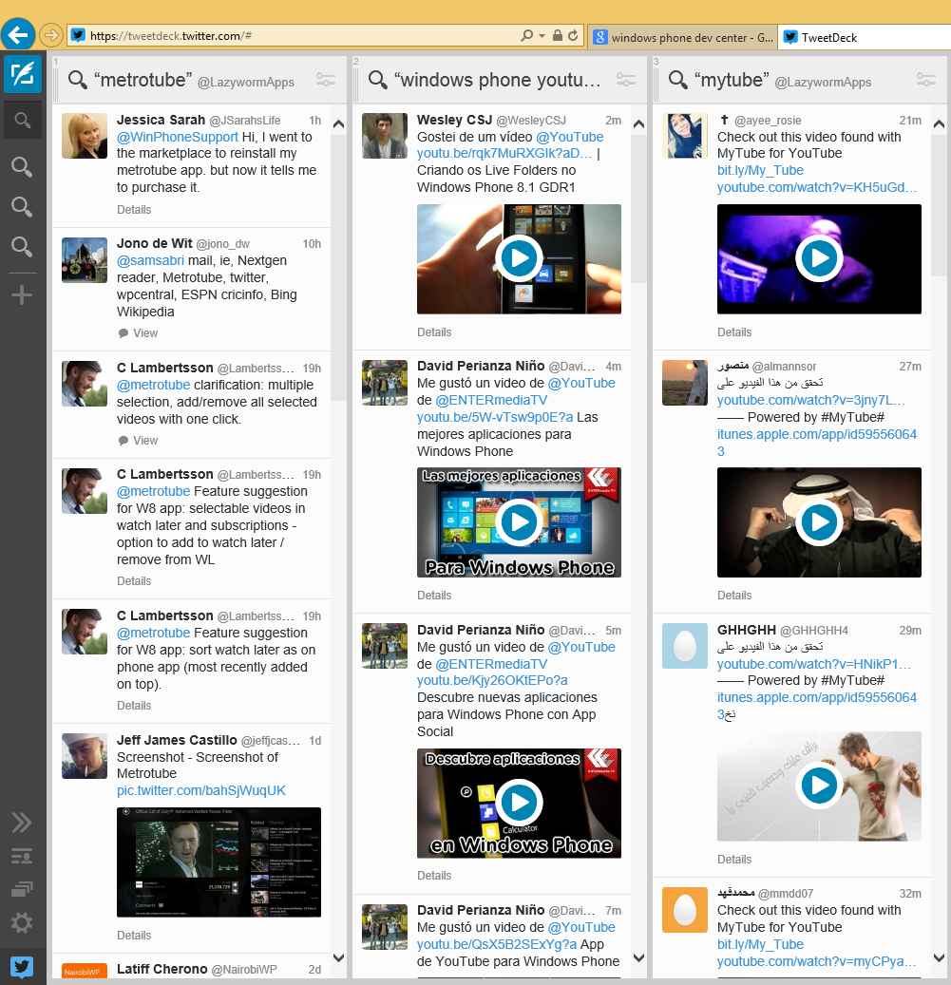

Slide 26
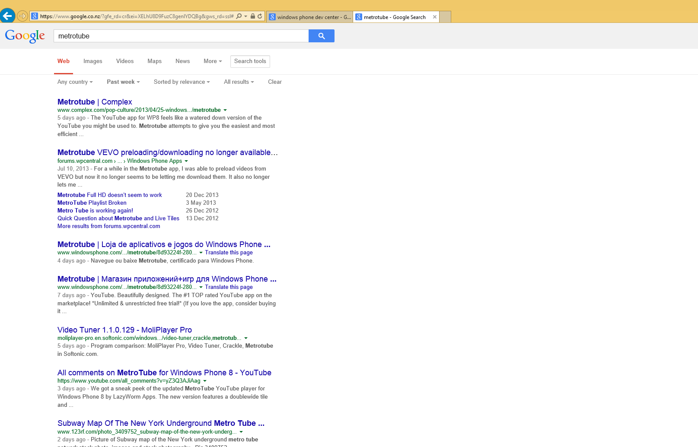

Slide 27
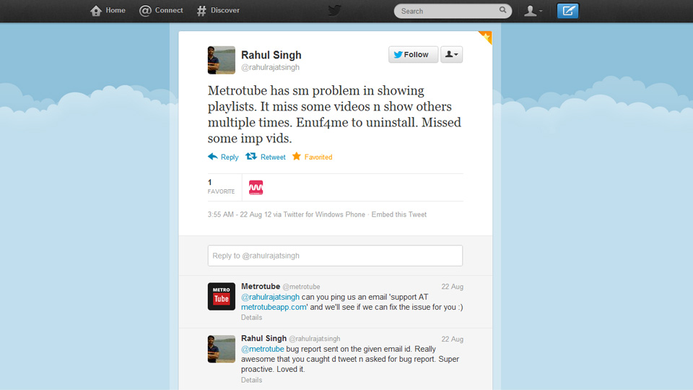

Slide 28
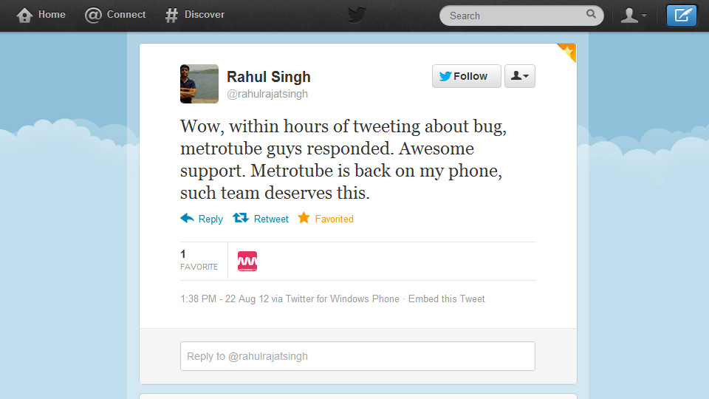

Slide 29
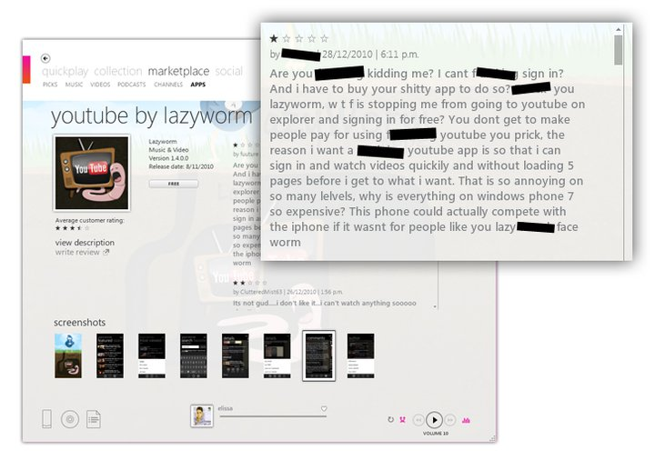

Slide 30
A Lesson in Metro

Slide 31
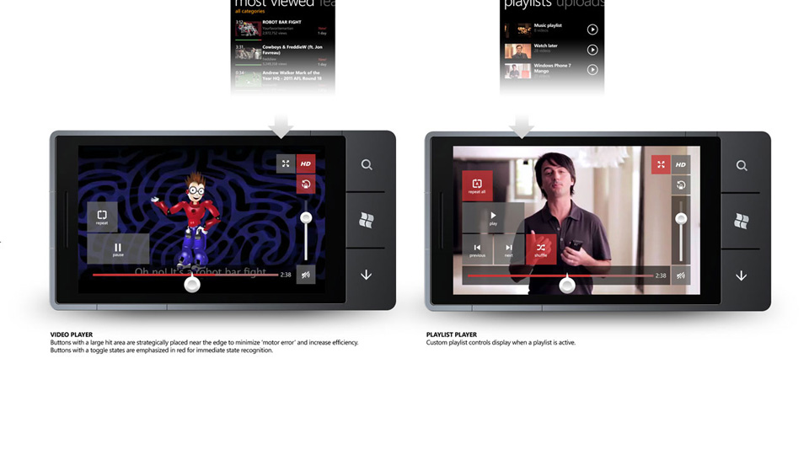

Slide 32
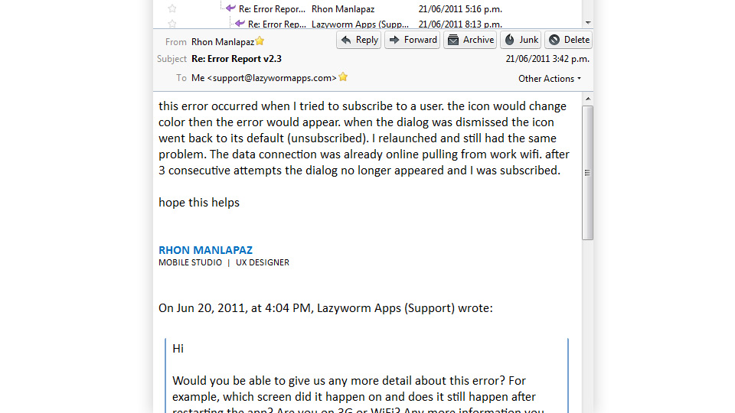

Slide 34
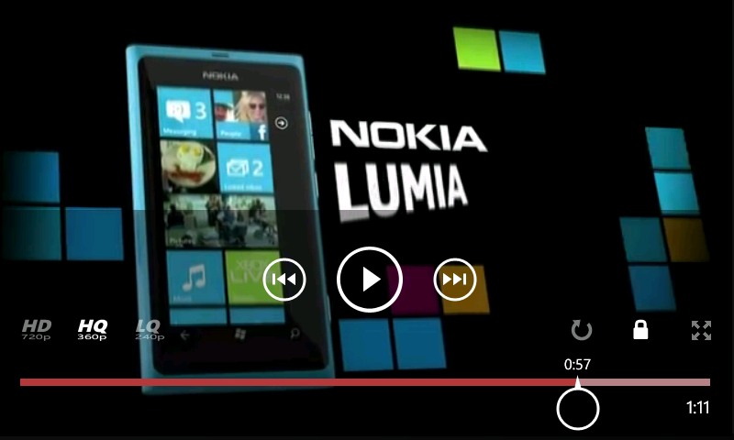
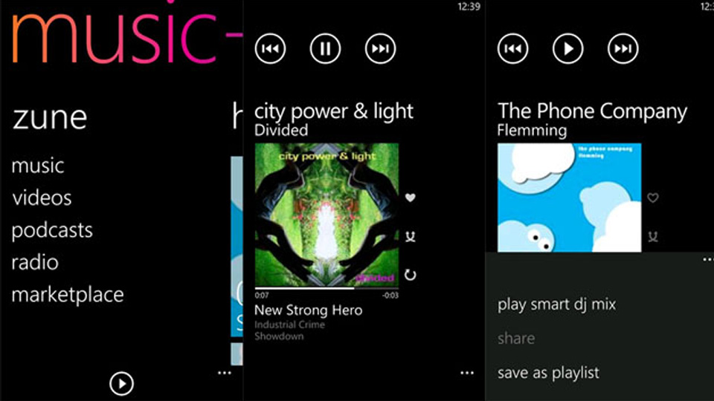

Slide 35
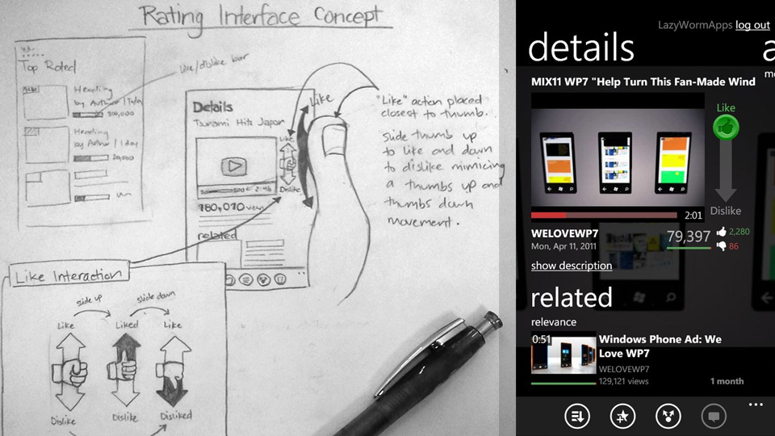

Slide 36
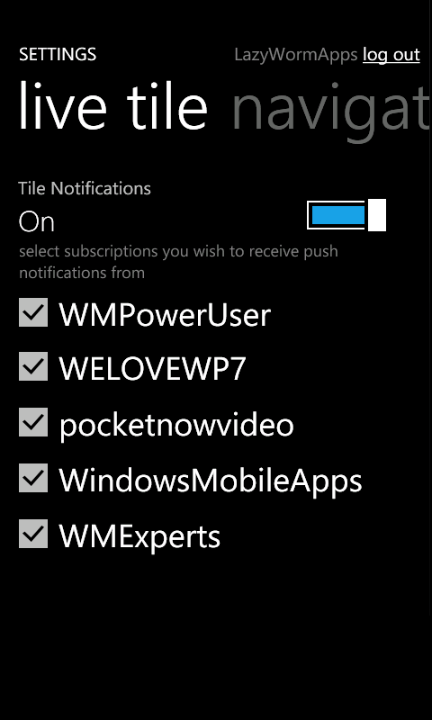

Slide 37
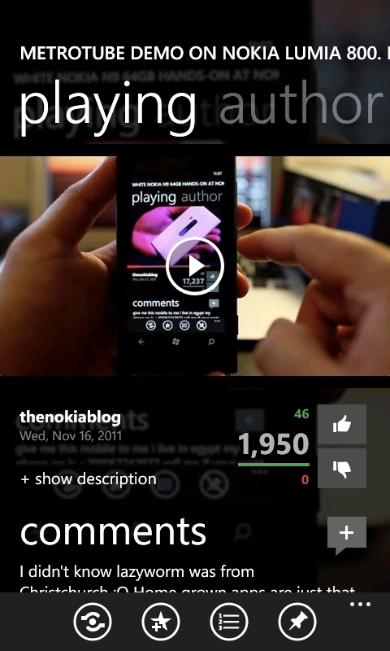

Slide 38
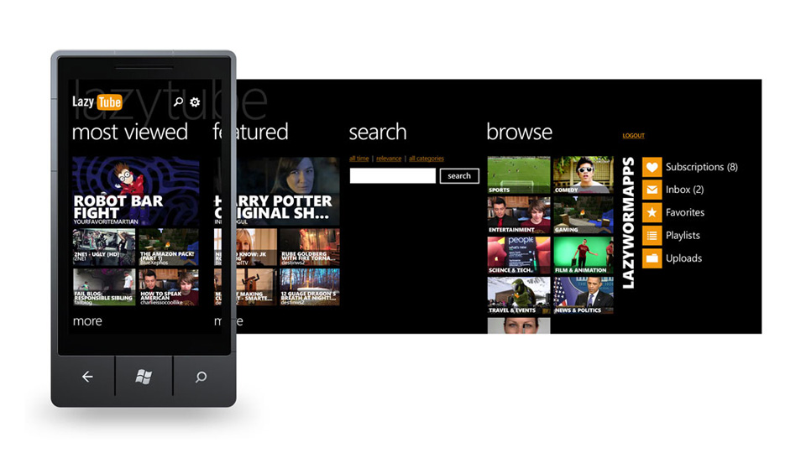

Slide 39
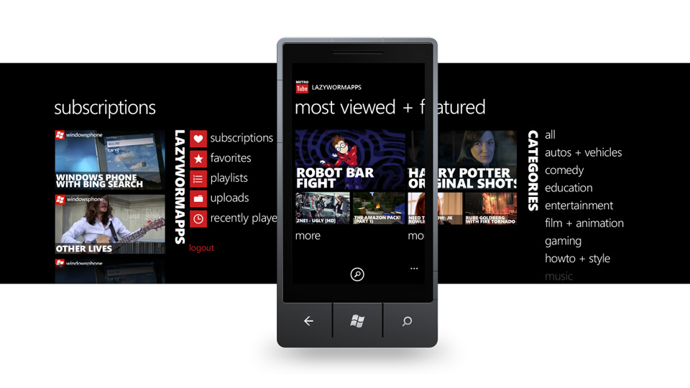

Slide 40
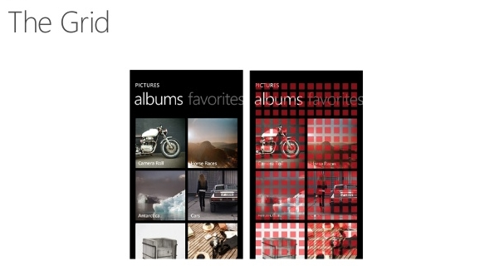

Slide 42
A Lesson in Design Process

Slide 43
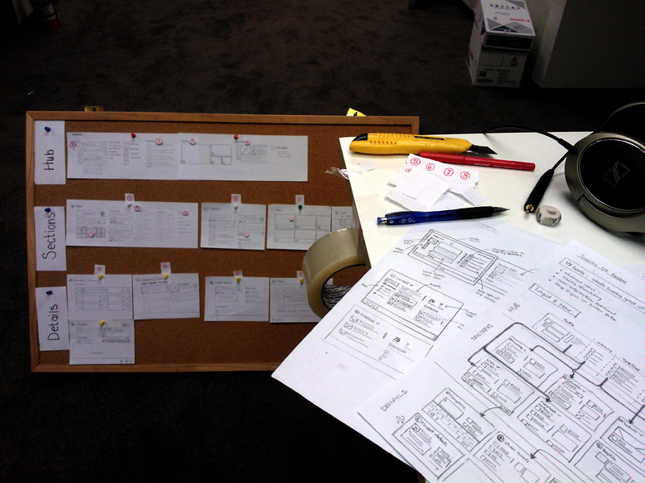

Slide 44
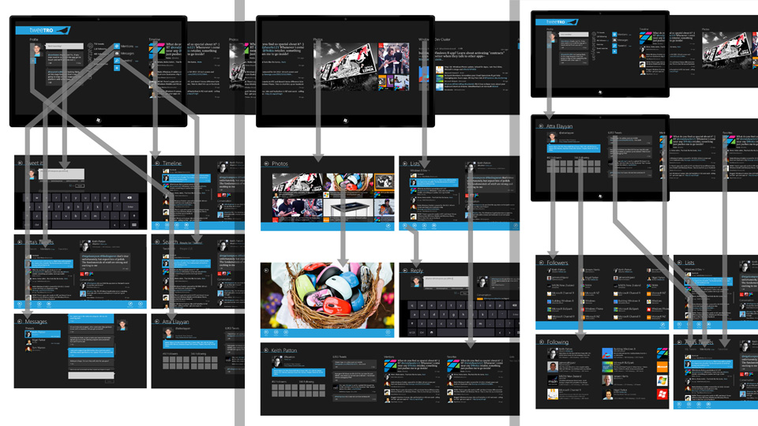

Slide 46
Challenges of a ‘Hybrid’ App

Slide 47
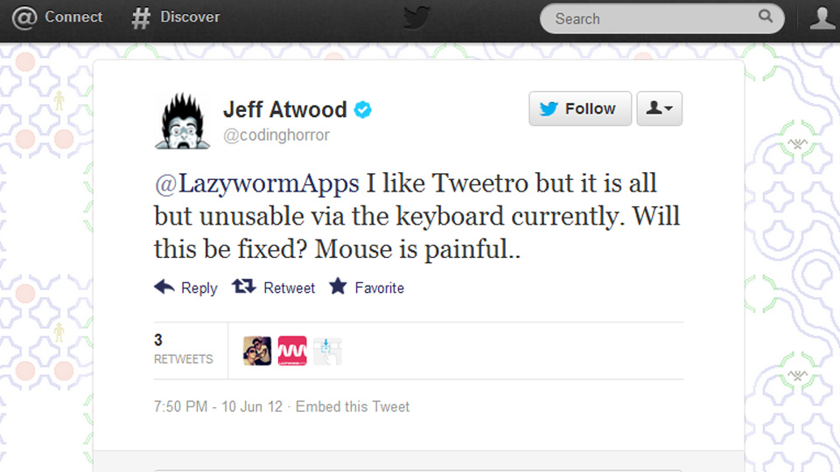

Slide 48
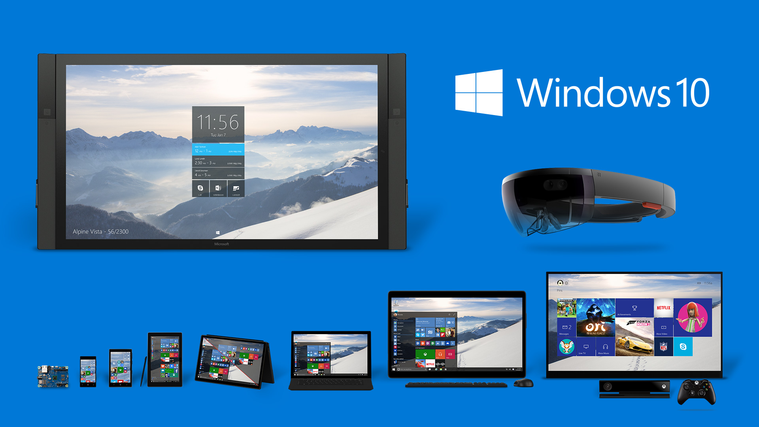

Slide 49
Understanding Clients

Slide 50
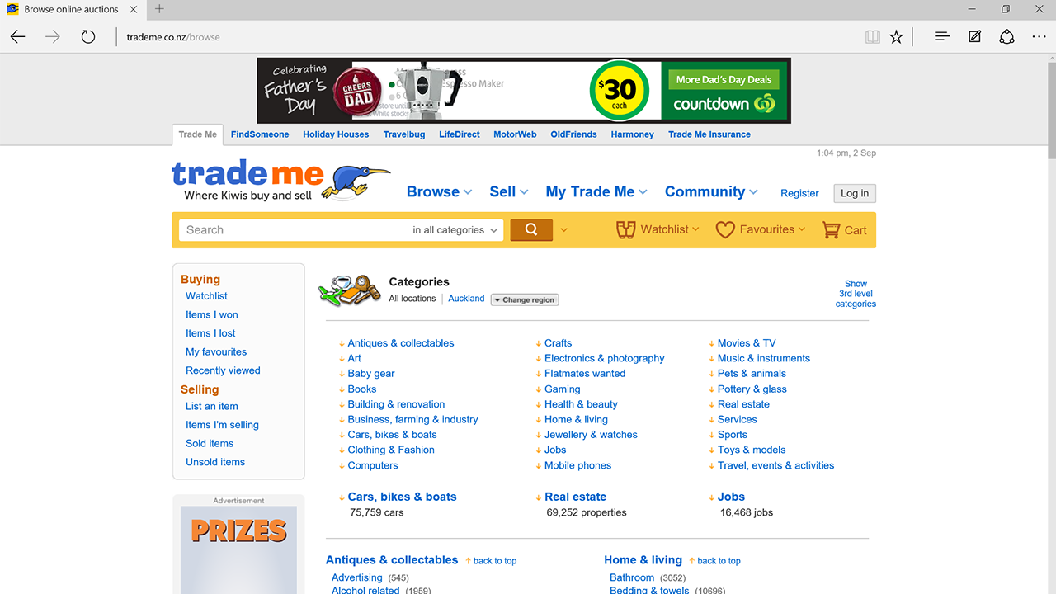

Slide 52
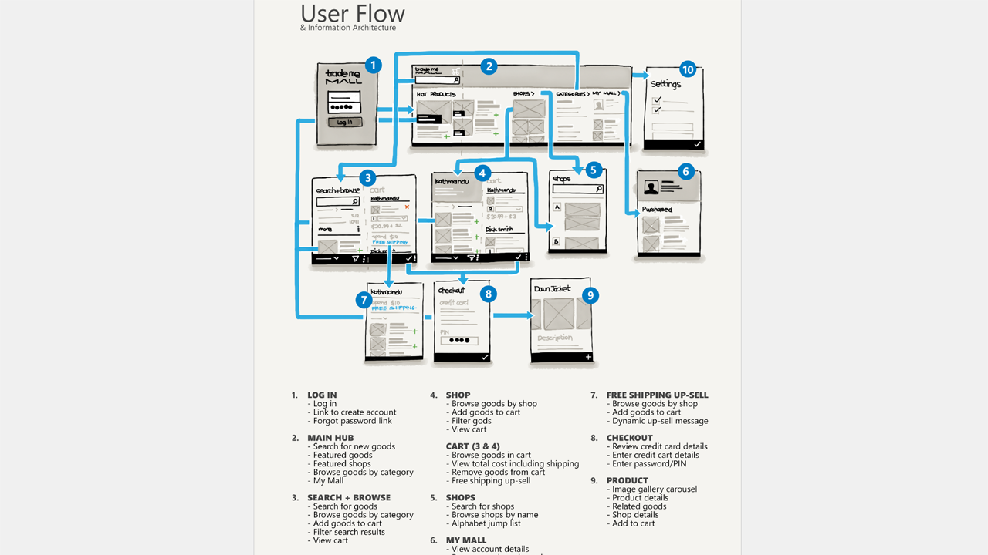

Slide 54
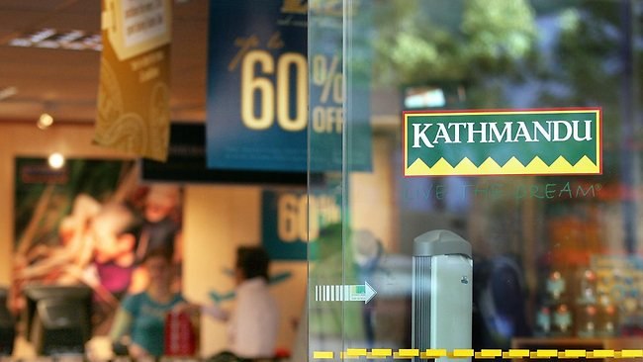

Slide 55
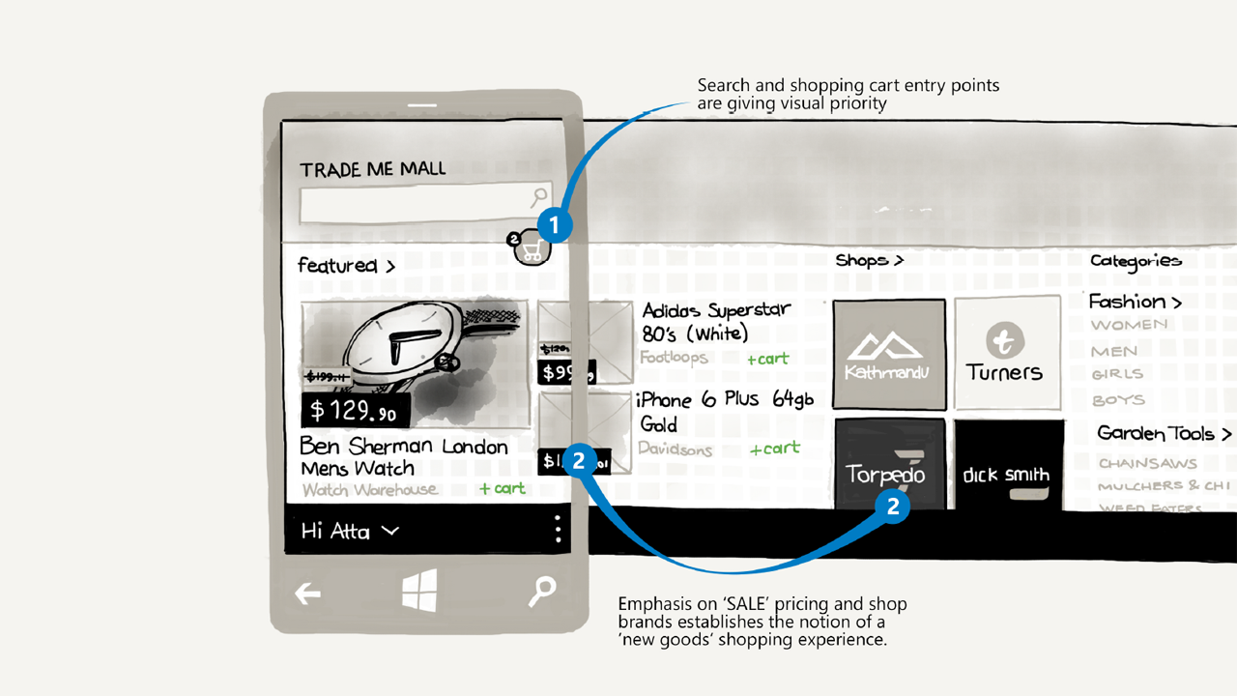

Slide 56
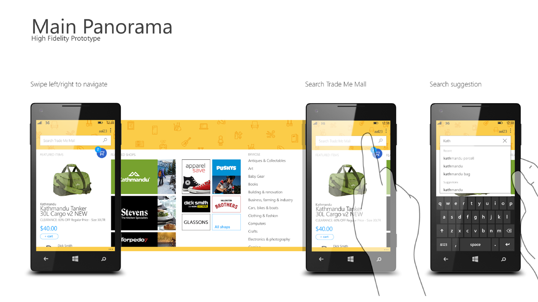

Slide 58
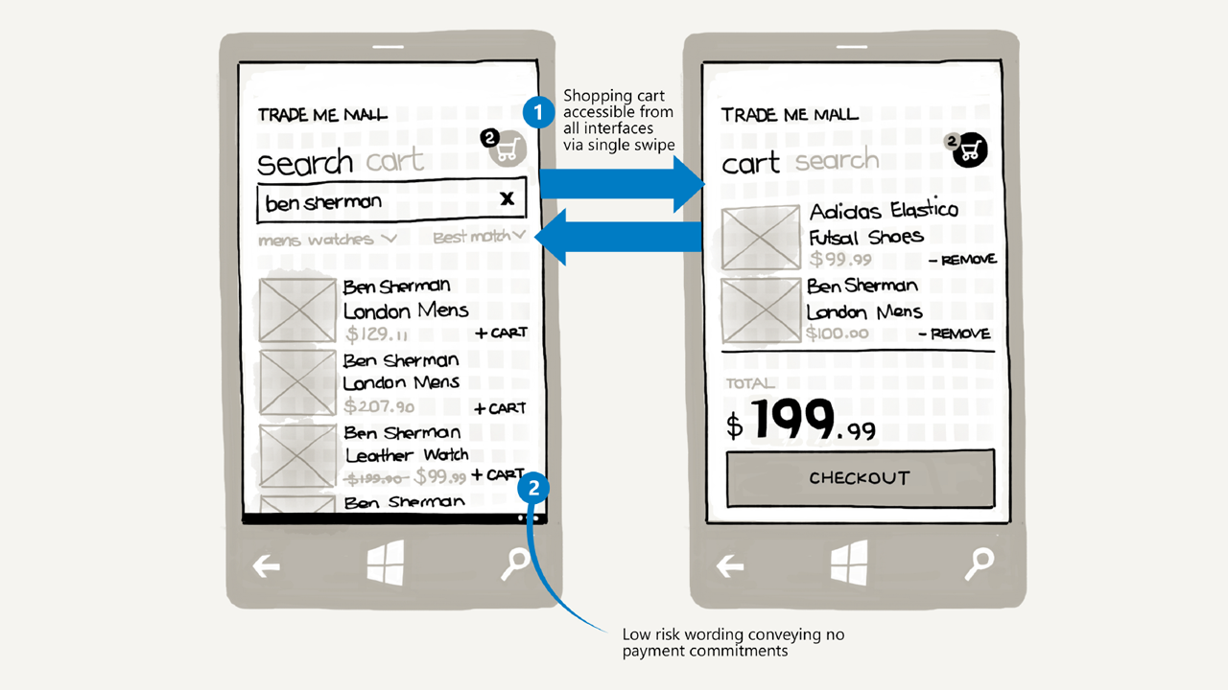

Slide 59
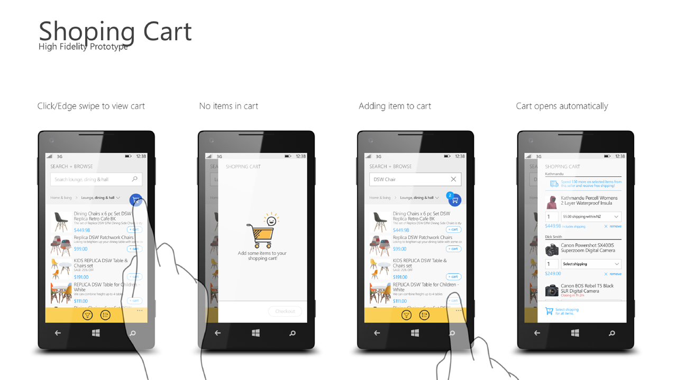

Slide 60
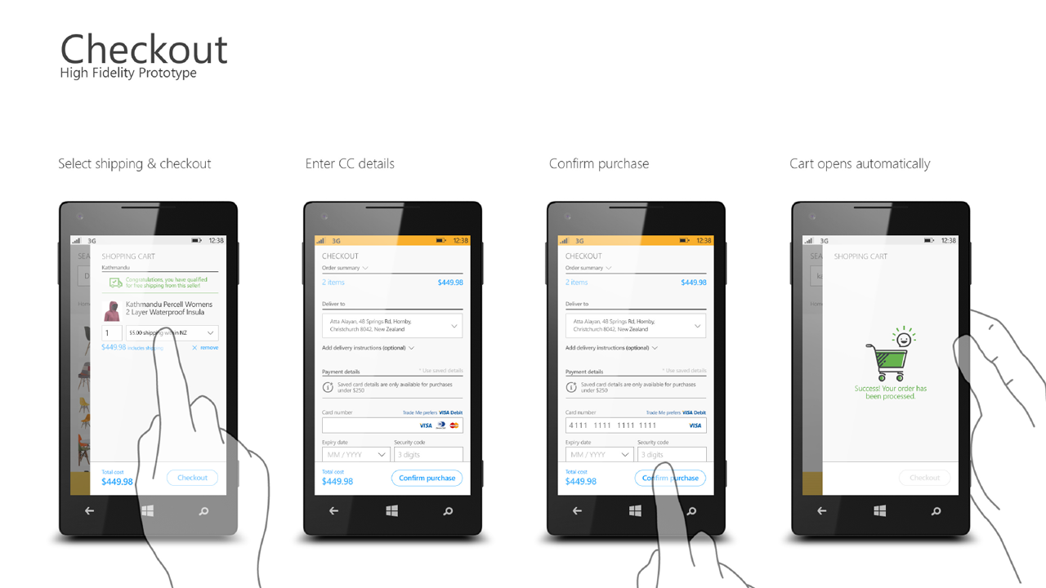

Slide 63
Design process recap

Slide 65
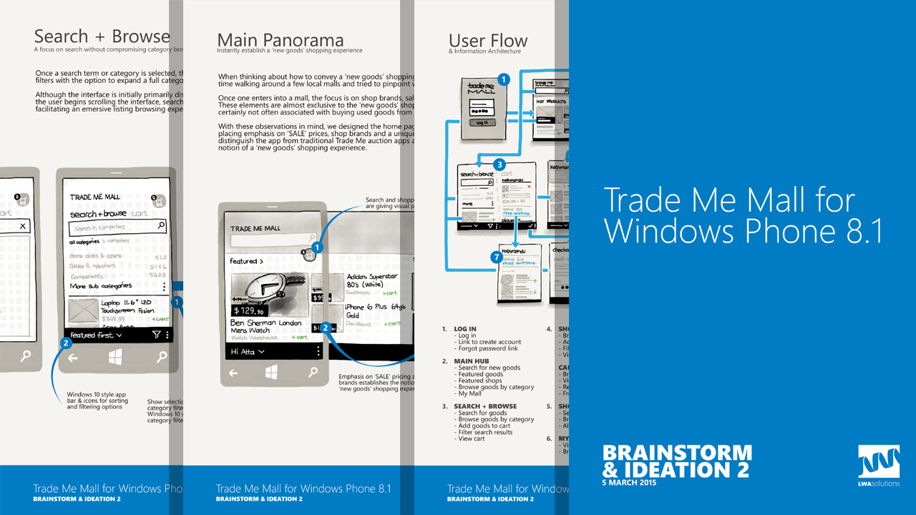

Slide 66
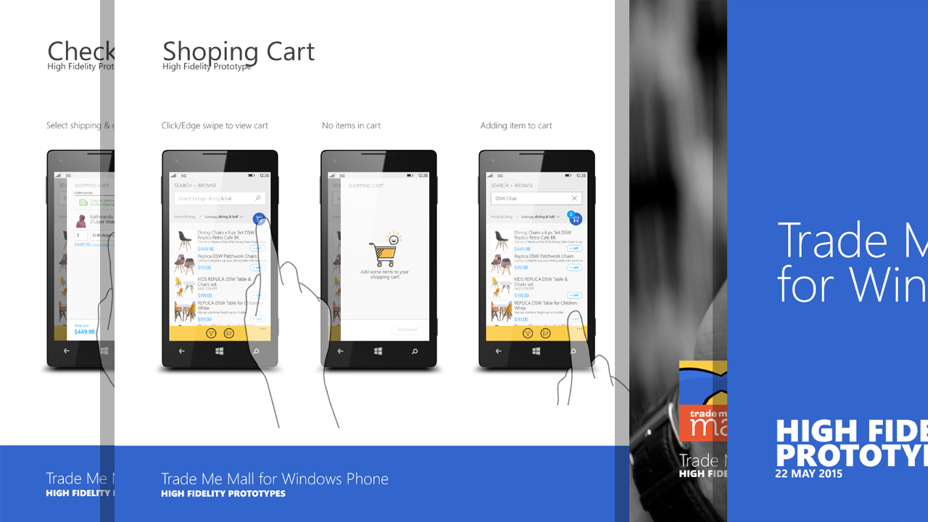

Slide 67
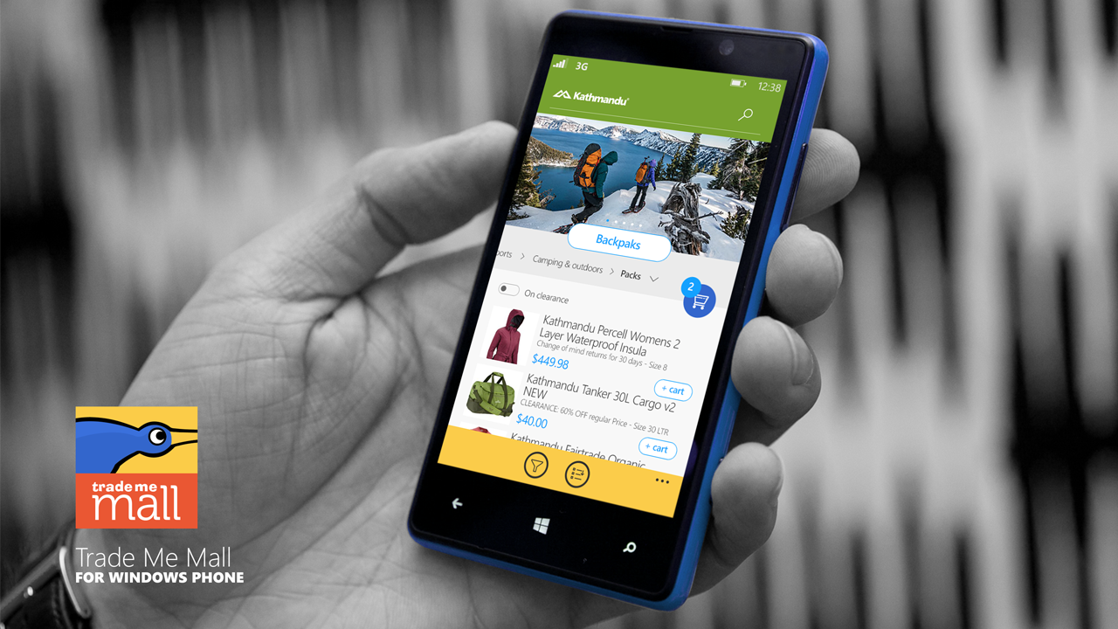

Slide 68
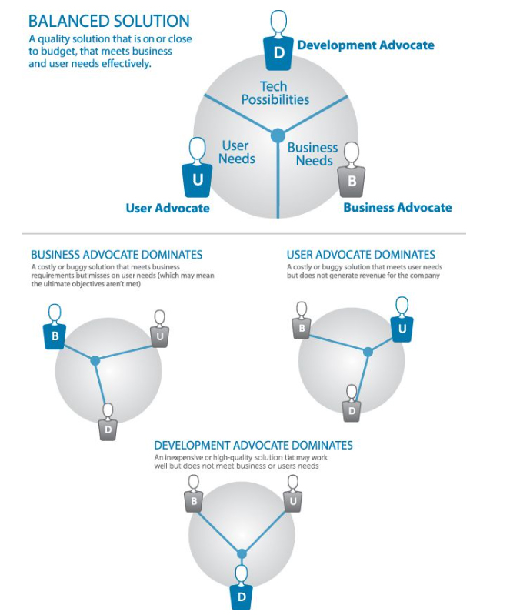

Slide 69
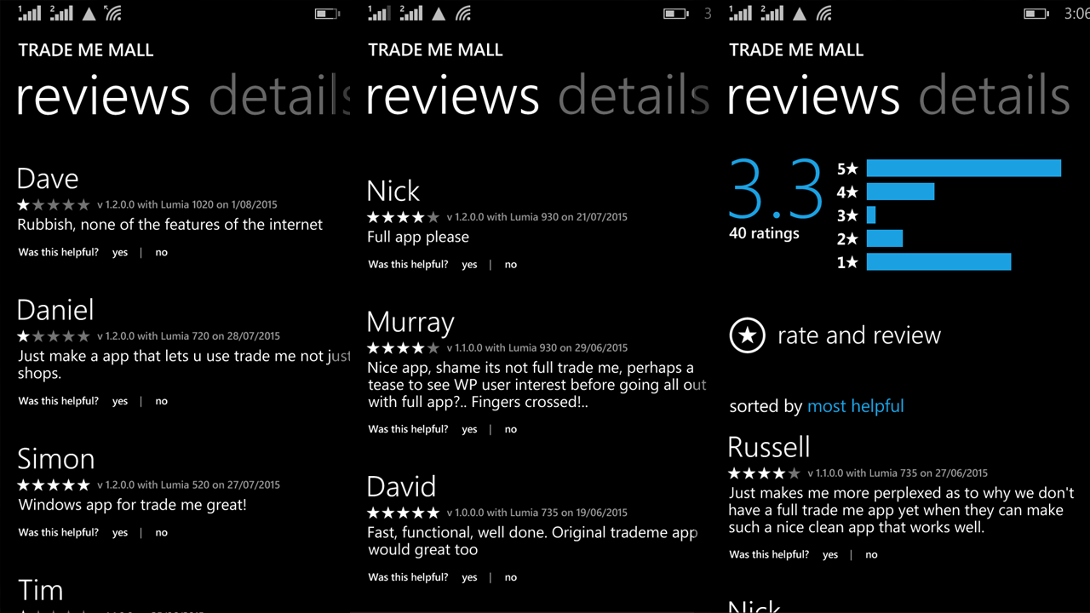

Slide 70
The consumerization of enterprise software

Slide 72
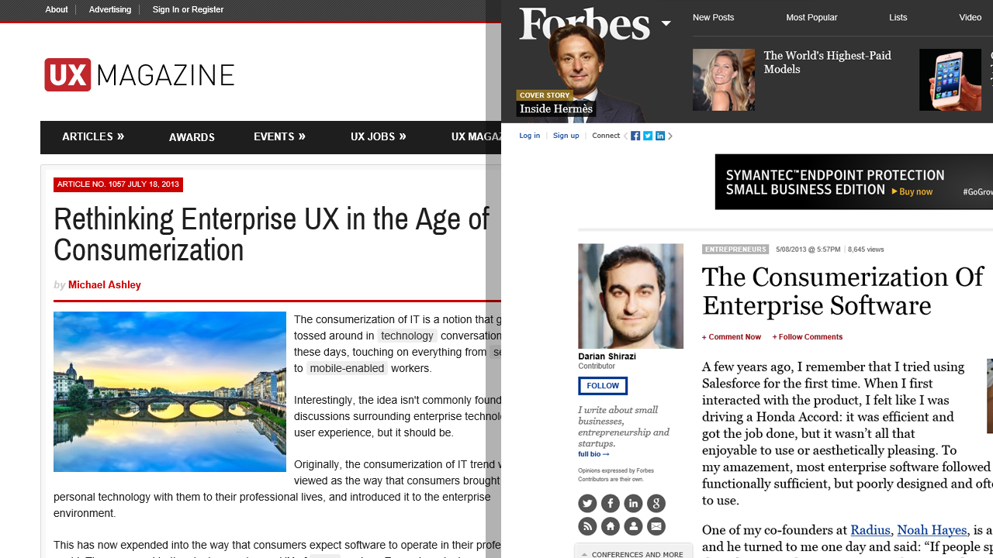

Slide 74
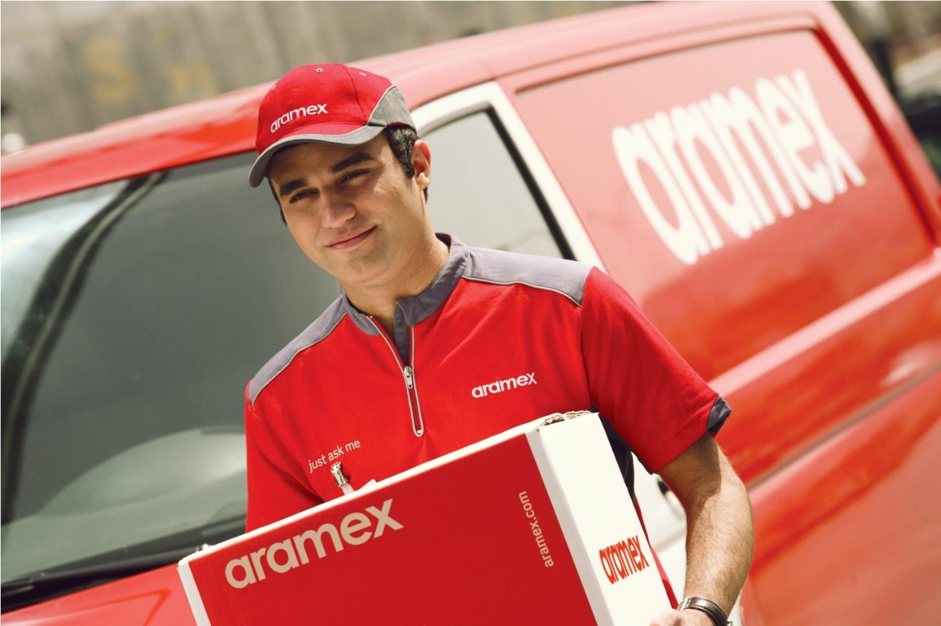

Slide 75
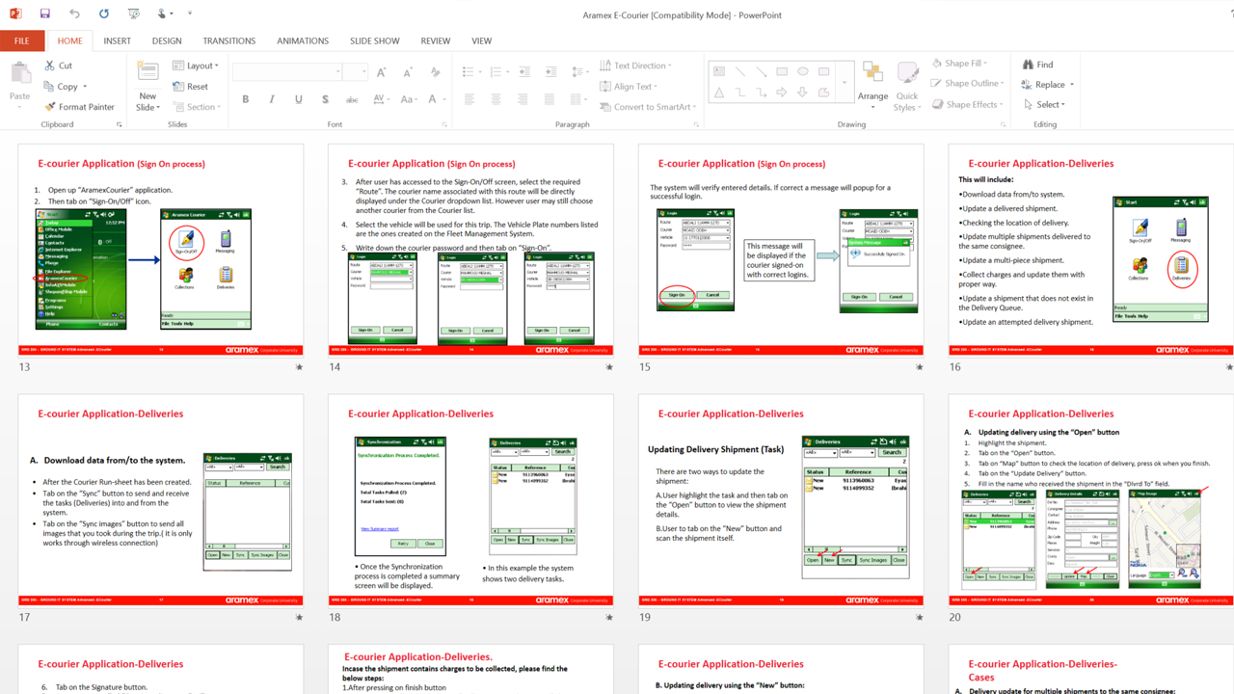

Slide 86
Validating Results

Slide 90
Session Recap

Slide 91
Modern UI design principles
MVP, listening to feedback & rapid iteration
Windows 10 & hybrid app challenge
Design processes & consumerization of enterprise
Solving unfamiliar problems via contextual inquiry
Validating results with UX testing

Slide 92
Related Ignite NZ Sessions
1
Windows 10 Ask Me Anything
Fri 1:55pm
2
The Network Effect of Bad UX
Find me later at…
Closing drinks Fri 3:00-4:30pm
Twitter @attaelayyan
Skype atta.elayyan
Email atta@LWAsolutions.com
3
If your idea is great, your wireframes
Should suck. Startup tips for NZ

Slide 93
Resources
Microsoft Virtual Academy
TechNet & MSDN Flash
Free Online Learning
http://aka.ms/mva
Subscribe to our fortnightly newsletter
http://aka.ms/technetnz http://aka.ms/msdnnz
Sessions on Demand
http://aka.ms/ch9nz

Slide 94
Complete your session evaluation now and be in to win!

