Slide 2
Security in a Container based World
Laura Bell
M255

Slide 4
Modern Architecture Security Series

Slide 5
caution: fast paced field ahead watch for out of date content

Slide 6
containers are here

Slide 7
In this talk
Container Fundamentals
Some important points that are worth refreshing
Prevention
Avoid common vulnerabilities and avoid mistakes
Detection
Prepare for survival and response

Slide 8
Container fundamentals

Slide 9
Language is hard Implication != Meaning

Slide 10
Virtual Machines vs. Containers
virtual
virtual
hypervisor
base processor

Slide 11
Containers do not contain

Slide 12
Until now, container implementations vary

Slide 13
open container initiative https://www.opencontainers.org/

Slide 14
Prevention

Slide 15
Check your privileges

Slide 16
The namespace issue there's no user ID isolation

Slide 17
“A process process running as root (UID 0) in a container has root-level privileges on the underlying host when interacting with the kernel”

Slide 18
Reduce your privileges as soon as possible

Slide 19
Don't run as root this may be easier said than done

Slide 20
Use trusted sources

Slide 21
Only run applications from a trusted source

Slide 22
Free, paid, trusted and private prebuilt containers and apps

Slide 23
Signing helps with trust Signing an image, container or containerised app can help determine its origin.

Slide 24
check decide run

Slide 25
Vulnerability Management and Updates

Slide 26
Patching the stack

Slide 27
Operating system Installed applications Installed services Containerisation software

Slide 28
patch every container instance and associated image

Slide 29
Isolate your containers

Slide 30
container
hypervisor
processor
Protect base operating systems by
using virtual machines

Slide 31
Use an entreprise grade host (and manage it as such)

Slide 32
Reduce your attack surface Minimise on host services to essentials only (ie. ssh + monitoring)

Slide 33
Defense at every layer

Slide 34
Your application is still the most likely attack vector

Slide 35
Detection

Slide 36
Monitoring your environment

Slide 37
Watch your logs like actually, for real, not just when you’re debugging

Slide 38
Monitor every layer
Base operating system
Virtualization layer
Container Orchestration
Application Components
Border Controls

Slide 39
impact of compromise
container compromise
privileged process compromise
host compromise

Slide 40
Seek assurance

Slide 41
Frequently changing architectures require frequent assessment by someone who understands the tech

Slide 42
container/host configuration review
container fuzzing
design review
API and endpoint testing
web application penetration testing

Slide 43
Summary

Slide 44
TL;DR
Container Fundamentals
Some important points that are worth refreshing
Prevention
Avoid common vulnerabilities and avoid mistakes
Detection
Prepare for survival and response

Slide 45
Prevention
Check your privilege
Principle of least privilege at all stages
Use trusted sources
Not all container images are equal
Vulnerability management and updates
Prepare for survival and response
Isolate your containers
Principle of least privilege at all stages
Layer your defenses
Principle of least privilege at all stages

Slide 46
Detection
Monitoring and Logging
Log and monitor all layers of your deployment architecture
Seek Assurance
Get appropriate penetration testing of both application and infrastructure components

Slide 47
Links and Resources
Container Security Cheat sheet
http://container-solutions.com/content/uploads/2015/06/15.06.15_DockerCheatSheet_A2.pdf
Docker Security Benchmark Tool
https://github.com/docker/docker-bench-security

Slide 48
Related Ignite NZ Sessions
1
Securing Microservice Architectures
Thursday 10:40am
5
6
2
3
Find me later at…
Hub Happy Hour Wed 5:30-6:30pm
Hub Happy Hour Thu 5:30-6:30pm
Closing drinks Fri 3:00-4:30pm
4

Slide 49
Resources
Microsoft Virtual Academy
TechNet & MSDN Flash
Free Online Learning
http://aka.ms/mva
Subscribe to our fortnightly newsletter
http://aka.ms/technetnz http://aka.ms/msdnnz
Sessions on Demand
http://aka.ms/ch9nz

Slide 50
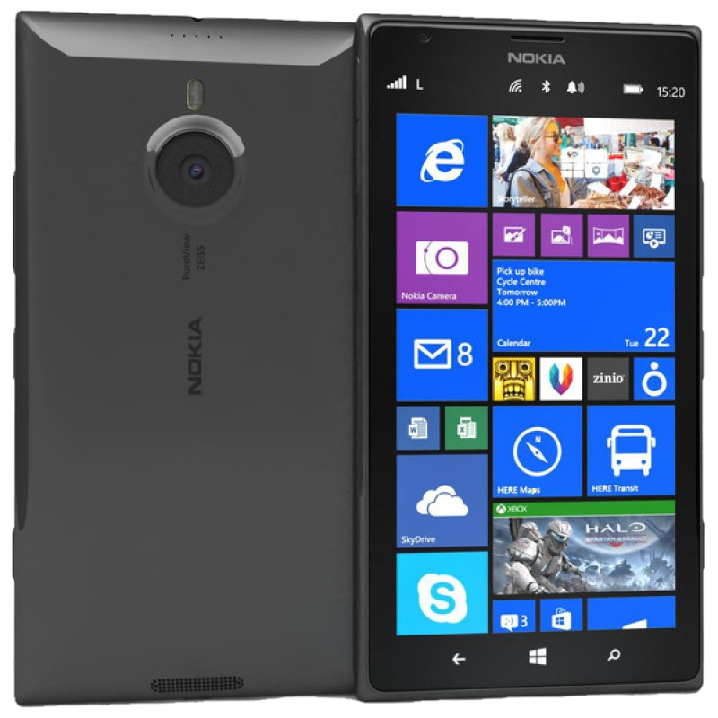
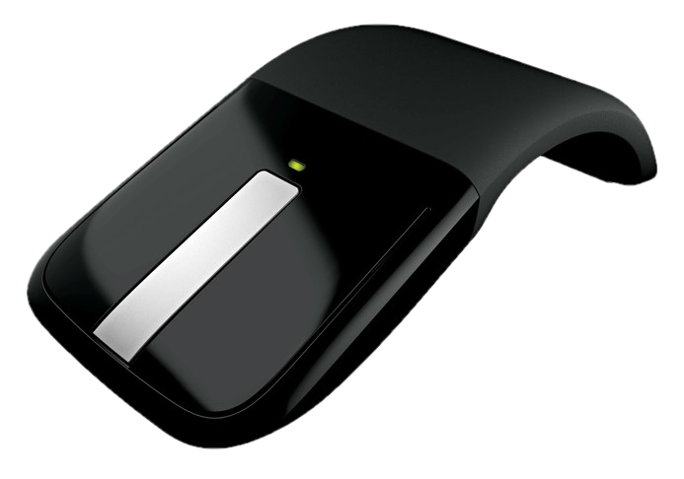
Complete your session evaluation now and be in to win!

