Slide 1
Universal Apps: A Developers Guide
Keith Patton – Marker Metro
M257

Slide 2
Agenda
A single platform
One Windows
Many devices
Developer experience
Windows tooling
.Net Native

Slide 3

Introducing the UWP

Slide 4
Windows Core
The refactored common core
One hardware platform
Universal hardware driver
Standard network and I/O
Desktop
SKU
Phone
SKU
Xbox
SKU
Windows Core
Desktop
Device
Phone
Device
Xbox
Device

Slide 5
One Windows
Desktop
SKU
Mobile
SKU
Xbox
SKU
IoT
SKU
IoT headless
SKU
Surface Hub
SKU
Holographic
SKU
PC
2 in 1
Tablet
Phablet
Phone
Xbox
Band
Raspberry Pi
Surface Hub
HoloLens
Home Automation

Slide 6
Each family adds features to the one it inherits

Slide 7

The convergence journey
Xbox 360
Xbox One
Unified core
and app platform
Converged
OS kernel
Windows 8.1
Windows 8
Converged
app model
Windows 10
Windows Phone 8.1
Windows Phone 8
Easy for users to get & stay current
Windows Phone 7.5
Windows on Devices

Slide 8
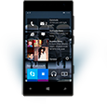
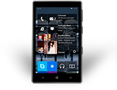
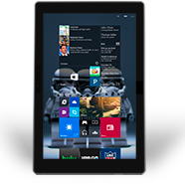
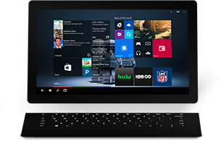
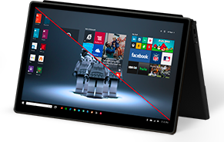
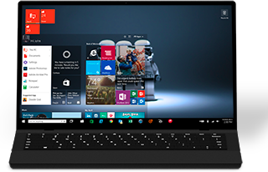
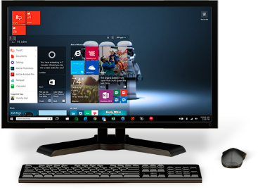
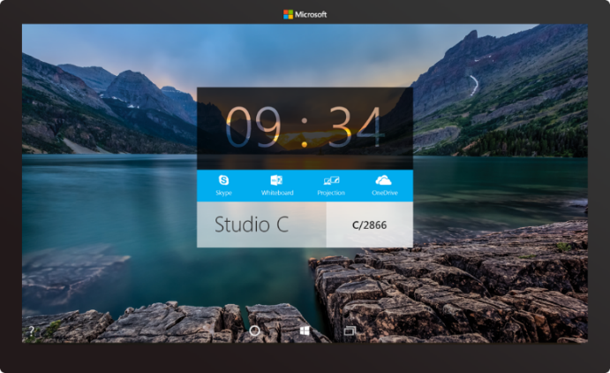

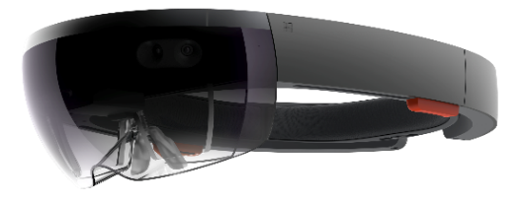

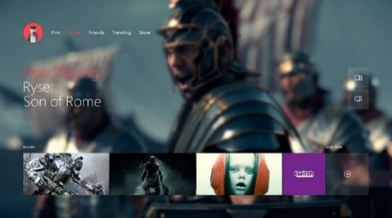

2-in-1s
(Tablet or Laptop)
Classic
Laptop
Desktops
& All-in-Ones
Phone
Phablet
Small Tablet
Large Tablet
Windows 10
Surface Hub
Xbox
Holographic
IoT

Slide 9
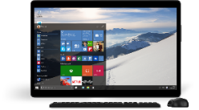
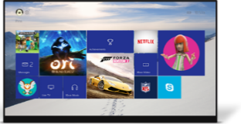
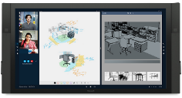
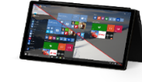

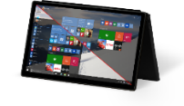

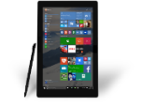












PC
XBox
Mobile
Surface Hub
Devices +IoT
HoloLens
Universal Windows Apps
Multiple device families
Adaptive
User Interface
Reuse Existing Code
Natural
User Inputs
One Store +
One Dev Center
One SDK + Tooling
One Universal Windows Platform

Slide 10
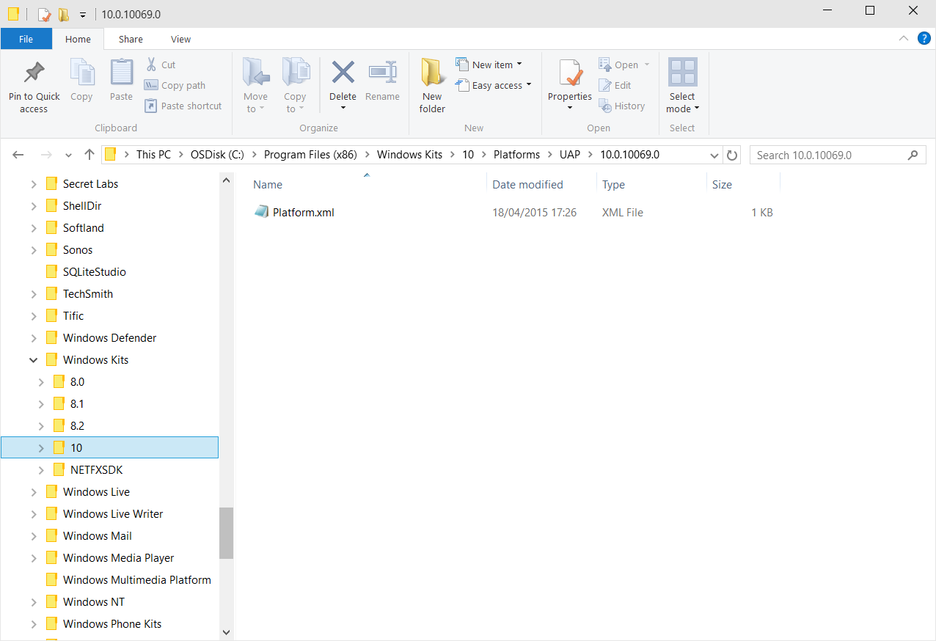
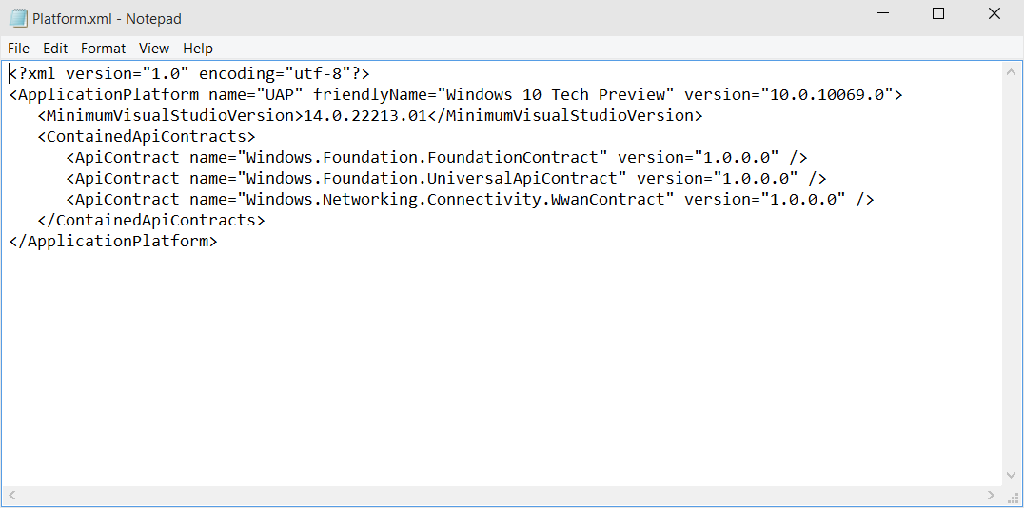
Universal Windows Platform
A single API surface
A guaranteed API surface
The same on all devices
Universal Windows Platform
Windows Core
Desktop
Device
Phone
Device
Xbox
Device

Slide 11
Apps don't target Windows 10, apps target the platform

Slide 12
<TargetDeviceFamily
Name="Windows.Universal"
MinVersion="10.0.10240.0"
MaxVersionTested="10.0.10240.0"/>

Slide 13
The Universal Windows Platform can update at its own cadence

Slide 14
Windows 8.1 Universal Apps
A Recap….

Slide 15
Windows 8.1 Universal:
Shared code, two binaries
Windows
Binary
Phone
Binary

Slide 16
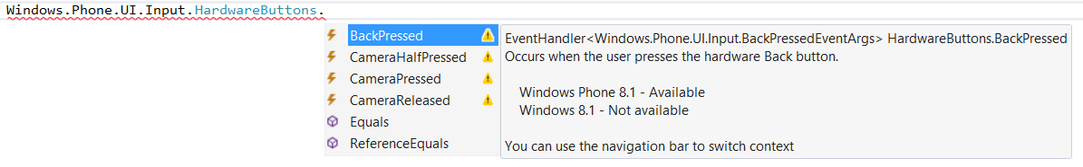
Not all APIs were available everywhere

Slide 17
Compilation directives
C# Syntax
#if WINDOWS_PHONE_APP Windows.Phone.UI.Input.HardwareButtons
.BackPressed += this.HardwareButtons_BackPressed;
#endif
C++ Syntax
#if WINAPI_FAMILY==WINAPI_FAMILY_PHONE_APP _backPressedEventToken = HardwareButtons
::BackPressed += ref new EventHandler <BackPressedEventArgs^> (this,
&NavigationHelper::HardwareButton_BackPressed);
#endif

Slide 18
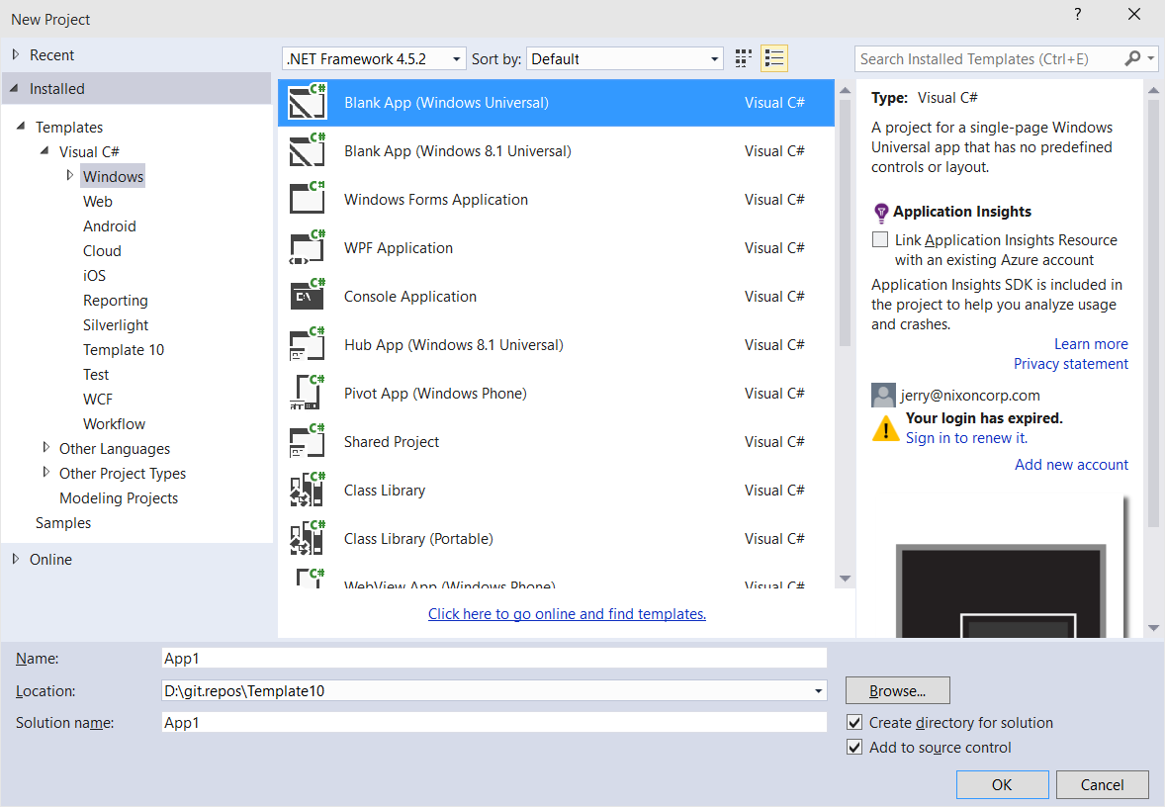
Windows Apps – Windows 10
A single binary
  Running on any device
  Testing for capabilities
  Adjusting to devices
Windows App
Universal Windows Platform
Windows Core
Desktop
Device
Phone
Device
Xbox
Device

Slide 19
Universal Apps
A Quick Overview
DEMO

Slide 20
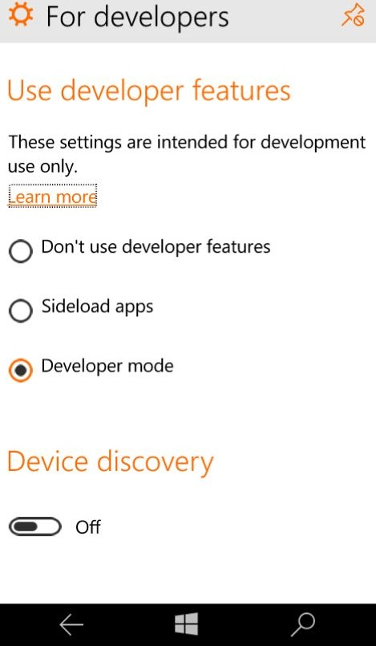
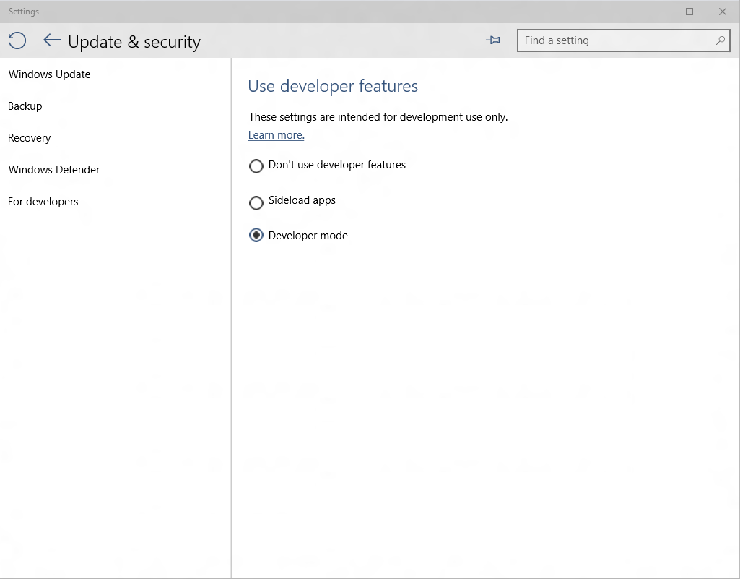
Developer unlock

Slide 21
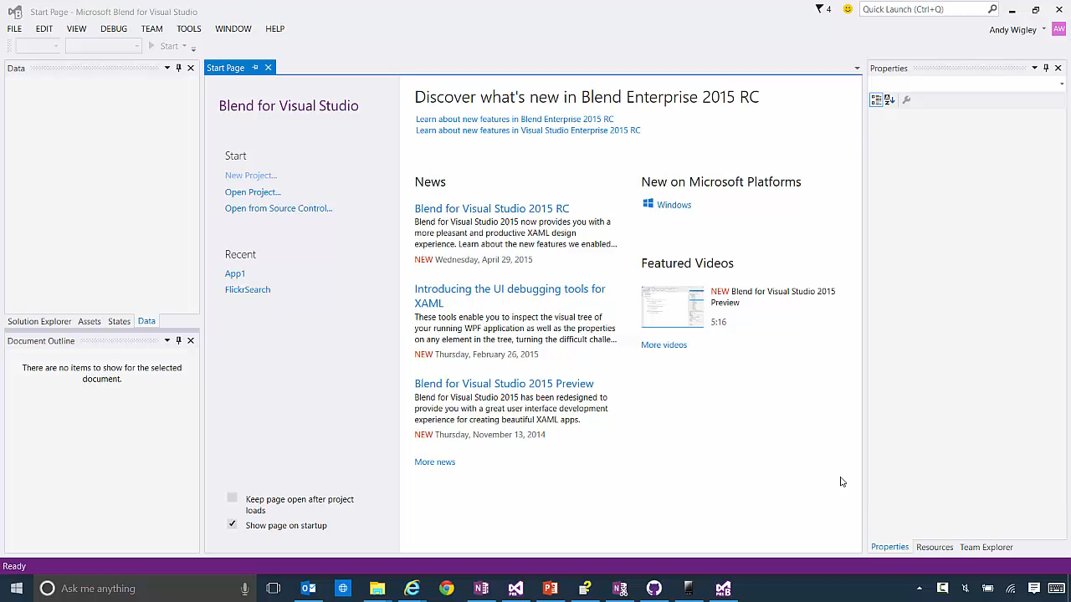

Slide 22
Introducing Platform
Extension SDKs

Slide 23
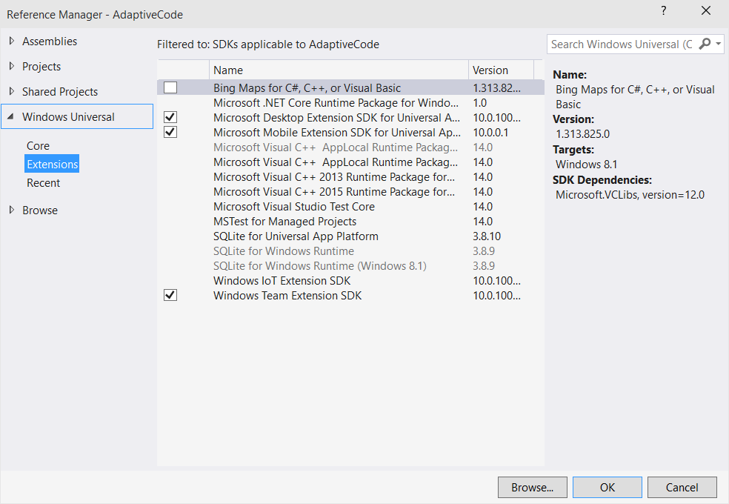
Platform extensions
Device-specific API
  Family-specific capabilities
  Compatible across devices
  Unique update cadence
Windows App
Desktop
extension
Phone
extension
Xbox
extension
Universal Windows Platform
Windows Core
Desktop
Device
Phone
Device
Xbox
Device

Slide 24
Extensions don't invalidate binaries on other devices

Slide 25
Adaptive code
A compatible binary across devices
  Universal API with device-specific implementation
Light up our app with capabilities
  Testing for capabilities and namespaces

Slide 26
Extensions & Adapative Code
Windows Mobile
DEMO

Slide 27
Test capabilities at runtime
Use Adaptive Code to light-up
your app on specific devices
      var api = "Windows.Phone.UI.Input.HardwareButtons";
      if (Windows.Foundation.Metadata.ApiInformation.IsTypePresent(api))
      {
        Windows.Phone.UI.Input.HardwareButtons.CameraPressed
        += CameraButtonPressed;
        }

Slide 28
Testing for capabilities
Windows.Foundation.Metadata.ApiInformation
IsApiContractPresent
IsEnumNamedValuePresent
IsEventPresent
IsMethodPresent
IsPropertyPresent
IsReadOnlyPropertyPresent
IsTypePresent
IsWriteablePropertyPresent

Slide 29
The ApiInformation API tests for capabilities at runtime.

Slide 30
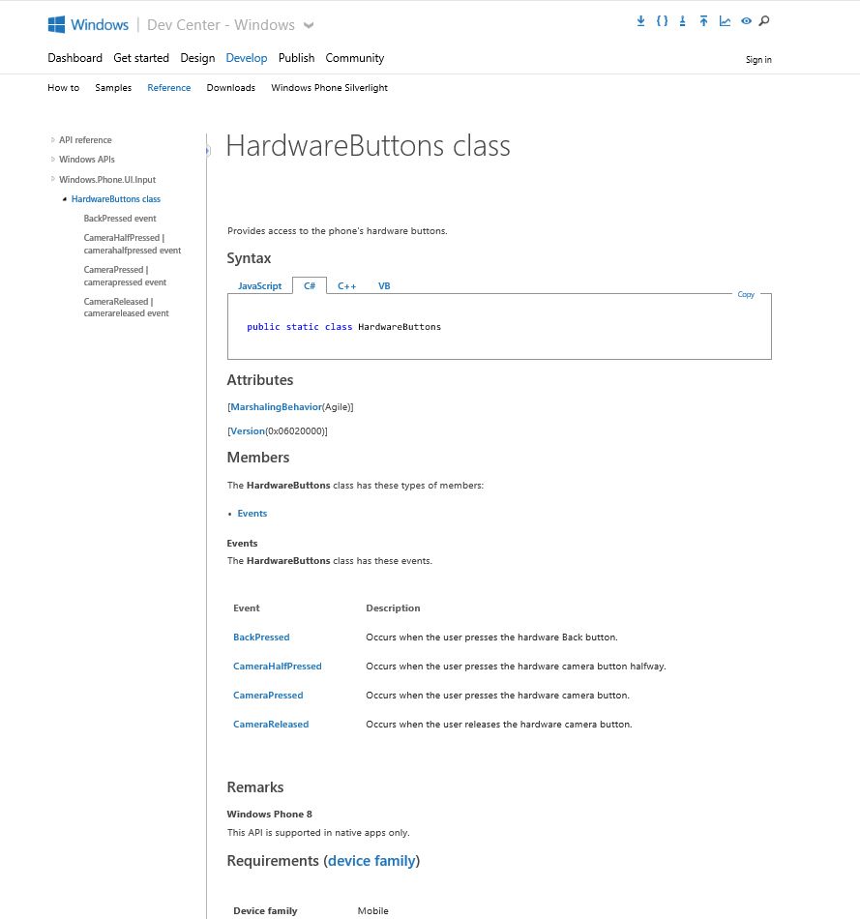
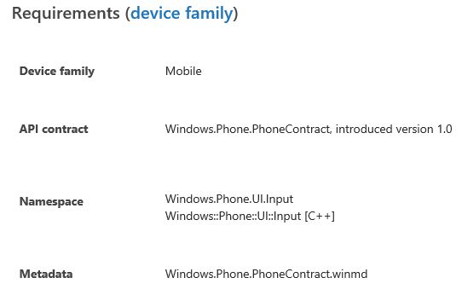
Identifying the Extension SDK
MSDN docs:

Slide 31
Adaptive code techniques can go beyond device family

Slide 32
Using Specific Versions of an API
Write your app against a base UWP version, but 6 months later, UWP v.Next ships to users machines
  plies to Extension SDKs and Packages as well – new versions may offer new functionality
You wish to support customers who haven’t updated yet, but take advantage of up-level APIs for those who have.

Slide 33
Gate use of up-level APIs
      var contract = "Devices.Scanners.ScannerDeviceContract";
      int majorVersionRequired = 3;
      if (Windows.Foundation.Metadata.ApiInformation.
      IsApiContractPresent(contract, majorVersionRequired ))
      {
        // Call the API that is present in V3 and above
        ...
        }
        else
        {
        // Your original code supporting users who haven’t upgraded yet
        ...
        }

Slide 34
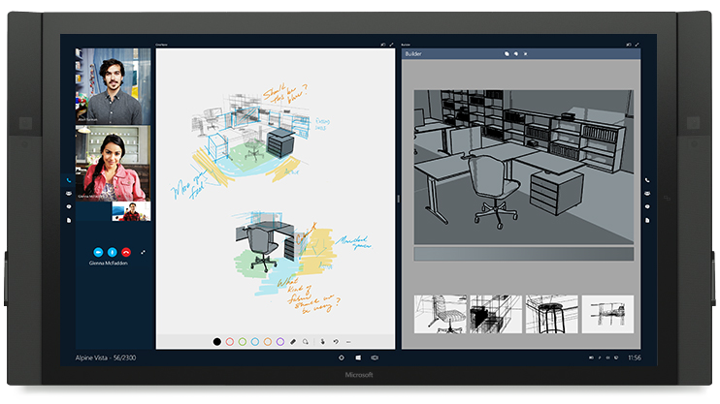
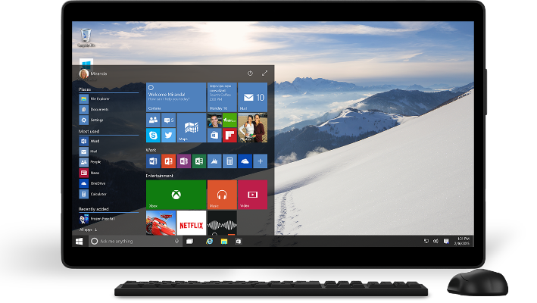
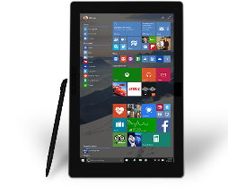

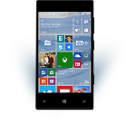
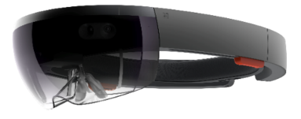
Universal Windows Platform
One Operating System
  One Windows core for all devices
One App Platform
  Apps run across every family
One Dev Center
  Single submission flow and dashboard
One Store
  Global reach, local monetization
  Consumers, Business & Education

Slide 35
Traditional Microsoft technologies are not the only way to create Windows apps

Slide 36
WPF
WF
MFC
XAML
HTML
Bridging technologies
Obj.C
iOS
Java
Android
Web
hosted
Win32
desktop
DirectX
.Net
languages
C++
.Net
languages
C++
& CX
WWA
.Net
runtime
Universal Windows Platform
Windows 10
operating system

Slide 37
Let’s talk about bridge technologies
Objective-C
  At Build we announced iOS code can be reused in a Windows app
  https://github.com/Microsoft/WinObjC/
Android
  At Build we announced Android code can be reused in a Windows app to run on Windows Phone
Web
  At Build we announced web sites can be wrapped to run on Windows
Win32
  At Build we announced that Classic Windows Apps (CWA) can be packaged as an Appx

Slide 38
Bridges bring more apps to the Windows platform
Hannes Nel
Bridges to the Magickal Faerie Land of Windows 10 [M263]
Friday, 10:40 AM NZ4

Slide 39
Adaptive design
Responsive design (Less Effort)
  Flexible layout responds to small changes
  Many controls handle basic responsiveness
Adaptive design (More Effort)
  Smart layout adjusts to large changes
  Features like visual states aid in this design
Tailored design (Most Effort)
  A device-specific app can simplify design
  Some devices have unique design languages

Slide 40
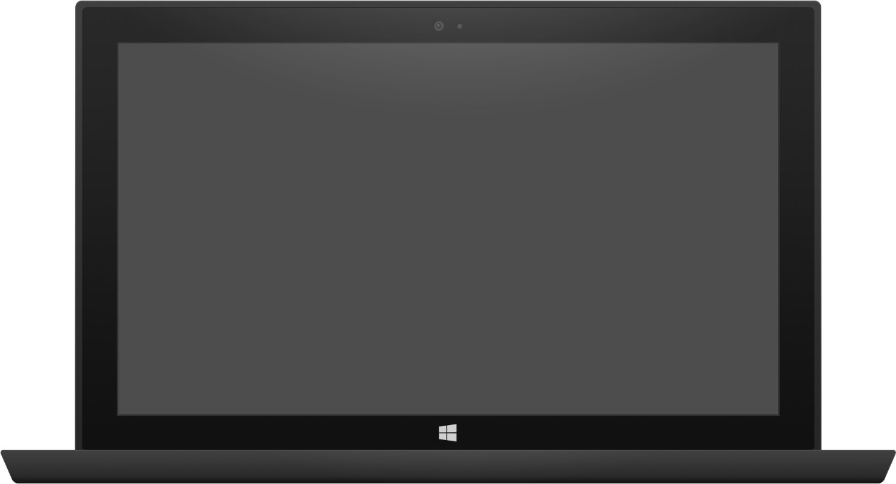

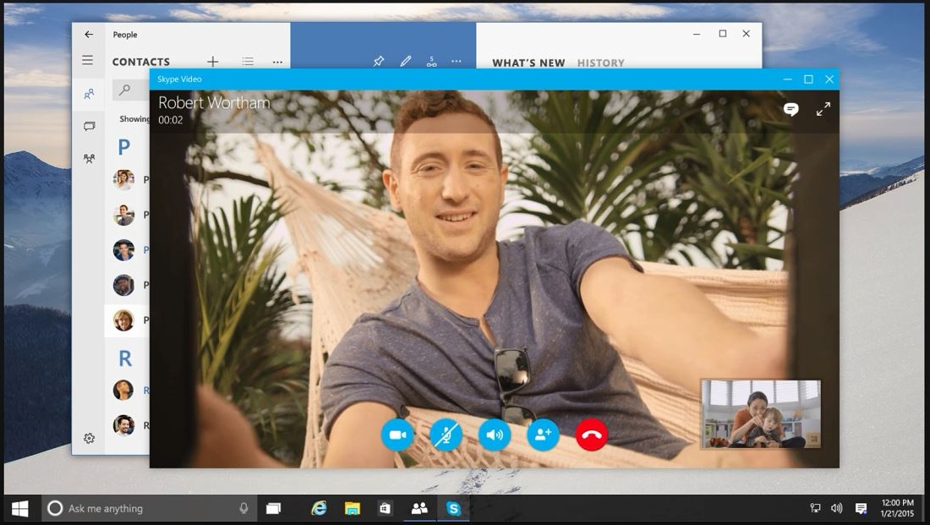
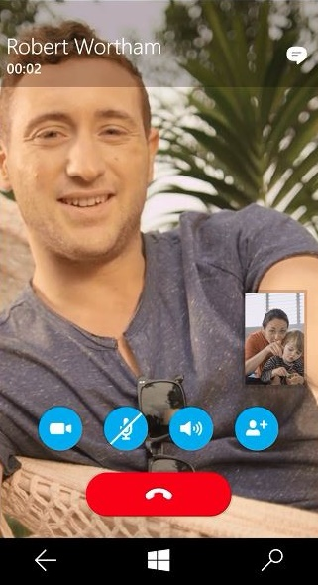
Adaptive design
Tablet (landscape) / Desktop
Phone (portrait)

Slide 41
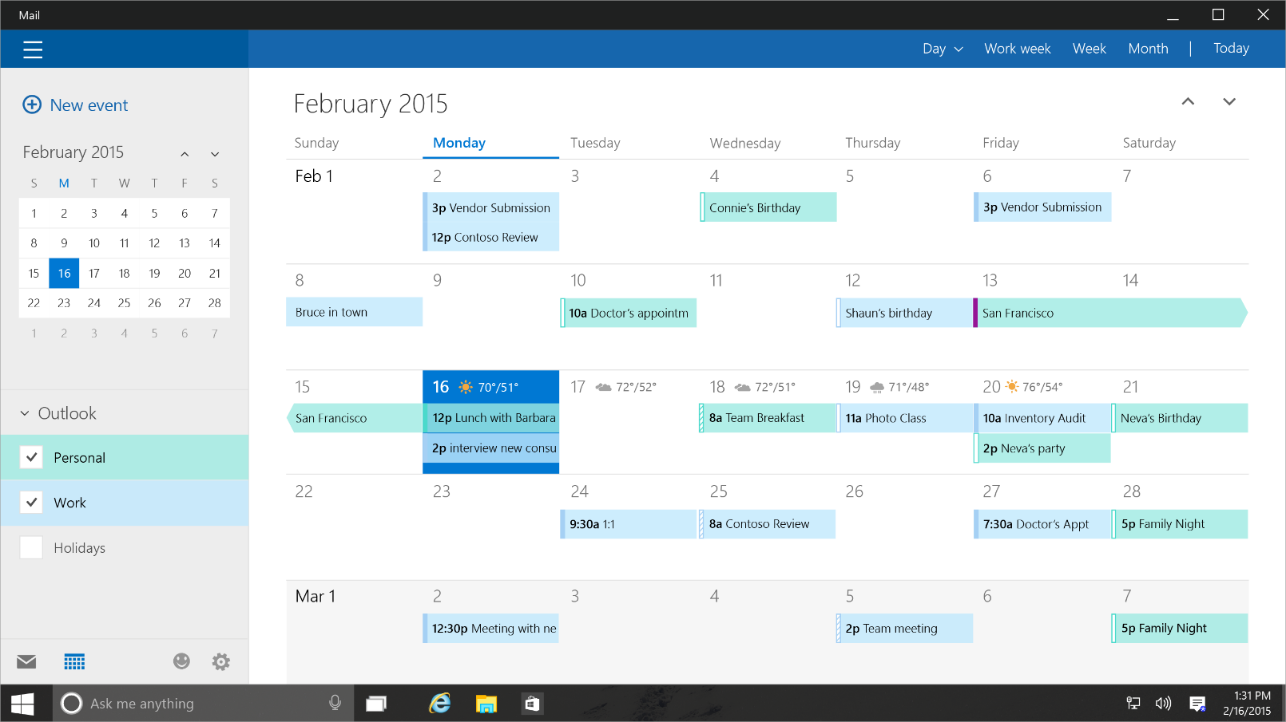
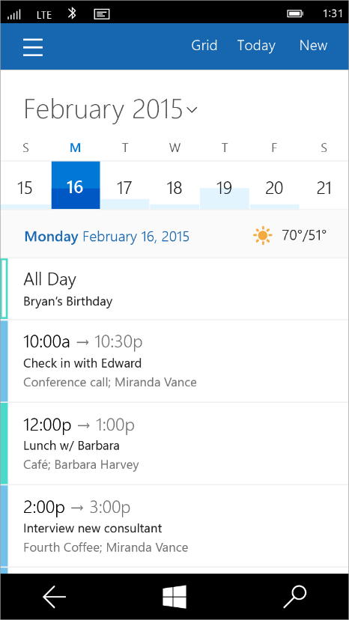
Tailored design
Tablet (landscape) / Desktop
Phone (portrait)

Slide 42
Adaptive Layout
DEMO

Slide 43
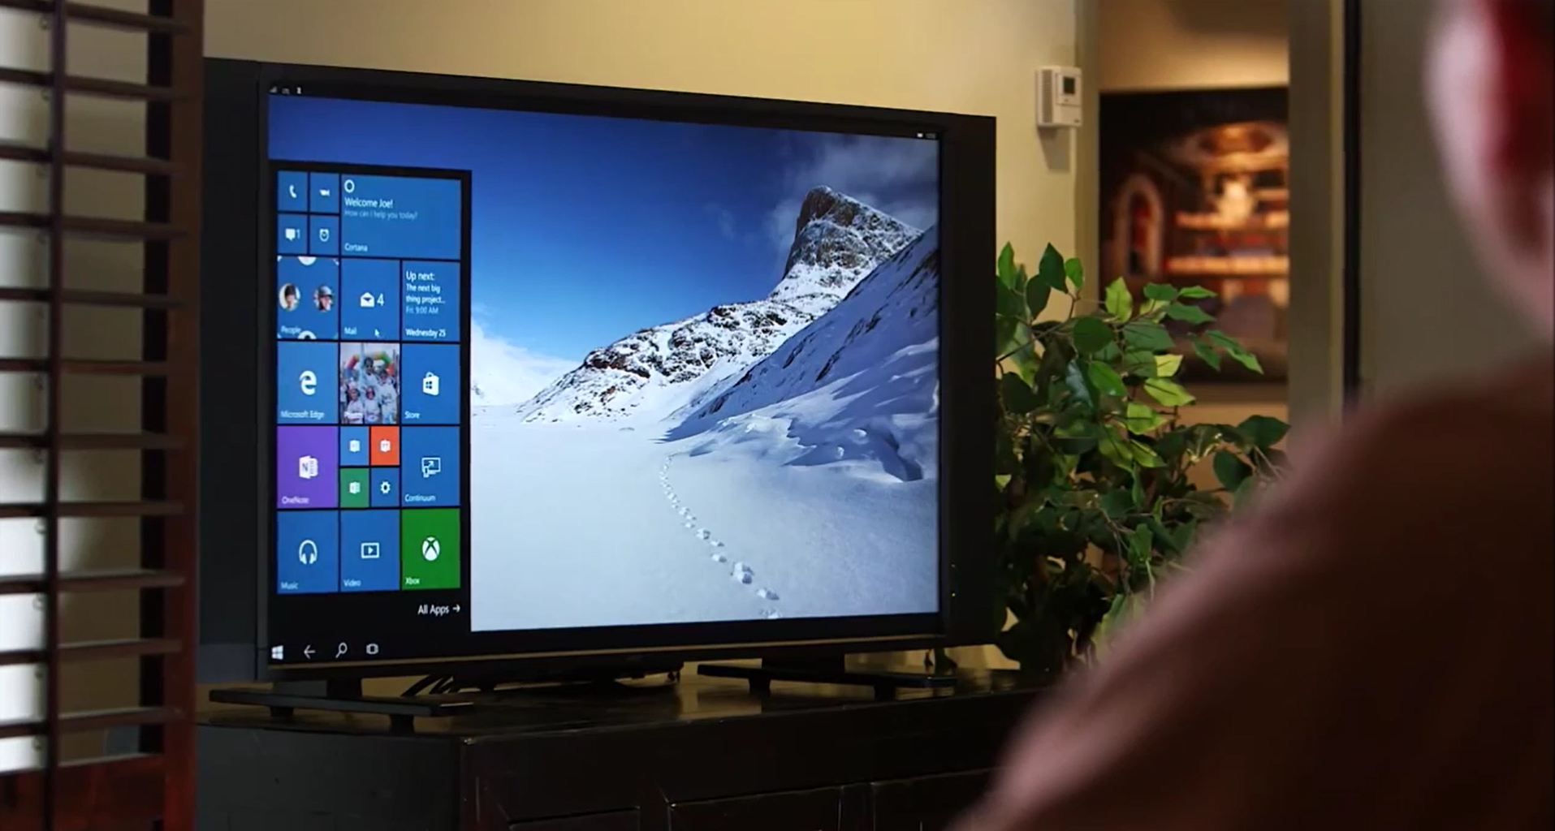
Continuum for Convertibles and Phones
Continuum for convertibles and Phones

Slide 44
Users love apps that work great on all their devices
Lars Klint
Adaptive UX - A Single UI for Everything [M219]
Today 11:55am NZ4

Slide 45
UWP
UWP
UWP
UWP
Windows Core
Windows Core
Windows Core
Windows Core
Desktop
Mobile
Xbox
More…

Slide 46
What about Shared Projects?

Slide 47
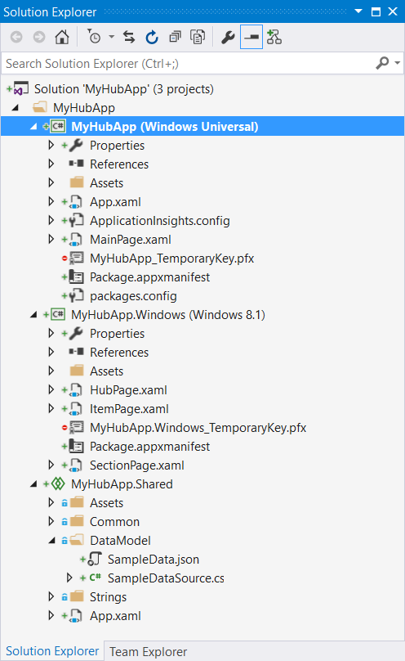
Shared Projects
Share code at the code level, pre-compilation
  Share with Windows 8.1 projects, Xamarin projects, anything…
Still completely supported
  #if Compilation directives used to conditionally include code by those projects referencing the Shared Project
    WINDOWS_APP
    WINDOWS_PHONE_APP
    WINDOWS_UAP (new)

Slide 48
Use Adaptive Code in Shared too!
#if WINDOWS_PHONE_APP
// Processing for Windows Phone 8.1 only
Windows.Phone.UI.Input.HardwareButtons.CameraPressed
+= this.Camera_Pressed;
#elif WINDOWS_UAP
      // Processing for Windows UWP – Desktop AND Mobile
      if (Windows.Foundation.Metadata.ApiInformation
      .IsTypePresent("Windows.Phone.UI.Input.HardwareButtons";))
      {
      // But this is only for UWP AND Mobile
      Windows.Phone.UI.Input.HardwareButtons.CameraPressed
      += this.Camera_Pressed;
        }
#endif

Slide 49
New Platform Features

Slide 50


New & adaptive controls
Adaptive controls
  Controls adapt to things like window size and input method.
Converged controls
  Pivot works on Windows as a tab control.
New controls
  SplitView gives the sidebar / hamburger menu.

Slide 51
Playing nice with the desktop
Customise the Title Bar
  Tweak the colours or replace entirely.
Support keyboard shortcuts
  Coming in a future release.
Enable drag and drop between applications
  Very similar to the Share / Data Transfer APIs.

Slide 52
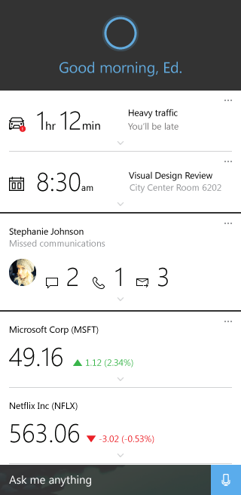
App to App communication
Foreground to foreground
  Protocol activation can now await results and query availability.
* to background
  App services enable a web of applications.
Cortana builds on top of this
  Invokes a background task for specific commands.

Slide 53
Tiles & Notifications
Adaptive tiles and notifications
  If you don’t like what’s available in the current tile template catalog.
Interactive toasts creates deep engagement
  Immediate action decreases likelihood of it being forgotten about.
Legacy templates are still supported
  If a template meets your needs go ahead and use that.

Slide 54
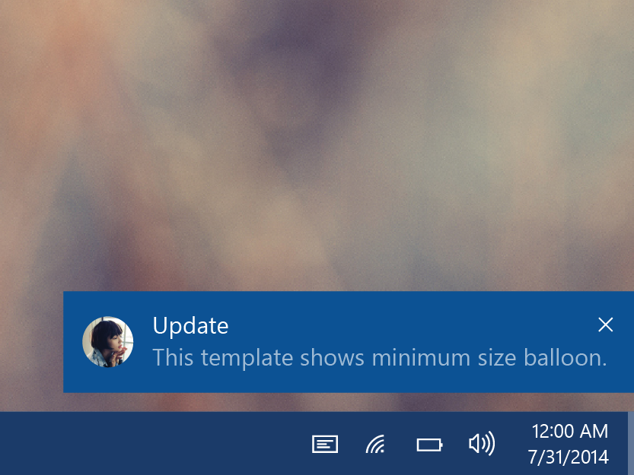
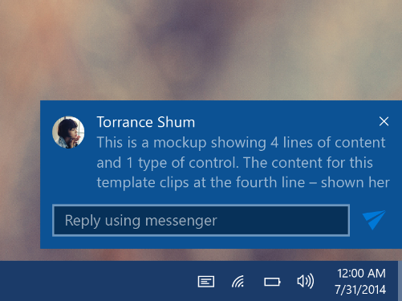
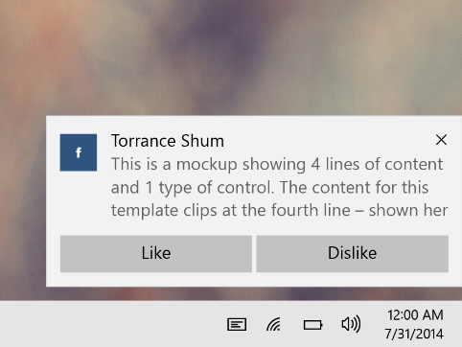
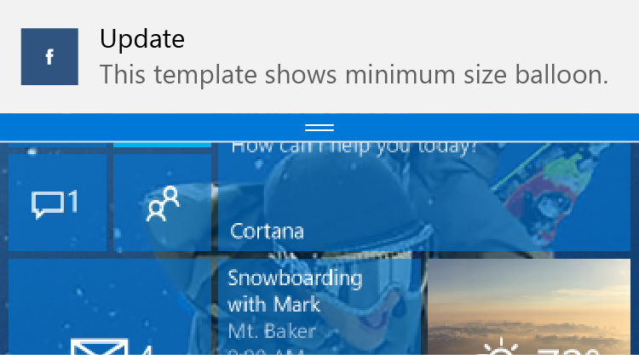
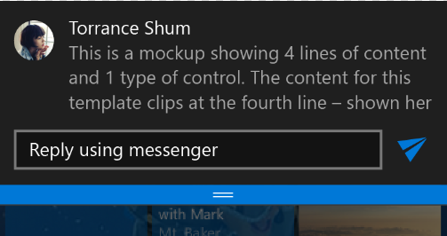
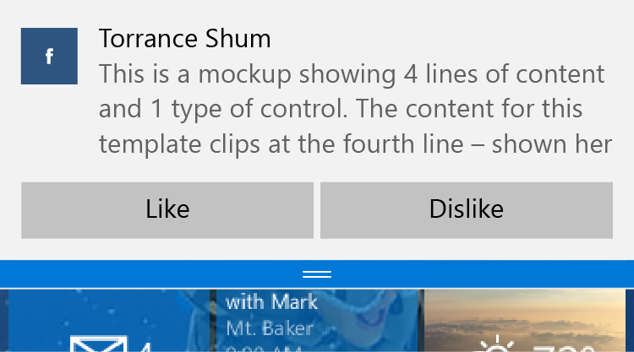
Interactive toast
Desktop
Mobile

Slide 55
New Platform Features
DEMO

Slide 56
One simple, unified, integrated development environment…

Slide 57
Visual Studio IDE
Every project type
  Desktop, Windows, Phone, Service, Web, Game, More…
Every developer task
  Code edit, Architecture design, UX design, Debug, Profile, Review, Test, More…
Every development language
  C++/CX, C#, Visual Basic, JavaScript, XAML, HTML, More…
Visual Studio Online
  Source repository, project management, bug tracking, More…

Slide 58
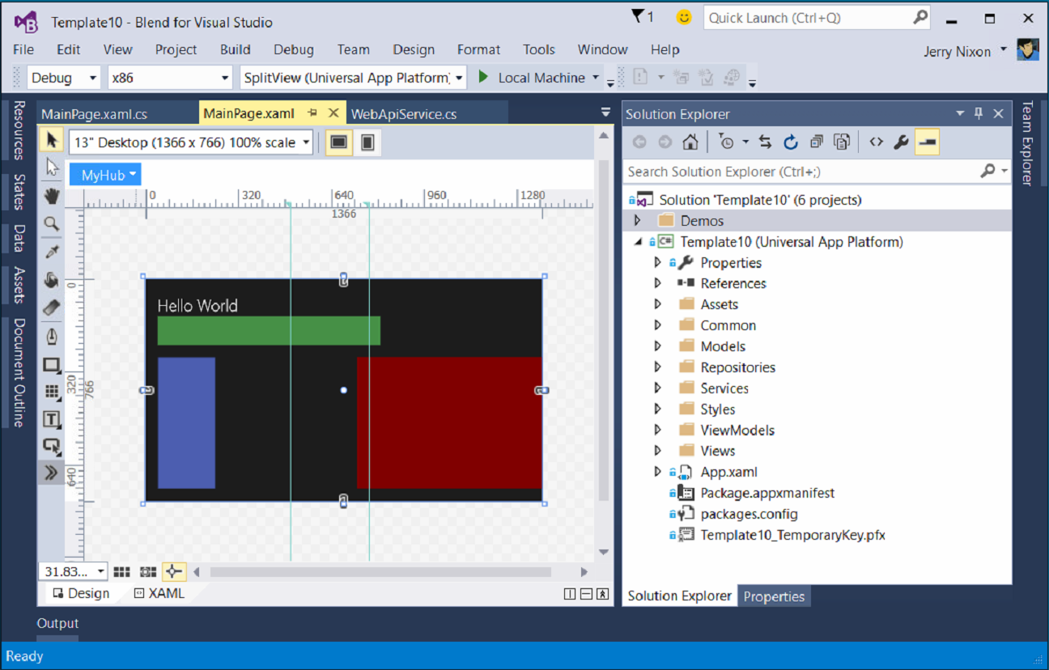
Blend for Visual Studio
The XAML Developer’s IDE
  Always part of Visual Studio
  Uses the Visual Studio shell
  Full auto-complete & intellisense
  Validation
  Snippets
  Peek
  File & solution management
  Resource management
  Data management
  Animation
  States

Slide 59
Visual Studio 2015
DEMO

Slide 60
Visual Studio 2015 Editions
Enterprise
  Architecture Modeling, Diagnostics, VSO/ALM & Release Management
Professional
  Architecture Validation, VSO/ALM & Feedback Management
Community Editions
  Visual Studio Professional Edition

Slide 61

Where can I develop?
Windows 10
  Requires Visual Studio 2015
Windows 8.1 & Windows Server 2012 R2
  The Visual Studio designer does not function
  Debugging requires a Windows 10 device or Remote Debugging Tools

Slide 62
Managed languages are more efficient than ever

Slide 63
.NET Native
Next generation compiler in the cloud
  Every Windows apps, only Windows app (right now)
Apps use the standard C++ optimizer
  As optimizer performance improves, so does .Net native
Apps with .Net bootstrapper
  Includes garbage collection
There is no runtime
  This is machine code

Slide 64
Every Windows app will be compiled with .Net Native

Slide 65
Real benefits with .Net Native
50% faster average startup time
14% less average memory usage

Slide 66
.Net Native enables the platform to update at a faster cadence

Slide 67
In Review
A single platform
  One Windows
  Many devices
Developer experience
  Windows tooling
  .Net Native

Slide 68

Related Ignite NZ Sessions
1
Adaptive UX – A Single UI for Everything [M219]
Lars Klint, Today, 11:55am NZ3
3
Developing Cross Platform Mobile Apps with XAML and MVVM [M347] Nigel Sampson, Tomorrow, 1:55pm NZ4
2
Javascript on mobile - Cordova less of a (phone) gap than ever [M334]
Damian Karzon, Today, 4:30PM NZ4
4
Bridges to the Magickal Faerie Land of Windows 10 [M263]
Hannes Nel, Friday, 10:40am NZ4
Find me later at…
Hub Happy Hour Wed 5:30-6:30pm
Hub Happy Hour Thu 5:30-6:30pm
Closing drinks Fri 3:00-4:30pm

Slide 69





Resources
Microsoft Virtual Academy
TechNet & MSDN Flash
  Free Online Learning
http://aka.ms/mva
  Subscribe to our fortnightly newsletter
http://aka.ms/technetnz http://aka.ms/msdnnz
  Sessions on Demand
http://aka.ms/ch9nz

Slide 70
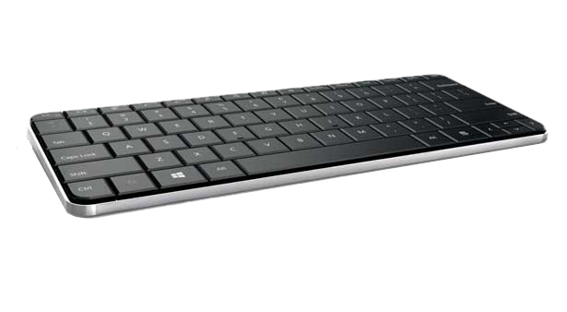
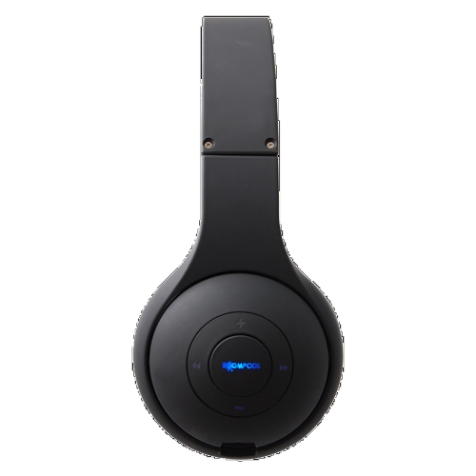
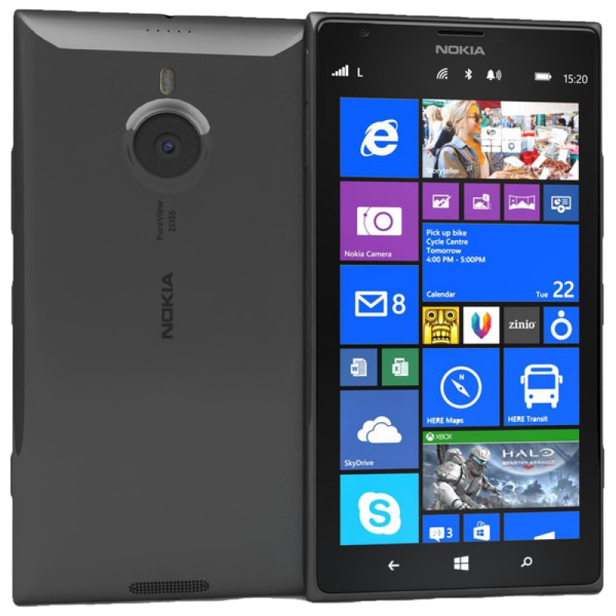
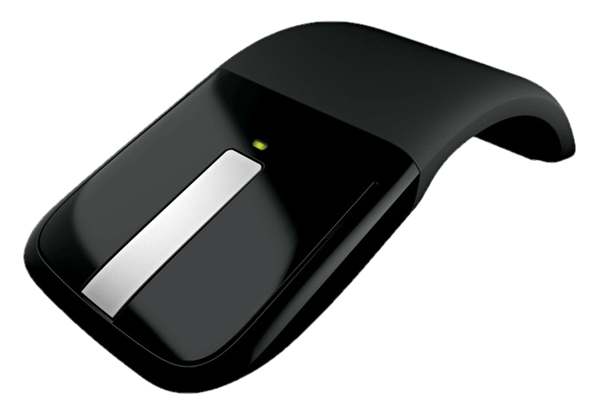

Complete your session evaluation now and be in to win!

