Slide 2
Enabling Your Active Directory to Embrace Windows 10
Simon May, Program Manager, MSFT
Andrew Kosmadakis, Intergen
M326

Slide 3
WHY DO THIS?

Slide 4

Protection against modern security threats

Slide 5

Replace passwords
Protect corporate identities
Protect sensitive corporate data
Biometrics
Hardware-based multi-factor
Hardware-based credential isolation
Automatic encryption
Persistent protection
Windows Hello
Microsoft Passport
Credential Guard
Enterprise Data Protection

Slide 6

Managed for continuous innovation

Slide 7

End “wipe-and-replace” deployment
Simplify device management
Embrace mobile-first, cloud-first
Eliminate the heavy lifting and inefficiency
Move to a single MDM platform for all devices
Enterprise-class cloud, universal app model, and store for business
In-place upgrades
Dynamic Provisioning
Mobile Device Management
Azure AD Join
Universal Apps for Windows
Windows Store for Business

Slide 8

Make things easy

Slide 9
Your PC recognizes you
Unencumbered, authorized access
You are your password
Single Sign On
Windows Hello
Microsoft Passport

Slide 10
DEMO:
Windows Hello/Passport

Slide 11
Why Microsoft’s Enterprise Mobility Solution?
Access from many devices
Manage and secure productivity
Preserve existing investments
Support iOS, Android, Windows
It’s integrated on common identity
It protects Office better
It just works
It’s comprehensive

Slide 12
EMS benefits for Windows
Identity and access management
Mobile device and app management
Information
protection
Enterprise Mobility
Suite
Conditional access policies for enhanced single sign on security
MDM auto enrollment
Self-service group and application management
Password reset with write-back to on-premises directory
Cloud based advanced security reports
Microsoft Identity Manager
Mobile device management
Mobile app management
Secure content viewer
Certificate, WiFi, VPN, email profile provisioning
Agent-based management of Windows devices (domain joined via ConfigMgr and internet-based via Intune)
Tracking and notifications for shared documents
Protection for content stored in Office & Office 365
Protection for on-premises Windows Server file shares
Behavioral analytics for advanced threat detection
Detection for known malicious attacks and security issues
Windows 10
Single sign-on for business cloud apps
Device set up and registration for Windows devices
Windows Store for Business
Traditional domain join manageability
Manageability via MDM and MAM
Encryption for data at rest and generated on device
Encryption for data included in roaming settings

Slide 13
Your Directory on the cloud
Manage everything from passwords to devices.
Monitor and protect access to cloud applications.
Empower Users

Slide 14
HOW DO I DO THIS?

Slide 15
BUILDING BLOCK #1:
CONNECT AZURE AD TO ON-PREM

Slide 16


Your Directory on the cloud
HR Apps
Connect and Sync on-premises directories with Azure.
Azure Active Directory Connect and Connect Health
MIM
*
*
PowerShell
Microsoft Azure
Active Directory
SQL (ODBC)
LDAP v3
Web Services
( SOAP, JAVA, REST)
Other Directories

Slide 17


Delivering a seamless user authentication experience
Active Directory
Microsoft Azure
Identity Synchronization with password (hash) sync
User attributes are synchronized using Identity Synchronization services including a password hash, Authentication is completed against Azure Active Directory
Identity Synchronization
Microsoft Azure
User attributes are synchronized using Identity Synchronization tools, Authentication is passed back through federation and completed against Windows Server Active Directory
AD FS

Slide 18
DEMO:
AZURE AD CONNECT

Slide 19
BUILDING BLOCK #2:
CONFIGURE AZURE AD

Slide 20
Identity as the control plane
Simple connection
Self-service
Single
sign on
Windows Server
Active Directory
Username
•••••••••••
Other
Directories
SaaS
Azure
Public
cloud
Office 365
On-premises
Cloud
Microsoft Azure Active Directory

Slide 21
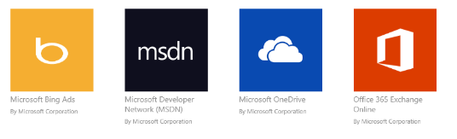
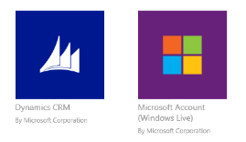


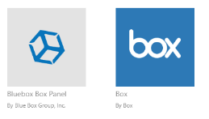
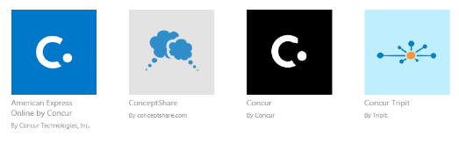










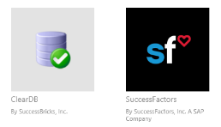

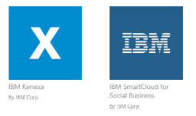

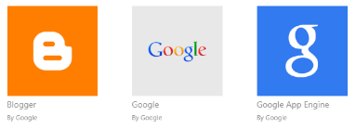





Preintegrated SaaS apps in the application gallery

Slide 22
Azure AD Join for Windows 10
Azure AD Join makes it possible to connect work-owned Windows 10 devices to your company’s Azure Active Directory.
Users can sign into Windows with their cloud-hosted work credentials and enjoy modern Windows experiences.
Enterprise-compliant services
SSO from the desktop to cloud and on-premises applications with no VPN
MDM auto enrollment
Support for hybrid environments
Apps in Azure
Azure AD &
Intune
3rd party apps & clouds
MDM
Auto-enrolment
On-premises apps
Windows 10 Azure AD Joined Devices

Slide 23
DEMO:
AZURE AD CONFIG

Slide 24
BUILDING BLOCK #3:
LICENSE MICROSOFT INTUNE

Slide 25
DEMO:
LICENSE INTUNE

Slide 26
BUILDING BLOCK #4:
CONFIGURE POLICY IN MICROSOFT INTUNE

Slide 27
DEMO:
CONFIGURE WINDOWS 10 POLICY IN MICROSOFT INTUNE

Slide 28
BUILDING BLOCK #5:
ENABLE MICROSOFT INTUNE IN AZURE AD

Slide 29
DEMO:
ENABLE MDM CONFIGURATION IN AZURE AD

Slide 30
BUILDING BLOCK #6:
AZURE AD JOIN WINDOWS 10

Slide 31
DEMO:
JOIN WINDOWS 10 TO AZURE AD

Slide 32
HOW DO I BUY THIS?

Slide 33

EMS
Windows 10
Office 365
Enterprise Cloud Suite
Azure Active Directory – RMS – Intune

Slide 34
Related Links
Azure Active Directory editions
https://msdn.microsoft.com/en-us/library/azure/dn532272.aspx
Windows 10
https://technet.microsoft.com/en-us/windows/windows10.aspx
Windows 10 Configuration service provider reference
https://msdn.microsoft.com/en-us/library/windows/hardware/dn920025(v=vs.85).aspx
Government ICT
https://www.ict.govt.nz

Slide 35
QUESTIONS?

Slide 36
Contact Us
Simon May
Contact: http://smay.co/connect-with-me
Twitter: @simonster
Andrew Kosmadakis
Email: Andrew.Kosmadakis@intergen.co.nz
Twitter: @KozNZ

Slide 37

Related Ignite NZ Sessions
1
101 ways to authenticate with Azure Active Directory
Ballroom1 Thu 10:40am
4
Windows 10 Ask Me Anything
Marlborough Fri 1:55pm
2
What's New in Windows 10 Management and the Windows Store
NZ1 Thu 3:40pm
Find us later at…
Hub Happy Hour Wed 5:30-6:30pm
Hub Happy Hour Thu 5:30-6:30pm
Closing drinks Fri 3:00-4:30pm
3
Windows 10 + Azure AD + Intune = full desktop management and provisioning in the cloud
NZ1 Fri 9:00am

Slide 38





Resources
Microsoft Virtual Academy
TechNet & MSDN Flash
  Free Online Learning
http://aka.ms/mva
  Subscribe to our fortnightly newsletter
http://aka.ms/technetnz http://aka.ms/msdnnz
  Sessions on Demand
http://aka.ms/ch9nz

Slide 39

Complete your
session evaluation
now and win!

