Slide 2
Deploying Exchange Server 2016
Preview
Scott Schnoll schnoll@microsoft.com
M329

Slide 3
Agenda
Preparing for Exchange Server 2016
Coexistence and Migration
Deploying Exchange Server 2016

Slide 4
Disclaimer
Things could change
Exchange 2016 is still in preview
The engineering train is still rolling along

Slide 5
Preparing for
Exchange Server 2016

Slide 6
What’s New in Exchange Server 2016
Client Access Server services now part of Mailbox server role
Outlook Web App has been renamed to Outlook on the Web
Support for Outlook Modern Authentication (ADAL)
MAPI over HTTP is default modern protocol
Integration with OneDrive and Outlook Web Apps Server

Slide 7
What’s New in Exchange Server 2016
Hybrid Configuration Wizard is now a cloud-based app that is downloaded at runtime
Additional sensitive information types added to DLP
Transport rules contain new conditions and actions
Public folder support for In-Place eDiscovery and In-Place Hold
Enhanced compliance search has been added to PowerShell

Slide 8
What’s Going or Gone from Exchange 2016
Gone
  Client Access server role
  Support for MAPI/CDO connectivity
  Support for Outlook 2007
  Support Outlook for Mac 2008 EWS Edition
De-Emphasized
  Third-Party Replication APIs
  RPC over HTTP
  Support for Cluster Administrative Access Points

Slide 9
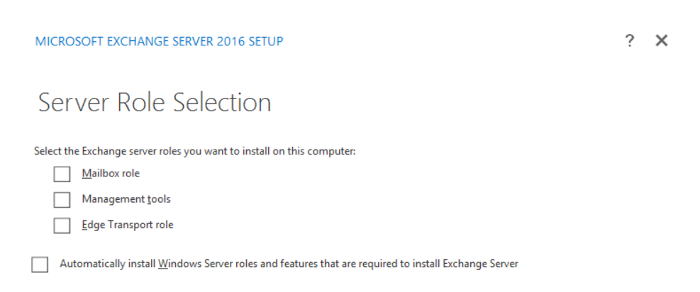
Setup Updates
D:\>setup /mode:install /roles:mailbox /iacceptexchangeserverlicenseterms

Slide 10
Environment Requirements
Exchange 2016 supports coexistence with
  Exchange 2010 SP3 RU11 and later* (Preview bits can coexist with 2010 SP3 RU10)
  Exchange 2013 CU10 and later* (Preview bits can coexist with 2013 CU9)
Exchange 2016 requires
  Windows Server 2008 FFM and later
  Windows Server 2008 and later Global Catalog servers in each site with Exchange installed
  Outlook clients running
    Outlook 2010 SP2 (with KB2956191 and KB2965295)* or later
    Outlook 2013 SP1 (with KB3020812)* or later
    Outlook 2016
    Outlook for Mac 2011 or later
* Subject to change

Slide 11
Server Requirements
Exchange 2016 is supported on full GUI installs of
  Windows Server 2012
  Windows Server 2012 R2
  Windows Server 2016
Exchange 2016 requires
  .NET Framework 4.5.2 or later 4.5.x version* (.NET 4.6 is not yet supported)
  Windows Management Framework 4.0*
  Unified Communications Managed API (UCMA) 4.0*
  Office Web Apps Server installed on separate server(s) for attachment rendering in Outlook on the web
Outlook on the web supports
  Microsoft Edge
  Internet Explorer 11
  Most recent versions of Mozilla Firefox, Google Chrome, and Safari
* Subject to change

Slide 12
Existing Exchange Servers
All existing Exchange server versions must meet prerequisite levels
May need to recreate Edge Subscriptions before running Exchange 2016 Setup
[PS] C:\>Get-ExchangeServer | FT Name,AdminDisplayVersion,ServerRole -AutoSize
Name
AdminDisplayVersion ServerRole
----
------------------- ----------
E2K10-EDG-001
Version 14.2 (Build 247.5) EdgeTransport
E2K13-MLT-001
Version 15.0 (Build 1104.5) Mailbox, ClientAccess

Slide 13
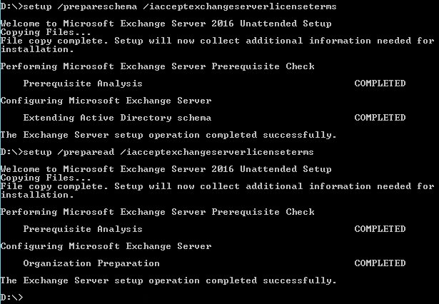
Before Running PrepareAD
Earlier versions of Exchange cannot be reintroduced after Exchange 2016 PrepareAD is run

Slide 14
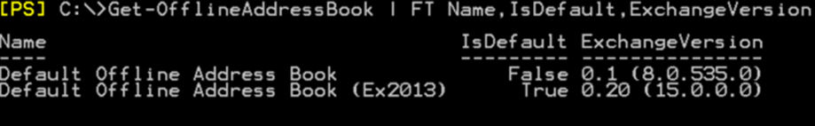
Offline Address Book
Exchange 2016 creates a new default OAB for the organization
Hard-code the current OAB on all existing databases before installing Exchange 2016

Slide 15
Coexistence and Migration

Slide 16
Exchange 2010 + Exchange 2016
Same experience as Exchange 2010 + Exchange 2013
No legacy namespace required
Exchange 2016 can proxy to Exchange 2010
Exchange 2010 can’t proxy to Exchange 2016

Slide 17
Client Connectivity - Exchange 2010 + 2016
Protocol/App | Exchange 2010 user accessing Exchange 2016 namespace
OWA/ECP | Mailbox is mounted in the same AD Site: Exchange 2016 proxies to Exchange 2010 CAS endpoint in the local site Mailbox is mounted in an Internal-only AD site: Exchange 2016 proxies to Exchange 2010 CAS endpoint in the remote site Mailbox is mounted in an Externally-facing AD site: Exchange 2016 proxies or issues a silent/SSO cross-site redirect to an ExternalURL in the remote site of your choice that could resolve to Exchange 2016, 2013, or 2010, as all are capable of getting the traffic to Exchange 2010 mailboxes in that site
Exchange ActiveSync Outlook Anywhere Exchange Web Services POP/IMAP Remote PowerShell Autodiscover Offline Address Book | Exchange 2016 proxies the request to an Exchange 2010 CAS endpoint
MAPI/HTTP | Not applicable for Exchange 2010 mailboxes

Slide 18
Exchange 2010 coexistence with Exchange 2016
Condensed steps to upgrade from Exchange 2010
  Prep your environment (service packs, RUs, DFL/FFL, schema, AD, domains, etc…)
  Install Exchange 2016 (consider using a deployment AD site)
  Configure the Exchange 2016 server URLs
  Import certificate(s) to Exchange 2016 servers
  Move load balanced namespaces to Exchange 2016 once ready to accept clients
  Setup your DAG(s)
  Start moving mailboxes
  Repeat for all Internet facing sites and then repeat for all non-Internet facing
  Move incoming mail flow to Exchange 2016 once it makes sense (>50% moved)

Slide 19


Exchange 2016/2010 Coexistence
OWA Redirect if ExternalURL exists in remote site
mail.contoso.com
europe.mail.contoso.com
Load Balancer
Load Balancer
Protocol Head
IIS
Protocol Head
HTTP Proxy
Exchange 2010 CAS
Site Boundary
Exchange 2010 CAS
RPC
Exchange 2016
RPC
Store
Protocol Head
Store
Database
Database
Database
Exchange 2010 Mailbox
Exchange 2010 Mailbox

Slide 20
Exchange 2013 + Exchange 2016
No legacy namespaces required
Exchange 2016 can proxy to Exchange 2013
Exchange 2013 can proxy to Exchange 2016

Slide 21
Client Connectivity – Exchange 2013 + 2016
Protocol/App | Exchange 2013 user accessing an Exchange 2016 namespace | Exchange 2016 user accessing an Exchange 2013 namespace
OWA/ECP | Mailbox mounted in the same AD Site: Exchange 2016 proxies to Exchange 2013 Mailbox server in local AD site with active database Mailbox mounted in an Internal only AD site: Exchange 2016 proxies to Exchange 2013 Mailbox server in remote AD site with active database Mailbox mounted in an External facing AD site: Exchange 2016 proxies to the Exchange 2013 Mailbox server with active database, or issues a silent/SSO cross-site redirect to site’s ExternalURL* (your choice). * Could resolve to Exchange 2016 or 2013 as both are capable of getting the traffic to Exchange 2013 mailboxes in that site | Mailbox mounted in the same AD Site: Exchange 2013 proxies to Exchange 2016 Mailbox server in local AD site with active database Mailbox mounted in an Internal only AD site: Exchange 2013 proxies to Exchange 2016 Mailbox server in remote AD site with active database Mailbox mounted in an External facing AD site: Exchange 2013 proxies to the Exchange 2016 Mailbox server with active database, or issues a silent/SSO cross-site redirect to the site’s ExternalURL* (your choice). * Could resolve to Exchange 2016 or 2013 as both are capable of getting the traffic to Exchange 2016 mailboxes in that site
Exchange ActiveSync Outlook Anywhere Exchange Web Services POP/IMAP Remote PowerShell MAPI/HTTP | Exchange 2016 proxies to Exchange 2013 Mailbox server with active database | Exchange 2013 proxies to Exchange 2016 Mailbox server with active database
Autodiscover | Exchange 2016 proxies to Exchange 2013 Mailbox server with active database | Exchange 2013 CAS proxies to Exchange 2016 Mailbox server with active database
Offline Address Book | Exchange 2016 proxies the request to an OAB generation mailbox with the OAB or a shadow copy of the OAB | Exchange 2013 proxies the request to an OAB generation mailbox with the OAB or a shadow copy of the OAB

Slide 22
Exchange 2013 + 2016 Coexistence
Option 1: Let Exchange 2013 up-version proxy
Condensed steps
  Prep your environment (service packs, CUs, DFL/FFL, schema, AD, domains, etc…)
  Install Exchange 2016
  Configure Exchange 2016 server URLs as you would have for Exchange 2013
  Import the certificate(s) to Exchange 2016 servers
  Setup your DAG(s)
  Start moving mailboxes
  Repeat for all Internet facing sites and then repeat for non-Internet facing
  Move incoming mail flow to Exchange 2016 once it makes sense (>50% moved)
  Swing the load balanced namespaces over from 2013 to 2016
    Recommended: Gradually introduce Exchange 2016 servers into the existing LB pool
    Supported: Cutover to all Exchange 2016 servers at once

Slide 23
Exchange 2013 + 2016 Coexistence
Option 2: Let Exchange 2016 down-version proxy
Condensed steps
  Prep your environment (service packs, CUs, DFL/FFL, schema, AD, domains, etc…)
  Install Exchange 2016
  Configure Exchange 2016 server URLs as you would have Exchange 2013
  Import the certificate(s) to Exchange 2016 servers
  Swing the load balanced namespaces over from Exchange 2013 to Exchange 2016
  Setup your DAG(s)
  Start moving mailboxes
  Repeat for all Internet facing sites and then repeat for non-Internet facing
  Move incoming mail flow to Exchange 2016 once it makes sense (>50% moved)

Slide 24

CAS replacement process w/up-version proxy
LB is sending traffic to Exchange 2013 CAS
Exchange 2016 is introduced
Exchange 2016 client access services added to LB pool
Exchange 2013 CAS services removed from LB pool
More Exchange 2016 introduced and added to LB pool
More 2013 CAS services removed from LB pool
More Exchange 2016 introduced and added to LB pool
Final 2013 CAS services removed from LB pool
2013 CAS
2013 CAS
2016
MBX
2016
MBX
E13 CAS
2016
MBX
2013 MBX
2013 MBX
2013 MBX
2013 MBX
2016
MBX
LB to Client Access Services
Client Access Services to Mailbox
2013 Client Access to 2016 Mailbox

Slide 25
CAS replacement using DNS response ratios
HWLB VIP1
HWLB VIP2
E13 CAS
E13 CAS
E13 CAS
2016
MBX
2016
MBX
2016
MBX
E13 MBX
E13 MBX
E13 MBX
LB to Client Access Services
Client Access Services to Mailbox
2013 Client Access to 2016 Mailbox

Slide 26
Exchange 2016/2013/2010 Coexistence
Proxy to server hosting active copy of user’s mailbox database
OWA/ECP redirects where appropriate
mail.contoso.com
europe.mail.contoso.com
Load Balancer
Load Balancer
16 Client Access Services
IIS
Protocol Head
IIS
HTTP Proxy
HTTP Proxy
Exchange 2013 CAS
Site Boundary
Exchange 2010 CAS
RPC
Protocol Head
Protocol Head
Store
DB
DB
DB
Exchange 2016 Store
Exchange 2013 MBX
Exchange 2010 MBX

Slide 27
Exchange 2016/2013/2010 Coexistence
OWA/ECP redirects where appropriate
mail.contoso.com
europe.mail.contoso.com
Load Balancer
Load Balancer
16 MBX Server
IIS
Protocol Head
Client Access Services
IIS
HTTP Proxy
HTTP Proxy
Exchange 2013 CAS
Site Boundary
Exchange 2010 CAS
RPC
Protocol Head
Protocol Head
Store
DB
DB
DB
Exchange 2016 Store
Exchange 2013 MBX
Exchange 2010 MBX

Slide 28
Exchange 2016/2013/2010 Coexistence
OWA/ECP redirects where appropriate
mail.contoso.com
europe.mail.contoso.com
Load Balancer
Load Balancer
16 MBX Server
Protocol Head
Client Access Services
IIS
HTTP Proxy
Exchange 2010 CAS
RPC
Site Boundary
Protocol Head
Protocol Head
Store
DB
DB
DB
Exchange 2016 Store
Exchange 2013 MBX
Exchange 2010 MBX

Slide 29
Installing
Exchange Server 2016

Slide 30
Recommended (and Easiest) Way to Install
Install new server in a deployment AD site
Install perquisites and reboot
Install Exchange 2016, allowing setup to install required Windows components, and reboot for settings to take effect
Configure and move to production AD site
Add the server to the load balancing pool

Slide 31
Using a Deployment Site
As soon as Exchange is installed into an AD site it becomes…
A valid Service Connection Point for Autodiscover requests
  An SCP’s default AutodiscoverServiceInternalUri value is the server’s FQDN, which will produce a certificate error
A valid source of answers for Autodiscover responses
  All of the virtual directory default values are the server’s FQDN, which will also produce a certificate error

Slide 32
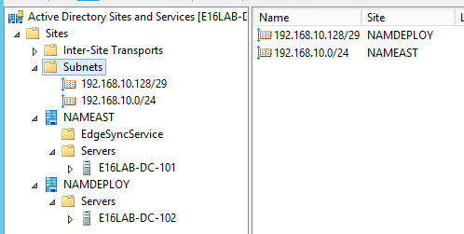
Using a Deployment Site
In this case a /29 subnet provides 6 host addresses from .129-.134 to use for server deployments within the overall /24 subnet
One of those IPs will be needed for a GC in the site

Slide 33
Using a Deployment Site
Check the server’s site with NLTEST before installing Exchange
Post-install, check the server’s site information from Exchange’s perspective with Get-ExchangeServer
Update the AD site scope before changing the server’s IP to an IP within the production site
[PS] C:\>nltest /dsgetsite
NAMDEPLOY
The command completed successfully
[PS] C:\>Get-ExchangeServer | FT Name,Site -AutoSize
Name
Site
----
----
E16LAB-2K10-101
corp.e16lab.com/Configuration/Sites/NAMEAST
E16LAB-2K16-101
corp.e16lab.com/Configuration/Sites/NAMDEPLOY
[PS] C:\>Get-ClientAccessServer | FT Name,AutodiscoverSiteScope -AutoSize
Name
AutoDiscoverSiteScope
----
--------------------
E16LAB-2K10-101
NAMEAST
E16LAB-2K16-101
NAMDEPLOY

Slide 34
MAPI/HTTP
Recommended as part of the Preferred Architecture
MAPI/HTTP will be enabled by default when…
  Exchange 2016 is the first Exchange server in a greenfield Exchange org
  The first Exchange 2016 server is installed in an Exchange 2010-only org
  The first Exchange 2016 server is installed in an Exchange 2013 org if MAPI/HTTP is already enabled
MAPI/HTTP will not be enabled by default when…
  The first Exchange 2016 server is installed in an Exchange 2013 org when MAPI/HTTP is not already enabled

Slide 35
MAPI/HTTP
We remind admins to enable it
Welcome to Microsoft Exchange Server 2016 Unattended Setup
Copying Files...
File copy complete.
Setup will now collect additional information needed for installation.
Languages
Management tools
Mailbox role: Transport service
Mailbox role: Client Access service
Mailbox role: Unified Messaging service
Mailbox role: Mailbox service
Mailbox role: Front End Transport service
Mailbox role: Client Access Front End service
Performing Microsoft Exchange Server Prerequisite Check
Configuring Prerequisites COMPLETED
Prerequisite Analysis COMPLETED
MAPI over HTTP, the preferred Outlook desktop client connectivity with Exchange server, is currently not enabled. Consider
enabling it using: Set-OrganizationConfig -MapiHttpEnabled $true
For more information, visit: http://technet.microsoft.com/library(EXCHG.150)/ms.exch.setupreadiness.WarnMapiHttpNotEnabled.aspx

Slide 36
MAPI/HTTP
Scenario: An Exchange 2013 org with MAPI/HTTP disabled is migrating to Exchange 2016
Goal: Enable only MAPI/HTTP for users as they are migrated to 2016
  Leave the organization level MapiHttpEnabled as $False
  Prior to moving mailboxes use Set-CasMailbox from the 2016 EMS to set MapiHttpEnabled to $True on the 2013 mailboxes
  Move the mailboxes to 2016
  Once all mailboxes are on 2016, set MapiHttpEnabled to $True at the organization level
  Use Set-CasMailbox on all 2016 mailboxes to set MapiHttpEnabled to $Null so the organization level value is inherited once again

Slide 37
MAPI/HTTP
Scenario: Customer running an Exchange 2016 org
Goal: Block external Outlook on Windows connectivity for all but a few users with minimal complexity and the fewest admin steps
  Ensure the InternalURL for the MAPI/HTTP and EWS vDirs as well as the Internal Hostname for Outlook Anywhere resolve only via internal DNS and cannot be reached by external clients (perhaps unless they use VPN)
  Use Set-CasMailbox and set MAPIBlockOutlookExternalConnectivity to $True for all users not allowed to connect remotely

Slide 38
Exchange 2013 to 2016 Public Folder Migrations
Move the Public Folder mailboxes to 2016 databases
Exchange 2013
Exchange 2016

Slide 39
Kerberos Authentication
Exchange 2010 + Exchange 2016
  Follow the current Exchange 2010 / Exchange 2013 guidance at http://aka.ms/kerbcoexist20102013
Exchange 2013+ Exchange 2016
  A single ASA used for both 2013 and 2016 servers in the same environment
Exchange 2010+ Exchange 2013+ Exchange 2016
  Two ASAs where one is 2010 and the other is shared with 2013 & 2016

Slide 40
System Mailbox Moves After Install
Move these system mailboxes from 2010/2013 to 2016
  SystemMailbox{1f05a927-d5d7-47a6-b498-f5266abdf909}
  SystemMailbox{bb558c35-97f1-4cb9-8ff7-d53741dc928c}
  SystemMailbox{e0dc1c29-89c3-4034-b678-e6c29d823ed9}
  FederatedEmail.4c1f4d8b-8179-4148-93bf-00a95fa1e042
  Migration.8f3e7716-2011-43e4-96b1-aba62d229136
If you don’t, you
  Can’t save admin tasks to the admin audit log or export it
  Can’t start eDiscovery searches
  Can’t start batch migrations with Exchange 2016 as target databases
  And more…

Slide 41
Office Web Apps Server and
Outlook on the web
Exchange 2016
Exchange 2016
autodiscover.fabrikam.com
mail.fabrikam.com
mail.fabrikam.com
Office Web Apps Server
Office Web Apps Server
oos.us.fabrikam.com
oos.us.corp.fabrikam.com*
oos.emea.fabrikam.com
oos.emea.corp.fabrikam.com*
* = Internal DNS Only

Slide 42
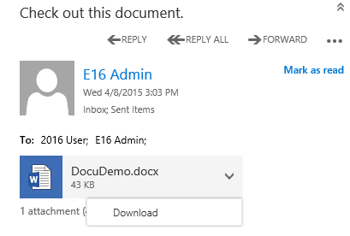
Outlook on the web - Before Attachment Viewing is Configured
Download Only
No Native App Installed
Native App Installed

Slide 43
Outlook on the web - Before Attachment Viewing is Configured
[PS] C:\>Get-MailboxServer E16LAB-2K16-101 | FL WACDiscovery*
WACDiscoveryEndpoint :

Slide 44
Configuring Outlook on the web Attachment Viewing
Configure WAC discovery endpoint per mailbox server
Restart MSExchangeOWAAppPool
[PS] C:\>Set-MailboxServer E16LAB-E2K16-101 –WACDiscoveryEndpoint https://oos.us.corp.e16lab.com/hosting/discovery
[PS] C:\>Get-MailboxServer E16LAB-E2K16-101 | FL WACDisc*
WACDiscoveryEndpoint : https://oos.us.corp.e16lab.com/hosting/discovery

Slide 45
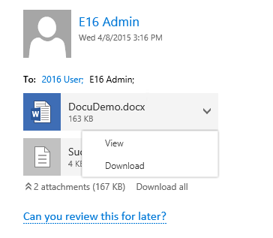
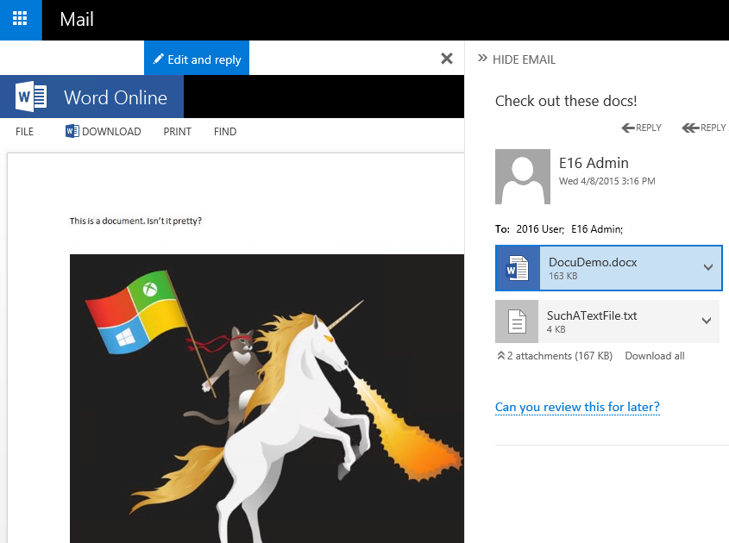
Outlook on the web - After Attachment Viewing is Configured
View or Download
New side-by-side (SxS) view

Slide 46




Outlook Web Apps Server Connectivity
Exchange 2016
Exchange uses discovery URL to ask OWAS which files types it can view and edit
OWAS returns table of supported file types
User opens mail with attachment that matches one of the file types OWAS supports and OOTW requests document URLs for supported types
Exchange builds URL with Auth token, app URL, and Attachment ID and returns it to OOTW
User clicks attachment within OOTW and spawns an iFrame on client to load the URL returned by Exchange
OWAS retrieves document content from Exchange
OWAS renders content in OWAS client (e.g., Word Web App)
3
4
1
2
6
OOTW
5
7
Office Web Apps Server

Slide 47
Object Management
Exchange 2013 can manage Exchange 2016 objects
Exchange 2016 can manage Exchange 2013 objects
Exchange 2010 object management varies, best to use version-specific tools

Slide 48
Summary
Exchange 2016 deployments have been simplified, but they still require up-front planning
Office Web App server integration provides optional in-line document viewing in Outlook on the web

Slide 49

Related Ignite NZ Sessions
1
Exchange Server Preferred Architecture
NZ3 Wed 1:55pm
Find me later at…
Hub Happy Hour Wed 5:30-6:30pm
Hub Happy Hour Thu 5:30-6:30pm
Closing drinks Fri 3:00-4:30pm
2
Deploying Exchange Server 2016
NZ3 Wed 3:10pm
3
Exchange Server High Availability and Site Resilience
NZ2 Thurs 3:10pm

Slide 50





Resources
Microsoft Virtual Academy
TechNet & MSDN Flash
  Free Online Learning
http://aka.ms/mva
  Subscribe to our fortnightly newsletter
http://aka.ms/technetnz http://aka.ms/msdnnz
  Sessions on Demand
http://aka.ms/ch9nz

Slide 51

Complete your
session evaluation
now and win!

