Slide 2
Protecting Against Credential Theft: Today and Tomorrow
Chris Jackson
M330

Slide 3
The Evolution of Attacks
2012 - Beyond
2005-PRESENT
Organized Crime
RANSOMWARE,
CLICK-FRAUD,
IDENTITY THEFT
Motive: Profit
Sophistication
Nation States, Activists, Terror Groups
BRAZEN,
COMPLEX,
PERSISTENT
Motives:
IP Theft,
Damage,
Disruption
2003-2004
Script Kiddies
BLASTER, SLAMMER
Motive: Mischief
Targeting

Slide 4
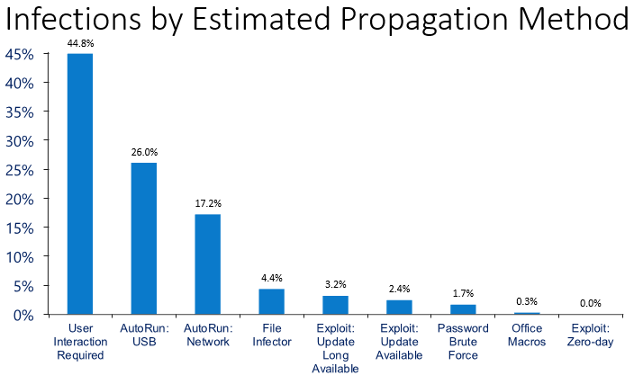
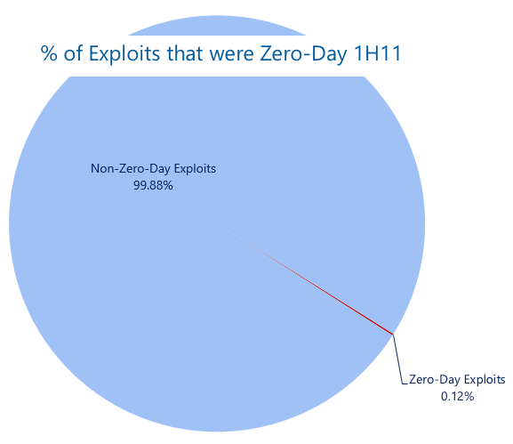
Are Attackers Getting More Sophisticated?
Microsoft Defies Court Order, Will Not Give Emails to US Government
NSA internet snooping: EU threatens to suspend data sharing with US
Data source: Microsoft Security Intelligence Report volume 11 microsoft.com/sir

Slide 5
Observed Adversary Tactics
Capture the Identity Infrastructure
Target Specific High Value Assets

Slide 6
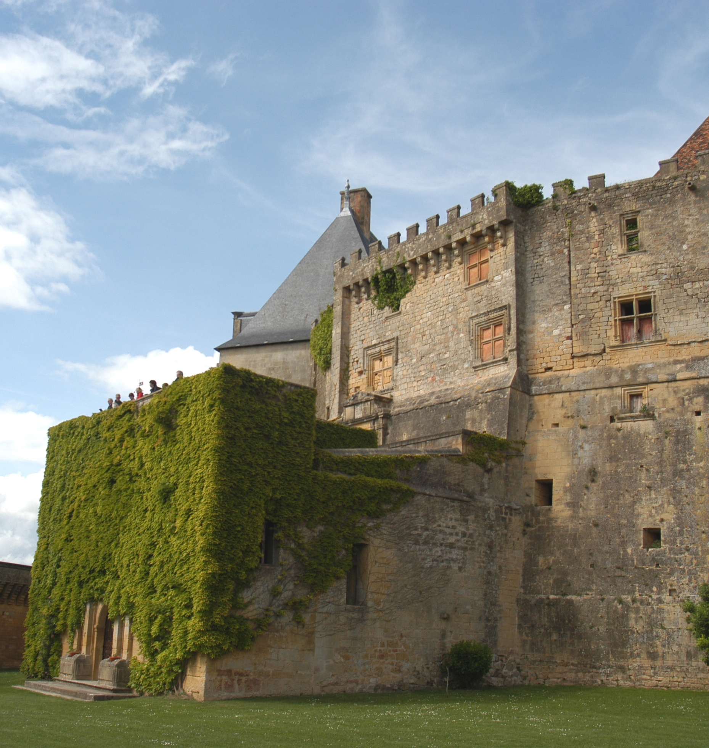


Slide 7
Cybersecurity Framework
Design and configure environment for resiliency
Use signals to detect adversaries early
Be prepared to respond calmly and rapidly to incidents

Slide 8















Typical Credential
Theft Attack
Beachhead (e.g. Phishing)
Steal credentials
Move laterally
Acquire Domain Admin credentials
Execute attacker mission

Slide 9
Typical Attack Timeline and Observations
24–48 Hours
Average 8 Months →
Initial compromise or entry
Vector.
  Core security
  compromised.
  Service outage, data theft, or
  exfiltration.
  Attack detected.


Slide 10

Tier Model for Credential Partitioning
Control
Tier-0
Data and
Services
Tier-1
Access
Tier-2

Slide 11

“If you protect your paper clips and diamonds with equal vigor, you’ll soon have more paper clips and fewer diamonds”
-Attributed to Dean Rusk,
US Secretary of State, 1961-1969

Slide 12
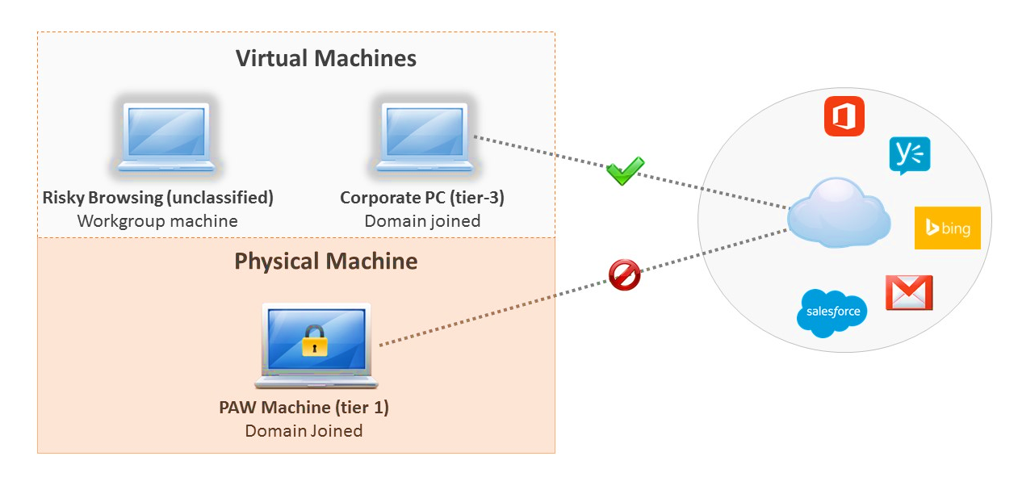
Hardened Workstation

Slide 13

Domain Administration
Privileged
Access
Control
Tier-0
IPsec
Data and
Services
Tier-1
Access
Tier-2

Slide 14





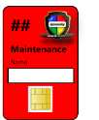

Production Domain
ESAE / Red Forest
IPsec
Domain Admins
Domain Controllers
Admin Workstations
SCOM Gateway
Monitoring
(SCOM)
Certificate
Authority
WSUS
Red Forest
Domain Controllers
Secure Vault
Break-glass Account
Red Forest Admins

Slide 15
Hardened Workstation

Slide 16

Local Admin Password Solution (LAPS)
PASS123
PASS123
PASS123
X
X
X
Active Directory
100110
110010
100011

Slide 17
Virtual Secure Mode
Windows
Apps
Virtual Secure Mode (VSM)
Local Security Auth Service
Virtual TPM
Hyper-Visor Code Integrity
Kernel
Kernel
Hypervisor
Hardware

Slide 18
Staying ahead of exploits
Stay current on
security updates
Use the newest
versions of applications
Use the Enhanced Mitigation Experience Toolkit (EMET)

Slide 20
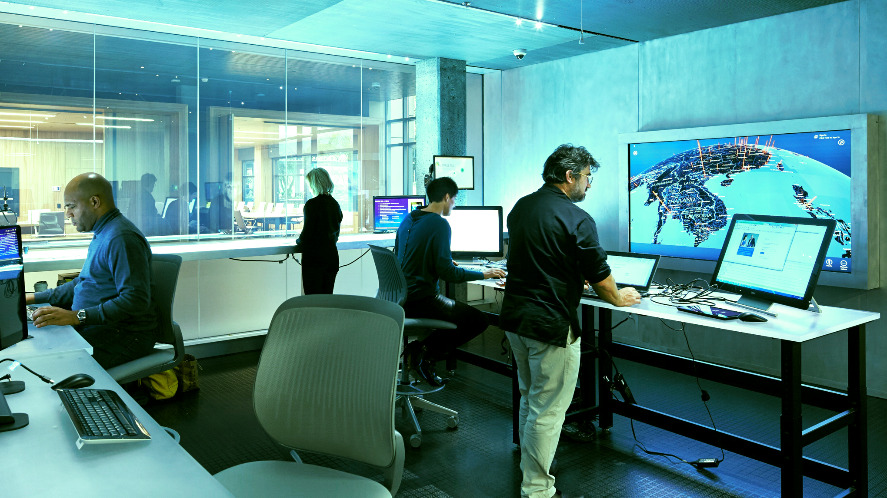
TODAYS CHALLENGE
Trusted by default, until defined as threat
Detection based methods are unable to keep up
APPS

Slide 21
Virtual Secure Mode
Windows
Apps
Virtual Secure Mode (VSM)
Local Security Auth Service
Virtual TPM
Hyper-Visor Code Integrity
Kernel
Kernel
Hypervisor
Hardware

Slide 22

Trusted Code Within a Process
Enhanced Mitigation Experience Toolkit
Behavior-based protection
Supports Group Policy and ConfigMgr

Slide 23
Security Development Lifecycle (SDL)
Reduce Number & Impact of security issues
Prioritize use of threat models
www.microsoft.com/sdl
Training
Requirements
Design
Implementation
Verification
Release
Response

Slide 24
How do you truly recover?
Tier 2
Tier 1
Tier 0

Slide 25

the era of cloud computing
is being born
in a time of war
-like constant hostility

Slide 26

Related Ignite NZ Sessions
1
5
6
2
3
Find me later at…
Hub Happy Hour Thu 5:30-6:30pm
4

Slide 27





Resources
Microsoft Virtual Academy
TechNet & MSDN Flash
  Free Online Learning
http://aka.ms/mva
  Subscribe to our fortnightly newsletter
http://aka.ms/technetnz http://aka.ms/msdnnz
  Sessions on Demand
http://aka.ms/ch9nz

Slide 28
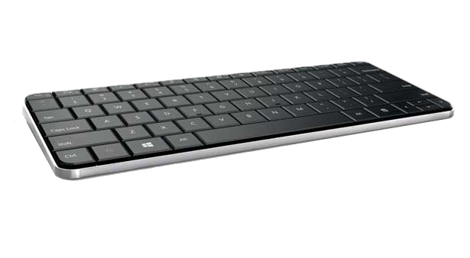

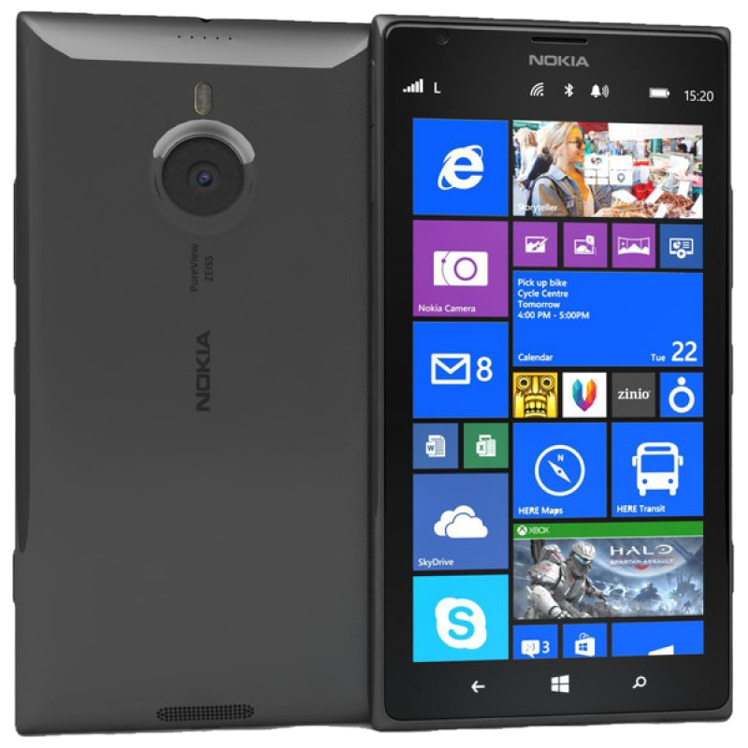
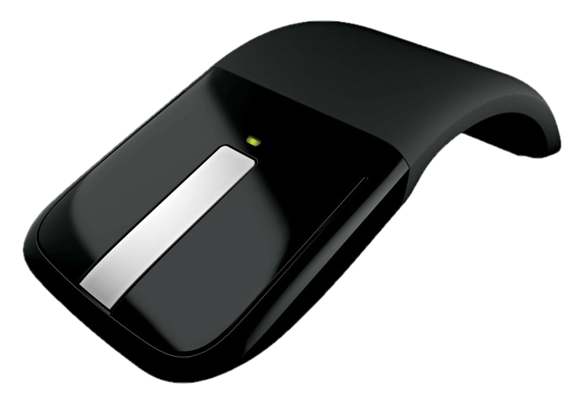

Complete your session evaluation now and be in to win!

