Slide 2
Skype for Business video interoperability master class
M337
Vakhtang Assatrian
Asia Communications TSP Lead, Microsoft

Slide 3
Agenda
Standards Based Video Interop
Interoperability modelling for Video
Skype for Business Video Interoperability Server (VIS)

Slide 4
Standards Based Video Interop

Slide 5
What is a VTC?
Video Teleconferencing (VTC)
  Traditional meeting room video conferencing systems
  Often deployed with two monitors: one for video and another for content sharing
  Can range from small fixed cameras and table microphones to multiple arrays of each
  Support variety of standards-based protocols like SIP, H.323, ISDN, TIP…
  Some may even support native registration directly to Lync/SfB, but most do not
  Lync Room System or Surface Hub are not categorised as a VTC

Slide 6
Foundational Concepts
Signaling
  Information exchange concerning establishment and control of a communications session between two endpoints
Media
  The modality session or payload handled by a coder/decoder (codec)
Peer Sessions
  Two-party communications paths where media is sent directly between caller and callee
  workloads: Voice, Video, Sharing
Conferences
  Multiparty sessions where all participants send media to a conferencing server
  workloads: Voice, Video, Sharing

Slide 7
Video Codecs
Video codecs
  H.264 – Advanced video coding (AVC)
  H.264 – Scalable video coding (SVC) (default codec)
  VC-1/RTVideo
H.264 profiles
  Constrained baseline
  Constrained high: offers improved bandwidth efficiency (added to H.264 standard in 1/2012)
Unified Communications Interop Forum (UCIF) modes
  UC mode 0: H.264 – AVC
  UC mode 1: H.264 – SVC with temporal scalability
Real-Time Transport Protocol (RTP)
  Follows RFC6190 but adds extensions as IETF simulcast, UC modes and profiles

Slide 8
Advanced and Scalable Video Coding
Advanced Video Coding (AVC)
  Standard for video compression and distribution
  First draft 2003
  Block-oriented motion-compensation-based codec VBSMC (Variable Block Size Motion Compenstation)
Scalable Video Coding (SVC)
  Extension of the H.264 standard
  The way that SVC works is the media stream is comprised of individual, complementary layers
  The MCU no longer has to perform any transcoding of the media streams
  Provides to different endpoints the ability to display the resolution and frame rate best suited for a given scenario

Slide 9
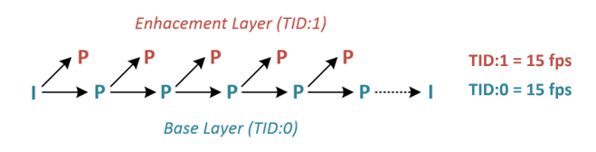
H.264 Scalable Video Coding (SVC)
Temporal Scaling
  Single stream per requested resolution for up to 2 frame rates (7.5fps, 15fps, 30fps supported)

Slide 10
SVC Multistream Capabilities
Multiple Frame Rates
  A single SVC encoded video stream can provide 2 different frame rate layers
  To provide all 3 supported frame rates a second stream will be required
15fps + 15fps
30 fps

Slide 11
SVC Multistream Capabilities
Multiple Frame Rates
  A single SVC encoded video stream can provide 2 different frame rate layers
  To provide all 3 supported frame rates a second stream will be required
15 fps
15fps + 15fps
30 fps

Slide 12
SVC Multistream Capabilities
Multiple Frame Rates
  A single SVC encoded video stream can provide 2 different frame rate layers
  To provide all 3 supported frame rates a second stream will be required
7.5 fps
7.5 fps
7.5fps + 7.5fps
15 fps
15fps + 15fps
30 fps

Slide 13
SVC Multistream Capabilities
Multiple Frame Rates
  A single SVC encoded video stream can provide 2 different frame rate layers
  To provide all 3 supported frame rates a second stream will be required
7.5 fps
7.5 fps
7.5fps + 7.5fps
15fps

Slide 14
SVC Multistream Capabilities
Multiple Resolutions
  Multiple encoded video streams required for each provided resolution
  Each stream is independent and includes entire video payload
180p
180p
360p
360p
720p
720p

Slide 15
Interop modelling for Video

Slide 16
Collaboration World around us
Microsoft Infrastructure
CISCO Infrastructure
Polycom Infrastructure

Slide 17
The missing link
Do not start with Architecture
Start with User and Services consumption modelling

Slide 18
Video Interop architecture options
Native
  Skype Network
  Direct Registration
3rd Party
  External Gateway
  External MCU
  External MCU Cascading
  External Services
**
  In some cases Content/App-Desktop Sharing capability influences architecture model

Slide 19
Video Interop | Native : Skype Network
Features
  IM, Audio, Video
  Peer Calls Only
  Native ICE/STUN/TURN
Limitations
  No Meeting Support
  No Content Sharing
Skype Gateway v2
Skype for Business Edge Server
Skype for Business Front End Server
signalling
Media: TURN
Media: STUN
Media: Local
Skype Desktop Client
SfB Client

Slide 20
Video Interop | Native : Direct Registration
Features
  No intermediary solutions required
  Greenfield or refreshed environments
  Video
  Peer & Conference Calls
  Native ICE/STUN/TURN
Limitations
  Some modalities are limited
Skype for Business Front End Server
Skype for Business Room System
Signalling
Media
Compatible VTC
Lync Client
SfB Client
SfB Client

Slide 21
Video Interop | 3rd Party : External Gateway
Features
  Video
  Peer Calls Only
  Third-Party Solutions
  New Video Interop Server
Limitations
  No Meeting Support
  No Content Sharing
Skype for Business Front End Server
Video Gateway
Signalling
Media
VTC
SfB Client
SfB Client

Slide 22
Video Interop | 3rd Party : External MCU
Features
  Video
  Peer & Conference* Calls Only
  Third-Party Solutions
  Connects foreign systems
  Inconsistent user experiences
Limitations
  Some modalities are limited
Skype for Business Front End Server
Skype for Business Room System
3rd Party MCU
Signalling
VTC
SfB Client
SfB Client

Slide 23
Video Interop | 3rd Party : External MCU
Features
  Video
  Peer & Conference* Calls Only
  Third-Party Solutions
  Connects foreign systems
  Inconsistent user experiences
Limitations
  Some modalities are limited
Skype for Business Front End Server
Skype for Business Room System
3rd Party MCU
Signalling
Media
VTC
SfB Client
SfB Client

Slide 24
Video Interop | 3rd Party : External MCU
Features
  Video
  Peer & Conference* Calls Only
  Third-Party Solutions
  Connects foreign systems
  Inconsistent user experiences
Limitations
  Some modalities are limited
Skype for Business Front End Server
Skype for Business Room System
3rd Party MCU
Signalling
Media
VTC
SfB Client
SfB Client

Slide 25
Video Interop | 3rd Party : External MCU Cascading
Features
  Video
  Peer & Conference Calls Only
  Third-Party Solution: Polycom
  Connects foreign systems
  Best of both worlds
  Single user experience
  All modalities bidirectional
Limitations
Skype for Business Front End Server
Skype for Business Room System
3rd Party MCU
Signalling
Media
VTC
SfB Client
SfB Client

Slide 26
Video Interop | 3rd Party : External Services
3rd Party MCU or Video GW
Skype for Business Front End Server
Skype for Business Room System
Signalling
Media
VTC
SfB Client
SfB Client

Slide 27
SfB VIS :
Video Interoperability Server

Slide 28
Video Interop Server (VIS)
Acts as an intermediary between Skype for Business Server and video teleconferencing systems

Slide 29
What can VIS provide
Peer Calls
A VTC user can call a Skype for Business 2015 or Lync 2013 client directly
Single video stream of a specific resolution and frame rate provided by each end
Conference Calls
A VTC user can join meetings hosted on a Skype for Business 2015 or Lync 2013 AVMCU
Call and conference control actions

Slide 30
What does VIS not provide
No Presence
The VTC is not registered to SfB Server and VIS does not relay presence information in either direction
No Content Sharing
No desktop, application or any other content sharing modality is supported through VIS
No Federated or Online Meetings
A VTC can only join Skype Meetings hosted in the same topology as the trunked VIS pool
No External VTCs
Only VTCs with local network access to the video gateway and VIS are supported
External SfB and Lync clients are supported via the Edge Server

Slide 31
What does VIS not provide
No RTV or CCCP Support
VIS only supports transcoding H.264 video for Lync/SfB clients
No interop with Lync 2010 and older clients
Cannot drag-and-drop VTCs into Skype Meetings
No PSTN Calling
  A VTC can neither place nor receive calls to the PSTN
Limited Standards-Based Features and Compatibility
No H.323, H.263, ISDN, TIP/ITP (multiscreen immersive rooms)
Active Speaker only, no continuous presence or ‘gallery’ view

Slide 32
VIS operation mode
A voice trunk, yet for video (and audio)
The Video Interop Server acts very much like a Mediation Server: SIP Trunk to CUCM

Slide 33

How does VIS work
Transcodes video in both directions
  Handles conversion of SVC and AVC streams without the need for traditional transcoding
  Used in Peer to Peer Calls and simple Skype Meetings
H.264 AVC
H.264 SVC
Signaling
Media Stack

Slide 34
How does VIS work
Can transcode additional video streams
  Transcodes a single AVC stream into one or more SVC streams in conference calls
  Capability can be disabled to increase scale

Slide 35
What can leverage VIS
Video Gateway
A SIP trunk is established between VIS and a supported video gateway
Supported room systems must be registered to the video gateway
Room Systems
SIP compatible endpoints
Models tested directly by Microsoft
Skype for Business VIS Server
Skype for Business Front End Server
Video Gateway
Signalling
Media
VTC
SfB Client

Slide 36
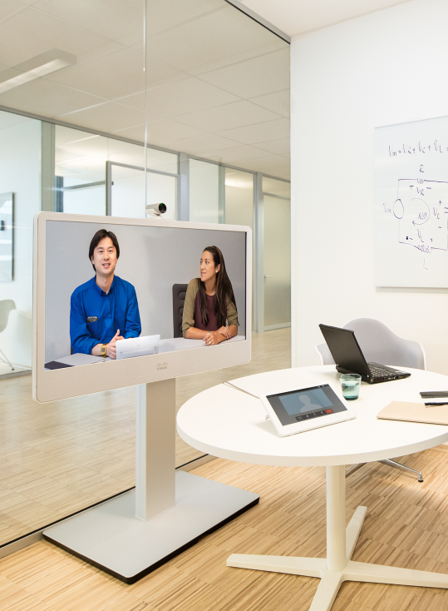
Currently Supported
Video Gateway
Cisco Unified Communications Manager (CUCM)
Release 10.5
Room Systems
Cisco TelePresence Room Systems
Cisco TelePresence Codecs (C40, C60, C90)
Cisco TelePresence DX Series (DX80)
Cisco TelePresence EX Series (EX60, EX90)
Cisco TelePresence MX Series (MX200, MX300)
Cisco TelePresence SX Series (SX20)
Cisco TelePresence Software
Release TC 7.0.0 or newer

Slide 37
VIS connections architecture
Signaling
Skype for
Business Server
Media
CAA
SfB client
AV MCU
VIS
CUCM
VTC
SfB client
VTC
VTC
SfB client
VTC

Slide 38
Lync Server Coexistence
Lync Server 2013 Pool
  Skype for Business Server 2015 pool required as next-hop target for VIS
  Lync Server 2013 CU5-HF9 required
Supported Clients
  Skype for Business 2015
  Lync 2013 Desktop Client
  Lync 2013 Mobile Clients
  Lync 2013 Windows Store App
Skype for Business VIS Server
Skype for Business Front End Server
Video Gateway
Signalling
SVC
AVC
VTC
Lync 2013 Client

Slide 39
Lync Client Coexistence
Mixed Version Meetings
  If a Lync 2010 or older client which only supports RTV joins the meeting then:
  These RTV streams will not be relayed by the AVMCU to the VIS pool
  Any Lync 2013 Mobile clients are instructed by the AVMCU to encode their video in RTV instead of SVC
Skype for Business VIS Server
Skype for Business Front End Server
Video Gateway
Signalling
SVC
SVC
AVC
SVC
VTC
SfB Client

Slide 40
Lync Client Coexistence
Mixed Version Meetings
  If a Lync 2010 or older client which only supports RTV joins the meeting then:
  These RTV streams will not be relayed by the AVMCU to the VIS pool
  Any Lync 2013 Mobile clients are instructed by the AVMCU to encode their video in RTV instead of SVC
Skype for Business VIS Server
Skype for Business Front End Server
Video Gateway
Signalling
SVC
SVC
RTV
AVC
RTV
RTV
SVC
VTC
Lync 2010 Client
SfB Client

Slide 41
Signalling Protocol Documentation
Real Time Protocol
  MS-RTP [Real Time Protocol Extensions]
  Contains payload format information and video source request
H264
  MS-H264PF [RTP Payload Format for H.264 Video Stream
  Extensions]
  Contains signaling of simulcast, smart framing toggling,
  and method to subscribe to video
Video Capability
  MS-SPDEXT [Session Description (SDP) Protocol Version
  2.0 Extensions]
  Contains capability of resolution, frame per second, max bit
  rate declaration
  For more information: Office Protocol Technical Documentation
  http://msdn.microsoft.com/en-us/library/cc307432(v=office.12).aspx

Slide 42
Session Takeaways
One Size doesn’t fit all
  Direct & 3rd party integration options
Key:
  Profile your users
  Understand consumption models

Slide 43
Related Ignite NZ Sessions
1
What's new in Skype for Business [M213]
2 September 9AM
2
Architecture options for implementing Skype for Business [M360]
3 September 4:30PM
3
Skype for Business voice interoperability master class [M384]
4 September 1:55PM

Slide 44

Complete your
session evaluation
now and win!

Slide 45
Questions

Slide 46





Resources
Microsoft Virtual Academy
TechNet & MSDN Flash
  Free Online Learning
http://aka.ms/mva
  Subscribe to our fortnightly newsletter
http://aka.ms/technetnz http://aka.ms/msdnnz
  Sessions on Demand
http://aka.ms/ch9nz

