Slide 1
Running Linux on Hyper-V and in Azure
Anurag Gupta
M357

Slide 2
Agenda
Product Goals
Overview
Hyper-V
Azure

Slide 3
Microsoft Linux

Slide 4
Microsoft is committed to Linux
Linux is a real business for Microsoft
20+% of IaaS VMs
in Azure run Linux
System Center
manages 100,000+’s of
Linux/UNIX servers
Many enterprises
and hosters run
Linux as a guest
on Hyper-V
We’ve been at this for a while
System Center has managed Linux and
UNIX servers since 2009
Linux drivers for Hyper-V available since 2010
Azure IaaS has run
Linux VMs since
“Day 1” in 2013
Now
Linux and open source are a fundamental part of what we do

Slide 5
Microsoft Linux and Unix Ecosystem
 | Linux |  |  |  |  |  | UNIX
 | Red Hat | SUSE | CentOS | Ubuntu | Debian | Oracle | AIX | HP-UX | Solaris
Operations Manager | ✓ | ✓ | ✓ | ✓ | ✓ | ✓ | ✓ | ✓ | ✓
Configuration Manager | ✓ | ✓ | ✓ | ✓ | ✓ | ✓ | ✓ | ✓ | ✓
Endpoint Protection | ✓ | ✓ | ✓ | ✓ | ✓ | ✓ | No Plans
Data Protection Manager | ✓ | ✓ | ✓ | ✓ | ✓ | ✓
Virtual Machine Manager | ✓ | ✓ | ✓ | ✓ | ✓ | ✓
Hyper-V | ✓ | ✓ | ✓ | ✓ | ✓ | ✓
Azure IaaS |  | ✓ | ✓ | ✓ |  | ✓

Slide 6

Goals for Linux Support
Enable the best experience for running Linux on Hyper-V and Azure.
Provide great choice and flexibility in running Linux distributions.
Customers can easily deploy and manage their Linux workloads in Hyper-V and Azure.

Slide 7
Linux and FreeBSD in Hyper-V

Slide 8
Universe of Hyper-V Functionality
Outside The Guest
Guest Cooperation Needed
  Rapid Live Migration w/ RDMA
  Software Defined Networking
  Software Defined Storage
  Storage QoS
  Enhanced management
  Dynamic memory
  Live backup
  Generation 2 VMs
Other Sessions
This Session
All works for Linux/FreeBSD!

Slide 9
Running a Guest OS on Hyper-V
Runs on x86/x64?
Have
Integration
Services?
Yes
Yes
Start
No
No
Dead end
Not going to run on
Hyper-V
Emulated Devices
No Hyper-V integration
Limited manageability
Limited functionality
OK CPU, weak disk/net
Synthetic Devices
Full Hyper-V integration
Best manageability
Best functionality
Perf near bare metal
AIX, HP-UX
Solaris SPARC
Windows RT
Solaris x86
Linux with no IS
BSD with no IS
Linux with IS
FreeBSD with IS
Windows with IS

Slide 10
Linux Integration Services (LIS)
Hyper-V presents synthetic devices to the Guest OS
Guest OS needs drivers for these synthetic devices
Integration Services are Guest OS driver for Hyper-V
Synthetic devices are agnostic of hardware underneath Hyper-V
Integration Services differ from Windows to Linux to FreeBSD
Includes user-space daemons that facilitate driver interaction

Slide 11

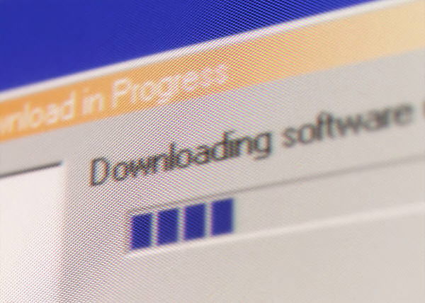






LIS Development, Distribution & Support
Microsoft
developers
LIS for Hyper-V
LIS for Hyper-V
Linux kernel main
Linux community
MS
download
center
Customer installs LIS
Support issues flow in reverse direction
Distro vendors
. . . .
Customer servers with Hyper-V
Linux distro w/LIS

Slide 12


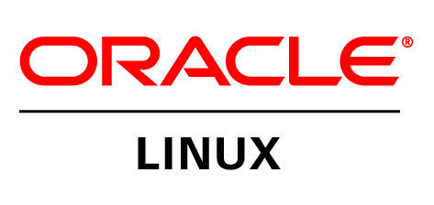
Linux Integration Services: LIS & Built-in
Red Hat Enterprise Linux
CentOS Linux Server
Red Hat Compatible Kernel
*Only 6.4 – 6.7, 7.0 – 7.1
Shared Versions | LIS Built-in? | LIS download?
5.5 thru 5.8 |  | LIS 4.0
5.9 thru 5.11 | Yes | LIS 4.0
6.0 thru 6.3 |  | LIS 4.0
6.4 thru 6.7 | Yes | LIS 4.0
7.0 thru 7.1 | Yes | LIS 4.0
RHEL versions with LIS built-in are certified by Red Hat for running on Hyper-V
Full benefits of your RHEL subscription

Slide 13


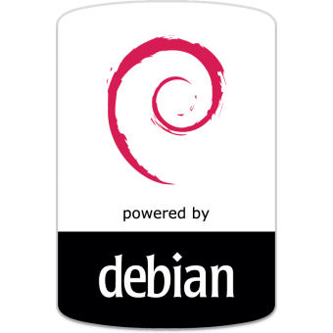
Linux Integration Services: Built In
Ubuntu Server
Versions: 12.04, 12.10, 13.04, 13.10, 14.04, 14.10, 15.04
SUSE Linux Enterprise Server
Versions: 11 SP2, 11 SP3, 11 SP4, 12
Oracle Linux
Unbreakable Enterprise Kernel
6.5 – 6.6, 7.0 – 7.1
Debian Server
Versions: 7.0 – 7.8, 8.0 – 8.1

Slide 14
LIS 4.0 Package
Newest version of Microsoft downloadable LIS package
  Succeeds LIS 3.5
Why upgrade?
  Numerous performance enhancements including increased networking throughput + Bug Fixes
    Highly recommended for CentOS VMs running in Azure
  Be cognizant of potential impact on RHEL supportability under Red Hat subscriptions
Compatibility
  RHEL, CentOS, Oracle Linux with Red Hat Compatible Kernel only
    VMs with no LIS installed
    VMs with LIS 3.5+ installed
    VMs with built-in LIS
  VM must be rebooted after installation

Slide 15
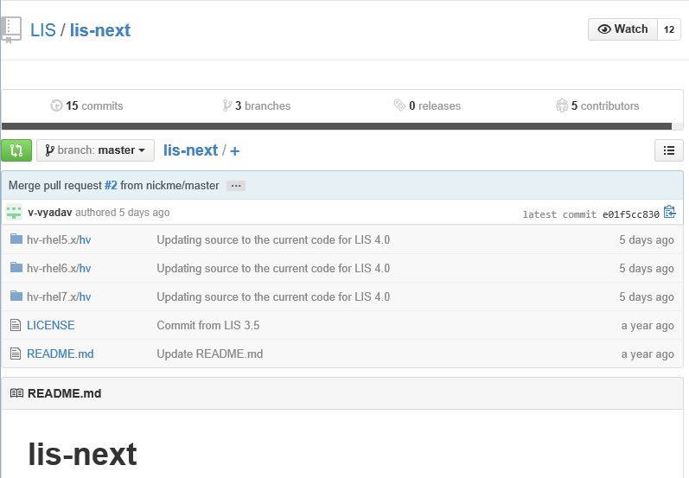
LIS Source Code
- On the LIS 4.0 ISO downloaded from Microsoft
- Upstream Linux kernel
  http://git.kernel.org/cgit/linux/kernel/git/next/linux-next.git/tree/?id=HEAD
- LIS github repository
  https://github.com/LIS/lis-next
Upstream Linux Kernel Files/Directories
arch/x86/include/asm/mshyperv.h
arch/x86/include/uapi/asm/hyperv.h
arch/x86/kernel/cpu/mshyperv.c
drivers/hid/hid-hyperv.c
drivers/hv/
drivers/input/serio/hyperv-keyboard.c
drivers/net/hyperv/
drivers/scsi/storvsc_drv.c
drivers/video/hypeinclude/linux/hyperv.h
tools/hv/rv_fb.c

Slide 16


FreeBSD in Hyper-V
FreeBSD is *not* Linux
  UNIX descendant from Berkley Software Distribution (BSD)
  Cannot use “UNIX” as a name due to copyrights
  FreeBSD is the most popular of *BSD variants (OpenBSD, NetBSD, etc)
Distribution | Version | BIS Availability
FreeBSD | Head (ports for 10.x avail) | BIS built-in

Slide 17
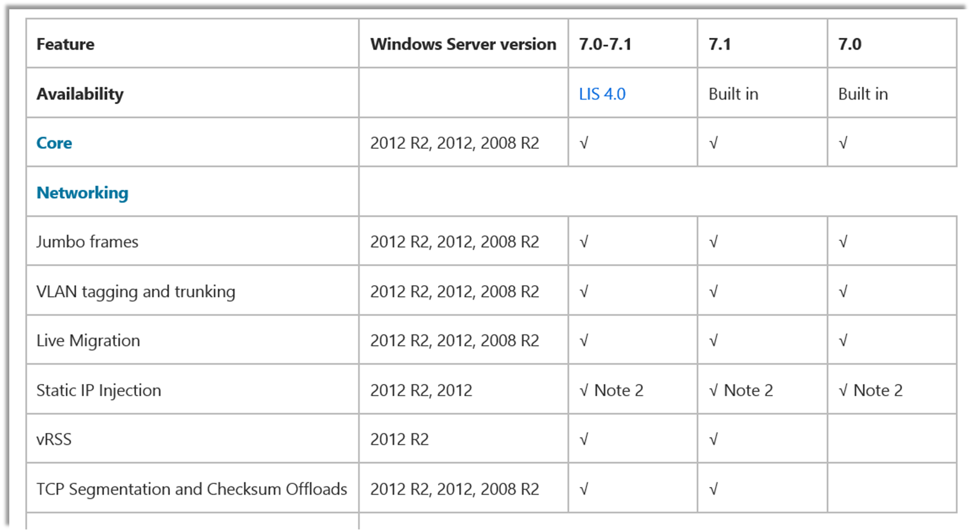
Linux and FreeBSD Documentation
Get the latest distro support information on TechNet
  What’s built-in vs. what’s available in an LIS download
  Feature grids
  Hyper-V versions
  Exceptions and notes
  Best practices

Slide 18
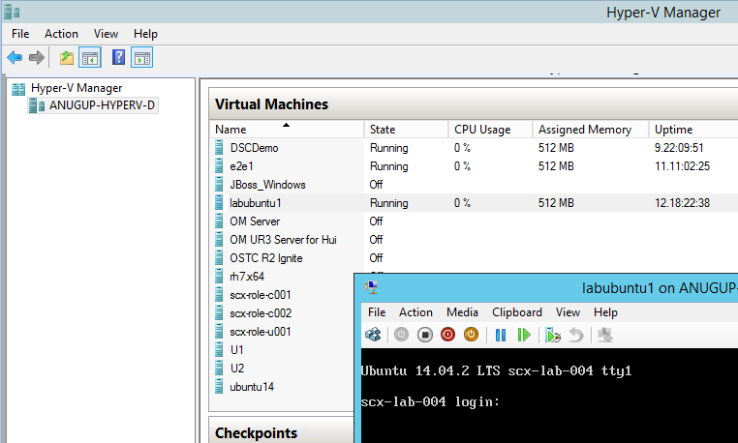

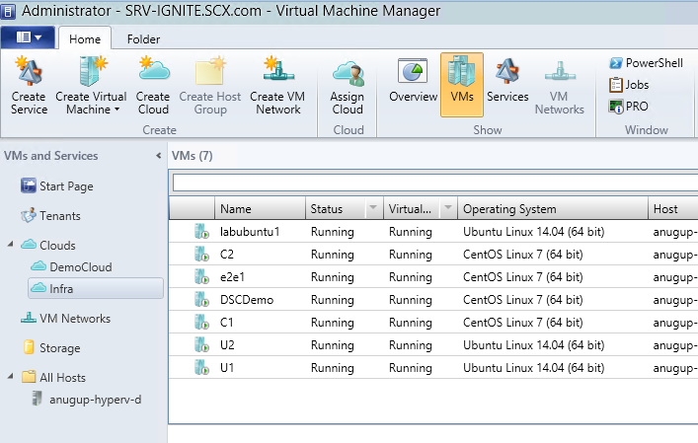
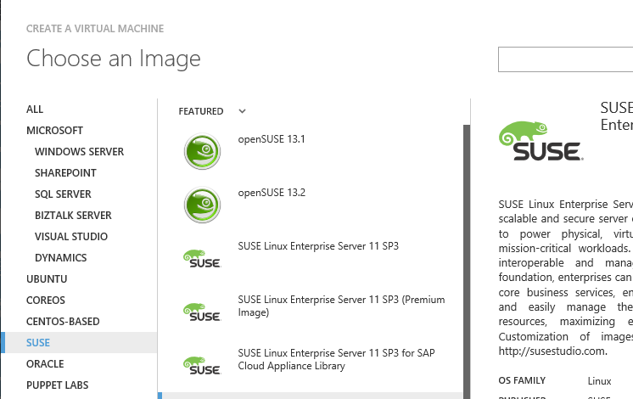
Operating Linux VMs in Hyper-V
Hyper-V
Manager
Hyper-V host
Linux VM
Powershell
FreeBSD VM
SC VMM &
Azure Pack
(Linux only)
Windows VM
Azure public
cloud

Slide 19
Linux Integration Services Features

Slide 20
LIS Feature: Enhanced Management
Shutdown Linux guests from management console
  Hyper-V signals LIS in the Linux guest to run the “shutdown” command
Time sync
  Linux guests sync to Hyper-V host time at start-up and upon resume
  Recommend running NTP in the Linux guest to avoid wall clock time drift in the guest
Key/Value Pairs
  Bi-directional host-guest communication path – no network connection required
  Used to communicate basic guest info (such as IP address) to the management console
  Can also be used by applications – APIs are published for use within a Linux guest

Slide 21

LIS Feature: Generation 2 VMs, VHDX Resize
Generation 2 VMs
  Slimmed down virtual machine with no legacy device emulation (serial ports, IDE, etc.)
  Boot using UEFI instead of BIOS
  PXE boot from synthetic Network Adapter
Secure Boot
  Standard feature of UEFI
  Newly implemented for Linux in Windows Server 2016 Hyper-V
  Works for latest versions of RHEL, CentOS, SLES, Ubuntu, and Oracle Linux
VHDX Resize
  Host side changes to VHDX size are visible in the guest almost immediately
  Can automate file system resize to match change in underlying disk

Slide 22
LIS Feature: Dynamic Memory
- Hyper-V controls memory allocated to the guest OS
- Higher VM density via memory overcommit
- Works for Windows and Linux guests on same host
Hot-Add
Ballooning
Adds memory between “Startup Memory” and “Maximum Memory”
Newly added memory increases total memory size seen by Linux guest OS
“Hot-Remove” is not implemented for Linux
Removes and re-adds memory between current size and “Minimum Memory”
Does not affect total memory size seen by Linux guest OS
Linux guest treats removed memory as used buffers

Slide 23
LIS Feature: Dynamic Memory
❶ Hot-Add: Linux memory size increases
Startup
Memory
Maximum
Memory
0
❷ Ballooning: Removes memory. Linux memory size is unchanged. Sum of dark blue doesn’t go below “Minimum Memory”
❸ Ballooning: Adds memory back. Linux memory size is unchanged

Slide 24
LIS Feature: Live Virtual Machine Backup
Full backup of a Linux VM without interrupting operations
Backup is file system consistent
  Linux guest file systems are temporarily frozen for a few seconds or less
  Linux file system buffers are flushed
  Not necessarily application consistent
Accomplished via interaction between Hyper-V and LIS drivers in Linux guest

Slide 25
LIS Feature: Live Virtual Machine Backup
❸ LIS VSS components freeze the file systems and flush in memory buffers
User Space
VSS*
Daemon
Linux
Guest
❷ Hyper-V signals LIS inside the Linux guest to do backup steps
File sys
buffers
VSS*
Driver
❶ Utility tells Hyper-V to start VM backup
Kernel
Hyper-V Host
Backup
Utility
❹ Hyper-V creates a
VM checkpoint & tells
LIS to unfreeze the FSs
❺ VSS in Hyper-V creates a snapshot of volume hosting the VHD
❻ Utility copies file-system consistent VHD from the snapshot
Guest
VHD
Hyper-V Storage
Backup
Storage
*Somewhat mis-named. Does not implement Windows VSS.

Slide 26
LIS Feature: Networking
Hot-add / hot-remove vNIC
  Add or remove a virtual NIC in a running Linux virtual machine
  Linux guest will add or remove the corresponding /dev entry
  New in Windows Server 2016 Hyper-V
Network throughput
  Implemented vRSS/vSSS and various TCP offloads
  See TechNet feature grids for which distros have the network throughput improvements
iperf3
(16 threads)
iperf3
(16 threads)
Linux guest
(8 vCPUs)
9.4 Gbps throughput
Linux guest
(8 vCPUs)…
Hyper-V host #1
Hyper-V host #2
10G Ethernet

Slide 27
Linux in Hyper-V Demo
Anurag Gupta

Slide 28
Linux and FreeBSD in Azure

Slide 29

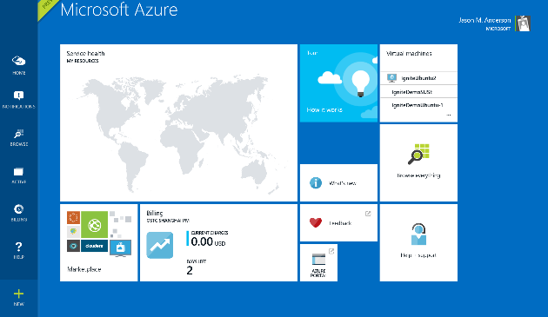


Ways to get a Linux or FreeBSD Image in Azure
Azure Marketplace
Upload Custom Image

Slide 30






Azure-Endorsed Marketplace Linux Images
Partner created, Microsoft tested
Standard Images
    Customers to contact Linux vendor/partner for Linux support
    Azure-related issues supported by Microsoft
Oracle
Linux
openSUSE
CoreOS
OpenLogic
CentOS-based
Canonical
Ubuntu
Premium Images
    Microsoft engages the Linux vendor/partner on behalf of the customer for support
    Currently only SLES 11 SP3 & 12
    More coming soon!
More
SUSE Linux
Enterprise Server
Coming Soon!

Slide 31








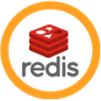

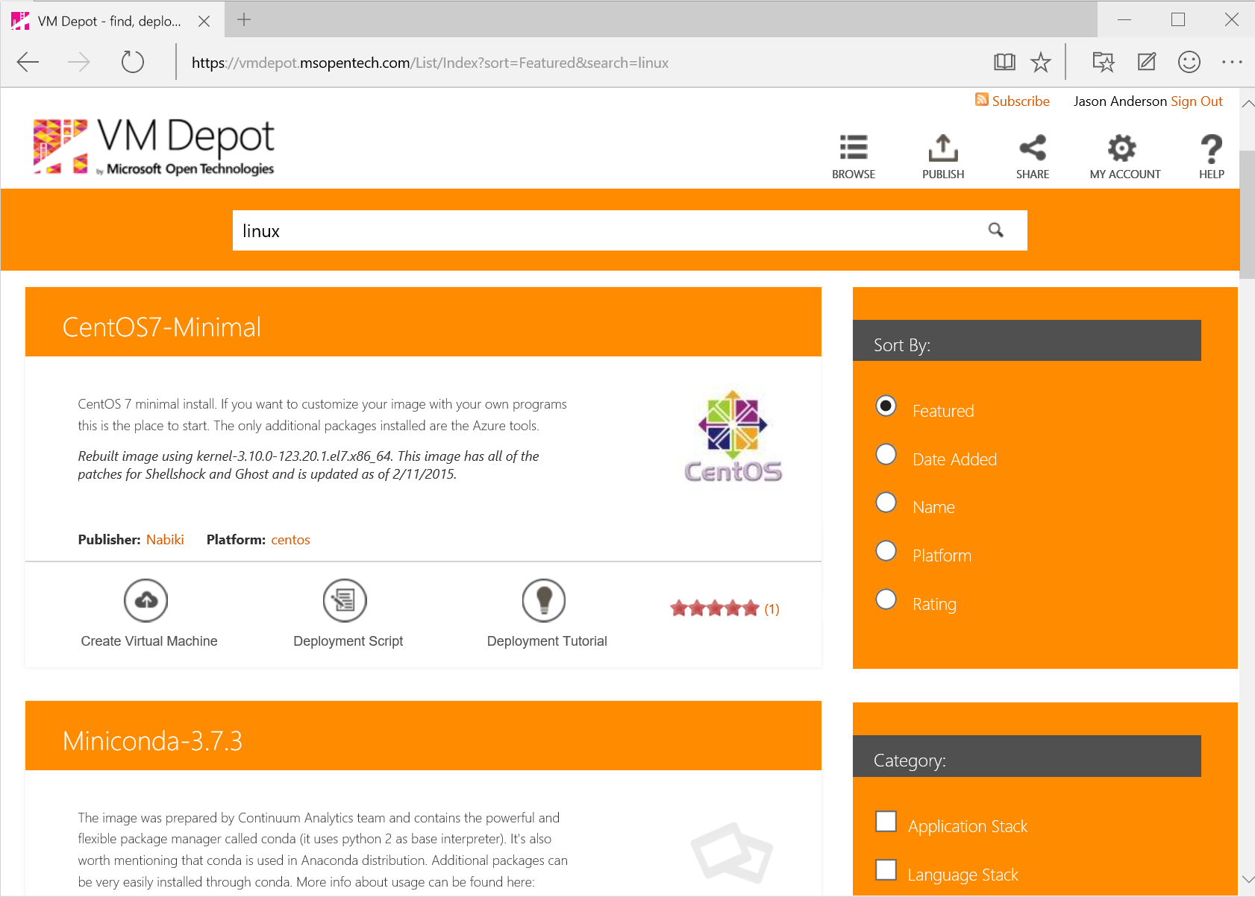
Other Linux and FreeBSD Images in Azure
Azure Marketplace
  Partner created and uploaded images
  Validated
  May be complete solution stacks or “vanilla” OS images
+ many more!
VM Depot
  Community created images made available through the VM Depot website for download, or browse/upload directly from Azure portal

Slide 32



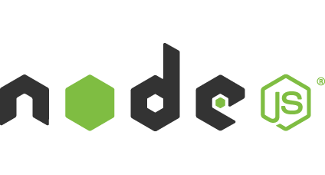

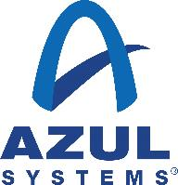









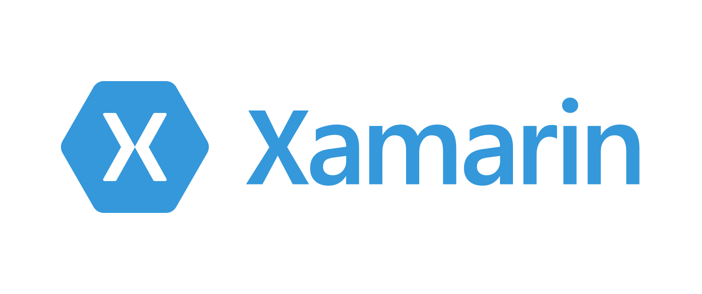
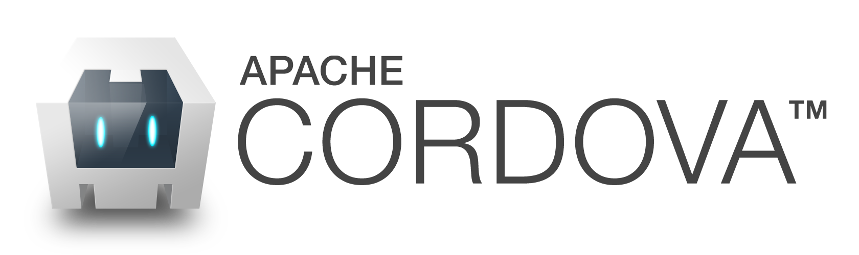
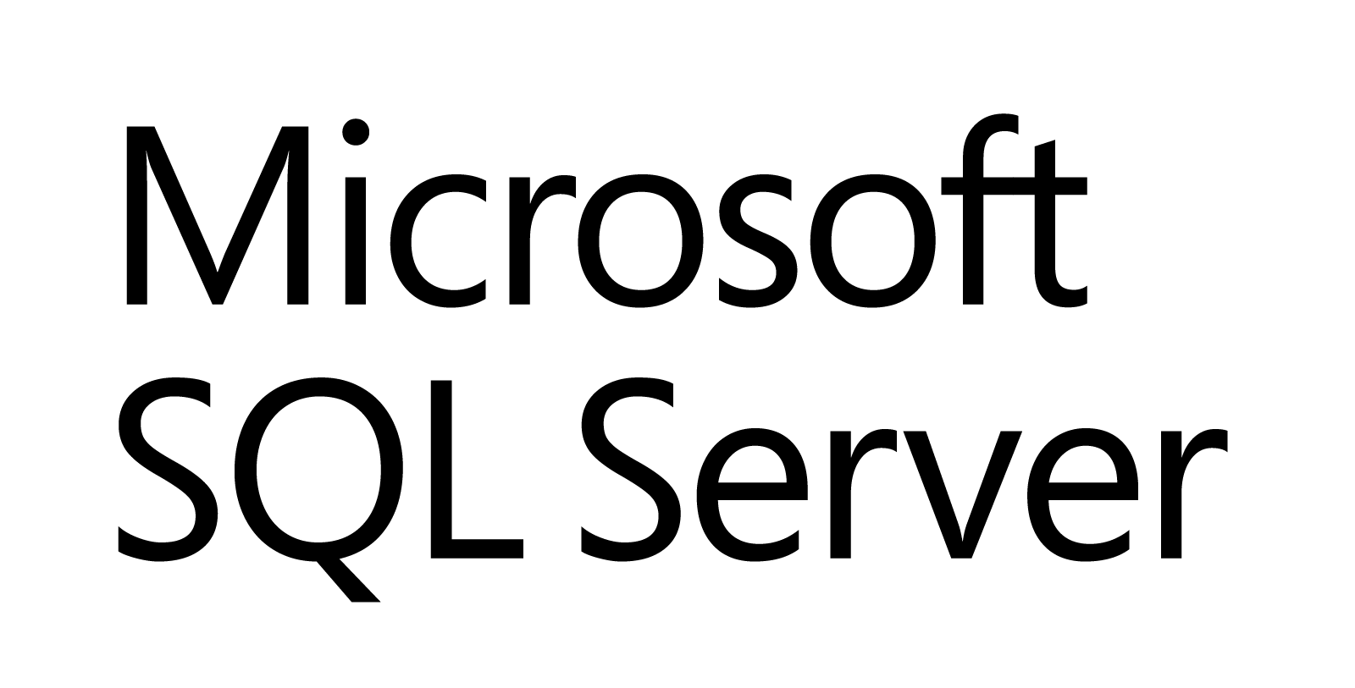








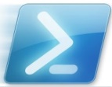
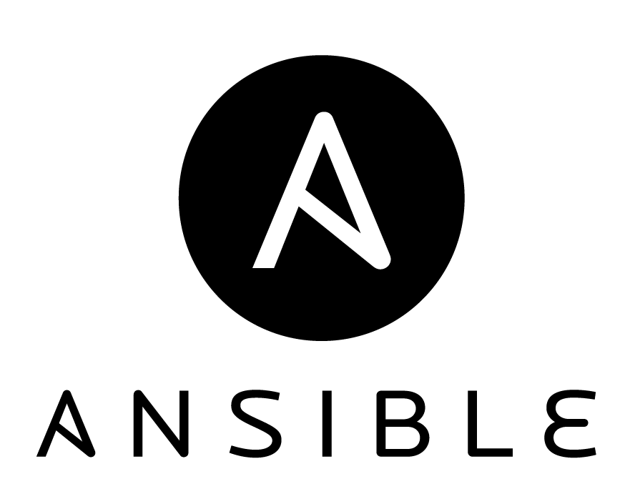

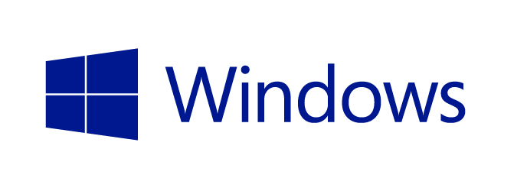
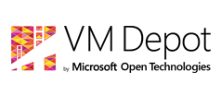

Azure is an Open Cloud
Public Cloud
Microsoft Integrated
Ecosystem Provided
Languages,
Dev Tools
and App Containers
Bring your own
CMS and Apps
Dozens of .NET and PHP CMS and Web applications
Devices
Via HTMl/JS, cross-platform and native
Databases
DocDB
Management
libcloud
jclouds
Operating
systems
Ubuntu, SUSE, OpenSUSE,
OpenLogic CentOS-based
Oracle Linux, CoreOS
Bring
your own

Slide 33
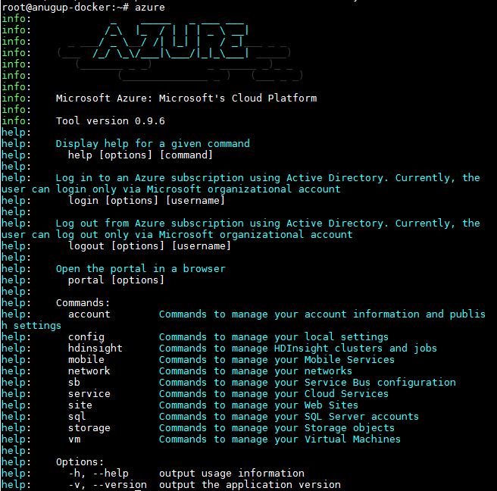
Manage Azure from Linux, Mac OSX, Windows
Azure CLI
  Node.js npm package
  Native platform packages
  Run from Docker container
New HTML 5 Portal
  http://portal.azure.com

Slide 34
Linux in Azure Demo
Anurag Gupta

Slide 35
Azure Linux Agent
What Is It?
  Manages interaction between the VM and the Azure fabric controller
  Released under the Apache 2.0 license, included in most Linux distributions as a RPM or Deb package and on GitHub
  Requires Python 2.6+
  Required for any Linux or FreeBSD VM to run in Azure
What It Does
  VM provisioning (host name, user account, SSH keys, disk mgmt.)
  Manages networking (routes for DHCP servers, networking interface name)
  Kernel functions (virtual NUMA, Hyper-V entropy & SCSI timeouts)
  Redirects console to the serial port for debugging
  VM extension handler

Slide 36
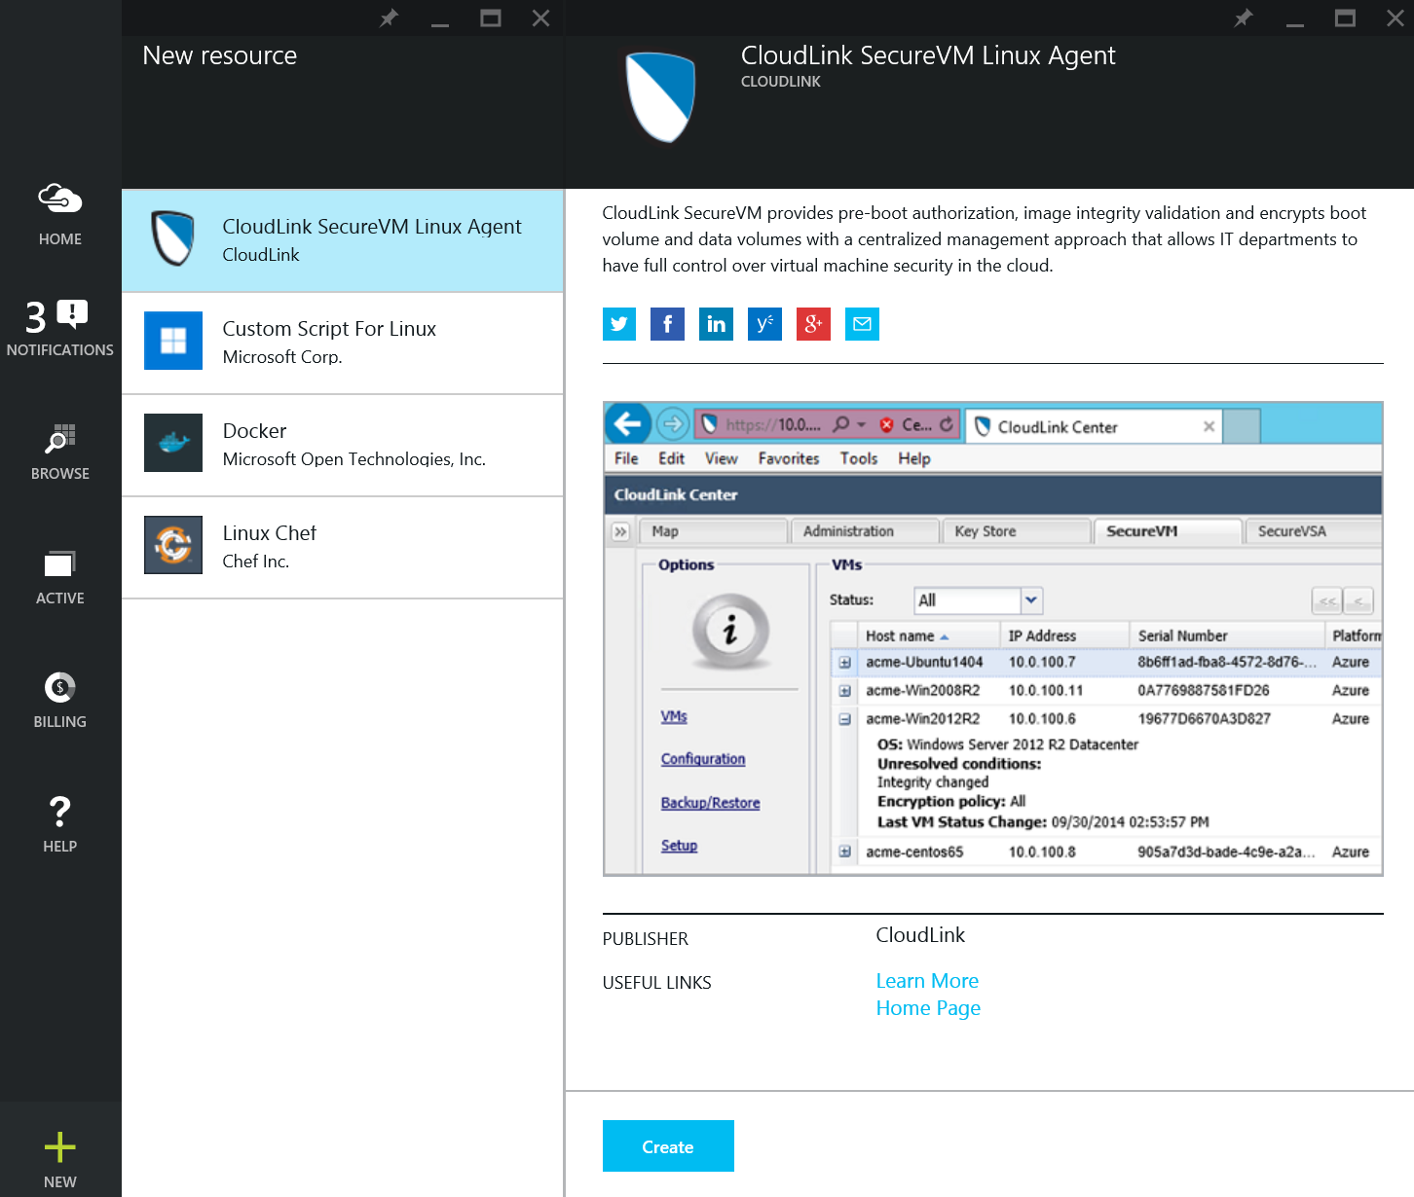
About VM Extensions
VM Extensions
  VM Extensions are software components that extend the functionality of the virtual machine
  Multiple extensions can be added, updated or removed
  Installed and managed by the Azure Linux Agent version 2.0.6 or greater
Support for Linux
  All Azure-Endorsed Linux images in the Azure Marketplace have support for VM Extensions

Slide 37
Microsoft VM Extensions for Linux
Current VM Extensions
Coming Soon…
CustomScript
  Automatically runs a specified script or a set of scripts on a running Virtual Machine
  Not limited to a specific scripting language
VMAccess
  Enables you to reset Secure Shell (SSH) settings on a Virtual Machine and to reset the password for the account that has administrator or sudo authority.
  OSPatching
  Automate VM OS updates with customized configurations
  Specify how often and when to install OS patches
  Specify what patches to install
  Configure the reboot behavior after updates
Monitoring
  Enables the user to collect monitoring and diagnostic data for debugging, trouble shooting, measuring performance, monitoring resource usage, traffic analysis and capacity planning and auditing.
VMSnapshot
  VM image backup utilizing Azure Backup for state restoration of VM images in Azure
VMEncryption
  Automate encryption of storage volumes
  Persistent reconnection & authentication of encrypted volumes after VM reboot

Slide 38
VM Extensions Demo
Anurag Gupta

Slide 39
In Summary
Linux is a core business for Microsoft
Hyper-V and Azure are the best platforms to run your Windows and Linux workloads
Support for Linux and FreeBSD in Hyper-V and Azure continues to be strengthened everyday

Slide 40

Related Ignite NZ Sessions
1
DevOps – The Future of Deployments with DSC
Crowne B2 Wed 11:55 am
Find me later at…
Hub Happy Hour Wed 5:30-6:30pm
Closing drinks Fri 3:00-4:30pm
2
SharePoint deployment automation with PowerShell Desired State Configuration
Crowne Elliot Wed 3:10pm
3
OMS @ Massey
NZ3 Thu 1:55pm

Slide 41





Resources
Microsoft Virtual Academy
TechNet & MSDN Flash
  Free Online Learning
http://aka.ms/mva
  Subscribe to our fortnightly newsletter
http://aka.ms/technetnz http://aka.ms/msdnnz
  Sessions on Demand
http://aka.ms/ch9nz

Slide 42


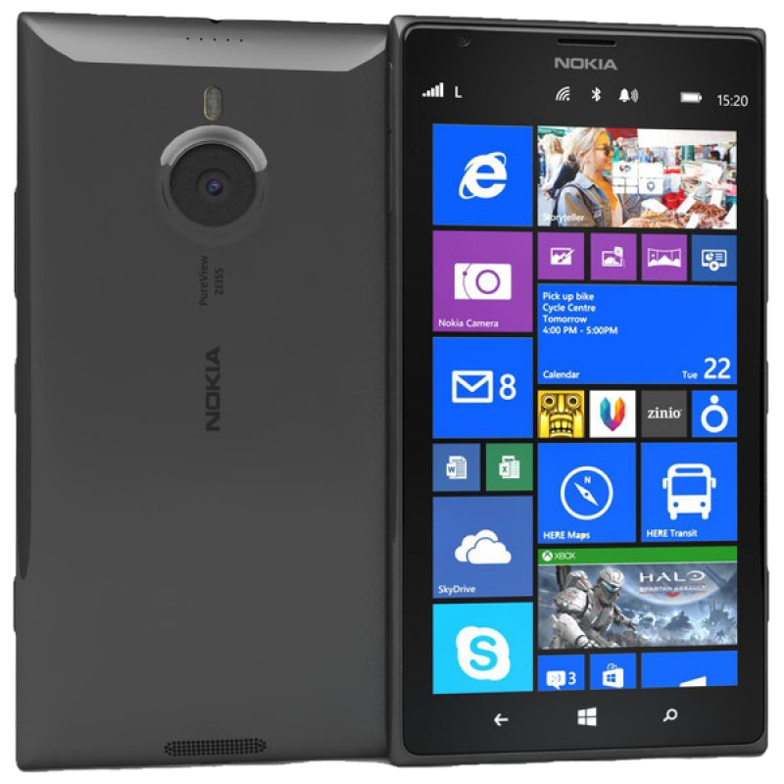
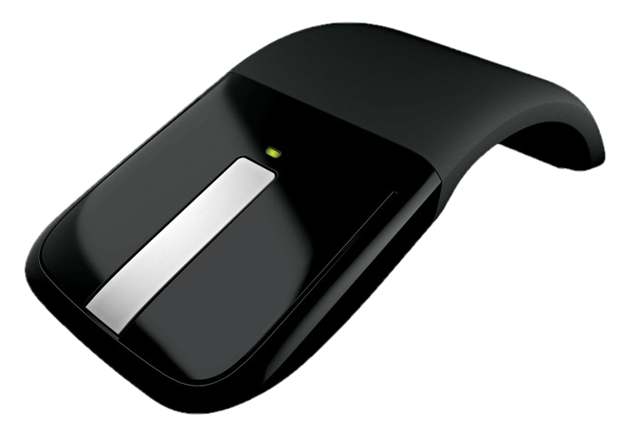

Complete your session evaluation now and be in to win!

