Slide 2
Identity Management in Office 365: Which one’s right for you?
Brendan Ross
M362

Slide 4
Start Simple

Slide 5
Agenda
Cloud Identity Model
Synchronised Identity Model
Federated Identity Model
New Identity Features

Slide 6
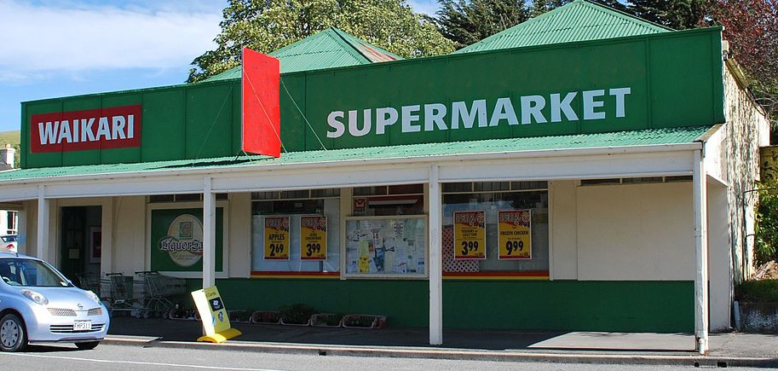
Scenario One – Mini Supermarket Cloud Identity Model
5 Stores
8 Staff Members
No on premise servers
User accounts created in Office 365 portal
Authentication takes place in Office 365
Self Service Password Reset included

Slide 7
Scenario One – Mini Supermarket Cloud Identity Model Tips & Tricks
Great way to pilot Office 365
Can use your own domain name
Windows 10 connects to Azure AD
http://blogs.technet.com/b/ad/archive/2015/05/28/azure-ad-join-on-windows-10-devices.aspx
Restructuring your AD
Can Import list of users (CSV)
Supports third party migration tools
Can still use if you have on premise servers

Slide 8
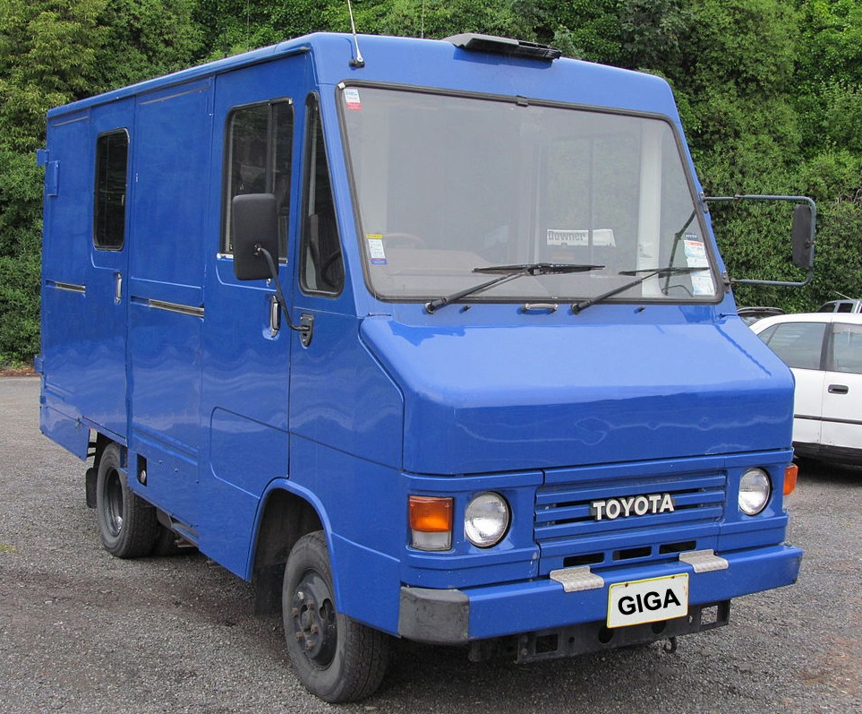
Scenario Two – Bing Logistics Synchronised Identity Model
3 Distribution Centers
42 Staff Members
6 On premise servers
Staff to be able to use same username and password
AADS to sync accounts and passwords
Passwords stored as a digest of a hash of the password
Authentication takes place in Office 365
Accounts managed via on premise AD
Azure AD used for other 3rd party/own cloud services.

Slide 9
Scenario Two – Bing Logistics Synchronised Identity Model
Tips & Tricks
Use the new AD Connect tool to configure AD sync
Dirsync (Office 365 portal) still supported by Microsoft
Must maintain an exchange server on-prem (or tool)
Can have reverse syncing from Azure AD to on-prem (with Azure AD Premium subscription)
With Azure AD Premium you can provide a self service password reset facility.
Don’t sync the msExchMailboxGUID attribute when using 3rd party migration tools (removing the attribute post sync won’t delete from O365)
Convert on premise mailboxes to mail enabled user – do not delete or disconnect the mailbox

Slide 10
Deep Dive: O365 - A Peek Inside the Sausage Factory [M367]
Date: Friday 3 Sept
Time: 9:00am
Speaker: Neil Hodgkinson, Steve Walker

Slide 11
Demo: Azure AD Connect Express Settings
Brendan Ross

Slide 12
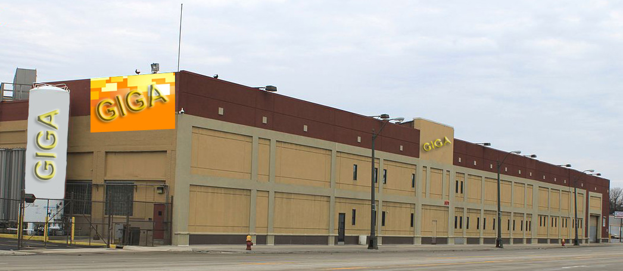
Scenario Three – Giga Beverages Federated Identity Model
4 Factories
300 Staff Members
50 servers and 34 applications
Group wide on-prem SharePoint
Utilise Office 365 services (SharePoint/SfB/BI)
Move applications to Azure in the future
SSO experience to reduce logon prompts
AD Connect to sync accounts and setup ADFS
ADFS servers on-prem/Azure to authenticate users
Users are redirected by Office 365 to ADFS servers for authentication

Slide 13
Scenario Three – Giga Beverages Federated Identity Model
Tips & Tricks
Only implement if really required
Read the Technet deployment guides
http://technet.microsoft.com/en-us/library/jj205462.aspx
Only implement the Office 365 requirements
Plan server requirements, perimeter network, NLB, DNS, Certs, firewall rules, Azure
Use the AD Connect tool, enable password sync as a backup (unless policies disallow)
Outlook doesn’t use SSO (yet)
Make sure you have NTP configured on ADFS servers – token sensitive to time.

Slide 14
Other considerations for choosing federation
You already have an AD FS Deployment
You already use a Third Party Federated Identity Provider
You use Forefront Identity Manager 2010
You have an On-Premises Integrated Smart Card or Multi-Factor Authentication (MFA) Solution
Custom Hybrid Applications or Hybrid Search is Required
You Require Sign-In Audit and/or Immediate Disable
Single Sign-On minimising prompts is Required
Require Client Sign-In Restrictions by Network Location or Work Hours
Policy preventing Synchronizing Password Hashes to Azure AD

Slide 15
Change between models as needs change
Cloud Identity to Synchronised Identity
Deploy AADS or AD Connect
Hard match or soft match of users
Synchronised Identity to Federated Identity
Deploy AD FS
Can leave password sync enabled as backup
Federated identity to Synchronised Identity
PowerShell Convert-MsolDomainToStandard
Takes 2 hours plus 1 additional hour per 2,000 users
Synchronised Identity to Cloud Identity
PowerShell Set-MsolDirSyncEnabled –EnableDirSync $false
Takes 72 hours and you can monitor with Get-MsolCompanyInformation

Slide 16
Summary
Cloud identity
Synchronised identity
Federated identity
Zero on-premises servers
Directory sync with password sync
Federation
Directory sync
Intend to remove on-premises server (e.g. Small Business)
On-premises identity
On-premises identity

Slide 17
Choose the simplest model for your needs
Cloud Identity is Recommended
Cloud Identity is the simplest model
Choose cloud when
You have no on-premises directory (now or in the short term)
There is on-premises directory restructuring
You are in pilot with Office 365

Slide 18
New Identity Features
ADAL
Public Preview
Enables these capabilities
Multi-Factor Authentication
SAML based identity providers
Smart Card and Cert authentication
Outlook no longer requiring basic authentication (SSO)
Check the web site for any outstanding limitations.
http://aka.ms/blogadalpreview
http://tinyurl.com/q2d3qrg
https://support.microsoft.com/en-nz/kb/2535227
Branding
Included in all Office 365 SKUs
Change the Sign-in Page
Text
Colours
Imagery
Previously available with the Azure AD Premium subscription.
Self Service Password Reset
Included in all Office 365 SKUs
Allows a user who has forgotten their password to reset it based on prearranged alternative personal information.
Previously available with the Azure AD Premium subscription
Self Service Password Reset is available for cloud users.
With synchronized identity model an Azure AD Premium subscription is still required (for sync back)

Slide 19
Related Ignite NZ Sessions
Required Slide
*delete this box once you have listed content that is related to your session.
Speakers, please list the other Breakout Sessions that relate to your session.
Also indicate where and when they can find you, to continue the discussion.
If you’re going to be at Hub Happy Hour (5.30-6.30pm Wed and Thu, let them know)
1
Office 365 and Azure Active Directory Premium
Wednesday 10:40am
4
O365 – A peek Inside the Sausage Factory
Friday 9:00am
5
2
101 Ways to Authenticate with Azure Active Directory
Thursday 10:40am
Windows 10 + Azure AD + Intune = Full desktop management and provisioning in the cloud
Friday 9:00am
Find me later at…
Hub Happy Hour Thu 5:30-6:30pm
Closing drinks Fri 3:00-4:30pm
3
Microsoft Azure and the Enterprise
Wednesday 9:00am

Slide 20
Brendan Ross
brendanr@datacom.co.nz

Slide 21
Resources
Microsoft Virtual Academy
TechNet & MSDN Flash
Free Online Learning
http://aka.ms/mva
Subscribe to our fortnightly newsletter
http://aka.ms/technetnz http://aka.ms/msdnnz
Sessions on Demand
http://aka.ms/ch9nz

Slide 22
Complete your
session evaluation
now and win!

