Slide 2
Windows 10 + Azure AD + Intune = desktop management and provisioning in the Cloud
Daniel Bowbyes & Malcolm Jeffrey
M368

Slide 3
Malcolm Jeffrey
Technical Trainer
Auldhouse
Daniel Bowbyes
CloudConsult Practice Lead
Datacom

Slide 4
Dave
OneDrive
Office 365
Azure
Dynamics

Slide 7
10

Slide 8
Azure AD Join
MDM
All staff in Dave's Azure AD can log in to the device
Set local administrators
10
Staff can be blocked from logging on to the device
MDM enrolment of device can be enforced

Slide 9
Intune Enrolment
Intune
Apply Policy Settings to the device
Push software down to the device
10
Report on the Health of the device against compliance Policies
If needed wipe the device

Slide 10
OneDrive
Office 365
Azure
Intune
Dynamics

Slide 11
Azure AD Join OOBE

Slide 12
Azure AD Join under the hood

Slide 13
Azure
Device Registration
Service
Microsoft Azure
Active Directory
Intune
10

Slide 14
Azure
Device Registration
Service
Microsoft Azure
Active Directory
Azure AD username and Password (+ MFA if enabled)
Intune
10

Slide 15
Azure
Device Registration
Service
Microsoft Azure
Active Directory
Azure AD returns ADRS SSO Token, Local admin accounts and MDM URL’s
Intune
10

Slide 16
Azure
Device Registration
Service
Microsoft Azure
Active Directory
Win 10 then performs a device registration against ADRS using token provided by Azure AD
Intune
10

Slide 17
ADRS writes a device object to Azure AD
Azure
Device Registration
Service
Microsoft Azure
Active Directory
Intune
10

Slide 18
Azure
Device Registration
Service
Microsoft Azure
Active Directory
ADRS issues a device registration certificate to the client
Intune
10

Slide 19
Azure
Device Registration
Service
Microsoft Azure
Active Directory
MDM URL’s passed to MDM Enrolment Agent
Intune
10

Slide 20
Azure
Device Registration
Service
Microsoft Azure
Active Directory
MDM Agent connects to Azure AD for SSO token to access MDM application
Intune
10

Slide 21
Azure
Device Registration
Service
Microsoft Azure
Active Directory
Azure AD returns MDM SSO Token
Intune
10

Slide 22
Azure
Device Registration
Service
Microsoft Azure
Active Directory
Intune
10
MDM Agent uses SSO Token to start MDM enrolment

Slide 23
Azure
Device Registration
Service
Microsoft Azure
Active Directory
Intune
10
MDM enrols device and pushes down policy to Windows 10

Slide 24
Under the Hood –
Azure AD Join

Slide 25
Azure AD Join &
Single Sign On to Azure AD Federated Applications

Slide 26
Primary Refresh Tokens

Slide 27
Dave authenticates to Azure AD as part of logon process
Microsoft Azure
Active Directory
10

Slide 28
Microsoft Azure
Active Directory
Primary Refresh Token (PRT)
Returned by Azure AD and cached by Windows 10
10

Slide 29
Office 365
Microsoft Azure
Active Directory
10

Slide 30
Office 365
Microsoft Azure
Active Directory
Here is my PRT can I please have an SSO token for Office 365
10

Slide 31
Office 365
Microsoft Azure
Active Directory
Your PRT checks out so here is the SSO token you have asked for
10

Slide 32
Office 365
Microsoft Azure
Active Directory
Here is my Office 365 SSO token give me access please
10

Slide 33
Under the Hood –
Intune

Slide 35
I’M
Azure AD
I’M A DC

Slide 36
Susan

Slide 39
Microsoft Azure
Active Directory
OneDrive
Office 365
Intune
Dynamics
Azure AD
Connect
SCCM Intune
Hybrid Connection
Windows Server
Active Directory
System Centre Configuration Manager

Slide 40
Microsoft Azure
Active Directory
OneDrive
Office 365
Intune
Dynamics
Primary
Refresh
Token
Username
Password
PRT
Username
Password
TGT
Kerberos Ticket
Windows Server
Active Directory
System Centre Configuration Manager

Slide 41
Microsoft Azure
Active Directory
OneDrive
Office 365
Intune
Dynamics
SSO Token
Kerberos Ticket
PRT
TGT
Windows Server
Active Directory
System Centre Configuration Manager

Slide 42
Windows 10 with Policies Deployed

Slide 43
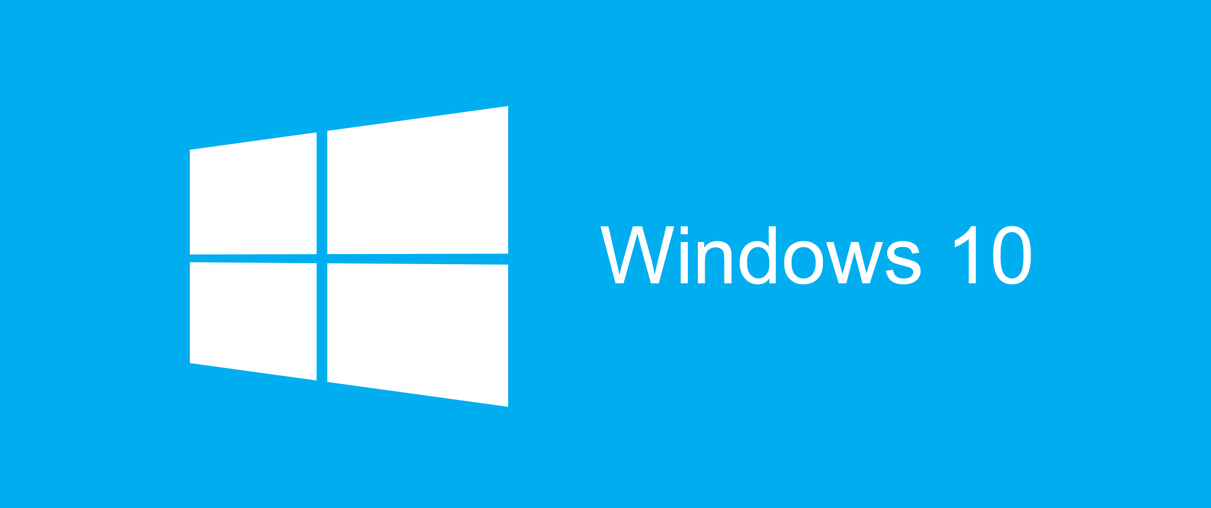
Windows 10 + Azure AD + Intune
Equals
Desktop Management in the Cloud
Intune

Slide 44

Related Ignite NZ Sessions
1
Managing Windows 10 with Group Policy and Intune [M393] Fri 10:40am – NZ1
5
Devices Devices Devices! [M120]
Fri 1:55pm – SkyCity Theatre
2
In-place Upgrade to Windows 10 Using New SCCM Tech Preview [M394]
Fri 11:55am – NZ1
Find us later at…
Malcyj-mct.blogspot.co.nz | @Malcy_J
Blog.Bowbyes.co.nz | @DBowbyes
Closing drinks Fri 3:00-4:30pm
3
Windows 10 Ask Me Anything [M265]
Fri 1:55pm - Marlborough

Slide 45





Resources
Microsoft Virtual Academy
TechNet & MSDN Flash
  Free Online Learning
http://aka.ms/mva
  Subscribe to our fortnightly newsletter
http://aka.ms/technetnz http://aka.ms/msdnnz
  Sessions on Demand
http://aka.ms/ch9nz

Slide 46

Complete your
session evaluation
now and win!

