Slide 1
Deadlines & Resources
Thank you for taking part in Ignite NZ 2015
Below is a list of key dates and resources:
Important Content Deadlines –detailed instructions are found on the Speaker Portal:
August 2 by 11:59pm: Upload a DRAFT of your PPT for Track Owner review.
August 28 by 11:59pm: Upload FINAL PPT presentation on the Speaker Portal. Continue to rehearse your spoken
presentation but do not make any more edits to the deck. The uploaded version will be available on the PCs at the venue.
YOUR PROMPT FINAL PPT SUBMISSION IS APPRECIATED.
No design support will be offered onsite at the conference.
  Slide Design Resources – Located on the Speaker Portal (graphics, webinar, etc.)
  If you include any third-party photography or art, licensing information and permission must be credited
  in the PPT or it may be deleted.
  Points of Contact
  Direct presentation questions to your track owner.
  PRINTING: This template is intentionally set to print in color or grayscale, not black and white.

Slide 2
Scrub Checklist
Upload your final deck on the speaker portal on or before August 28, 2015 at 11:59pm NZST.
PowerPoint presentations undergo a brief scrub process and are posted online for delegates to access
after the conference.
The Scrub Process will include:
Verification that required slides are included
Remove any non-template logos and graphics from the walk-in slide
Remove all comments, hidden slides and speaker notes from slides
Set file properties box
Reset printability to grayscale
Notify Presentation Manager of any images identified as unlicensed for escalation
Rename files to match naming convention
Correct session title and session code to match printed Mini Guide and Schedule Builder
Speakers, you must:
Use the provided event template and associated colors, fonts, layout and transition slides
Correct product names to follow applicable branding rules

Slide 4
Avoiding the on-premises SharePoint train wreck
Berry Stefanus and Wayne Ewington
M369
Notes:
Explain the intent of the RAPaaS finding talk is to inform Audience on some of the common pitfalls found on the customer environment so the Audience can take these messages back to their environment and improve their environment. The findings in the environment is not to say the environment was configure incorrectly/badly but it could be certain road blocks / limitations found during the deployment that made customer to configure it in that particular way.

Slide 5

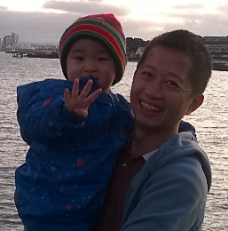



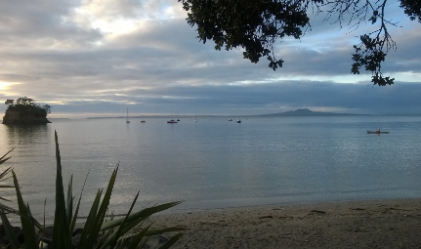


Who is Berry Stefanus?
Bio
  Senior Premier Field Engineer
  Microsoft New Zealand
Contact Info
  Email: berryst@Microsoft.com
WE

Slide 6
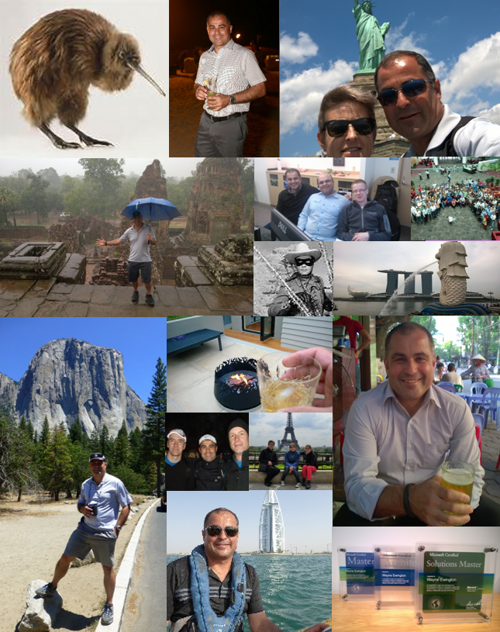
Who is Wayne Ewington?
Bio
  Principal Consultant
  Microsoft New Zealand
Contact Info
  Email: wayne.ewington@microsoft.com

Slide 7

Agenda
RAP as a Service
Common issues
Performance monitoring
Future proofing
Other considerations
BS

Slide 8
RAP as a Service

Slide 9
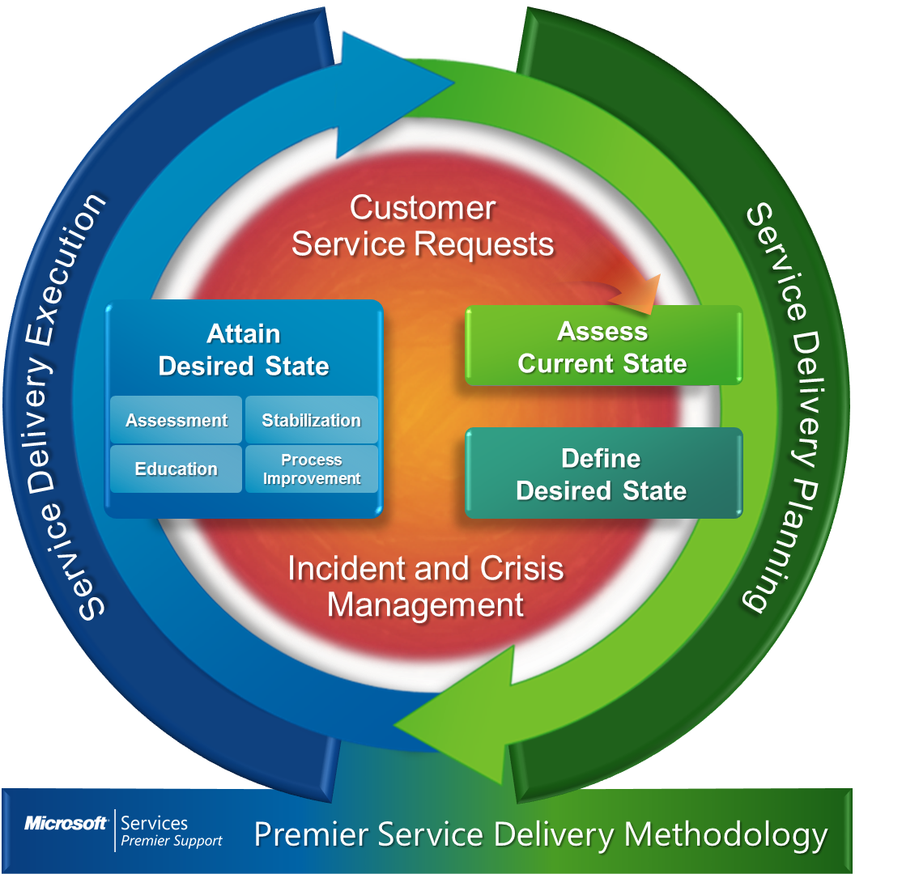



RAP as a Service (RAPaaS) Overview
Microsoft Services
Technology & Processes Assessed
SharePoint
SQL
Operation Interview
Operating System
Processes
Data Collection
Analysis
Recommenda-tions
Notes:
Only available for premier
Proactive monitoring
How do you do it?
What’s the value for the customer
2-3 slides

Slide 10
The values of RAPaaS
Understand your health and risk issues
Knowledge transfer
Remediation plan
Notes:
Understand Health and Risk issues on your environment based on Microsoft recommendations
Knowledge Transfer to explain and discuss health and risk issues
Establish a Remediation Plan to improve your SharePoint environment

Slide 11
Common Issues

Slide 12
SQL Server configuration
Disk layouts
TempDB
“Balanced” power setting
WE
Notes:
Database files, Transaction logs, and Backups are on the same drive
TempDB is not optimised
Power Setting is not set to optimum
In Windows Server 2008 and later OS, the default power saving setting is set to Balanced, which means that components such as CPU and storage will be scaled back if the system is not busy. In some cases this may result in performance degradation for SQL Server.

Slide 13
Disk layouts
Separate drives for different purposes
Disk latency
Database 15ms, Logs 2ms
Perf Counters: Avg Disk sec/Read and Avg Disk sec/Write
Prioritise for faster disk
TempDB, Logs, Database
TempDB
Logs
Database
OS
Backups
Prioritise

Slide 14
TempDB files
Only one transaction log file
Use RAID-10
Pre-size TempDB files
Set Auto Growth to fixed size < 200 MB
Turn on Trace Flag 1117
Ensures even auto growth of TempDB files
TempDB

Slide 15

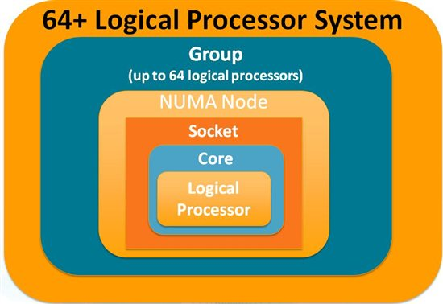
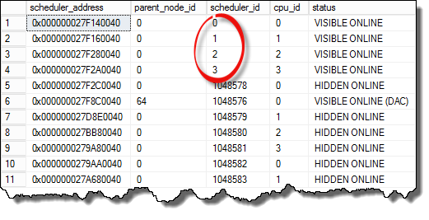

Number of TempDB data files
Same number of data files as CPUs (max of 8)
If still latch contention on TempDB system pages, increase the file count and test
SELECT * FROM sys.dm_os_schedulers
BS

Slide 16

Exceeding the threshold limits
> 5000 items in a view
> 8 lookup field columns
> 10 application pools
Handling Large Folders and Lists
https://msdn.microsoft.com/en-us/library/office/ee557257(v=office.14).aspx
Designing large lists and maximizing list performance (SharePoint Server 2010)
https://technet.microsoft.com/en-us/library/cc262813(v=office.14).aspx
Notes:
More than 5000 items in a view
More than 8 lookup field columns
More than 10 application pools

Slide 17
Orphaned items
Feature & web part orphans
Site orphans
SharePoint Feature Administration and Clean Up Tool:
http://featureadmin.codeplex.com/
Deleting Orphan Sites:
http://social.technet.microsoft.com/wiki/contents/articles/21968.sharepoint-deleting-orphan-sites.aspx
Notes:
Make sure feature is deactivated before removed
Developer : Leave no residue on deactivation
Detach SP database before removal

Slide 18
Operational management
No governance plans
No routine maintenance task
SharePoint Server 2013: Operations Framework and Checklists
http://www.microsoft.com/en-us/download/details.aspx?id=42531
Database maintenance for SharePoint 2010 Products
https://technet.microsoft.com/en-us/library/cc262731(v=office.14).aspx
Notes:
No governance plans
No routine maintenance task
<<SharePoint Whitepaper>>

Slide 19
Baseline monitoring

Slide 20
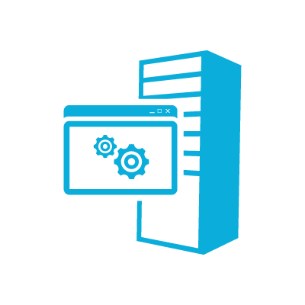
Baseline monitoring
Server performance
Site usage
Performance Analysis of Logs Tool:
http://pal.codeplex.com/
Analyzing Microsoft SharePoint Products and Technologies Usage:
http://www.microsoft.com/en-us/download/details.aspx?id=4616

Slide 21
Baseline performance monitoring and IIS log analysis
Notes:
Do demos around SharePoint on-premises performance monitoring
Provide counters for WFE / App Server Monitoring
Provide counters for back-end SQL Server monitoring
Use PAL to analyse these counters
We can show the use of IIS Logs Analysis from the current SharePoint farm as well
PowerShell script for monitoring SharePoint 2013 -

Slide 22
Performance baseline reference
Performance counters
IIS log analysis
WE

Slide 23
Future proofing

Slide 24
Deployment Options
On-Premises PLA Design
Microsoft Office 365
Public Cloud
On-Premises recommended practices
Supported
Recommended
Structured
Standardised

Slide 25



Product Line Architecture
Support costs
Manage costs
Reduce complexity
Office 365 ready

Slide 26
General PLA guidance
Single Web Application
Host named site collection
One Application Pool for Services
SharePoint Apps

Slide 27
Other Considerations

Slide 28
Governance Overview
Technical
Process
Guidance
Can
May
Should
Can Not
May Not
Should Not

Slide 29
Sample Policies
The Test, Pre-Production, and Production environments can automatically receive and install updates from Windows Update.
Customisations that are full trust solutions may not be deployed into the Client-X environment unless the release notes contain a valid business reason and justification (as to why it is a full trust solution).
All Site Collections should have at least two Owners.
BS

Slide 30


Disaster recovery
DR environment
A tested DR plan
Regular DR drill exercise

Slide 31

Technical implementation
Https
Database naming convention
No local Administrators
Using SSL for Central Administration with SharePoint 2013
http://www.harbar.net/archive/2013/02/13/Using-SSL-for-Central-Administration-with-SharePoint-2013.aspx
WE

Slide 32
Naming standards
No GUIDs
A standard is better than NO standard ☺
Consider multiple Farms and environments
Type | Name | Example
Configuration | SP_<Farm Id>_Config | SP_F1_Config
Content DB | SP_<Farm Id>_Content_<Name or Purpose> | SP_F1_Content_Intranet
Service Application | SP_<Farm Id>_Service_<Service Application> | SP_F1_Service_SecureStore

Slide 33
Summary
RAP as a Service
Common issues
Performance monitoring
Future proofing
Other considerations
BS

Slide 34
Microsoft | Services
Speak to us if you’re interested in RAPaaS or PLA
ServicesNZ@Microsoft.com
Notes:
Microsoft services can help you with the implantation/delivery/scoping of RAPaaS or PLA – should you need it.
We have a full range of support offerings, and you can either speak to me after the session, services experts at the Microsoft Stand, or send your inquiry to the ServicesNZ email address, and the right person will get in touch with you.

Slide 35

Related Ignite NZ Sessions
1
Ten things every Office 365 Developer should know
4
Disaster Recovery for SharePoint 2013 with Azure Site Recovery
2
Office Developer Patterns & Practices – 0-100kph and beyond
5
Deep Dive into custom Add-In Provisioning and Deployment in Microsoft Office 365
NZ4 Fri 1:55pm
3
Application Lifecycle Management for SharePoint and Office365 app development
Find me later at…
Hub Happy Hour Wed 5:30-6:30pm
Hub Happy Hour Thu 5:30-6:30pm
Closing drinks Fri 3:00-4:30pm

Slide 36





Resources
Microsoft Virtual Academy
TechNet & MSDN Flash
  Free Online Learning
http://aka.ms/mva
  Subscribe to our fortnightly newsletter
http://aka.ms/technetnz http://aka.ms/msdnnz
  Sessions on Demand
http://aka.ms/ch9nz

Slide 37

Complete your
session evaluation
now and win!

