Slide 2
Managing Linux with System Center and PowerShell DSC
Anurag Gupta
M382

Slide 3
Microsoft ♥ Linux

Slide 4
Your datacenter reality
You operate Windows workloads
You operate Linux workloads
You just want them both to run great
You want the simplicity of unified systems management
Microsoft “gets it”

Slide 5
Focus of this Session
Traditional
Virtualized
Private Cloud
Public Cloud
☑ Windows
Linux
☑ Windows
Linux
☑ Windows
Linux
☑ Windows
Linux
Managing Linux workloads:
In your datacenter or private cloud
With System Center 2016

Slide 6
Agenda
SC Linux Feature Overview
Monitoring Linux Applications
JEE
Apache
MySQL
Extensibility
What’s New in System Center for UNIX/Linux?
Operations Manager
Configuration Manager
PowerShell DSC for Linux

Slide 7
Linux Feature Overview

Slide 8
Running Linux
Hyper-V/LIS
Drivers for synthetic (virtualized) devices
SC Virtual Machine Manager
Fabric and VM management
Azure Stack
Azure in your Datacenter
Administer hosts, networks, storage
Define VM and Service Templates
Deploy and manage VMs and Services
Integrated into the Linux kernel and distributed by Linux distro vendors – “built-in”
Supported by Microsoft and Linux vendor
Host<->Guest communication daemon
Linux as a first class citizen

Slide 9
Managing Linux
SC Operations Manager
Monitor OS health & performance
SC Configuration Manager
Inventory hardware
Data Protection Manager
Desired State Configuration
Live backup Linux VMs on Hyper-V just like Windows VMs
Hyper-V cooperates with LIS running in Linux to flush file system buffers, giving a file system consistent backup
Detect and repair configuration drift
Integrate Windows configuration and Linux configuration
Inventory installed applications
Create inventory based collections
Distribute and install software
Report on inventory & software dist
Endpoint Protection (anti-virus)
Monitor log files
Monitor JEE app servers
Monitor line-of-business applications
Monitor databases and web servers
Declarative configuration platform for Linux OS and applications
Enable continuous delivery

Slide 10
Deploying Linux Applications

Slide 11
Linux Application Deployment Options
Configuration Manager
Deploy any Linux application with ConfigMgr Software Distribution
Define “package” and “program” and distribute on defined schedule with maintenance windows
VMM/Azure Pack
Use “RunOnce” commands in a VM template or VM Role to install software during VM provisioning
Bootstrap a Configuration Manager
Use “RunOnce” commands in a VM template or VM Role to “bootstrap” Chef, Puppet, or DSC agents for automated software configuration

Slide 12
Monitoring Linux Applications

Slide 13
Linux Application Monitoring
JEE App Servers
Available since OpsMgr 2012
Monitor JEE App Servers and applications
MySQL
Databases
New MP for 2016
Monitor MySQL database servers
WebSphere, WebLogic, Tomcat, JBoss
Monitor Server, Database, Storage Engine, etc., for health and performance
Apache Web Servers
New MP for 2016
Monitor Apache HTTP Servers (2.2 – 2.4)
Monitor Server, Virtual Host, and SSL certificates for health and performance

Slide 14
Monitor JEE AppServers
Monitor top four JEE application servers
Discovery, basic health, memory usage, garbage collection, running modules
Health and performance data from custom Mbeans
New versions in 2012 R2 UR4: JBoss 7 & 8, Tomcat 8
 | Tomcat 5.5, 6.0, 7, 8 | JBoss 4.2, 5.1, 6, 7, 8 | WebSphere 6.1, 7.0, 8.X | WebLogic 10g Rel3, 11g Rel1, 12c Rel 1
Windows Server | ✓ | ✓ | ✓ | ✓
Linux | ✓ | ✓ | ✓ | ✓
Oracle Solaris |  |  |  | ✓
IBM AIX |  |  | ✓
HP-UX

Slide 15
JEE App Server Monitoring
Anurag Gupta

Slide 16
New OSS Management Packs
Preview available now with SC 2016 TP2
Apache and MySQL MPs join JEE MPs as first wave of open source application monitoring
Approach: build CIM providers that extend OpsMgr Linux agent
Let us know what you want next!

Slide 17
Monitor MySQL Servers
New MySQL Server Management Pack
Uses deployable MySQL provider
Provider auto-installed with OpsMgr agent if MySQL is present
Dynamically discover MySQL Servers
Supports MySQL & MariaDB
Monitor MySQL Server, and Databases
Performance metrics for key cache, query cache, table cache, and optional metrics for InnoDB buffer pool
Extend monitoring with custom stored procedure monitoring

Slide 18
MySQL Monitoring Architecture
OMI Server
(CIM Server)
Authentication
File defines credentials
WS-Man
MySQL Server
MySQL_Server*
Providers
MySQL Client
Database
Database
SCX_OperatingSystem
SCX_FileSystem
SCX_UnixProcess
Linux
Computer
MySQL Server
OpsMgr Linux Agent

Slide 19
MySQL Server Monitoring
Anurag Gupta

Slide 20
Monitor Apache HTTP Servers
New Apache HTTP Server Management Pack
Uses Apache Module and OMI Provider
Module & provider auto-installed with OpsMgr agent if Apache is present
Dynamically discover Apache HTTP Servers
Monitor Apache server, Virtual Hosts, and SSL certs
Optional URL Probe rules/monitors defined in the MP for remote polling of availability and response time
Standards-based management interface for Apache
CIM provider for OMI exposes Apache health and performance via WS-Man
Provider to be open sourced

Slide 21
Apache Monitoring Architecture
Apache HTTP Server
OMI Server
(CIM Server)
WS-Man
Shared memory
mod_cimprov
Apache_HTTPD*
Providers
mod_php
SCX_OperatingSystem
mod_ssl
SCX_FileSystem
mod_alias
SCX_UnixProcess
Linux
Computer
Apache Web Server
OpsMgr Linux Agent

Slide 22
Apache HTTP Server Monitoring
Anurag Gupta

Slide 23
Monitoring Other Applications

Slide 24
Extensibility via Partners
OpsMgr Management Pack Catalog
http://pinpoint.microsoft.com/en-US/category.aspx?catid=1&fpf=700004
Search for Management Packs
Representative partners:
Partner | Management Packs
Bridgeways | Oracle, DB2, others
NiCE | Oracle, DB2, Domino, zLinux, BlackBerry
OpsLogix | Oracle, VMware, Blackberry, SWIFT
E-View | AS/400 and zOS
Veeam | VMware ESX

Slide 25
Extensibility via Templates
Log File Monitoring
Monitor any logfile
Process Monitoring
Monitor by name any service, daemon or process
Command Line Rules and Monitors
Run any shell command line to determine health or performance
Specify regular expression to match against
Target a single computer or group of computers
Distinguish duplicate names with regex filter on process arguments
Specify minimum and maximum counts
Target a single computer or group of computers
Target a single computer or group of computers
Script Rules and Monitors
Run any script to get health or performance (shell, Python, PERL, etc.)
Target a single computer or group of computers

Slide 26
What’s New in System Center?

Slide 27
What Else is New in OpsMgr 2016?
Option to use default (stored) RunAs Credentials in Discovery Wizard and PowerShell discovery
Shell Command/Script executions are multi-threaded
Create Shell Command or Script diagnostic or recovery task
OpsMgr and ConfigMgr agents share OMI installation
OMI version 1.0.8
File System discovery can be filtered by type or name in MP overrides
New Linux distros
RHEL 7, CentOS 7, Oracle 7, Ubuntu 14.04, SLES 12

Slide 28
What’s New in ConfigMgr 2015
Clients packaged as “native” packages
rpm, deb, depot, lpp, pkg
OpsMgr and ConfigMgr clients share OMI instance
OMI version 1.0.8
Clients respect A/D Site Boundaries in content distribution
New Linux distros
RHEL 7, CentOS 7, Oracle 7, Ubuntu 14.04, SLES 12

Slide 29
New OpsMgr Features
Anurag Gupta

Slide 30
PowerShell DSC for Linux

Slide 31
PS Desired State Configuration Overview
A declarative configuration platform
Define intended state, and DSC will “Make it so”
Protects against configuration drift
“Uses language extensions and providers to enable declarative, autonomous and idempotent (repeatable) Deployment, Configuration and Conformance of standards-based managed elements”

Slide 32
Version 1 Now Available!
Now available: www.microsoft.com/downloads
Source code available at: https://github.com/MSFTOSSMgmt/WPSDSCLinux
Requires Open Management Infrastructure: https://collaboration.opengroup.org/omi/
Supports:
CentOS 5, 6 and 7 (x86/x64)
Debian GNU/Linux 6, 7, and 8 (x86/x64)
Oracle Linux 5, 6 and 7 (x86/x64)
Red Hat Enterprise Linux Server 5, 6 and 7 (x86/x64)
SUSE Linux Enterprise Server 10, 11 and 12 (x86/x64)
Ubuntu Server 12.04 LTS and 14.04 LTS (x86/x64)

Slide 33
PowerShell DSC for Linux
DSC For Linux
Implements the Local Configuration Manager (an OMI provider) and Linux Resource Providers
Features
10 Built-In Resource Providers for Linux
Delivered as native packages (rpm/deb)
Push & Pull support (http/https)
Pull custom resources
Partial Configuration support w/ Pull server
Built-In Resources
Resource | Configures
nxArchive | Sync .tar/.zip with directory
nxFile | Files and Directories
nxFileLine | Lines in a file
nxPackage | Packages (rpm/deb, yum, zipper, apt-get)
nxUser | Local user accounts
nxGroup | Local groups
nxScript | Arbitrary scripts
nxService | Services (init, upstart, systemd)
nxEnvironment | Environment variables
nxSshAuthorizedKeys | User’s authorized ssh keys

Slide 34
Example DSC Configuration
Configuration ApacheRole{
Node “$nodename"{
nxPackage httpd
{
Name = "httpd"
Ensure = "Present"
PackageManager = "Yum"
}
nxPackage mod_ssl
{
Name = "mod_ssl"
Ensure = "Present"
PackageManager = "Yum"
}
nxService ApacheService
{
Name = "httpd"
State = "running"
Enabled = $true
Controller = "init"
}
}}

Slide 35
Configuring Linux Applications with DSC
Kristopher Bash

Slide 36
Wrap-Up
Microsoft is committed to running and managing Linux in the heterogeneous datacenter
Continuing investment as part of our normal product development cycle
Production ready for real customers
Linux is an integral part of Microsoft’s offering, right alongside Windows
Existing System Center infrastructure easily incorporates Linux servers

Slide 37
Related Ignite NZ Sessions
1
Roadmap for System Center Orchestrator, Service Management Automation, and Azure Automation
SKYCITY Wed 10:40am
3
OMS @ Massey – Taking a peek into your infrastructure
NZ3 Thu 1:55 pm
2
Automating Operational and Management Tasks in Microsoft Operations Management Suite and Azure
SKYCITY Theatre Thu 9:00am
Find me later at…
Hub Happy Hour Wed 5:30-6:30pm
Closing drinks Fri 3:00-4:30pm

Slide 38
Resources
Microsoft Virtual Academy
TechNet & MSDN Flash
Free Online Learning
http://aka.ms/mva
Subscribe to our fortnightly newsletter
http://aka.ms/technetnz http://aka.ms/msdnnz
Sessions on Demand
http://aka.ms/ch9nz

Slide 39
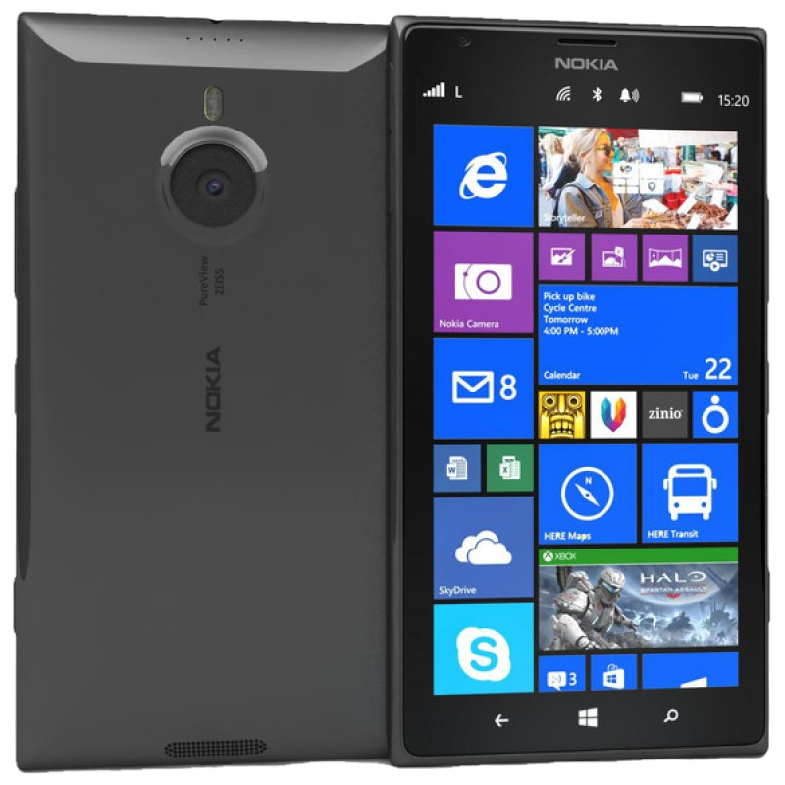
Complete your session evaluation now and be in to win!

